Slide 1




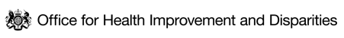

IMPACTS OF RISING COST OF LIVING ON LONDON
Data Companion Pack
BUILDING THE EVIDENCE DATA WORKING GROUP
January 2023

Slide 2
EXECUTIVE SUMMARY
Headline inflation was running at over 11% in December 2022, the first time in many Londoners’ living memory that they have experienced such a rapid decline in their real incomes.
The rising cost of living threatens to worsen living standards, increase poverty and widen inequalities in health.
Everyone is affected by rising living costs, but lower income groups spend comparably more of their income on essential goods, such as food and home energy, that are rising much faster than headline inflation.
This contributes to a social gradient in the effects of the rising cost of living, and this is likely to mirror the social gradient in health: the finding that people who are more socioeconomically advantaged have better health than people who are less advantaged, and this relationship is continuous from the lowest to the highest income groups.
Similarly, people who are more affluent are likely to be better able to absorb rising living costs, but many people who were previously financially secure will be drawn towards, or into, poverty and financial hardship.
This data companion pack accompanies a rapid review of evidence for interventions to mitigate the impacts of the rising cost of living on London.
The data companion pack has been produced by the UCL Institute of Health Equity for the Greater London Authority, in collaboration with them, and system partners across government, and the NHS to provide context for the need for action in London.
The accompanying rapid review of of evidence for interventions produced by the Institute of Health Equity focuses on supporting a coordinated response to the cost of living crisis across health and public services, local authorities, the Greater London Authority, businesses and voluntary, community faith and social enterprises.

Slide 3
AUDIENCE FOR THIS WORK AND HOW TO USE THIS RESOURCE
Audience for this work
This is a resource intended to frame the linked rapid review of evidence for interventions to address the cost of living crisis.
It is intended to provide a high-level overview of the need people in London have for support to deal with the cost of living crisis through intelligence available in the public domain. Given there are significant gaps in intelligence available, the pack also highlights these gaps and limitations in our understanding.
It will be useful for health leaders, analysts, officers, and policy makers from local and regional government, integrated care systems, NHS, academia, VCS organisations and partners across London to support their work to address the costs of living crisis by
Advocating for the need for action to address the rising cost of living given impacts on health and health inequalities
Framing the context for the interventions highlighted in the linked rapid review of interventions
Engaging communities
How to use this resource
The resource is provided in PDF and PowerPoint format to support colleagues in their work to address the cost of living crisis and health inequalities
The resource provides the context of the cost of living crisis in London only, and should be read alongside the accompanying rapid review of evidence for interventions to mitigate the impacts of the rising cost of living on London, which contains the recommendations for action.

Slide 4
CONTENT NAVIGATOR
PART 1: London: The rising costs of living in context: Inflation in London and how it is affecting the spending patterns of people in London.
PART 2: Who is at greatest risk due to rising cost of living?: changes in the spending power of local authorities in London and
baseline inequalities in wealth and income and which groups are most affected by these
PART 3: Indicators of rising financial insecurity in London: Many essential living costs in London are higher than in other parts of the UK
PART 4: Access to support with rising living costs: Indicators of uptake of advice and assistance to manage rising living costs in London
PART 5: Health and the rising cost of living: A short introduction to the impacts on health arising from the rising cost of living in London
PART 6: Gaps in available data: gaps in the data that would support improved monitoring of impacts of high inflation in London.

Slide 5
APPROACH, PURPOSE AND LIMITATIONS
APPROACH
LIMITATIONS
Greater London Authority (GLA) Health, GLA City Intelligence Unit, Office for Health Improvement and Disparities London (OHID), Association of Directors of Public Health London (ADPH) London, NHSE and Institute of Health Equity (IHE) have collaboratively produced this report on indicators of which population groups are most at risk from the rising cost of living in London.
Drawing on the expertise and intelligence held by members of the above group, this slide deck gathers indicators of how high inflation is affecting people living in London, evidence for its potential impacts, and which population groups are likely to be the most impacted.
We aim to use this work to
Help frame and provide intelligence and context for the linked rapid intervention review being published by the Institute of Health Equity into the rising cost of living in London
Identify gaps in current knowledge and scope for further research.
Key limitations include:
The indicators of financial hardship and inequalities presented in this deck are limited to data that is available publicly
Further limitations in the breadth and granularity of intelligence and indicators available that would improve the monitoring of financial hardship are noted in the final slide on gaps in available data

Slide 6
PART 1: LONDON - THE RISING COSTS OF LIVING IN CONTEXT

Slide 7
PART 1: LONDON - THE RISING COSTS OF LIVING IN CONTEXT
Inflation in the cost of many essential goods and services, including rented housing, food and home energy, is outstripping that of more discretionary items, and some of these are rising faster than other parts of the UK.
This section looks at indicators of how this is affecting people living in London, with rises in self-reported financial struggles, and declines in ability to afford essential bills. This translates into changes in behaviour, several of which are likely to have health consequences – such as not heating homes, eating poorer quality food and using up savings.
These occur in a context in which local authorities, by necessity due to reductions in spending power, are spending less on non-statutory services to support their communities through this period.

Slide 8
LONDON’S PRICES INITIALLY ROSE FASTER THAN THE REST OF THE UK, WITH ITEM CATEGORIES CONTRIBUTING DIFFERENTLY TO INFLATION IN THE CAPITAL
Using Office for National Statistics (ONS) price quotes, the Greater London Authority (GLA) have built a measure of underlying local inflation for the capital.
The measure suggests local prices in London initially rose faster for the first half of 2022 than the UK average. Those trends have now reversed, suggesting London inflation may have peaked sooner.
When London prices were rising faster, food was a key factor in the gap, and as lower-income households tend to spend more on food, this is likely to have widened inequalities in the capital.
Energy is not part of this measure and people living in London spend less on it than the UK average, so the overall inflation experience may be higher still in other regions.
Fig 1. Top five and bottom five price categories in terms of the difference between their contributions to London and UK inflation, 2022
Note: X-axis units in this graph are percentage point contributions to the London inflation measure, over and above the same category’s contribution to the UK measure.
Source: 1) GLA Calculations based on date from ONS Family Spending dataset, Workbook 2

Slide 9
Overall in December 2022, 51% of Londoners were either ‘financially struggling’ or ‘just about managing’ financially.
One in five Londoners (20%) said they were ‘struggling financially’ in December up from 12% in January, while a third (31%) say they were “just about managing” ¹
A HIGH PROPORTION OF LONDONERS ARE STRUGGLING FINANCIALLY
In August 2022, 90% of Londoners said their household costs had risen over the last six months.²⁻⁴
CPI annual inflation hit a 40-year high of 11.1% in October.
Increases in the cost of living are likely to be most pronounced for the lowest-income Londoners. Lower-income households devote a larger share of their spending to food and fuel.^{2,3}
NIESR (National Institute of Economic and Social Research) estimate the rise in living costs will equate to an income cut of 9.5% for the hardest-hit households, vs 0.6% for the highest income households.²
In YouGov polling commissioned by the GLA in October 2022 ¹, 86% of Londoners said their cost of living had increased over the last six months, with 51% saying it had increased a lot.
7% of Londoners had fallen behind on some or all bill payments, while 12% were constantly struggling to pay their bills.
12% said they have regularly or occasionally been unable to buy food or essential items.
Note: ‘Financially struggling’ is ‘I am having to go without my basic needs and / or rely on debt to pay for my basic needs’ plus ‘I’m struggling to make ends meet’ Question: “Thinking about your current financial situation, which of these statements best applies to you?”
Source: 1) YouGov Plc polling data completed on behalf of the GLA https://data.london.gov.uk/dataset/gla-poll-results-cost-of-living-2022, October and December 2022 2) NIESR modelling (using LINDA, NiReMS) ; 3) ONS Family Spending dataset, Workbook 2​

Slide 10
Home energy and rent are the largest financial concerns for people in London
Whilst around 80% of Londoners were worried about costs over the next 12 months, when asked about the ability to meet payments in the future this reduces.
Two in five Londoners (44%) think they will definitely or probably struggle to pay their energy bills and four in ten renters (40%) saying that they will definitely or probably struggle to meet rent payments in the next six months.
Note: Rent / mortgage ability amongst those who pay rent or have a mortgage
Question: And do you think you will, or will not struggle to meet the following payments in the next six months? Excluding not applicable responses
Source: YouGov Plc polling data completed on behalf of the GLA https://data.london.gov.uk/dataset/gla-poll-results-cost-of-living-2022, October 2022

Slide 11
LONDONERS who are ‘financially struggling’ are more likely to go without essentials (32%), use credit Or GO INTO DEBT (31%)
Fig 4. Actions to manage rising living costs
Around a third of Londoners (32%) said they are buying less in food and essentials. This rose to two-thirds (66%) among Londoners who are ‘struggling financially’.
Source: YouGov Plc polling data completed on behalf of the GLA https://data.london.gov.uk/dataset/gla-poll-results-cost-of-living-2022, December 2022

Slide 12
PART 2: WHO IS AT GREATEST RISK DUE TO THE RISING COST OF LIVING?

Slide 13
PART 2: WHO IS AT GREATEST RISK DUE TO THE RISING COST OF LIVING?
This section summarises some of the major factors that will determine the resilience of London and people living in London to the health impact of falling real incomes.
These include:
Changes in the spending power of local authorities in London.
Large inequalities in wealth and income which affect who is most impacted by inflation.
There are significant health inequalities in London at baseline.
Low income is the primary risk factor for adverse impacts of the rising cost of living, and some sub-groups are more likely to be affected by low income.
In particular, children, lone parents and people living with disabilities are at higher risk and often underserved by the support available.

Slide 14
Fig 6. Change in local authority spending power 2010/11 – 2020/21
Local authorities enter this period of rising costs with less spending power than following the 2008 financial crash
Fig 5. Change in local authority spending power, by deprivation, London local authorities, 2010/11 – 2020/21
Local authority government grants were reduced significantly between 2010 and 2020, with up to 40% reductions in spending power in some London local authorities.
This disproportionately affected more deprived local authorities. Figure 5 displays the trend in spending reductions from the least (left hand side) to most (right hand side) deprived local authorities in London.
Source: National Audit Office. Financial sustainability of local authorities data visualisation raw data

Slide 15
Wealth is unequally distributed in London
Fig 7. Trend in median wealth in London by income decile, 2010 to 2018
Wealth provides resilience to rising living costs as people with significant wealth are more likely to own their own homes, have a pension, and investments that provide additional income.
The lowest four wealth deciles in London have seen almost no change in wealth in the last decade.
Between 2010-12 and 2016-18, the median wealth of people in the lowest wealth decile in London grew by £200, whilst for those in the highest decile it increased by just under £600,000
More recent data are available at quartile points: wealth at the 25th percentile point in London was less than £10,000 (<50 per cent) higher in 2020 than in 2006-08, yet had doubled, rising by over £450,000, for households at the 75th percentile point.
Source: ONS Wealth and Assets Survey

Slide 16
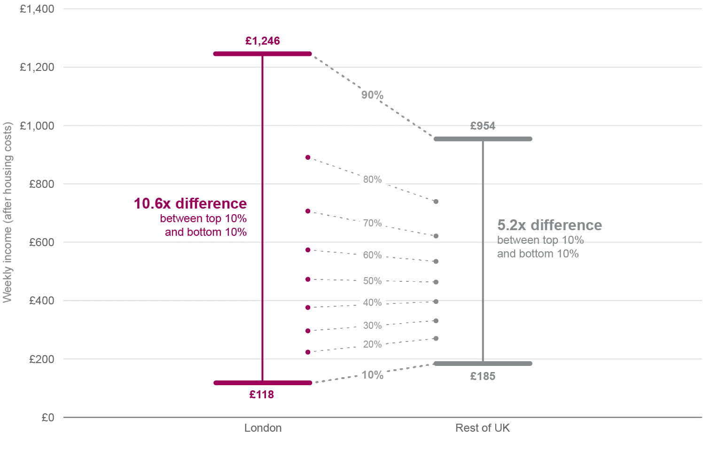
The Richest 10% of people in London have 10x more income than the poorest 10%
Fig 8. Difference in weekly income (after housing costs) between top and bottom deciles in London and UK (2017/18 – 2019/20 )
The richest tenth of people living in London have more than 10x the income of the poorest tenth.
  Incomes at the lowest decile are 30% below the rest of the UK.¹
  London has the highest rate of poverty of any region in the UK, with more than a quarter (27%) of London residents in poverty after housing costs.²
The unemployment rate in London is above the UK average but varies widely within the capital and despite improvements persistent inequalities in labour market outcomes remain:³
  The employment gap between disabled and non-disabled people living in London stayed the same overall between 2020 and 2019 (25 percentage points(pp)), but fell between males and females from 11pp to 7pp
  In London, the employment gaps between White and BAME groups combined has improved in 2020, falling to 12 pp, (improvement has also been seen in the employment gap between White and most other ethnic groups compared to 2019, except for Mixed ethnic group)
Source: (1) London Datastore - Income Inequality (2) London Datastore – Poverty (3) London Datastore - Employment Gaps

Slide 17
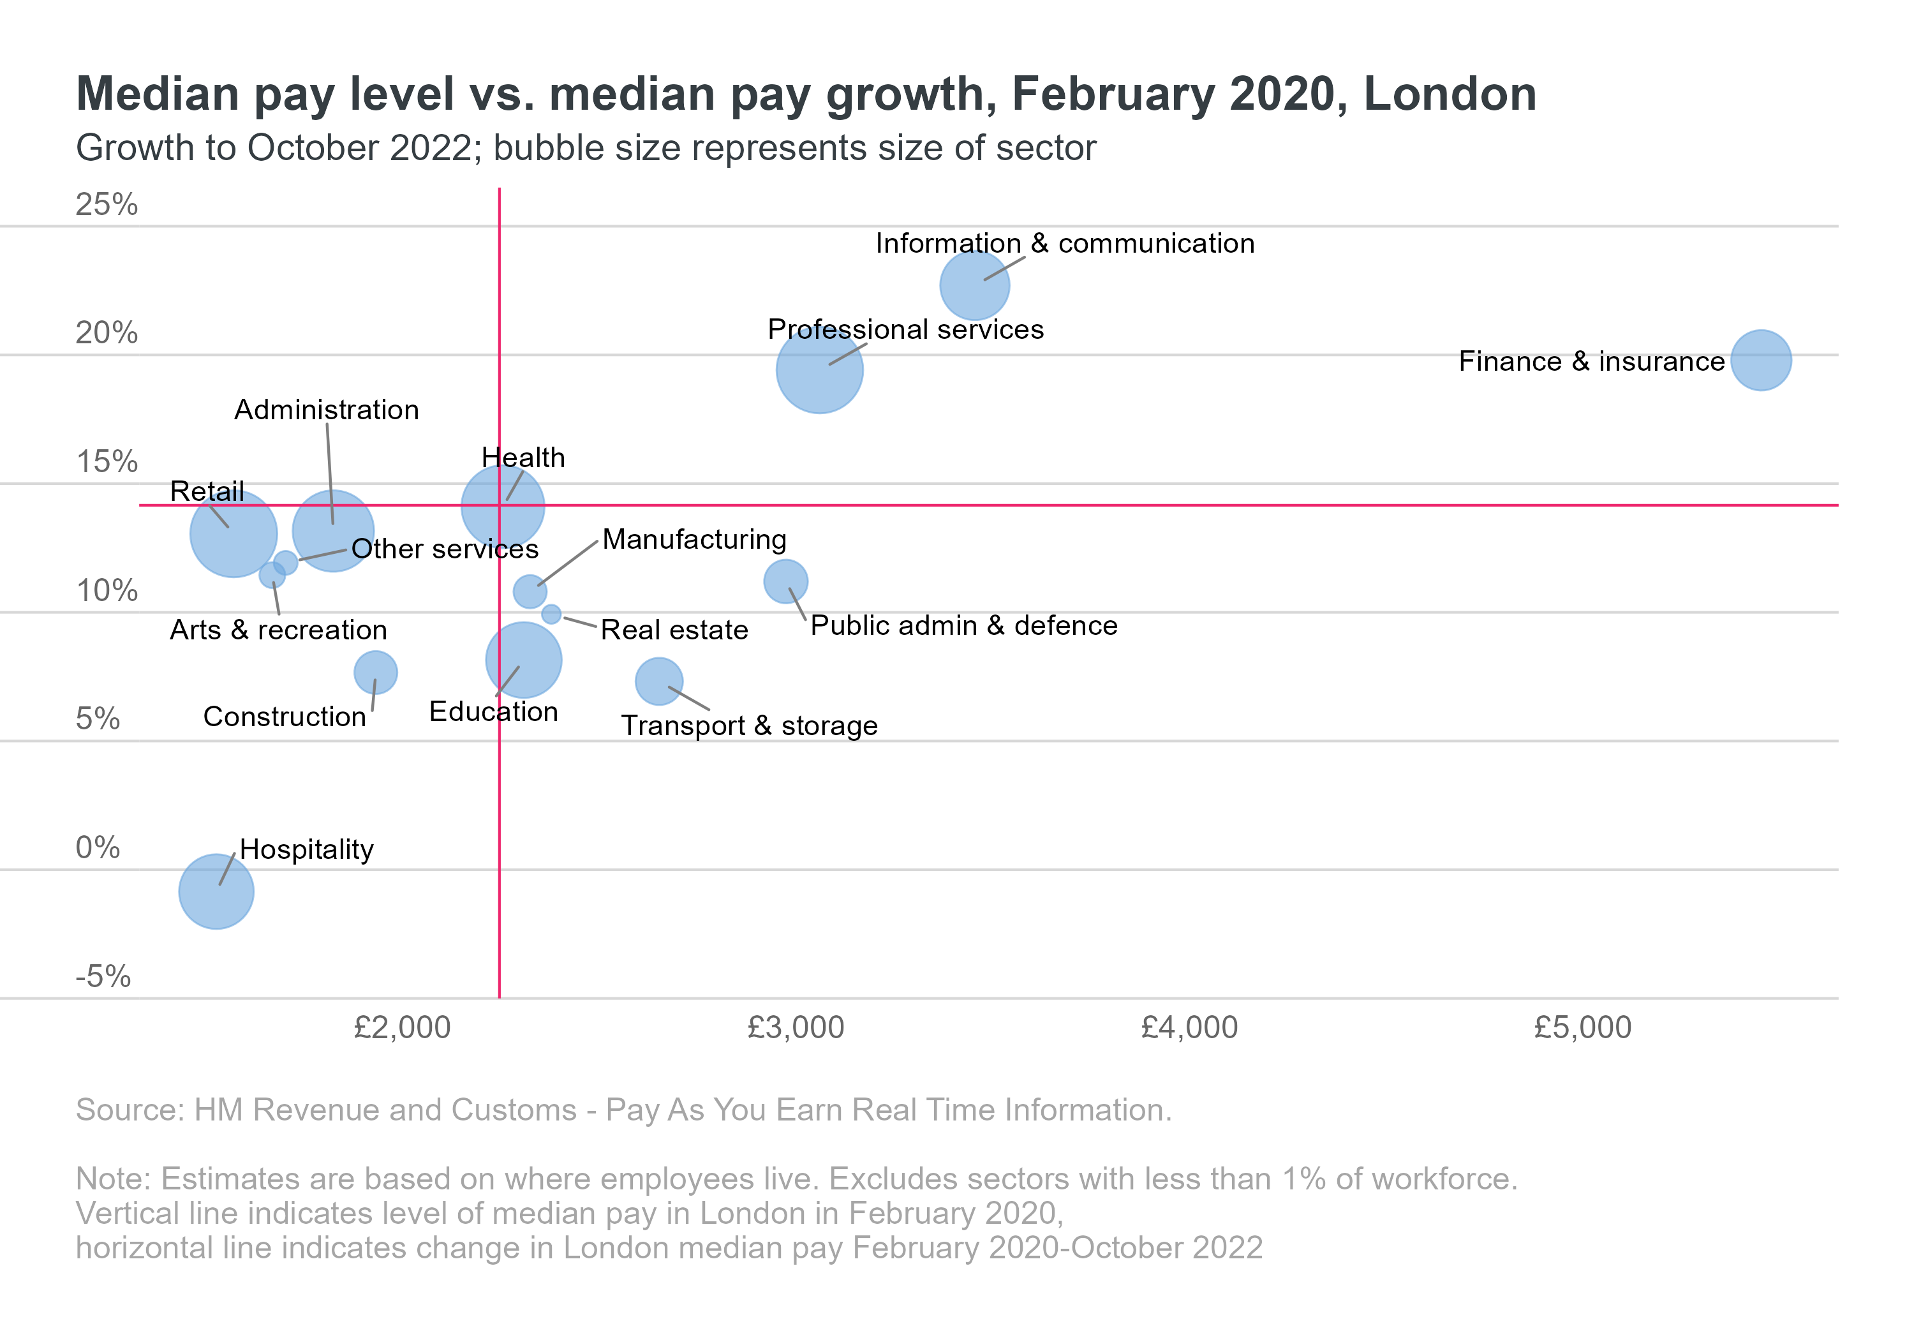
The wage recovery has skewed towards well-paid sectors, further widening inequalities as real pay falls
Fig 9. Median pay level vs. median pay growth. February 2020, London
Real wages initially recovered firmly from the pandemic, but have gone into reverse as inflation drags on pay.
Lower-paid sectors in London have seen a weaker pay recovery since the pandemic, leaving low-income households more vulnerable.
Hospitality has the lowest median pay in the private sector and has seen that fall by 1% since February 2020 even before taking inflation into account.
Meanwhile median employee pay in ICT (Information and Communications Technology) was over 50% higher than the London average before the pandemic and grew by 20% up to July 2022.

Slide 18
Fig 10. Dwelling stock by tenure, London, 2002-2021
Declines in wealth are reflected in changing nature of housing tenure in London
Trends in housing tenure in London mirror trends across the UK.
Whilst owner-occupation has declined across the UK, in London it started from a lower baseline, and has ended with fewer than half of homes being owner-occupied.
Meanwhile, the percentage of homes that were privately rented in London almost doubled between 2002 and 2020.
The proportion of people living in private rental accommodation has implications for the ability to save, and unequal vulnerability to the cost of living crisis as rents rise faster than inflation.
Further information on interventions to address housing related health inequalities in London is available in the published intervention review
Source: 1) MHCLG & DLUHC 2) IHE Evidence Review: Housing and Health Inequalities in London

Slide 19
Social renters and PEOPLE LIVING IN LONDON with a gross household income of BELOW £20,000 are most impacted
Social renters and Londoners with a gross household income of less than £20,000 are not only more likely to be ‘financially struggling’ but are also more likely to be ‘just about managing’ financially based on December 2022 polling data.
People living in London in the C2DE group (See Note below); Asian; Black; with a gross household income between £20,000 and £39,999; renters (in particular social renters); and those who are disabled are also more likely to be ‘struggling financially’.
Question: Thinking about your current financial situation, which of these statements best applies to you?
Note: 1| Numbers less than 5% removed from chart 2| For definition of ‘Financially struggling’ and full response options see slide 9 and linked data sheet
3) C2DE is a category from the social grade model referring to those in skilled manual occupations (C2) and semi-skilled & unskilled manual occupations, unemployed and lowest grade occupations (DE)
Source: YouGov Plc polling data completed on behalf of the GLA https://data.london.gov.uk/dataset/gla-poll-results-cost-of-living-2022, December 2022

Slide 20
PART 3: INDICATORS OF RISING FINANCIAL INSECURITY IN LONDON

Slide 21
PART 3 INDICATORS OF RISING FINANCIAL INSECURITY IN LONDON
  Part 3 presents data on how high living costs and low incomes already disproportionately affect people living in London, and some of these costs are rising faster than inflation.
  Parents in London are impacted by the highest childcare costs in the country combined with the highest housing costs. It is unsurprising that London is also home to the highest proportion of children in after housing cost poverty.
  Costs such as these, mean people in low income communities are increasingly likely to struggle with debt and the cost of utilities.
  The linked Cost of Living intervention review describes how the combined effects of these contribute to stress and anxiety, with impacts on physical and mental health, and the quality of people’s relationships, in particular the quality of parenting.

Slide 22
London has the highest childcare costs in England
In early 2022, in inner London, average childcare costs for a two-year old in a full-time nursery place were over 30% higher in Inner London than average for England, at £347.25 per week, and 16% higher in Outer London at £308.79 per week
Parents in London are further impacted by higher commuting costs and often less local family support with childcare.
Access to good quality childcare is a key determinant of reducing differences in early years development between socioeconomic groups.
Source: Coram Family and Childcare Annual Survey 2022

Slide 23
Fig 13. Capped households (Housing Benefit only) by family type and number of children, London, May 2022
The housing benefit cap disproportionately affects children in lone parent households
The benefit cap for households with children is £1916.67 in Greater London. This does not affect all benefits, but affects those most likely to be claimed, including Universal Credit, Child Benefit, and Housing Benefit.
As lone parents are less able to work (see following slide), they are more likely to be affected by the benefit cap.
Children in lone-parent families are much more likely to be affected by the Housing Benefit cap than children in two-parent families.
The proportion of the population in a local authority that are affected by the roll-out of Universal Credit (UC), benefit sanctions, reductions in the main out-of-work benefit and the ‘bedroom tax’ are all statistically significant predictors of foodbank usage.
Source: DWP

Slide 24
New rental prices are soaring in London, so housing will soon add to high inflation in essential goods
Fig 14. HomeLet Rental Index for average new private rents
Rent is the single biggest outgoing for many people in London and one on which they devote a higher share of their spending than the UK average.
ONS (Office for National Statistics) private rent data suggests London is seeing lower rent growth than the rest of the UK. But this is likely due to long contracts locking in low rents from the pandemic.
New rental prices are soaring in the capital, with the HomeLet Rental Index showing London asking rents rising nearly 14% year on year.
As existing contracts roll over to line up with new prices, overall housing costs for people living in London will rise sharply.
Source: 1) HomeLet Rental Index 2) Housing in London Report 2022

Slide 25
Fig 15. Residential loans to individuals for house purchase or remortgage, £ millions, London, 2010 Q1 – 2022 Q2
HOUSING SECURITY OF OWNER OCCUPIERS WILL ALSO BE IMPACTED BY RISING INTEREST RATES
The average amount loaned each month against house purchases and re-mortgages in London increased by more than 150% between 2010 and 2022.
This has implications for exposure to higher interest rates when remortgaging.
Source: Bank of England

Slide 26
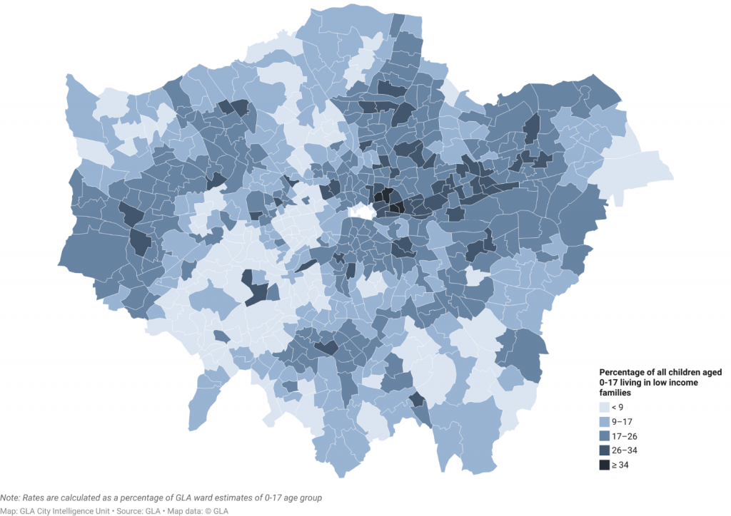
TWO IN FIVE CHILDREN LIVE IN POVERTY WHEN HOUSING COSTS ARE INCLUDED
Data from previous years informs us that nearly 40% of London’s children are likely to be living below the poverty line (using the relative poverty after housing costs measure). ^{1,2}
Modelled estimates of children living in low-income families indicate that 17% of London’s children overall were living in poverty before taking housing costs into account in 2020/21.^{1,2}
These modelled estimates for small areas highlight some of the areas in London where the issue of child poverty is most acute, most notably some of the wards in Tower Hamlets and Camden.
The Survey of Londoners 2021-22 found that 14% of parents had children who had experienced food insecurity in the past 12 months (around 300,000 children).³
Groups of parents more likely to have children in food insecurity included; Black parents, disabled parents, non-degree educated parents and single parents.
Due to methodological difficulties in data collection in the pandemic, there is increased data uncertainty and more detailed characteristics of the data have not been published.
There are no official published poverty estimates for London for 2020/21.
Fig 16. Percentage of children under 18 living in low income families, London wards, 2020/21
Source: 1) London Datastore – Poverty in London 2020/21 2) Economic Fairness – Population in Poverty – London Datastore 3) GLA, Survey of Londoners 2021-22

Slide 27
UNSECURED DEBT AND FINANCIAL EXCLUSION ARE MORE LIKELY TO ADVERSELY AFFECT DEPRIVED COMMUNITIES
People in more deprived communities in London are more likely to have unsecured loans and credit agreements.
People in those communities are also more likely to feel debt is a heavy burden
People in the same communities are also more likely to rely on cash, indicating reduced access to banking and regulated financial services. This increases their vulnerability to unregulated creditors, including loan sharks.
Fig 17. Those who owe money who feel their debt is a heavy burden, percentage, IMD quintiles (2019), London, 2021/22
Fig 18. Those who rely on cash in day-to-day life a great or very great extent, percentage, IMD quintiles (2019), London, 2021/22
Source: Survey of Londoners 2021-22

Slide 28
Fig 20. Those who cannot keep their home warm enough in winter, percentage, IMD quintiles (2019), London, 2021/22
PEOPLE IN MORE DEPRIVED COMMUNITIES ARE MORE LIKELY TO STRUGGLE WITH HOME ENERGY BILLS
The energy efficiency performance rating of homes is generally higher in more deprived areas of London, which is in part related to the proportion of people living in flats, which are typically better insulated than houses, and to the improving quality of social rented housing stock.
However, despite this, people in more deprived communities are more likely to struggle to afford energy bills and keep their homes warm than in the least deprived communities.
Fig 19. Percentage of dwellings with an EPC rating of at least 'C' and deprivation (IMD 2019), London local authorities, FYE March 2022
Source: Survey of Londoners 2021-22

Slide 29
PART 4: ACCESS TO SUPPORT WITH RISING LIVING COSTS

Slide 30
PART 4 ACCESS TO SUPPORT WITH RISING LIVING COSTS
  Benefits provide a safety net for people facing financial hardship and are a central pillar of the welfare state.
  Whilst data on uptake of benefit entitlements is minimal at a London level, national official indicators include that in 2018/19 up to £3.4 billion of available Housing Benefit went unclaimed, and in 2019/20 official estimates are that 3 of 10 older people entitled to Pension Credit (averaging £1,900 per household/year) do not claim it, and 23% of total Pension Credit goes unclaimed.
  The following slides present limited London-specific indicators of uptake of some entitlements and demand for non-statutory hardship support (such as food banks), where available. This includes rising demand for food banks, yet low uptake of Healthy Start vouchers among those eligible. It includes indicators that people’s awareness of support available to claim benefits and entitlements is much lower than would be expected in some areas of London.

Slide 31
Fig 22. Individuals that were not aware of particular hardship support organisations, London constituency assemblies and London, 2021/22
Demand for hardship support is rising, though awareness of the support available varies across London
Demand for food parcels from the Trussell Trust peaked during the pandemic when routes to access emergency food parcels were temporarily opened up. Since then they have returned to a long-term trend of rising demand, which has increased almost three-fold since between 2014/15 and 2021/22.
Not all individuals are aware that hardship support is available, and some areas of London may need to invest more in raising awareness, taking into account the language and access needs of some groups more likely to be affected by financial hardship.
Fig 21. Number of emergency food parcels given out by Trussell Trust food banks, London, 2014/15 - 2021/22
Source: 1) Trussell Trust 2) Survey of Londoners 2021-22

Slide 32
THE SUBJECTS OF FINANCIAL ADVICE ARE CHANGING AS LIVING COSTS RISE
Fig 23. Change in volume of advice given by Citizens Advice (breakdown of utilities and communications) compared to previous 12 months, by subject, London, November 2021 - October 2022
Roughly three-quarters of advice sessions delivered by Citizens advice in London are on the topic of benefits and tax credits, including Universal Credit.
The amount of advice given on benefits and tax credits, debt and utilities and communications all increased in the year to October 2022. Without knowing how much the capacity to deliver advice changed it is difficult to assess how this reflects demand.
Social housing tenants were over twice as likely to receive benefits advice from Citizens Advice than private rental sector tenants in October 2022, and over five times more likely than owner occupiers per 10,000 of the population.
Utilities advice is a small proportion of the total advice given, but increased proportionately more than any other topic, with advice sought on home energy costs increasing by almost 150 percent in the 12 months to October 2022 in London (see Fig 23.).
The age groups most likely to seek advice on fuel costs are 35-64 year olds, over 65s almost half as likely to seek advice. This may relate to unwillingness to request advice rather than being less affected.
Source: Citizens Advice

Slide 33
UPTAKE OF HEALTHY START VOUCHERS IS LOW
Fig 24. Uptake of Healthy Start vouchers, London local authorities, 2020
The main form of direct subsidy for food in England is Healthy Start vouchers worth up to £8.50 per week. They are available to pregnant women and young children under 4 years old in low-income households to subsidise the purchase of fruit and vegetables, and infant formula.
Healthy Start vouchers can stretch food budgets further for those eligible and are particularly valuable to families that otherwise have no recourse to public funds, as they are eligible to receive them if on a low income.
Fewer than half of eligible households in London participate in the programme, amounting to over £10million per year in unclaimed vouchers.
Source: Healthy Start Vouchers Take-up in London - London.gov.uk

Slide 34
PART 5: HEALTH AND THE RISING COST OF LIVING

Slide 35
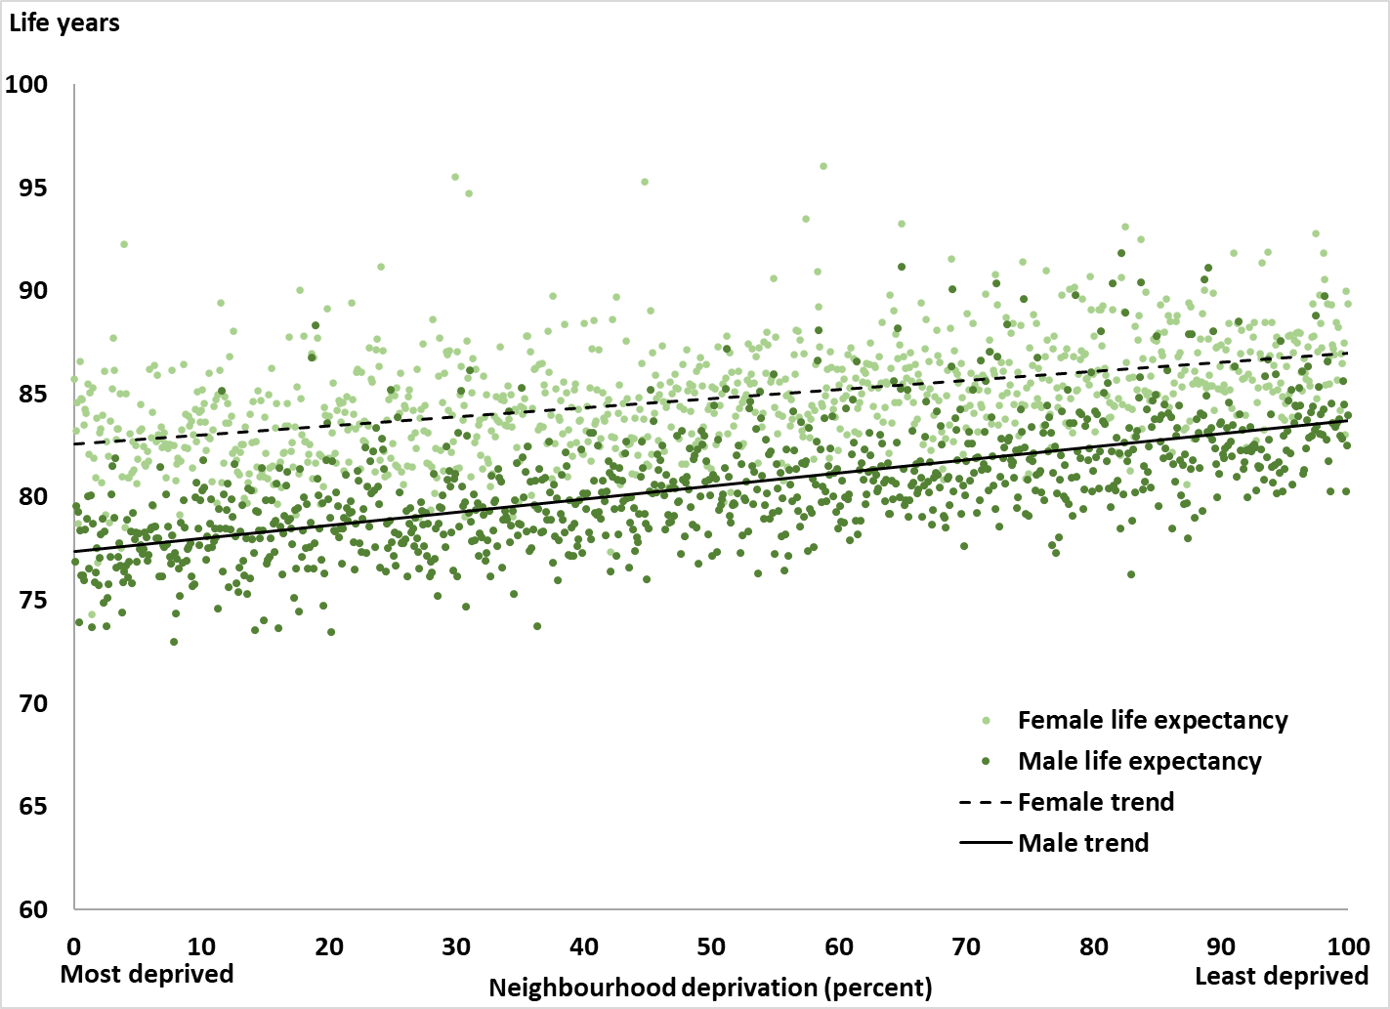
INEQUALITY IN LIFE EXPECTANCY AND HEALTH IN LONDON EXISTED PRIOR TO THE COST OF LIVING CRISIS
Prior to the recent rises in inflation and emergence of a cost of living crisis, London has been recovering from the devastating impact of the Covid-19 pandemic
Our recently published Snapshot of Health Inequalities in London highlights how there is already significant inequality in health and life expectancy between the most and least deprived communities in London, and also across protected characteristics, and inclusion health groups living in London
The relationship between poverty and ill health and lower life expectancy in London is well established
  Based on the line shown in the graph, the average gap in life expectancy between the least and most deprived middle-layer super output areas in London (areas with a population of around 7,500) was 4.4 years for males and 6.3 years for females
Fig 25. Inequality in life expectancy by gender and deprivation for London Boroughs, 2016-20
Source 1) Snapshot of Health Inequalities in London

Slide 36
The cost of living crisis risks worsening EXISTING HEALTH INEQUALITIES in London
Healthy life expectancy provides an estimate of lifetime spent in "very good" or "good" health, based on how individuals perceive their general health. There is variation across London boroughs with the range of healthy life expectancy spanning from:
  58.1 years in Barking and Dagenham, to 70.2 years in Richmond upon Thames, for males
  And 57.8 years in Tower Hamlets to 70.1 years in Wandsworth, for females.¹
Premature mortality was three times higher in the most vs least deprived decile of London in 2019-21³ and the largest increase in premature mortality rates were seen in the most deprived deciles.²
Equally, health challenges that existed for London pre-pandemic such as obesity, and smoking persist; while increasing pressure on health and social care services is evident with those living in most deprived areas most adversely affected
An online survey conducted in September 2022 in London indicates that around 2 in 5 Londoners are concerned of the impact the cost-of-living crisis is having on their physical health (43%), and half are concerned about the impact on their mental health and wellbeing (50%) (noting the small sample size of 292 people in London for this survey).
The cost of living crisis risks widening these existing inequalities through mechanisms that have been well described in evidence generated in the aftermath of the 2008 financial crash, examining the impact on health of rising poverty (see next slide)
    Inflation results in real-term declines in funding for public services and in personal incomes that are not dissimilar to the effects of recession and the policies of austerity seen following the 2008 financial crash. As people are living on lower incomes in real-terms, this will push more people towards, or into, poverty.
  Intelligence consistently shows that people living on the lowest incomes have the worst health in London, and the relationship between income and health is continuous between the most and least deprived communities.
Source 1) Snapshot of Health Inequalities in London - London Datastore 2) PHE Public Health Outcomes Framework - Healthy life expectancy at birth 3) Figure 7b, Health Profile for London, 2021 (4) Fingertips - Mortality profile 4) Marmot Review 10 Years On 5) Cost of Living Survey data published by Yonder

Slide 37
As THE COST OF LIVING RISES, real incomes decline, fewer people LIVING in London (especially those on lower incomes) ARE able to lead healthy LIVES
The factors that explain why people on low incomes have worse health are called the wider or ‘social’ determinants of health – these are factors that make it more or less likely that someone can lead a healthy life. Economic factors that are affected by falling real incomes include that:
The rising cost of essentials, such as food, housing, home energy and childcare, all contribute to stress and anxiety and limit people’s choices
Insufficient income causes stress as people struggle to afford essentials and deal with the uncertainty and social exclusion that low income can create. Continuous stress is bad for long-term health and can also worsen mental health in the short term.
Being unable to afford a healthy lifestyle – for example, to live in a healthy home, eat a healthy diet, access green space and avoid environmental pollution - makes it more likely someone will lead an unhealthy lifestyle. ‘Healthy behaviours’ are not always an option for people when they cannot afford to make healthy choices.
In London, smoking, high body mass index and diet were the top health behaviours driving death and disability between 2009 and 2019. These harmful health behaviours themselves reflect the impacts of social inequalities and their prevalence is unequal across population groups.
  For example, calorie-for-calorie, cheaper foods are more likely to be poor quality, highly processed and high in fat, sugar and salt. As more people switch to cheaper foods, it is likely that rates of obesity will rise.
  Meanwhile, more people may turn to unhealthy coping behaviours in response to stress and anxiety, which may increase rates of smoking, alcohol and substance misuse.
As population health behaviours worsen on average, they translate into increases in illnesses, particularly long-term illnesses which risks putting further pressures on health and care services
Source 1) Snapshot of Health Inequalities in London - London Datastore 2) Marmot Review 10 Years On 3) Living in poverty was bad for your health long before COVID-19

Slide 38
PART 6: GAPS IN AVAILABLE DATA

Slide 39
Gaps in available data
There are significant gaps in the data available in the public domain on impacts of cost of living. Data is needed that can be broken down to understand impacts on dimensions of inequality such as protected characteristic; disability and ethnicity in particular.
There are gaps in identifying those eligible for benefits, with local data on Housing Benefits being a particular issue. Data regarding uptake of benefits would allow for a targeted approach to the most vulnerable groups who are unable to take up their benefit entitlement.
To estimate the local uptake rate for benefits would require accurate population denominators – which is a recognised challenge in London, with some current borough supplied data (e.g. vaccination uptake) based on uncertain population data.
Some gaps in intelligence noted here could be addressed by more comprehensive London-wide surveys, however others require greater accountability from the representative organisations.
There is also need for analysis of data to identify pressures on health and care services that may emerge immediately, secondary to increased stress and anxiety due to the rising cost of living, and then more gradually due to potential adoption of worse health behaviours during this period.
Monitoring of financial hardship in London would also be enhanced with:
More systematic and consistent data collection, recording and coding of data relating to geography, across all protected characteristics, and of key inclusion health groups
More timely, disaggregated and publicly available data concerning cost of living pressures on health services and the health and social care workforce.
Granular intelligence regarding energy payment default, households unable to re-mortgage, and mortgage repossessions to enable early identification of those needing support.
Data regarding food bank usage. Currently the data is only available at an organisational level and is not representative of London or London boroughs.
The number of households being transferred to pre-payment meters to deal with debt and the number of households struggling to top these up. These data is held by Ofgem but is not publicly available.

