Slide 1
COVID-19 online diary
Weeks 3 and 4

Slide 2
Overview of the research
20 Londoners were recruited through Talk London to complete an only diary over the course of 8 weeks.
The diary allows us to capture ground-up, spontaneous qualitative insight as well as immediate responses to major developments and announcements.
The aim of this research is to complement existing representative polling and online engagement, through highlighting individual experiences.

Slide 3
Methodology
Each week respondents are asked to use an online research platform to reflect on their previous week and answer ad-hoc questions through videos, text, and polls.
The sample was recruited to include a mix of demographic and socio-economic characteristics, such as age, gender, social grade, and ethnicity, but is not representative of London's population and includes those who are more engaged with City Hall.
The sample includes key groups of Londoners that have been particularly affected by the coronavirus outbreak:
  Furloughed workers and those recently unemployed
  People who are working from home (because of Covid-19)
  Regular public transport users (before Covid-19)
  Parents of primary school and secondary school children
  Those living alone
This report summarises key findings from weeks 3 and 4 of the diary (4th June to 17th June), which explored priorities for London’s recovery, both short and long-term, and views on the Test and Trace system.
The slides contains video clips from respondents. If you have trouble viewing the videos online, please view the slides in Slide Show mode or 'Open in Desktop App’.

Slide 4
Summary
London’s recovery
The aims of the London Recovery Board seem appropriate, though some questioned the role of the board.
There is appetite for change – respondents see coronavirus as a catalyst, and want London's recovery to capitalise on it.
Respondents want an economic recovery that is local and fair, not ‘profit-making for the sake of profit-making’.
Safety remains paramount – this should be emphasised alongside economic recovery measures.
Immediate financial relief and support for Londoners is also needed, alongside supporting businesses.
Respondents stress the importance of supporting those most at need, and the role of community support.
Test and Trace
The scheme is seen as a good idea in principal, but respondents question its effectiveness and timing.
There are key flaws and concerns that underpin respondents’ perceived effectiveness, notably compliance with self-isolation and uptake of the app.

Slide 5
London’s recovery

Slide 6
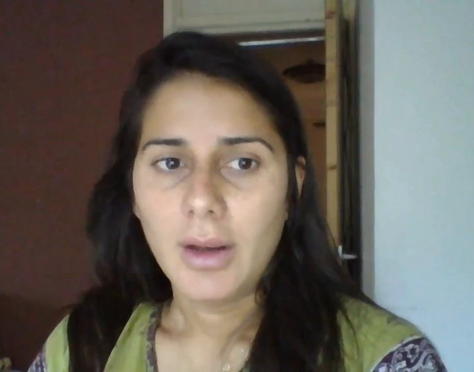

The aims of the London Recovery Board seem appropriate, though some questioned the role of the board.
Respondents agree with current aims* of the London Recovery Board – they seem to cover the main issues. However they are not particularly surprising, and many expected City Hall and London's councils to be working on these already.
A few respondents were sceptical of what they deem to be 'yet another board', and questioned what the board will do and what the outcomes will be. Questions were also raised around what the board can achieve versus what is out of its hands or is instead the responsibility of Government, for example around reducing unemployment.
“It's difficult within London to do that when you're trying to work with schemes that have been set up government.”
*Reverse the pattern of rising unemployment and lost economic growth; Support our communities, including those most impacted by the virus; Keep young people safe; Narrow social, economic and health inequalities; Deliver a cleaner, greener London​

Slide 7


There is appetite for change – respondents see coronavirus as a catalyst, and want London's recovery to capitalise on it.
Over the last 4 weeks many respondents have highlighted some of the positive changes during the pandemic, notably environmental, and have seen the pandemic as an opportunity and catalyst for change. They want London's recovery to capitalise on this, and for these changes to become the new normal, not for London to return to how it was before.
Some are now more optimistic that positive changes can be made, and quickly, if there is desire and action. For example, improving air quality, changing lifestyles, working flexibly, helping homeless people off the streets.
“This is a great opportunity where we’ve taken [the homeless] off the streets, so now let’s keep them off the streets.”

Slide 8
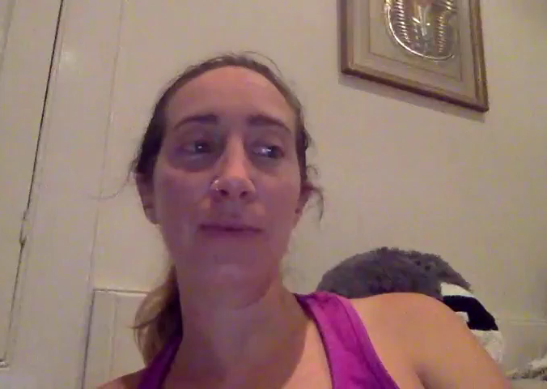
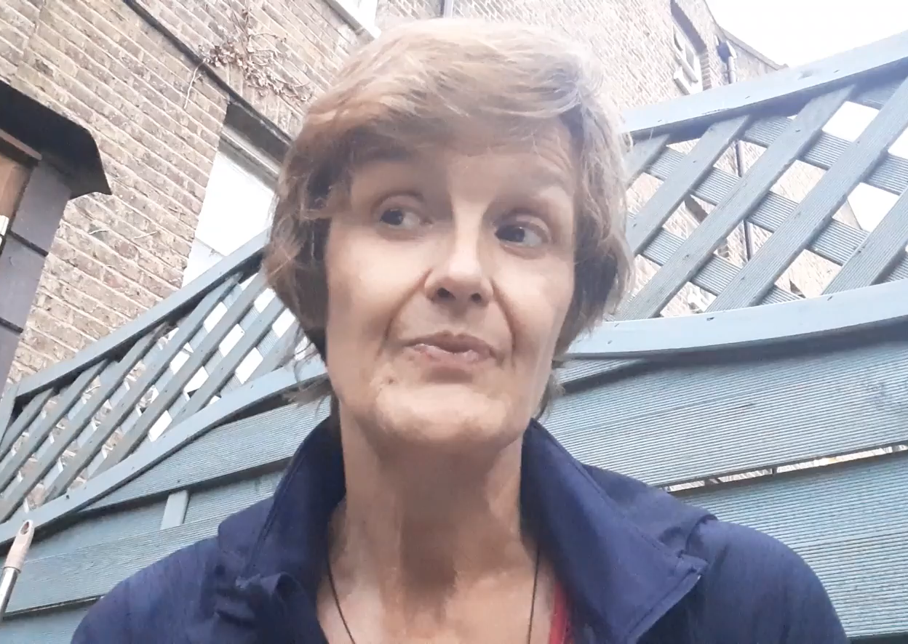

Respondents want an economic recovery that is local and fair, not ‘profit-making for the sake of profit-making’.
Respondents see the economy at the centre of London’s long-term recovery, but want ‘good growth’. As part of this, many see the need the need for investment and government intervention, for both the economy and Londoners.
Supporting small and local business and supporting sectors that have been most affected during lockdown are seen to be key priorities for rebuilding the economy. But this should not happen at the expense of worker’s rights and pay.
Support small and local businesses
Support at-risk sectors (e.g. culture and hospitality)
Protect worker’s rights and pay

Slide 9
Respondents identified some immediate support and ideas for London’s small businesses and high streets.
“I think extra support for small businesses and not-for-profits is really needed. I know many in my immediate local area that have suffered and are under threat because they didn't receive any support/ grants etc due to falling through some of the many loopholes in the government support packages.”
“Make arrangements for congestion charge side streets to be pedestrianised so restaurants and bars can move tables outside onto the streets so people can social distance and dine out.”
“I am not sure what role the GLA has with regard to the High Street but it seems like it needs special help to reimagine itself. Could the Mayor launch a competition or a series of awards and cash… A bit like the Britain in Bloom awards, but for innovative and creative use of High Street Space, and with big grant awards going to the winners.”
“I have seen it already with the expansion of pavements but perhaps pedestrianising some local high streets completely to encourage people to shop locally, supporting local business but also to feel safe doing so.”
“For retailers who don’t have online deliveries...teach them how to do the online business as well, so that most of the businesses can be online.”

Slide 10
Safety remains paramount – this should be emphasised alongside economic recovery measures.
Recovery of the economy is key, but in the short term there is still the threat of coronavirus and a possible second wave. Many are still nervous about relaxing lockdown, and feel strongly that this should be accompanied by strict preventive measures. They need reassurance that the economy is opening up in a safe way. This includes:
  More of the measures that are already being seen across London, such as free masks, hand sanitizer outside shops, widening pavements or pedestrianizing streets.
  More practical advice, including from City Hall, on how to stay safe as lockdown eases (on TV, not just online).
  Reassurance of the steps TfL are taking to ensure public transport is safe.
  Promoting active travel and keep streets car-free to make this an attractive option.
“I would like to feel more safe if in few weeks I will need to work from office and I will need to take tube or buses. I am not sure that travelling with face covered will be enough. I think more information and more reassurances will be a good start point. All the practical information about COVID is provided in a inconsistent way from companies and I would like to get more info from City Hall directly.”
“Provide lots of places to get free recyclable masks and sanitizer.”
“Possibly making a campaign of 'get London walking' and developing a app that rewards Londoners for walking to places and counts their miles etc. Get fewer people to use vehicles as a means of transport.”

Slide 11
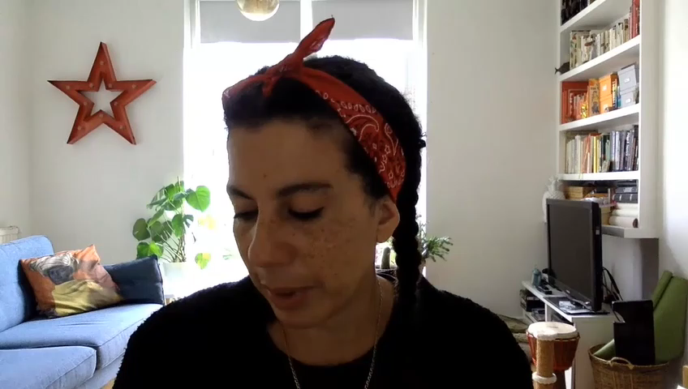
Immediate financial relief and support for Londoners is also needed, alongside supporting businesses.
Respondents understand that supporting businesses and the economy will positively impact on Londoners, through increasing employment for example. But they stressed the need to provide financial relief and support to individual Londoners alongside this, which will then in turn help the economy through labour supply and spending.
Reducing the financial strain – e.g. by reducing council tax
Providing practical financial advice – such as that offered by Money Saving Expert (e.g. shopping smarter. managing household bills, negotiating rent)
Universal income – to provide financial security, avoid the complicated benefits system/ Universal Credit, and ‘jumpstart’ the economy by making it easier for some people to work
Employment and skills support – training opportunities, work experience and careers advice (especially for young people)

Slide 12
Respondents stress the importance of supporting those most at need, and the role of community support.
Respondents are agreed that immediate recovery efforts should prioritise those most in need – for example the elderly, single parents, homeless, those with health conditions. They want councils to proactively identify and support those most at need. They also don’t want to see the support services established during the pandemic to disappear.
Others want to harness the community support and community initiatives that came out of the pandemic – they want to know how to support people in their local communities (e.g. reducing loneliness; improving digital skills to ensure Londoners can work and shop online, supporting people with essential shopping and chores).
“In the short-term I feel it will be important for local councils to continue to support local communities, businesses and those more vulnerable so that we can come out of this safely and with confidence…”
“I think we need to teach people how to do their work online…shopping as well so that they can do the shopping online.”
“Run anti-loneliness initiatives e.g. befriending and digital skills courses to help older people who are still isolating. Continue keeping homeless people housed, do not kick them out of the accommodation that was provided for lockdown.”

Slide 13
Views on Test and Trace

Slide 14

Test and Trace is seen as a good idea in principal, but respondents question its effectiveness and timing.
Respondents see the need for some form of contact-tracing, alongside social distancing. They noted successes in other countries, and a few respondents feel more reassured going out now that Test and Trace is up and running.
However, many questioned why it has taken so long to introduce the manual contact-tracing and why the app is not yet ready. They think both were needed much earlier (at least before easing lockdown), and question how effective it will be at this point in the pandemic when transmission is currently low.
Respondents highlighted concerns and flaws that underpin their perceived effectiveness of it (see next slides).
“I think it will still be effective in stopping the spread of the virus and it does give me some reassurance when I leave the house.”
“Some form of Test and Trace should have been implemented months ago. The effectiveness today is probably minuscule relative to what it would have been had it started in February or March.”

Slide 15
Key concerns and flaws with Test and Trace in general:
It relies on cooperation from the public and is seen by some to be ‘too voluntary’. Some respondents questioned whether people, if notified, will decide to self-isolate for 14 days especially now that lockdown is easing. There is also no guarantee that somebody will have coronavirus just because they were in contact with somebody who did.
Some Londoners may also be unable to self-isolate for 14 days, if this will affect income or caring responsibilities.
Concerns were raised over how employers would react if staff were 'advised' to self-isolate for 14 days.
The scheme also relies on mass testing, with rapid turn-around, to identify those who have the virus. Some have doubts whether testing in the UK is currently at that stage.
“People are less likely to self-isolate if they're notified, they’ve been in contact with the virus. The scheme is too voluntary: people are sick of lockdown and want to get back to normal.”
“There are too many question marks over it. It relies on cooperation. People may say they never got a message if they were contacted. They can just ignore it. How on earth do you convince your boss? You got this spurious message about coming into contact with somebody with coronavirus and now you have to be off work for 2 weeks.”
“In my opinion it is not 100% safe to stop the spread of the virus as the whole population would have to test first to see who is positive or not.”

Slide 16
Key concerns and flaws with the manual contact-tracing:
It relies on individuals remembering who they were in close contact with and only identifies already ‘close’ contacts, not strangers that they may have been in contact with. For this reason, the app is seen to be a more effective tracer.
If tested positive, many respondents would notify their close friends and family anyway.
Some have doubts over the speed and efficiency of the manual contact-tracing, and think it will be too slow to notify close contacts. To be effective, they think the contract-tracing needs to notify contacts straight away. Again, this is another reason why some think the app will be more effective at notifying those with suspected coronavirus.
“As my partner says, as a train driver, he might interact with over 50 people a day. Is he expected to remember them all?”
“If that person was on a bus and sneezed… there are people on the bus who are not 'contacts' but may have been infected and pass it on without ever being traced.”
“I think the app will be more effective in contact tracing because it will help identify not just the people you have knowingly passed but those who you didn't know you came into contact with.”
“Until one shares details of whom/ where they have been in contact with and the NHS notifies them, it all takes some time…people (that will eventually be notified) will already have been in contact with many others.”

Slide 17
Key concerns and flaws with the smartphone app:
Respondents believe the app will only be effective when used en masse. They question how many people, especially those most at risk, will even use the app and thus whether there is any point in using it themselves.
There are inevitably concerns around how the government will use their personal data, now as well as in the future.
There is also some scepticism about the technology itself and how well the app* will work.
“I fail to see how effective the app would be unless the vast majority used it, which would never be the case. I know lots of people who don't own smartphones, don't use many apps, or believe different theories about coronavirus.”
“I have no confidence in the protection of personal information. This includes what information might be collected now or expanded upon in future; what algorithms will be used on the data collected; what other data the information will be combined with; how long the data will be stored, who it will be shared with now or in the future.”
“Both Apple and Google have already developed Apps that are capable of doing this… I would expect tech companies who are experts in this field to deliver a better product than a government is capable of.”
*Note: responses were collated before Government announced on 18th June that it would switch to technology developed by Apple and Google

Slide 18
COVID-19 online diary
Weeks 3 and 4 (June 2020)
For more information please contact Myles Wilson, GLA Intelligence
Greater London Authority, City Hall, The Queen’s Walk, More London, London SE1 2AA
e-mail: Myles.Wilson@London.gov.uk
Phone: 07925 126 936
Copyright © Greater London Authority, 2020
NOT FOR GENERAL CIRCULATION

