Slide 1
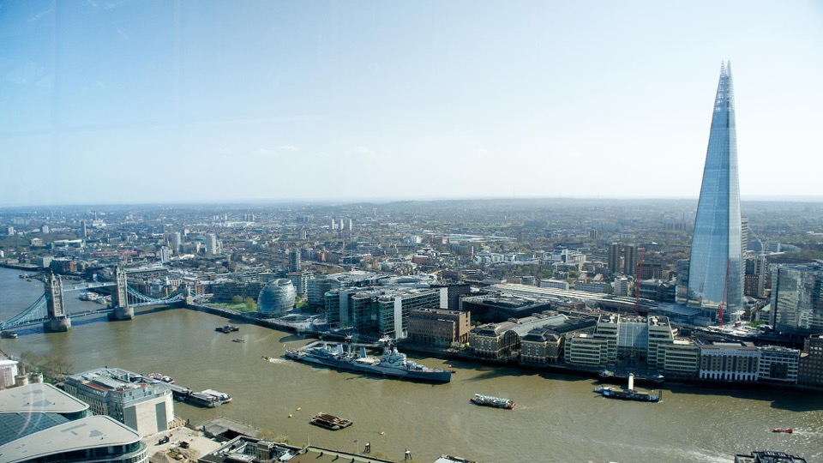



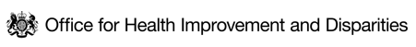

HEALTH INEQUALITIES IN LONDON
A snapshot of health inequalities in London
BUILDING THE EVIDENCE DATA WORKING GROUP
December 2022

Slide 2
EXECUTIVE SUMMARY (1 of 4)
This report provides a snapshot of health inequalities in London based on available data sources and a shared overarching narrative that relevant partners can use in their work
An adapted version of the Kings Fund framework for measuring inequalities and the Marmot principles for addressing inequality have been used to organise this snapshot of inequalities in London into 7 parts summarised below
Part 1 – Current context
The Covid-19 pandemic had a devastating impact on London which was the region in England with the highest excess mortality ratio (1.23) between March 2020 and July 2021. This exposed existing health inequalities and how different circumstances of our lives ultimately determine our chances of poor health
Uncertainties now remain around the size of the population currently living in London because:
(1) the 2021 census was undertaken at the pandemic peak when many young adults were known to have temporarily left London
(2) London continues to experience high volumes of population churn
Initial 2021 census estimates place London population at 8.8 million, but projections suggest the population may have further recovered and grown since, albeit at a slower rate than pre-pandemic
Part 2 – Health Inequality in Health Status
Over the last decade increases in life expectancy in both London and England have slowed, and in 2021 life expectancy in London was 79.5 years for males and 83.8 years for females
Gender, geographical, and socioeconomic inequalities are evident. The average gap in life expectancy between the least and most deprived Middle Layer Super Output Areas (MSOAs are areas containing ~7,500 residents) being 4.4 years for males and 6.3 years for females

Slide 3
EXECUTIVE SUMMARY (2 of 4)
Part 2 – Health Inequality in Health Status – contd.
Variation exists across London boroughs in healthy life expectancy. This ranges from 58.1 years in Barking and Dagenham to 70.2 years, in Richmond upon Thames for males; and 57.8 years in Tower Hamlets to 70.1 years in Wandsworth for females
Ethnic inequalities in life expectancy and disease are evident for instance with South Asian and Black people 2-4 times more likely to develop type 2 diabetes mellitus
High numbers of individuals belonging to inclusion health groups such as rough sleepers, asylum seekers and Gypsy, Roma and Traveller communities live in London. There is limited timely data available on the health of some of these populations, though data available consistently shows high health needs and higher prevalence of communicable and non-communicable diseases compared to the general population
Part 3 - Why Inequality exists? - Wider determinants
This part on wider determinants is structured using the 8 Marmot principles and highlights how significant social inequalities evident from early years through to later life, ultimately drive health inequalities seen in London
2 in 5 children in London live in poverty when housing costs are included, while the least deprived decile of Londoners have 10x more income than the poorest
The cost of living crisis has meant a quarter of Londoners are buying less food and essentials to manage, while overcrowding, quality and affordability of housing is negatively impacting most on those in low income and minority ethnic groups
Consistently, intelligence shows how low income and minority ethnic Londoners engage less in active travel, have less access to green space, experience the worst of the climate crisis and air pollution, meaning collectively they have less opportunity for good health
43% of Black and 33% of Asian Londoners reported being treated unfairly due to their ethnicity compared to 12% for the London population in general

Slide 4
EXECUTIVE SUMMARY (3 of 4)
Part 4 – Health behavioural risk factors
Social inequalities seen in Part 3, determine inequalities evident in the prevalence of health behaviours
Smoking prevalence has decreased in recent years to 12.9% in London. However inequalities remain with prevalence in routine and manual occupations (for those aged 18 to 64 years) at 20.7%, twice that of managerial and professional occupations (10.3%).
In 2020/21, 56.0% of the adult population in London were either overweight or obese, with obesity prevalence lowest in least deprived (~4%) and highest in the most deprived areas (~10%) of London
In 2019/20, one in five reception-age children and around two in five Year 6 children in London were classified as overweight or obese, with similar inequalities seen by deprivation
Part 5 – Death and Illness in London
All-cause premature mortality rate in London increased by 23% between 2019 and 2020 for males, and by 17% for females largely due to direct and indirect impacts of the pandemic
The premature mortality rate in the most deprived decile in 2020 was almost three times that of the least deprived decile
COVID-19, cardiovascular disease, cancer and respiratory disease contributed significantly to gaps in life expectancy between the most and least deprived decile
Low back pain, depression and headache contributes most to illness in London and nearly one in four Londoners aged over 16 report characteristics of poor mental health

Slide 5
EXECUTIVE SUMMARY (4 of 4)
Part 6 – Healthcare Inequalities in London
Inequalities in access to and the quality of health and care provision risk further compounding and worsening existing health inequalities
Emergency department and non-elective per capita spend in London for people aged 65-84 is higher in the most deprived quintile than in the least deprived (£97 vs £58; £787 vs £457); while elective care per capita spend is slightly higher in the least deprived quintile than in the most deprived (£264 vs £250). This collectively highlights how deprived areas tend to receive more reactive than proactive healthcare
Unvaccinated rates for Covid-19, increase with deprivation (22.6% in most deprived quintile, 11.1% in least deprived) and are highest in the Black Caribbean (39.1%), Other White (25.2%) and Black African (24.9%) populations
Those belonging to the most deprived deciles have the lowest rates of breast and bowel cancer screening uptake
Part 7 - Conclusion
The report highlights that data evidencing health inequalities in London is plentiful but disjointed. There are still important gaps in the availability of data to describe, analyse and interpret inequalities.
More systematic and consistent collection, recording and coding of data relating to geography, across all protected characteristics, and of key inclusion health groups should remain a priority
Partnership action could be used to identify means of accessing more novel and timely data, more integrated and linked datasets between heath and care and wider determinants.
This would allow better application of evidence-based approaches such as the Marmot Principles and 'Health in all Policies' to help address inequalities in London

Slide 6
AUDIENCE FOR THIS WORK AND HOW TO USE THIS RESOURCE
Audience for this work
This is a resource intended for health leaders, analysts, officers, and policy makers from local and regional government, integrated care systems, NHS, academia, VCS organisations and partners across London to support their work to address inequalities by helping
Frame discussions with system partners
Engage communities
Identify data sources on a given topic
Advocate for the need for action to address health inequalities
How to use this resource
The resources includes a content navigator which allows the user to navigate to any part or topic of interest via the embedded link
The separate appendices (Appendix A and Appendix B) also provides a list of all data sources used by topic and alphabetically
The resource is provided in PDF and PowerPoint format to support colleagues in their work on inequalities

Slide 7
CONTENT NAVIGATOR (1 of 2)
Part 1 Current Context
London 2021 Census
Limitations of Population Estimates
Population Churn in London
Covid-19 and recovery
Part 2 Health Inequality in Health Status
Inequality in Life expectancy
Inequality by ethnicity in health
Inequality by select inclusion health groups in health
Inequality in healthy life expectancy
Inequality in disability free life expectancy
Inequality in low birthweight
Part 3 Why Inequality exists? - Wider determinants
1. Give every child the best start in life
  Child Poverty
2. Enabling children, young people and adults to maximise their capabilities
  School Readiness
  KS4 educational attainment
  Mental Health
3. Fair employment and good work for all
  Income and Employment
4. Healthy standard of living for all
  Cost of Living
Part 3 – Contd.
5. Healthy and sustainable places and communities
  Housing
  Active Travel
  Green Space
  Air Pollution
  Built Environment
  Neighbourhood Cohesion
  Violence
6. Ill Health prevention
  Key behavioural risk factors
7. Racism and Discrimination
8. Environmental Sustainability and Equity
  Climate Risk

Slide 8
CONTENT NAVIGATOR (2 of 2)
Part 4 Health behavioural risk factors
Smoking
Obesity in Adults (including diet)
Obesity in Children
Physical Activity
Alcohol Misuse, Drug Misuse and High Blood Pressure
Part 5 Death and Illness in London
Premature and Preventable Mortality
Causes of death in London
Illness in London
Prevalence of disease
Mental health in Adults
Infant mortality
Part 6 Healthcare Inequalities
Spend on Care
Covid-19 vaccination uptake
Flu vaccination uptake
Screening uptake
Care for diabetes
Part 7 Conclusion
Concluding comments
Gaps in Evidence and in this deck
Acknowledgements

Slide 9
METHODOLOGY AND LIMITATIONS
APPROACH
LIMITATIONS
This report has been produced collaboratively by the Greater London Authority (GLA) Health team, GLA City Intelligence Unit, Office for Health Improvement and Disparities London (OHID), Association of Directors of Public Health London (ADPH), NHSE and Institute of Health Equity (IHE)
An adapted version of the Kings Fund measures of health inequalities alongside the 8 Marmot Principles has been used to help structure this deck and identify topic areas to illustrate the breadth of inequalities challenges in London
The structure of the deck, divided in parts, covers current context, health inequality in health status, wider determinants (structured to the Marmot 8 principles), health behavioral risk factors, death and illness and healthcare inequalities
Throughout the deck, inequalities have been examined where possible across 4 dimensions (deprivation, geography, protected characteristics and inclusion health)
Sources of data were identified from existing published data, working in partnership through iterative discussion
Further information on methodology and limitations are provided in Appendices C and D (see companion appendices)
We aim to use this work to:
Provide an overview of major inequalities issues affecting London in an accessible format
Highlight existing data resources available in London to measure inequalities around a shared narrative that colleagues can use
Provide a platform for partnership work across London such as identifying key gaps in intelligence, that would improve our understanding of inequalities
Key limitations include:
This is only a snapshot of inequalities in London and not intended to comprehensively cover all inequalities issues affecting London, every inequality dimension or factor driving inequalities in London.
Only content published in the public domain is used
This report cannot be used in isolation to prioritise health inequalities issues in London or indeed Identify actions needed to address inequalities which are beyond its scope

Slide 10
PART 1: CURRENT CONTEXT
DEMOGRAPHIC OVERVIEW OF LONDON AND COVID RECOVERY

Slide 11
PART 1 OVERVIEW: CURRENT CONTEXT
Before reviewing health inequalities in London, a key challenge we have is assessing who is now living in London following the Covid-19 pandemic, given extensive in- and out-migration during and post-pandemic.
It is also important to reflect on the impact the pandemic had on the city, and how this has shaped the health of Londoners and exposed and widened existing inequalities
In this part we specifically outline:
London census day population
Limitations of the census
Limitations of population estimates
Population churn in London
Reflection on impact of Covid-19 in London
  Mortality due to Covid-19 in London
  How Covid-19 exposed existing inequalities

Slide 12
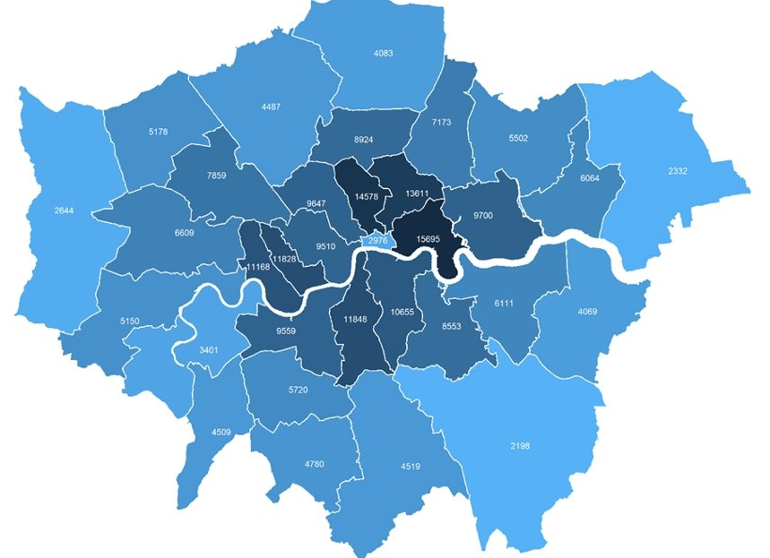

LONDON’S 2021 CENSUS DAY POPULATION WAS 8.8 MILLION, BUT GROWTH HAS HAPPENED SINCE
The 2021 census estimate of London’s population is 8.8 million​
GLA (Greater London Authority) population projections indicate London’s population may have recovered since the census
As recovery continues population growth is expected, albeit at a slower rate than in recent decades.
However limitation of these estimates (next slides) does mean we remain uncertain about the exact status of London demography
Key statistics
46% of Londoners are Black, Asian and minority ethnic groups
41% of Londoners are born outside UK (Rest of England 13%)
50% of Londoners are aged 35 or under (Rest of England 43%)
19% of London’s working-age population are disabled ²
20% of Londoners are 16 or under (Rest of England 20%)
37% of Londoners are born outside of the UK, compared with 11% in the rest of the UK
Fig 1. Population Density (persons per km²) by London Borough, 2021 Census
Source: (1) England Wales Census 2021 (2) Annual population survey 2021-22

Slide 13
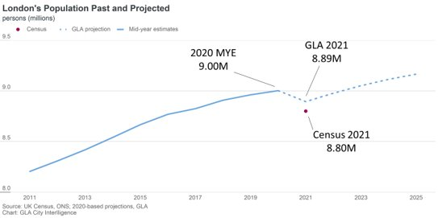
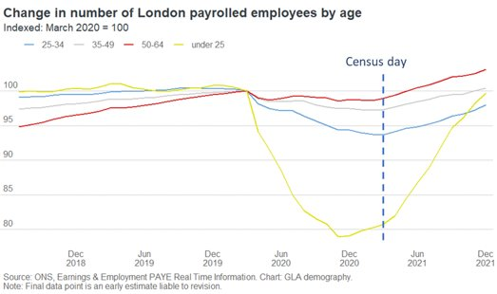
2021 CENSUS WAS HELD IN A PANDEMIC AND UNCERTAINTY EXISTS IN LONDON DEMOGRAPHY
Data from the March 2021 census is being published by ONS in line with a planned schedule of outputs:¹
Initial data estimates the London’s population as 8.8 million​
This is 200,000 lower than the 2020 mid-year estimate and 90,000 below GLA projections​
The census was taken at the height of the pandemic. The extent to which this will affect the results is unknown but considerations include:^{2,3}
Timing of census occurred at a point when many young adults are known to have temporarily left London​ during the pandemic
However in the 15 months since the census, migration to London of students, hospitality/entertainment industry workers and those who left London temporarily during the pandemic, will mean populations (particularly among young adults) are higher now than the census results indicate​
Further differences seen between census and prior ONS estimates is likely attributable to how population inflation was incorporated into annual estimates over the past decade​
Uneven impacts of the pandemic on results across areas and population groups will also add uncertainty to future analysis
Fig 2. London’s population past and projected (top) and change in number of London employees over time (below)
Source: (1) England Wales Census 2021
(2) Population change in London during the pandemic (3) Earnings and employment from PAYE

Slide 14
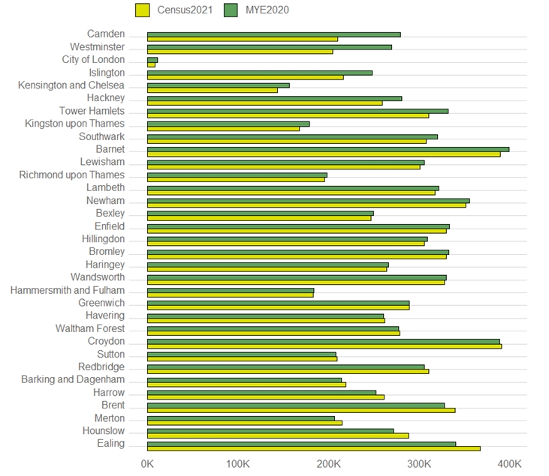
THERE ARE LIMITATIONS TO CONSIDER IN POPULATION ESTIMATES FOR LONDON AS WELL
There are a number of limitations to existing methods used to estimate London demography which should be considered during interpretation:¹⁻⁴
Official estimates are anchored in the results and limitations of previous census and only account for subsequent estimates of birth, deaths, and migration​
High levels of mobility and migration into, across and out of London​
Systematic errors in the estimates accumulate and compound over course of the decade​
Official population estimates usually operate on 1-year lag
Often estimates are unable to account for inclusion health groups
The pandemic affected estimates in a number of ways:
  Difficulties in data collection (e.g. delays to birth registrations, end of international passengers surveys)
  Changed behaviours (modelling assumptions no longer sound for population churn)
2021 census confirmed issues with current official series: inflated the number of children and old people, and a failure to accurately capture returning international students​.
The figure shows the most recent official population estimates (Mid Year estimates for 2020) with census estimates for each London borough
This led to distortion of a range of measures and indicators that use estimates as denominators, including life expectancy, and prevalence and vaccination rates
Fig 3. Population estimates from 2020 and 2021 (1000s) compared to Census 2021, for London boroughs
Note: MYE= Mid-year Estimates; Boroughs sorted by descending % difference between estimates
Source: (1) England Wales Census 2021 (2) Population change in London during the pandemic (3) Earnings and employment from PAYE
(4) Census 2021 first release - CIU Report on London Datastore

Slide 15
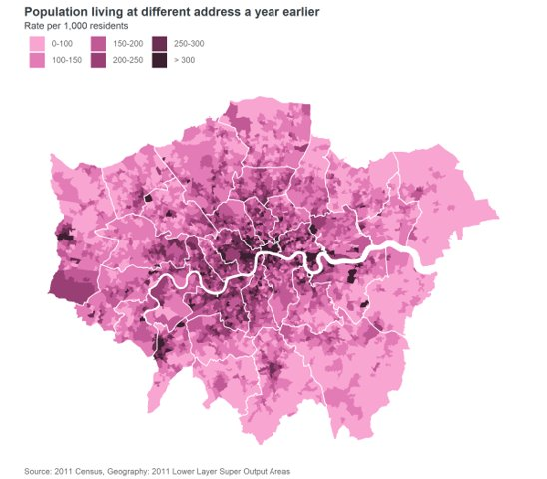
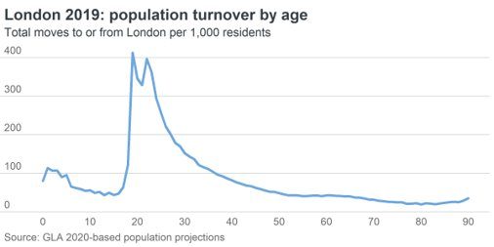
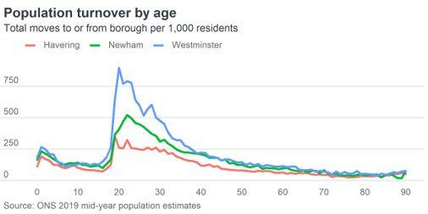
POPULATION CHURN IN LONDON
London historically experiences very high levels of migration and mobility, with large net international inflows offset by similarly large net domestic outflows​
Fig 4. Population Churn in London: (A) Heat Map of population address changes over a year
(B) population turnover by age in London and (C) across specific London boroughs
In a typical year, over 900,000 people migrate across London’s boundary – a turnover rate of over 100 moves per 1000 residents​.
Levels of population turnover and churn vary greatly by age and location​. The highest levels are seen in Central London and near to universities
Rates are highest among young adults in their early twenties​
B
C
A
Source: 2011 Census

Slide 16
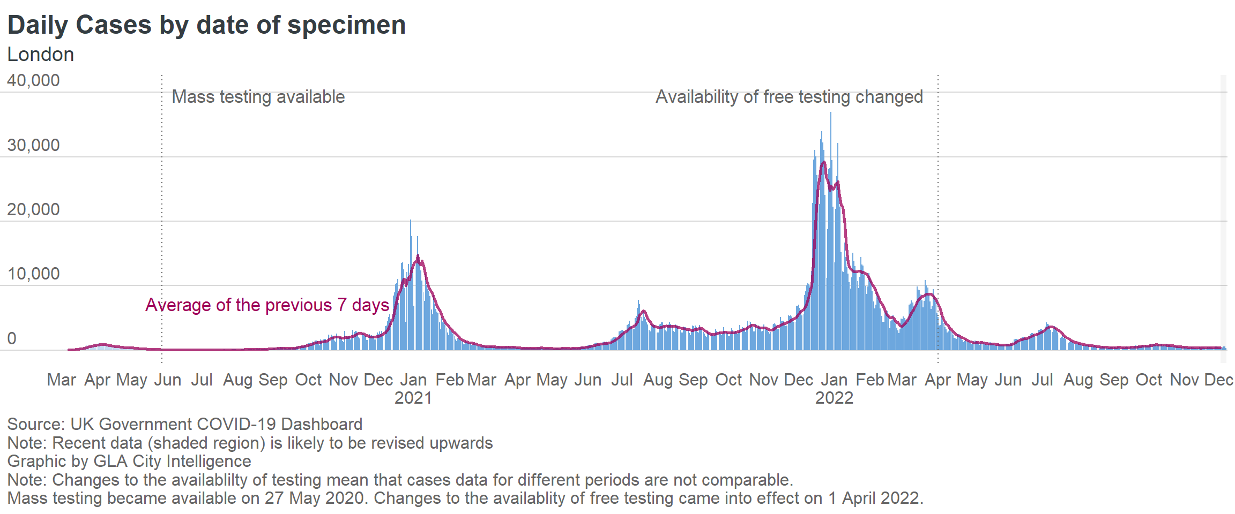
3.1 MILLION COVID-19 CASES WERE RECORDED IN LONDON WITH 24,640 DEATHS BY DECEMBER 2022
3.1 million cases in London (15.3% of the England total) were detected as of December 2022 however eligibility and availability of testing has changes across time
24,640 Londoners have died within 28 days following a positive Covid-19 test during this period
Fig 5. Daily cases of Covid-19 by specimen in London, March 2020 to Dec 2022
Note: Specimen date = the date the sample was taken from the person being tested
Source: (1) UK Government Covid-19 Dashboard (2) London Datastore - Covid-19 Updates

Slide 17
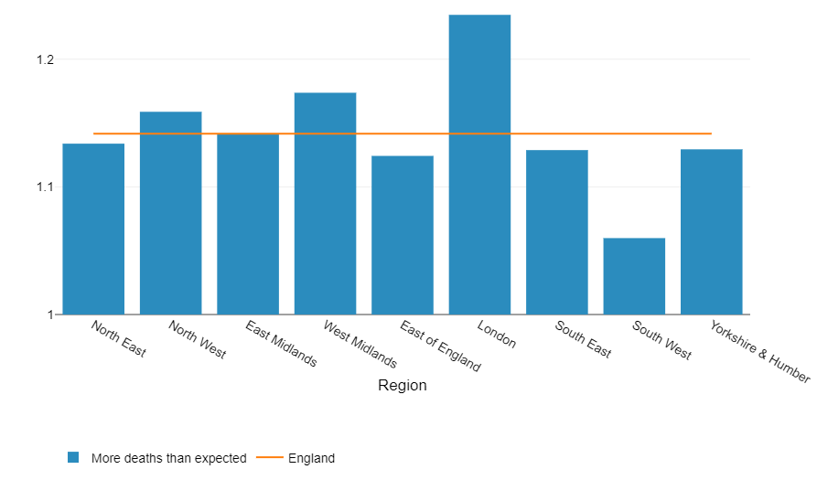
LONDON HAD THE HIGHEST REGIONAL EXCESS MORTALITY RATIO IN ENGLAND DURING COVID-19
Excess mortality is a measure of how much higher all-cause mortality (death from any cause) was in the pandemic period than expected, compared to previous years
It is expressed as a ratio comparing registered deaths to expected deaths
In all English regions there were more deaths than expected during the pandemic period but excess mortality was highest in London compared to previous years.
In London, the excess mortality ratio was 1.23 times higher than expected between March 2020 and July 2021
This was the highest of any region in England
Fig 6. Cumulative excess mortality ratio, by regions in England, week ending 27 March 2020 to week ending 2 July 2021
Note: Excess mortality ratio (1= same as expected)
Source: Health Profile for England, 2021

Slide 18
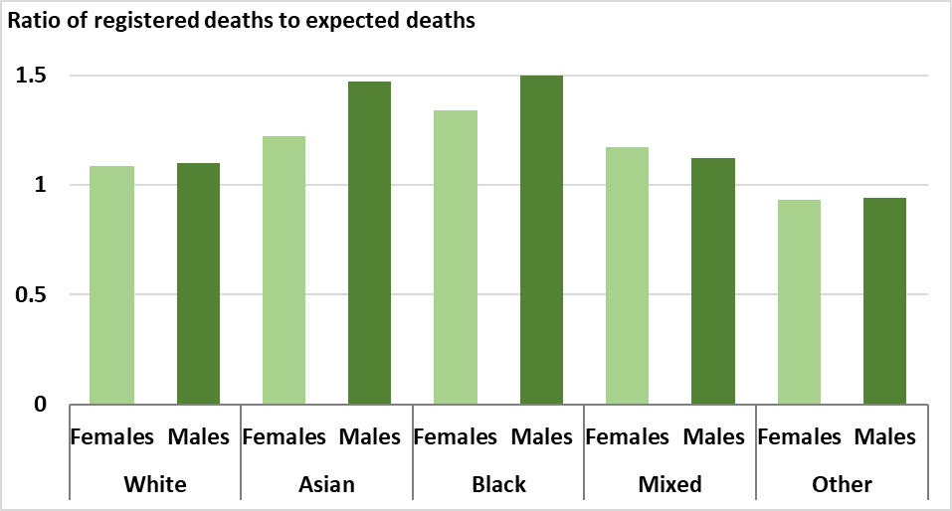
COVID EXPOSED EXISTING HEALTH INEQUALITIES IN LOW INCOME AND MINORITY ETHNIC GROUPS
The impact of Covid-19 on deaths across ethnic groups can be seen in the ratio of registered deaths to expected deaths by ethnic group.¹
This ratio is highest for male (1.5) and females (1.3) from Black ethnic groups
Black, Pakistani and Bangladeshi communities were disproportionately exposed to the virus and the consequence of worse outcomes as a result of factors including:²
  social and economic inequalities such as living in overcrowded housing and financial vulnerabilities
  racism
  discrimination and stigma
  occupational risk, e.g. greater likelihood of working in public-facing roles
  inequalities in the prevalence of conditions that increase the severity of disease including obesity, diabetes, CVD (cardiovascular diseases) and asthma.
Many of these negative experiences are shared with low income groups from a range of ethnicities
Black and ethnic minority groups are over-represented in the low income population
Fig 7. Ratio of deaths registered compared to those expected, by ethnic group in London, 21 March 2020 to 20 May 2022
Note: Excess mortality ratio (1= same as expected). Expected deaths based on death rates in London for each ethnic group in 2015-19
Source: 1) Excess mortality in England and English region 2) Beyond the data: Understanding the impact of COVID-19 on BAME groups

Slide 19
PART 2: HEALTH INEQUALITY IN HEALTH STATUS

Slide 20
PART 2 OVERVIEW:HEALTH INEQUALITY IN HEALTH STATUS
The purpose of this part is to help illustrate the scale of inequality in London across health status for dimensions below (where there is reported data in public domain). It is not intending or able to capture every dimension of inequality
Deprivation
Gender
Geography
This section highlights health inequalities relating to groups below recognising the lack of data available on the health of these groups and limitations of data that exists:
Ethnic minority groups
Inclusion health groups*
Other common measures of health inequality in health status that are available for London will also be presented including:
Inequality in healthy life expectancy
Inequality in disability free life expectancy
Low birthweight in London
*Inclusion health refers to any population group that is socially excluded. This can include people who experience homelessness, vulnerable migrants, Gypsy, Roma and Traveller communities, drug and alcohol dependence, sex workers, people in contact with the justice system and victims of modern slavery, and other socially excluded groups.

Slide 21
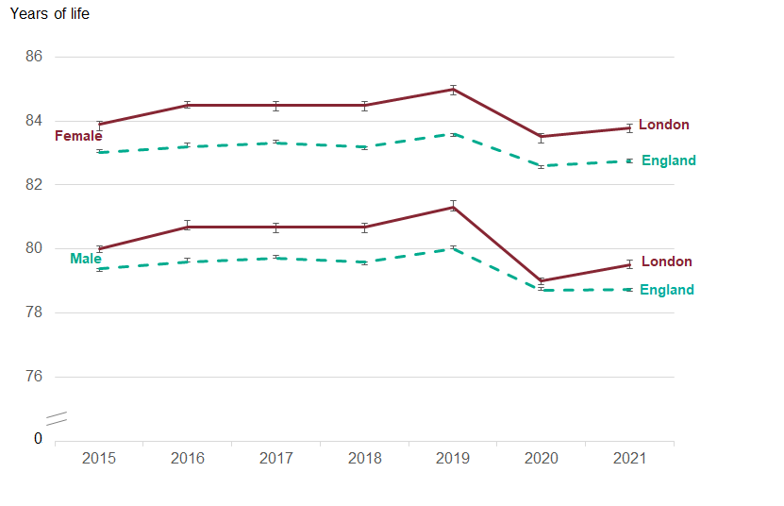
LIFE EXPECTANCY DECREASED IN 2020 DUE TO COVID-19 HOWEVER HAS INCREASED IN 2021
Increases in life expectancy have slowed over the course of the past decade both in London and England as shown
In 2021, life expectancy in London was 79.5 years for males and 83.8 years for females.
Due to the impact of the Covid-19 pandemic between 2019 and 2020, life expectancy fell significantly for both sexes in London, but increased slightly in 2021 by 0.51 years in males and 0.27 years in females.
Although there were decreases in life expectancy in all English regions between 2019 and 2020, the greatest reduction was seen in London.
Not all regions saw increased life expectancy in 2021 however.
Fig 8. Trend in life expectancy at birth, London and England, by sex, 2015 - 2021
Source: OHID CHIME tool

Slide 22
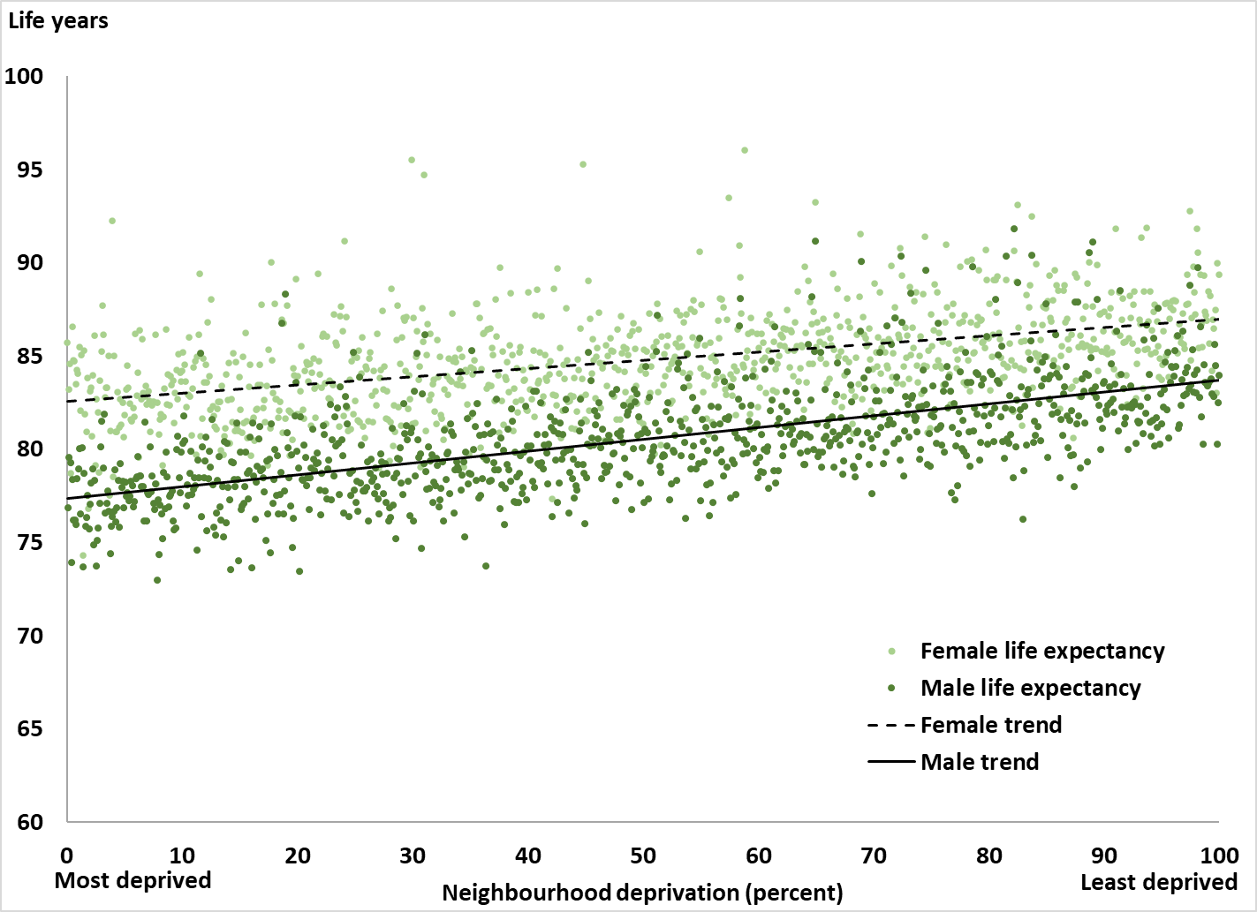
INEQUALITY IN LIFE EXPECTANCY FOR LONDON EXISTS BY GENDER AND DEPRIVATION
The graph illustrates the gradient of inequality in life expectancy experienced across two dimensions;^{1,2}
Geographically between those in the most and least deprived MSOAs (Middle Layer Super Output Area) in London as determined by IMD 2019
By gender
Based on the regression line shown in the graph, the average gap in life expectancy between the least and most deprived MSOAs was 4.4 years for males and 6.3 years for females
Life expectancy in the least deprived MSOA in London in Bromley (Petts Wood - 025) was 84.0 years for males and 89.3 years for females
Life expectancy in the most deprived MSOA in London in Haringey (Northumberland Park - 002) was 76.9 years for males and 85.7 years for females
Note:
1. Middle Layer Super Output Areas (MSOAs)
have an average population of ~7500 residents or consist of
~4000 households.
2. Most recent available Life expectancy data from
ONS spanning 2017-20 used.
Fig 9. Inequality in life expectancy by gender and deprivation for London Boroughs, 2016-20
Note: Percentage distribution derived by ranking neighbourhoods (MSOAs) within London by their IMD2019 deprivation score. This includes data from Covid-19 in 2020 which may distort patterns.
Source: (1) ONS National Life Tables (2) English indices of deprivation 2019: mapping resources

Slide 23
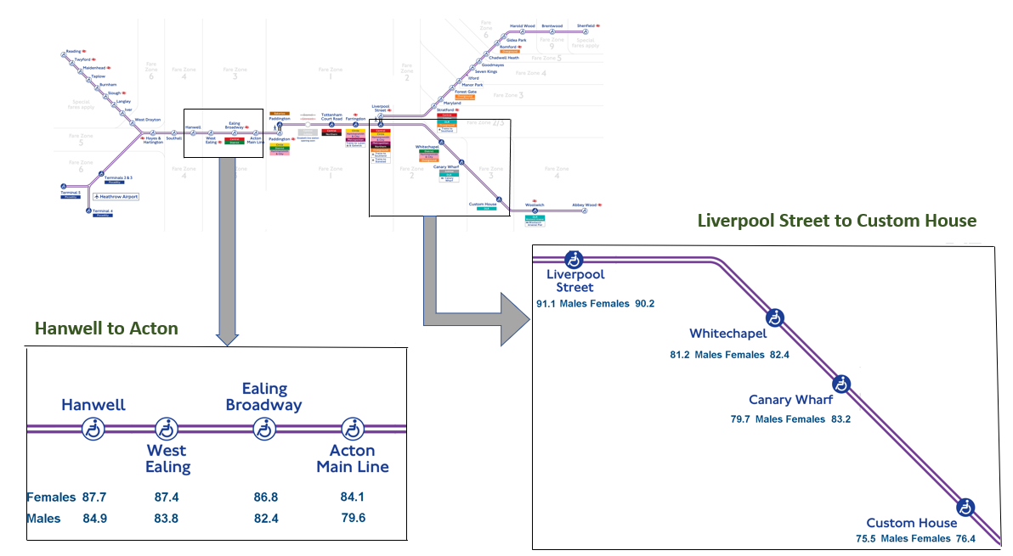
INEQUALITY IN LIFE EXPECTANCY EXISTS ACROSS ELIZABETH LINE STOPS IN LONDON
Geographical inequality in life expectancy in London is illustrated as one travels along the Elizabeth line in London
The graph provided illustrates two sections of the line where there are systematic changes in life expectancy for both men and woman
Moving both from Hanwell to Acton and Liverpool Street to Custom House a gradient of inequality in life expectancy is evident
Note: 1.The Liverpool Street (City of London) life expectancy calculation has limitations due to challenges with calculating a denominator and capturing who exactly lives in this area (as it is theorised that some individuals may list this as their place of residence, but may not live there)
2. Middle Layer Super Output Areas (MSOAs)
have an average population of ~7500 residents or
~4000 households.
Fig 10. Inequality in life expectancy as measured across stops on the London Elizabeth line, using MSOA data, 2015-19
Source: ONS National Life Tables

Slide 24
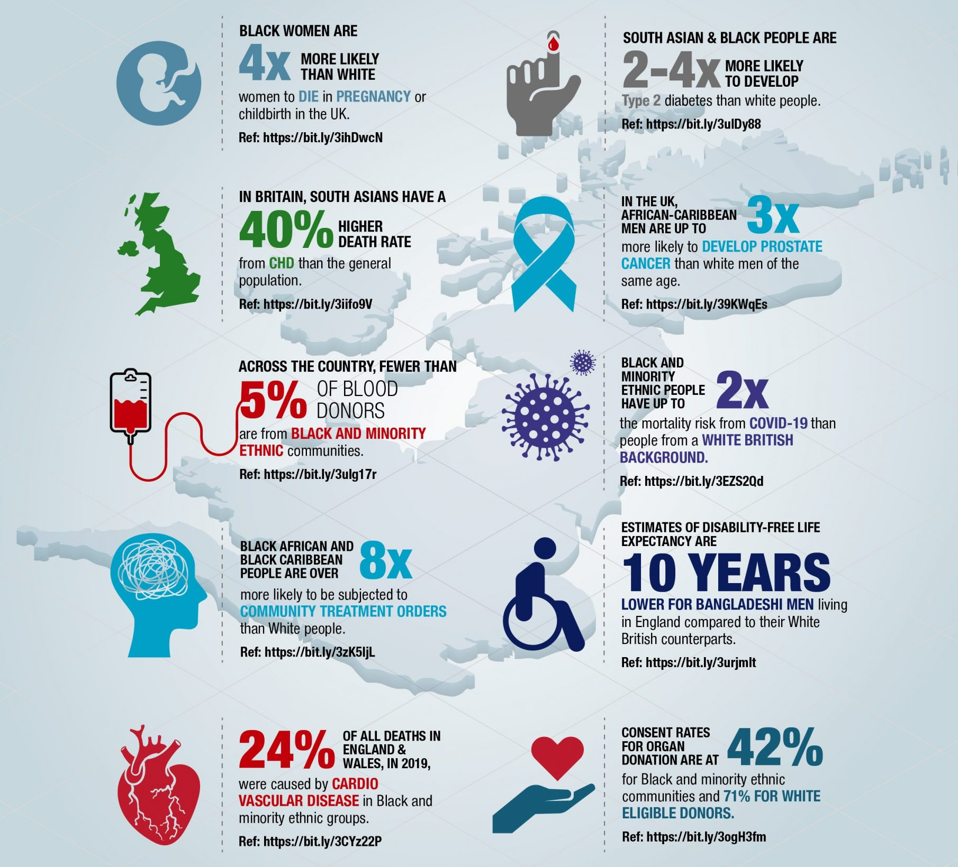
HEALTH INEQUALITY BY ETHNICITY WAS EVIDENT PRE-PANDEMIC AND EXPOSED DURING COVID-19
The most recent reliable figures for life expectancy by ethnicity are for 2011-14 (based on follow-up of the Census) and highlighted complex differences in life expectancy and cause-specific mortality for different ethnic groups in England and Wales as a whole.¹
White and Mixed ethnic groups had lower life expectancy at birth than all other ethnic groups, while the Black African group had statistically significant higher life expectancy than most groups based on pre-pandemic data
The Public Health England (PHE) Covid-19 review of disparities in risks and outcomes found that risk of dying from Covid-19 was higher in those from Black, Asian and minority ethnic groups.²
Examples of ethnic inequalities in the UK are highlighted in this infographic from the NHSE Race & Health Observatory.³
Fig 11. Ethnic inequalities in the UK (Taken from NHSE Race & Health observatory)
Source: (1) ONS Ethnic Difference in Life Expectancy (2) COVID-19: review of disparities in risks and outcomes (3) NHS Race & Health Observatory

Slide 25
ETHNIC INEQUALITIES EXIST IN INCOME, EMPLOYMENT AND DISEASE PATTERNS
A further report on ethnic disparities in the UK highlights:¹
  People in Bangladeshi, Pakistani and Black ethnic groups are the most likely to be living in deprived neighbourhoods
  Unemployment rates are highest among Black, Bangladeshi, and Pakistani populations, while White and Indian groups are more likely to be in employment
  People in Bangladeshi, Pakistani, Chinese and Black ethnic groups are around twice as likely to be living on a low income, and experiencing child poverty, as White people
The report also highlights ethnic differences in disease patterns including:¹
  People from South Asian ethnic groups having more heart disease, hypertension and diabetes than White people
  Black people having more hypertension and diabetes but lower heart disease than White people
  People from South Asian ethnic and Black ethnic groups have higher risk of type 2 diabetes and stroke
  People from South Asian ethnic groups having a much lower incidence of ‘all cancers’, while Black ethnic groups having slightly lower incidence than White (though patterns vary for different cancer types)
Source: Ethnic disparities in the major causes of mortality and their risk factors

Slide 26
HIGH NUMBERS OF INDIVIDUALS BELONGING TO INCLUSION HEALTH GROUPS LIVE IN LONDON THOUGH DATA AVAILABLE ON HEALTH IS LIMITED
Rough Sleepers
Estimates of rough sleepers on a single night in Autumn in 2021 indicate that nearly 640 (26.2%) of total estimated 2,440 rough sleepers in England were in London.¹
8,329 people were seen rough sleeping by outreach workers in London across 2021/22 which represented a 24% decrease compared to 11,018 in 2020/21.²
These statistics do not capture the full homelessness problem which includes those in temporary accommodation, sofa surfing and other forms of insecure housing​
Higher prevalence of long-term physical health problems (41%) and diagnosed mental health problems (45%) have been identified in homeless groups compared to 28% and 25% in the general population respectively.³
Asylum Seekers
It is estimated that more than half of the UK’s 674,000 undocumented adults and children live in London (397,000).​⁴
In Feb 2022, there were 25,000 people in initial accommodation hotels, with the majority of these accommodations in London.⁴
The number of Afghan refugees in bridging hotels in London is in addition, and has changed over time with thousands accommodated in London in Feb 2022.^{4,5}
Common health challenges prevalent in this group include untreated communicable diseases, poorly controlled chronic conditions, maternity care, mental health and specialist support needs.⁶
Gypsy, Roma and Travellers
Past research found up to 30,000 Gypsies and Travellers living in London, though we await more accurate estimates from 2021 census for Gypsy, Roma and Travellers⁷
Studies have reported higher prevalence of long-term illness including diabetes, anxiety and depression and worse birth outcomes and maternal health in this group.⁸
Source: (1) Inclusion Health (2) London Datastore - CHAIN Reports (3) The impact of homelessness on health: a guide for local authorities | Local Government Association (4) Home Affairs Committee Report (5) Inspection of contingency asylum accommodation (6) Unique health challenges for refugees and asylum seekers (7) Why we’re needed (8) Aspinall Report

Slide 27
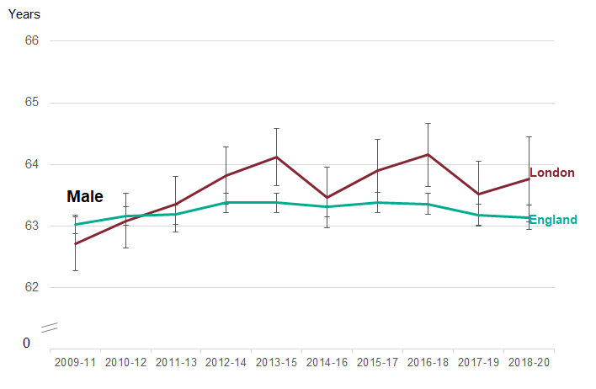
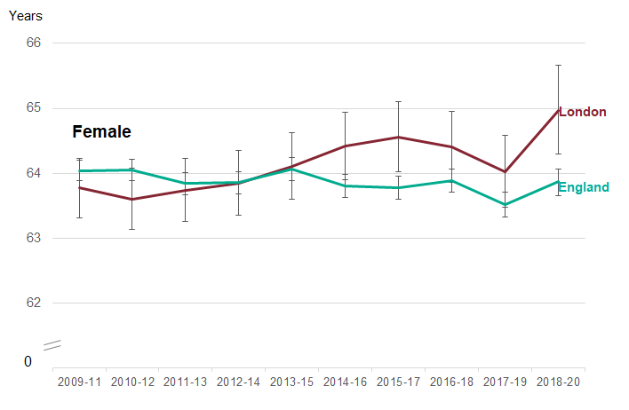
HEALTHY LIFE EXPECTANCY IN LONDON
In 2018-20, healthy life expectancy was similar in London to England for males at 63.8 years and above the national average for females at 65.0 years
Fig 12. Trend in healthy life expectancy at birth, by sex, London compared to England, 2009-11 to 2018-20
There had been recent improvements for both sexes but as this period only includes one year of pandemic figures this may change. There is wide variation across London boroughs (next slide). Note: The most recent data is based on 3-year figures which includes one year of pandemic data and will not entirely reflect the impact of the pandemic
Note: Healthy life expectancy provides an estimate of lifetime spent in 'very good' or 'good' health, based on how individuals perceive their general health
Source: PHE Public Health Outcomes Framework - Healthy life expectancy at birth

Slide 28
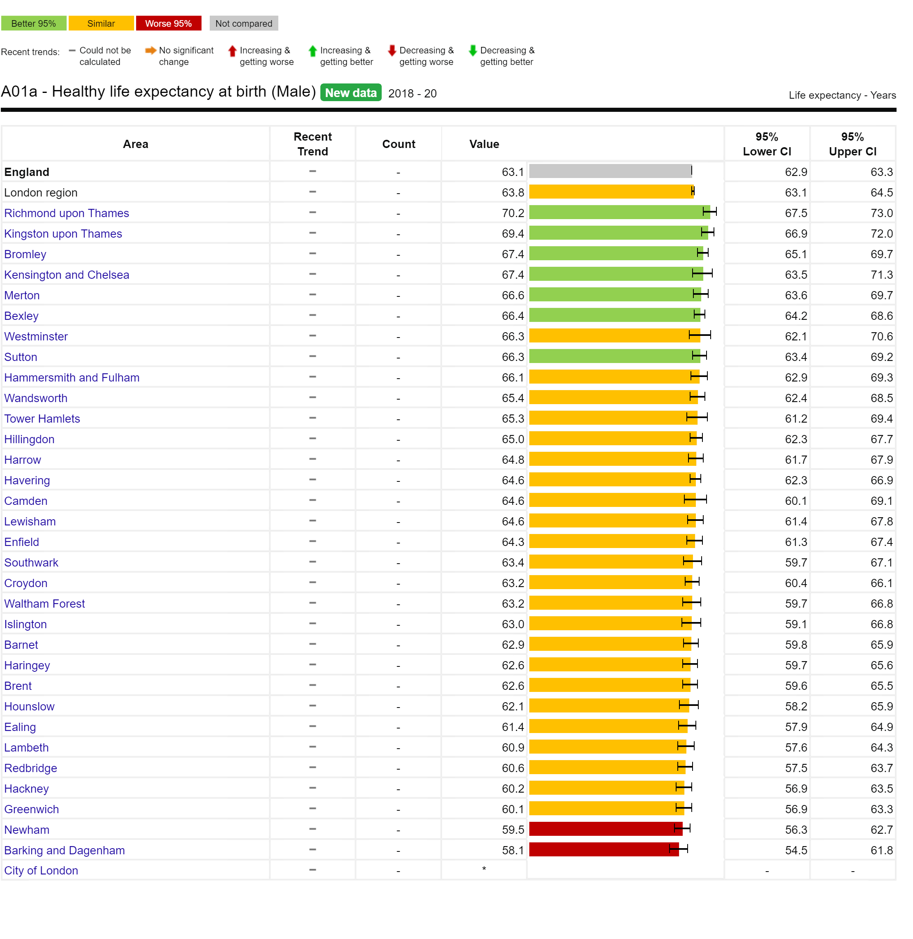
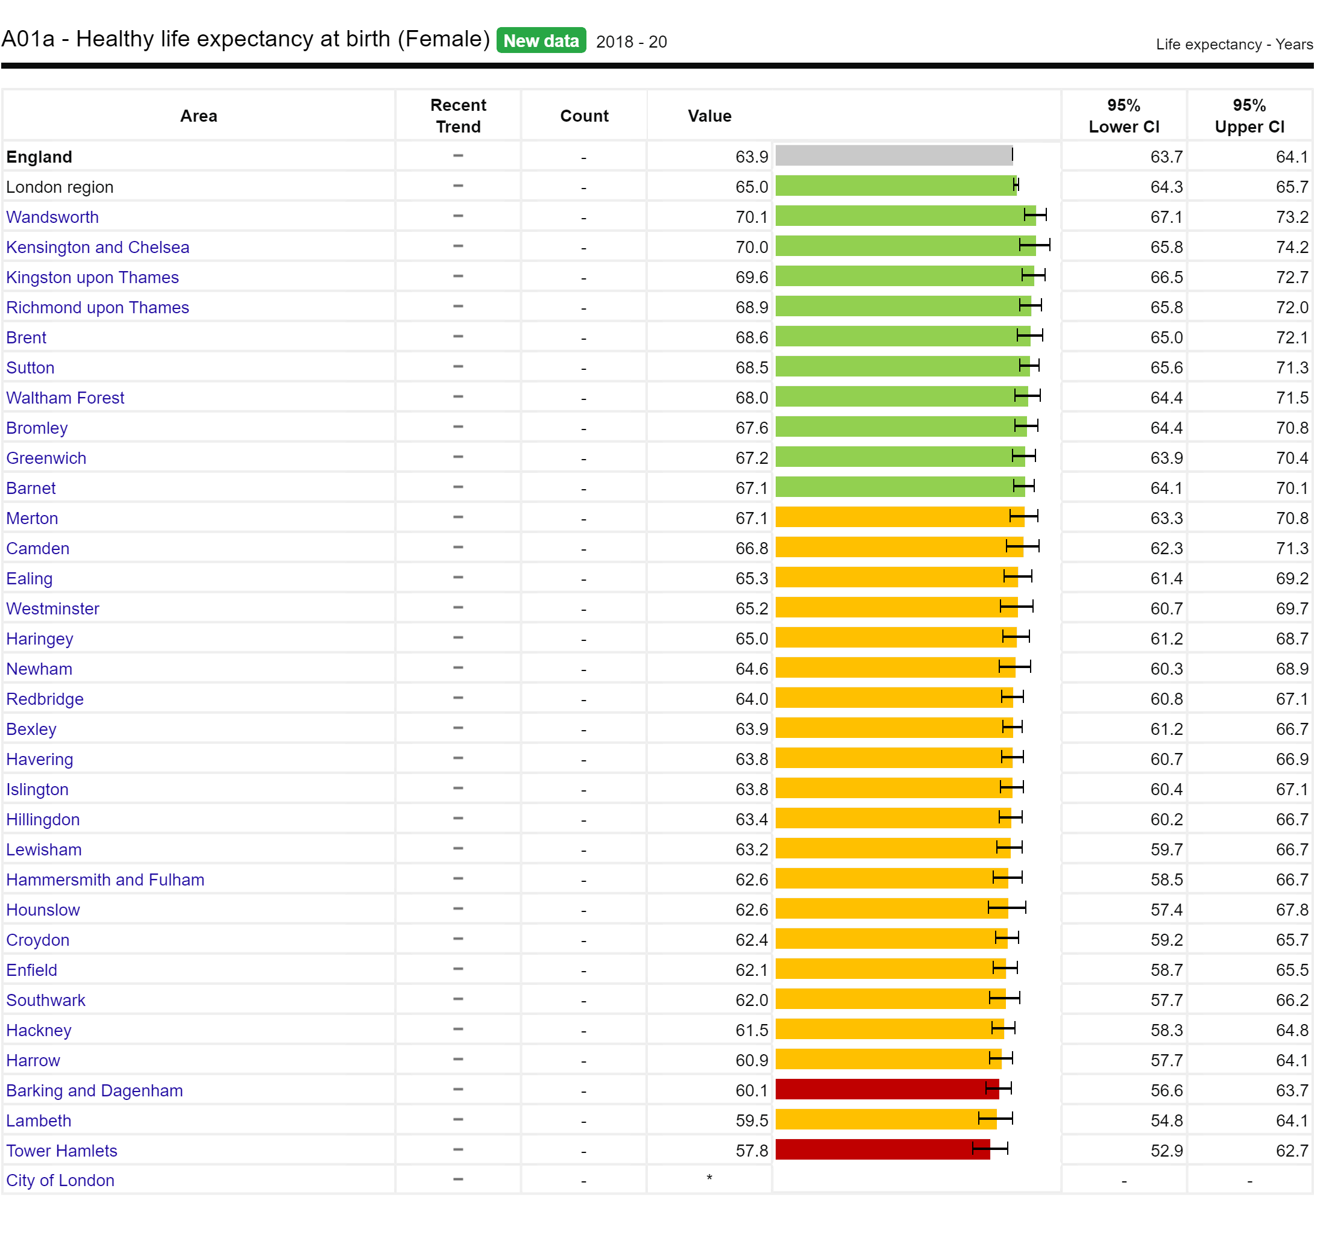
SIGNIFICANT VARIATION IN HEALTHY LIFE EXPECTANCY BY LONDON BOROUGH
Healthy life expectancy provides an estimate of lifetime spent in 'very good' or ‘good’ health, based on how individuals perceive their general health*
There is variation across London boroughs with the range of healthy life expectancy spanning from:
58.1 years in Barking and Dagenham, to 70.2 years in Richmond upon Thames, for males
57.8 years in Tower Hamlets to 70.1 years in Wandsworth, for females
Note: *Healthy life expectancy is defined in the OHID Fingertips Public Health Outcomes Framework (PHOF) as 'A measure of the average number of years a person would expect to live in good health based on contemporary mortality rates and prevalence of self-reported good health. The prevalence of good health is derived from responses to a survey question on general health’
Fig 13. Healthy life expectancy at birth by London borough for males (left) and females (right), 2018-2020
Source: PHE Public Health Outcomes Framework - Healthy life expectancy at birth

Slide 29
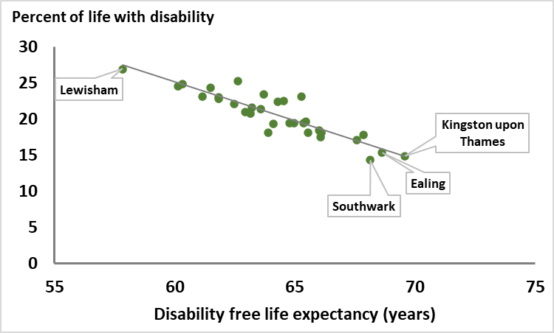
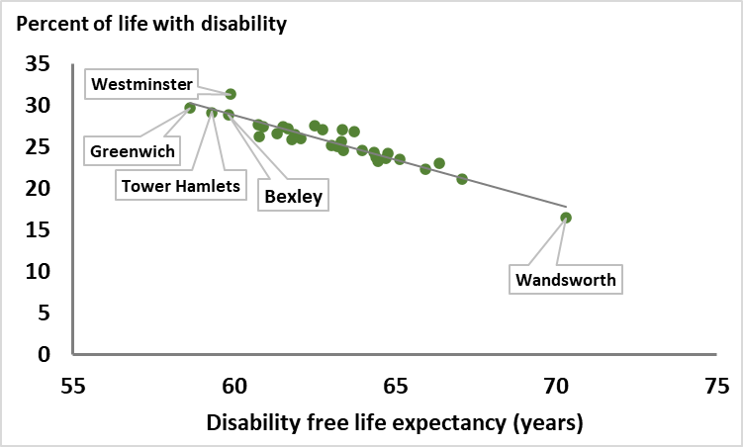
DISABILITY FREE LIFE EXPECTANCY IN LONDON
In 2017-19, there were several boroughs where both males and females could expect to live around 25% (a quarter of their life) in disability
Fig 14. Percent of life spent with a disability, by length of life free of a disability, London Borough and sex, 2017-19
There was significant variation in percent of life spent with disability across London. For males this varied from around 25% in males in Lewisham, to around 15% in Southwark and Ealing. For females, this varied from around 30% in Greenwich, Westminster and Tower Hamlets to around 15% in Wandsworth
Male
Female
Note: Disability-free life expectancy is defined as the average number of years a person aged 'x' would live disability-free (no limiting long-term illness) if he or she experienced the particular area's age-specific mortality and health rates throughout their life.
Source: ONS Health state life expectancies, UK

Slide 30
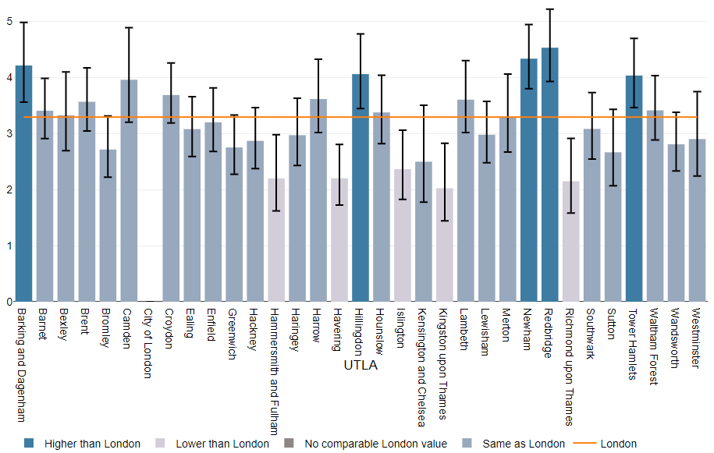
LOW BIRTHWEIGHT IN LONDON
In 2020, 3.3% of babies born were low birthweight, which is higher than England (2.9%) and represents a continuing worsening trend since 2017
Low birthweight (weight less than 2,500 grams) is associated with an increased risk of infant mortality, developmental problems in childhood and poorer health in later life.¹
In 2020, the proportion of babies born at term with a low birthweight in London was higher than the England average (3.3% for London compared to 2.9% for England).¹
There is some variation by local authority.¹
  Within London, the proportion ranged from 2.0% (Kingston upon Thames) up to 4.5% (Redbridge).
  Redbridge (4.5%) and Newham (4.3%) ranked among the five local authorities in both London and England with the highest proportion of low birthweight babies.
Note: An important consideration when interpreting this indicator is that low birthweight is more common in some Black and minority ethnic groups for example: Indian, Pakistani and Bangladeshi infants are 280–350 g lighter, and 2.5 times more likely to be low birthweight compared with White infants due likely to a combination of genetic and social determinants.² These population groups are more prevalent in London.
Fig 15. Percentage of low birthweight babies at term by local authority in London, 2020
Source: (1) Health Profile for London 2021 – Low Birthweight (2) Kelly et al

Slide 31
PART 3: WHY INEQUALITY EXISTS?
WIDER DETERMINANTS OF HEALTH
(“Causes of the causes” of health inequalities)

Slide 32
PART 3 OVERVIEW: WIDER DETERMINANTS
Wider determinants known as the 'causes of the causes' affect opportunity for good health – as they relate to where we live, work, our income and ultimately influence the opportunities to be active, to eat well, to live securely, and to grow and age well
Wider determinants influence the formation of unhealthy behaviours and health inequalities, far more than healthcare access and quality alone (which accounts for only 10-20% of our opportunity to live healthy lives)
The more we can do to narrow the gap in social inequalities across the wider determinants as illustrated in this part, the more benefit we will see in reductions in health inequalities.
The majority of data presented highlights inequality in those from more deprived backgrounds, certain geographic regions, and Black and ethnic minority groups as that is where data is available. It is important to recognise a major limitation is that there are likely to be other dimensions of inequalities (across other protected characteristics and inclusion health groups where inequalities exists) but cannot be demonstrated using data, as it is unavailable or of insufficient quality.
This part has been structured according to the Marmot 8 principles for addressing inequality and includes topics below:
  .
  Give every child the best start in life
    Child Poverty
  Enabling children, young people and adults to maximise their capabilities
    School Readiness
    KS4 educational attainment
    Mental Health
  Fair employment and good work for all
    Income and Employment
  4. Healthy standard of living for all
    Cost of Living
  5. Healthy and sustainable places and communities
    Housing
    Active Travel
    Green Space
    Air Pollution
    Neighbourhood Cohesion
    Built Environment
    Crime
  6. Ill Health prevention
    Key behavioural risk factors
  7. Racism and Discrimination
  8. Environmental Sustainability and Equity
    Climate Risk
Source: Health Equity in England: The Marmot Review 10 Years On

Slide 33
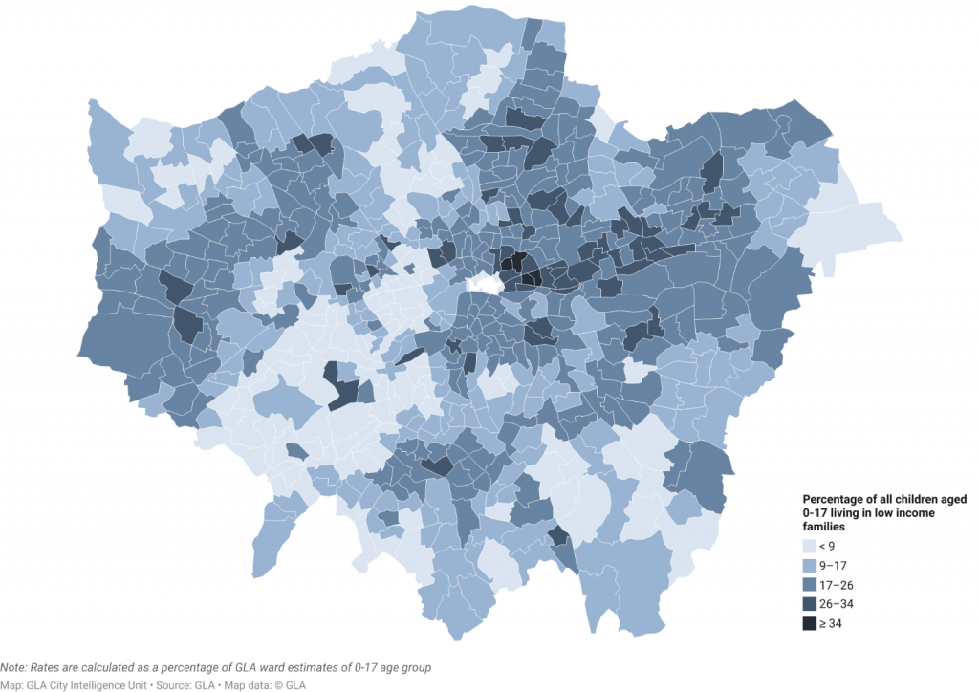
1. GIVE EVERY CHILD THE BEST START IN LIFE
TWO IN FIVE CHILDREN LIVE IN POVERTY WHEN HOUSING COSTS ARE INCLUDED
Data from previous years informs us that nearly 40% of London’s children are likely to be living below the poverty line (using the relative poverty after housing costs measure). ^{1,2}
Modelled estimates of children living in low-income families indicate that 17% of London’s children overall were living in poverty before taking housing costs into account in 2020/21.^{1,2}
These modelled estimates for small areas highlight some of the areas in London where the issue of child poverty is most acute, most notably some of the wards in Tower Hamlets and Camden.
The Survey of Londoners 2021-22 found that 14% of parents had children who had experienced food insecurity in the past 12 months (around 300,000 children).³
Groups of parents more likely to have children in food insecurity included; Black parents, disabled parents, non-degree educated parents and single parents.
Due to methodological difficulties in data collection in the pandemic, there is increased data uncertainty and more detailed characteristics of the data have not been published.
There are no official published poverty estimates for London for 2020/21.
Fig 17. Percentage of children under 18 living in low income families, London wards, 2020/21
Source: (1) London Datastore – Poverty in London 2020/21 (2) Economic Fairness – Population in Poverty – London Datastore (3) GLA, Survey of Londoners 2021-22

Slide 34
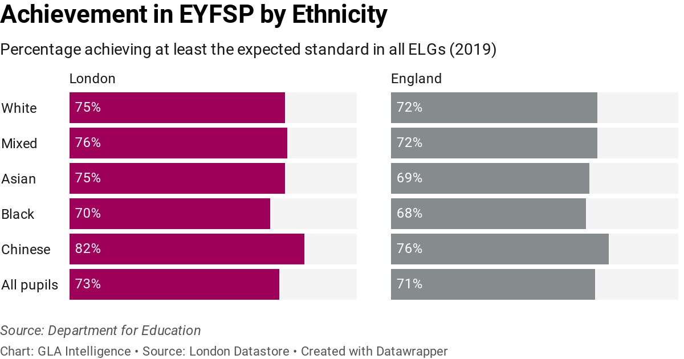
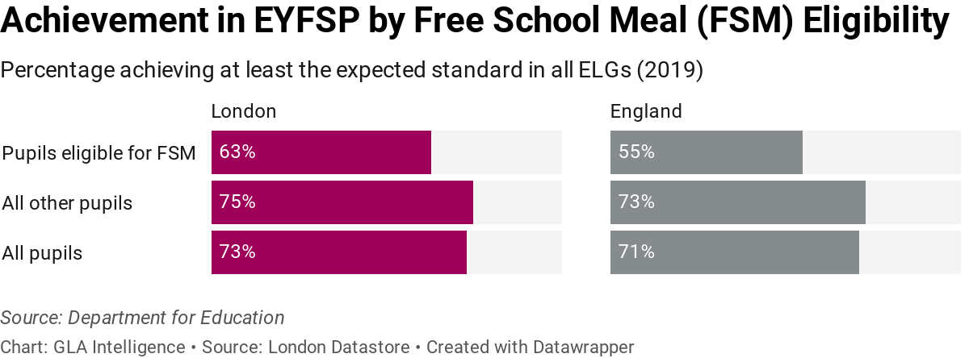
2. ENABLING CHILDREN, YOUNG PEOPLE AND ADULTS TO MAXIMISE THEIR CAPABILITIES
LONDON CHILDREN EXHIBIT HIGH LEVELS OF SCHOOL READINESS BUT INEQUALITIES EXIST
Early Years Foundation Stage Progress (EYFSP) tests have shown higher levels of school readiness among London’s young children than those in every other region of England, except for the South East which scores highest overall
Across specific characteristics below, inequalities exist. However, London children do at least as well, and in most cases better, than those elsewhere in England with the same characteristics including:
  ethnicity
  first language
  eligibility for free school meals (FSM)
  those with SEN (special educational) support needs
There are still differences between these sub-groups, however, with Chinese children most likely to achieve the expected standard across Early Learning Goals (ELG) in London.
There were no assessments in 2020 and 2021 due to the pandemic, but the EYFSP publication will resume for the 2021/22 academic year.
Fig 18. Achievement in Early Years Foundation Stage Progress (EYFSP) by ethnicity (top) and Free School Meal eligibility (below), 2019
Source: (1) London Datastore – School Readiness

Slide 35
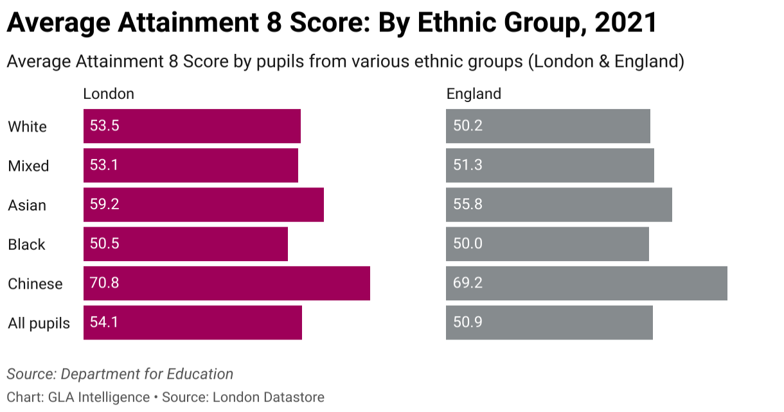
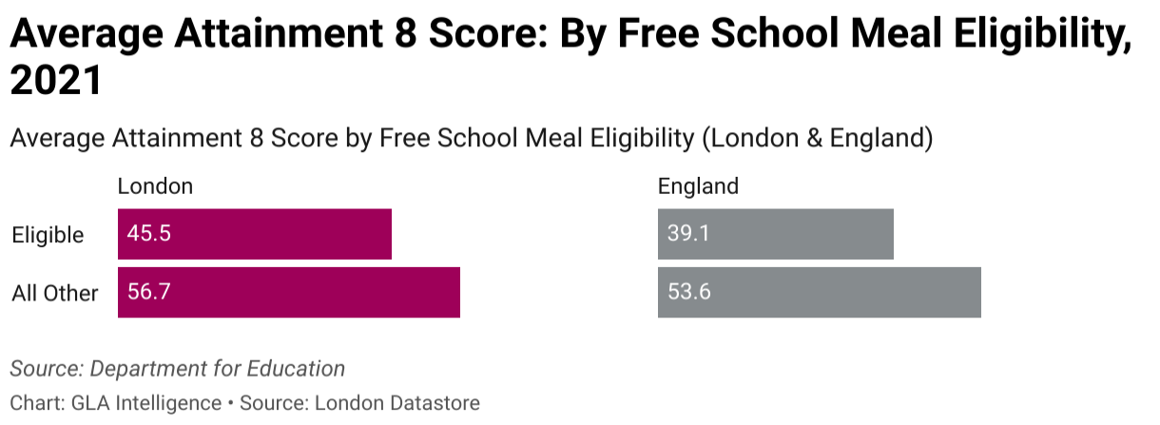
2. ENABLING CHILDREN, YOUNG PEOPLE AND ADULTS TO MAXIMISE THEIR CAPABILITIES
KS4 ATTAINMENT GAPS EXIST BY ETHNICITY, SPECIAL NEEDS AND FSM ELIGIBILITY STATUS
Pupils at London’s schools have higher GCSE scores than those from any other region. The average 'Attainment 8' score, which gives a score across various core and optional elements, is more complex than the previous GCSE measures.
London pupils do better than those across England as a whole, on each element of the Attainment 8 score and across all attributes from ethnicity to free school meal (FSM) status.
  The average Attainment 8 score in London was 54.1 in 2021 and as in other years, this was higher than the national figure (50.9).
There are still differences between sub-groups, however, with Chinese pupils achieving the highest average score and Black pupils the lowest.
Attainment gaps also exist by special educational needs (SEN) status and FSM eligibility status.
Note: Due to the COVID-19 pandemic, GCSE exams were cancelled in 2020 and 2021. Pupils’ grades were determined through other methods, meaning GCSE results from 2019/20 and from 2020/21 are not comparable with those from other years.
Fig 19. Achievement in Average Attainment 8 Score by Ethnicity (above) and Free School Meal eligibility (below), 2021
Source: (1) London Datastore – KS4 Achievement

Slide 36
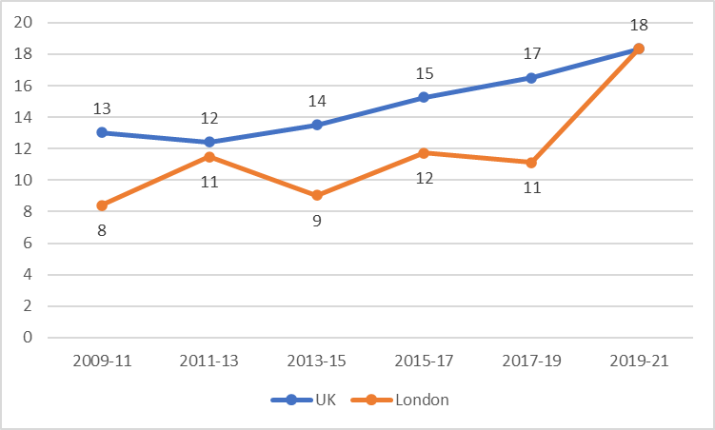
2. ENABLING CHILDREN, YOUNG PEOPLE AND ADULTS TO MAXIMISE THEIR CAPABILITIES
THE MENTAL HEALTH OF CHILDREN AGED 10-15 HAS DECLINED IN THE LAST 10 YEARS
This data is from the strengths and difficulties questionnaire (SDQ) which is an emotional and behavioural screening questionnaire for children and young people.
  The total difficulties score is the sum of the emotional symptoms, conduct problems, hyperactivity/inattention and peer relationships problems subscales, and ranges from 0-40
  The total difficulties score results from the Understanding Society survey for 10-15-year-olds, categorised as: normal (0 to 14); slightly raised (15 to 17); high (18 to 19); and very high (20 to 40).
  In 2015, ONS used the proportion of children reporting a high or very high total difficulties score (18+) as the headline measure for the prevalence of mental ill health.
In 2009-11, 8% of Londoners aged 10-15 had a probable mental disorder, lower than across the UK (13%). The London proportion has remained below the UK proportion over the last 10 years, though in the most recent wave of the Understanding society survey 2019-21 (partially covering the pandemic period), the proportions equalised at 18%.
Rates of probable mental disorder in this age group have increased in the last 10 years both in London and the UK
Fig 20. Proportion of children aged 10-15 in the UK and London with a high or very high total difficulties score (18 or more) (%), 2009-21
Source: (1) University of Essex, Institute for Social and Economic Research. (2022). Understanding Society: Waves 1-11, 2009-2020 and Harmonised BHPS: Waves 1-18, 1991-2009. http://doi.org/10.5255/UKDA-SN-6614-16.

Slide 37
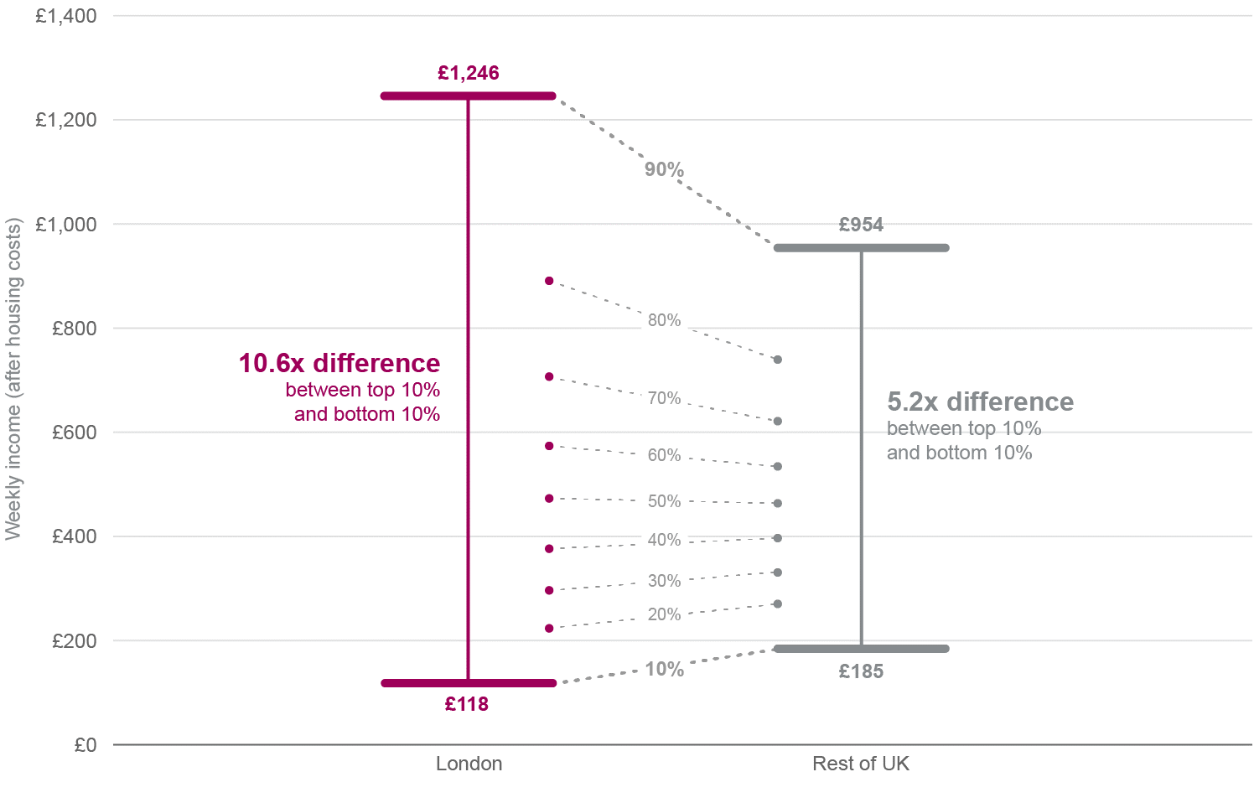
LEAST DEPRIVED DECILE OF LONDONERS HAVE 10 TIMES MORE INCOME THAN THE POOREST DECILE
3. FAIR EMPLOYMENT AND GOOD WORK
The richest tenth of Londoners have more than 10 times the income of the poorest tenth.
  Incomes at the lowest decile are 30% below the rest of the UK.¹
  London has the highest rate of poverty of any region in the UK, with more than a quarter (27%) of London residents in poverty after housing costs.²
The unemployment rate in London is above the UK average but varies widely within the capital and despite improvements persistent inequalities in labour market outcomes remain:³
  The employment gap between disabled and non-disabled Londoners stayed the same overall between 2020 and 2019 (25 percentage points(pp)), but fell between males and females from 11pp to 7pp
  In London, the employment gaps between White and minority ethnic groups overall has remained at around 12pp, (however improvement has been seen in the gap between White and most other ethnic groups compared to 2019, except for mixed ethnic group)
Fig 21. Difference in weekly income (after housing costs) between top and bottom deciles in London and UK (2017/18 – 2019/20 )
Source: (1) London Datastore - Income Inequality (2) London Datastore – Poverty (3) London Datastore - Employment Gaps

Slide 38
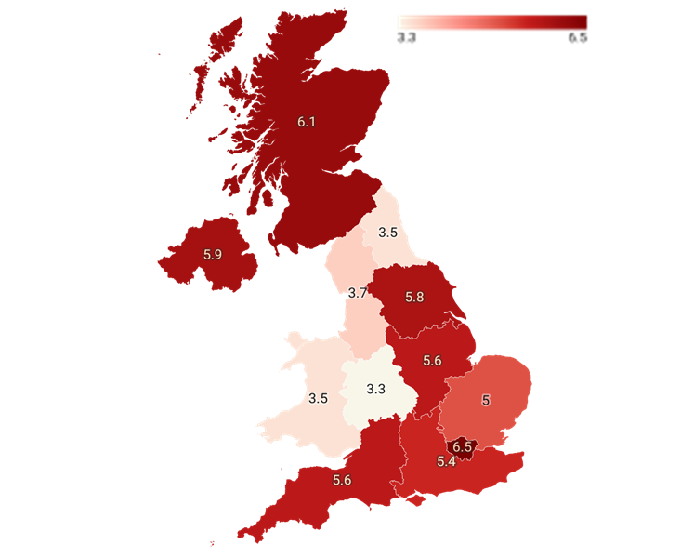
4. HEALTHY STANDARD OF LIVING
A QUARTER OF LONDONERS REPORT BUYING LESS FOOD AND ESSENTIALS TO MANAGE THE RISING COST OF LIVING
The National Institute of Economic & Social Research found that, before the latest Government support package, 236,000 London households (6.5% of the total) would see their energy and food bills exceed their total disposable income in 2022 and 2023. This would be the highest share of any UK region.¹
In August 2022, 90% of Londoners say their household costs have risen over the last six months²
  CPI annual inflation hit a 40-year high of 9.4% in June.
Increases in the cost of living are likely to be most pronounced for the lowest-income Londoners. Lower-income households devote a larger share of their spending to food and fuel.^{2,3}
  NIESR estimate the rise in living costs will equal an income cut of 9.5% for the hardest-hit households, vs 0.6% for the highest income households.²
  YouGov polling commissioned by the GLA in May 2022 showed 8% of Londoners had fallen behind on some bill payments, while 12% were constantly struggling to pay their bills.
  Around a quarter (26%) of Londoners say they are buying less in food and essentials. This rises to around two-thirds (65%) among Londoners who are struggling financially.
Fig 22. Projection of share of households with food and energy bills above disposable income in UK, 2022-23
Source: 1) NIESR modelling (using LINDA, NiReMS) ; (2) GLA Cost of Living 2022 Reports 3) ONS Family Spending dataset, Workbook 2​

Slide 39
4. HEALTHY STANDARD OF LIVING
LONDON’S PRICES ARE RISING FASTER THAN REST OF UK, WITH FOOD COSTS LEADING THE WAY
Using ONS price quotes, the GLA have built a measure of underlying local inflation for the capital.
The measure suggests local prices in London are rising 1.5 percentage points faster than the UK average.
Food is a key factor in this gap, and as lower-income households tend to spend more on food, this will widen inequalities in the capital.
Energy is not part of this measure, and Londoners spend less on it than the UK average, so the overall inflation gap may be narrower.
Fig 23. Top five and bottom five price categories in terms of the difference between their contributions to London and UK inflation, 2022
Source: 1) GLA Calculations based on date from ONS Family Spending dataset, Workbook 2

Slide 40
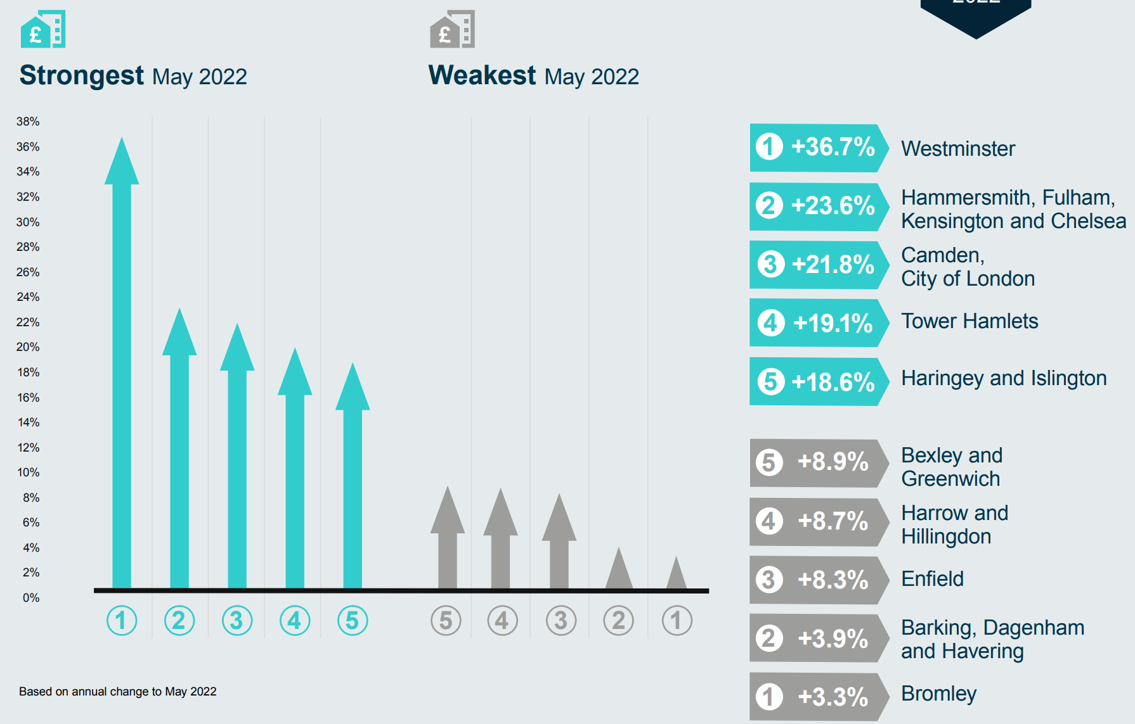
5. HEALTHY AND SUSTAINABLE PLACE AND COMMUNITY
OVERCROWDING, QUALITY AND AFFORDABILITY OF HOUSING AFFECTS LONDONERS UNEQUALLY
Around 9% of households in London are overcrowded (defined as lacking one or more bedrooms compared to estimated need). ^{1,2}
  Londoners from Black, Asian and other minority groups are around twice as likely to live in overcrowded conditions as White.
1.6% of all households (54,080) were assessed as owed a homelessness duty in London in 2019-20,
  This rate varies enormously by ethnicity - from less than one in every 1,000 for Chinese, Indian and White British households to four or five in every 100 for Black and Mixed ethnicity.
15% of homes in London fell below the official Decent Homes Standard in 2019, ranging from 13% of owner-occupied homes to 18% of private rented homes. ^{1,2}
  Londoners of Asian ethnicity are more likely to live in homes that fail to meet the Decent Homes Standard, while Black Londoners are more likely to have damp problems.
Housing affordability and rent for new tenancies (Homelet Rental Index) is rising unequally but faster overall in London than in other regions and is a severe problem for many households. ^{1,2}
  Black and ethnic minority households in privately rented homes in London spend a significantly higher average proportion of their household incomes on rent, than their White counterparts
Fig 24. Change in average rents for new tenancies in inner London, 2022
Source: (1) London Datastore - Housing in London (2) State of London Report - Dashboard

Slide 41
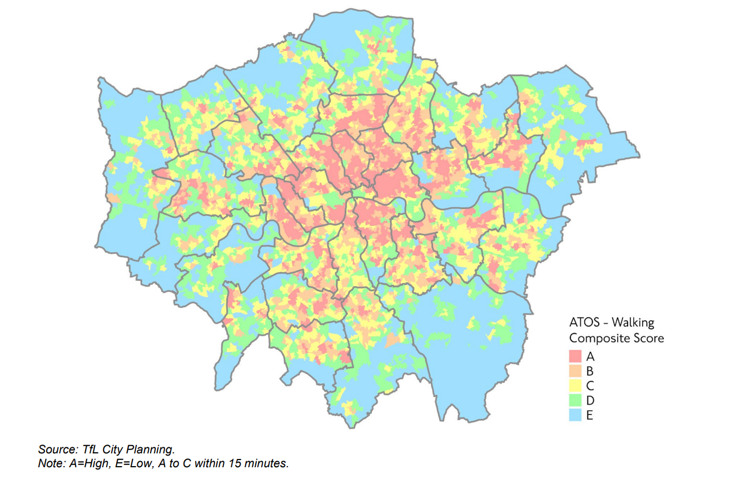
PEOPLE FROM DEPRIVED AREAS ENGAGE IN LESS ACTIVE TRAVEL AND ARE MORE LIKELY TO BE INJURED ON THE ROAD
5. HEALTHY AND SUSTAINABLE PLACE AND COMMUNITY
.
Higher access to opportunities score (ATOS)* scores tend to be focused in inner London, whereas there are large areas of outer London which do not meet this criterion, i.e. walking access to essential services is greater than 15 minutes.¹
There are barriers to active travel. For example, Black and ethnic minority groups, women, people from more deprived neighbourhoods, those with disabilities and older people are typically under-represented in cycling.²
Currently, 45 per cent of disabled Londoners find planning and making trips on public transport stressful.¹
People from deprived backgrounds are twice as likely to be injured in a road traffic collision as those from the least deprived areas, and Black people are 2.3 times more likely to be killed or seriously injured on London’s roads than White people.¹
The risk of being killed or seriously injured for children aged 4-15 living in deprived areas is nearly three times higher than for their peers in the least deprived areas.¹
Note: *ATOS (Access to Opportunities and Services) scores look at walking times from all locations to reach essential services such as schools, healthcare, food shopping and open spaces.
Fig 25. Access to opportunities score (ATOS) showing accessibility on foot within 15 metres in London, 2021
Source: (1) TfL (2021) ‘Travel in London Report 14 (2) Barriers to cycling amongst ethnic minority groups and people from deprived backgrounds

Slide 42
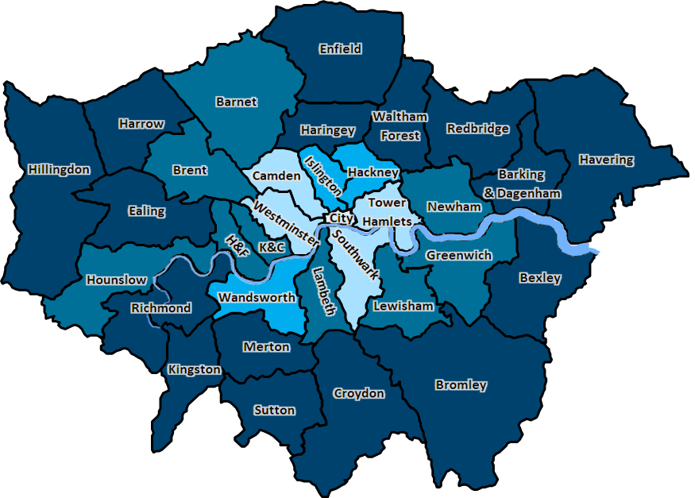
LOWER INCOME & BLACK LONDONERS ARE LEAST LIKELY TO HAVE ACCESS TO GREEN SPACE
5. HEALTHY AND SUSTAINABLE PLACE AND COMMUNITY
One in five Londoners (21%) have no access to a garden, the highest percentage of any region in the UK and almost double the national average.¹
Private gardens in London are also the smallest in any region in Britain, 26% less than the national average.
Lower income Londoners and Black Londoners are least likely to have access to a garden
London has the lowest provision of green space per person of all regions in the UK. Friends of the Earth analysis found that the ten worst local authorities for access to green space are all in London.^{2,3}
Half of all London households are in areas of deficiency of access to open space (i.e. more than 400m from a local park)
Ethnic minority Londoners and those living in more deprived neighbourhoods are more likely to have poor access to high quality local green spaces.
Fig 26. Percentage of addresses with private outdoor space in local authorities in London, 2020
Source: (1) City Monitor (2) ONS (3) Access to green space in England | Friends of the Earth

Slide 43
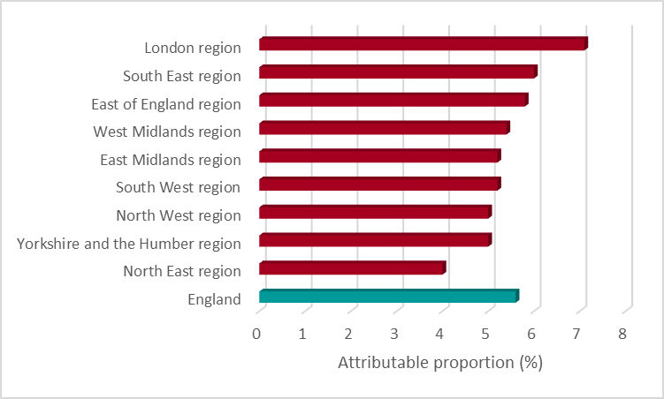
5. HEALTHY AND SUSTAINABLE PLACE AND COMMUNITY
LONDON HAS THE HIGHEST % OF DEATHS IN ENGLAND ATTRIBUTABLE TO AIR POLLUTION
London had the highest percentage of deaths attributable to particulate air pollution (7.2%) of all English regions in 2020, with little improvement in more recent years.¹
  Of the top 25 upper tier local authorities in England with the highest proportion (%) of deaths attributable to PM 2.5 in 2019, 23 were London boroughs.¹
  However the trend in the level of air pollution from man-made fine particulate matter for London has been decreasing since 2011 and will take time to have a lagged impact on mortality²
Air Quality is worst in deprived areas of London ³
  NO² and PM2.5 concentrations are highest in deprived areas
White ethnic groups in London are more likely to be exposed to lower levels of air pollution
  In 2019, between 31% and 35% of areas with the highest proportion of black and mixed/multiple ethnicities were in areas with higher levels of air pollution (top 25%), reducing to 15-18% for Asian ethnic groups and just 4-5% for White ethnic groups.³
Fig 27. Proportion (%) of mortality attributable to particulate air pollution by region in England, 2020
Source: (1) OHID Fingertips- Fraction of mortality attributable to particulate air pollution (2) Health Profile for London 2021 (3) Air Pollution and Inequalities in London: 2019 Update

Slide 44
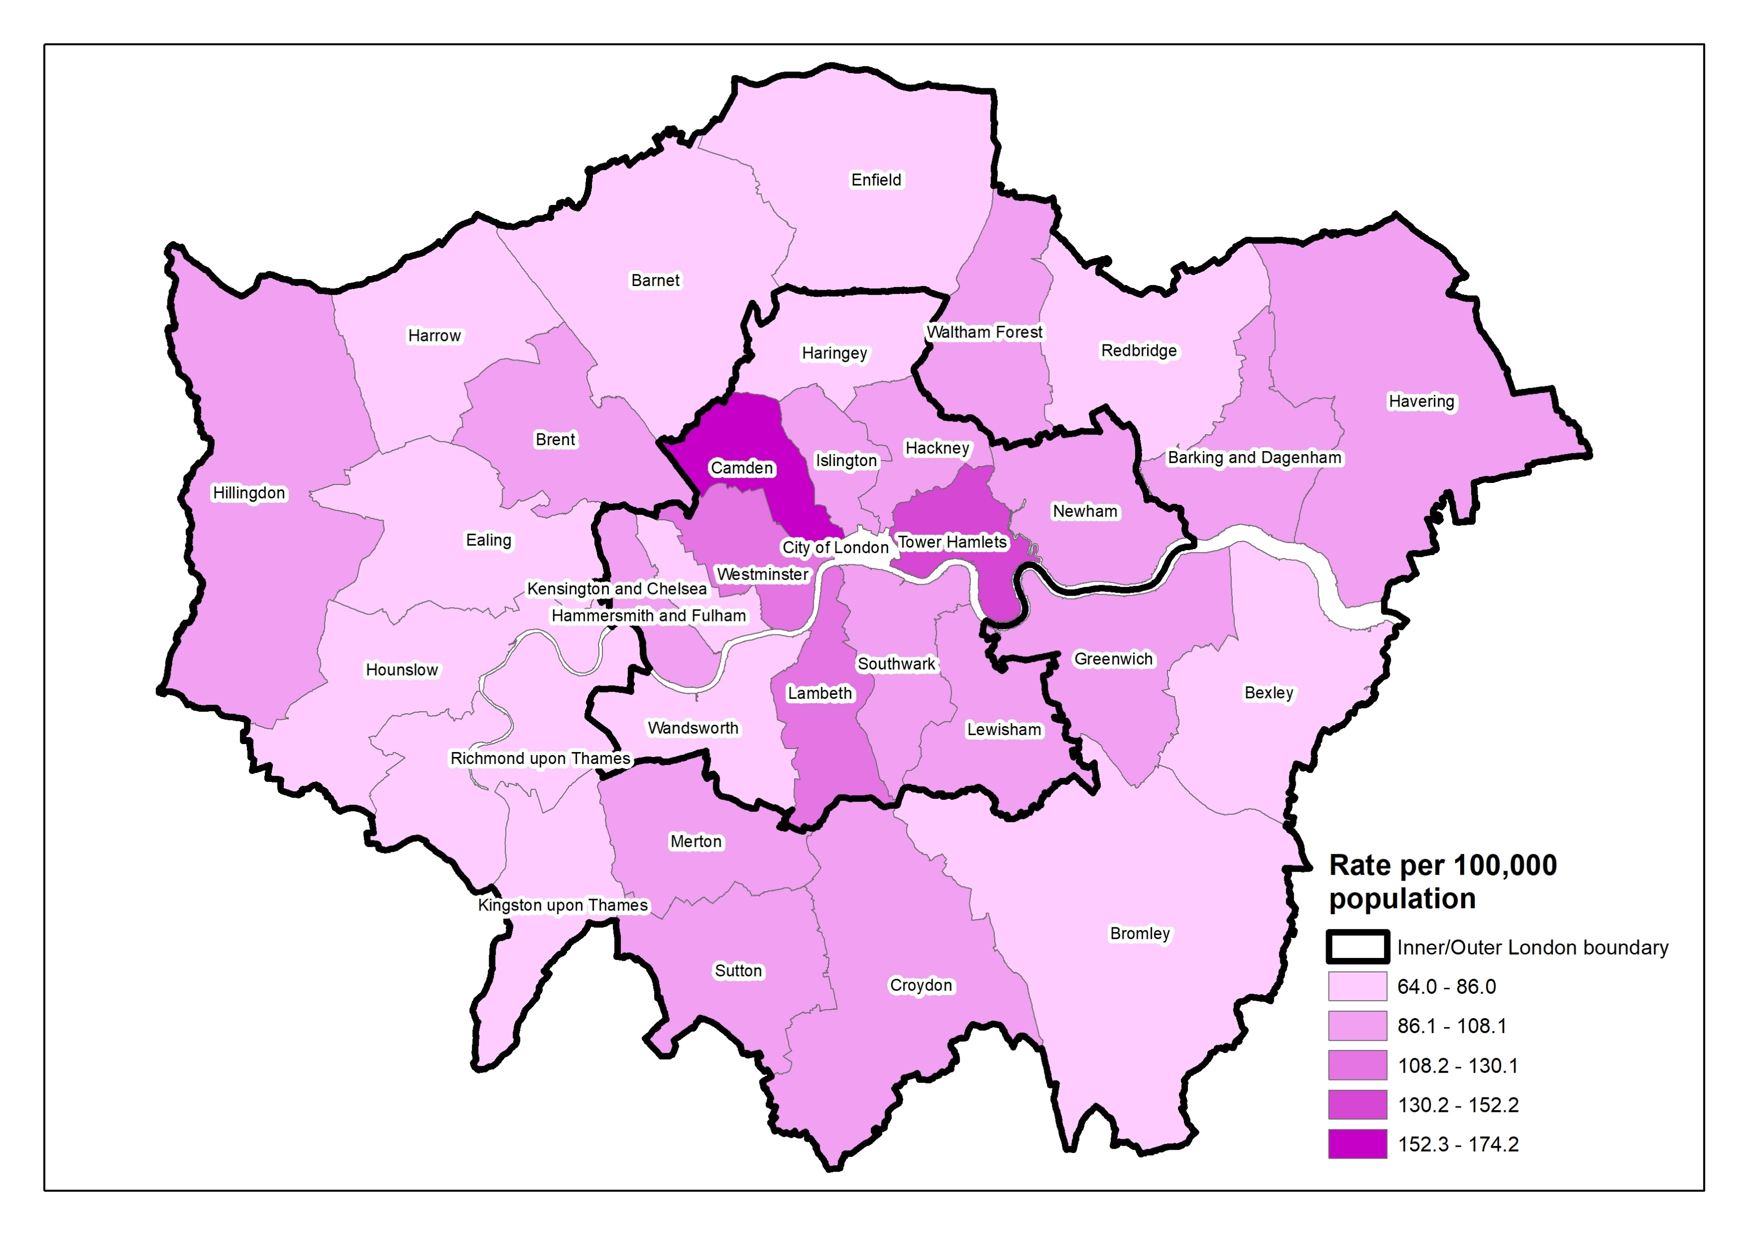
5. HEALTHY AND SUSTAINABLE PLACE AND COMMUNITY
MORE DEPRIVED LOCAL AUTHORITIES HAD A GREATER DENSITY OF FAST FOOD OUTLETS
‘Fast food’ refers to energy dense food that is available quickly, therefore it covers a range of outlets that include, but are not limited to, burger bars, kebab and chicken shops, chip shops and pizza outlets.
  Across England, more deprived local authorities had greater density of fast food outlets though this is data from 2017
Out of all local authorities in England, Camden had the second highest density of fast food outlets across England (174 per 100,000 population).
However, the average density across all London local authorities (93 per 100,000) was similar to that of England overall (91 per 100,000).
The Healthy Streets coalition put together scorecards in 2022 for London boroughs, based on what they want boroughs to implement: including low Traffic Neighbourhoods, a default 20mph speed limit, small-area Controlled Parking Zones, protected cycle lanes on main roads and traffic-free streets around all schools with safe walking and cycling provision.
  Best scoring London boroughs were the City, Islington, Hackney and Camden in Inner London.
  Poorest scoring boroughs Hillingdon, then Barking & Dagenham and Redbridge
Fig 28. Density of fast food outlets in London, 31 December 2017
Source: (1) Public Health England (OHID) Fast food outlets: density by local authority in England, 2018 (2) 2022 London Boroughs Healthy Streets Scorecard

Slide 45
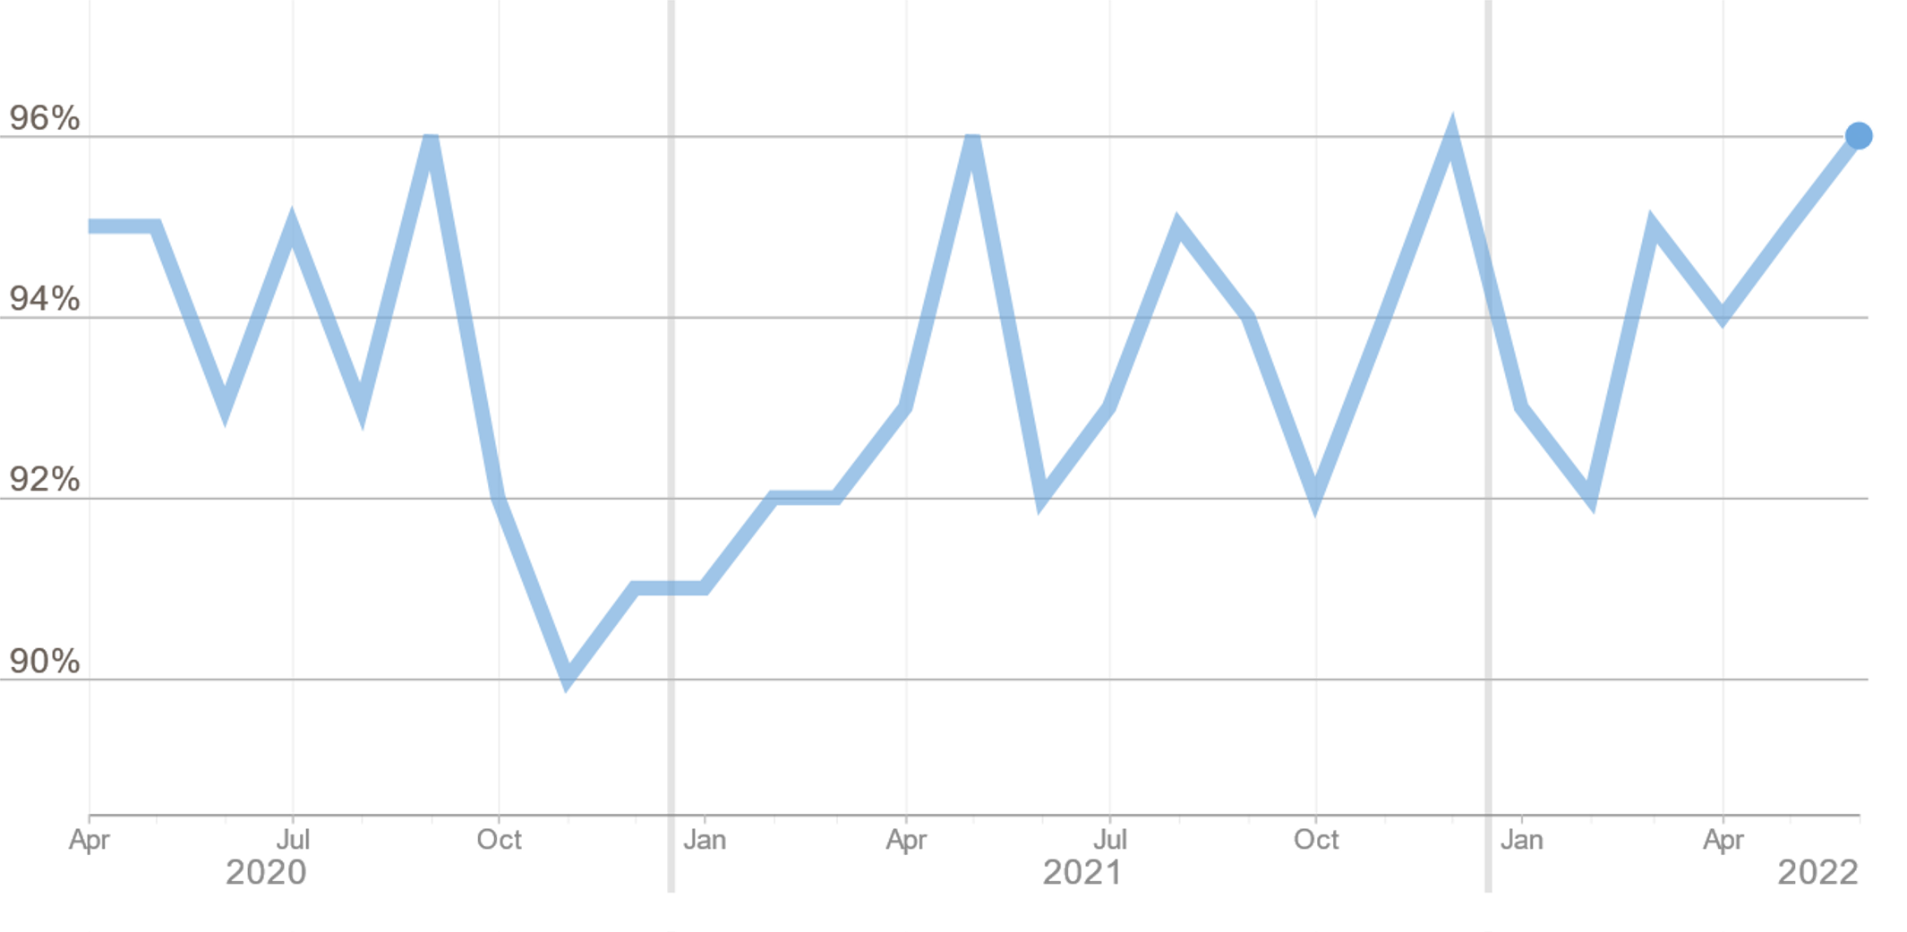
NEIGHBOURHOOD COHESION IS GENERALLY HIGH THOUGH LOWER FOR SOME LONDON BOROUGHS
5. HEALTHY AND SUSTAINABLE PLACE AND COMMUNITY
In 2008, neighbourhood cohesion was much lower than it is today with around three quarters of Londoners (73%) agreeing with the statement ‘my local area is a place where people from different backgrounds get on well together’.
There were annual increases up until 2013-14 when 95% of Londoners agreed with this statement. Every year since then it has been above 90% and in the final year before fieldwork on the survey was disrupted by the pandemic (2019-20), it was 92%.
Fig. 29 shows monthly data from the same survey, from around the time the pandemic started.
It has remained above 90% each month and, as of June 2022, 95% of Londoners agreed with the statement though there is variation across borough.
In 2021-22, some boroughs with highest agreement rates were:
  Richmond upon Thames (99%); Wandsworth (98%); Redbridge (97%); Kingston upon Thames (97%); and Hackney (97%)
Some boroughs with the lowest agreement rates were:
  Barking and Dagenham (85%); Bexley (87%); and Havering (91%)
Fig 29. Proportion who agree that people from different backgrounds get on well in their local area of London (%), 2020-2022
Source: (1) MOPAC, Public Attitude Survey (PAS)

Slide 46
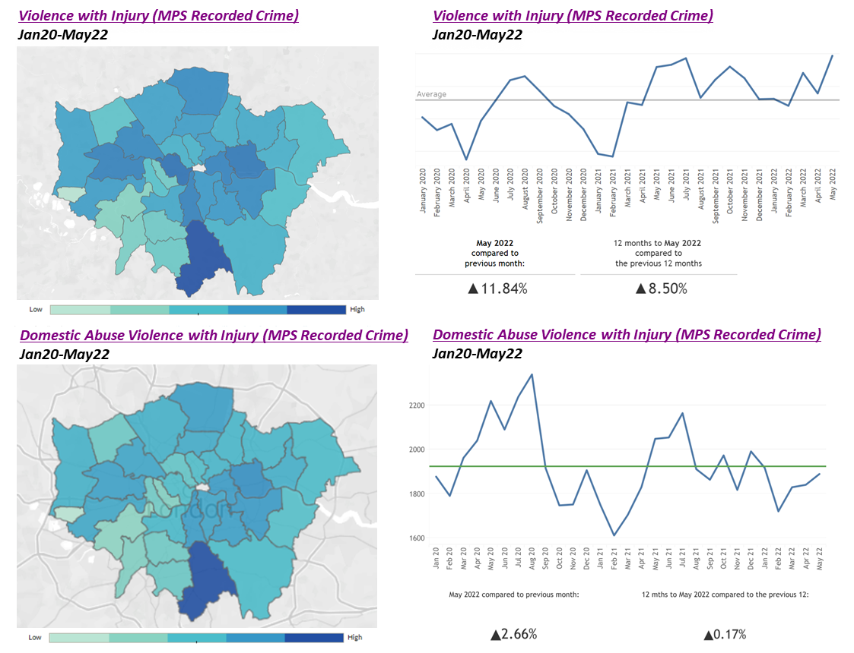
VIOLENCE IS EXPERIENCED UNEQUALLY ACROSS LONDON AND MOST IN DEPRIVED AREAS
5. HEALTHY AND SUSTAINABLE PLACE AND COMMUNITY
.
Some geographical areas of London experience much higher rates and concentrations of violence than others.¹
However, some socio-demographic and socio-economic groups are disproportionately overrepresented as the victims and/or offenders.
Research has found that young black males were disproportionately more likely to be either a victim or a perpetrator of serious violence than any other category of young people.¹
The Crime Survey for England and Wales (CSEW) found that:²
  Men were more likely to be victims of CSEW violent crime than women for all types of violence (2% vs 1.3%) except for domestic violence, where women were more likely to be victims (0.3% vs 0.1%)
  People with disabilities were more likely to be victims of violent crime than people without disabilities (2.4% vs 1.5%).
  Adults aged 16-24 years (3.6%) were much more likely to be victimised than older age groups across all violence
Fig 30. Violence with Injury and Domestic Abuse Violence with Injury across London Boroughs, 2020-22
Source: (1) Understanding serious violence among young people in London (2) Crime Survey for England and Wales

Slide 47
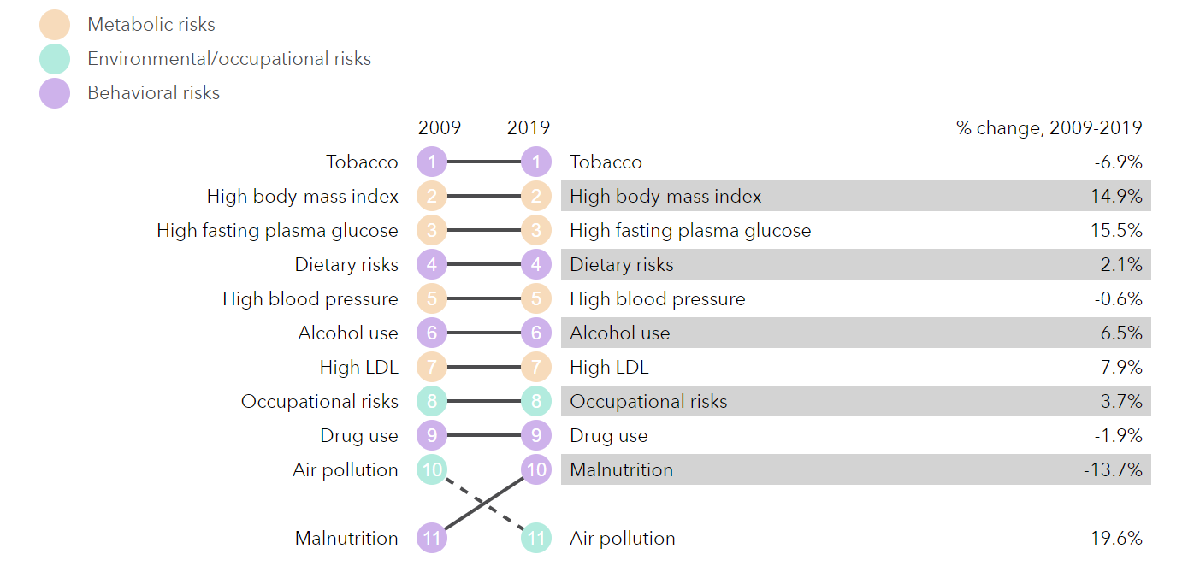
TOBACCO, HIGH BMI AND DIET ARE THE TOP RISK FACTORS DRIVING DEATH AND DISABILITY
6. ILL HEALTH PREVENTION
.
The Global Burden of disease (GBD) tool identifies tobacco, high BMI (Body Mass Index), high fasting glucose and diet as the health behaviours most responsible for driving disability and death in London between 2009 and 2019
The top nine risk factors driving ill health in London as per the GBD tool in 2009 were the same in 2019
Only air pollution has moved from 10 to 11, and malnutrition has moved in the opposite direction
Greatest progress in risk factor reduction was seen for tobacco and air pollution while high BMI and high fasting glucose (raised blood sugar) have worsened in prevalence
In Part 4, we illustrate how these harmful health behaviours (focusing on tobacco, obesity (high BMI) and physical activity) themselves reflect the consequences of social inequalities in how their prevalence is unequally distributed across population groups
More disadvantaged groups experiencing inequalities are also more likely to have a cluster of unhealthy behaviours such as – smoking, drinking, low consumption of fruit and vegetables, and low levels of physical activity.
Fig 31. Ranked risk factors driving the most death and disability in London, and percent change in risk factors from 2009-2019
Source: Global Burden of Disease Tool for London

Slide 48
BLACK LONDONERS REPORT AN INCRESE IN BEING UNFAIRLY TREATED DUE TO ETHNICITY
7. RACISM AND DISCRIMINATION
The Survey of Londoners 2021-22 repeated the question used in the 2018-19 survey about whether respondents had been treated unfairly by people in the past 12 months (with one small modification to include option to report if unfair treatment was from friends and family)
A comparable measure can be derived for 2021-22 to compare against 2018-19 in 2021-22, 36% of Londoners had been treated unfairly in the past 12 months because of one or several protected characteristics, or because of their social class (no significant difference from 2018-19 when it was 35%).
In 2021-22 ethnicity was the characteristic Londoners were most likely to report being treated unfairly by (19%), followed by sex (13%), age (12%), social class (8%) and religion (6%).
  Unfair treatment because of their ethnicity has increased from 16% to 19% between the two surveys
  Black Londoners were the only ethnic group to have seen an increase in unfair treatment experienced as a result of their ethnicity between the two surveys (from 26% to 43%).
Women were much more likely than men to report being treated unfairly because of their sex (22% and 4% respectively) and it has also increased since 2018-19, when it was 18%.
Fig 32. Londoners were more likely to be treated unfairly because of their ethnicity than any other characteristic, 2018/19 vs 2021/22
* This characteristic was labelled ‘gender identity’ in the 2021-22 survey, and as ‘being or becoming a transsexual person’ in the 2018-19 survey. Therefore, these are not wholly comparable labels.
Source: GLA, Survey of Londoners 2021-22
Notes:
DISABILITY DATA TO BE ADDED

Slide 49
PARTICULAR groups of Londoners were more likely to REPORT unfair treatment
7. RACISM AND DISCRIMINATION
A summary from the Survey of Londoners 2021-22, of how different groups of Londoners experience different forms of unfair treatment based on several characteristics is included in Table 33.
Londoners aged 16-24 were more likely to report being treated unfairly because of their age than the overall average (20% and 12% respectively).
Women were more likely to report being treated unfairly because of their sex than the overall average (22% and 13% respectively).
Black and Asian Londoners were more likely to report being treated unfairly because of their ethnicity than the overall average (43%, 33% and 19% respectively).
Muslim and Jewish Londoners were more likely to report being treated unfairly because of their religion than the overall average (27%, 18% and 6% respectively).
Disabled Londoners were more likely to report being treated unfairly because of disability related reasons than the overall average (20% and 4% respectively).
LGBTQ+ Londoners were more likely to report being treated unfairly because of their sexual orientation than the overall average (26% and 3% respectively).
Table 33. Some groups of Londoners were more likely to experience unfair treatment because of a particular characteristic than Londoners overall, 2021/22
Unfair treatment by this characteristic | Sub-group | % | Base | London % | Base
Age | 16-24 | 20% | 522 | 12% | 5,963
Sex | Woman | 22% | 3,204 | 13% | 5,963
Ethnicity | Black | 43% | 407 | 19% | 5,963
Ethnicity | Asian | 33% | 1,263 | 19% | 5,963
Religion | Muslim | 27% | 671 | 6% | 5,963
Religion | Jewish | 18% | 100 | 6% | 5,963
Disability | Disabled | 20% | 1,086 | 4% | 5,963
Sexual orientation | LGBTQ+ | 26% | 505 | 3% | 5,963
Source: GLA, Survey of Londoners 2021-22
Notes:
DISABILITY DATA TO BE ADDED

Slide 50
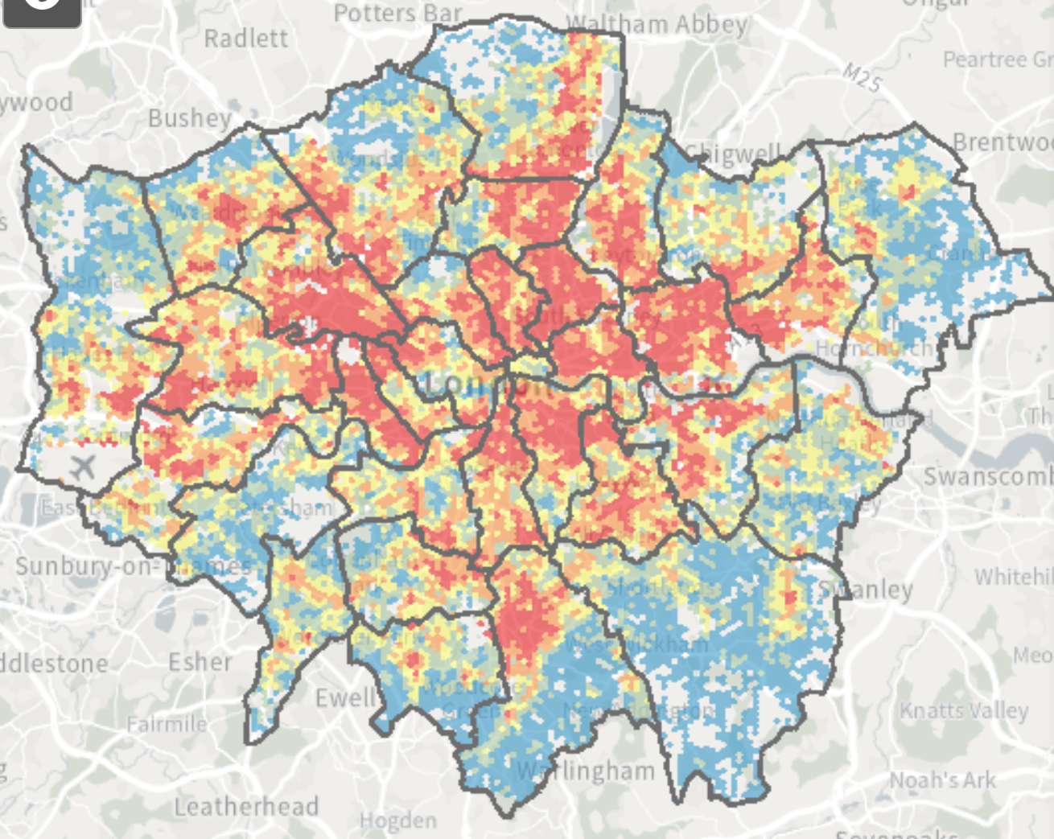
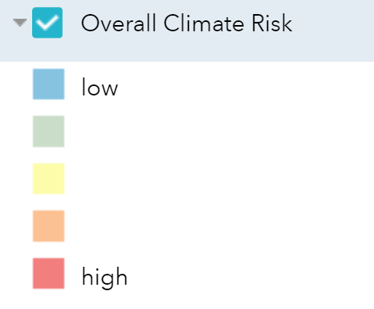
8. ENVIRONMENTAL SUSTAINABILITY AND EQUITY
DEPRIVED AND ETHNICALLY DIVERSE AREAS OF LONDON FACE THE HIGHEST CLIMATE RISK
It is well-established in research from the Intergovernmental Panel on Climate Change (IPCC) that the poorest around the world - predominantly Black and Asian people, who tend to have the smallest carbon footprints - will suffer the most severe consequences.¹
Geographical regions of London with Black, Asian and minority ethnic populations of more than 50% are more likely to face the highest climate risk in London.^{1,2}
  This includes flooding, exposure to toxic air, heat risk and limited access to green space.
These risks often intersect with social vulnerability, disproportionately affecting minority groups.¹
  This has been highlighted by the Covid-19 crisis, where existing inequalities have further exacerbated impacts of the pandemic, particularly for those in deprived neighbourhoods.
Fig 34. Geographical distribution of overall climate risk in London, 2021
Source: (1) BAME Londoners more likely to be affected by climate emergency | London City Hall (2) Climate Risk Map | London City Hall

Slide 51
PART 4: HEALTH BEHAVIOURAL RISK FACTORS
(Direct causes of poor health)

Slide 52
PART 4 OVERVIEW: HEALTH BEHAVIOURAL RISK FACTORS
The purpose of this section is to help illustrate how social inequalities described in part 3 with respect to the wider determinants, drives inequalities in the prevalence of health behaviours which in turn drive inequalities in illness and death in London (Part 5)
This includes an overview of behaviours below and identification of inequalities within:
  Smoking prevalence
  Overweight/obesity prevalence in adults (including diet)
  Overweight/obesity prevalence in children
  Physical activity
  Alcohol misuse, drug misuse and high blood pressure
More detail on these factors and other behavioural risk factors is available on the Health Profile for London

Slide 53
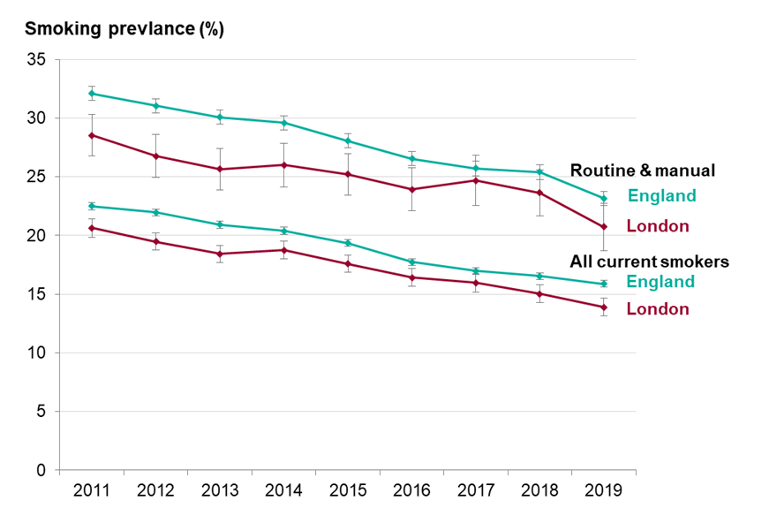
SMOKING PREVALENCE IN LONDON
Smoking prevalence has decreased to 12.9% in London, but significant inequalities remain with rates higher in deprived areas, in those with mental illness and routine and manual occupations
Smoking tobacco remains London’s leading cause of premature death killing 8,000 people per year​.¹
Between 2015 and 2019, adult smoking prevalence [Annual Population Survey(APS)] fell in London from 16.3% to 12.9%.^{2,3}
In 2020, the adult smoking prevalence from the APS was 11.1%, however as this data was collected only via a telephone survey due to Covid-19 (not face to face interviews as well) concerns were raised that this figure may be an under-estimate
Smoking prevalence ranged from 8.0% in Richmond upon Thames to 18.1% in Barking & Dagenham, in 2019.³
Prevalence in routine and manual occupations (aged 18-64 years) was 20.7%, twice that of managerial and professional occupations (10.3%).³
Prevalence in 2019 was 16.2% for men vs 9.8% for woman.²
Data from the GP Patient Survey (GPPS) shows that smoking prevalence is higher in adults (18+) with a long-term mental health condition in London (26.6%) in 2019/20, compared to 13.1% in the general adult population.³​
Smoking during pregnancy is the leading modifiable risk factor for poor birth outcomes​. In 2020/21, 9.5% of women were smoking at the time of delivery in England.⁴
Fig 35. Trend in smoking prevalence (%) by current smokers and by those in routine and manual occupations, ages 18+, London & England, 2011-2019
Note: The trend in smoking prevalence should be interpreted with caution as survey methodology switched to a telephone based survey in recent years, potentially influencing the estimates.
Source: (1) London Vision -Tobacco-control-and-reducing-smoking (2) Local Tobacco Control Profiles (3) Health Profile for London 2021 (4) Fact Sheets - ASH

Slide 54
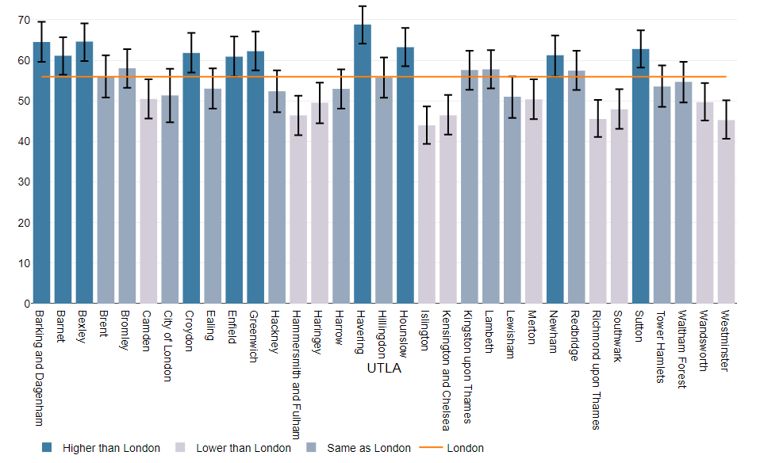
OVERWEIGHT/OBESITY IN ADULTS IN LONDON
In 2020/21, more than half (56.0%) of the adult population in London were either overweight or obese, with no improvement over time and wide variation across London local authorities
There is some variation by local authority.¹
  Bexley (64.6%) had the highest proportion of overweight or obese adults and Islington (44.0%) had the lowest.
In both males and females, obesity was lowest in those aged under 25 with a gradual increase by age through to 55-64 years, after which prevalence decreases.
Obesity prevalence was lowest in the least deprived and highest in the most deprived (~4% in least vs 10% in most) ²
The impact of the pandemic on adult obesity levels is not yet known. Given the changes in other risk factors presented, such as diet, physical activity, and alcohol, it is possible that there has been an increase and widening of inequalities.¹
Diet and Physical activity are key risk factors for being overweight/obesity.¹
  In 2019/20, the proportion of the population meeting the recommended 5 portions of fruit and vegetables on a ‘usual day’ in London was 55.8%, similar to England (55.4%).
  National data highlights that 5-a-day consumption is lower in people who are unemployed (45.2%), living with a disability (52.1%), Asian (47.2%), Black (45.7%), or living in the most deprived areas (45.7%).
Fig 36. Percentage of adults (aged 18+) classified as overweight/obese by local authority in London, 2020/21
Source: (1) Health Profile for London 2021 - Obesity and Diet (2) Quality and Outcomes Framework (QOF) 2020/21

Slide 55
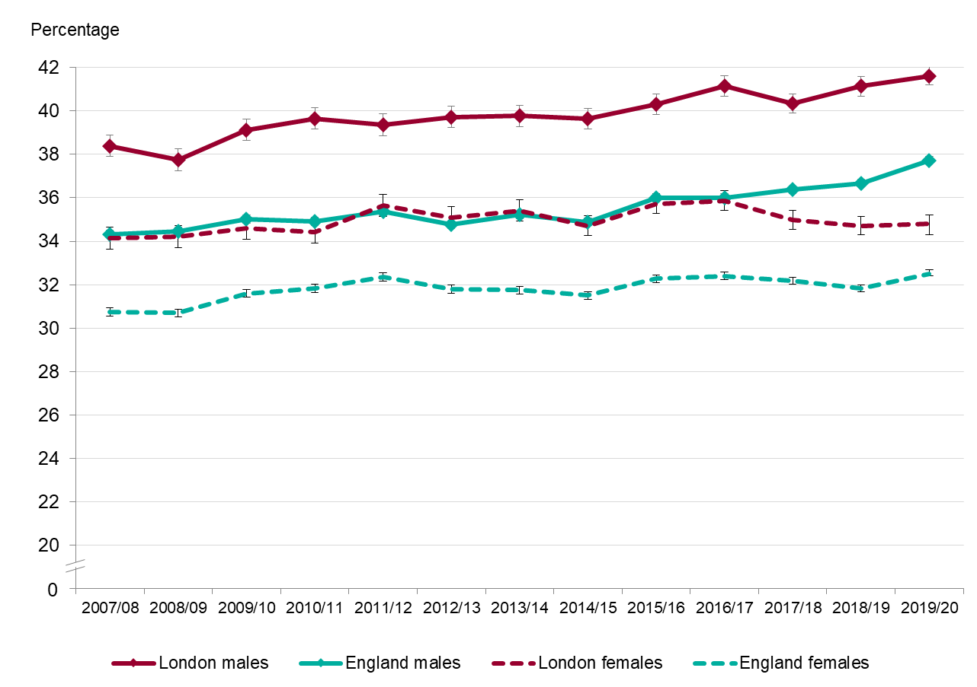
OVERWEIGHT/OBESITY IN CHILDREN IN LONDON
In 2019/20, one in five reception-age children and nearly two in five Year 6 children in London were classified as overweight or obese
Excess weight in 4-5 year olds is less prevalent in London (21.6%) than in England (23.0%). However, prevalence varies within London and on average 1 in 5 children in this age group are overweight/obese.¹
Excess weight in 10-11 year olds remains more prevalent in London (38.2%) than England (35.2%) with higher and worsening rates in males (41.6%) compared to females (34.8%), who have seen recent improvements.²
For all London local authorities, prevalence was higher in Year 6 children than Reception, with prevalence ranging from 11.1% in Richmond upon Thames to 29.0% in Barking and Dagenham (data not available for all London local authorities).³
In 2019/20 in England, children in the most deprived areas were more than twice as likely as children in the least deprived to be obese, while the Black African group had the highest prevalence of obesity in both Reception and Year 6.³
Fig 37. Trend in percentage of 10-11 year olds (Year 6), overweight or obese by sex in London and England, 2007/8-2019/20
Note: 2019/20 data on child obesity is less robust than previous years as fewer measurements were taken due to school closures in the pandemic
Source: (1) OHID Fingertips - Reception: Prevalence of overweight (including obesity) (2) OHID Fingertips– Year 6: Prevalence of overweight (including obesity) (3) Health Profile for London 2021 _ Child Obesity

Slide 56
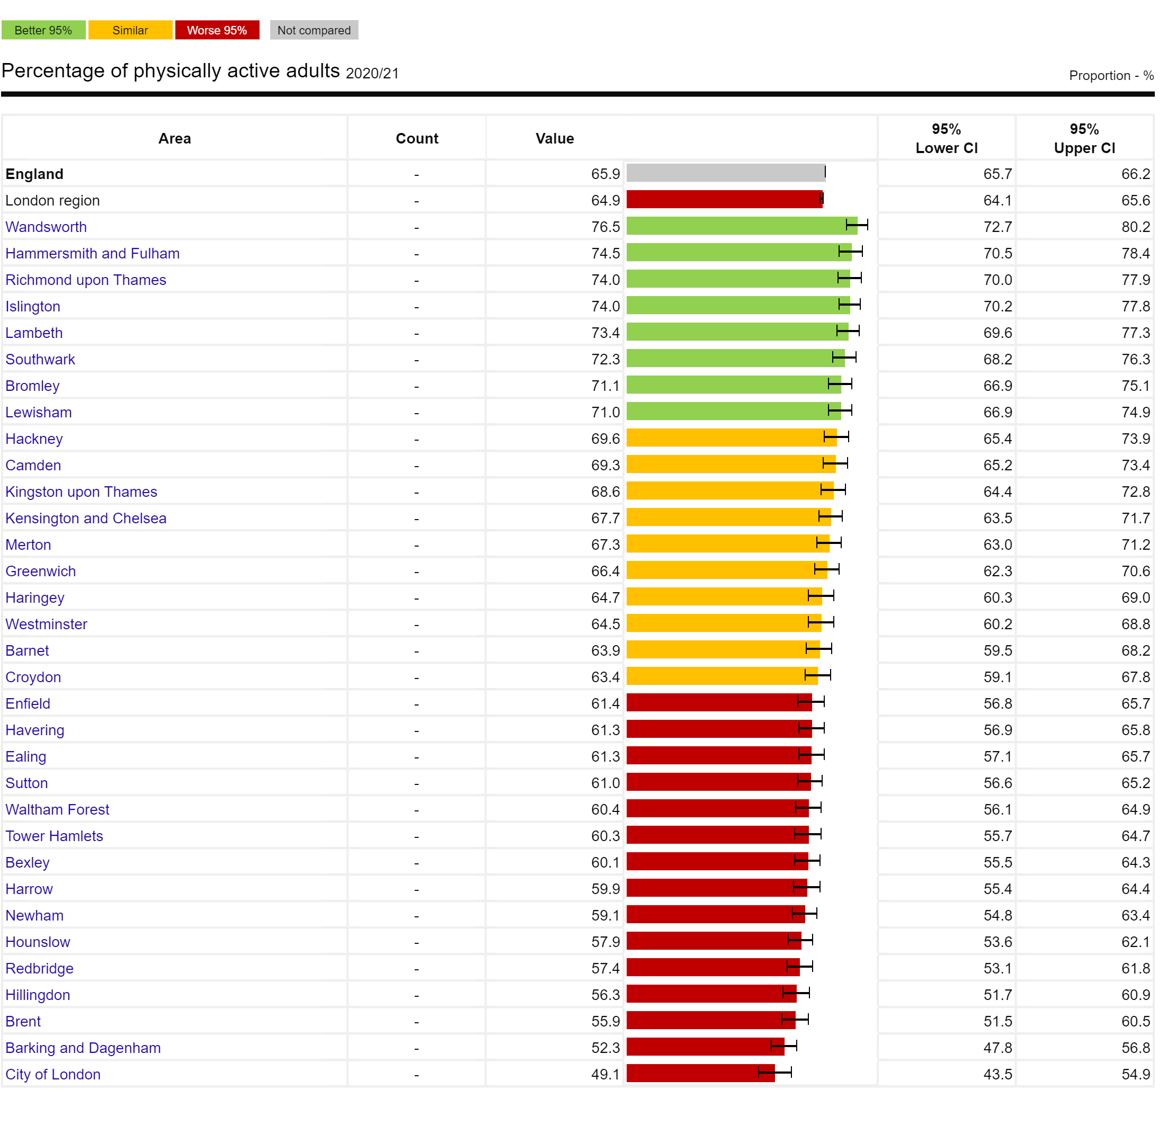
PHYSICAL ACTIVITY IN LONDON
The percentage of physically active adults in London remains significantly worse than England with over 1 in 3 adults insufficiently active, with significant variation by local authority
In 2020/21, 64.9% of adults (aged 19+) were physically active in London. This is lower than the England average of 65.9% with significant variation by Local Authority.¹
  This equates to over 1 in 3 adults being insufficiently physically active in London
Findings from Sport England found wide inequalities in physical activity in adults. The proportion of physically active adults was lower for: ²
  People in routine/semi-routine jobs and those who are long-term unemployed or have never worked (52%)
  Those living with a disability or long-term health condition (45%)
  Asian ethnic groups (48%)
  Black ethnic groups (52%)
Note: The definition of being physically active is taking at least the recommended level of 150 minutes of moderate intensity physical activity or equivalent per week.¹
Fig 38. Percentage of physically active adults by local authority, London, ages 18+, 2020/2021
Source: (1) OHID Fingertips -. Percentage of physically active adults (2) Sports England
Notes:
To consider footnote on impact of pandemic - restrictions of time spent outdoors during some periods, but also some travel mode shift

Slide 57
PREVALENCE OF ALCOHOL & DRUG MISUSE AND HIGH BLOOD PRESSURE VARIES ACROSS LONDON
Alcohol Misuse
In 2019, the Health Survey for England showed prevalence of ‘increasing or higher risk drinkers’ in London was 20.1% (vs 22.7% for England) and the proportion of ‘higher risk drinkers’ (more than 35 units for women or 50 units for men per week) was 5%
For local authorities within London, estimates for prevalence of ‘increasing or higher risk drinkers’ vary from 10.0% to 41.3%
The number of deaths related to alcohol in London was 2,197 in 2020, which represents a rate of 32.2 per 100,000 population and is significantly lower than the England average
The prevalence of ‘increasing or higher risk’ drinking in England is generally greatest in the highest household income group. However, the rate of hospital admissions for alcohol-related conditions is highest in the most deprived areas – a phenomenon known as the 'alcohol harm paradox' and is believed to be due to interactions with other health behaviours in more deprived areas such as smoking, poor diet and exercise.
Drug Misuse
In London, the rate of death due to drug misuse was 3.5 per 100,000, lower than for England (5.0 per 100,000) and lowest of any region. Within London, rates ranged from 1.9 per 100,000 in Enfield up to 8.0 per 100,000 in Hammersmith and Fulham.
National data highlights that the rate of deaths due to drug misuse continue to be highest among those born in the 1970s with the highest rate in those aged 45 to 49.
Blood Pressure
The recorded prevalence of high blood pressure in London changed little between 2015/16 (11.0%) and 2020/21 (10.8%)
  Havering (14.3%) had the highest recorded prevalence while Hammersmith and Fulham (7.1%) had the lowest. However, it is acknowledged that this local authority variation could reflect better diagnosis rates between GPs in an area.
This indicator from QOF (Quality and Outcomes Framework) only includes recorded prevalence of hypertension, so may not reflect true prevalence in the population
Source: Health Profile for London 2021

Slide 58
PART 5: DEATH AND ILLNESS IN LONDON

Slide 59
PART 5 DEATH AND ILLNESS IN LONDON
The purpose of this section is to help illustrate how social inequalities across the wider determinants (Part 3), leading to inequalities in health behaviours (Part 4), ultimately manifest in inequalities in patterns of death and disease seen in London
The data presented in this section highlights what diseases and causes of death are driving the inequalities in life expectancy and healthy life expectancy seen in London
Specifically in this part we will examine below topics and present data cut by dimensions of inequality where available:
  Premature and preventable mortality
  Causes of death
  Causes of illness (morbidity)
  Mental health of adult Londoners
  Infant mortality

Slide 60
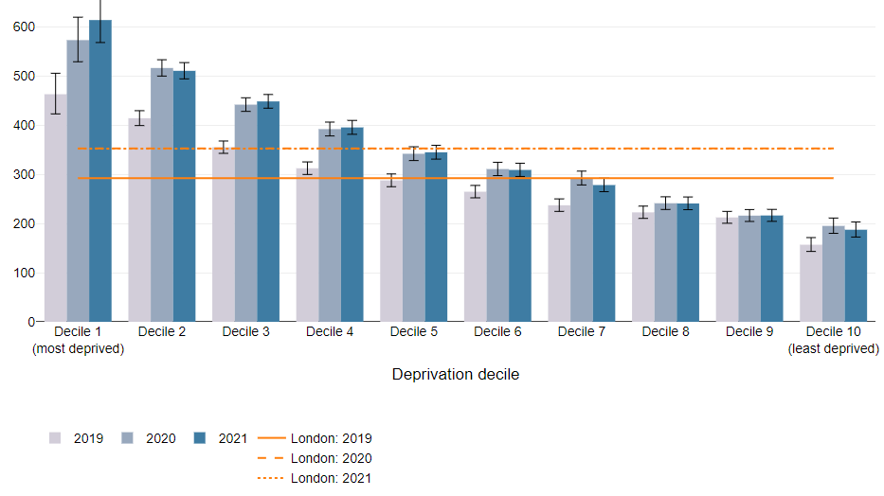
PREMATURE MORTALITY WAS THREE TIMES HIGHER IN THE MOST VS LEAST DEPRIVED DECILE
Premature mortality refers to age-standardised mortality rate for all deaths registered in people aged under 75 years.^{1,2}
  All-cause premature mortality rate in London increased by 23% between 2019 and 2020 for males, and by 17% for females largely due to direct and indirect impacts of the pandemic. This was the largest increase of any region in the UK
  In comparison, between 2020 and 2021, little change was observed
The biggest increase in premature mortality rates were seen in the most deprived deciles.¹
  The premature mortality rate in the most deprived decile between 2019-21 has consistently been nearly three times that of the least deprived decile.
Under 75 mortality rates from all causes considered preventable* using data from 2017-19 for London, were similar or better than the England average.²
  This includes cardiovascular, cancer, liver and respiratory diseases causes considered preventable*
*Preventable mortality: Deaths are considered preventable if, in light of the understanding of the determinants of health at the time of death, all or most deaths from the underlying cause could mainly be avoided through public health and primary prevention.²
Fig 39. Premature mortality rates (Age standardised mortality rates for under 75 per 100,000), by deprivation decile for London, 2019-21
Source: (1) Figure 7b, Health Profile for London, 2021 (2) Fingertips - Mortality profile

Slide 61
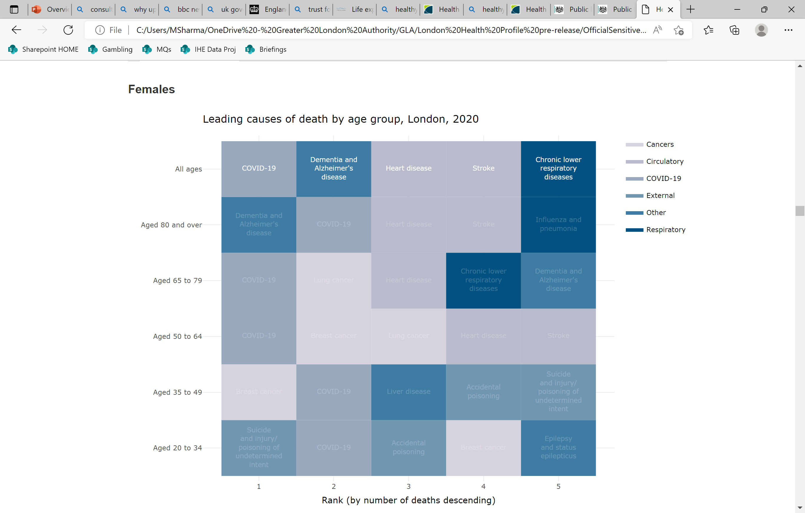
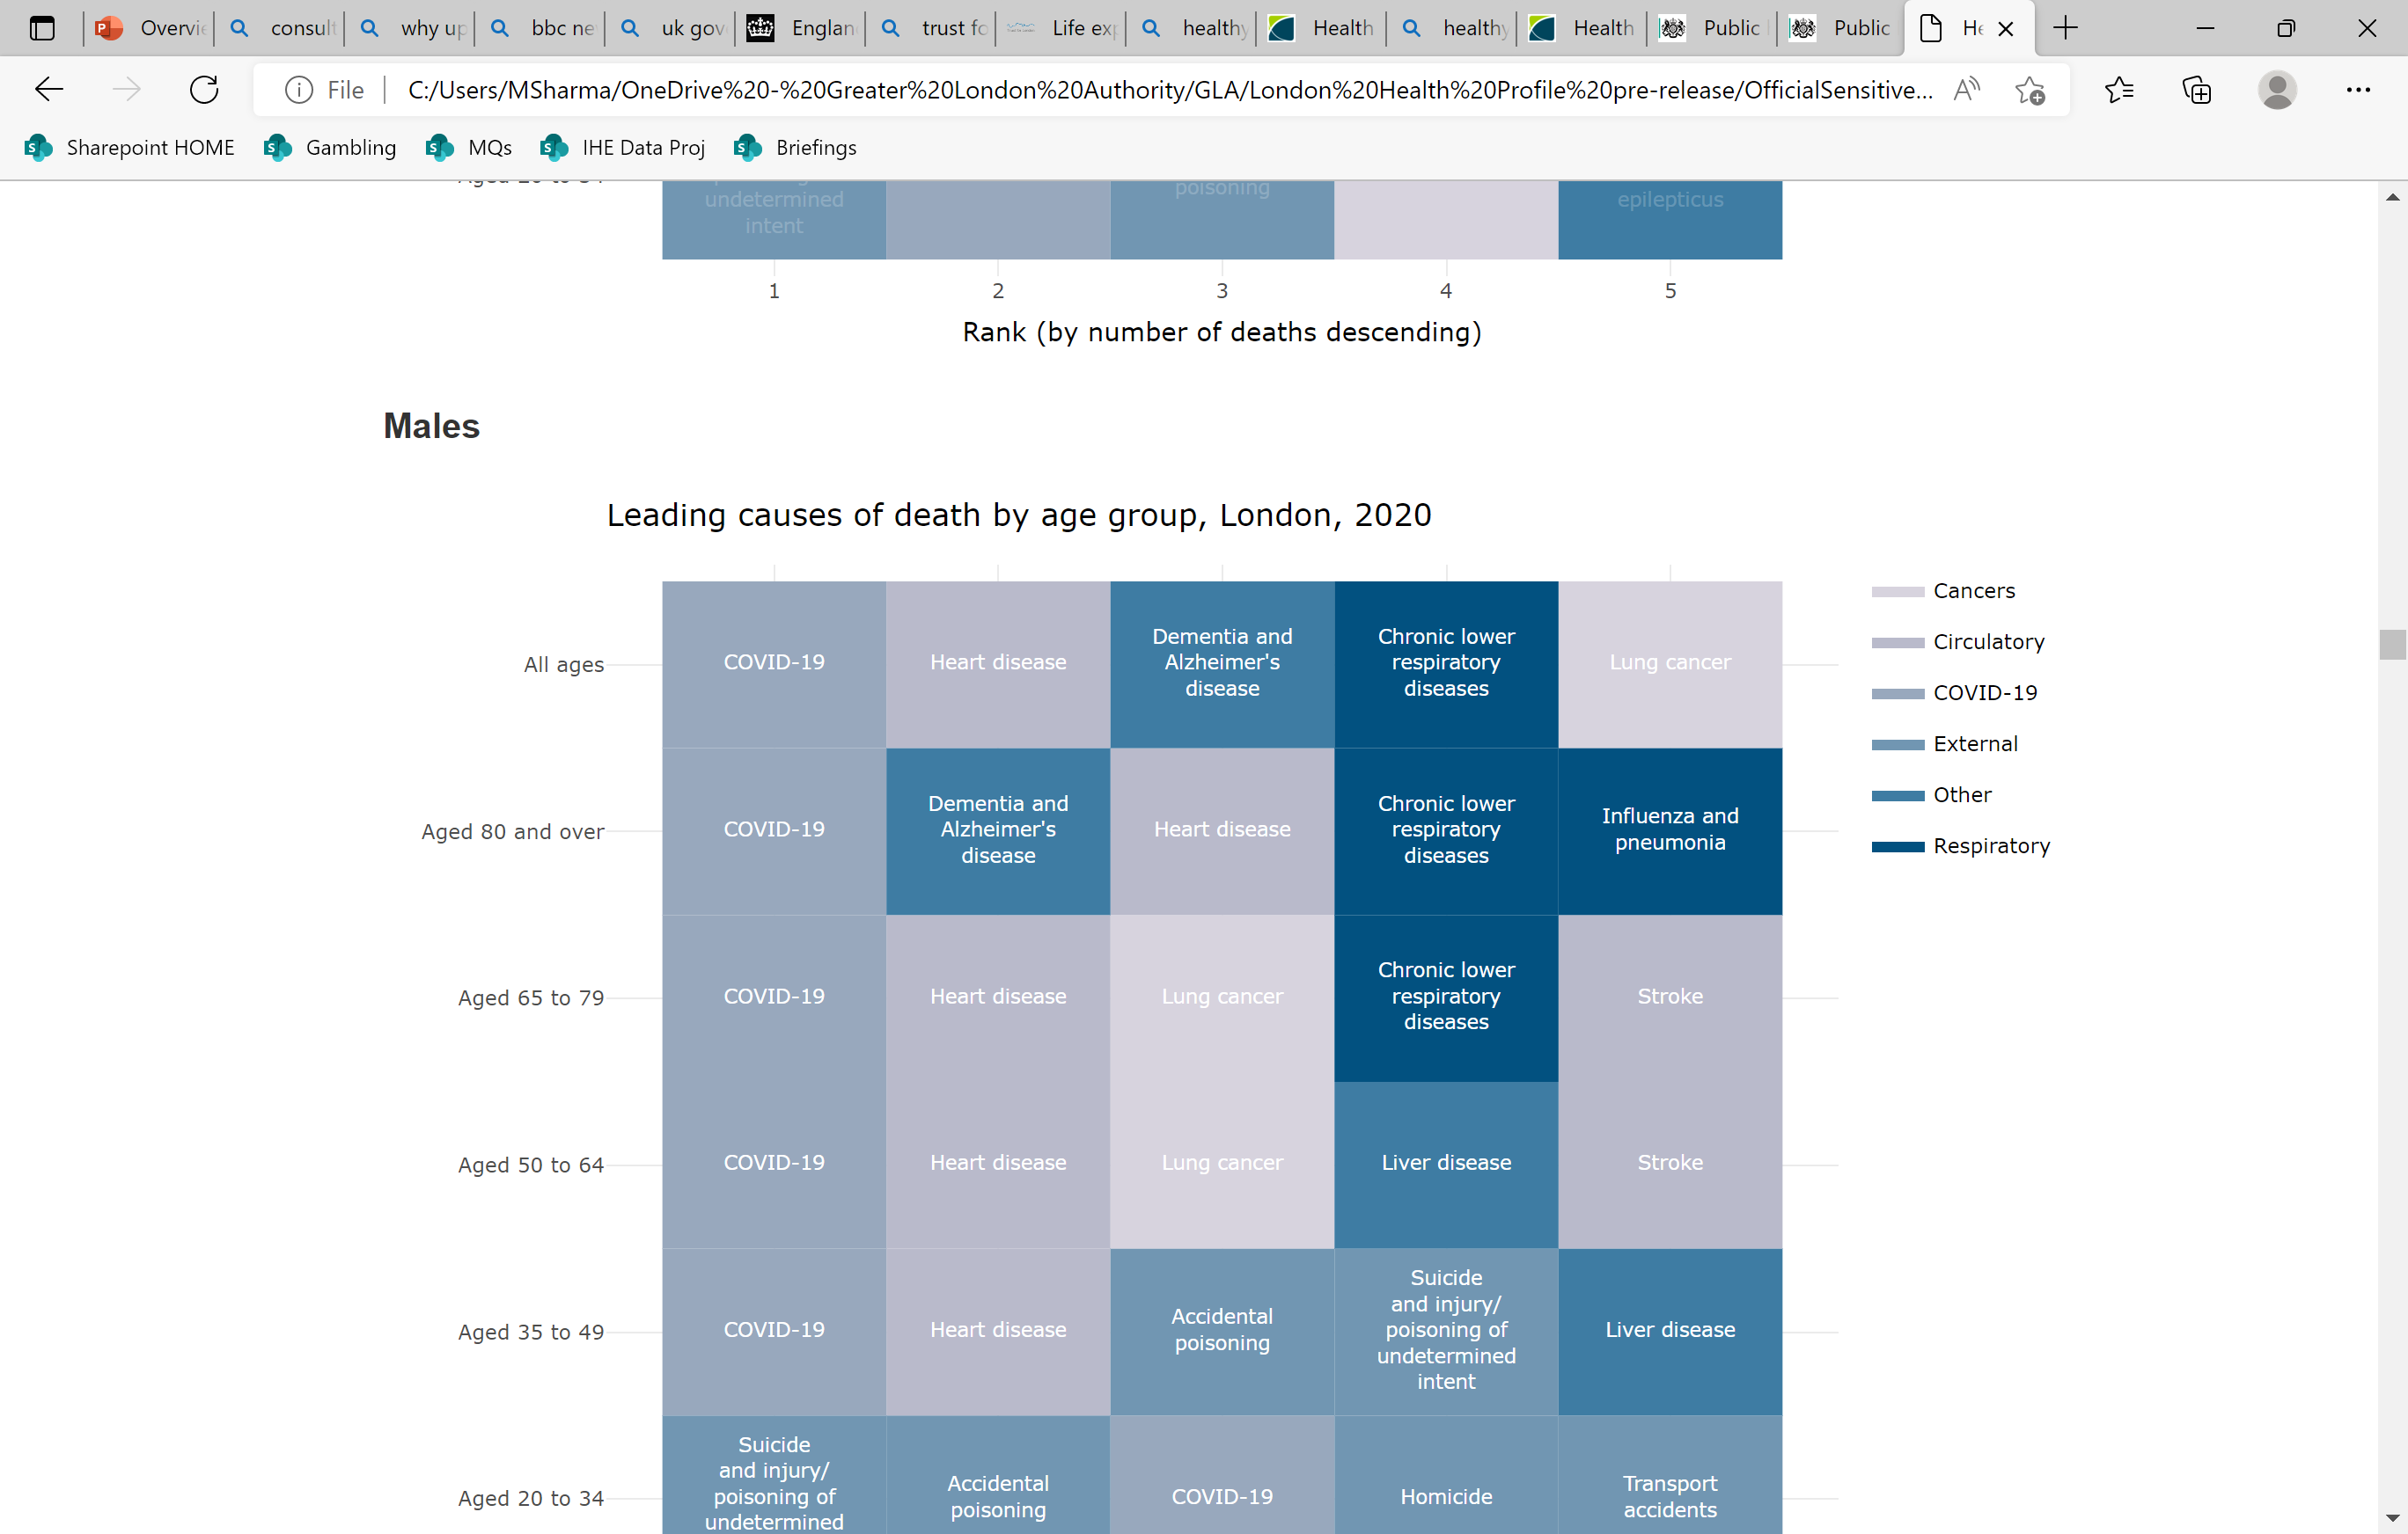
COVID-19, DEMENTIA, HEART DISEASE, STROKE, LUNG DISEASE AND LUNG CANCER WERE THE COMMON CAUSES OF DEATH IN LONDON
After Covid-19 which was the leading cause of death in 2020 in all ages for males and females, the main other causes of death included
  Dementia
  Heart disease
  Stroke
  Chronic respiratory (lung) diseases
Four of the top five leading causes of death in 2020 were shared between males and females except:
  Lung cancer was the 5th leading cause of death in males while stroke was the 4th leading cause of death in females
Fig 40. Leading causes of death by sex (all ages) in London, 2020
Source: Adapted from Figure 8, Health Profile for London, 2021

Slide 62
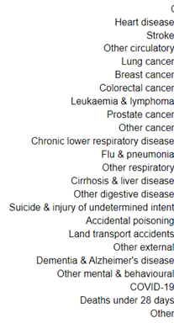
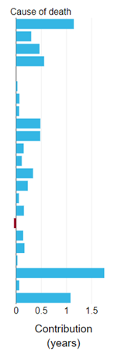

COVID-19, HEART DISEASE, CANCERS AND LUNG DISEASE ADDED TO GAP IN LIFE EXPECTANCY BETWEEN MOST AND LEAST DEPRIVED DECILES
Higher mortality due to Covid-19 had the biggest impact on the gap in life expectancy, between the most and least deprived deciles
After Covid-19, deaths due to cardiovascular disease (heart disease, stroke, other circulatory), cancer and respiratory disease contributed significantly to gaps in life expectancy
However, nearly every cause of death noted, contributed to the gap seen in life expectancy between the most and least deprived deciles
Fig 41. Breakdown of the gap in life expectancy in between the most and least deprived deciles by cause of death in London, 2021
Males 2021
Females 2021
Source: OHID CHIME tool

Slide 63

LOW BACK PAIN, DEPRESSION AND HEADACHE CONTRIBUTE MOST TO ILLNESS IN LONDON
Years lived with disability as measured by the Global Burden of Disease tool helps assess the impact across the population of different illnesses and symptoms (morbidity)
Low back pain, depressive symptoms and headache continue to contribute significantly to years lived with disability in London
Several others causes increased too since 1990, but the most significant increase was seen in diabetes
For males in 2019, the top three causes were low back pain, diabetes, and depressive disorders. For females, these were low back pain, headache disorders, and depressive disorders.
Fig 42. Age-standardised morbidity rate (years lived with disability) in London for all persons, per 100,000 population, 1990 vs 2019
Note: Change between years should be interpreted with caution as it may reflect changes in methodology and categorisation, and uncertainty limits are wide for most causes.)
Source: Figure 16, Health Profile for London, 2021

Slide 64


PREVALENCE OF SEVERAL COMMON DIAGNOSED DISEASES WAS HIGHER IN DEPRIVED GROUPS
The Segmentation Model uses nationally available datasets to assign conditions to the entire GP registered population based on their historic health service usage.
Patients aged 65-84 in the most deprived quintile in London, have higher morbidity and much higher (estimated) prevalence of hypertension (44.6% vs 33.7%) and diabetes (31.3% vs 16.1%) compared to the least deprived quintile.
Higher prevalence in more deprived groups of other major diseases was also observed including osteoarthritis, coronary heart disease, cerebrovascular disease, asthma, and depression.
Note
Patients with conditions that can be managed entirely within primary care without presenting to secondary/community care will not be 'detected' by the Segmentation Model.
65-84 category is a large age bracket, which could be skewed differently between populations.
Fig 43. Comparison of prevalence of several common diseases, people aged 65-84, most and least deprived groups, London, June 2021
Source: Segmentation Model developed by Data, Analysis and Intelligence Service (DAIS) in NHSEI, Public Health England (PHE), Outcomes Based Healthcare (OBH) and Arden & GEM CSU. https://apps.model.nhs.uk/report/PaPi

Slide 65

THE PREVALENCE OF COMMON DIAGNOSED DISEASES IN LONDON VARIES BY ETHNICITY
The Segmentation Model highlights several examples of ethnic inequality in the prevalence of common diseases in London
Hypertension: A much higher prevalence is seen in Asian (56.5%) and Black (56.0%) ethnic groups compared to White (42.2%).
Diabetes: A much higher prevalence is seen in Asian (49.2%) and Black (40.4%) ethnic groups than White (18.8%).
Other: Higher coronary heart disease (CHD) and asthma prevalence in Asian ethnic groups; while a lower cancer prevalence is observed
Note
Ethnicity coding has improved but remains incomplete with concerns remaining especially around secondary care coding quality.
Missing records likely to be skewed towards patients not routinely accessing healthcare services/younger people.
Fig 44. Comparison of prevalence of several common diseases in people aged 65-84, by ethnic group, London, June 2021
Source: Segmentation Model developed by Data, Analysis and Intelligence Service (DAIS) in NHSEI, Public Health England (PHE), Outcomes Based Healthcare (OBH) and Arden & GEM CSU. https://apps.model.nhs.uk/report/PaPi

Slide 66

NEARLY ONE IN FOUR LONDONERS AGED 16+ REPORT SIGNS OF POOR MENTAL HEALTH
The General Health Questionnaire (GHQ-12) helps to identify minor psychiatric disorders in the general population. Higher scores are indicative of poorer mental health.
In 2009-11 around one in five (20%) of Londoners aged 16+ reported characteristics of poor mental health. It has remained quite stable over the last 10 years, though in the most recent wave of the survey 2019-21 (partially covering the pandemic period), the proportion increased to 24%.
Female Londoners (28%) were more likely to display features of poorer mental health than male Londoners (18%).
Londoners aged 50+ (18%) were less likely to display features of poorer mental health than Londoners aged 16-29 and 30-49 (27% and 28% respectively).
Fig 45. Percentage of Londoners aged 16+ with a high GHQ-12 score (4 or more), 2009-21
Note: The General Health Questionnaire focuses on two major areas: the inability to carry out normal functions; and the appearance of new and distressing phenomena, with each of the 12 items rated on a four-point response scale. A coding method was used whereby the maximum score for any respondent is 12, with higher values indicating poorer mental health. A threshold of 4 or more was set as the difference between 'no or few mental health problems' and 'poorer mental health’.
Source: University of Essex, Institute for Social and Economic Research. (2022). Understanding Society: Waves 1-11, 2009-2020 and Harmonised BHPS: Waves 1-18, 1991-2009. [data collection]. 15th Edition. UK Data Service. SN: 6614, http://doi.org/10.5255/UKDA-SN-6614-16.

Slide 67

INFANT MORTALITY IN LONDON
In 2018-20, infant mortality was 3.4 per 1,000 live births and lower than the England average (3.9 per 1000) though no improvement has been seen in recent years
Infant mortality includes all deaths within the first year of life.
The majority of these are neonatal deaths which occur during the first month, with the main cause relating to prematurity and preterm birth, followed closely by congenital anomalies.
There is some variation by local authority.
Within London infant mortality rates range from 1.9 per 1,000 in Wandsworth up to 4.7 per 1,000 in Hounslow
Nationally data shows the rate of infant mortality increases as deprivation increases.
Note: Infant mortality rates are presented as a three-year rolling average to smooth out variation.
Fig 16. Infant mortality rate per 1,000 live births by local authority in London, 2018-20
Source: Health Profile for London 2021 – Infant Mortality

Slide 68
PART 6: HEALTHCARE INEQUALITIES

Slide 69
PART 6 HEALTHCARE INEQUALITIES
The purpose of this part is to help illustrates through select examples (due to limitations around what data is available in public domain) how inequalities evident in access to, quality and experience of health and care provision can further compound and worsen existing health inequalities
Specifically in this part, we will examine below topics, and present data cut by dimensions of inequality where available:
  Spend on unplanned care by deprivation
  Covid-19 vaccination uptake by deprivation
  Covid-19 vaccination uptake by ethnicity
  Influenza vaccination uptake by deprivation
  Breast and Bowel cancer screening uptake by deprivation
  Inequality in diabetes care by deprivation

Slide 70

THERE IS HIGHER SPEND ON UNPLANNED CARE AND LOWER ON PLANNED IN DEPRIVED AREAS
The Segmentation Model uses nationally available datasets to assign conditions and costs to the entire GP registered population based on their historic health service usage.
Emergency department (ED) and non-elective (NEL) per capita spend in London, for people aged 65-84, is higher in the most deprived quintile than in the least deprived (£97 vs £58; £787 vs £457).
Elective (EL) per capita spend is slightly higher in the least deprived quintile than in the most deprived (£264 vs £250).
Outpatient (OP) spend is slightly higher in the most deprived quintile than in the least deprived (£286 vs £278).
This collectively highlights how deprived areas tend to receive more reactive than proactive healthcare
Note:(1) Financial values are based on national tariffs, supplemented with reference cost information where no tariff exists for an indicative price value.
(2) ED=Emergency Department; NEL=Non-elective care; EL=elective care; OP=outpatient
Fig 46. Cost by point of delivery for care in most deprived compared to least deprived quintiles (ages 65-84)
Source: Segmentation Model developed by Data, Analysis and Intelligence Service (DAIS) in NHSEI, Public Health England (PHE), Outcomes Based Healthcare (OBH) and Arden & GEM CSU. https://apps.model.nhs.uk/report/PaPi

Slide 71

SOCIOECONOMIC INEQUALITY WAS EVIDENT IN COVID-19 VACCINATION UPTAKE IN LONDON
An element of inequality in quality of care can be seen in uptake of Covid-19 vaccination in London by deprivation.
  A gradient of decreasing vaccination uptake by increasing deprivation (as per IMD quintile) is evident.
  Unvaccinated rates increase with deprivation (22.6% in most deprived quintile vs 11.1% in least deprived).
  Cumulative COVID-19 mortality rates also increase significantly with deprivation (545 deaths per 100,000 in most deprived decile vs 252 in least deprived).
Note:(1) Deprivation quintiles are intra-London not national.
(2) Measures are age/sex standardised.
(3) Vaccination data only covers a subset of the population and may differ from NHSE weekly published figures.
Fig 47. Cumulative age-standardized percentage of adults aged 18+ unvaccinated for Covid-19 by deprivation quintile, Dec 2020 to May 2022
Source: OHID CHIME tool. Vaccination rates calculated by ONS https://analytics.phe.gov.uk/apps/chime/

Slide 72

ETHNIC INEQUALITY WAS EVIDENT IN COVID-19 VACCINATION UPTAKE IN LONDON
An element of inequality in quality of care for vaccination can be seen in uptake of Covid-19 vaccination in London by ethnicity.
  A gradient of decreasing vaccination uptake across ethnic groups is evident.
  Unvaccinated rates are lowest in the White British (8.6%) and Indian (9.2%) populations, and highest in the Black Caribbean (39.1%), Other White (25.2%) and Black African (24.9%) populations.
  Cumulative COVID-19 mortality rates much higher in Black/Black British (606 deaths per 100,000) and Asian/Asian British groups (577 deaths per 100,000) vs White (321 deaths per 100,000) and Mixed/Multiple ethnic groups (330 deaths per 100,000).
Note:(1) Measures are age/sex standardised.
(2) Vaccination data only covers a subset of the population and may differ from NHSE weekly published figures.
Fig 48. Cumulative age-standardized percentage of adults aged 18+ unvaccinated for Covid-19, by ethnicity, Dec 2020 to May 2022
Source: OHID CHIME tool. Vaccination rates calculated by ONS https://analytics.phe.gov.uk/apps/chime/

Slide 73

ETHNIC INEQUALITY IN FLU VACCINATION UPTAKE
In 2021-22, the lowest flu vaccine uptake was in Black/Black British Caribbean group (49%)
Fig 49. Cumulative uptake data for London of seasonal influenza vaccination given to people aged 65 and over, from 1 September 2021 to 28 February 2022 (provisional data)
Source: Immform website, registered GP data.
https://www.gov.uk/government/statistics/seasonal-flu-vaccine-uptake-in-gp-patients-monthly-data-2021-to-2022

Slide 74


INEQUALITY IN SCREENING UPTAKE IN LONDON
In 2020-21, breast cancer and bowel cancer screening uptake was lower in deprived areas
Fig 50. Percentage uptake of breast cancer screening (persons aged 50-70) and bowel cancer screening (persons aged 60-74) within 6 months of invitations, 2020-21
Note: 1) Labels refer to the numerator (i.e. number of people screened). 2) IMD metrics are calculated from GP level aggregate data (not patient-level data). Composite GP IMD scores have been calculated based on the proportion of registered population in each LSOA (1=most deprived vs 10=least deprived).
Breast Cancer
Bowel Cancer
Source: Bowel Cancer Data Source: Extracted from the Bowel Cancer Screening System (BCSS) via the Open Exeter system.
Data was collected by the NHS Cancer Screening Programme. https://fingertips.phe.org.uk/profile/cancerservices/data#page/1

Slide 75

INEQUALITY IN QUALITY OF CARE EXISTS FOR DIABETES EVIDENT VIA THE VARIATION IN HBA1C
An illustration of inequality in quality of care across long-term illnesses can be seen in characteristics of patients registered in primary care in London that have well-controlled diabetes.
  Glycated haemoglobin (HbA1c) is commonly used to monitor glucose control. Rising levels of HbA1c increase the risk of acute complications such as hyperosomolar hyperglycaemic states and mortality and chronic complications both macrovascular and microvascular.
  Achieving a target of HbA1c ≤ 58 mmol/mol is a sign of good glucose control.
  With the exception of the most deprived decile, IFCC-HbA1c levels appear to be better regulated in less deprived areas.
Note:(1) The outlier values for the most deprived decile may be driven by the relatively low numbers of patients within these areas.
(2) The utility of these measures depends on clinical case finding by GPs (i.e. people with diabetes being detected and properly recorded in GP records). (3) COVID-19 may have impacted 2020/21 QOF data.
(4) Denominators include Personalised Care Adjustments (PCAs); patients who are deemed unable to receive a particular treatment. PCAs are usually the result of a decision by a patient or GP at a personal level; e.g. patient/carer refusing a treatment, interactions between different medications etc.
Fig 51. Percentage of people with diabetes without frailty, registered in GP, that is well-controlled (IFCC-HbA1c≤ 58 mmol/mol)
Note: Labels refer to the number of patients with diabetes and IFCC-HbA1c <=58mmol/mol
Source: Quality and Outcomes Framework (QOF) 2020/21, NHS Digital. https://fingertips.phe.org.uk/profile/general-practice/data#page/1/

Slide 76
PART 7: CONCLUSION

Slide 77
CONCLUDING COMMENTS
The Covid-19 pandemic reshaped the lives of Londoners and showed with devastating effect how the different circumstances of our lives can affect our chances of poor health.
Uncertainties remains around the population now living in London given extensive in- and outmigration in these past years, and because the 2021 census was undertaken at the peak of the pandemic
Health inequalities known to exist in London between more and less deprived areas, across characteristics like age, gender and race, inclusion health and geographies have been exposed
This report presents a rapid snapshot of health inequalities in London, what existing data is available and what it shows, as a baseline to monitor our efforts as we move through recovery and building London back better
Many challenges that existed for London pre-pandemic such as childhood obesity, air pollution and climate change remain with further ones around health and social care access, ethnic inequality and structural racism, housing and the costs of living rising in importance
There is already a huge volume of data and action taking place at national and local level, to address inequalities, though data pertaining to certain topic areas such as healthcare inequalities is sparse
Data evidencing health inequalities in London is also disjointed with important gaps in the availability of data to describe, analyse and interpret inequalities. More systematic and consistent collection, recording and coding of data relating to geography, across all protected characteristics, and of key inclusion health groups should remain a priority
Partnership action could be used to identify means of accessing more novel and timely data, more integrated and linked datasets between heath and care and wider determinants. This would address some gaps and provide more effective intelligence, enabling targeted strategic work across all populating groups and communities
This could include better application of evidence based approaches such as the Marmot Principles and “Health in all Policies” to help address inequalities

Slide 78
GAPS IN EVIDENCE AND GAPS IN THIS DECK
The purpose of this slide deck is to provide a snapshot of health inequalities pertaining to some key issues in London, however it has identified recurrent gaps in our intelligence in particular the need for:
More granular data for topic areas available at a local level and cut by dimensions of inequality in particular
  Ethnicity, disability and other protected characteristics
  Inclusion health groups
More integrated health and social care data and better linked datasets to allow more effective longitudinal and cross-sectional analysis of inequalities
There is also a clear need for further work on identifying useful and timely intelligence to expand on the impact on health and health inequalities of topic areas, already identified as important for London and aligned to the Building the Evidence (BTE) intervention reviews such as:
Cost of Living
Structural Racism
Housing
Liveable cities
Skills for Work
Climate change

Slide 79
ACKNOWLEDGEMENTS
This work has been a collaborative product and a sincere thanks must go to all colleagues involved in the Building the Evidence (BTE) data working group from the organisations listed below, as well as the advisory group overseeing the direction of the work
GREATER LONDON AUTHORITY HEALTH
GREATER LONDON AUTHORITY CITY INTELLIGENCE UNIT
INSTITUTE OF HEALTH EQUITY
OFFICE FOR HEALTH IMPROVEMENT AND DISPARITIES LONDON
ASSOCIATION OF DIRECTORS OF PUBLIC HEALTH LONDON
NHS ENGLAND

Slide 80
END

