Slide 1
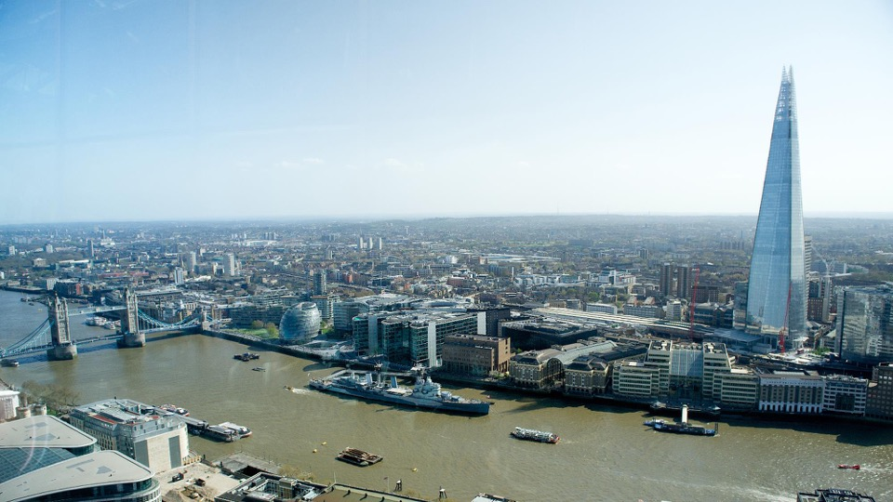



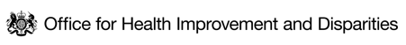


HEALTH INEQUALITIES IN LONDON
Children and Young People Pack
BUILDING THE EVIDENCE DATA COLLABORATIVE
August 2024
All data correct as of July 2024

Slide 2
CONTENTS
CONTEXT
Population of London at the 2021 Census
BROAD INDICATORS OF HEALTH STATUS
Low birth weight
Infant mortality
WIDER DETERMINANTS
School readiness
KS4 educational attainment
Mental health in children
Looked after children
Youth violence
Child poverty
Demographic inequalities in poverty
Housing and homelessness
HEALTH BEHAVIOURS
Childhood overweight and obesity
HEALTHCARE INEQUALITIES
MMR coverage across London
Addendum (05 December 2024): Slide 14 stated that ‘In London, children in the most deprived areas are more than twice as likely as children in the least deprived to be obese’. This statement applied to England but not to London, so has been corrected with London data.​
​

Slide 3
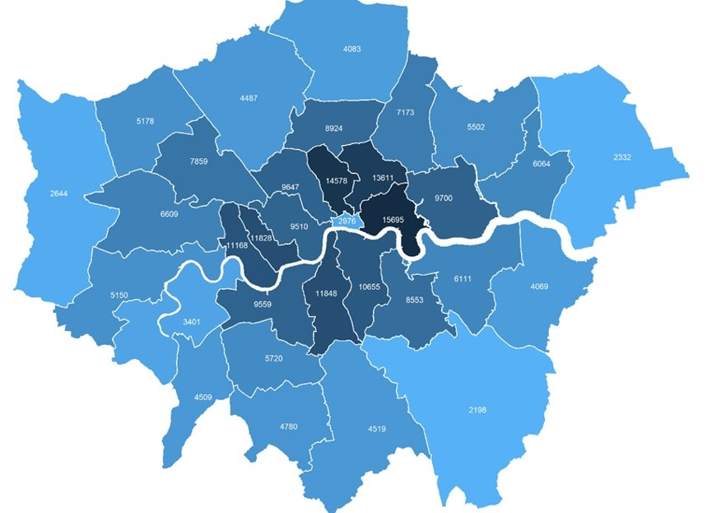

LONDON’S 2021 CENSUS DAY POPULATION WAS 8.8 MILLION, LOWER THAN 2020 OR 2022
The census population estimate of 8.8 million was likely to be close to a low point in London’s population, brought about by a temporary dip during the COVID-19 pandemic.
We know the pandemic caused some outflow of families and young adults from London and a virtual halt in international movements. We don’t know how far COVID affected the census responses that were recorded.
Key Census statistics
41% of Londoners were born outside UK (Rest of England 13%), and 46% were of Asian, Black, Mixed or Other ethnicities
50% of Londoners were aged 35 or under (Rest of England 43%) and 12% were aged 65 or over (Rest of England 20%)
4.2% of Londoners aged 16 or over identified as LGB+ and 0.9% said their gender identity differed from their sex at birth
12% of London’s working-age (aged 18-66) population reported they were disabled (Rest of England 17%) and 3.9% reported bad or very bad health (Rest of England 4.8%)
Fig 1. Population Density (persons per km²) by London Borough, 2021 Census
Source: England and Wales Census 2021

Slide 4
LOW BIRTHWEIGHT IN LONDON CORRELATES WITH BOROUGH LEVEL DEPRIVATION
Low birthweight (weight less than 2,500 grams) is associated with an increased risk of infant mortality, developmental problems in childhood and poorer health in later life.¹
In 2021, 3.3% of babies born at term had low birthweight, which is higher than the England average (2.9%). Unlike England, which shows a stable rate, this represents part of a continuing worsening trend since 2017.¹
The proportion of low birthweight babies varies significantly by borough. As of 2021:¹
  The range in proportion went from 2.1% in Kingston upon Thames to 5.1% in Newham
  Newham (5.1%) and Tower Hamlets (4.3%) rank in the top five local authorities in England for highest proportion of low birthweight babies.
  The proportion of low birthweight babies in London boroughs correlates with the average deprivation level of that borough (Fig 7).
Note: Low birthweight is more common in some Black, Asian and minority ethnic groups. For example, Indian, Pakistani and Bangladeshi infants are 280–350 g lighter, and 2.5 times more likely to be low birthweight compared with White infants due likely to a combination of genetic and social determinants.² These population groups are more prevalent in London and unequally distributed across London boroughs.
Fig 2. Percentage of low birthweight babies at term by deprivation for local authorities in London, 2021
Newham
Barking & Dagenham
Richmond-upon-Thames
Kingston-upon-Thames
Source: (1) Child and Maternal Health – Low Birthweight (2) Kelly et al
All data correct as of July 2024

Slide 5
INFANT MORTALITY CORRELATES WITH AREA DEPRIVATION AT LONDON AND NATIONAL LEVELS
In 2020-22, infant mortality was 3.6 per 1,000 live births and lower than the England average (4.0 per 1000) with a gradual increase being seen since 2014-16.
Fig 3. Infant mortality rate per 1,000 live births by deprivation score by local authority in London, 2020-22
The infant mortality rate (IMR) is the number of deaths under the age of one year per 1,000 live births. Most infant deaths occur during the first month, most commonly due to immaturity related conditions in babies born preterm (< 37 weeks gestation) and congenital anomalies¹.
Around 7 babies died per week in London in 2020-22, many from preventable causes. There is significant variation across boroughs:
  Greenwich is the only London borough with a significantly higher infant mortality rate than London (4.8 per 1,000).
  Wandsworth is the only borough where it is significantly lower than average (1.9 per 1,000).
The rate has increased in London from 3.2 per 1,000 in 2014-16
Nationally data shows the rate of infant mortality increases as deprivation increases, from 6.2 per 1,000 in the most deprived decile, to 2.9 per 1,000 in the least deprived. This trend is apparent at the London borough level (Fig 8).
Between 2017-19, the rate of stillbirths and infant deaths in England and Wales was highest for Black children, and higher for Asian children, relative to children of White ethnicity². This may be partially explained by children from minority ethnic groups disproportionately being born in more deprived areas.
Greenwich
London avg.
Wandsworth
Note: Infant mortality rates are presented as a three-year rolling average to smooth out variation.
Source: (1) OHID Public health profiles – infant mortality rate (2) ONS

Slide 6
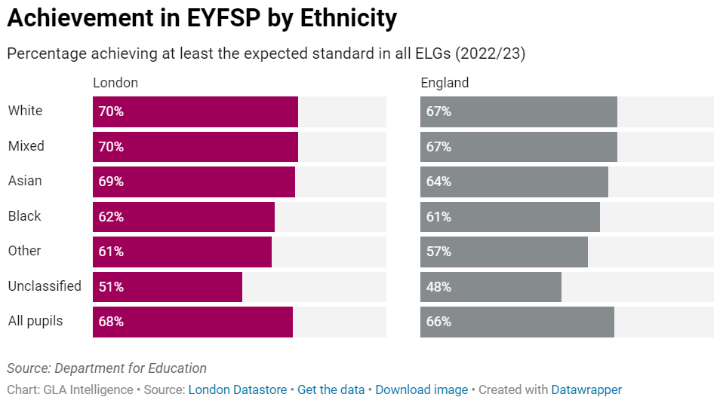
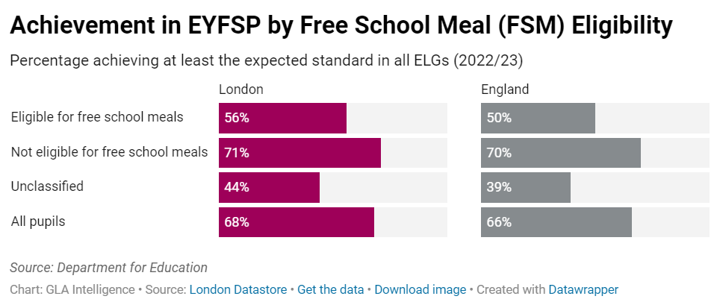
LONDON CHILDREN EXHIBIT HIGH LEVELS OF SCHOOL READINESS BUT INEQUALITIES EXIST
In 2022, Early Years Foundation Stage Progress (EYFSP) tests have shown higher levels of school readiness among London’s young children (aged 5 years) than those in every other region of England, except for the South East which scores highest overall.
However, significant inequalities exist (Fig. 4):
  Almost half of children eligible for free school meals (FSM) in London (44%) do not meet the expected school readiness standard, relative to 29% for children not eligible.
  Children of Other (61%) and Black (62%) ethnicity are least likely to achieve the required standard, while White and Mixed ethnicity children are the most likely (both 70%). Chinese children (79%) are most likely to achieve the expected standard across Early Learning Goals (ELG).
  Children with a first language other than English, or with a Special Educational Need or Disability (SEND) are also less likely to meet the standard than other children.
Note: There were no assessments in 2020 and 2021 due to the pandemic, but the EYFSP publication resumed for the 2021-22 academic year. Children in this analysis were aged 3 at the beginning of the pandemic.
Fig 4. Achievement in Early Years Foundation Stage Progress (EYFSP) by ethnicity and Free School Meal eligibility, 2022/23
Source: (1) London Datastore – School Readiness

Slide 7
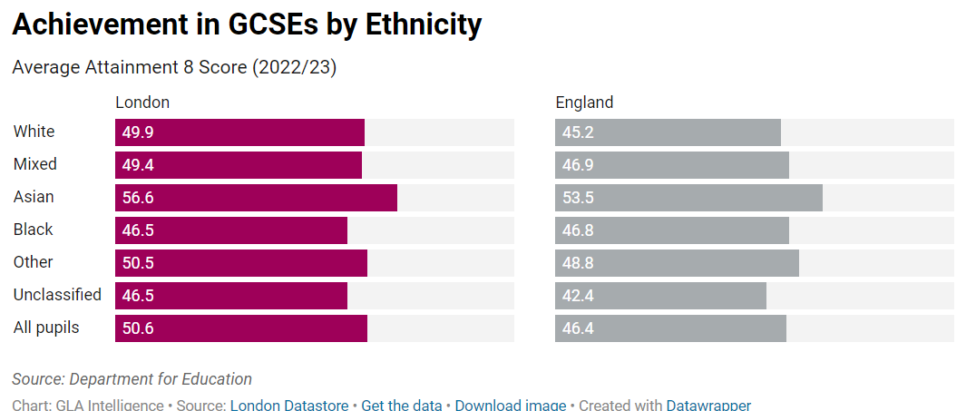
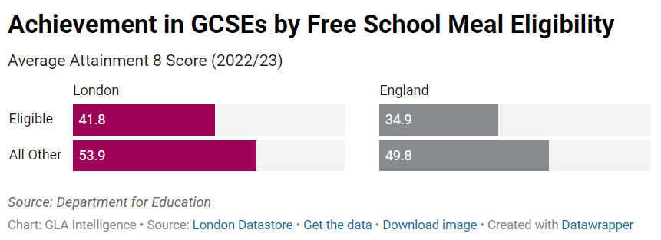
KS4 ATTAINMENT GAPS EXIST BY ETHNICITY, SPECIAL NEEDS AND FSM ELIGIBILITY STATUS
Pupils at London’s schools have higher GCSE scores than those from other English regions. The average 'Attainment 8' score, which gives a score across various core and optional elements, is more complex than the previous GCSE measures.
London pupils do better than those across England as a whole, on each element of the Attainment 8 score and across almost all attributes from ethnicity to free school meal (FSM) status.
  The exception showing in the scores from 2022/23 is that Black pupils – both boys and girls in London had slightly lower average Attainment 8 scores than Black pupils for England as a whole.
  The average Attainment 8 score in London was 50.6 in 2022/23, lower than the results given for the pandemic years (52.7 in 2021/22), but higher than in 2018/19, the last year of “normal” grading – 49.7.
Attainment gaps also exist by ethnic group, FSM eligibility, Special Educational Needs (SEN) status and disadvantage status.
Note: Due to the COVID-19 pandemic, GCSE exams were cancelled in 2020 and 2021. Pupils’ grades were determined through other methods, meaning GCSE results from 2019/20 and from 2020/21 onwards are not comparable with those from other years.
Fig 5. Achievement in Average Attainment 8 Score by Ethnicity and Free School Meal eligibility, 2022/23
Source: (1) London Datastore – KS4 Achievement

Slide 8
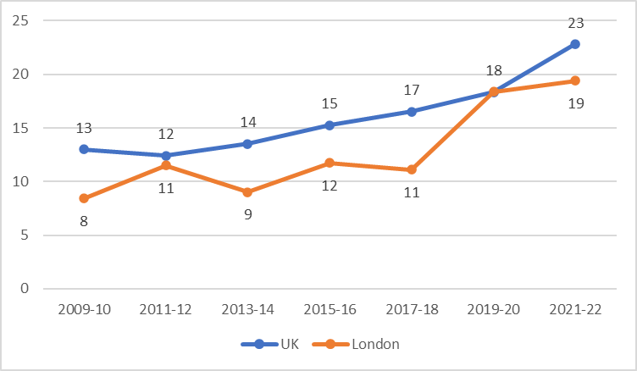
THE MENTAL HEALTH OF CHILDREN AGED 10-15 YEARS HAS DECLINED IN THE LAST DECADE
In 2009-10, 8% of Londoners aged 10-15 had a probable mental disorder, lower than across the UK (13%). The London proportion has remained below the UK proportion over the last 10 years, and in the most recent wave of the survey covering 2021-22 (partially covering the pandemic period), the proportions were 19% and 23% respectively.
Rates of probable mental disorder in this age group have increased in the last 10 years both in London and the UK.
Fig 6. Proportion of children aged 10-15 in the UK and London with a high or very high total difficulties score (18 or more) (%), 2009-22
Note: This data is from the strengths and difficulties questionnaire (SDQ) which is an emotional and behavioural screening questionnaire for children and young people.
The total difficulties score is the sum of the emotional symptoms, conduct problems, hyperactivity/inattention and peer relationships problems subscales, and ranges from 0-40
The total difficulties score results from the Understanding Society survey for 10-15-year-olds, categorised as: normal (0 to 14); slightly raised (15 to 17); high (18 to 19); and very high (20 to 40).
In 2015, ONS used the proportion of children reporting a high or very high total difficulties score (18+) as the headline measure for the prevalence of mental ill health.
Source: (1) University of Essex, Institute for Social and Economic Research. (2023). Understanding Society: Waves 1-13, 2009-2022 and Harmonised BHPS: Waves 1-18, 1991-2009. [data collection]. 18th Edition. UK Data Service. SN: 6614, DOI: http://doi.org/10.5255/UKDA-SN-6614-19.

Slide 9
CHILDREN IN CARE HAVE POORER HEALTH AND EDUCATIONAL OUTCOMES RELATIVE TO PEERS
In March 2023, 9,710 children were in care in London, 12% of the national total. There is currently limited data available on health outcomes for children in care in London.¹
London has a higher-than-average percentage of children in care who have developed a substance misuse issue.²
Looked after children can be at a higher risk of missing out on childhood vaccinations. London has the lowest percentage nationally of children in care who are up to date with the vaccinations in the NHS routine list. London is around the national average in uptake of annual health checks and dental checks for children in care.³
In 2023/24, 58.5% of looked after children in London were recorded as having Special Educational Needs, compared to 17.4% of all pupils. Looked after children with SEN were almost three times more likely to have needs related to social, emotional and mental health than all pupils with SEN (Fig. 7).⁴
In England pupils in key social care groups perform less well than their peers across all Key Stage 4 metrics. However, looked after children and children in need are much more likely to have a SEN.⁵
Fig 7. Primary special educational need (SEN) for all children and for looked after children in London with SEN (EHC plan and/or SEN support), 2023/24⁴
Source: (1) Children looked after in England including adoptions, DfE. (2) Children looked after in England including adoptions, CLA for 12 months, substance use outcomes, DfE (3) Children looked after in England including adoptions, CLA for 12 months, health outcomes, DfE (4) Children looked after with SEN, DfE and Special education needs in England, DfE. (5) Outcomes for children in need, including children looked after by local authorities in England, DfE. (5) Outcomes for children in need, DfE.

Slide 10
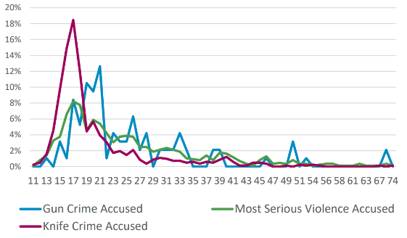
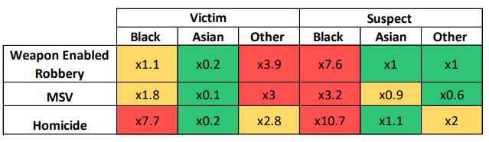
YOUTH VIOLENCE DISPROPORTIONATELY AFFECTS MALE AND BLACK YOUNG PEOPLE
While concern around youth violence in London has been rising, all types of serious violence experienced by young people are lower compared to pre-pandemic levels.¹
In 2021, rates of victimisation were highest among those aged 20-24, except for knife crime where the rate was highest for those aged 15-19 (Fig 8).²
Statistical modelling found that deprivation (living environment); area rates of risky health behaviour (indicated by rates of chlamydia); and school policy (rates of suspensions); as well as employment among young people; can predict the Boroughs with the highest rates of victimisation.²
We see disproportionality across youth violence by gender and ethnicity, for example:¹
  90% of teenage violence victims, and 94% of offenders are male.
  Black young people are almost eight times more likely to the victim of teenage homicide than White people, and the most likely of all ethnic groups to be a suspect in violent youth crime (Table 1).
Fig 8. Proportion of offenders involved in youth violence by age of offender and offence type in London, 2021²
Table 1. Disproportionality in being a victim or suspect in youth violence by ethnicity and offence type in London, 2022¹
Source: (1) MOPOC Serious Youth Violence Problem Profile (2022). (2) Understanding serious violence among young people in London – London Datastore
* MSV = Most serious violence

Slide 11
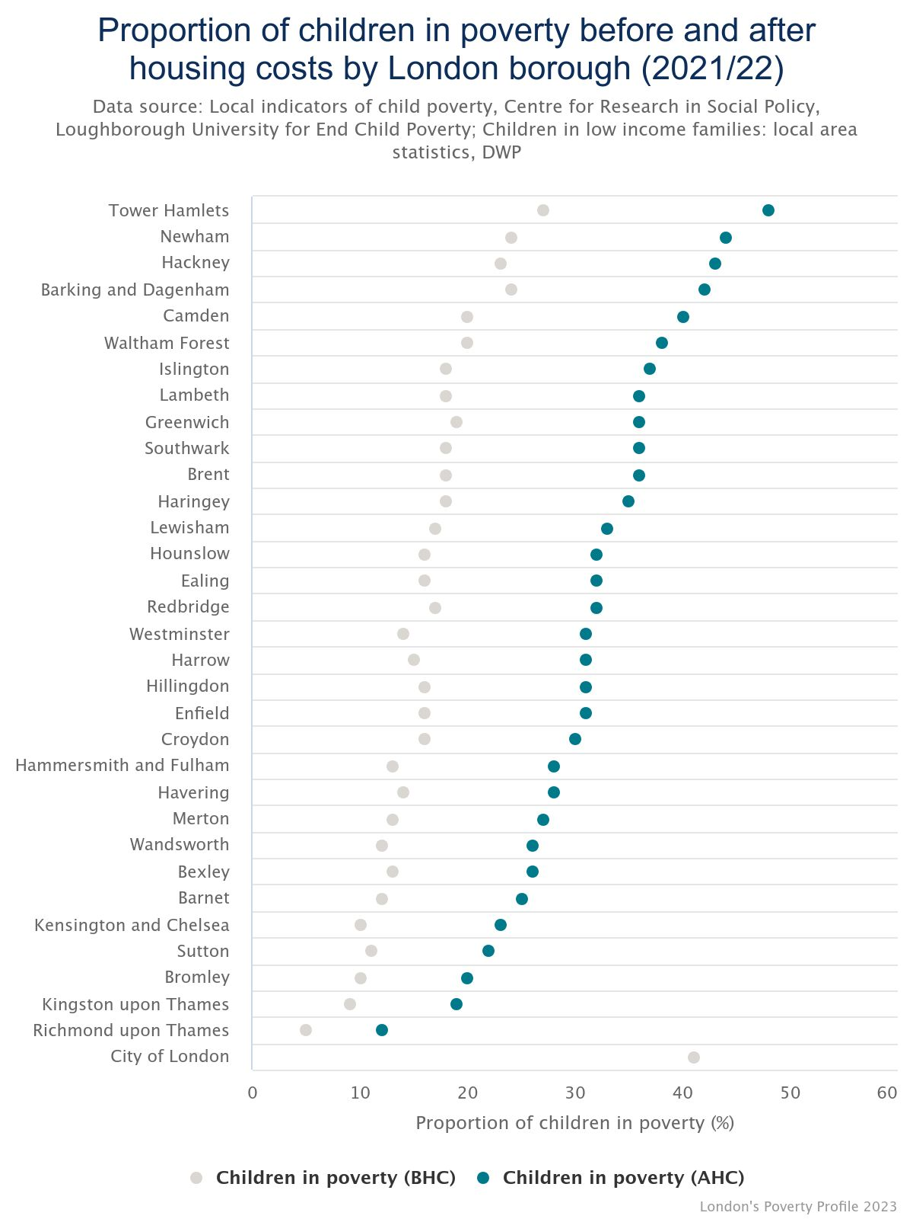
CHILDREN ARE MORE LIKELY TO BE LIVING IN POVERTY IN LONDON AND RATES ARE HIGHER THAN FOR ENGLAND
Children in London are more likely to be living in poverty than adults overall, with the latest estimate of 33% of London’s children (700,000) in poverty for 2019/20-2021/22 using the relative poverty after housing costs measure.¹
Whilst this is a substantial decrease on the previous year (38% of London’s children) and below the rates given for several other regions, it is still well above national levels (30% of children and 25% for the population as a whole).¹
Substantial variation in child poverty rates exist within London, with Tower Hamlets having the highest rate of child poverty (after housing costs). In Tower Hamlets almost half (48%) of children are growing up in poverty.²
The child poverty rate at least doubles when housing costs are accounted for in 20 of the 33 boroughs.²
*Note: The data collection used to create these poverty statistics was heavily affected by the COVID-19 pandemic. The Department for Work and Pensions (DWP), who publishes these statistics, advises caution when making comparisons with previous years and when interpreting larger changes
Figure 9: Percentage of children in poverty before and after housing costs by London borough (2020/21)
This chart was adjusted from Trust for London to add national averages
National child poverty rate
(AHC)
National poverty rate for the whole population (AHC)
Source: (1) Poverty in London 2021/22 – London Datastore, (2) Children in poverty by London borough, before and after housing costs | Trust for London

Slide 12
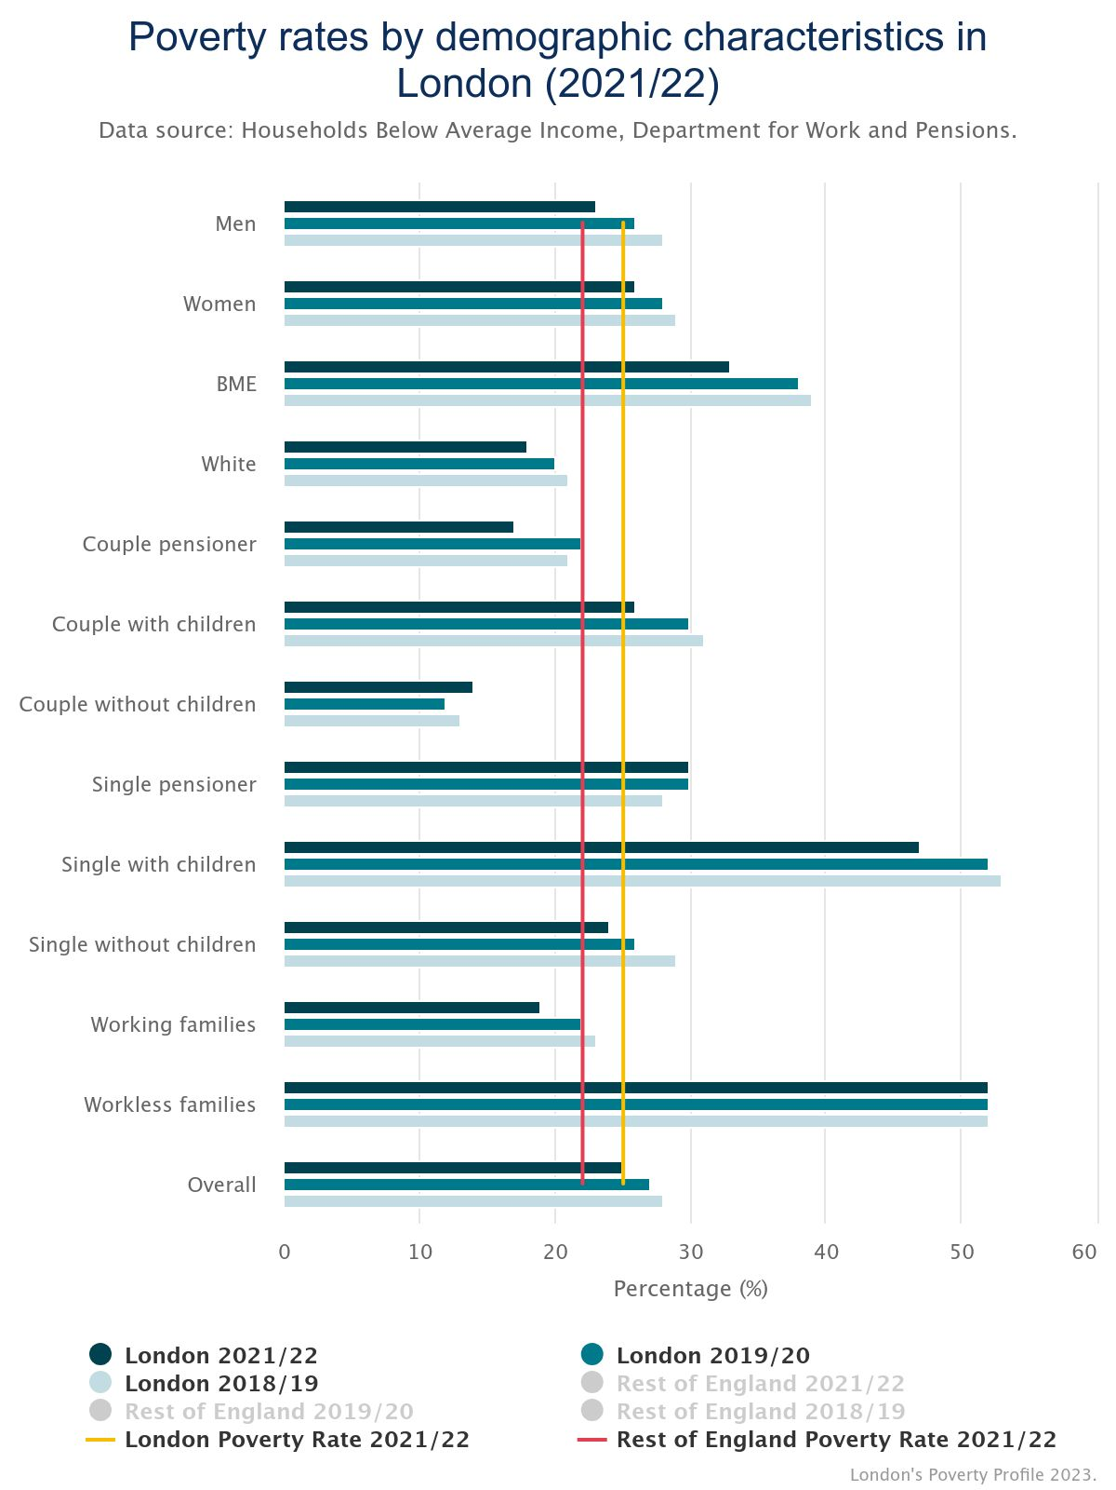
POVERTY RATES VARY SIGNIFICANTLY ACROSS DIFFERENT DEMOGRAPHIC GROUPS IN LONDON
Figure 10: Poverty rates by demographic characteristics in London (2021/22)*
The highest poverty rates are experienced by families with nobody in paid employment (52%) and households comprised of single people with children (47%)¹.
Black and minority ethnic groups are far more likely to be in poverty (33%) than White people (18%), and single pensioners also see a higher than average poverty rate at 30%¹.
All groups in London have higher poverty rates than the national average except working families, couples without children, couple pensioner and white individuals¹.
In the three years to 2021/22 Londoners who live in families that include a disabled person are more likely to be in poverty (33%) than those living in families that do not include a disabled person (22%)².
Intersectionality must also be considered because different identities are not separate, but overlapping, and these different elements an identity interact and create distinct experiences of poverty³.
*Note: Data for 2020/21 was not included in this average due to the significant impact of the COVID-19 pandemic in that year
Source: (1) Health Inequalities In London - Trust For London | Trust for London; (2) Health Inequalities In London - Trust For London | Trust for London, (3) Intersectionality Revealing the Reality of Poverty and Inequality in Scotland

Slide 13
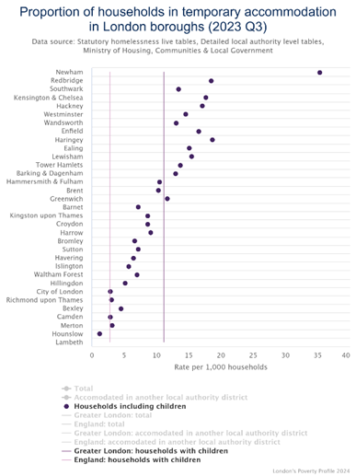
HOMELESSNESS AMONG CHILDREN & YOUNG PEOPLE IN LONDON HAS INCREASED IN RECENT YEARS
Figure 11: Proportion of households in temporary accommodation in London boroughs (2023 Q3)²
Recent research from London Councils found that 1 in 50 Londoners are homeless, including 1 in 23 children. This means that on average there is at least one homeless child in every London classroom. ¹
There were 139,000 under-18s living in temporary accommodation in England in 2023, with 82,000 of those from London. This has increased from 74,470 in 2022.³
In the last decade, the number of families being placed in temporary accommodation in a borough other than where they applied has increased by more than 100%. This often means children are placed further from their school, extended family members and friends.³
Source: (1) London Councils, 2024 (2) Poverty Profile for London 2024 - Trust For London | Trust for London (3) London’s temporary accommodation crisis – Trust for London, 2024

Slide 14
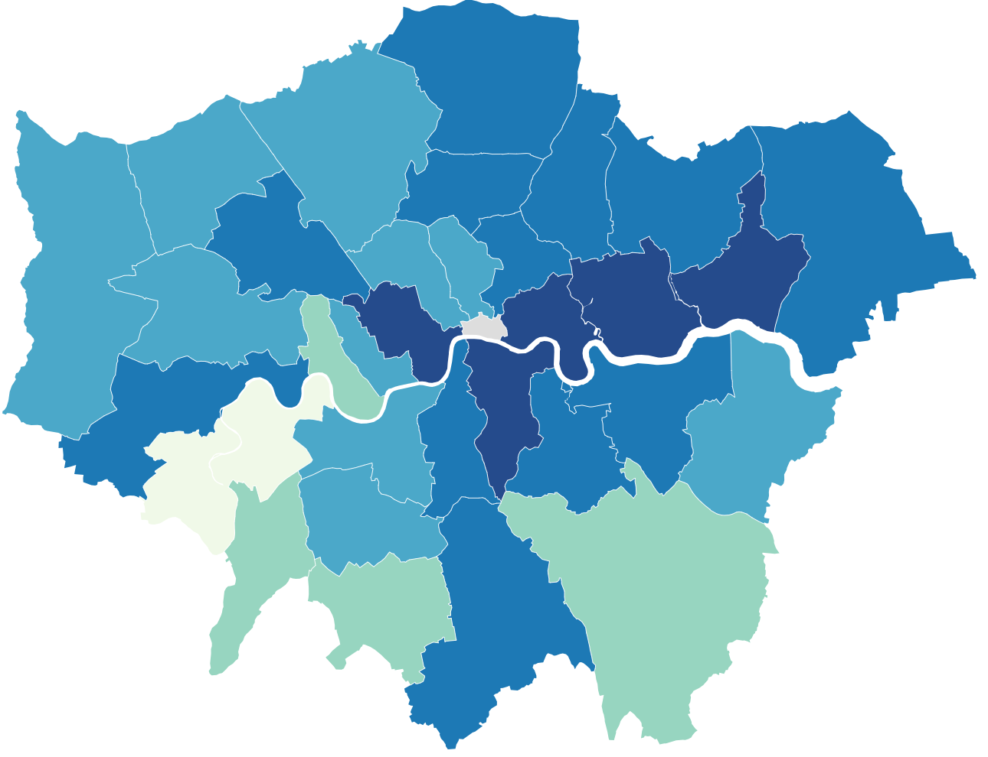
OVERWEIGHT/OBESITY IN CHILDREN IN LONDON
In 2022/23, one in five reception-age children and nearly two in five Year 6 children in London were classified as overweight or obese
Fig 12. Rate of obesity among Year 6 children by borough 2022/23 ³
Excess weight in 4-5 year olds is at a lower prevalence in London (20%) than in England (21.3%) and is lower than it was before the COVID-19 pandemic. However, prevalence varies across boroughs¹.
Excess weight in 10-11 year olds remains at a higher prevalence in London (38.8%) than England (36.6%)². This is a continuation of an increasing trend in London seen before the COVID-19 pandemic.
In London, children in the most deprived areas are more likely to be obese compared to children in the least deprived areas in both Reception (1.5 times more likely) and Year 6 (1.8 times), while the Black African group had the highest prevalence of obesity in both Reception (27.7%) and Year 6 (47.7%).^{1,2}
Across London, excess weight is increasing in 10-11 year olds, and more prevalent compared to reception age.
45.5% of Year 6 children in Newham are overweight or obese, compared to 23.3% in Richmond upon Thames³. Newham has the second highest prevalence of overweight or obesity in England.
Source: (1) OHID Fingertips - Reception: Prevalence of overweight (including obesity, 2022/23)
2) OHID Fingertips– Year 6: Prevalence of overweight (including obesity, 2022/23)

Slide 15
MMR VACCINATION COVERAGE IN LONDON
London’s MMR vaccine uptake is significantly lower than for England
and has been on a downward trend since 2015/16
Fig 14. Proportion of children aged 5, who received a reinforcing dose of DTaP/IPV and 2 doses of an MMR vaccine between the ages of 1 and 5 years in 2022/23 at London GP practices, by deprivation decile
Two doses of the Measles, Mumps and Rubella (MMR) vaccine prevents 99% of measles and rubella, and 88% of mumps infections.
The coverage of full vaccination with MMR (2 doses) in London was 74.0% in 2022/23, lower than for England (84.5%) and well below the WHO target of 95% required for herd immunity.
Coverage varies markedly across London boroughs from the lowest coverage in Hackney (56.3%) to the highest in Bromley (87%)
With the exception of the most deprived decile, there was no clear pattern in proportion of children aged 5 registered at GP practices receiving two doses of MMR in 2022/23 by deprivation level.
Research looking at vaccine coverage between 2006 and 2021 found that Black African and Caribbean children were less likely to be vaccinated with MMR, and that this disparity increased over time.
COVID-19 led to a significant decrease in the uptake of MMR in England, occurring to a lesser extent in White children relative to other ethnic groups.¹
Note:(1) The graph provides data comparing the average proportion of children at each GP practice in London receiving two doses of MMR in 2022/23 by IMD rank.
(2) The higher uptake of MMR observed in GP practices in the most deprived areas may be affected by a relatively much smaller number of patients within these practices compared to the other deciles.
Source: (1) Ethnic inequities in routine childhood vaccinations in England 2006–2021 (2) National rates and disparities in childhood vaccination during the COVID-19 pandemic
Notes:
New slide

Slide 16
END

