Slide 1
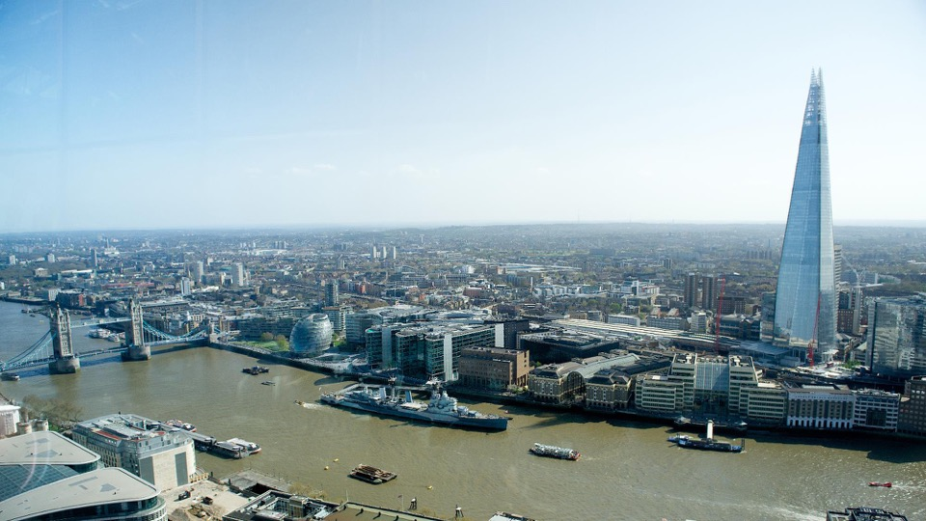



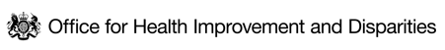


HEALTH INEQUALITIES IN LONDON
Summary Pack
HEALTH EQUITY DATA COLLABORATIVE
July 2024

Slide 2
CONTENTS
CONTEXT
Population of London at the 2021 Census
Population in inclusion health groups
BROAD INDICATORS OF HEALTH STATUS
Life expectancy at birth
Healthy life expectancy
Premature mortality
Low birthweight
Infant mortality
Effects of COVID-19 on inequalities
Persistent ethnic inequalities in health
WIDER DETERMINANTS
Persistent poverty and destitution in London
Inequalities in poverty
Housing
Air pollution
Climate risks
Addendum
19 July 2024: Figure 10 (Ethnic inequalities in the UK (Taken from NHSE Race & Health observatory)) was removed from the document due to a data error. The figure stated an incorrect number for the proportion of deaths among Black and Minority ethnic groups in England and Wales in 2019 caused by cardiovascular disease.
05 December 2024: Slide 25 stated that ‘In London, children in the most deprived areas are more than twice as likely as children in the least deprived to be obese’. This statement applied to England but not to London, so has been corrected with London data.

Slide 3
EXECUTIVE SUMMARY (1 of 5)
This report provides a snapshot of health inequalities in London based on available data sources and a shared overarching narrative that relevant partners can use in their work
An adapted version of the Kings Fund framework for measuring inequalities and the Marmot principles for addressing inequality have been used to organise this snapshot of inequalities in London into 7 parts summarised below
Part 1 – Current context
Following a temporary decline during the COVID-19 pandemic, London’s population has continued its long-term pattern of growth, mostly driven by a significant increase in international immigration.
The 2021 Census recorded a London population of 8.8 million; however, this is likely to represent the lowest point in the COVID-19 dip.
London is the youngest and most ethnically diverse region of the UK.
There are large populations of people in inclusion health groups (e.g. homeless people, asylum seekers and refugees, and Gypsy, Roma and Traveller communities) living in London. People in these groups experience greater risk of poor health and complex health challenges.
The COVID-19 pandemic exposed stark health inequalities across the city, with people from Black and minority ethnic groups, and people living in deprived areas being most at risk of exposure and death.
Part 2 – Health Inequality in Health Status
Life expectancy at birth in London was 80.3 years for males, and 84.4 for females in 2022. This represents a recovery to pre-pandemic levels, following a COVID-19 dip. Healthy life expectancy (HLE) has not changed significantly in London in recent years.
Not all London boroughs experienced a decline in life expectancy during the pandemic, and there is variation in life expectancy at birth and healthy life expectancy across boroughs. This correlates with the average level of deprivation in the borough.
Data on life expectancy by ethnic group from 2011-2014 in England and Wales showed a complex pattern. Black African people had higher life expectancy than most. Disproportionately high mortality during COVID-19 may have reversed this, but ethnic group mortality rates are converging.

Slide 4
EXECUTIVE SUMMARY (2 of 5)
Part 2 – Health Inequality in Health Status – continued.
London has a higher rate of low birthweight babies than England as a whole (3.3% vs 2.9%) and, unlike England, shows a worsening trend since 2017. Low birthweight is highest in Newham (5.1%) and lowest in Kingston-upon-Thames (2.1%), showing a correlation with deprivation although ethnicity is also likely a contributor.
Part 3 – Why Inequality exists? (Wider determinants)
Ethnic and socioeconomic inequalities in the wider determinants of health occur in London across education, income and poverty, crime, the built environment and climate. The cost of living crisis and escalating climate risks are exacerbating these inequalities.
While school readiness and Attainment 8 scores in London are higher than for England, people from Black ethnic backgrounds or those who are eligible for free school meals tend to have lower levels of achievement.
The UK has experienced a sharp rise in inflation in recent years. Despite recent decreases, and positive turns in employee real pay growth in London, a significant proportion of Londoners still struggle with the cost of living.
The wealthiest tenth of Londoners have around 9 times the income of the lowest income households, with London having a greater income disparity than the rest of the UK.
A quarter of Londoners now live in relative poverty, and a fifth in absolute poverty, after housing costs. This is higher than the UK rate. Child poverty in London is also significant, with 32% of children living in poverty after housing costs as of 2020/21-2022/23.
Approximately 9% of London households are overcrowded, and Asian and Black people are more likely to live in overcrowded conditions or homes that fail to meet the Decent Homes Standard. The unaffordability of housing has reached a record high, with significant disparities affecting Black and ethnic minority households.
Violent crime in London is disproportionately concentrated in deprived areas, with significant local variations, and disproportionately affects specific socio-demographic groups, including young Black men, men in general (except for domestic violence where women are more affected), and people with disabilities.

Slide 5
EXECUTIVE SUMMARY (3 of 5)
Part 3 – Why Inequality exists? (Wider determinants) – continued.
London had the highest percentage of deaths attributable to particulate air pollution among English regions in 2022, with a noticeable decline from previous years. Air pollution exposure disproportionately affects deprived and minority ethnic groups.
As London responds to the climate emergency, climate risks are found to disproportionately affect the most deprived and disadvantaged individuals who are both more exposed and more vulnerable to their impacts, with reduced capacity to adapt. Specific at-risk groups include homeless people, people in non-decent housing, outdoor workers, and those with fewer financial resources.
Part 4 – Health behavioural risk factors
Tobacco use, high BMI, and poor diet were the top risk factors driving death and disability in London in 2019.
Smoking prevalence in London in 2022 was 11.7%, part of a continuing long-term decline from 2012. There is significant variation across boroughs, from 6.2% in Kingston up to 16.3% in Hounslow. Higher rates are observed in routine and manual occupations as well as among adults with a long-term mental health condition.
The proportion of overweight or obese adults in London in 2022/23 was 57.2%, lower than the national average of 64.0%, yet with significant variations across boroughs and no overall improvement over time.
In 2022/23, over one third of Year 6 children in London were classified as overweight or obese, continuing an increasing trend seen before the COVID-19 pandemic, with higher rates in the most deprived areas and among Black African children.
In 2022/23, 66.3% of London adults were physically active, below the England average of 67.1%. Physical inactivity was higher among those in routine/semi-routine jobs and long-term unemployment, people with a disability, and Black and Asian ethnic groups.
In London, a quarter of people over 16 were ‘increasing or higher risk’ drinkers in 2021, exceeding the national rate. Highest consumption was in less deprived areas, but more alcohol-related hospital admissions occurred in poorer areas.
Drug-related death rates between 2018-2020 were lower than the national average but varied across the city.

Slide 6
EXECUTIVE SUMMARY (4 of 5)
Part 5 – Death and Illness in London
London saw a decrease in all cause premature mortality from 2021 to 2022, returning to pre-pandemic levels. However, latest estimates show rates nearly three times higher in the most deprived areas compared to the least.
Most major causes of death were more common in people from the most versus least deprived deciles, with COVID-19, heart disease and lung cancer contributing most significantly to the gap.
People aged 65-80 years from the most deprived backgrounds are more likely to be diagnosed with hypertension, diabetes and coronary heart disease than those in the least deprived decile. Black and South Asian groups in this age category are also more likely to have hypertension and diabetes, while those from Asian backgrounds have a higher prevalence of coronary heart disease, compared to those from White backgrounds.
One in four adults (aged 16+) show signs of poor mental health, a slight decrease from a pandemic peak. This particularly affects younger adults, a trend mirrored by a decade-long rise in mental health issues in children aged 10-15, in London and the UK.
Infant mortality in London is lower than England at 3.6 per 1,000 live births but shows a continuing gradual increase since 2014-16. Deprivation is found to be a predictor of infant mortality at the national level, a trend also represented at the London borough level.
Part 6 – Healthcare Inequalities in London
Healthcare spending on emergency versus elective care is relatively higher in deprived areas, suggesting a reactive approach to health issues prevalent in these regions.
Vaccination uptake for influenza and COVID-19 is lower in deprived areas and among certain ethnic groups, including people who are of Black Caribbean or African, Mixed, Bangladeshi or Pakistani ethnicity. With a resurgence of childhood infectious diseases affecting London, there are also inequalities in uptake of childhood vaccines by deprivation and ethnic groups.
Screening for breast and bowel cancers shows a marked linear decrease in uptake with increasing deprivation.

Slide 7
EXECUTIVE SUMMARY (5 of 5)
Part 6 – Continued
Management of hypertension and diabetes, measured by patients achieving treatment targets at individual GP practices, shows a declining trend with increasing deprivation.
However, NHS Health Checks are more likely to be taken up by people in more deprived areas and by people from Black, Asian and Other ethnicities, offering an opportunity to promote health in people known to be at significant disadvantage.
Part 7 - Conclusion
This report highlights a continuing story of inequalities in health by deprivation and ethnicity, from the upstream wider determinants to the ultimate outcomes such as disease and mortality.
Still recovering from the impacts of the COVID-19 pandemic, London has been faced with new threats to health including a long-spanning cost of living crisis that, alongside shifts in the housing market, is driving more Londoners into financial difficulties and poverty. The advance of climate change and the unique risks posed by changing weather patterns and the frequency of environmental disasters is also an emerging issue. Due to the disproportionate impact of these threats onto already disadvantaged groups, these trends are likely to contribute to widening health inequalities over time.
Given the complex intersection of environment, social factors, health behaviours and health status, tackling health inequalities will require joined-up working and partnerships, such as through implementing and advocating for a ‘Health in All Policies’ approach.
The data available does not currently allow us to capture a full picture of health inequalities in London. Efforts to improve systematic and consistent collection, recording and coding of data relating to geography, across all protected characteristics, and of key inclusion health groups should remain a priority to provide more effective intelligence.
Partnership action could be used to identify means of accessing more novel and timely data, more integrated and linked datasets between heath and care and wider determinants. This would enable more targeted, evidence-based strategies.

Slide 8
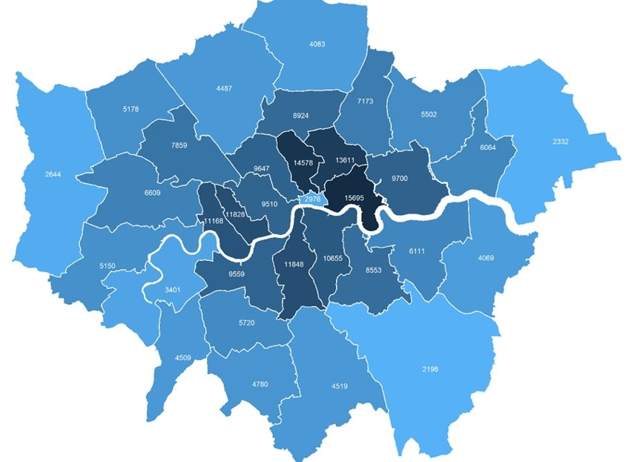

LONDON’S 2021 CENSUS DAY POPULATION WAS 8.8 MILLION, LOWER THAN 2020 OR 2022
The census population estimate of 8.8 million was likely to be close to a low point in London’s population, brought about by a temporary dip during the COVID-19 pandemic.
We know the pandemic caused some outflow of families and young adults from London and a virtual halt in international movements. We don’t know how far COVID affected the census responses that were recorded.
Key Census statistics
41% of Londoners were born outside UK (Rest of England 13%), and 46% were of Asian, Black, Mixed or Other ethnicities
50% of Londoners were aged 35 or under (Rest of England 43%) and 12% were aged 65 or over (Rest of England 20%)
4.2% of Londoners aged 16 or over identified as LGB+ and 0.9% said their gender identity differed from their sex at birth
12% of London’s working-age (aged 18-66) population reported they were disabled (Rest of England 17%) and 3.9% reported bad or very bad health (Rest of England 4.8%)
Fig 1. Population Density (persons per km²) by London Borough, 2021 Census
Source: England and Wales Census 2021

Slide 9
LONDON HAS LARGE POPULATIONS IN INCLUSION HEALTH GROUPS WHO ARE LIKELY TO HAVE UNIQUE HEALTH CHALLENGES
Homeless People 31,620 households in London were owed a statutory relief duty due to homelessness in 2022-23, up 11% from 2021-22.¹ Through 2022-23, 10,053 people were seen rough sleeping in London by outreach workers, up 21% from 8,329 in 2021/22, but down 9% from 2020/21.² Around 858 people were estimated to be sleeping rough in London on a single night in autumn 2022, a 34% increase from 2021.¹ These statistics provide an indication but do not capture the entire homeless population, including people living in temporary accommodation, sofa surfing and in other forms of insecure housing who have not been assessed as owed a duty​. Around 41% of homeless people have a long-term physical health and 45% a diagnosed mental health condition compared to 28% and 25% of the general population respectively.⁴
Asylum Seekers and Refugees, and Irregular Migrants Estimates suggest there were 397,000 undocumented adults and children living in London in 2017, approximately half the estimated UK-wide population at the time.​⁴ There were 25,160 supported asylum seekers in London in June 2023, with the majority in contingency hotels. London hosts one in five (21%) of the total UK asylum seeker population.⁵ Common health challenges prevalent in this group include untreated communicable diseases, poorly controlled chronic conditions, maternity care, mental health and specialist support needs.⁶
Gypsy, Roma and Travellers There were 44,580 Gypsy, Roma and Irish Travellers living in London at the 2021 Census, 0.5% of London’s total population.⁷ Studies have reported higher prevalence of long-term illness including diabetes, anxiety and depression and worse birth outcomes and maternal health in this group.⁸
Source: (1) Homelessness Statistics (2) London Datastore - CHAIN Reports (3) Local Government Association (4) Migration Observatory (5) House of Commons Library (6) Unique health challenges for refugees and asylum seekers (7) Census 2021 (Nomis) (8) Aspinall Report

Slide 10
LIFE EXPECTANCY AT BIRTH HAS NOT YET RECOVERED FROM A COVID-19 DIP
In 2022, the three-year average life expectancy at birth in London was 79.1 years for males, and 83.6 years for females.
Life expectancy at birth in London has been consistently higher than for England for both sexes, although the gap is narrowing for males.
From a peak of 80.4 years for males and 84.4 years for females in 2017-19, life expectancy at birth decreased significantly for both sexes in the subsequent years, mostly due to the impact of the COVID-19 pandemic.
The three-year moving average of life expectancy at birth has not yet recovered to previous highs following the pandemic.
Some boroughs in London did not experience significant declines in life expectancy during COVID-19 and have had a relatively stable life expectancy for both males and females in recent years.
Fig 2. Trend in life expectancy at birth (3 year rolling average), London and England, by sex, 2015 - 2022
Source: OHID PHOF Indicators
Notes:
Updated with new data. Replaced single year life expectancy with 3 year rolling average because only this is comparable with previous years.

Slide 11
LIFE EXPECTANCY AT BIRTH VARIES SIGNIFICANTLY ACROSS LONDON BOROUGHS
Between 2020-2022, there were significant differences in life expectancy at birth across London boroughs¹. The range for each gender was:
Males: 76.3 years in Barking and Dagenham to 82.4 years in Richmond-upon-Thames
Females: 80.4 years in Barking and Dagenham to 86.3 years in Kensington and Chelsea
Variation in the life expectancy at birth correlates with 2019 Indices of Multiple Deprivation Scores at the London borough level (Fig. 3), reflecting a common pattern seen across England².
Fig 3. Life expectancy at birth by deprivation for London boroughs, 2020-2022
Kensington & Chelsea
Richmond
Barking & Dagenham
Richmond
Barking & Dagenham
Source: OHID PHOF Indicators (2) ONS: Health state life expectancies by national deprivation deciles, England: 2018 to 2020

Slide 12
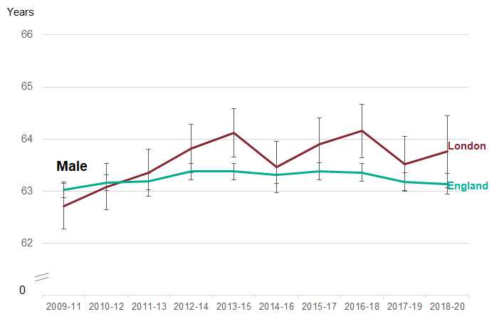
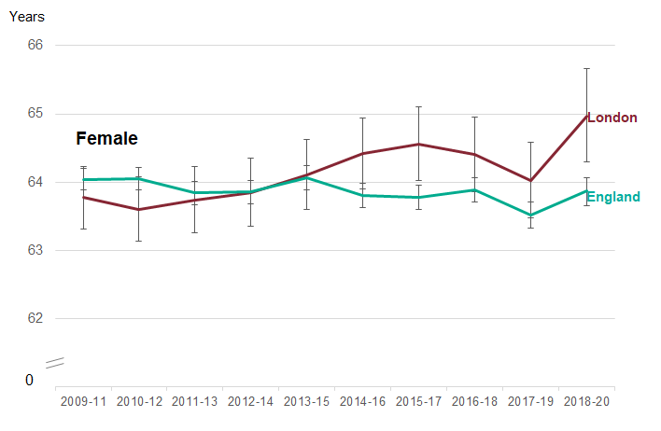
HEALTHY LIFE EXPECTANCY IN LONDON
Not updated from 2022
Data on this slide should be interpreted with caution. It is based on population estimates extrapolated from the 2011 Census. These were notably different from the population measured at the 2021 Census.
Healthy life expectancy provides an estimate of lifetime spent in 'very good' or 'good' health, based on how individuals perceive their general health
Between 2018-20, healthy life expectancy at birth for males in London was in line with England at 63.8 years, whereas it was above the national average for females at 65.0 years
Fig 4. Trend in healthy life expectancy at birth, by sex, London compared to England, 2009-11 to 2018-20
Note: The most recent data is based on 3-year figures which includes one year of pandemic data and will not entirely reflect the impact of the pandemic
Source: PHE Public Health Outcomes Framework - Healthy life expectancy at birth
Notes:
Update not possible – data is most recent

Slide 13
HEALTHY LIFE EXPECTANCY VARIES SIGNIFICANTLY ACROSS LONDON BOROUGHS
Data on this slide should be interpreted with caution. It is based on population estimates extrapolated from the 2011 Census. These were notably different from the population measured at the 2021 Census.
Between 2018-2020, there were significant differences in healthy life expectancy across London boroughs. The range for each gender was:
Males: 58.1 years in Barking and Dagenham to 70.2 years in Richmond upon Thames
Females: 57.8 years in Tower Hamlets to 70.1 years in Wandsworth
More deprived boroughs tended to have a lower healthy life expectancy for both males and females (Fig. 5).
Note: Healthy life expectancy is defined in the OHID Fingertips Public Health Outcomes Framework (PHOF) as 'A measure of the average number of years a person would expect to live in good health based on contemporary mortality rates and prevalence of self-reported good health. The prevalence of good health is derived from responses to a survey question on general health’
Fig 5. Healthy life expectancy at birth by deprivation for London boroughs, 2018-2020
Richmond
Wandsworth
Tower Hamlets
Barking & Dagenham
Source: PHE Public Health Outcomes Framework - Healthy life expectancy at birth
Notes:
Update not possible – data is most recent

Slide 14
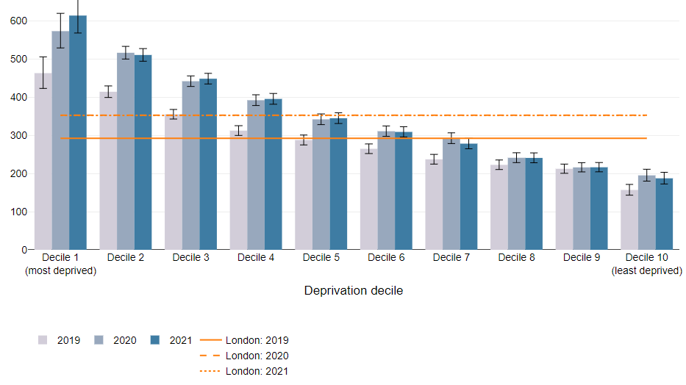
PREMATURE MORTALITY WAS THREE TIMES HIGHER IN THE MOST VS LEAST DEPRIVED DECILE
Premature mortality refers to the age-standardised rate of deaths per 100,000 people aged under 75 years.^{1,2}
All-cause premature mortality in London decreased by 13.8% from 2021 to 2022, representing a return to pre COVID-19 pandemic levels:
  Men have a higher premature mortality rate than women (391.7 per 100,000 vs 234 per 100,000) but also experienced the steepest decline post-pandemic (14.6% for males and 12.7% for females).
The most recent data on inequalities by deprivation are from 2021. In this data, higher rates of premature mortality were seen in the most deprived deciles (as seen in Fig. 6).¹
  The premature mortality rate in the most deprived decile between 2019-21 was consistently nearly three times that of the least deprived decile.
Under 75 mortality rates from all causes considered preventable* were better for London than the England average.²
  This includes for circulatory disease, cancer, liver and respiratory diseases considered preventable*
Fig 6. Premature mortality rates (Age standardised mortality rates for under 75 per 100,000), by deprivation decile for London, 2019-21
*Preventable mortality: Deaths are considered preventable if, in light of the understanding of the determinants of health at the time of death, all or most deaths from the underlying cause could mainly be avoided through public health and primary prevention.
Source: (1) Figure 7b, Health Profile for London, 2021 (2) Fingertips - Mortality profile
Notes:
Partially updated – unable to update further due to no further data on inequalities

Slide 15
LOW BIRTHWEIGHT IN LONDON CORRELATES WITH BOROUGH LEVEL DEPRIVATION
Low birthweight (weight less than 2,500 grams) is associated with an increased risk of infant mortality, developmental problems in childhood and poorer health in later life.¹
In 2021, 3.3% of babies born at term had low birthweight, which is higher than the England average (2.9%). Unlike England, which shows a stable rate, this represents part of a continuing worsening trend since 2017.¹
The proportion of low birthweight babies varies significantly by borough. As of 2021:¹
  The range in proportion went from 2.1% in Kingston upon Thames to 5.1% in Newham
  Newham (5.1%) and Tower Hamlets (4.3%) rank in the top five local authorities in England for highest proportion of low birthweight babies.
  The proportion of low birthweight babies in London boroughs correlates with the average deprivation level of that borough (Fig 7).
Note: Low birthweight is more common in some Black, Asian and minority ethnic groups. For example, Indian, Pakistani and Bangladeshi infants are 280–350 g lighter, and 2.5 times more likely to be low birthweight compared with White infants due likely to a combination of genetic and social determinants.² These population groups are more prevalent in London and unequally distributed across London boroughs.
Fig 7. Percentage of low birthweight babies at term by deprivation for local authorities in London, 2021
Newham
Barking & Dagenham
Richmond
Kingston
Source: (1) Child and Maternal Health – Low Birthweight (2) Kelly et al

Slide 16
INFANT MORTALITY CORRELATES WITH AREA DEPRIVATION AT LONDON AND NATIONAL LEVELS
In 2020-22, infant mortality was 3.6 per 1,000 live births and lower than the England average (4.0 per 1000) with a gradual increase being seen since 2014-16.
Fig 8. Infant mortality rate per 1,000 live births by deprivation score by local authority in London, 2020-22
The infant mortality rate (IMR) is the number of deaths under the age of one year per 1,000 live births. Most infant deaths occur during the first month, most commonly due to immaturity related conditions in babies born preterm (< 37 weeks gestation) and congenital anomalies¹.
Around 7 babies died per week in London in 2020-22, many from preventable causes. There is significant variation across boroughs:
  Greenwich is the only London borough with a significantly higher infant mortality rate than London (4.8 per 1,000).
  Wandsworth is the only borough where it is significantly lower than average (1.9 per 1,000).
The rate has increased in London from 3.2 per 1,000 in 2014-16
Nationally data shows the rate of infant mortality increases as deprivation increases, from 6.2 per 1,000 in the most deprived decile, to 2.9 per 1,000 in the least deprived. This trend is apparent at the London borough level (Fig 8).
Between 2017-19, the rate of stillbirths and infant deaths in England and Wales was highest for Black children, and higher for Asian children, relative to children of White ethnicity². This may be partially explained by children from minority ethnic groups disproportionately being born in more deprived areas.
Greenwich
London avg.
Wandsworth
Note: Infant mortality rates are presented as a three-year rolling average to smooth out variation.
Source: (1) OHID Public health profiles – infant mortality rate (2) ONS

Slide 17
PRE-EXISTING ETHNIC HEALTH INEQUALITIES WERE EXACERBATED DURING COVID-19
The most recent official data for life expectancy by ethnicity in England and Wales are from 2011-14 (based on follow-up of the 2011 Census).
This showed complex inequalities in life expectancy and cause-specific mortality for different ethnic groups in England and Wales.¹
White and Mixed ethnic groups had lower life expectancy at birth than all other ethnic groups, while the Black African group had a higher life expectancy than most groups.
Mortality rates were significantly higher for minority ethnic groups during the pandemic, suggesting that any previous life expectancy advantages were moderated during that time¹.
Monthly mortality data by ethnic group for England up to January 2023 (Fig. 9) shows that inequalities have since reduced. In January 2023, Black people had a lower mortality rate than White people.
Fig 9. Age-standardised monthly mortality rates per 100,000 person-years in England by ethnic group, March 2020 to January 2023
Source: (1) ONS Ethnic Difference in Life Expectancy (2) COVID-19: review of disparities in risks and outcomes (3) OHID CHIME Tool

Slide 18
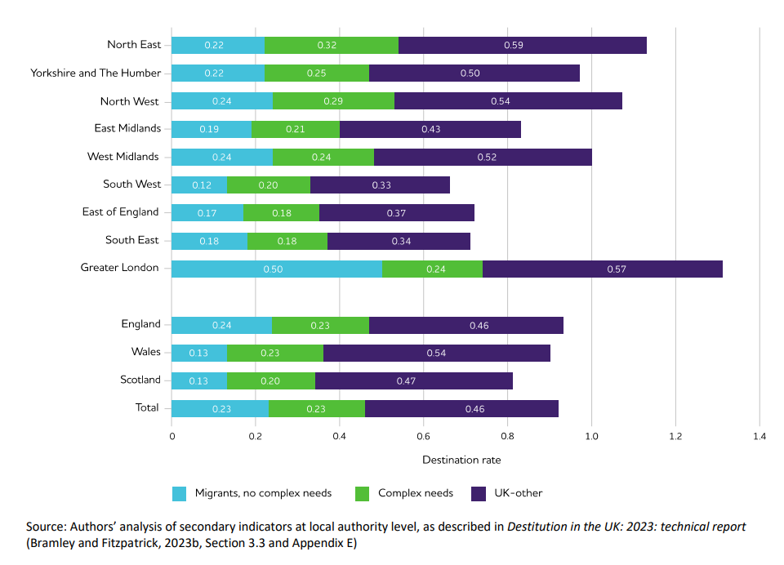
LONDONERS EXPERIENCE HIGHER RATES OF PERSISTENT POVERTY AND DESTITUTION COMPARED TO THE UK
Persistent poverty refers to being in poverty in the current year and at least two of the three preceding years. It is a particularly important issue for health, because prolonged periods of poverty have cumulative effects.¹
  Around one in six (16%) of all Londoners live in households in persistent poverty (after housing costs), and rates are consistently higher in London compared to the UK at 12%.²
The Joseph Rowntree Foundation has investigated the scale of destitution, which is where people cannot afford to meet their most basic physical needs to stay warm, dry, clean and fed. This most extreme form of material hardship impacts on heath, mental health and people’s prospects.³
  London had the highest overall destitution score in 2022, replacing the North East as the region with the highest destitution rates since 2019.
  This higher rate of destitution in London was driven by relatively high levels of destitution in both migrant populations and other Londoners without complex needs (i.e. not experiencing two or more of homelessness, drug and/or alcohol problems, offending, domestic violence or begging)
Figure 11: Destitution rates estimated from secondary indicators, by region or country and by analytical subgroup % of households, weekly basis, 2022
Destitution rate
Source: (1) Inequalities in persistent poverty - The Health Foundation, (2) Economic Fairness – Persistent Poverty – London Datastore, (3) Destitution in the UK 2023 | Joseph Rowntree Foundation (jrf.org.uk)

Slide 19
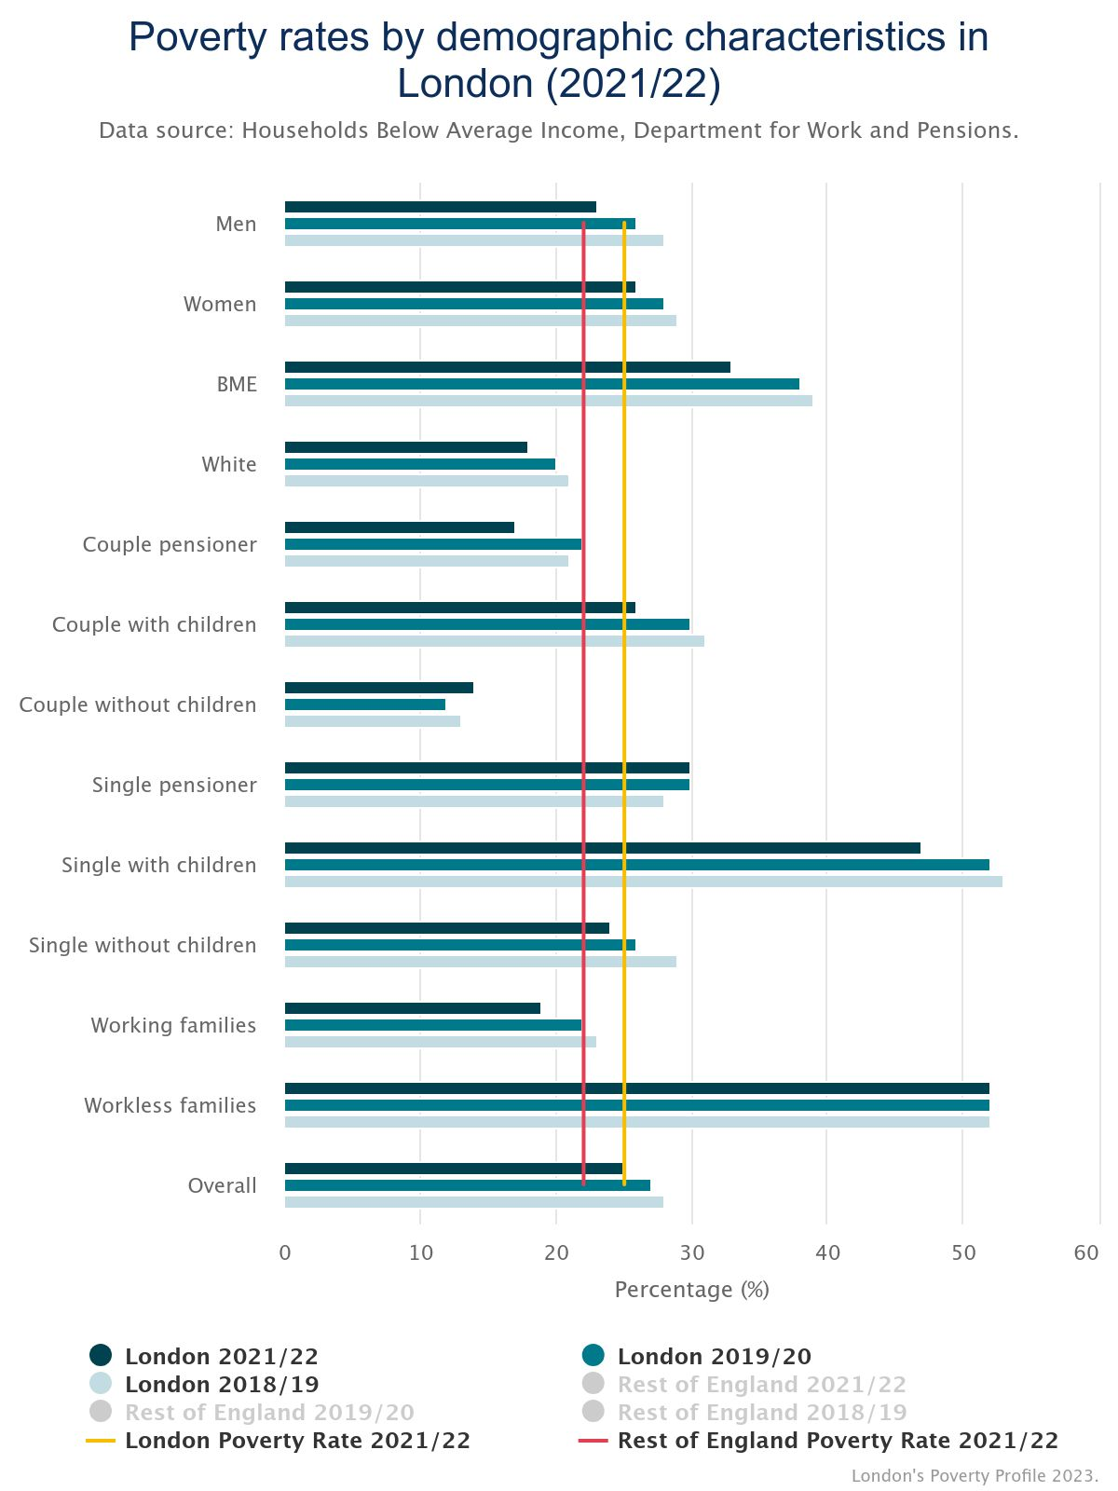
POVERTY RATES VARY SIGNIFICANTLY ACROSS DIFFERENT DEMOGRAPHIC GROUPS IN LONDON
The highest poverty rates are experienced by workless families (52%) and households comprised of single people with children (47%)¹.
Black and minority ethnic groups are far more likely to be in poverty (33%) than White people (18%), and single pensioners also see a higher than average poverty rate at 30%.¹
All groups in London have higher poverty rates than the national average except working families, couples without children, couple pensioner and White individuals.¹
In the three years to 2021/22* Londoners who live in families that include a disabled person are more likely to be in poverty (33%) than those living in families that do not include a disabled person (22%).²
Intersectionality must also be considered because different identities are not separate, but overlapping, and these different elements of identity interact and create distinct experiences of poverty.³
*Note: Data for 2020/21 was not included in this average due to the significant impact of the COVID-19 pandemic in that year
Figure 24: Poverty rates by demographic characteristics in London (2021/22)
Source: (1) Health Inequalities In London - Trust For London | Trust for London; (2) Health Inequalities In London - Trust For London | Trust for London, (3) Intersectionality Revealing the Reality of Poverty and Inequality in Scotland

Slide 20
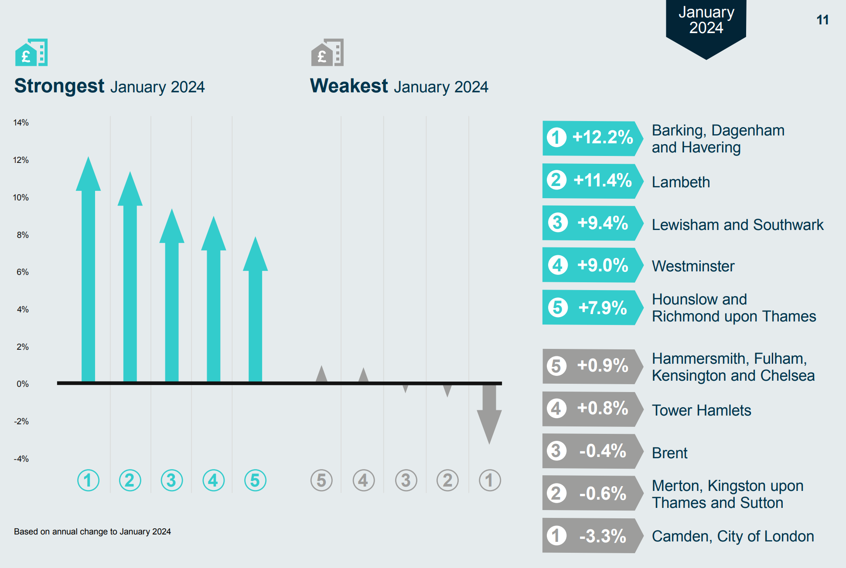
OVERCROWDING, QUALITY AND AFFORDABILITY OF HOUSING AFFECTS LONDONERS UNEQUALLY
Around 9% of households in London are overcrowded (defined as lacking one or more bedrooms compared to estimated need). ¹
  Londoners from Black, Asian and other minority groups are around twice as likely to live in overcrowded conditions as White.
1.6% of all households (57,150) were assessed as owed a homelessness duty in London in 2022-23.¹
  This varies enormously by ethnicity, with the highest rates of homelessness experienced by Black and Mixed Londoners.
  Around 40% (22,740) of households owed a homelessness duty in 2022-23 had dependent children.²
An estimated 9% of homes in London fell below the official Decent Homes Standard in 2021, ranging from 6% of owner-occupied homes to 14% of private rented homes. ¹
  Londoners of Asian ethnicity are more likely to live in homes that fail to meet the Decent Homes Standard, while Black Londoners are more likely to have damp problems.
Average rents for new private tenancies have risen sharply over the past two years, and the affordability burden in London reached a record high in January 2024, according to data from the Homelet Rental Index.
  Black and ethnic minority households in privately rented homes in London spend a significantly higher average proportion of their household incomes on rent, than their White counterparts
Fig 13. Change in average rents for new tenancies in inner London, year to January 2024
Source: (1) London Datastore - Housing in London

Slide 21
DEPRIVED AND MINORITY ETHNIC GROUPS FACE DISPROPORTIONATE AIR POLLUTION EXPOSURE
London had the highest percentage of deaths attributable to particulate air pollution (7.1%) of all English regions in 2022, but the proportion has continued to reduce from 9.0% in 2018.¹
  Of the 25 upper tier local authorities in England with the highest proportion (%) of deaths attributable to air pollution in 2022, 22 were London boroughs.¹
  Average concentrations of PM2.5 in London have shown a decreasing trend since 2018 (from 12.3μg/m3 to 8.7 μg/m3).²
Air pollution is worse in more deprived areas of London ³
  NO² concentrations range 4.4µg/m3 in a linear trend from most to least deprived areas, while PM2.5 concentrations range 0.7µg/m3.
White and Asian people are least likely to be exposed air pollution in London:
  In 2019, Black people and people from ‘Other’ ethnicities were more often living in the 30% most air polluted areas of London than would be expected from their population; 7.1% more likely for Black people and 33.3% more likely for ‘Other’ ethnicities.³
  Meanwhile, White and Asian people were 3.7% and 9.5% underrepresented in the most air polluted areas in 2019.
  Projections to 2030, based on modelling of air pollution concentration and population, show a continuing advantage for White people relative to other ethnic groups.
Fig 14. Over- or under-representation of ethnic groups living in the 30% most polluted OAs relative to their 2019 and 2030 London-wide populations³
Source: (1) OHID Fingertips- Fraction of mortality attributable to particulate air pollution (2) Health Profile for London 2021 (3) GLA air quality exposure and inequalities study

Slide 22
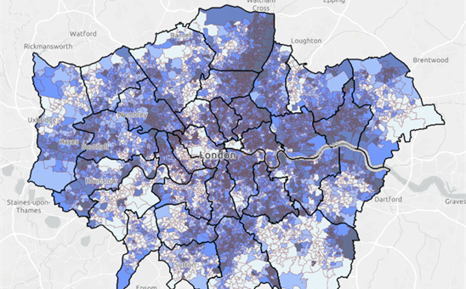
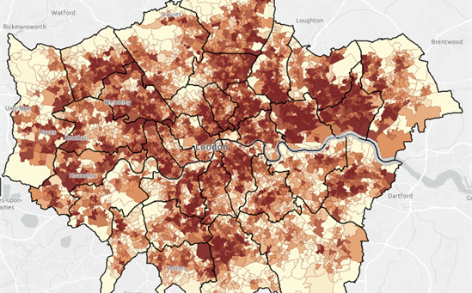
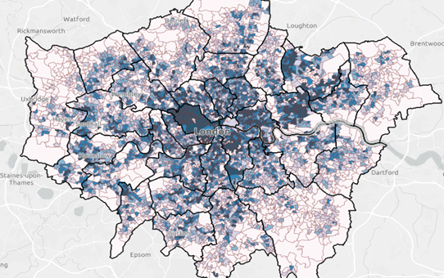
INEQUALITIES IN EXPOSURE TO CLIMATE RISKS
Fig 15. Geographical distribution of deprivation, surface temperature and flood risk across London
Income deprivation
Land surface temperature
Flood risk
Source: Bloomberg cliamte risk maps, based on data from English Indices of Multiple Deprivation (MHCLG), 2015.
Source: Bloomberg climate risk maps, based on data from ARTI analytics BV, 2016-2020.
Source: Bloomberg climate risk maps, based on data from Environment Agency, 2013.
People living in the most deprived areas, people from ethnic minority communities, and people already experiencing disadvantage are more likely to be exposed to high temperatures, cold temperatures, flooding, and food and water insecurity.¹
Socio-environmental risk factors include housing conditions, the built environment, work and financial insecurity.²
Those who are homeless, who live in non-decent housing and / or experience fuel poverty are more likely to be exposed to extreme temperatures.³​
People living in more deprived areas have less access to green and blue space for cooling, flood resilience and other ecosystem services.^{4​}
Those who work in manual jobs or spend the majority of the day working outdoors are more likely to be exposed to extreme temperatures and vector-borne diseases.^{5​}
Climate and ecological change are key risks for future food availability and prices, those on lower incomes will be disproportionately exposed to these shocks.⁶
Source: (1) Sheng et al. (2) Environment Agency (3) Taylor et al (4) Bloomberg Associates (5) CDC (6) NatCen Social Research

Slide 23
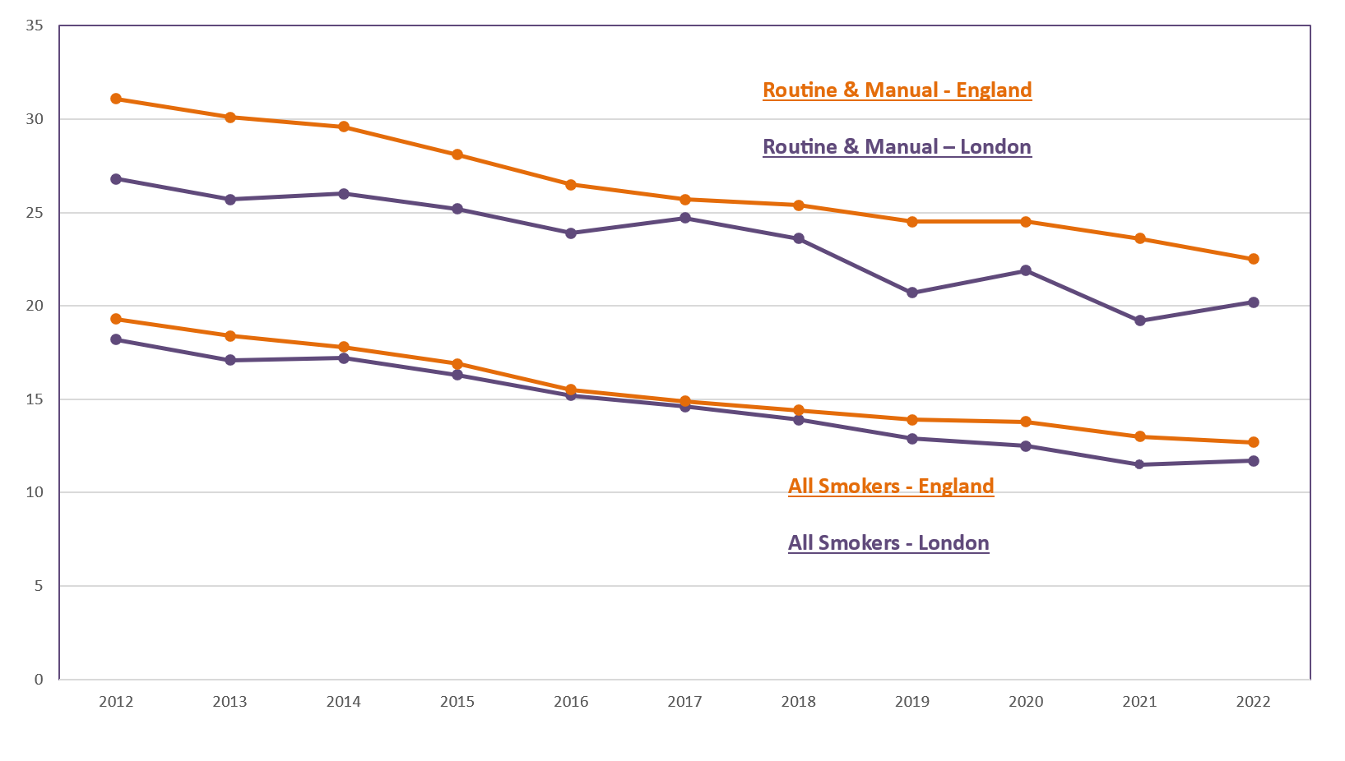
SMOKING PREVALENCE IN LONDON
Smoking prevalence is 11.7% in London, but significant inequalities remain with rates higher in deprived areas, in those with mental illness and routine and manual occupations
Smoking tobacco remains London’s leading cause of premature death, killing 8,000 people per year​.¹
In 2022, the adult smoking prevalence from the APS was 11.7% - a 0.6% increase from the 2020 data.² However, as the 2020 data was collected only via a telephone survey due to COVID-19 (not face to face interviews as well) concerns were raised that this figure may have been an under-estimate
Smoking prevalence ranged from 6.2% in Kingston to 16.3% in Hounslow, in 2022.²
In 2022 prevalence in routine and manual occupations (aged 18-64 years) was 20.2% ², more than twice that of managerial and professional occupations (8.4%).²
Data from the GP Patient Survey (GPPS) shows that smoking prevalence is higher in adults (18+) with a long-term mental health condition in London (27.2%) in 2021/22, compared to 14.9% in the general adult population.²
Smoking during pregnancy is the leading modifiable risk factor for poor birth outcomes​. In 2022/23, 4.6% of women were smoking at the time of delivery in London, representing a continuing decreasing trend (vs 8.8% of women in England).²
Fig 16. Trend in smoking prevalence (%) by current smokers and by those in routine and manual occupations, ages 18+, London & England, 2012-2022
Source: (1) London Vision -Tobacco-control-and-reducing-smoking (2) Local Tobacco Control Profiles

Slide 24
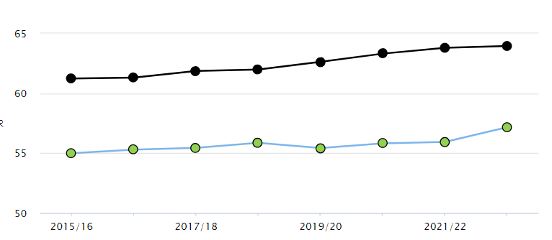

OVERWEIGHT/OBESITY IN ADULTS IN LONDON
In 2022/23 57.2% of adults (18+) in London were classified as overweight or obese. This is significantly lower than the national average of 64.0% but shows no improvement over time and there is wide variation across London local authorities¹.
Barking & Dagenham (70.5%) had the highest proportion of overweight or obese adults and Kensington & Chelsea (45.8%) had the lowest.
The impact of the pandemic on obesity levels is not yet known. Given the changes in other risk factors presented, such as diet, physical activity, and alcohol, it is possible that there has been an increase and widening of inequalities.¹
Diet and physical activity are key risk factors for overweight/obesity and London (30%) has fallen below the national average (31%) when it comes to the proportion of the population meeting the recommended 5 portions of fruit and vegetables on a ‘usual day^{’2}.
National data highlights that 5-a-day consumption is lower in people who are unemployed (20.1%), living with a disability (30.8%), Asian (20.7%), Black (20.1%), or living in the most deprived areas (21.6%).
In London the number of physically active adults (66.3%) has fallen further below the national average (67.1%)³
Fig 17. Percentage of adults (aged 18+) classified as overweight/obese in London VS national average 2015-23
Source: (1) C15-17, Public Health Outcomes Framework (PHOF), (2) Health Profile for London 2021 - Obesity and Diet (3) Sports England

Slide 25
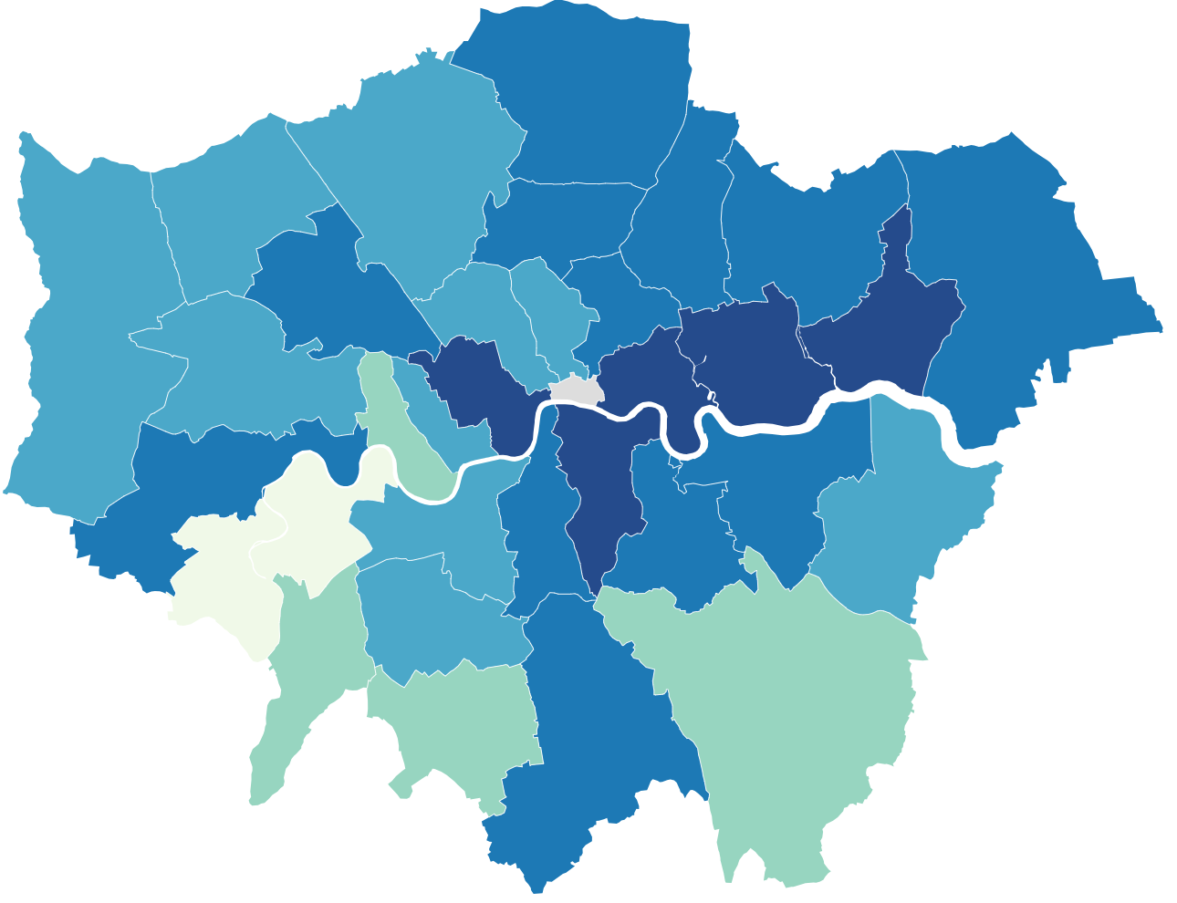
MORE THAN A THIRD OF 10-11 YEAR OLDS IN LONDON ARE OVERWEIGHT OR OBESE
In 2022/23, one in five reception-age children and nearly two in five Year 6 children in London were classified as overweight or obese
Fig 18. Rate of obesity among Year 6 children by borough 2022/23 ³
Excess weight in 4-5 year olds is at a lower prevalence in London (20%) than in England (21.3%) and is lower than it was before the COVID-19 pandemic. However, prevalence varies across boroughs¹.
Excess weight in 10-11 year olds remains at a higher prevalence in London (38.8%) than England (36.6%)². This is a continuation of an increasing trend in London seen before the COVID-19 pandemic.
In London, children in the most deprived areas are more likely to be obese compared to children in the least deprived areas in both Reception (1.5 times more likely) and Year 6 (1.8 times), while the Black African group had the highest prevalence of obesity in both Reception (27.7%) and Year 6 (47.7%).^{1,2}
Across London, excess weight is increasing in 10-11 year olds, and more prevalent compared to reception age.
31.7% of Year 6 children in Newham are overweight or obese, compared to 23.3% in Richmond upon Thames³. Newham has the second highest prevalence of overweight or obesity in England.
Source: (1) OHID Fingertips - Reception: Prevalence of overweight (including obesity, 2022/23)
2) OHID Fingertips– Year 6: Prevalence of overweight (including obesity, 2022/23)

Slide 26
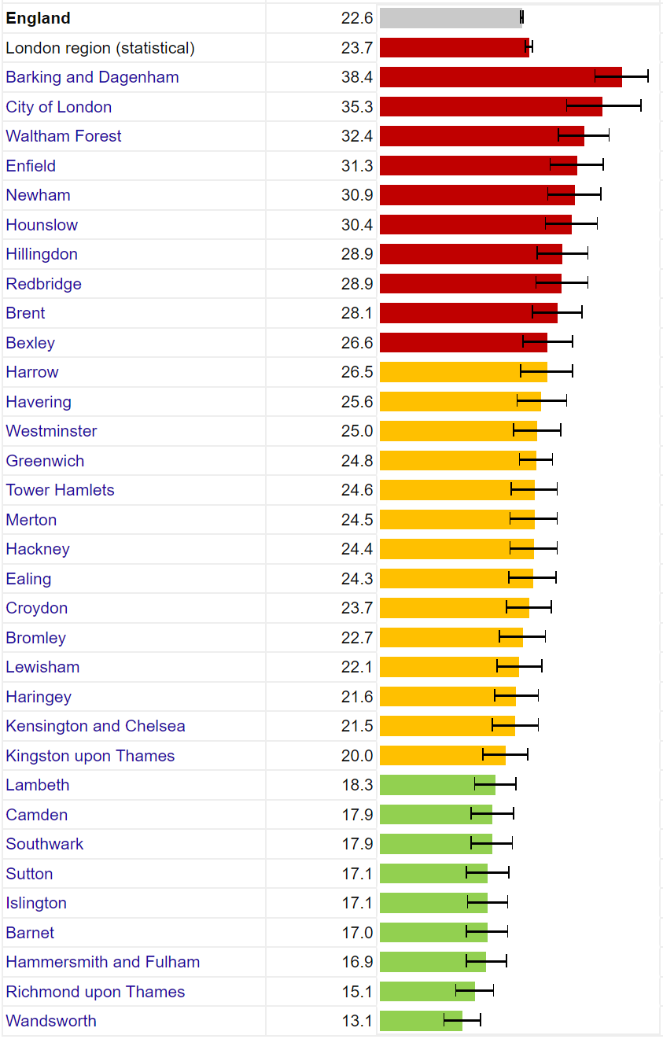
PHYSICAL ACTIVITY IN LONDON
The percentage of physically active adults in London is lower than England with around 1 in 3 adults insufficiently active, but there is significant variation by local authority
In 2022/23, 66.3% of adults (aged 19+) were physically active in London, compared to the England average of 67.1% with significant variation by local authority.¹
  This equates to around 1 in 3 adults being insufficiently physically active in London
Findings from a Sport England report² found wide inequalities in physical activity in adults. The proportion of physically active adults in 2021/22 was lower for: ²
  People in routine/semi-routine jobs and those who are long-term unemployed or have never worked (52.7%)
  Those living with a disability or long-term health condition (47.5%)
  Asian ethnic groups excluding Chinese (55%)
  Black ethnic groups (56%)
Note: The definition of being physically active is taking at least the recommended level of 150 minutes of moderate intensity physical activity or equivalent per week.¹
Fig 19. Percentage of physically inactive adults by local authority, London, ages 19+, 2022/2023
Source: (1) OHID Fingertips -. Percentage of physically active adults (2) Sports England

Slide 27
HEALTH RISKS FROM DRUG AND ALCOHOL MISUSE VARY ACROSS LONDON
Alcohol Misuse The 2021 Health Survey for England showed 25.2% people aged over 16 in London were ‘increasing or higher risk drinkers’ (compared to 21.3% for England). This was an increase from 20.1% in 2019.¹ Around 5.5% of Londoners were ‘higher risk drinkers’ (consuming more than 35 units for women or 50 units for men per week), relative to 3.6% for England. The most recent data at the local authority level is for 2016-2018. This demonstrated significant variability in the prevalence of ‘increasing or higher risk drinkers (from 10.0% in Barnet to 41.3% in Kensington and Chelsea) There were 2,257 alcohol related deaths in London in 2022, representing a rate of 33.4 per 100,000 population. This was significantly lower than the England average 39.7 per 100,000)² Across England, the prevalence of ‘increasing or higher risk’ drinking is highest in the least deprived areas. Meanwhile, the rate of hospital admissions for alcohol-related conditions is highest in the most deprived areas. This mismatch represents a phenomenon known as the 'alcohol harm paradox' and is believed to be due to interactions of alcohol consumption with other health behaviours which are more prevalent in deprived areas such as smoking, poor diet and exercise.¹
Drug Misuse Between 2018-2020, the rate of death due to drug misuse in London was 3.5 per 100,000 people, lower than for England (5.0 per 100,000) and lowest of any region. Within London, rates ranged from 1.9 per 100,000 in Enfield up to 8.0 per 100,000 in Hammersmith and Fulham.³ Data highlights that in England and Wales, the rate of deaths due to drug misuse continue to be highest among those born in the 1970s with the highest rate in those aged 40 to 49.⁴
Source: (1) Health Survey for England Part 1 2021 (2) Public health profiles – alcohol related deaths (3) Public health profiles – deaths due to drug misuse. (4) ONS statistics
Notes:
Updated – blood pressure moved to healthcare inequalities section

Slide 28
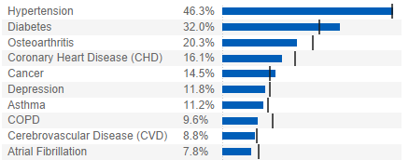
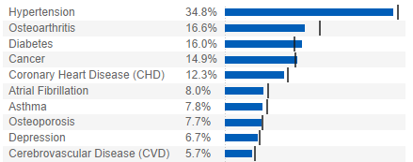

PREVALENCE OF SEVERAL COMMONLY DIAGNOSED DISEASES WAS HIGHER IN DEPRIVED GROUPS
The Segmentation Model uses nationally available datasets to assign conditions to the entire GP registered population based on their historic health service usage (Fig. 20).
Patients aged 65-84 in the most deprived quintile in London, have higher morbidity and much higher (estimated) prevalence of hypertension (46.3% vs 34.8%) and diabetes (32.0% vs 16.0%) compared to the least deprived quintile.
Higher prevalence in more deprived groups of other major diseases was also observed including osteoarthritis, coronary heart disease, cerebrovascular disease, asthma, and depression.
Note
Patients with conditions that can be managed entirely within primary care without presenting to secondary/community care will not be 'detected' by the Segmentation Model.
65-84 category is a large age bracket, which could be skewed differently between populations.
Data only captures people who are registered at a GP practice which may underestimate prevalence.
Fig 20. Comparison of prevalence of several common diseases, people aged 65-84, most and least deprived groups, London, September 2022
Most deprived quintile
Key
London
England
Least deprived quintile
Source: Segmentation Model developed by Data, Analysis and Intelligence Service (DAIS) in NHSEI, Public Health England (PHE), Outcomes Based Healthcare (OBH) and Arden & GEM CSU. https://apps.model.nhs.uk/report/PaPi

Slide 29
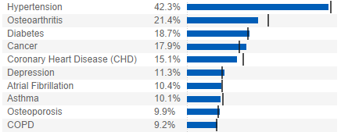
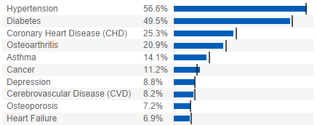
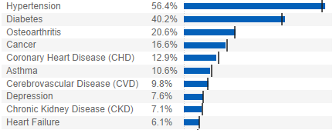
THE PREVALENCE OF COMMONLY DIAGNOSED DISEASES IN LONDON VARIES BY ETHNICITY
The Segmentation Model highlights several examples of ethnic inequality in the prevalence of common diseases in London (Fig. 21):
Hypertension: A much higher prevalence is seen in Asian (56.6%) and Black (56.4%) ethnic groups compared to White (42.3%).
Diabetes: A much higher prevalence is seen in Asian (49.5%) and Black (40.2%) ethnic groups than White (18.7%).
Other: Higher coronary heart disease (CHD) and asthma prevalence in Asian ethnic groups; while a lower cancer prevalence is observed.
Note
Ethnicity coding has improved but remains incomplete with concerns remaining especially around secondary care coding quality.
Missing records likely to be skewed towards patients not routinely accessing healthcare services/younger people.
Fig 21. Comparison of prevalence of several common diseases in people aged 65-84, by ethnic group, London, September 2022
White
Key
Asian/British Asian
London
England
Black/British Black
Source: Segmentation Model developed by Data, Analysis and Intelligence Service (DAIS) in NHSEI, Public Health England (PHE), Outcomes Based Healthcare (OBH) and Arden & GEM CSU. https://apps.model.nhs.uk/report/PaPi

Slide 30
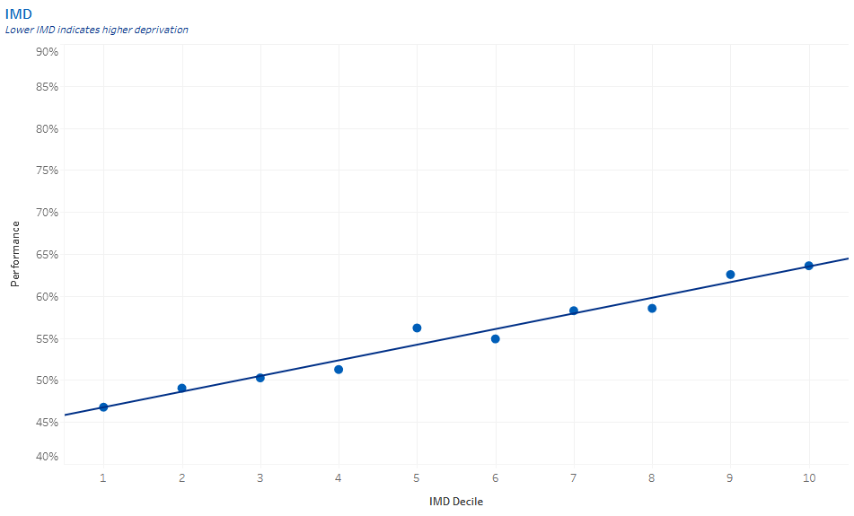
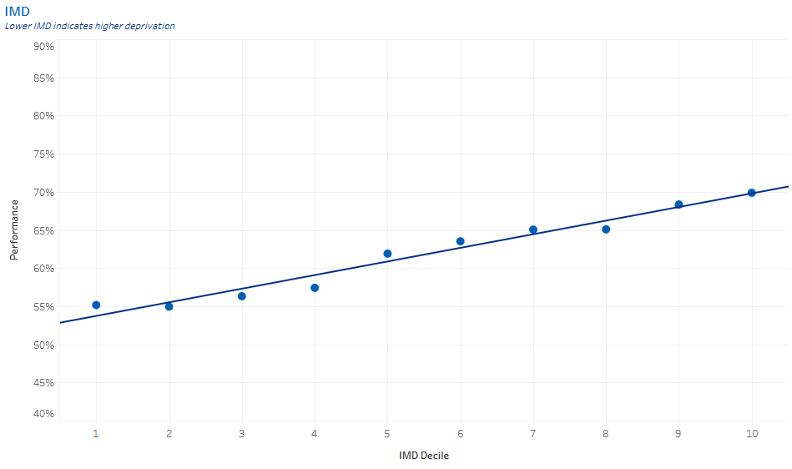
INEQUALITY IN SCREENING UPTAKE IN LONDON
Uptake of bowel cancer screening in London has been increasing since 2015 with 63.5% of eligible people taking up screening in 2023, but is still below the uptake rate for England as a whole (72%).
Meanwhile, uptake of breast cancer screening has declined significantly following the COVID-19 pandemic from 67.3% in 2019 to 55.8% in 2023. A similar pattern has been seen in England as a whole, but uptake is higher in England (66.2%)
In June 2023, breast and bowel cancer screening uptake was lower in deprived areas (Fig. 22)
Uptake of bowel cancer screening has been found to be lower in most minority ethnic groups (except Chinese) relative to White people in West London¹. There are also differences in uptake by ethnicity for breast cancer screening, with South Asian women being particularly less likely to take up screening².
Fig 22. Percentage uptake of breast cancer screening (persons aged 50-70) and bowel cancer screening (persons aged 60-74) within 6 months of invitations, rolling 12-month uptake to June 2023.
Breast Cancer
Bowel Cancer
Note: IMD metrics are calculated from GP level aggregate data (not patient-level data). Composite GP IMD scores have been calculated based on the proportion of registered population in each LSOA (1=most deprived vs 10=least deprived).
Source: (1) Extracted via the Open Exeter system. (Data was collected by NHS England Public Health London Regional Team), (2) Singh et al: Ethnic disparities in the uptake of colorectal cancer screening, (3) GOV.UK: Breast screening: identifying inequalities
Notes:
Updated slide

Slide 31
NHS HEALTH CHECK UPTAKE IS HIGHER IN DEPRIVED AREAS AND FOR MINORITY ETHNIC GROUPS
NHS Health Checks are offered every 5 years to people aged 40-74 years who do not already have a long-term condition. They aim to provide an opportunity for targeted prevention.
In 2022/23, 45.6% of the 524,168 people invited for an NHS Health Check in London took up the offer, better than the 38.9% uptake of invites for England as a whole.
The most recent data on inequalities come from an analysis of NHS Health Checks in 2017-2018. This data showed:
  People in the most deprived deciles of London were more likely to attend an NHS Health Check when invited than those in less deprived areas (range from 52% in the most deprived decile to 36% in the 3rd least deprived).
  People from Asian, Black and Other ethnicities were the ethnic groups most likely to take up the offer of an NHS Health Check (56.2%, 52.1% and 48.9%, respectively). A large number of patients (10%) had no ethnicity recorded and these were the least likely to attend a Health Check (13.7%).
Fig 23. Proportion of GP registered adults aged 40-74 who took up the invite to an NHS Health Check in 2017-18, by deprivation (top) and ethnicity (bottom)
Source: Quality and Outcomes Framework (QOF) 2020/21, NHS Digital. https://fingertips.phe.org.uk/profile/general-practice/data#page/1/
Notes:
New slide

Slide 32
THE MOST DEPRIVED LONDONERS ARE LEAST LIKELY TO HAVE CONTROLLED HYPERTENSION
The diagnosed prevalence of hypertension (blood pressure consistently >140/90mmHg) in London changed little between 2015/16 (11.0%) and 2022/23 (10.9%)¹
  Bexley (14.7%) had the highest prevalence, while Tower Hamlets (7.2%) had the lowest. Differences in age structure between boroughs may contribute to this variation.
  This data relies on GPs diagnosing all hypertension cases. This is unlikely and may be inconsistent across practices.
Patients aged over 45 in the 2nd-4th most deprived areas are more likely to have had their blood pressure checked in the last 5 years than patients in any other deprivation decile (Fig. 24).²
Hypertension patients in the most deprived areas were less likely to have their blood pressure well controlled in 2022/23 (Fig. 25).²
  61.2% under 80 years in the most deprived decile had blood pressure ≤140/90mmHg, compared to an average of 67.8%
National research between 2006 and 2019 found that Black African and Caribbean patients with hypertension were less likely to have well controlled blood pressure, potentially because of differences in consistently taking medication.³
Fig 24. Proportion of GP registered patients aged over 45 with a blood pressure check in last 5 years, by deprivation, 2022/23
Fig 25. Proportion of hypertension patients aged <80 years with blood pressure reading ≤140/90mmHg in last 12 months.
Source: (1) Public health profiles – hypertension (2) QOF 2022/23 (3) Ethnic differences in hypertension management, medication use and blood pressure
Notes:
New slide

Slide 33
CONCLUDING COMMENTS
London, as with the rest of the UK, has made progress in recovering from the impact of the COVID-19 pandemic. This is reflected in broad indicators of health in the region, including life expectancy measures that have shown signs of returning to pre-pandemic highs.
Clear inequalities are seen in health status by deprivation and ethnic group. Life expectancy, low birthweight and infant mortality in London correlate with levels of deprivation in the borough. Black African people had a higher life expectancy than most other ethnic groups in 2011-14, but this may not be reflective of the post-pandemic period. Minority ethnic groups experience a wide range of health inequalities.
Inequalities in the wider determinants of health, including education, income, poverty, and living environment, are likely to explain a large degree of the variation in broad health outcomes for people from different deprivation deciles and ethnic backgrounds. The cost of living crisis has led to increasing levels of poverty in London with adverse health outcomes. Meanwhile, people living in the most deprived areas and from minority ethnic groups are most at risk of health effects from changes in the climate.
Health behaviours including smoking, diet and physical activity are among the top contributors to disease and death in London. While smoking rates continue to show a long-term decreasing trend in London, child overweight and obesity is increasing. Obesity and physical activity in adulthood have shown no recent change. People from more deprived areas are less likely to adopt health-promoting behaviours, while Black children are the most likely to be overweight or obese.
A disproportionate amount of spending is allocated to unplanned care in more deprived areas of London, indicating a reactive model of care. Engagement in vaccination and screening programmes generally declines with level of deprivation, as does effective management of diabetes and hypertension. Prevalence of hypertension, diabetes and coronary heart disease is higher in minority ethnic groups. Interestingly, Asian and Black people and people from more deprived areas are more likely to take up the offer of an NHS Health Check, indicating an opportunity to reverse health inequalities affecting these groups.
More systematic and consistent collection, recording and coding of data relating to geography, across all protected characteristics, and of key inclusion health groups should remain a priority to provide more effective intelligence of health inequalities in London, informing strategic action. Partnership working could further unlock more timely, integrated and linked data across health and wider determinants.
Health inequalities persist, and in some cases have worsened across London, from upstream in the wider determinants of health through to ultimate outcomes such as mortality rates. A joined-up approach with partners within and adjacent to health will be needed to address many of the systemic drivers of inequality, possibly through a ‘Health in All Policies’ approach.

Slide 34
END

