Slide 1
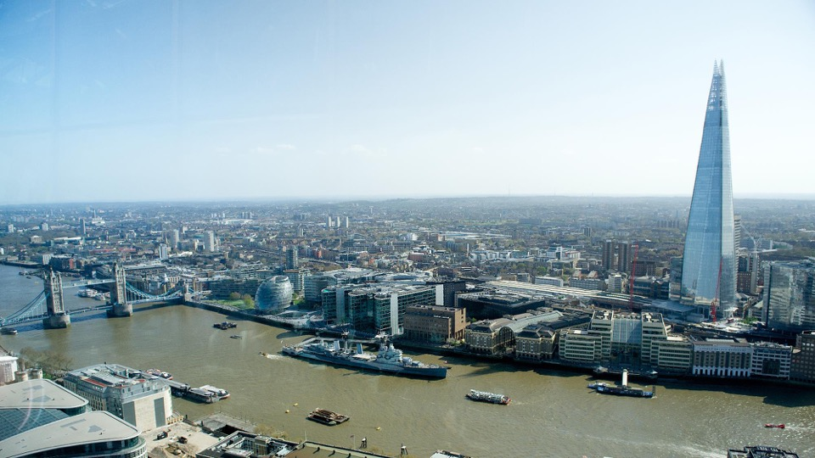



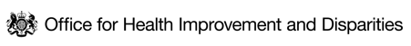


HEALTH INEQUALITIES IN LONDON
Climate and Environment Pack
BUILDING THE EVIDENCE DATA WORKING GROUP
August 2024

Slide 2
CONTENT NAVIGATOR
Introduction to Climate Inequalities in London
Inequalities in Exposure to Climate Risks
Inequalities in Vulnerability to Climate Risks
Inequalities in Adaptive Capacity to Climate Risks
Cumulative Risk from Climate Risks
Cumulative Risk from Climate Risks – Example
Access to Opportunities and Active Travel
Inequalities in Access to Green Spaces
Inequalities in Exposure to Air Pollution

Slide 3
CLIMATE IMPACTS ARE NOT EXPERIENCED EQUALLY ACROSS LONDON
Inequalities are experienced at each step along the causal path to a climate-related health outcome:
  Exposure
  Vulnerability
  Adaptive capacity
Despite having the lowest carbon emissions, the poorest and most disadvantaged Londoners are disproportionately exposed to climate risks, are more sensitive to their impacts, and have less capacity to adapt and respond.
Fig 1. Overlap of inequalities in climate risk exposure, vulnerability and adaptive capacity.
Inequality in exposure to climate risks
Inequality in adaptive capacity, the ability to respond and recover
Inequality in vulnerability & sensitivity to the impacts

Slide 4
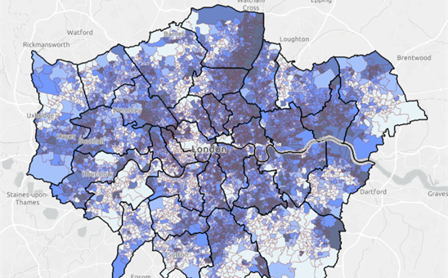
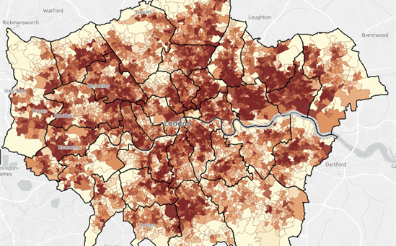
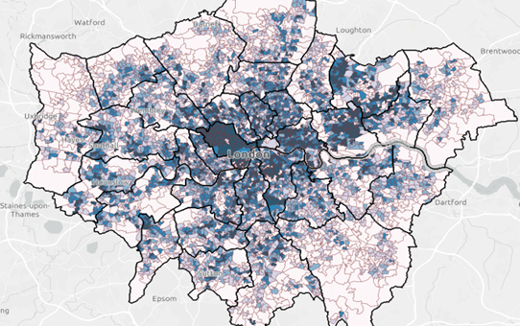
INEQUALITIES IN EXPOSURE TO CLIMATE RISKS
Fig 2. Geographical distribution of deprivation, surface temperature and flood risk across London
Income deprivation
Land surface temperature
Flood risk
Source: Bloomberg cliamte risk maps, based on data from English Indices of Multiple Deprivation (MHCLG), 2015.
Source: Bloomberg climate risk maps, based on data from ARTI analytics BV, 2016-2020.
Source: Bloomberg climate risk maps, based on data from Environment Agency, 2013.
People living in the most deprived areas, people from ethnic minority communities, and people already experiencing disadvantage are more likely to be exposed to high temperatures, cold temperatures, flooding, and food and water insecurity.¹
Socio-environmental risk factors include housing conditions, the built environment, work and financial insecurity.²
Those who are homeless, who live in non-decent housing and / or experience fuel poverty are more likely to be exposed to extreme temperatures.³​
People living in more deprived areas have less access to green and blue space for cooling, flood resilience and other ecosystem services.^{4​}
Those who work in manual jobs or spend the majority of the day working outdoors are more likely to be exposed to extreme temperatures and vector-borne diseases.^{5​}
Climate and ecological change are key risks for future food availability and prices, those on lower incomes will be disproportionately exposed to these shocks.⁶
Source: (1) Sheng et al. (2) Environment Agency (3) Taylor et al (4) Bloomberg Associates (5) CDC (6) Food systems transformation group NatCen Social Research

Slide 5
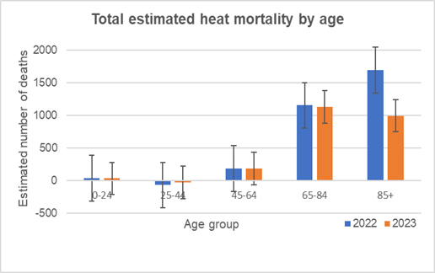
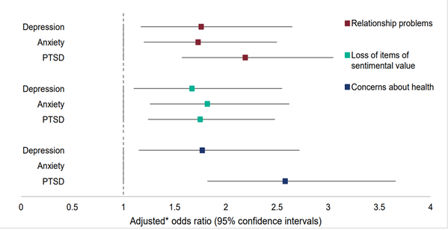
INEQUALITIES IN VULNERABILITY TO CLIMATE RISKS
People aged over 65, babies and young children, those with certain underlying physical or mental health conditions, pregnant women and people living in deprived circumstances are more likely to experience poor health outcomes as a result of exposure to extreme temperatures, flooding and food insecurity¹ . Figure 3 illustrates the impact of high temperatures on people over 65 years of age.
Climate sensitive health conditions, such as cardiovascular disease and mental health conditions, are unequally distributed across London, with those in the most deprived areas and people from ethnic minority communities most likely to be affected². Figure 4 illustrates how concerns about health are associated with increased likelihood of Post Traumatic Stress Disorder in people who have been flooded.
Fig 3. Excess deaths by age during heat events in 2022 and 2023³
Fig 4. People with health concerns as a 'secondary stressor’ after flooding were more likely to experience depression, anxiety and PTSD⁴
Fig. 1 Excess mortality by age group during heat periods
Source: Heat mortality monioritng reports (2022 and 2023).
Source: (1) UKHSA (2) OHID PHOF (3) UKHSA (4) The English National Study of Flooding and Health

Slide 6
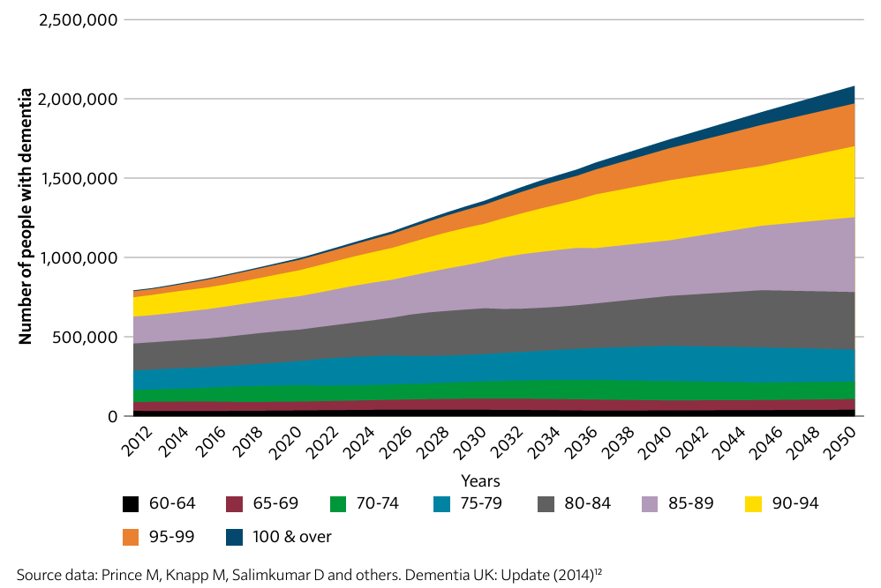
INEQUALITY IN ADAPTIVE CAPACITY TO CLIMATE RISK
People experiencing disadvantage are less likely to have the capacity, resources and opportunity to adapt and respond to climate change, for example, through implementing options for adaptation as described in Table 1. ¹ They are also less likely to live in areas that benefit from interventions that reduce risk, such as urban greening (see Slide 46: Access to Green Space)
Figure 1 illustrates projected trends in the number of people with dementia, an increase that will occur in parallel with a warming and increasingly volatile climate. Those with physical and mental disabilities, who rely on support to live independently, or have cognitive impairment (eg dementia, substance abuse) will find it difficult prepare, recover and respond to increasingly frequent and intense extreme weather events².
Table 1. Options for adaptation to climate risks
Fig 1. Projected increases in the number of people with dementia in the UK by age group, 2012-2051³
Adapting to heatwaves | Installing passive cooling measures at home Improving ventilation at home Working from home to avoid travelling in hot weather
Adapting to flooding | Making changes to home and surrounding landscape Taking out appropriate home or buildings insurance
Adapting to food insecurity | Meal planning and bulk buying Making dietary changes Growing food
Adapting to shocks and stressors | Saving up an emergency fund Knowing where and how to access timely support
Source: (1) Institute of Health Equity (2) US National Climate Assessment (3) Chief Medical Officers Report 2023
Notes:
Figure 2.20: Projected increases in the number of people with dementia in the UK, by age group, from 2012 to 2051

Slide 7
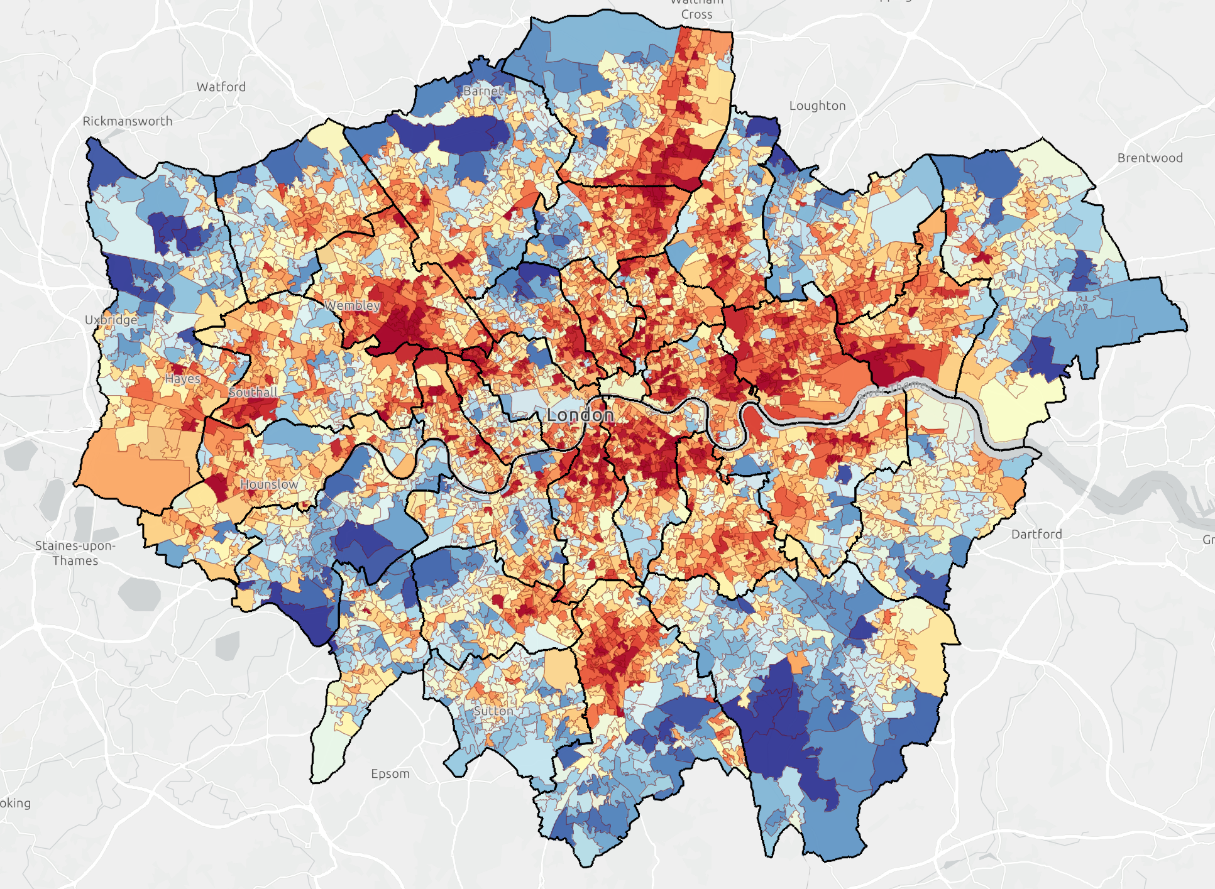
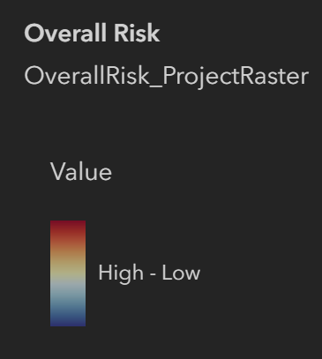
CUMULATIVE RISK FROM CLIMATE CHANGE
Evidence shows that:
Emergency hospital admissions due to extreme heat are higher in more socioeconomically deprived areas.¹
Those from the most deprived backgrounds are more likely to be admitted for heat exacerbated health conditions, including respiratory metabolic and infectious diseases, as well as accidents.¹
The most deprived areas and those with the lowest level of education also have a significantly higher risk of mortality from extreme heat.²
Figure 6. Overall climate risk across London³*
Fig X. Percentage of people rating their GP practice 'very' or 'fairly good' by deprivation quintile
*Note: Based on: Ages Under 5, Ages Over 75, English Proficiency, Income Deprivation, Social Renters, BAME, Average Land Surface Temperature, Surface Water Flood Risk, PM2.5, NO2, Green/Blue Land Cover, Areas of Deficiency in Access to Public Open Space
Source: (1) Rizmie et al (2) Williams & Marmot (3) Bloomberg climate risk maps

Slide 8
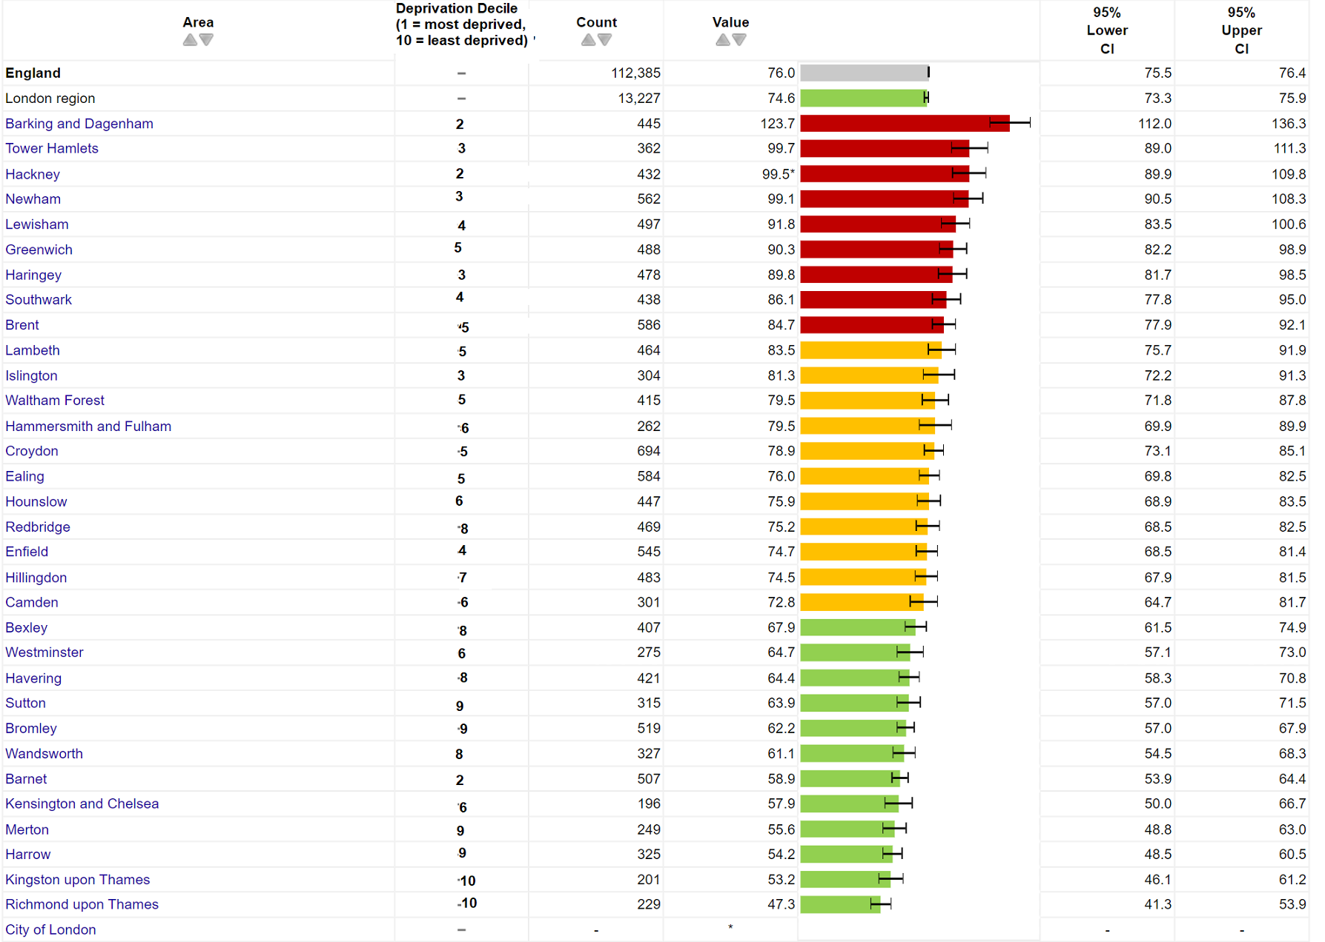
CUMULATIVE IMPACT EXAMPLE – CARDIOVASCULAR DISEASE
Figure 7. Under 75 mortality rate from all circulatory disease by borough and deprivation decile
People living in the most deprived areas of the capital are more likely to be affected by cardiovascular disease and to die prematurely as a result¹.
Climate related issues such as extreme heat and air pollution contribute to both the development of and worsening of cardiovascular disease². Evidence shows that a 1°C increase in ambient temperature is associated with higher cardiovascular disease mortality and a significant increase in morbidity^{3,4}.
As people living in the most deprived areas are already more likely to be exposed to hot weather and air pollution, are more likely to be living with a long term health condition which may be climate sensitive, and have less adaptive capacity, the impact of increased temperatures and increased air pollution is likely to be particularly severe, and lead to the gap between the most and least deprived widening further.
Source: (1) OHID (2) Jacobsen et al (3) Liu et al (4) Moghadamnia et al

Slide 9
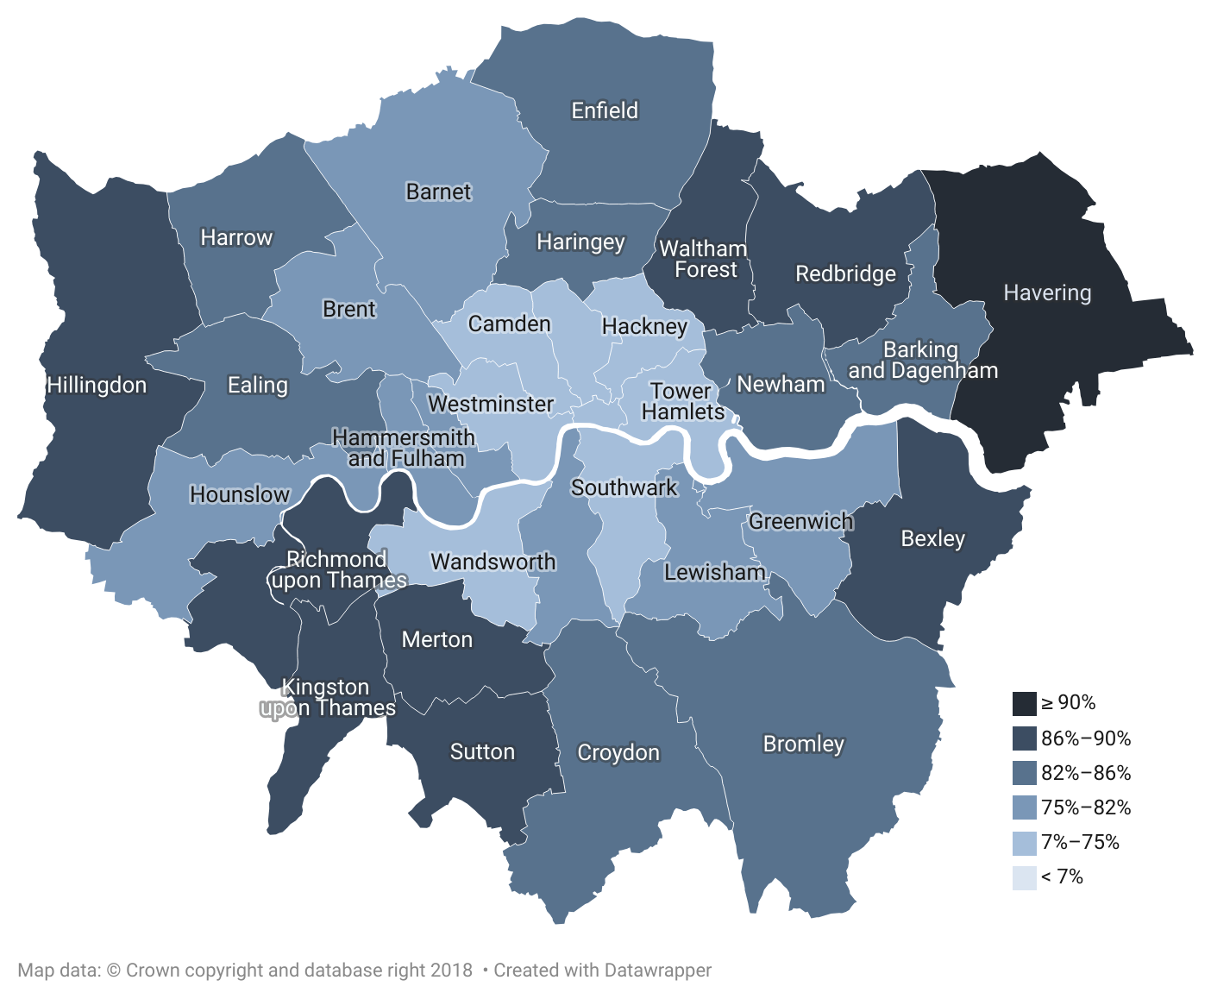
LOWER INCOME & BLACK PEOPLE IN ENGLAND ARE LEAST LIKELY TO HAVE ACCESS TO GREEN SPACE
One in five Londoners (21%) have no access to a garden, the highest percentage of any region in the UK and almost double the national average.¹
Private gardens in London are also the smallest in any region in Britain, 26% less than the national average.²
  Despite being least likely to have access to a private garden, people in London are most likely to have a park nearby.²
London has the lowest provision of green space per person of all regions in the UK. Friends of the Earth analysis found that the ten worst local authorities for access to green space are all in London.^{3,4}
Lower income and BAME households have been hit hardest – black people in England are four times less likely than white people to have no outdoor space at home.^{1,5}
Half of all London households are in areas of deficiency of access to open space (i.e. more than 400m from a local park) – the maximum distance recommended by the London Plan.⁵
Fig 9. Percentage of addresses with private outdoor space in local authorities in London, 2020
Source: (1) ONS Data (2020) (2) ONS commentary (2020) (3) ONS (4) Access to green space in England | Friends of the Earth (2020) (5) RCIS (2020)

Slide 10
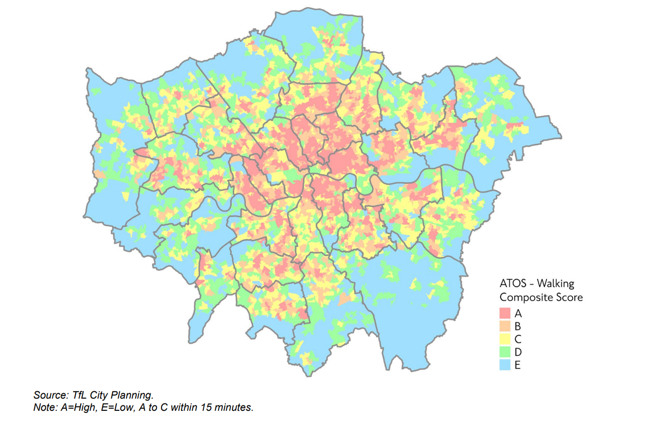
ACCESS TO OPPORTUNITIES AND PARTICIPATION IN ACTIVE TRAVEL VARIES ACROSS GEOGRAPHY AND BY AGE, DEPRIVATION, DISABILITY AND ETHNICITY
.
Higher access to opportunities score (ATOS)* scores tend to be focused in inner London, whereas there are large areas of outer London which do not meet this criterion, i.e. walking access to essential services is greater than 15 minutes.¹
There are barriers to active travel. For example, Black and ethnic minority groups, women, people from more deprived neighbourhoods, those with disabilities and older people are typically under-represented in cycling.²
Currently, 45 per cent of disabled Londoners find planning and making trips on public transport stressful.¹
Deprivation, sex, age and mode of transport have a significant impact on casualty risk rate and casualty location rate in London.³
  Twice as many people were killed or seriously injured per kilometre of road network in the most deprived 30% London, compared to the 30% in the least deprived areas.
  Per thousand people, more men are injured than women. This difference increases with deprivation and injury severity.
Note: *ATOS (Access to Opportunities and Services) scores look at walking times from all locations to reach essential services such as schools, healthcare, food shopping and open spaces.
Fig 8. Access to opportunities score (ATOS) showing accessibility on foot within 15 metres in London, 2021
Source: (1) TfL (2021) ‘Travel in London Report 14 (2) Barriers to cycling amongst ethnic minority groups and people from deprived backgrounds (3) TFL Inequalities in road danger in London (2017-2021)

Slide 11
DEPRIVED AND MINORITY ETHNIC GROUPS FACE DISPROPORTIONATE AIR POLLUTION EXPOSURE
London had the highest percentage of deaths attributable to particulate air pollution (7.1%) of all English regions in 2022, but the proportion has continued to reduce from 9.0% in 2018.¹
  Of the 25 upper tier local authorities in England with the highest proportion (%) of deaths attributable to air pollution in 2022, 22 were London boroughs.¹
  Average concentrations of PM2.5 in London have shown a decreasing trend since 2018 (from 12.3μg/m3 to 8.7 μg/m3).²
Air pollution is worse in more deprived areas of London ³
  NO² concentrations range 4.4µg/m3 in a linear trend from most to least deprived areas, while PM2.5 concentrations range 0.7µg/m3.
White and Asian people are least likely to be exposed air pollution in London:
  In 2019, Black people and people from ‘Other’ ethnicities were more often living in the 30% most air polluted areas of London than would be expected from their population; 7.1% more likely for Black people and 33.3% more likely for ‘Other’ ethnicities.³
  Meanwhile, White and Asian people were 3.7% and 9.5% underrepresented in the most air polluted areas in 2019.
  Projections to 2030, based on modelling of air pollution concentration and population, show a continuing advantage for White people relative to other ethnic groups.
Fig 10. Over- or under-representation of ethnic groups living in the 30% most polluted OAs relative to their 2019 and 2030 London-wide populations³
Source: (1) OHID Fingertips- Fraction of mortality attributable to particulate air pollution (2) Health Profile for London 2021 (3) GLA air quality exposure and inequalities study

Slide 12
END

