Slide 1
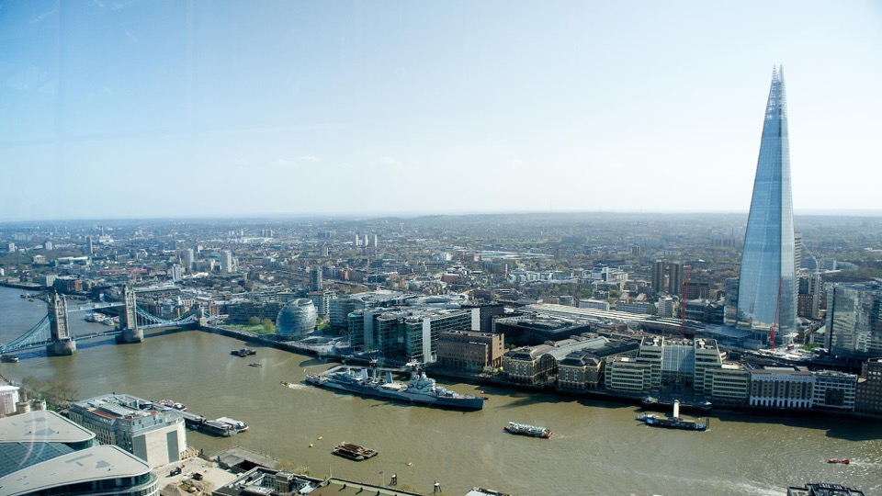



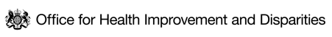


HEALTH INEQUALITIES IN LONDON
An update to the snapshot of health inequalities in London
HEALTH EQUITY DATA COLLABORATIVE
July 2024

Slide 2
AUDIENCE FOR THIS WORK AND HOW TO USE THIS RESOURCE
Audience for this work
This resource is intended for health leaders, analysts, officers, and policy makers from local and regional government, integrated care systems, NHS, academia, VCS organisations and partners across London to support their work to address inequalities by helping
Frame discussions with system partners
Engage communities
Identify data sources on a given topic
Advocate for the need for action to address health inequalities
How to use this resource
The content navigators on slides 10-12 of this resource allow the user to navigate to any part or topic of interest via hyperlinks.
The resource is provided in PDF and PowerPoint format to support colleagues in their work on inequalities
Cite this resource:
If you wish to use any content or analysis from this pack in future work, please cite as:
  Institute of Health Equity, NHS England, Greater London Authority, Office for Health Improvement and Disparities, & City Intelligence. (2024). Health Inequalities in London: An update to the snapshot of health inequalities in London. Building the Evidence Data Collaborative.

Slide 3
Contents
AUDIENCE FOR THIS WORK AND HOW TO USE THIS RESOURCE Slide 2
EXECUTIVE SUMMARY Slides 4-8
METHODOLOGY AND LIMITATIONS Slide 9
CONTENT NAVIGATOR Slides 10-11
PART 1: CURRENT CONTEXT Slides 12-18
PART 2: HEALTH INEQUALITY IN HEALTH STATUS Slides 19-28
PART 3: WHY INEQUALITY EXISTS? Slides 29-58
PART 4: HEALTH BEHAVIOURAL RISK FACTORS Slides 59-66
PART 5: DEATH AND ILLNESS IN LONDON Slides 67-79
PART 6: HEALTHCARE INEQUALITIES Slides 80-89
PART 7: CONCLUSION Slides 90-93
Addendum
19 July 2024: Figure 14 (Ethnic inequalities in the UK (Taken from NHSE Race & Health observatory)) was removed from the document due to a data error. The figure stated an incorrect number for the proportion of deaths among Black and Minority ethnic groups in England and Wales in 2019 caused by cardiovascular disease.
05 December 2024: Slide 64 stated that ‘In London, children in the most deprived areas are more than twice as likely as children in the least deprived to be obese’. This statement applied to England but not to London, so has been corrected with London data.

Slide 4
EXECUTIVE SUMMARY (1 of 5)
This report provides a snapshot of health inequalities in London based on available data sources and a shared overarching narrative that relevant partners can use in their work
An adapted version of the Kings Fund framework for measuring inequalities and the Marmot principles for addressing inequality have been used to organise this snapshot of inequalities in London into 7 parts summarised below
Part 1 – Current context
Following a temporary decline during the COVID-19 pandemic, London’s population has continued its long-term pattern of growth, mostly driven by a significant increase in international immigration.
The 2021 Census recorded a London population of 8.8 million; however, this is likely to represent the lowest point in the COVID-19 dip.
London is the youngest and most ethnically diverse region of the UK.
There are large populations of people in inclusion health groups (e.g. homeless people, asylum seekers and refugees, and Gypsy, Roma and Traveller communities) living in London. People in these groups experience greater risk of poor health and complex health challenges.
The COVID-19 pandemic exposed stark health inequalities across the city, with people from Black and minority ethnic groups, and people living in deprived areas being most at risk of exposure and death.
Part 2 – Health Inequality in Health Status
Life expectancy at birth in London was 80.3 years for males, and 84.4 for females in 2022. This represents a recovery to pre-pandemic levels, following a COVID-19 dip. Healthy life expectancy (HLE) has not changed significantly in London in recent years.
Not all London boroughs experienced a decline in life expectancy during the pandemic, and there is variation in life expectancy at birth and healthy life expectancy across boroughs. This correlates with the average level of deprivation in the borough.
Data on life expectancy by ethnic group from 2011-2014 in England and Wales showed a complex pattern. Black African people had higher life expectancy than most. Disproportionately high mortality during COVID-19 may have reversed this, but ethnic group mortality rates are converging.

Slide 5
EXECUTIVE SUMMARY (2 of 5)
Part 2 – Health Inequality in Health Status – continued.
London has a higher rate of low birthweight babies than England as a whole (3.3% vs 2.9%) and, unlike England, shows a worsening trend since 2017. Low birthweight is highest in Newham (5.1%) and lowest in Kingston-upon-Thames (2.1%), showing a correlation with deprivation although ethnicity is also likely a contributor.
Part 3 – Why Inequality exists? (Wider determinants)
Ethnic and socioeconomic inequalities in the wider determinants of health occur in London across education, income and poverty, crime, the built environment and climate. The cost of living crisis and escalating climate risks are exacerbating these inequalities.
While school readiness and Attainment 8 scores in London are higher than for England, people from Black ethnic backgrounds or those who are eligible for free school meals tend to have lower levels of achievement.
The UK has experienced a sharp rise in inflation in recent years. Despite recent decreases, and positive turns in employee real pay growth in London, a significant proportion of Londoners still struggle with the cost of living.
The wealthiest tenth of Londoners have around 9 times the income of the lowest income households, with London having a greater income disparity than the rest of the UK.
A quarter of Londoners now live in relative poverty, and a fifth in absolute poverty, after housing costs. This is higher than the UK rate. Child poverty in London is also significant, with 32% of children living in poverty after housing costs as of 2020/21-2022/23.
Approximately 9% of London households are overcrowded, and Asian and Black people are more likely to live in overcrowded conditions or homes that fail to meet the Decent Homes Standard. The unaffordability of housing has reached a record high, with significant disparities affecting Black and ethnic minority households.
Violent crime in London is disproportionately concentrated in deprived areas, with significant local variations, and disproportionately affects specific socio-demographic groups, including young Black men, men in general (except for domestic violence where women are more affected), and people with disabilities.

Slide 6
EXECUTIVE SUMMARY (3 of 5)
Part 3 – Why Inequality exists? (Wider determinants) – continued.
London had the highest percentage of deaths attributable to particulate air pollution among English regions in 2022, with a noticeable decline from previous years. Air pollution exposure disproportionately affects deprived and minority ethnic groups.
As London responds to the climate emergency, climate risks are found to disproportionately affect the most deprived and disadvantaged individuals who are both more exposed and more vulnerable to their impacts, with reduced capacity to adapt. Specific at-risk groups include homeless people, people in non-decent housing, outdoor workers, and those with fewer financial resources.
Part 4 – Health behavioural risk factors
Tobacco use, high BMI, and poor diet were the top risk factors driving death and disability in London in 2019.
Smoking prevalence in London in 2022 was 11.7%, part of a continuing long-term decline from 2012. There is significant variation across boroughs, from 6.2% in Kingston up to 16.3% in Hounslow. Higher rates are observed in routine and manual occupations as well as among adults with a long-term mental health condition.
The proportion of overweight or obese adults in London in 2022/23 was 57.2%, lower than the national average of 64.0%, yet with significant variations across boroughs and no overall improvement over time.
In 2022/23, over one third of Year 6 children in London were classified as overweight or obese, continuing an increasing trend seen before the COVID-19 pandemic, with higher rates in the most deprived areas and among Black African children.
In 2022/23, 66.3% of London adults were physically active, below the England average of 67.1%. Physical inactivity was higher among those in routine/semi-routine jobs and long-term unemployment, people with a disability, and Black and Asian ethnic groups.
In London, a quarter of people over 16 were ‘increasing or higher risk’ drinkers in 2021, exceeding the national rate. Highest consumption was in less deprived areas, but more alcohol-related hospital admissions occurred in poorer areas.
Drug-related death rates between 2018-2020 were lower than the national average but varied across the city.

Slide 7
EXECUTIVE SUMMARY (4 of 5)
Part 5 – Death and Illness in London
London saw a decrease in all cause premature mortality from 2021 to 2022, returning to pre-pandemic levels. However, latest estimates show rates nearly three times higher in the most deprived areas compared to the least.
Most major causes of death were more common in people from the most versus least deprived deciles, with COVID-19, heart disease and lung cancer contributing most significantly to the gap.
People aged 65-80 years from the most deprived backgrounds are more likely to be diagnosed with hypertension, diabetes and coronary heart disease than those in the least deprived decile. Black and South Asian groups in this age category are also more likely to have hypertension and diabetes, while those from Asian backgrounds have a higher prevalence of coronary heart disease, compared to those from White backgrounds.
One in four adults (aged 16+) show signs of poor mental health, a slight decrease from a pandemic peak. This particularly affects younger adults, a trend mirrored by a decade-long rise in mental health issues in children aged 10-15, in London and the UK.
Infant mortality in London is lower than England at 3.6 per 1,000 live births but shows a continuing gradual increase since 2014-16. Deprivation is found to be a predictor of infant mortality at the national level, a trend also represented at the London borough level.
Part 6 – Healthcare Inequalities in London
Healthcare spending on emergency versus elective care is relatively higher in deprived areas, suggesting a reactive approach to health issues prevalent in these regions.
Vaccination uptake for influenza and COVID-19 is lower in deprived areas and among certain ethnic groups, including people who are of Black Caribbean or African, Mixed, Bangladeshi or Pakistani ethnicity. With a resurgence of childhood infectious diseases affecting London, there are also inequalities in uptake of childhood vaccines by deprivation and ethnic groups.
Screening for breast and bowel cancers shows a marked linear decrease in uptake with increasing deprivation.

Slide 8
EXECUTIVE SUMMARY (5 of 5)
Part 6 – Continued
Management of hypertension and diabetes, measured by patients achieving treatment targets at individual GP practices, shows a declining trend with increasing deprivation.
However, NHS Health Checks are more likely to be taken up by people in more deprived areas and by people from Black, Asian and Other ethnicities, offering an opportunity to promote health in people known to be at significant disadvantage.
Part 7 - Conclusion
This report highlights a continuing story of inequalities in health by deprivation and ethnicity, from the upstream wider determinants to the ultimate outcomes such as disease and mortality.
Still recovering from the impacts of the COVID-19 pandemic, London has been faced with new threats to health including a long-spanning cost of living crisis that, alongside shifts in the housing market, is driving more Londoners into financial difficulties and poverty. The advance of climate change and the unique risks posed by changing weather patterns and the frequency of environmental disasters is also an emerging issue. Due to the disproportionate impact of these threats onto already disadvantaged groups, these trends are likely to contribute to widening health inequalities over time.
Given the complex intersection of environment, social factors, health behaviours and health status, tackling health inequalities will require joined-up working and partnerships, such as through implementing and advocating for a ‘Health in All Policies’ approach.
The data available does not currently allow us to capture a full picture of health inequalities in London. Efforts to improve systematic and consistent collection, recording and coding of data relating to geography, across all protected characteristics, and of key inclusion health groups should remain a priority to provide more effective intelligence.
Partnership action could be used to identify means of accessing more novel and timely data, more integrated and linked datasets between heath and care and wider determinants. This would enable more targeted, evidence-based strategies.

Slide 9
METHODOLOGY AND LIMITATIONS
APPROACH
LIMITATIONS
This report is an updated version of the initial Snapshot of Health Inequalities in London, published in 2022.
It was produced collaboratively by the Greater London Authority (GLA) Health team, GLA City Intelligence Unit, Office for Health Improvement and Disparities London (OHID), and NHSE.
It is structured according to a combination of the Kings Fund measures of health inequalities and 8 Marmot Principles which helped identify topic areas to illustrate the breadth of inequalities challenges in London
The report, divided in parts, covers current context, health inequality in health status, wider determinants (structured to the Marmot 8 principles), health behavioral risk factors, death and illness, and healthcare inequalities.
Throughout the report, inequalities have been examined where possible across 4 dimensions (deprivation, geography, protected characteristics and inclusion health)
Sources of data were identified from existing published data, working in partnership through iterative discussion
We aim to use this work to:
Provide an update to the overview of major inequalities issues affecting London in an accessible format
Highlight existing data resources available in London to measure inequalities around a shared narrative
Provide a platform for partnership work across London such as identifying key gaps in intelligence, that would improve our understanding of inequalities
Key limitations include:
This is only a snapshot of inequalities in London and not intended to comprehensively cover all inequalities issues affecting London, every inequality dimension or factor driving inequalities in London.
Only content published in the public domain has been used.
Due to data availability, not all slides have been updated since 2022. Slides not updated are indicated for ease of use.
This report cannot be used in isolation to prioritise health inequalities issues in London or indeed Identify actions needed to address inequalities which are beyond its scope

Slide 10
CONTENT NAVIGATOR (1 of 2)
Part 1
Current Context
Population trends
2021 Census population
Population churn
Populations of inclusion health groups
Health inequalities exposed through COVID-19
Part 2
Health Inequality in Health Status
Life expectancy at birth
Healthy life expectancy
Disability-free life expectancy
Low birthweight
Effects of the COVID-19 pandemic on health status
Health inequalities by ethnic group
Part 3
Why Inequality exists? - Wider determinants
Give every child the best start in life
  School readiness
Enabling children, young people and adults to maximise their capabilities
  KS4 Attainment
Fair employment and good work for all
  Income and Employment
Healthy standard of living
  Poverty
  Cost of living
Part 3 – Contd.
Healthy and sustainable places and communities
  Housing
  Active Travel
  Green Space
  Air Pollution
  Built Environment
  Neighbourhood Cohesion
  Civic Strength Index
  Violent crime
Racism and Discrimination
  Unfair treatment due to a protected characteristic
Environmental Sustainability and Equity
  Climate risk

Slide 11
CONTENT NAVIGATOR (2 of 2)
Part 4
Health Behavioural Risk Factors
Contributors to death and disability in London
Smoking prevalence
Overweight & obesity in adults
Overweight & obesity in children
Physical activity
Drug and alcohol misuse
Part 5
Death and Illness in London
Premature mortality
Causes of death in London
Contributors to inequality in life expectancy
Causes of illness in London
Inequalities in prevalence of commonly diagnosed diseases
Mental health in adults
Mental health in children
Infant mortality
Part 6
Healthcare Inequalities
Spending on unplanned care
Inequality in COVID-19 vaccination
Inequality in influenza vaccination
MMR vaccination coverage
Inequality in cancer screening
NHS Health Check uptake
Inequalities in diabetes care
Inequalities in hypertension management
Part 7
Conclusion
Concluding comments
Gaps in the evidence and in this snapshot
Acknowledgments

Slide 12
PART 1: CURRENT CONTEXT
DEMOGRAPHIC OVERVIEW OF LONDON

Slide 13
PART 1 OVERVIEW: CURRENT CONTEXT
Understanding health inequalities in London requires knowledge of the city's demographics. London is the youngest and most ethnically diverse region of the UK. It also has one of the most transient populations, becoming a temporary home for many, particularly during young adulthood. Relatively large populations in inclusion health groups* also contribute to a unique demographic profile for London.
Although London has been in recovery from the COVID-19 pandemic since 2021, its impact still paints an important backdrop in exposing health inequalities across London's demographic groups. The subsequent cost of living crisis is still affecting Londoners, though its impact may not yet be fully reflected in the health metrics reviewed in this report.
The following sections are explored in this part of the Snapshot:
Population growth in London
London 2021 Census Day population
Population churn in London
Populations in inclusion health groups
Reflection on impact of COVID-19 in London
*Inclusion health refers to any population group that is socially excluded. This can include people who experience homelessness, vulnerable migrants, Gypsy, Roma and Traveller communities, drug and alcohol dependence, sex workers, people in contact with the justice system and victims of modern slavery, and other socially excluded groups.

Slide 14
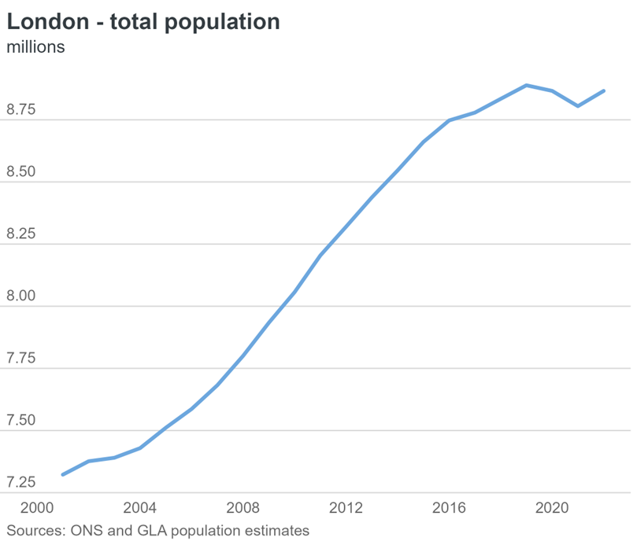
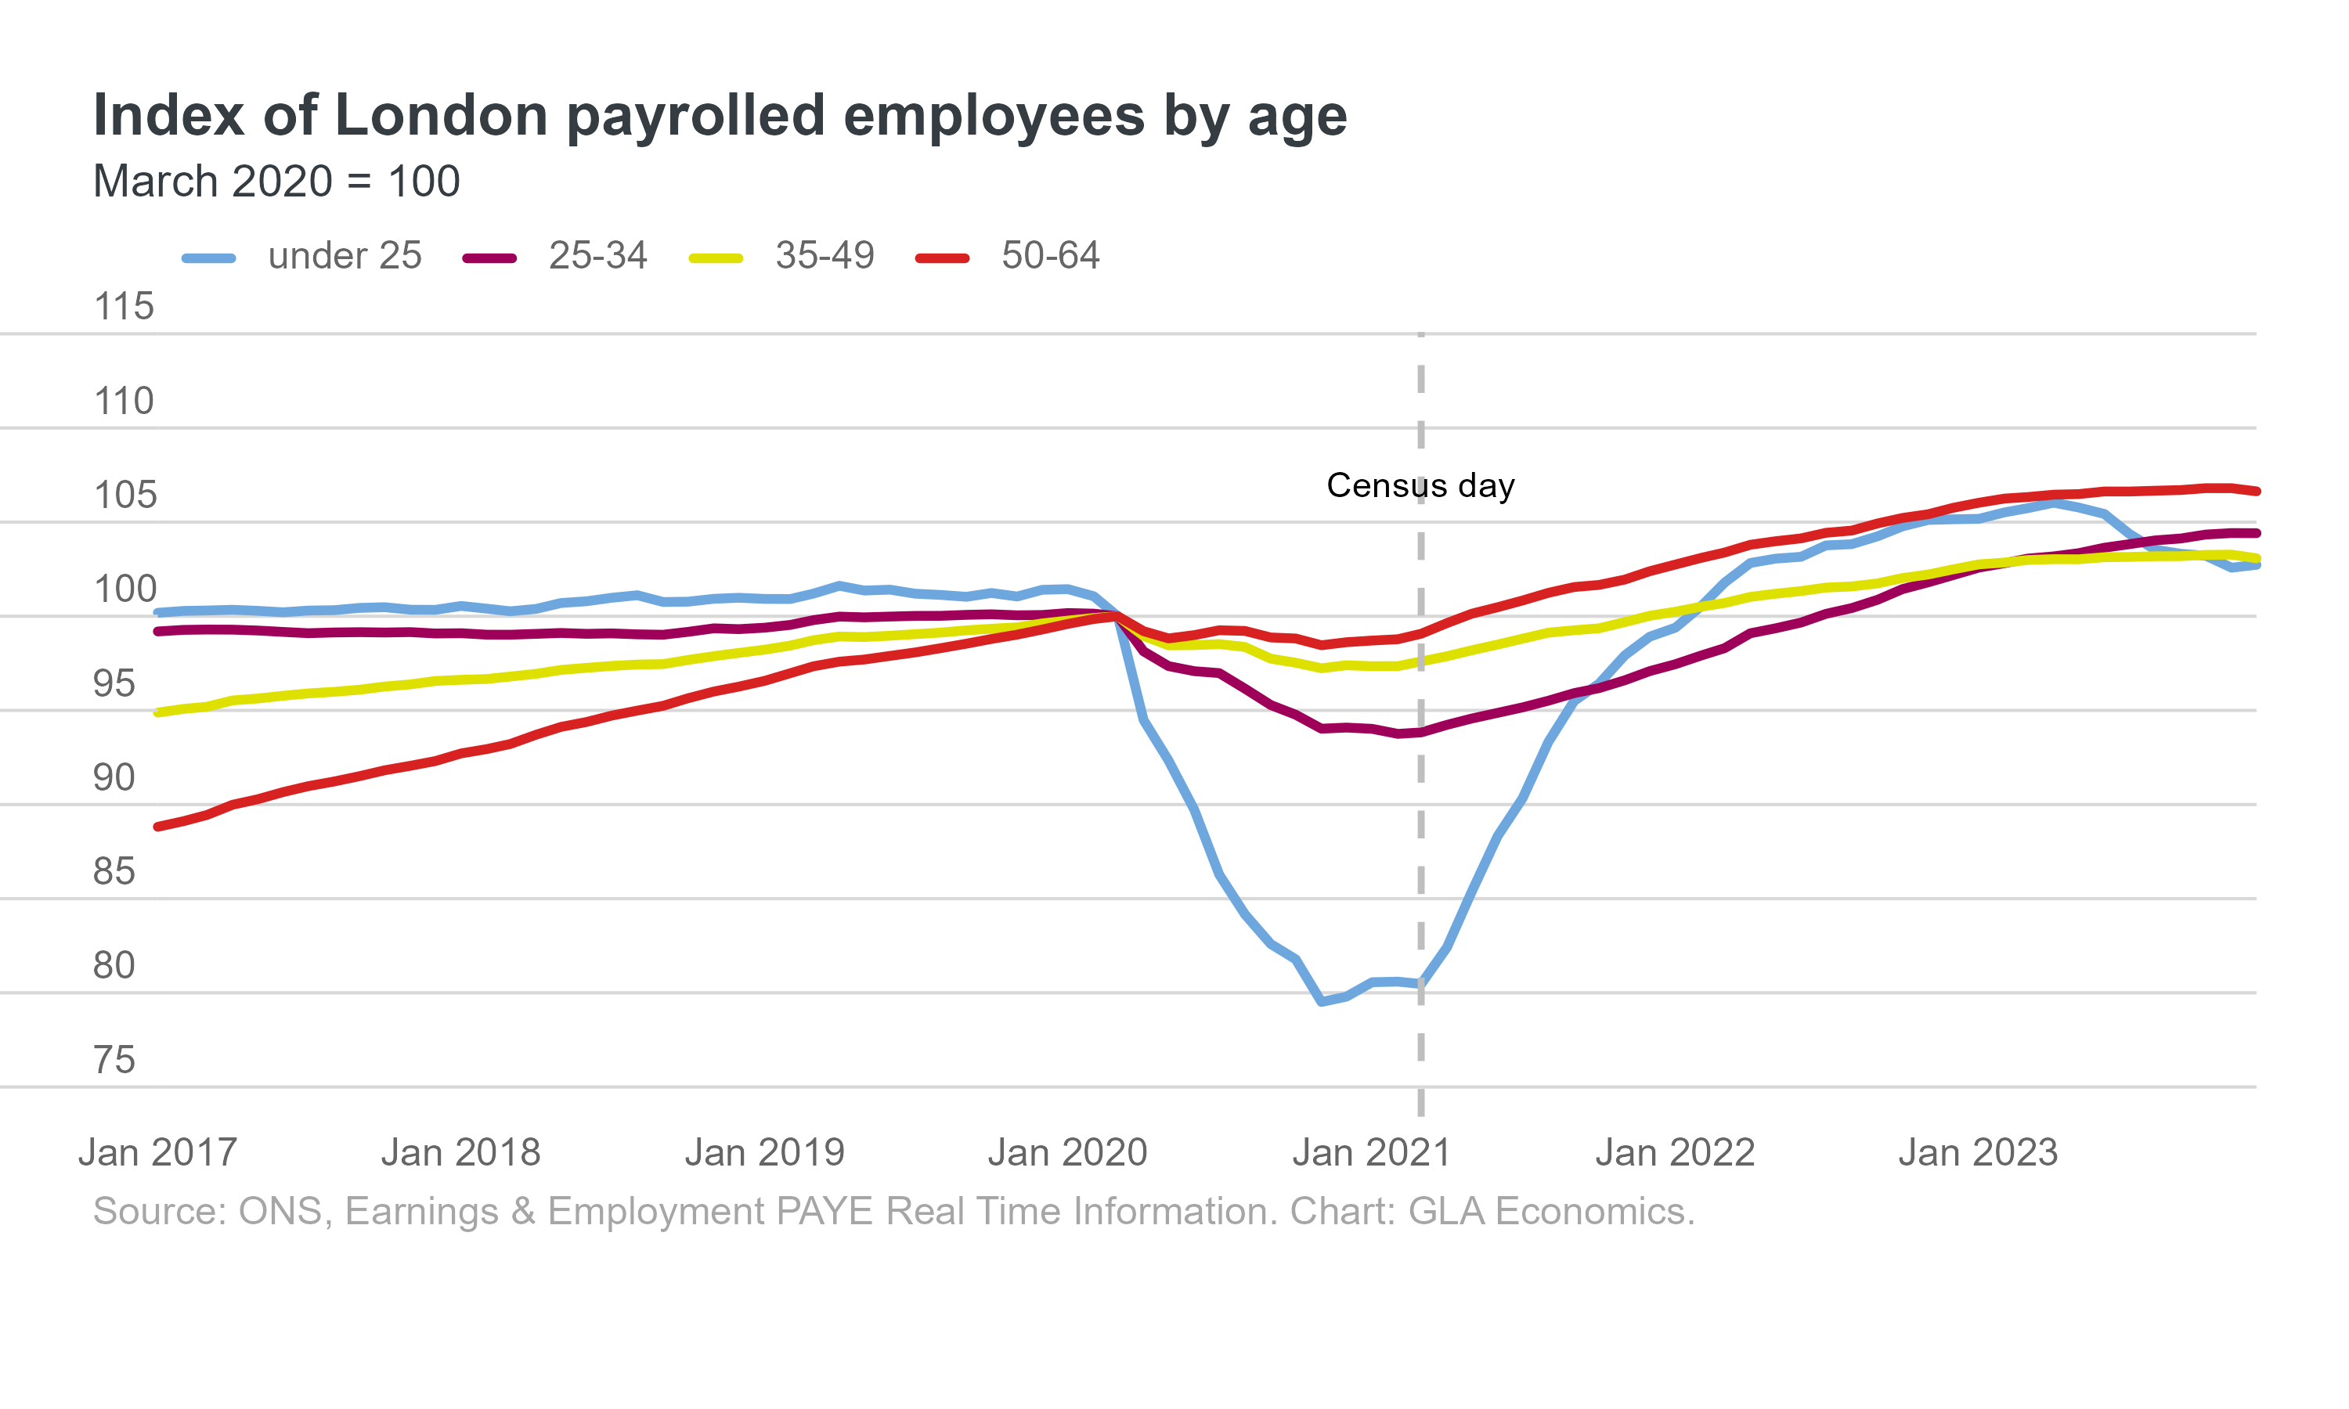
LONDON’S POULATION GROWTH HAS SLOWED SINCE 2015, WITH A TEMPORARY FALL IN POPULATION DURING THE COVID-19 PANDEMIC
London’s population growth has slowed since 2015 as a result of:¹
  Declining birth rates
  Rising domestic outflows
  A fall in international migration following the Brexit referendum.
The COVID-19 pandemic led to a temporary fall in London’s population due to relocation of families and young adults, and international movement restrictions.
Population growth resumed in the year to mid-2022, driven by a significant increase in international migration to the UK.
Fig 1. London’s population, 2000 to 2022
Fig 2. Change in number of London employees over time
Source: (1) ONS and GLA population estimates

Slide 15
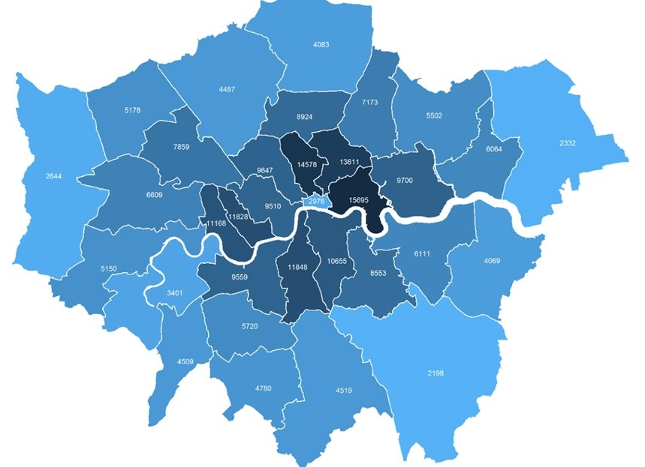

LONDON’S 2021 CENSUS DAY POPULATION WAS 8.8 MILLION, LOWER THAN 2020 OR 2022
The census population estimate of 8.8 million was likely to be close to a low point in London’s population, brought about by a temporary dip during the COVID-19 pandemic.
We know the pandemic caused some outflow of families and young adults from London and a virtual halt in international movements. We do not know how far COVID-19 affected the census responses that were recorded.
Key Census statistics
41% of Londoners were born outside UK (Rest of England 13%), and 46% were of Asian, Black, Mixed or Other ethnicities
50% of Londoners were aged 35 or under (Rest of England 43%) and 12% were aged 65 or over (Rest of England 20%)
4.2% of Londoners aged 16 or over identified as LGB+ and 0.9% said their gender identity differed from their sex at birth
12% of London’s working-age (aged 18-66) population reported they were disabled (Rest of England 17%) and 3.9% reported bad or very bad health (Rest of England 4.8%)
Figure 3. Population Density (persons per km²) by London Borough, 2021 Census
Source: England and Wales Census 2021

Slide 16
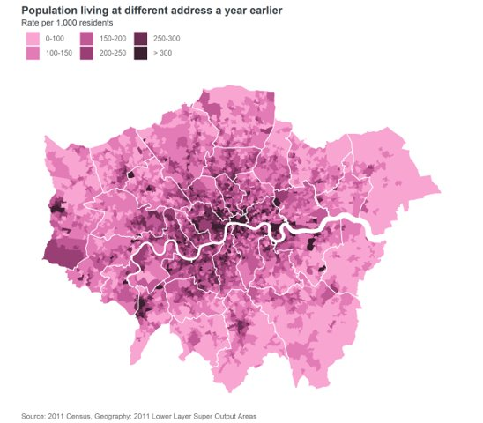
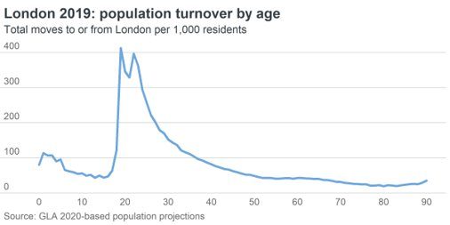
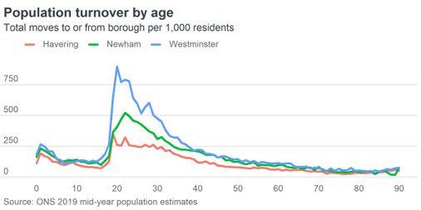
POPULATION CHURN IN LONDON
Not updated from 2022
London historically experiences very high levels of migration and mobility, with large net international inflows offset by similarly large net domestic outflows​
Fig 4. Population Churn in London: (A) Heat Map of population address changes over a year
(B) population turnover by age in London and (C) across specific London boroughs
In a typical year, over 900,000 people migrate across London’s boundary – a turnover rate of over 100 moves per 1000 residents​.
Levels of population turnover and churn vary greatly by age and location​. The highest levels are seen in Central London and near to universities
Rates are highest among young adults in their early twenties​
B
C
A
Source: 2011 Census

Slide 17
LONDON HAS LARGE POPULATIONS IN INCLUSION HEALTH GROUPS WHO ARE LIKELY TO HAVE UNIQUE HEALTH CHALLENGES
Homeless People 31,620 households in London were owed a statutory relief duty due to homelessness in 2022-23, up 11% from 2021-22.¹ Through 2022-23, 10,053 people were seen rough sleeping in London by outreach workers, up 21% from 8,329 in 2021/22, but down 9% from 2020/21.² Around 858 people were estimated to be sleeping rough in London on a single night in autumn 2022, a 34% increase from 2021.¹ These statistics provide an indication but do not capture the entire homeless population, including people living in temporary accommodation, sofa surfing and in other forms of insecure housing who have not been assessed as owed a duty​. Around 41% of homeless people have a long-term physical health and 45% a diagnosed mental health condition compared to 28% and 25% of the general population respectively.⁴ The average age at death is 43.2 years for men and 45.4 years for women.⁵
Asylum Seekers and Refugees, and Irregular Migrants Estimates suggest there were 397,000 undocumented adults and children living in London in 2017, approximately half the estimated UK-wide population at the time.​⁴ There were 25,160 supported asylum seekers in London in June 2023, with the majority in contingency hotels. London hosts one in five (21%) of the total UK asylum seeker population.⁶ Common health challenges prevalent in this group include untreated communicable diseases, poorly controlled chronic conditions, maternity care, mental health and specialist support needs.⁷
Gypsy, Roma and Travellers There were 44,580 Gypsy, Roma and Irish Travellers living in London at the 2021 Census, 0.5% of London’s total population.⁸ Studies have reported higher prevalence of long-term illness including diabetes, anxiety and depression and worse birth outcomes and maternal health in this group.⁹
Source: (1) Homelessness Statistics (2) London Datastore - CHAIN Reports (3) Local Government Association (4) London’s children and young people who are not British citizens: A profile (5) ONS - Deaths of homeless people in England and Wales (6) House of Commons Library (7) Unique health challenges for refugees and asylum seekers (8) Census 2021 (Nomis) (9) Aspinall Report

Slide 18
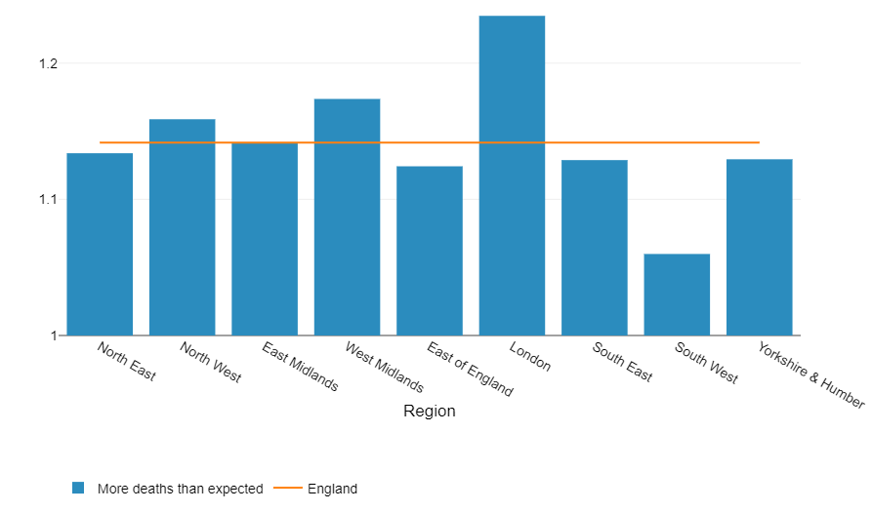
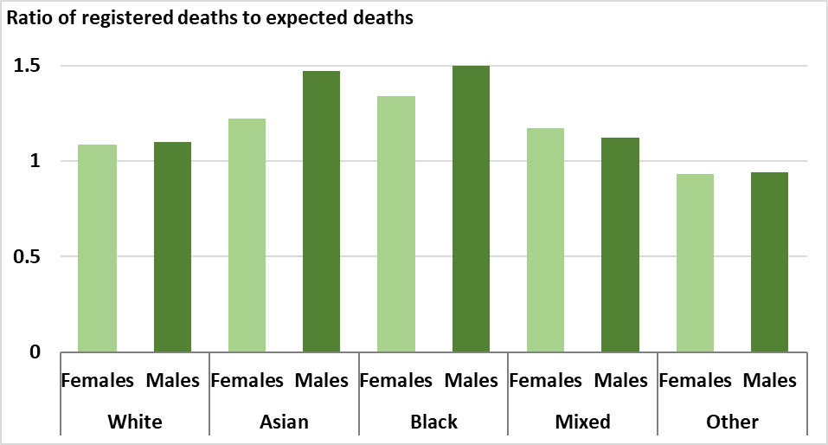
COVID-19 EXPOSED HEALTH INEQUALITIES AFFECTING DEPRIVED & MINORITY ETHNIC GROUPS
Not updated from 2022
Excess mortality refers to numbers of deaths above what would be expected in a given period. It is expressed as a ratio comparing registered deaths to expected deaths
In London, excess mortality was 1.23 times higher than expected between March 2020 and July 2021, the highest of all English regions.
The ratio was highest for males (1.5) and females (1.3) from Black ethnic groups.
Black, Pakistani and Bangladeshi communities were disproportionately exposed to the virus and experienced worse outcomes because of factors including:³
  social and economic inequalities such as living in overcrowded housing, and financial vulnerabilities
  racism, discrimination and stigma
  occupational risk, e.g. More likely to work in public-facing roles
  prevalence of conditions that increase the severity of disease including obesity, diabetes, cardiovascular diseases, and asthma.
Many of these negative experiences are shared among people in low-income groups from a range of ethnicities
Black and ethnic minority groups are over-represented in the low-income population
Fig 5. Cumulative excess mortality ratio, by regions in England, week ending 27 March 2020 to week ending 2 July 2021
Note: Excess mortality ratio (1= same as expected)
Fig 6. Ratio of deaths registered compared to those expected, by ethnic group in London, 21 March 2020 to 20 May 2022
Note: Excess mortality ratio (1= same as expected). Expected deaths based on death rates in London for each ethnic group in 2015-19
Source: (1) Health Profile for England, 2021 (2) Excess mortality in England and English region (3) Beyond the data: Understanding the impact of COVID-19 on BAME groups

Slide 19
PART 2: HEALTH INEQUALITY IN HEALTH STATUS

Slide 20
PART 2 OVERVIEW: HEALTH INEQUALITY IN HEALTH STATUS
Broad indicators of health status include life expectancy, and its variations such as healthy life expectancy and disability-free life expectancy, as well as measures of child health. These measures generally show a worsening trend in London since 2017.
Most data on inequalities in these indicators by geography and deprivation have not yet been updated post the 2021 Census and previous estimates are unreliable due to their reliance on earlier mid-year population estimates. They therefore must be treated with caution until they are revised.
Reports into racial inequalities in health status in the UK have found a complex pattern of health inequalities and different patterns of disease and mortality in people from different ethnic groups. The picture is likely to have been impacted by the COVID-19 pandemic and cost of living crisis London.
The following sections are explored in this part of the Snapshot:
  Life expectancy
  Healthy life expectancy
  Disability-free life expectancy
  Low birthweight
  Ethnic inequalities in health status and disease patterns

Slide 21
LIFE EXPECTANCY AT BIRTH HAS RECOVERED FROM ITS COVID-19 DIP
Fig 7. Trend in life expectancy at birth for females and males in London, three year rolling (dotted line) and single year (solid line), 2010-2022
In 2022, the life expectancy at birth for males and females increased and returned to pre-pandemic peaks following a COVID-19 dip, at 80.3 and 84.4 years respectively.
The three-year rolling average for life expectancy at birth shows a longer trend, but is sensitive to the unique impact of the COVID-19 pandemic on mortality, resulting in the appearance that life expectancy at birth has not yet recovered to previous highs following the pandemic.
Life expectancy at birth in London on both a three-year and single-year basis was consistently higher than the England average before the pandemic. In 2020, life expectancy at birth for males in London fell below the England average, though the gap now shows signs of reversing and widening back out to pre-pandemic levels.
Some boroughs in London did not experience significant declines in life expectancy during COVID-19 and have had a relatively stable life expectancy for both males and females in recent years.
COVID pandemic years 2020 & 2021
Females
Males
Source: OHID PHOF Indicators

Slide 22
LIFE EXPECTANCY AT BIRTH VARIES SIGNIFICANTLY ACROSS LONDON BOROUGHS
Between 2020-2022, there were significant differences in life expectancy at birth across London boroughs¹. The range for each gender was:
Males: 76.3 years in Barking and Dagenham to 82.4 years in Richmond upon Thames
Females: 80.4 years in Barking and Dagenham to 86.3 years in Kensington and Chelsea
Variation in the life expectancy at birth correlates with 2019 Indices of Multiple Deprivation Scores at the London borough level (Fig. 8), reflecting a common pattern seen across England².
Fig 8. Life expectancy at birth by deprivation for London boroughs, 2020-2022
Kensington & Chelsea
Richmond
Barking & Dagenham
Richmond
Barking & Dagenham
Source: OHID PHOF Indicators (2) ONS: Health state life expectancies by national deprivation deciles, England: 2018 to 2020

Slide 23
HEALTHY LIFE EXPECTANCY IN LONDON
Healthy life expectancy (HLE) provides an estimate of lifetime spent in 'very good' or 'good' health, based on how individuals perceive their general health
HLE has not changed significantly in London since 2011-13, while it has decreased in London overall.
Between 2020-22, HLE at birth for both males and females in London was higher than for England at 63.9 years and 63.7 years respectively. This represents the first time that males had a higher HLE than females since 2011-13.
Males on average spent 80.8% of their life in ‘good’ health versus 76.2% for women.
Fig 9. Trend in healthy life expectancy at birth, by sex, London compared to England, 2011-13 to 2020-22
Male
Female
London
London
England
England
Source: PHE Public Health Outcomes Framework - Healthy life expectancy at birth

Slide 24
HEALTHY LIFE EXPECTANCY VARIES SIGNIFICANTLY ACROSS LONDON BOROUGHS
Data on this slide should be interpreted with caution. It is based on population estimates extrapolated from the 2011 Census. These were notably different from the population measured at the 2021 Census.
Between 2018-2020, there were significant differences in healthy life expectancy across London boroughs. The range for each gender was:
Males: 58.1 years in Barking and Dagenham to 70.2 years in Richmond upon Thames
Females: 57.8 years in Tower Hamlets to 70.1 years in Wandsworth
More deprived boroughs tended to have a lower healthy life expectancy for both males and females (Fig 10.)
Note: Healthy life expectancy is defined in the OHID Fingertips Public Health Outcomes Framework (PHOF) as 'A measure of the average number of years a person would expect to live in good health based on contemporary mortality rates and prevalence of self-reported good health. The prevalence of good health is derived from responses to a survey question on general health’
Fig 10. Healthy life expectancy at birth by deprivation for London boroughs, 2018-2020
Richmond
Wandsworth
Tower Hamlets
Barking & Dagenham
Source: PHE Public Health Outcomes Framework - Healthy life expectancy at birth

Slide 25
DISABILITY FREE LIFE EXPECTANCY IN LONDON
Between 2020-2022, Londoners could expect to live just under one fifth (19%) of their lives with a disability, a similar proportion to the previous year. Disability-free life expectancy has declined by 2 years for women since 2014-16, but not changed significantly for males.
Data below should be interpreted with caution. It is based on population estimates extrapolated from the 2011 Census. These were notably different from the population measured at the 2021 Census.
In 2018-20, there was significant variation in the proportion of life spent with disability across London. For males, this varied from 26% in Greenwich, to 12% in Southwark; while for females, this ranged from 35% in Hammersmith and Fulham, to 18% in Wandsworth
The relationship between disability-free life expectancy and proportion of life spent with disability for London boroughs (Fig. 11) demonstrates that lower disability-free life expectancy is not wholly explained by lower life expectancy, suggesting that significant inequalities in morbidity as well as mortality occur across geographies.
Fig 11. Percent of life spent with a disability, by disability free life expectancy from birth, London Borough and sex, 2018-20
Kensington & Chelsea
Bromley
Greenwich
Hammersmith & Fulham
Male
Southwark
Female
Wandsworth
Note: Disability-free life expectancy is defined as the average number of years a person aged 'x' would live disability-free (no limiting long-term illness) if he or she experienced the particular area's age-specific mortality and health rates throughout their life.
Source: ONS Health state life expectancies, UK
Notes:
Updated

Slide 26
LOW BIRTHWEIGHT IN LONDON CORRELATES WITH BOROUGH LEVEL DEPRIVATION
Low birthweight (weight less than 2,500 grams) is associated with an increased risk of infant mortality, developmental problems in childhood and poorer health in later life.¹
In 2021, 3.3% of babies born at term had low birthweight, which is higher than the England average (2.9%). Unlike England, which shows a stable rate, this represents part of a continuing worsening trend since 2017.¹
The proportion of low birthweight babies varies significantly by borough. As of 2021:¹
  The range in proportion went from 2.1% in Kingston upon Thames to 5.1% in Newham
  Newham (5.1%) and Tower Hamlets (4.3%) rank in the top five local authorities in England for highest proportion of low birthweight babies.
  The proportion of low birthweight babies in London boroughs correlates with the average deprivation level of that borough (Fig 12).
Note: Low birthweight is more common in some Black, Asian and minority ethnic groups. For example, Indian, Pakistani and Bangladeshi infants are 280–350 g lighter, and 2.5 times more likely to be low birthweight compared with White infants due likely to a combination of genetic and social determinants.² These population groups are more prevalent in London and unequally distributed across London boroughs.
Fig 12. Percentage of low birthweight babies at term by deprivation for local authorities in London, 2021
Newham
Barking & Dagenham
Richmond
Kingston
Source: (1) Child and Maternal Health – Low Birthweight (2) Kelly et al

Slide 27
PRE-EXISTING ETHNIC HEALTH INEQUALITIES WERE EXACERBATED DURING COVID-19
The most recent official data for life expectancy by ethnicity in England and Wales are from 2011-14 (based on follow-up of the 2011 Census).
This showed complex inequalities in life expectancy and cause-specific mortality for different ethnic groups in England and Wales.¹
White and Mixed ethnic groups had lower life expectancy at birth than all other ethnic groups, while the Black African group had a higher life expectancy than most groups.
Mortality rates were significantly higher for minority ethnic groups during the pandemic, suggesting that any previous life expectancy advantages were moderated during that time¹.
Monthly mortality data by ethnic group for England up to January 2023 (Fig. 13) shows that inequalities have since reduced. In January 2023, Black people had a lower mortality rate than White people.
Fig 13. Age-standardised monthly mortality rates per 100,000 person-years in England by ethnic group, March 2020 to January 2023
Source: (1) ONS Ethnic Difference in Life Expectancy (2) COVID-19: review of disparities in risks and outcomes (3) OHID CHIME Tool

Slide 28
ETHNIC INEQUALITIES EXIST IN INCOME, EMPLOYMENT AND DISEASE PATTERNS
Not updated from 2022
A research review of ethnic disparities in mortality by the UK's Commission on Race and Ethnic Inequalities found that:¹
  People in Bangladeshi, Pakistani and Black ethnic groups are the most likely to be living in deprived neighbourhoods
  Unemployment rates are highest among Black, Bangladeshi, and Pakistani populations, while White and Indian groups are more likely to be in employment
  People in Bangladeshi, Pakistani, Chinese and Black ethnic groups are around twice as likely to be living on a low income, and experiencing child poverty, as White people
The report also highlights ethnic differences in disease patterns including:¹
  People from South Asian ethnic groups have greater risk of heart disease, hypertension and diabetes than White people
  Black people are at higher risk of hypertension and diabetes but lower risk of heart disease than White people
  People from South Asian ethnic and Black ethnic groups have higher risk of type 2 diabetes and stroke
  People from South Asian ethnic groups have a much lower, and Black ethnic groups a slightly lower incidence of ‘all cancers’, compared to people in the White ethnic group (though patterns vary for different cancer types)
Source: Ethnic disparities in the major causes of mortality and their risk factors

Slide 29
PART 3: WHY INEQUALITY EXISTS?
WIDER DETERMINANTS OF HEALTH
(‘Causes of the causes’ of health inequalities)

Slide 30
PART 3 OVERVIEW: WIDER DETERMINANTS
Wider determinants known as the 'causes of the causes' affect opportunity for good health – as they relate to where we live, work, our income and ultimately influence the opportunities to be active, to eat well, to live securely, and to grow and age well
Wider determinants influence propensity towards health harming behaviours and health inequalities, far more than healthcare access and quality alone (which accounts for only 10-20% of our opportunity to live healthy lives).
The narrower the gap in social inequalities across the wider determinants, the greater will be the benefit to health inequalities.
Most data presented highlights inequality in those from more deprived backgrounds, certain geographic regions, and Black and ethnic minority groups as that is where data is available. It is important to recognise a major limitation is that there are likely to be other dimensions of inequalities (across other protected characteristics and inclusion health groups where inequalities exist) but cannot be demonstrated using data, as it is unavailable or of insufficient quality.
This part has been structured according to the Marmot 8 principles for addressing inequality and includes topics below:
  5. Healthy and sustainable places and communities
    Housing
    Active Travel
    Green Space
    Air Pollution
    Neighbourhood Cohesion
    Civil Strength
    Built Environment
    Crime
  Give every child the best start in life
    School Readiness
  Enabling children, young people and adults to maximise their capabilities
    KS4 educational attainment
    Mental Health
  Fair employment and good work for all
    Income and Employment
  Healthy standard of living for all
    Poverty and Cost of Living
  6. Ill Health prevention
    See Part 4
  7. Racism and Discrimination
    Perceived discrimination
  8. Environmental Sustainability and Equity
    Climate Risk
Source: Health Equity in England: The Marmot Review 10 Years On

Slide 31
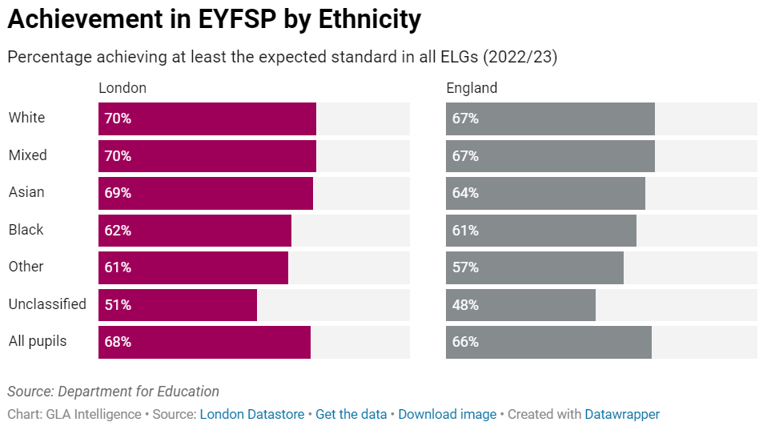
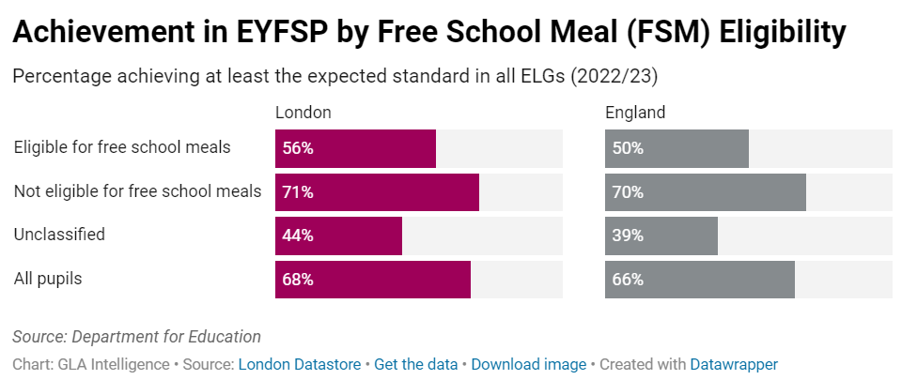
LONDON CHILDREN EXHIBIT HIGH LEVELS OF SCHOOL READINESS BUT INEQUALITIES EXIST
1. GIVE EVERY CHILD THE BEST START IN LIFE
In 2022, Early Years Foundation Stage Progress (EYFSP) tests have shown higher levels of school readiness among London’s young children (aged 5 years) than those in every other region of England, except for the South East which scores highest overall.
However, significant inequalities exist (Fig. 15):
  Almost half of children eligible for free school meals (FSM) in London (44%) do not meet the expected school readiness standard, relative to 29% for children not eligible.
  Children of Other (61%) and Black (62%) ethnicity are least likely to achieve the required standard, while White and Mixed ethnicity children are the most likely (both 70%). Chinese children (79%) are most likely to achieve the expected standard across Early Learning Goals (ELG).
  Children with a first language other than English, or with a Special Educational Need or Disability (SEND) are also less likely to meet the standard than other children.
Note: There were no assessments in 2020 and 2021 due to the pandemic, but the EYFSP publication resumed for the 2021-22 academic year. Children in this analysis were aged 3 at the beginning of the pandemic.
Fig 15. Achievement in Early Years Foundation Stage Progress (EYFSP) by ethnicity and Free School Meal eligibility, 2022/23
Source: (1) London Datastore – School Readiness

Slide 32
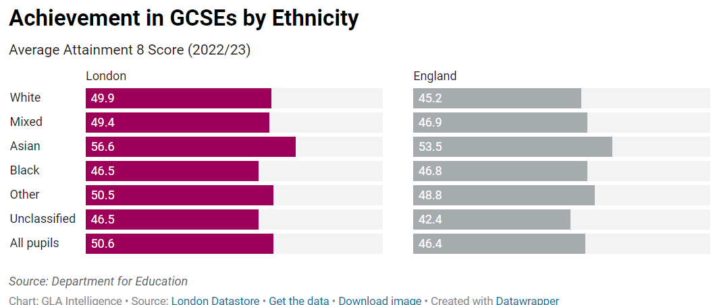
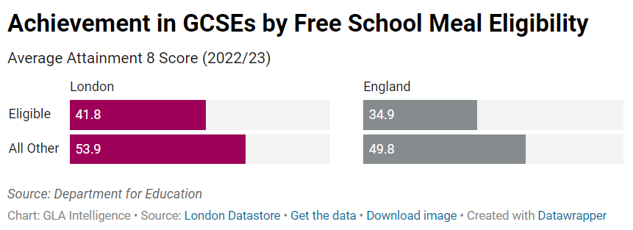
KS4 ATTAINMENT GAPS EXIST BY ETHNICITY, SPECIAL NEEDS AND FSM ELIGIBILITY STATUS
2. ENABLING CHILDREN, YOUNG PEOPLE AND ADULTS TO MAXIMISE THEIR CAPABILITIES
Pupils at London’s schools have higher GCSE scores than those from other English regions. The average 'Attainment 8' score, which gives a score across various core and optional elements, is more complex than the previous GCSE measures.
London pupils do better than those across England as a whole, on each element of the Attainment 8 score and across almost all attributes from ethnicity to free school meal (FSM) status.
  The exception showing in the scores from 2022/23 is that Black pupils – both boys and girls in London had slightly lower average Attainment 8 scores than Black pupils for England as a whole.
  The average Attainment 8 score in London was 50.6 in 2022/23, lower than the results given for the pandemic years (52.7 in 2021/22), but higher than in 2018/19, the last year of “normal” grading – 49.7.
Attainment gaps also exist by ethnic group, FSM eligibility, Special Educational Needs (SEN) status and disadvantage status.
Note: Due to the COVID-19 pandemic, GCSE exams were cancelled in 2020 and 2021. Pupils’ grades were determined through other methods, meaning GCSE results from 2019/20 and from 2020/21 onwards are not comparable with those from other years.
Fig 16. Achievement in Average Attainment 8 Score by Ethnicity and Free School Meal eligibility, 2022/23
Source: (1) London Datastore – KS4 Achievement

Slide 33
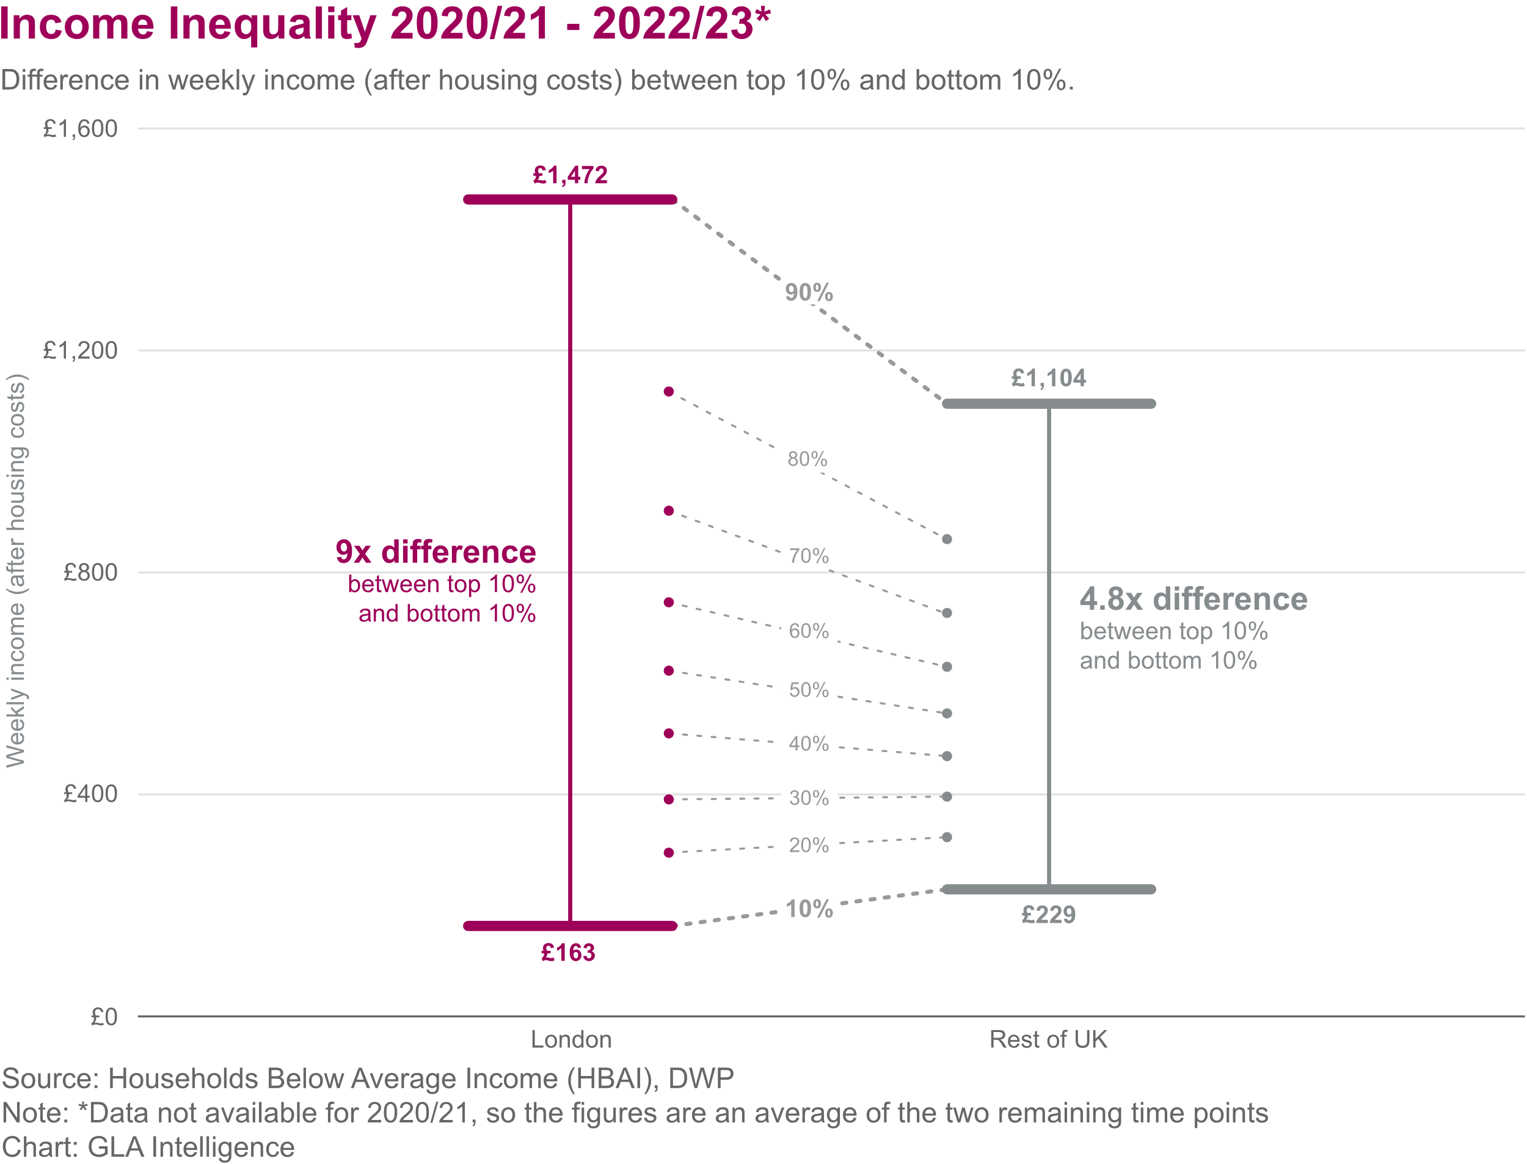
LEAST DEPRIVED LONDONERS RECEIVE 9 TIMES MORE INCOME THAN THE POOREST DECILE
3. FAIR EMPLOYMENT AND GOOD WORK
The richest tenth of Londoners have around 9 times the income of the lowest income households in London.¹
  The differences in income are much greater in London than in the rest of the UK, particularly after the high costs of housing in the capital accounted for.
  London has one of the highest rates of poverty of any region in the UK in 2020/21-2022/23*, with around a quarter (24%) of London residents in poverty after housing costs. ²
The unemployment rate in London is above the UK average but varies widely within the capital and despite improvements persistent inequalities in labour market outcomes remain: ³
  The employment gap between disabled and non-disabled Londoners has continued to decrease. In 2023 this was 21 percentage points (pp), with a larger gap between disabled and non-disabled men (28pp) than for women (14pp). ⁴
  The employment gaps between White and all other ethnic minority groups combined has risen slightly between 2022 and 2023 both in London and nationally. Significant gaps still remain, most notably in London, between White and Mixed ethnicity men and White and Black men (both 19pp) and between White and Bangladeshi/Pakistani women (28pp).
Fig 17. Difference in weekly income (after housing costs) between top and bottom deciles in London and UK (2020/21-2022/23*)
*Issues with carrying out surveys during the pandemic and reduced response rates since March 2020 mean there is increased uncertainty in the figures.
Source: (1) London Datastore - Income Inequality (2) London Datastore – Population in Poverty (3) London Datastore – Unemployment Rate (4) London Datastore - Employment Gaps

Slide 34




POVERTY IMPACTS ON HEALTH AND WIDER LIFE CHANCES. TO UNDERSTAND THE LONDON PICTURE MULTIPLE POVERTY MEASURES MUST BE CONSIDERED
4. HEALTHY STANDARD OF LIVING
Poverty damages physical and mental health, and poor health increases the risk of poverty.¹
There are different ways to measure poverty. Two commonly used measures of poverty are:
  Relative poverty: where household income is a certain percentage below median incomes
  Absolute poverty: where household income is below a necessary level to maintain basic living standards
To enable comparisons, this section will mainly use relative poverty measures, however key findings from other poverty measures will also be outlined to build a picture of who is most affected and the trends.
Whilst the latest available data on poverty are presented here at the time of writing, due to data publication timings it will not fully reflect the most recent impact of the cost of living crisis.
Fig 18. Health effects of poverty, adapted from The Health Foundation¹
An inadequate income can cause poor health
because it is more difficult to:
Avoid stress and feel
in control
Access experiences and material resources
Adopt and maintain healthy behaviours
Feel supported by a financial safety net
Living with the day-to-day stresses of poverty in early childhood can have damaging consequences for long-term health.
Money allows people to access better quality living conditions, including housing, and to fully participate in society.
Healthy behaviours can feel unattainable. It can be more expensive to get the energy we need from health foods from unhealthy foods.
A safety net enables people to invest in their future, including studying and retraining.
Source: (1) The Health Foundation - Poverty and health

Slide 35
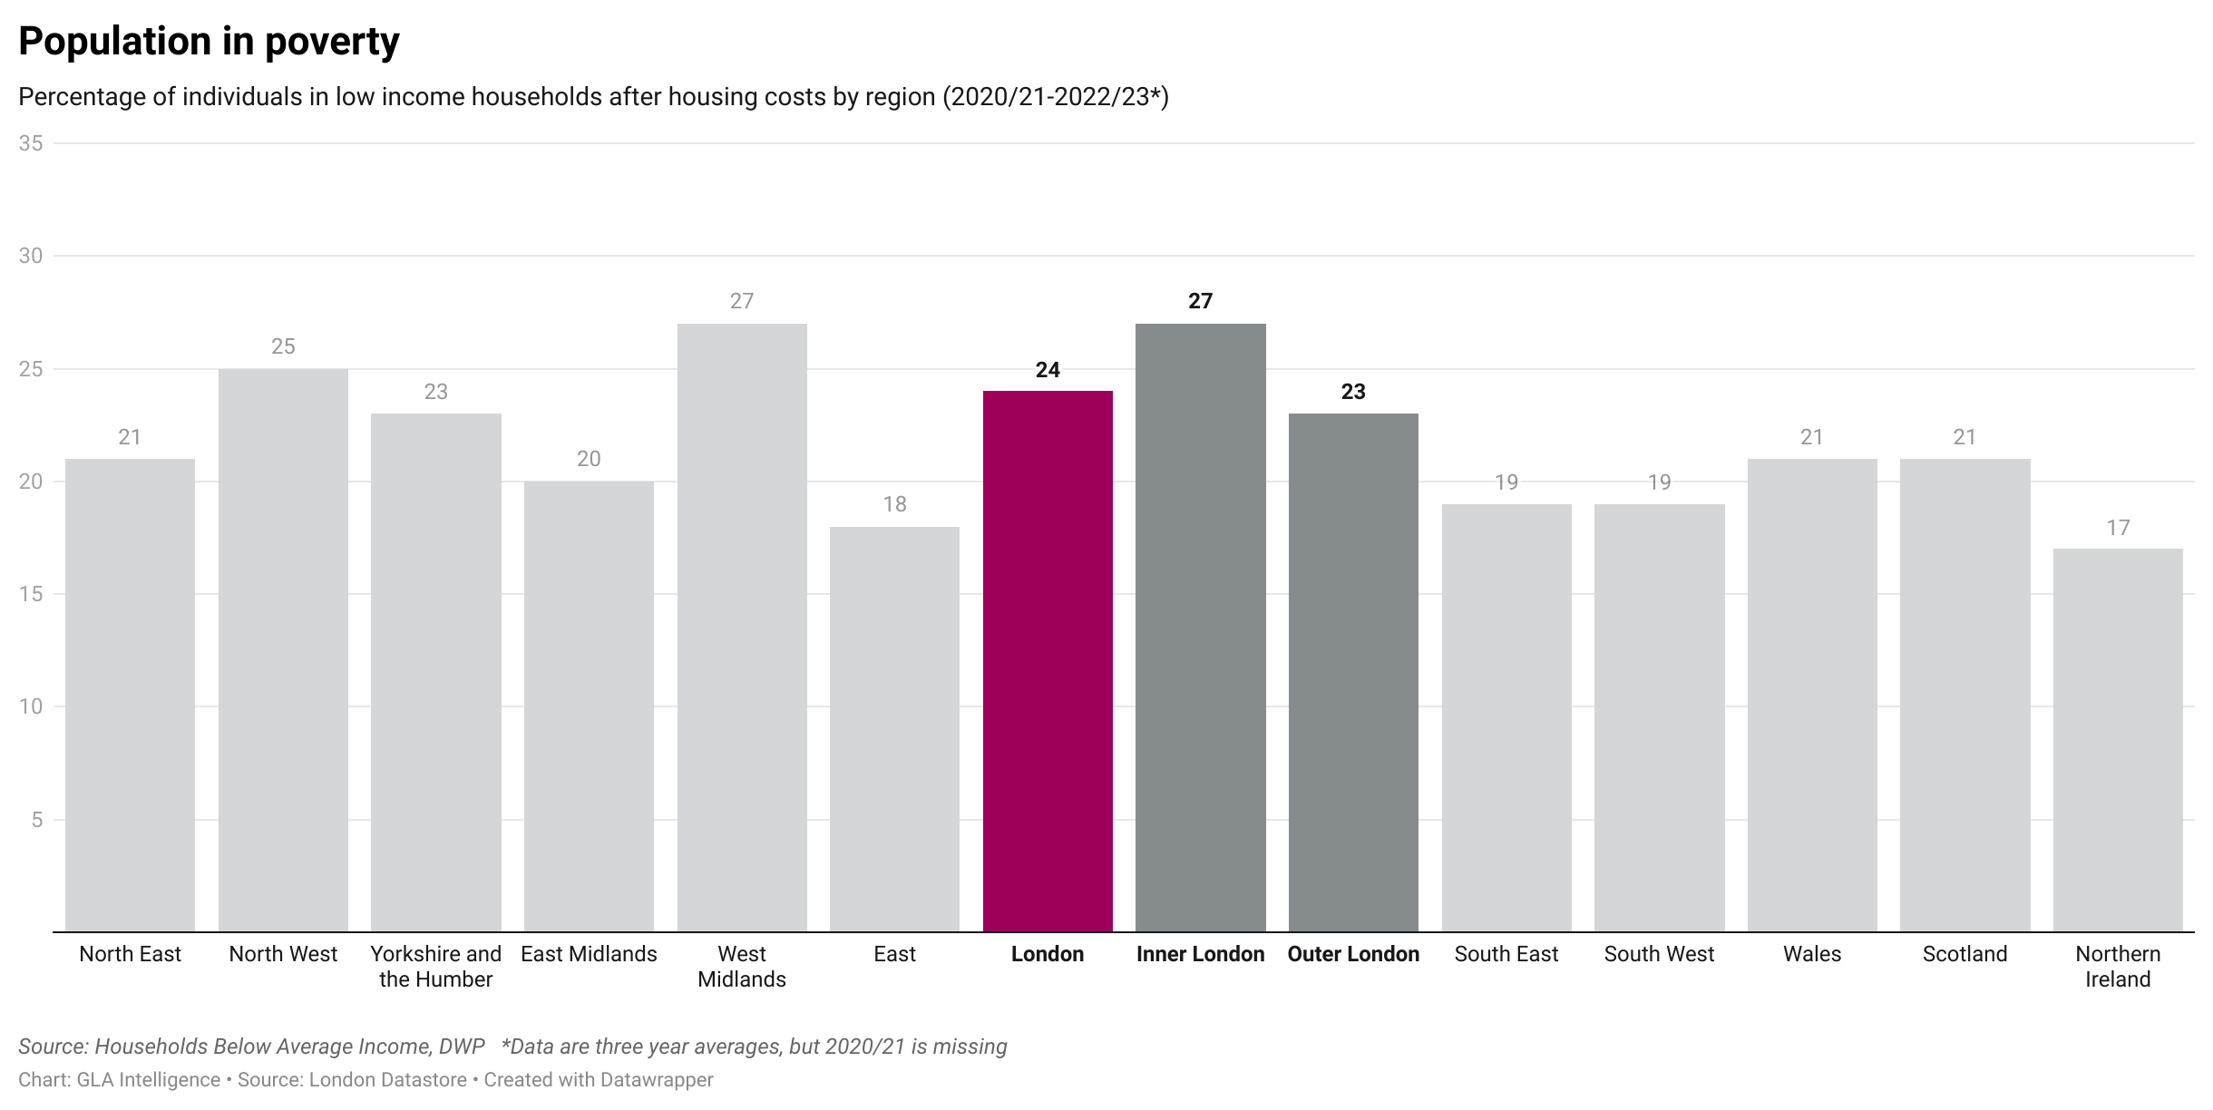
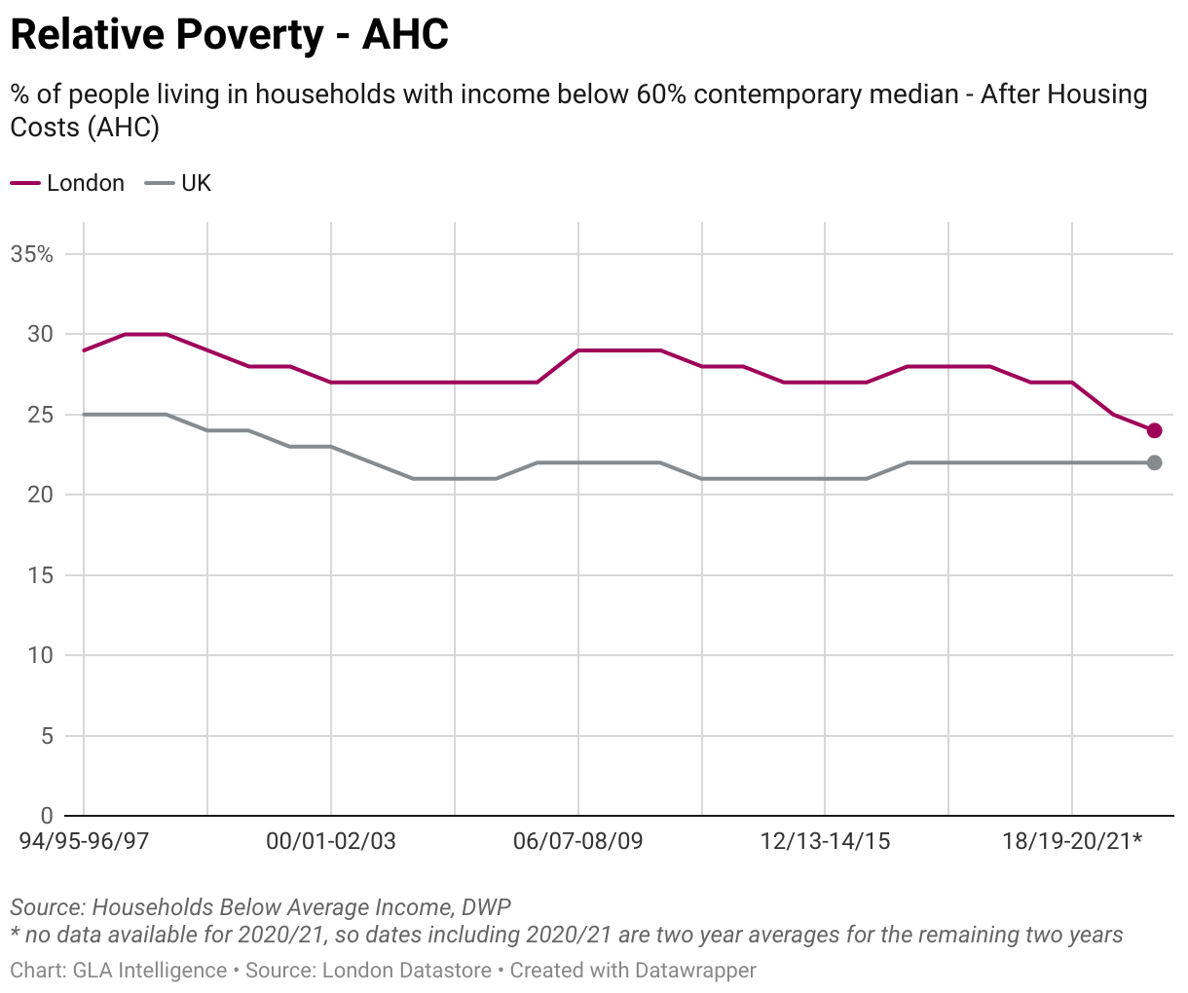
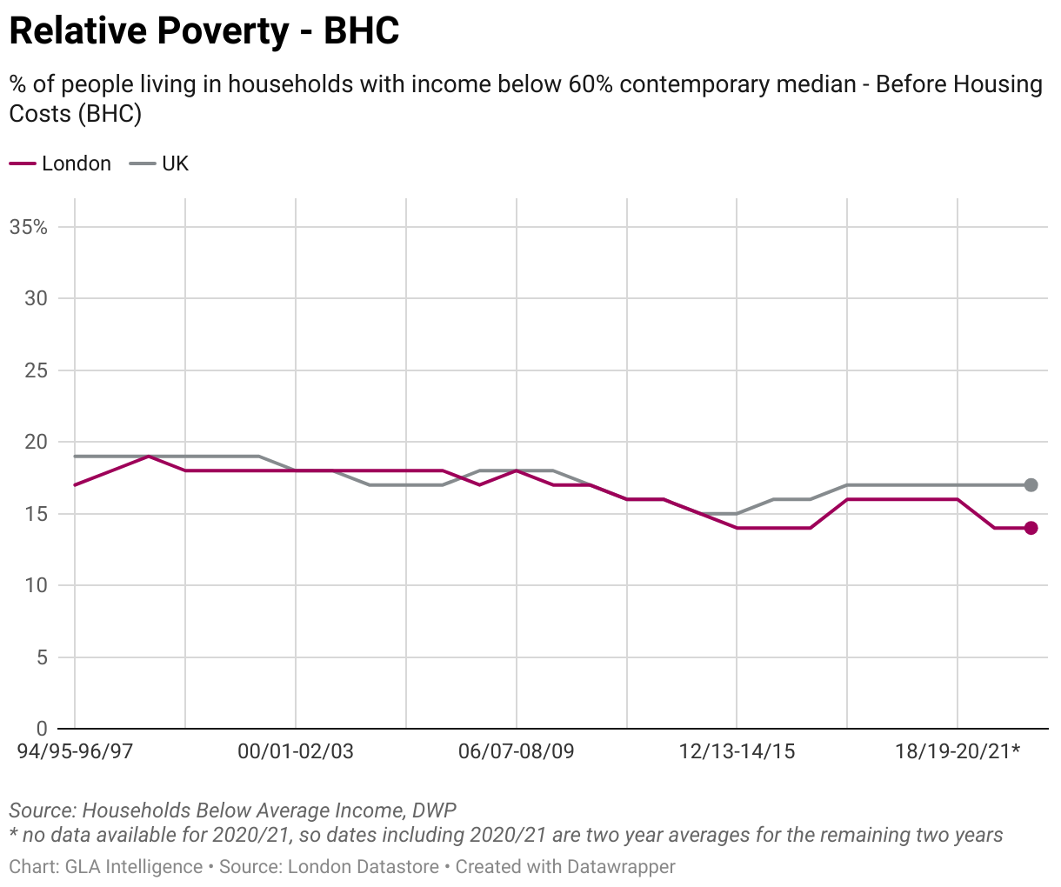
A QUARTER OF LONDONERS ARE LIVING IN RELATIVE POVERTY, A RATE CONSISTENTLY HIGHER THAN THE UK
4. HEALTHY STANDARD OF LIVING
Around one in four (24%) Londoners were in relative poverty after housing costs (AHC) in 2020/21-2022/23 relative to 22% for the UK¹:
  London is no longer the region with the highest level of poverty, behind the West Midlands and North West* (27% and 25% respectively; Fig. 19).
  Despite a higher poverty rate in Inner London, more people live in poverty in Outer London due to population size.
  Relative poverty in London has been stable and higher than the national average for at least the last two decades (Fig. 20)
  When relative poverty before housing costs is compared, London has a lower rate than the UK, indicating that housing costs are an important driver of elevated poverty levels in London.
In 2020/21 to 2022/23, the rate of absolute poverty AHC in London was 20%, compared to a UK-wide rate of 18%.²
Fig 19. Proportion of households in relative poverty after housing costs, 2020/21 – 2022/23¹
UK rate
Fig 20. Percentage of households with income below 60% median in London and the UK, 1994/95-2022/23, after housing costs (left) and before housing costs (right)
*Note: Due to the impact of the pandemic on data collection, the Department for Work and Pensions (DWP) advises caution when making comparisons with previous years and when interpreting larger changes.
Source: (1) London Datastore – Poverty, (2) Economic Fairness – Absolute Poverty – London Datastore

Slide 36
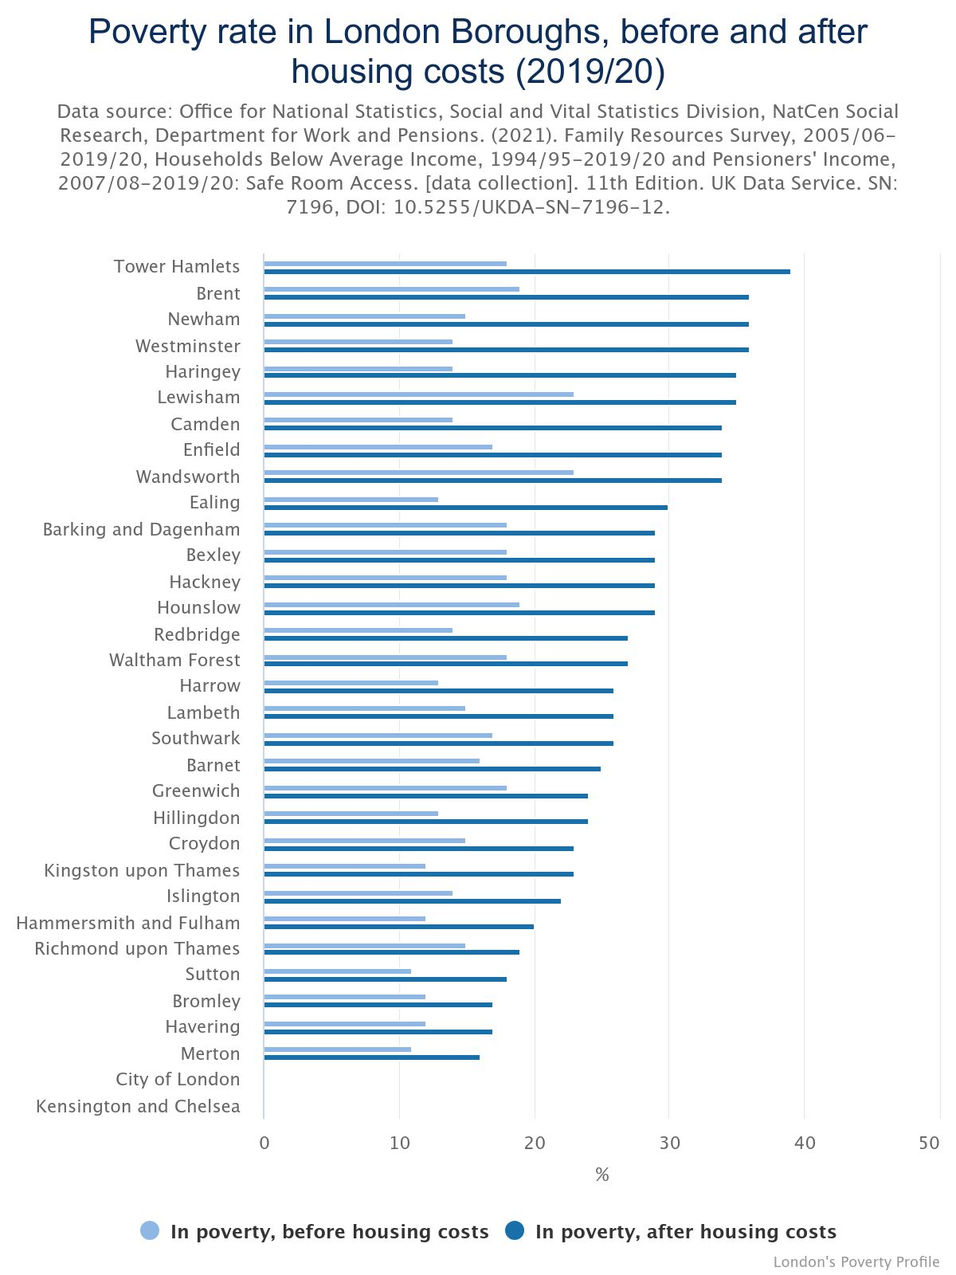
POVERTY RATES VARY ACROSS LONDON BOROUGHS, AND ARE SIGNIFICANTLY IMPACTED BY HOUSING COSTS
4. HEALTHY STANDARD OF LIVING
Concentrating on the measure of relative poverty, and comparing rates before and after housing costs are taken into consideration, the most recent pooled poverty rates for London Boroughs indicate:¹
  Westminster has the most dramatic impact of housing costs on its poverty rate, with a 22 percentage point increase after housing costs (AHC) are factored in, while Richmond sees the smallest change in poverty rate at 4 percentage points.
  Haringey, Newham, Tower Hamlets, and Camden also see a change in the BHC/AHC poverty rate of greater than 20 percentage points.
*No data for Kensington and Chelsea, and City of London in Figure 20 due to small sample sizes
Fig 21. Poverty rate in London Boroughs, before and after housing costs, 2019/20¹
Source: (1) London's Poverty Profile: borough-level poverty 2022 | Trust for London
*

Slide 37
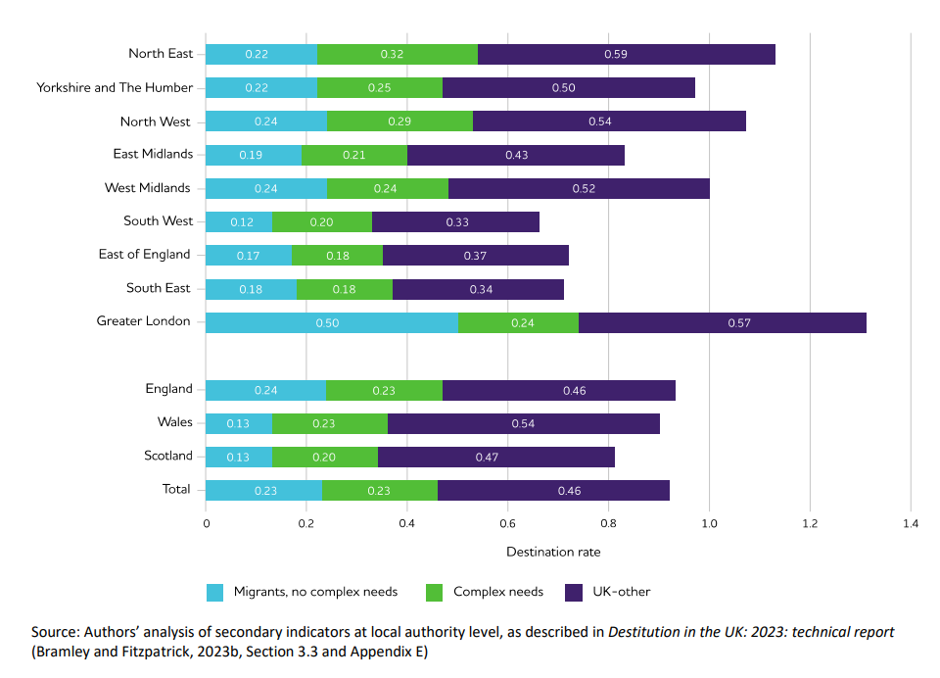
LONDONERS EXPERIENCE HIGHER RATES OF PERSISTENT POVERTY AND DESTITUTION COMPARED TO THE UK
4. HEALTHY STANDARD OF LIVING
Persistent poverty refers to being in poverty in the current year and at least two of the three preceding years. It is a particularly important issue for health, because prolonged periods of poverty have cumulative effects.¹
  Around one in seven (14%) of all Londoners live in households in persistent poverty (after housing costs), and rates are consistently higher in London compared to the UK at 12%.²
The Joseph Rowntree Foundation has investigated the scale of destitution, which is where people cannot afford to meet their most basic physical needs to stay warm, dry, clean and fed. This most extreme form of material hardship impacts on heath, mental health and people’s prospects.³
  London had the highest overall destitution score in 2022, replacing the North East as the region with the highest destitution rates since 2019.
  This higher rate of destitution in London was driven by relatively high levels of destitution in both migrant populations and other Londoners without complex needs (i.e. not experiencing two or more of homelessness, drug and/or alcohol problems, offending, domestic violence or begging)
Figure 22: Destitution rates estimated from secondary indicators, by region or country and by analytical subgroup % of households, weekly basis, 2022
Destitution rate
Source: (1) Inequalities in persistent poverty - The Health Foundation, (2) Economic Fairness – Persistent Poverty – London Datastore, (3) Destitution in the UK 2023 | Joseph Rowntree Foundation (jrf.org.uk)

Slide 38
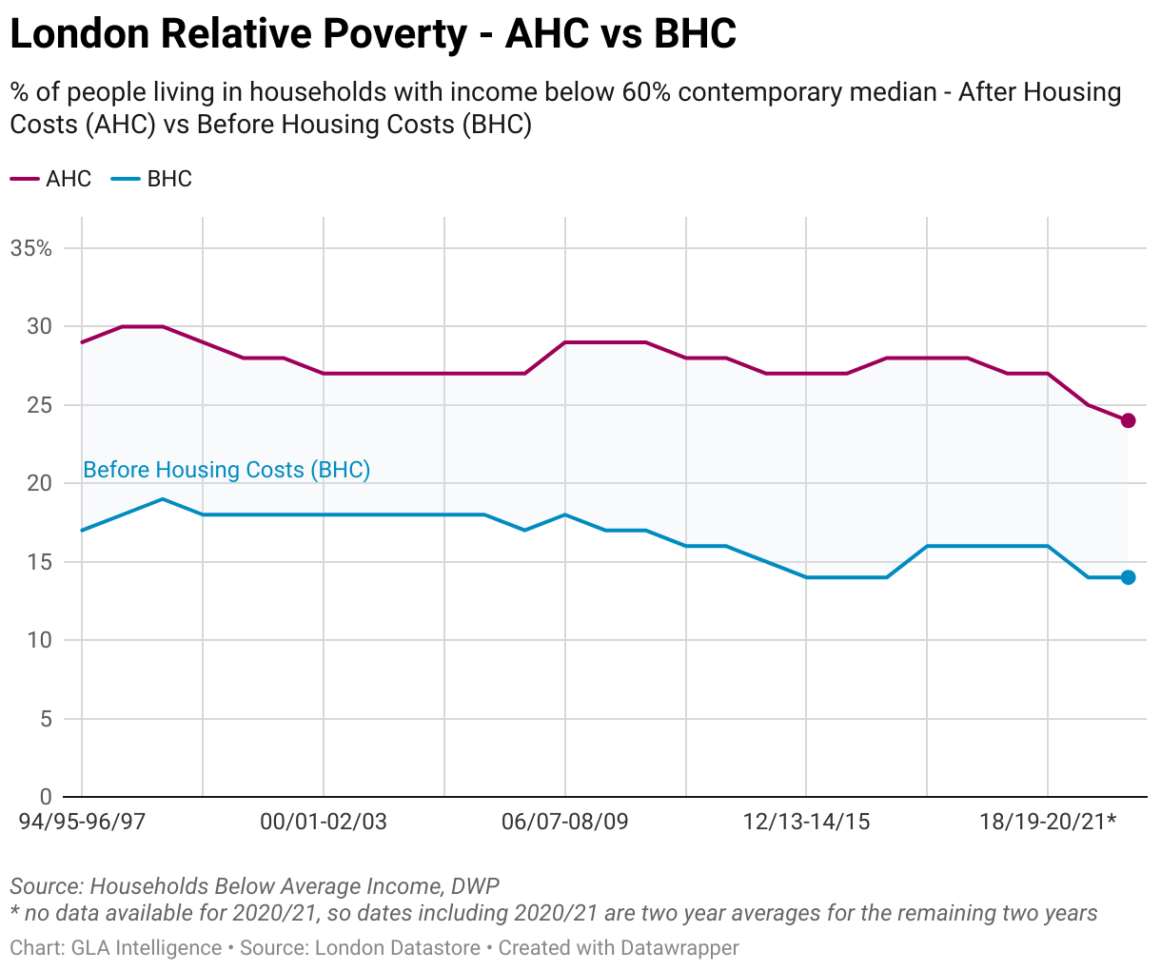
DRIVERS OF POVERTY IN LONDON ARE COMPLEX BUT THERE ARE WIDELY ACCEPTED CONTRIBUTING FACTORS
4. HEALTHY STANDARD OF LIVING
Housing costs: In London, poverty rates almost double when housing costs are accounted for showing that housing costs are a significant driver of poverty.¹
In work poverty: The proportion of people (aged 16 and over) in poverty who are working appears to be higher in London than in the rest of England². This may be driven by reductions in benefits available to low-income families, increasing housing costs, and being unable to work the number of hours desired.³
Provision of childcare: Costs of childcare are between 25 and 33 per cent higher in London than for Great Britain as a whole, which can lead to a barrier to work.⁴
Cost of Living: Analysis shows Londoners are experiencing higher inflation for local goods and services than the average across the UK.⁵
Figure 23: Households with income below 60% median in London, 1994/95-2022/23, before and after housing costs (%)
Source: (1) Economic Fairness – Population in Poverty – London Datastore, (2) Work & Worklessness, London Unemployment - Trust For London | Trust for London, (3) Joseph Rowntree Foundation - What has driven the rise of in-work poverty? (4) Economic Fairness – Childcare Costs – London Datastore, (5) Impacts of rising cost of living on London - London Datastore

Slide 39
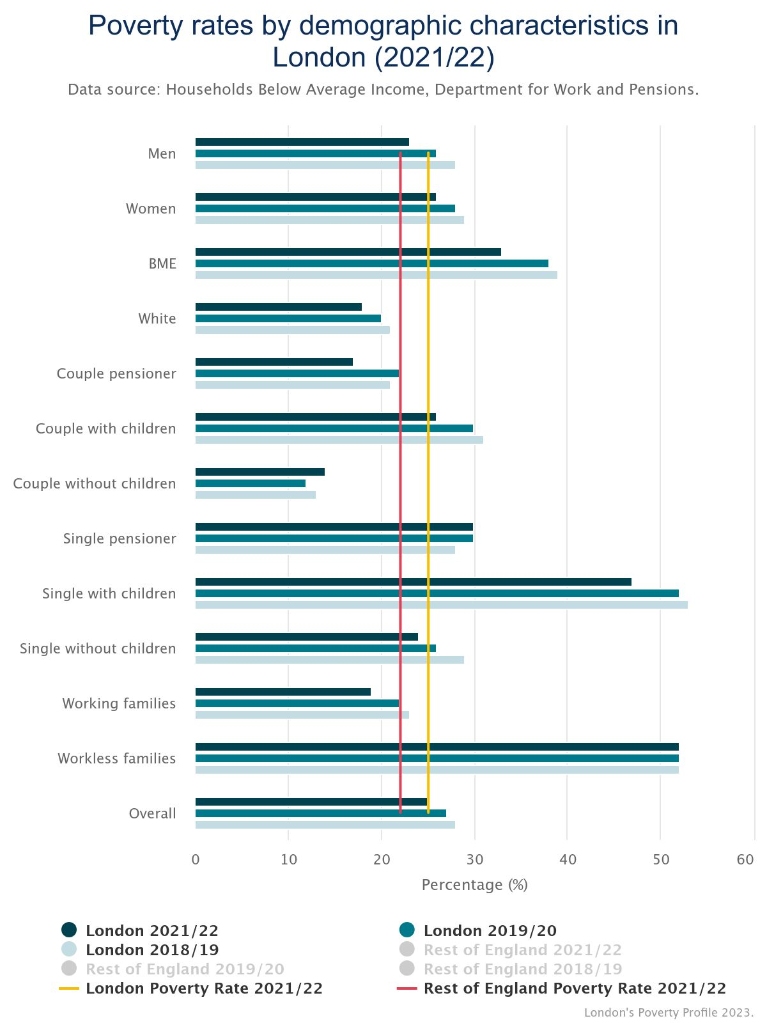
POVERTY RATES VARY SIGNIFICANTLY ACROSS DIFFERENT DEMOGRAPHIC GROUPS IN LONDON
4. HEALTHY STANDARD OF LIVING
The highest poverty rates are experienced by workless families (52%) and households comprised of single people with children (47%)¹.
Black and minority ethnic groups are far more likely to be in poverty (33%) than White people (18%), and single pensioners also have a higher than average poverty rate at 30%.¹
All groups in London have higher poverty rates than the national average except working families, couples without children, couple pensioner and White individuals.¹
In the three years to 2021/22* Londoners who live in families that include a disabled person are more likely to be in poverty (33%) than those living in families that do not include a disabled person (22%).²
Intersectionality must also be considered because different identities are not separate, but overlapping, and these different elements of identity interact and create distinct experiences of poverty.³
*Note: Data for 2020/21 was not included in this average due to the significant impact of the COVID-19 pandemic in that year
Figure 24: Poverty rates by demographic characteristics in London (2021/22)
Source: (1) Health Inequalities In London - Trust For London | Trust for London; (2) Health Inequalities In London - Trust For London | Trust for London, (3) Intersectionality Revealing the Reality of Poverty and Inequality in Scotland

Slide 40
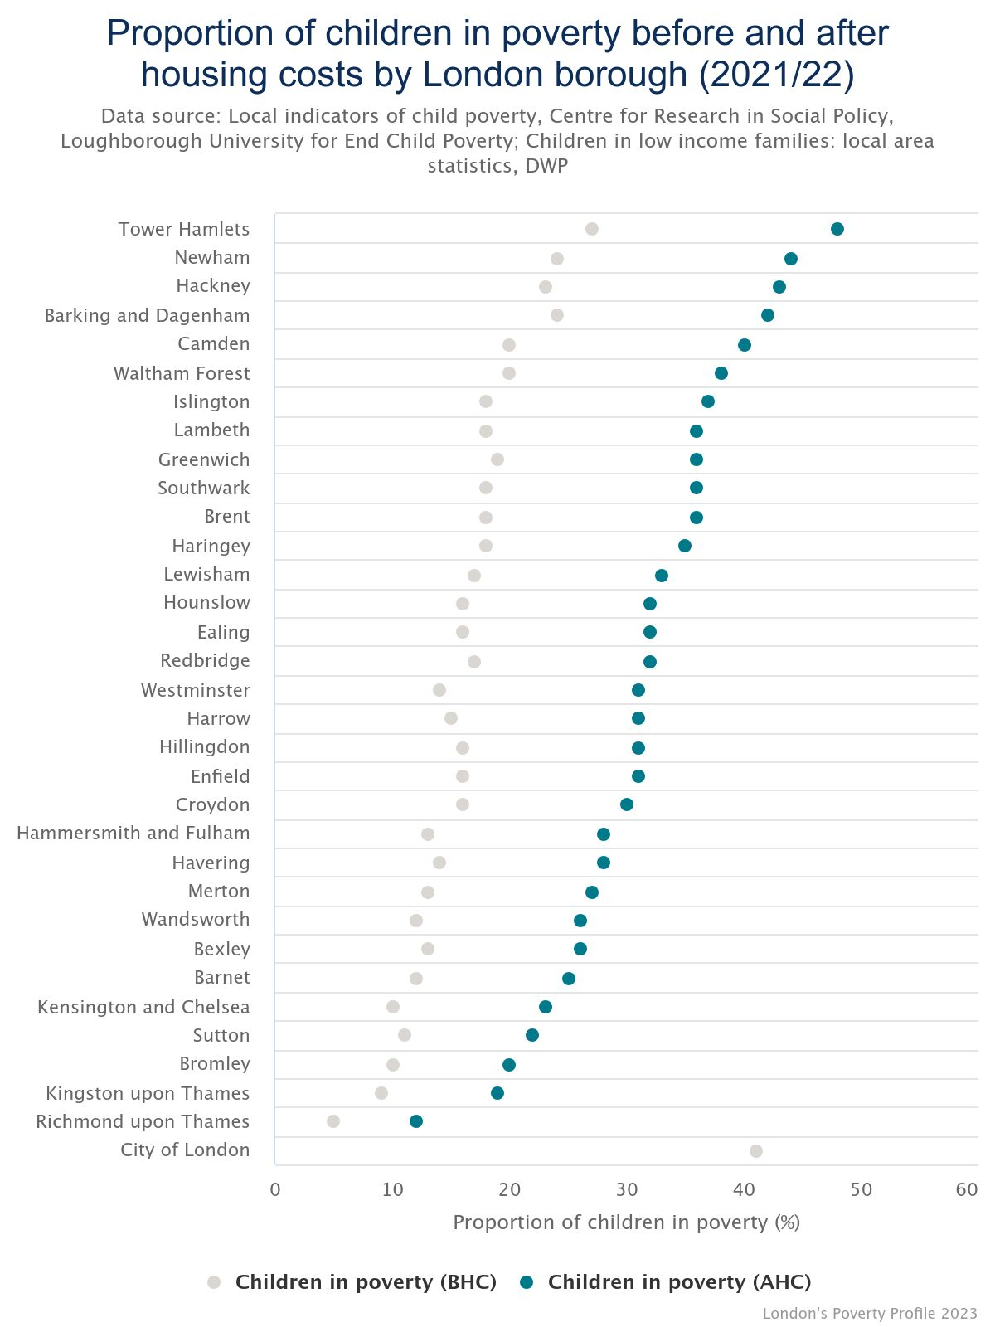
CHILDREN ARE MORE LIKELY TO BE LIVING IN POVERTY IN LONDON AND RATES ARE HIGHER THAN FOR ENGLAND
4. HEALTHY STANDARD OF LIVING
Figure 25: Percentage of children in poverty before and after housing costs by London borough (2020/21)
This chart was adjusted from Trust for London to add national averages
Children are more likely to be living in poverty than adults overall, with the latest estimate of 32% of London’s children in poverty for 2020/21-2022/23 using the relative poverty after housing costs measure.¹
Whilst there appears to be a substantial decrease since pre-pandemic* (38% of London’s children in 2017/18-2019/20) and below the rates given for two other regions, it is still well above national levels (30% of children and 24% for the population as a whole).¹
Substantial variation in child poverty rates exist within London, with Tower Hamlets having the highest rate of child poverty (after housing costs). In Tower Hamlets almost half (48%) of children are growing up in poverty.²
The child poverty rate at least doubles when housing costs are accounted for in 20 of the 33 boroughs.²
*Note: The data collection used to create these poverty statistics was heavily affected by the COVID-19 pandemic. The Department for Work and Pensions (DWP), who publishes these statistics, advises caution when making comparisons with previous years and when interpreting larger changes
National child poverty rate
(AHC)
National poverty rate for the whole population (AHC)
Source: (1) London Datastore – Poverty, (2) Children in poverty by London borough, before and after housing costs | Trust for London

Slide 41
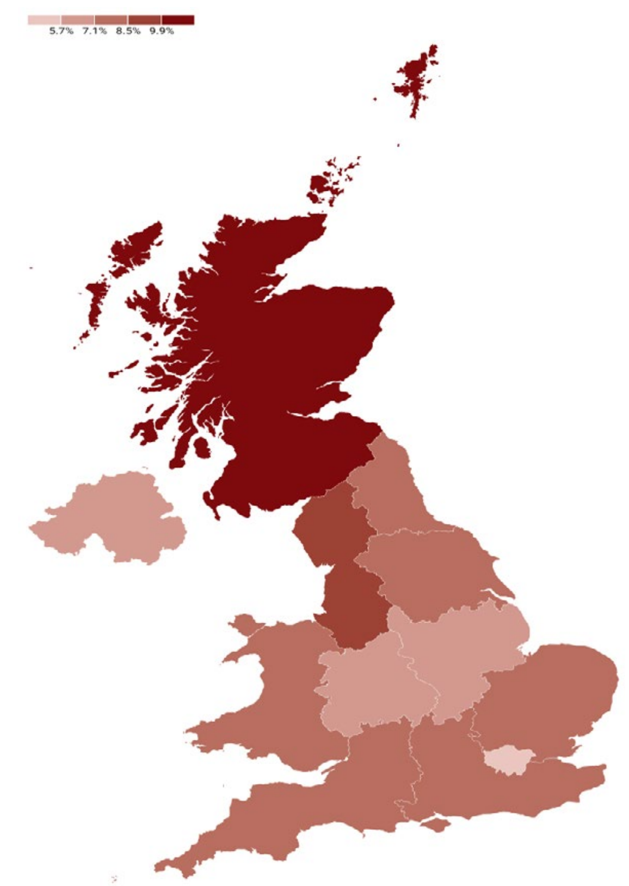

COST OF LIVING CHALLENGES PERSIST AND A SIGNIFICANT PROPORTION OF LONDONERS ARE STILL STRUGGLING
4. HEALTHY STANDARD OF LIVING
  Core measures of inflation remain stubbornly high.
    Energy costs, despite a significant drop, are still considerably above their levels at the start of 2022.
    Even with the recent decrease, food prices remain elevated relative to the figures recorded in prior years.
  Although the real wage growth has turned positive, wage growth in London is still low. ¹
    The median wage growth in London is 4.2%.
    London’s wage growth rate is the lowest in the UK, with the highest regional rate being 11.3%.
  A majority of Londoners feel that the cost of living is still increasing.²
    A total of 87% of Londoners feel that the cost of living has increased.
    Among them, 48% feel the cost of living has increased a lot, and 38% feel it has increased a little.
  A significant proportion of Londoners have fallen behind or struggled to meet their regular needs in the last six months.
    48% falling behind or struggling to meet credit commitments, 46% their household bills, 43% their housing payments and 51% their food and essential shopping needs (either struggling or going without).
    These figures are similar to those from one year ago.
Fig 26. Weekly Gross Pay Year on Year Growth for the Median Percentile (2022-23)¹
NIESR National Institute UK Economic Outlook Winter 2024;
Source: 1) NIESR National Institute UK Economic Outlook Winter 2024; (2) GLA Cost of Living Polling (Jan 2024).

Slide 42
INFLATION EASED AND EMPLOYEE REAL PAY TURNED POSITIVE IN 2024
4. HEALTHY STANDARD OF LIVING
Consumer Price Index (CPI) inflation dropped to 4% in January 2024 from the recent peak of 11.1% in October 2022.¹
  Gas price inflation fell by 26.5% in the year to January 2024, and motor fuel prices also decreased by 9.2% during the same period.²
  London's shelf-front food inflation decreased to 7.0% in January 2024, down from a peak of 10.8% in June 2023.³
In real terms, the annual growth of employee real pay turned positive in the last quarter of 2023.⁴
Fig 27. Real pay in London and food inflation in London and UK
a. Decomposition of real median pay in London
b. ‘Shelf-front’ food inflation, London and UK
Note: Inflation measure does not account for region-specific price changes. Sign of inflation rates has been reversed (higher inflation rates are associated with lower real pay growth).
Source: 1) ONS CPI 2) ONS Energy prices; 3) GLA Economics, ONS price quotes in the Long-Run Price Database by Prof. Richard Davies; 4) GLA Calculations based on ONS Pay As You Earn Real Time Information and CPI data.

Slide 43
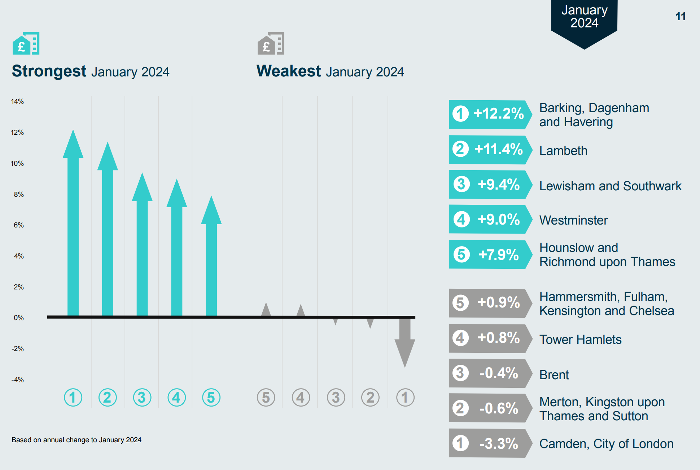
OVERCROWDING, QUALITY AND AFFORDABILITY OF HOUSING AFFECTS LONDONERS UNEQUALLY
5. HEALTHY AND SUSTAINABLE PLACE AND COMMUNITY
Around 9% of households in London are overcrowded (defined as lacking one or more bedrooms compared to estimated need). ¹
  Londoners from Black, Asian and other minority groups are around twice as likely to live in overcrowded conditions as White.
1.6% of all households (57,150) were assessed as owed a homelessness duty in London in 2022-23.¹
  This varies enormously by ethnicity, with the highest rates of homelessness experienced by Black and Mixed Londoners.
  Around 40% (22,740) of households owed a homelessness duty in 2022-23 had dependent children.²
An estimated 9% of homes in London fell below the official Decent Homes Standard in 2021, ranging from 6% of owner-occupied homes to 14% of private rented homes. ¹
  Londoners of Asian ethnicity are more likely to live in homes that fail to meet the Decent Homes Standard, while Black Londoners are more likely to have damp problems.
Average rents for new private tenancies have risen sharply over the past two years, and the affordability burden in London reached a record high in January 2024, according to data from the Homelet Rental Index.
  Black and ethnic minority households in privately rented homes in London spend a significantly higher average proportion of their household incomes on rent, than their White counterparts
Fig 28. Change in average rents for new tenancies in inner London, year to January 2024
Source: (1) London Datastore - Housing in London (2) GOV.UK: Tables on homelessness

Slide 44
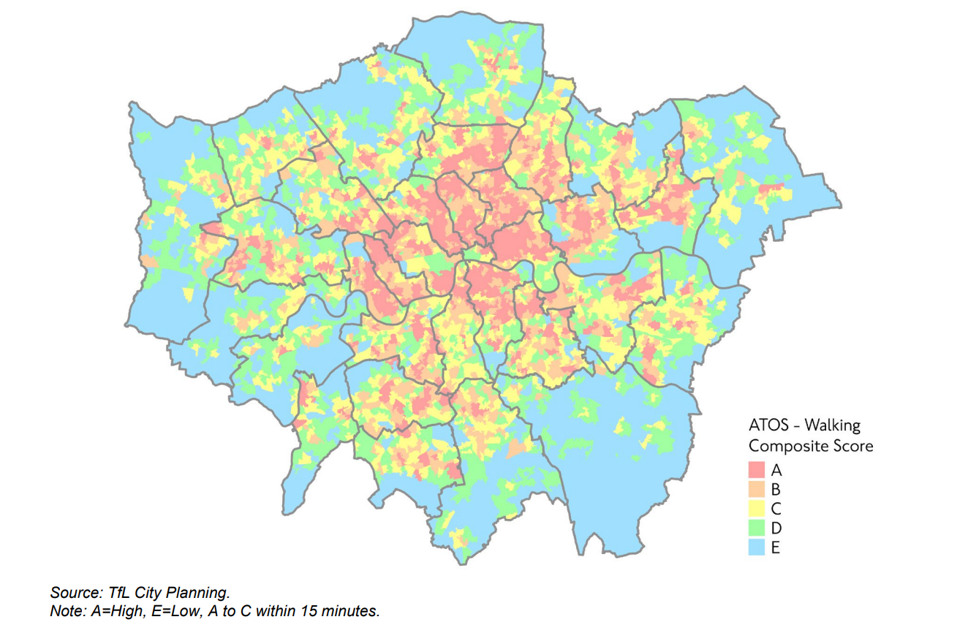
5. HEALTHY AND SUSTAINABLE PLACE AND COMMUNITY
ACCESS TO OPPORTUNITIES AND PARTICIPATION IN ACTIVE TRAVEL VARIES ACROSS GEORGRAPHY AND BY AGE, DEPRIVATION, DISABILITY AND ETHNICITY
.
Higher access to opportunities score (ATOS)* scores tend to be focused in inner London, whereas there are large areas of outer London which do not meet this criterion, i.e. walking access to essential services is greater than 15 minutes.¹
There are barriers to active travel. For example, Black and ethnic minority groups, women, people from more deprived neighbourhoods, those with disabilities and older people are typically under-represented in cycling.²
Currently, 45 per cent of disabled Londoners find planning and making trips on public transport stressful.¹
Deprivation, sex, age and mode of transport have a significant impact on casualty risk rate and casualty location rate in London.³
  Twice as many people were killed or seriously injured per kilometre of road network in the most deprived 30% London, compared to the 30% in the least deprived areas.
  Per thousand people, more men are injured than women. This difference increases with deprivation and injury severity.
Note: *ATOS (Access to Opportunities and Services) scores look at walking times from all locations to reach essential services such as schools, healthcare, food shopping and open spaces.
Fig 29. Access to opportunities score (ATOS) showing accessibility on foot within 15 metres in London, 2021
Source: (1) TfL (2021) ‘Travel in London Report 14 (2) Barriers to cycling amongst ethnic minority groups and people from deprived backgrounds (3) TFL Inequalities in road danger in London (2017-2021)

Slide 45
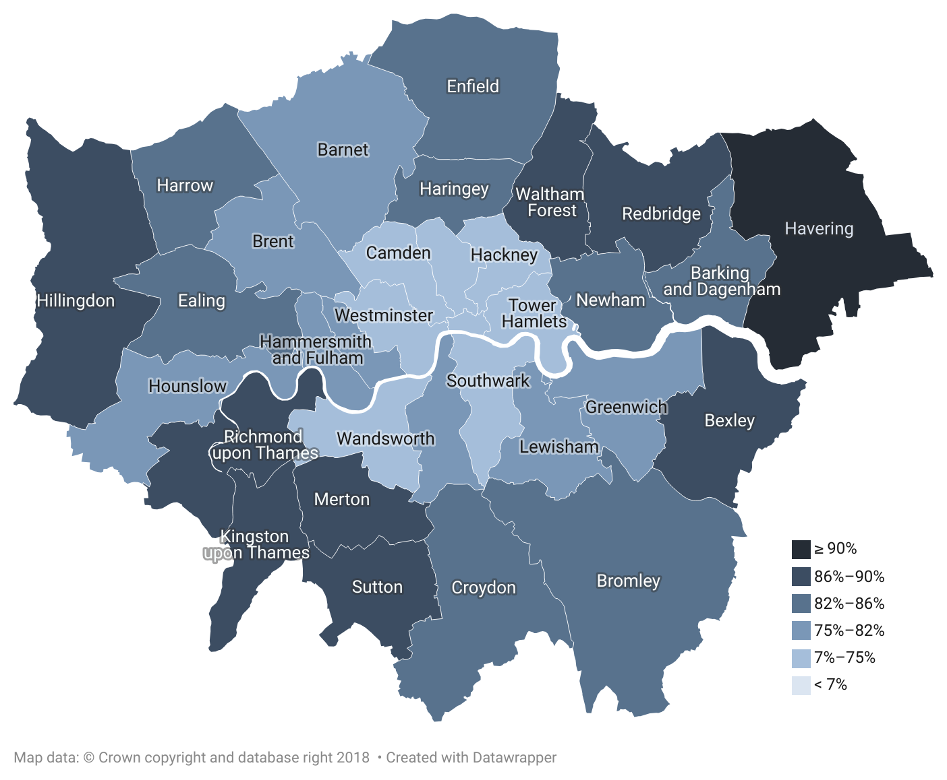
LOWER INCOME & BLACK PEOPLE IN ENGLAND ARE LEAST LIKELY TO HAVE ACCESS TO GREEN SPACE
5. HEALTHY AND SUSTAINABLE PLACE AND COMMUNITY
Not updated from 2022
One in five Londoners (21%) have no access to a garden, the highest percentage of any region in the UK and almost double the national average.¹
Private gardens in London are also the smallest in any region in Britain, 26% less than the national average.²
  Despite being least likely to have access to a private garden, people in London are most likely to have a park nearby.²
London has the lowest provision of green space per person of all regions in the UK. Friends of the Earth analysis found that the ten worst local authorities for access to green space are all in London.^{3,4}
Lower income and BAME households have been hit hardest – black people in England are four times less likely than white people to have no outdoor space at home.^{1,5}
Half of all London households are in areas of deficiency of access to open space (i.e. more than 400m from a local park) – the maximum distance recommended by the London Plan.⁵
Fig 30. Percentage of addresses with private outdoor space in local authorities in London, 2020
Source: (1) ONS Data (2020) (2) ONS commentary (2020) (3) ONS (4) Access to green space in England | Friends of the Earth (2020) (5) RCIS (2020)

Slide 46
DEPRIVED AND MINORITY ETHNIC GROUPS FACE DISPROPORTIONATE AIR POLLUTION EXPOSURE
London had the highest percentage of deaths attributable to particulate air pollution (7.1%) of all English regions in 2022, but the proportion has continued to reduce from 9.0% in 2018.¹
  Of the 25 upper tier local authorities in England with the highest proportion (%) of deaths attributable to air pollution in 2022, 22 were London boroughs.¹
  Average concentrations of PM2.5 in London have shown a decreasing trend since 2018 (from 12.3μg/m3 to 8.7 μg/m3).²
Air pollution is worse in more deprived areas of London ³
  NO² concentrations range 4.4µg/m3 in a linear trend from most to least deprived areas, while PM2.5 concentrations range 0.7µg/m3.
White and Asian people are least likely to be exposed air pollution in London:
  In 2019, Black people and people from ‘Other’ ethnicities were more often living in the 30% most air polluted areas of London than would be expected from their population; 7.1% more likely for Black people and 33.3% more likely for ‘Other’ ethnicities.³
  Meanwhile, White and Asian people were 3.7% and 9.5% underrepresented in the most air polluted areas in 2019.
  Projections to 2030, based on modelling of air pollution concentration and population, show a continuing advantage for White people relative to other ethnic groups.
Fig 14. Over- or under-representation of ethnic groups living in the 30% most polluted OAs relative to their 2019 and 2030 London-wide populations³
Source: (1) OHID Fingertips- Fraction of mortality attributable to particulate air pollution (2) Health Profile for London 2021 (3) GLA air quality exposure and inequalities study

Slide 47
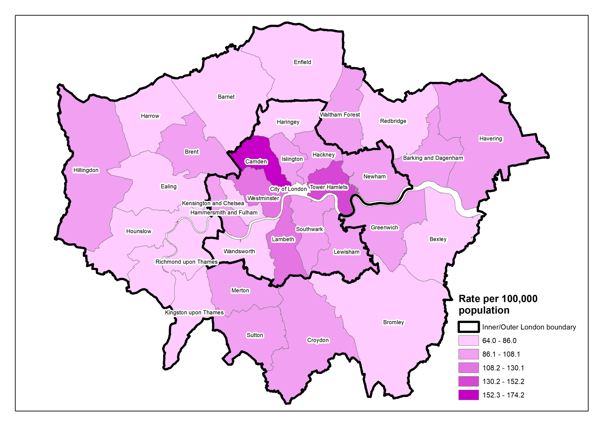
MORE DEPRIVED LOCAL AUTHORITIES HAD A GREATER DENSITY OF FAST FOOD OUTLETS
5. HEALTHY AND SUSTAINABLE PLACE AND COMMUNITY
Not updated from 2022
‘Fast food’ refers to energy dense food that is available quickly, therefore it covers a range of outlets that include, but are not limited to, burger bars, kebab and chicken shops, chip shops and pizza outlets.
  Across England, more deprived local authorities had greater density of fast food outlets though this is data from 2017
Out of all local authorities in England, Camden had the second highest density of fast food outlets across England (174 per 100,000 population).
However, the average density across all London local authorities (93 per 100,000) was similar to that of England overall (91 per 100,000).
The Healthy Streets coalition put together scorecards in 2022 for London boroughs, based on what they want boroughs to implement: including low Traffic Neighbourhoods, a default 20mph speed limit, small-area Controlled Parking Zones, protected cycle lanes on main roads and traffic-free streets around all schools with safe walking and cycling provision.
  Best scoring London boroughs were the City, Islington, Hackney and Camden in Inner London.
  Poorest scoring boroughs Hillingdon, then Barking & Dagenham and Redbridge
Fig 32. Density of fast food outlets in London, 31 December 2017
Source: (1) Public Health England (OHID) Fast food outlets: density by local authority in England, 2018 (2) 2022 London Boroughs Healthy Streets Scorecard

Slide 48
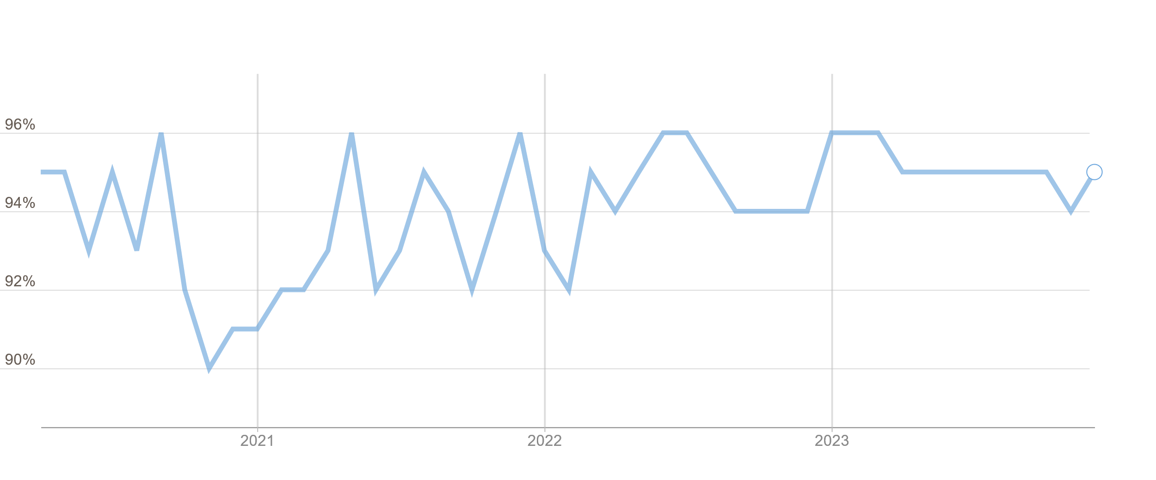
NEIGHBOURHOOD COHESION IS GENERALLY HIGH THOUGH LOWER FOR SOME LONDON BOROUGHS
5. HEALTHY AND SUSTAINABLE PLACE AND COMMUNITY
Neighbourhood cohesion can be measured through agreement with the statement ‘my local area is a place where people from different backgrounds get on well together’. It is collected monthly as part of the Public Attitude Survey.¹
Fig. 33 shows monthly data from the survey, from around the time the COVID-19 pandemic started.
Neighbourhood cohesion in London has increased substantially since 2008, from 73% up to 95% in 2023 indicating strong neighbourhood cohesion. It has been above 90% every year since 2013-14.
Across the financial year 2022-23, the boroughs with the highest agreement rates of 97% were Barnet, Bromley, Merton, Waltham Forest and Wandsworth.
The boroughs with the lowest agreement rates were Newham (91%) and Enfield (92%).
Fig 33. Proportion who agree that people from different backgrounds get on well in their local area of London (%), 2020-2023
Source: (1) MOPAC, Public Attitude Survey (PAS)

Slide 49
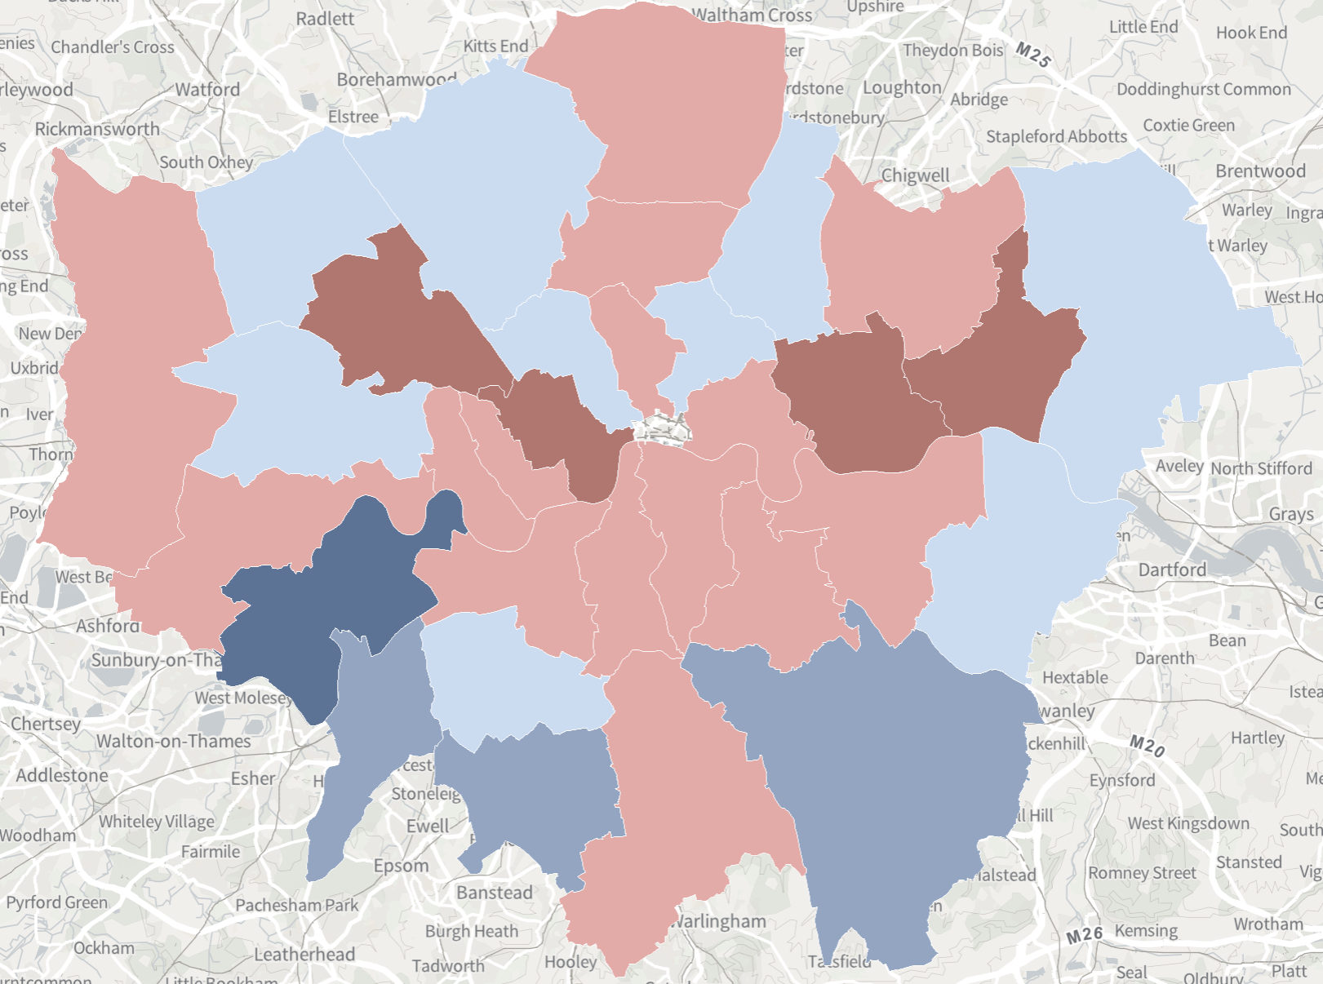
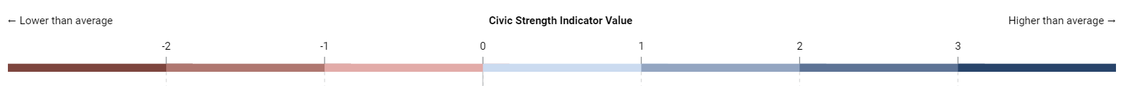
LONDON’S CIVIC STRENGTH INDEX – MEASURING WHAT MAKES A STRONG COMMUNITY IN LONDON
5. HEALTHY AND SUSTAINABLE PLACE AND COMMUNITY
The London Civic Strength Index is a tool that aims to identify and measure what makes a strong community in London.
Co-designed and co-created with Londoners, the index is based on a framework of three domains (Relationships and Social Capital, Democratic Engagement and Physical and Social Infrastructure) and a total of twelve subdomains.
Open source data underpins the subdomains, including from the Survey of Londoners, Google mobility data and ONS surveys.
The overall score reflects the 'mix' of strengths and areas for further work, as evidenced by data collected.
Civic Strength varies across London boroughs (Fig 34.):
  Overall score is highest in Richmond, Bromley and Sutton. Meanwhile, Barking & Dagenham, Westminster and Newham have the lowest scores.
  Overall scores may mask individual strengths and weaknesses in different domains and sub-domains across boroughs.
Fig 34. Civic Strength Index overall score, London boroughs, 2023
Source: (1) GLA, London’s Civic Strength Index

Slide 50
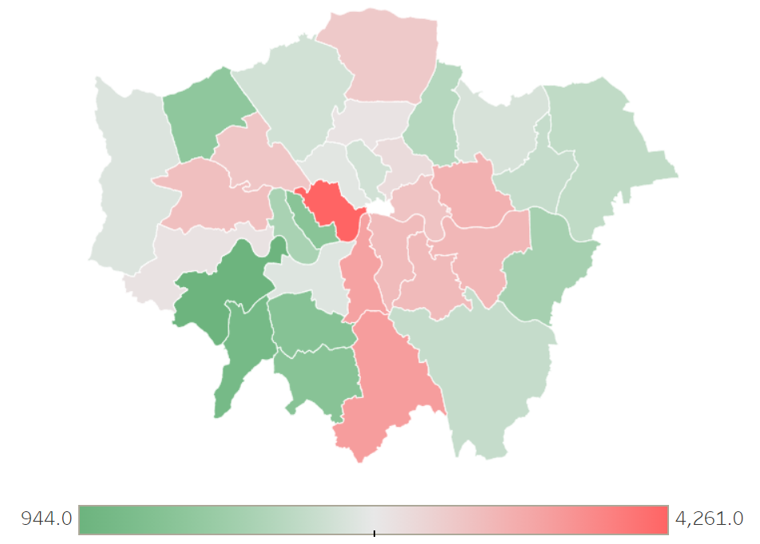
VIOLENCE IS EXPERIENCED UNEQUALLY ACROSS LONDON AND MOST IN DEPRIVED AREAS
5. HEALTHY AND SUSTAINABLE PLACE AND COMMUNITY
Violent crime varies significantly across different areas of London¹. As shown in Fig. 39, during 2023, the highest rate of violent crime with injury occurred in Westminster (20.7 per 1,000 pop), and lowest rate in Richmond (4.8 per 1,000 pop).
Violence is highly localised - with a disproportionate amount of the total violence accounted for by a small, limited number of geographical areas.
These spatial concentrations of violence tend to correlate with areas that are also experiencing significantly high deprivation.
Over-representation also extends to the individual characteristics of those involved in violence, either as a victim, perpetrator, or both.
The Crime Survey for England and Wales (CSEW) recently found that:²
  While there were no differences in the incidence rates* for overall violence with injury across males and females, females had a higher incidence rate for Domestic Violence victimisation than males (2.7 versus 1.6).
  The incidence rate for violence with injury across ages differed between male and female victims.
  The 25-34 years age group had the highest incidence rate for female victims (20.9 versus 9.1 for males), whereas the 16-24 years age group had the highest incidence rate for male victims (24 versus 13.9 for females).
  People living in the 20% most deprived areas (based on the employment deprivation index) had a higher incidence rate for victimisation than those living in the 20% least deprived areas (10.6 versus 5.3).
  Males were much more likely to be perpetrators of violence with injury than females (76% vs 17%).
Fig 35. Violence with Injury (by volume) across
London Boroughs, January-December 2023 ¹
*Incidence rates = number of victims per 1000 people. Source: (1) Violence Dashboard (MOPAC) (2) Crime Survey for England and Wales (12 months to December 2023)

Slide 51
BLACK LONDONERS REPORT AN INCRESE IN BEING UNFAIRLY TREATED DUE TO ETHNICITY
7. RACISM AND DISCRIMINATION
Not updated from 2022
The Survey of Londoners 2021-22 repeated the question used in the 2018-19 survey about whether respondents had been treated unfairly by people in the past 12 months (with one small modification to include option to report if unfair treatment was from friends and family)
A comparable measure can be derived for 2021-22 to compare against 2018-19 in 2021-22, 36% of Londoners had been treated unfairly in the past 12 months because of one or several protected characteristics, or because of their social class (no significant difference from 2018-19 when it was 35%).
In 2021-22 ethnicity was the characteristic Londoners were most likely to report being treated unfairly by (19%), followed by sex (13%), age (12%), social class (8%) and religion (6%).
  Unfair treatment because of their ethnicity has increased from 16% to 19% between the two surveys
  Black Londoners were the only ethnic group to have seen an increase in unfair treatment experienced as a result of their ethnicity between the two surveys (from 26% to 43%).
Women were much more likely than men to report being treated unfairly because of their sex (22% and 4% respectively) and it has also increased since 2018-19, when it was 18%.
Fig 36. Londoners were more likely to be treated unfairly because of their ethnicity than any other characteristic, 2018/19 vs 2021/22
* This characteristic was labelled ‘gender identity’ in the 2021-22 survey, and as ‘being or becoming a transsexual person’ in the 2018-19 survey. Therefore, these are not wholly comparable labels.
Source: GLA, Survey of Londoners 2021-22
Notes:
DISABILITY DATA TO BE ADDED

Slide 52
PARTICULAR groups of Londoners were more likely to REPORT unfair treatment
7. RACISM AND DISCRIMINATION
Not updated from 2022
A summary from the Survey of Londoners 2021-22, of how different groups of Londoners experience different forms of unfair treatment based on several characteristics is included in Table 1.
Londoners aged 16-24 were more likely to report being treated unfairly because of their age than the overall average (20% and 12% respectively).
Women were more likely to report being treated unfairly because of their sex than the overall average (22% and 13% respectively).
Black and Asian Londoners were more likely to report being treated unfairly because of their ethnicity than the overall average (43%, 33% and 19% respectively).
Muslim and Jewish Londoners were more likely to report being treated unfairly because of their religion than the overall average (27%, 18% and 6% respectively).
Disabled Londoners were more likely to report being treated unfairly because of disability related reasons than the overall average (20% and 4% respectively).
LGBTQ+ Londoners were more likely to report being treated unfairly because of their sexual orientation than the overall average (26% and 3% respectively).
Table 1. Some groups of Londoners were more likely to experience unfair treatment because of a particular characteristic than Londoners overall, 2021/22
Unfair treatment by this characteristic | Sub-group | % | Base | London % | Base
Age | 16-24 | 20% | 522 | 12% | 5,963
Sex | Woman | 22% | 3,204 | 13% | 5,963
Ethnicity | Black | 43% | 407 | 19% | 5,963
Ethnicity | Asian | 33% | 1,263 | 19% | 5,963
Religion | Muslim | 27% | 671 | 6% | 5,963
Religion | Jewish | 18% | 100 | 6% | 5,963
Disability | Disabled | 20% | 1,086 | 4% | 5,963
Sexual orientation | LGBTQ+ | 26% | 505 | 3% | 5,963
Source: GLA, Survey of Londoners 2021-22
Notes:
DISABILITY DATA TO BE ADDED

Slide 53
CLIMATE IMPACTS ARE NOT EXPERIENCED EQUALLY ACROSS LONDON
8. ENVIRONMENTAL SUSTAINABILITY AND EQUITY
Fig 37. Overlap of inequalities in climate risk exposure, vulnerability and adaptive capacity.
Inequalities are experienced at each step along the causal path to a climate-related health outcome:
  Exposure
  Vulnerability
  Adaptive capacity
Despite having the lowest carbon emissions, the poorest and most disadvantaged Londoners are disproportionately exposed to climate risks, are more sensitive to their impacts, and have less capacity to adapt and respond.
Inequality in exposure to climate risks
Inequality in adaptive capacity, the ability to respond and recover
Inequality in vulnerability & sensitivity to the impacts

Slide 54
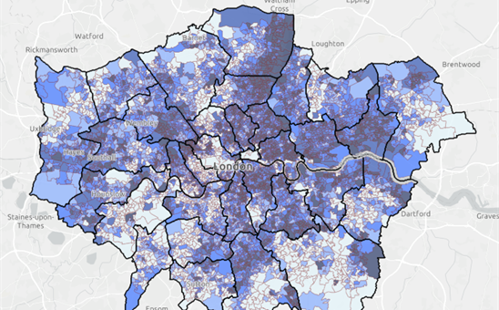
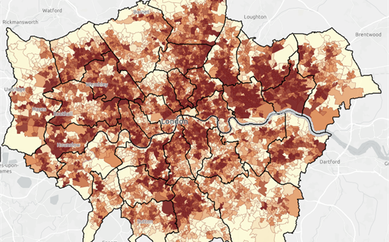
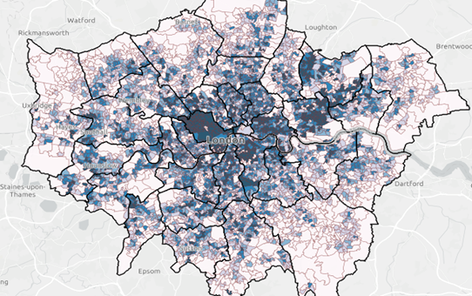
INEQUALITIES IN EXPOSURE TO CLIMATE RISKS
8. ENVIRONMENTAL SUSTAINABILITY AND EQUITY
Fig 38. Geographical distribution of deprivation, surface temperature and flood risk across London
Income deprivation
Land surface temperature
Flood risk
Source: Bloomberg cliamte risk maps, based on data from English Indices of Multiple Deprivation (MHCLG), 2015.
Source: Bloomberg climate risk maps, based on data from ARTI analytics BV, 2016-2020.
Source: Bloomberg climate risk maps, based on data from Environment Agency, 2013.
People living in the most deprived areas, people from ethnic minority communities, and people already experiencing disadvantage are more likely to be exposed to high temperatures, cold temperatures, flooding, and food and water insecurity.¹
Socio-environmental risk factors include housing conditions, the built environment, work and financial insecurity.²
Those who are homeless, who live in non-decent housing and / or experience fuel poverty are more likely to be exposed to extreme temperatures.³​
People living in more deprived areas have less access to green and blue space for cooling, flood resilience and other ecosystem services.^{4​}
Those who work in manual jobs or spend the majority of the day working outdoors are more likely to be exposed to extreme temperatures and vector-borne diseases.^{5​}
Climate and ecological change are key risks for future food availability and prices, those on lower incomes will be disproportionately exposed to these shocks.⁶
Source: (1) Sheng et al. (2) Environment Agency (3) Taylor et al (4) Bloomberg Associates (5) CDC (6) Food systems transformation group NatCen Social Research

Slide 55
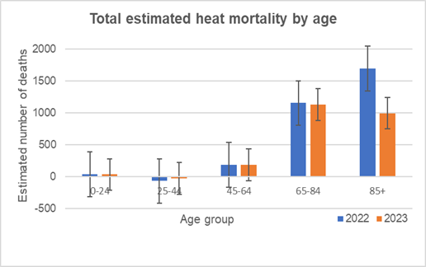
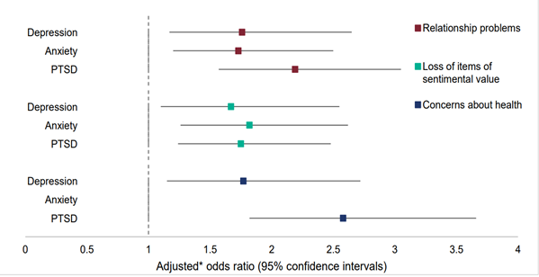
INEQUALITIES IN VULNERABILITY TO CLIMATE RISKS
8. ENVIRONMENTAL SUSTAINABILITY AND EQUITY
People aged over 65, babies and young children, those with certain underlying physical or mental health conditions, pregnant women and people living in deprived circumstances are more likely to experience poor health outcomes as a result of exposure to extreme temperatures, flooding and food insecurity¹ . Figure 39 illustrates the impact of high temperatures on people over 65 years of age.
Climate sensitive health conditions, such as cardiovascular disease and mental health conditions, are unequally distributed across London, with those in the most deprived areas and people from ethnic minority communities most likely to be affected². Figure 40 illustrates how concerns about health are associated with increased likelihood of Post Traumatic Stress Disorder in people who have been flooded.
Fig 39. Excess deaths by age during heat events in 2022 and 2023³
Fig 40. People with health concerns as a 'secondary stressor’ after flooding were more likely to experience depression, anxiety and PTSD⁴
Source: (1) UKHSA (2) OHID PHOF (3) UKHSA (4) The English National Study of Flooding and Health

Slide 56
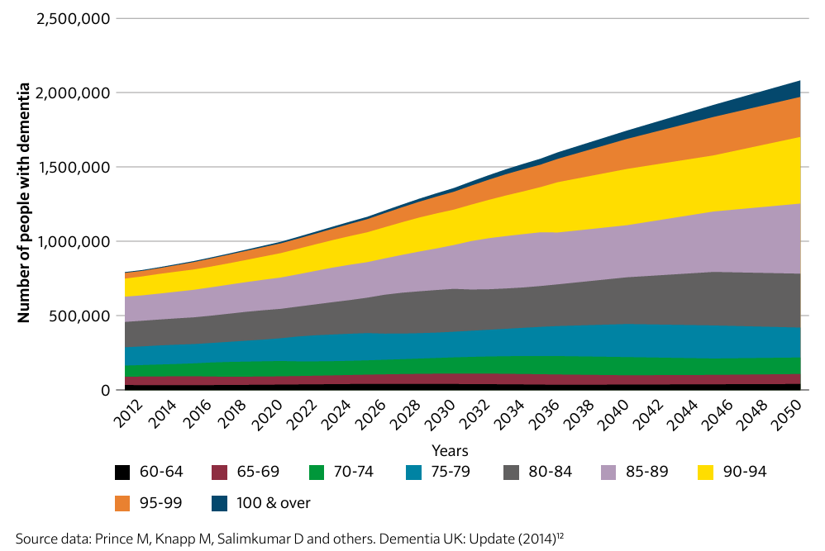
INEQUALITY IN ADAPTIVE CAPACITY TO CLIMATE RISK
8. ENVIRONMENTAL SUSTAINABILITY AND EQUITY
People experiencing disadvantage are less likely to have the capacity, resources and opportunity to adapt and respond to climate change, for example, through implementing options for adaptation as described in Table 2. ¹ They are also less likely to live in areas that benefit from interventions that reduce risk, such as urban greening (see Slide 46: Access to Green Space)
Figure 41 illustrates projected trends in the number of people with dementia, an increase that will occur in parallel with a warming and increasingly volatile climate. Those with physical and mental disabilities, who rely on support to live independently, or have cognitive impairment (eg dementia, substance abuse) will find it difficult prepare, recover and respond to increasingly frequent and intense extreme weather events².
Table 2. Options for adaptation to climate risks
Fig 41. Projected increases in the number of people with dementia in the UK by age group, 2012-2051³
Adapting to heatwaves | Installing passive cooling measures at home Improving ventilation at home Working from home to avoid travelling in hot weather
Adapting to flooding | Making changes to home and surrounding landscape Taking out appropriate home or buildings insurance
Adapting to food insecurity | Meal planning and bulk buying Making dietary changes Growing food
Adapting to shocks and stressors | Saving up an emergency fund Knowing where and how to access timely support
Source: (1) Institute of Health Equity (2) US National Climate Assessment (3) Chief Medical Officers Report 2023
Notes:
Figure 2.20: Projected increases in the number of people with dementia in the UK, by age group, from 2012 to 2051

Slide 57
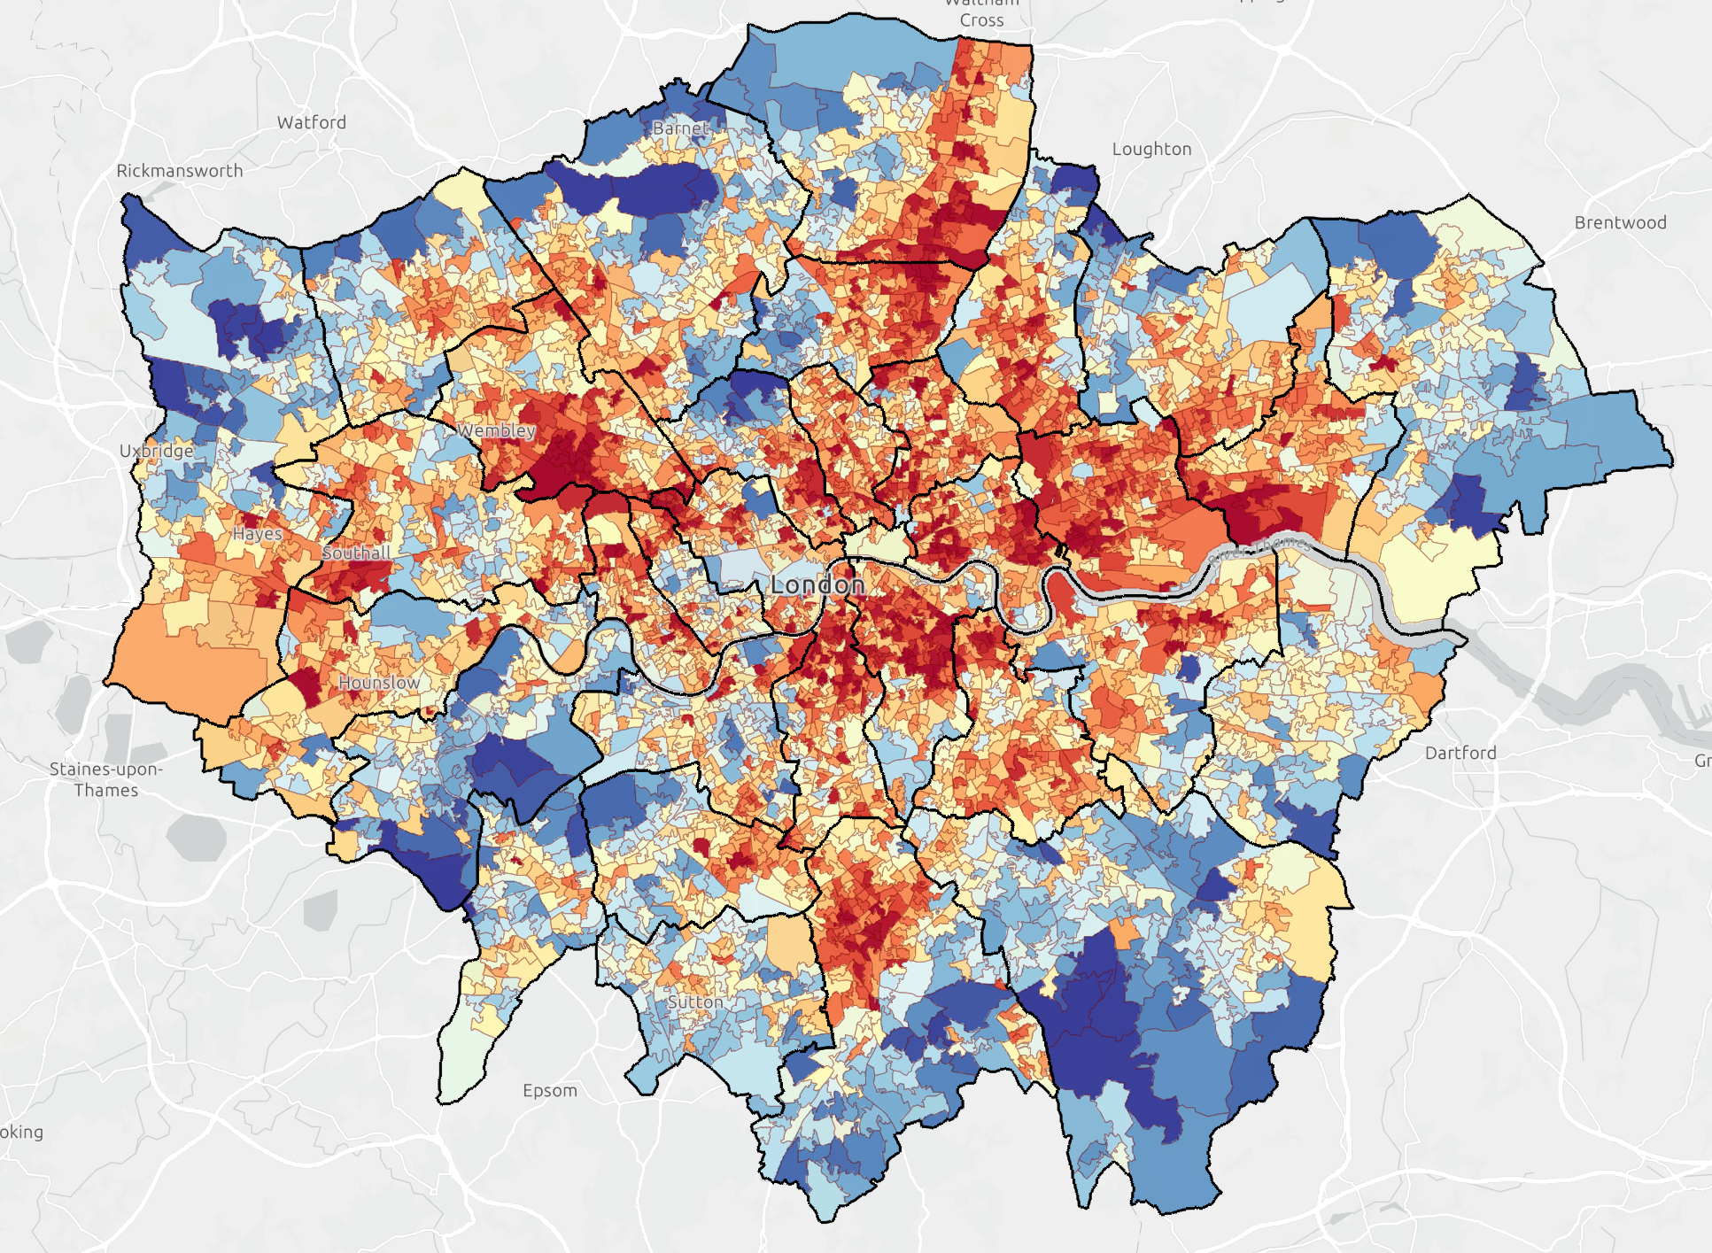
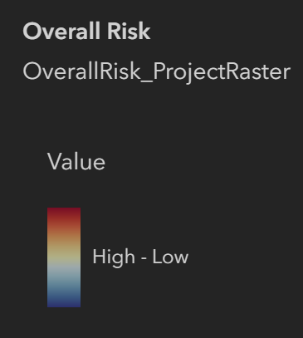
CUMULATIVE RISK FROM CLIMATE CHANGE
8. ENVIRONMENTAL SUSTAINABILITY AND EQUITY
Evidence shows that:
Emergency hospital admissions due to extreme heat are higher in more socioeconomically deprived areas.¹
Those from the most deprived backgrounds are more likely to be admitted for heat exacerbated health conditions, including respiratory metabolic and infectious diseases, as well as accidents.²
The most deprived areas and those with the lowest level of education also have a significantly higher risk of mortality from extreme heat.³
Figure 42. Overall climate risk across London¹³*.
*Note: Based on: Ages Under 5, Ages Over 75, English Proficiency, Income Deprivation, Social Renters, BAME, Average Land Surface Temperature, Surface Water Flood Risk, PM2.5, NO2, Green/Blue Land Cover, Areas of Deficiency in Access to Public Open Space
Source: (1) Rizmie et al (2) Williams & Marmot (3) Bloomberg climate risk maps

Slide 58
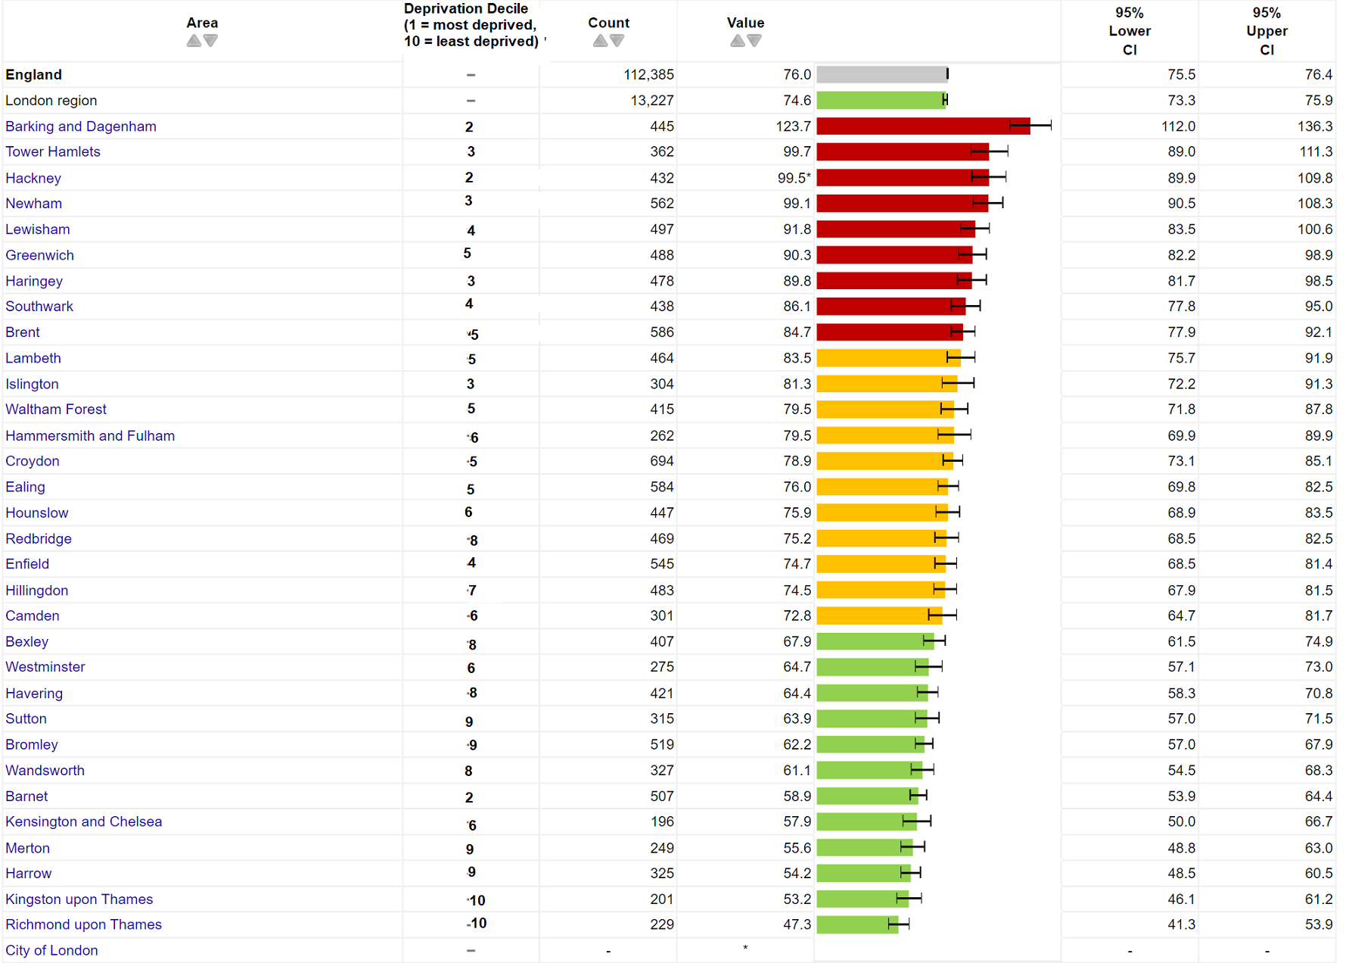
CUMULATIVE IMPACT EXAMPLE – CARDIOVASCULAR DISEASE
8. ENVIRONMENTAL SUSTAINABILITY AND EQUITY
Figure 43 illustrates the difference in mortality rates from circulatory disease across London Boroughs. People living in the most deprived areas of the capital are more likely to be affected by cardiovascular disease and to die prematurely as a result¹..
Climate related issues such as extreme heat and air pollution contribute to both the development of and worsening of cardiovascular disease². Evidence shows that a 1°C increase in ambient temperature is associated with higher cardiovascular disease mortality and a significant increase in morbidity^{3,4}.
As people living in the most deprived areas are already more likely to be exposed to high temperatures and air pollution, are more likely to be living with a long-term health condition which may be climate sensitive, and have less adaptive capacity, the impact of increased temperatures and increased air pollution is likely to be particularly severe, and lead to the gap between the most and least deprived widening further.
Figure 43. Under 75 mortality rate from all circulatory disease by borough and deprivation decile
Source: (1) OHID (2) Jacobsen et al (3) Liu et al (4) Moghadamnia et al

Slide 59
PART 4: HEALTH BEHAVIOURAL RISK FACTORS
(Direct causes of poor health)

Slide 60
PART 4 OVERVIEW: HEALTH BEHAVIOURAL RISK FACTORS
Certain behaviours can be either health promoting or health harming. These behaviours include smoking, diet, physical activity and consumption of drugs and alcohol. To a certain extent, these are factors over which individuals have control, but in practice are often overwhelmingly influenced by the social and structural environment people find themselves in. Health behavioural risk factors can be a conduit for wider determinants of health (as illustrated in Part 3) to impact on health outcomes (Part 5).
This section of the Snapshot includes an overview of behaviours below and identification of inequalities within:
  Smoking prevalence
  Overweight/obesity prevalence in adults (including diet)
  Overweight/obesity prevalence in children
  Physical activity
  Alcohol misuse, drug misuse and high blood pressure

Slide 61
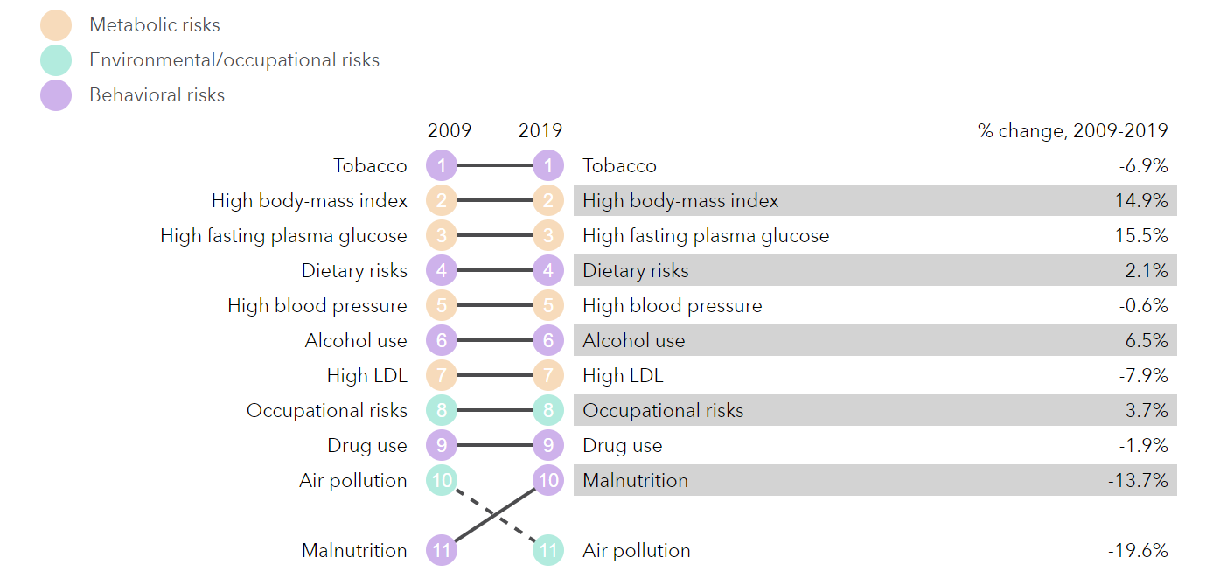
TOBACCO, HIGH BMI AND DIET ARE THE TOP RISK FACTORS DRIVING DEATH AND DISABILITY
Not updated from 2022
The Global Burden of disease (GBD) tool identifies tobacco, high BMI (Body Mass Index), high fasting glucose and diet as the health behaviours most responsible for driving disability and death in London between 2009 and 2019
The top nine risk factors driving ill health in London as per the GBD tool in 2009 were the same in 2019
Only air pollution has moved from 10 to 11, and malnutrition has moved in the opposite direction
Greatest progress in risk factor reduction was seen for tobacco and air pollution while high BMI and high fasting glucose (raised blood sugar) have worsened in prevalence
In Part 4, we illustrate how these harmful health behaviours (focusing on tobacco, obesity (high BMI) and physical activity) themselves reflect the consequences of social inequalities in how their prevalence is unequally distributed across population groups
More disadvantaged groups experiencing inequalities are also more likely to have a cluster of unhealthy behaviours such as – smoking, drinking, low consumption of fruit and vegetables, and low levels of physical activity.
Fig 44. Ranked risk factors driving the most death and disability in London, and percent change in risk factors from 2009-2019
Source: Global Burden of Disease Tool for London

Slide 62
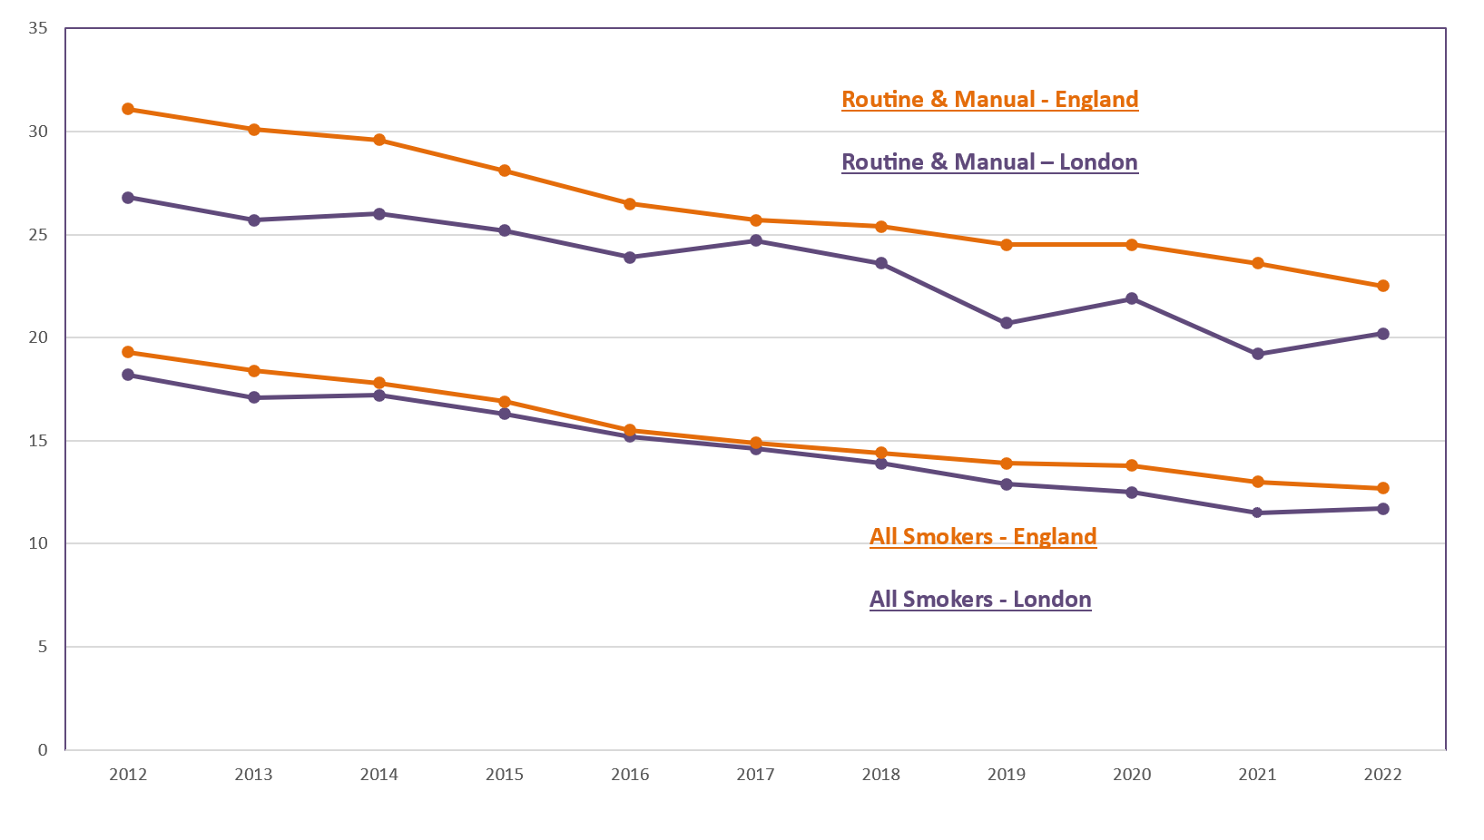
SMOKING PREVALENCE IN LONDON
Smoking prevalence is 11.7% in London, but significant inequalities remain with rates higher in deprived areas, in those with mental illness and routine and manual occupations
Smoking tobacco remains London’s leading cause of premature death, killing 8,000 people per year​.¹
In 2022, the adult smoking prevalence from the APS was 11.7% - a 0.6% increase from the 2020 data.² However, as the 2020 data was collected only via a telephone survey due to Covid-19 (not face to face interviews as well) concerns were raised that this figure may have been an under-estimate
Smoking prevalence ranged from 6.2% in Kingston to 16.3% in Hounslow, in 2022.²
In 2022 prevalence in routine and manual occupations (aged 18-64 years) was 20.2% ², more than twice that of managerial and professional occupations (8.4%).²
Data from the GP Patient Survey (GPPS) shows that smoking prevalence is higher in adults (18+) with a long-term mental health condition in London (27.2%) in 2021/22, compared to 14.9% in the general adult population.²
Smoking during pregnancy is the leading modifiable risk factor for poor birth outcomes​. In 2022/23, 4.6% of women were smoking at the time of delivery in London, representing a continuing decreasing trend (vs 8.8% of women in England).²
Fig 45. Trend in smoking prevalence (%) by current smokers and by those in routine and manual occupations, ages 18+, London & England, 2012-2022
Source: (1) London Vision -Tobacco-control-and-reducing-smoking (2) Local Tobacco Control Profiles

Slide 63
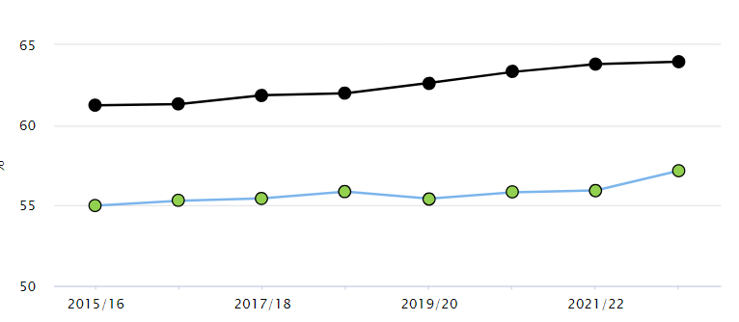

OVERWEIGHT/OBESITY IN ADULTS IN LONDON
In 2022/23 57.2% of adults (18+) in London were classified as overweight or obese. This is significantly lower than the national average of 64.0% but shows no improvement over time and there is wide variation across London local authorities¹.
Barking & Dagenham (70.5%) had the highest proportion of overweight or obese adults and Kensington & Chelsea (45.8%) had the lowest.
The impact of the pandemic on obesity levels is not yet known. Given the changes in other risk factors presented, such as diet, physical activity, and alcohol, it is possible that there has been an increase and widening of inequalities.¹
Diet and physical activity are key risk factors for overweight/obesity and London (30%) has fallen below the national average (31%) when it comes to the proportion of the population meeting the recommended 5 portions of fruit and vegetables on a ‘usual day^{’2}.
National data highlights that 5-a-day consumption is lower in people who are unemployed (20.1%), living with a disability (30.8%), Asian (20.7%), Black (20.1%), or living in the most deprived areas (21.6%).
In London the number of physically active adults (66.3%) has fallen further below the national average (67.1%)³
Fig 46. Percentage of adults (aged 18+) classified as overweight/obese in London VS national average 2015-23
Source: (1) C15-17, Public Health Outcomes Framework (PHOF), (2) Health Profile for London 2021 - Obesity and Diet (3) Sports England

Slide 64
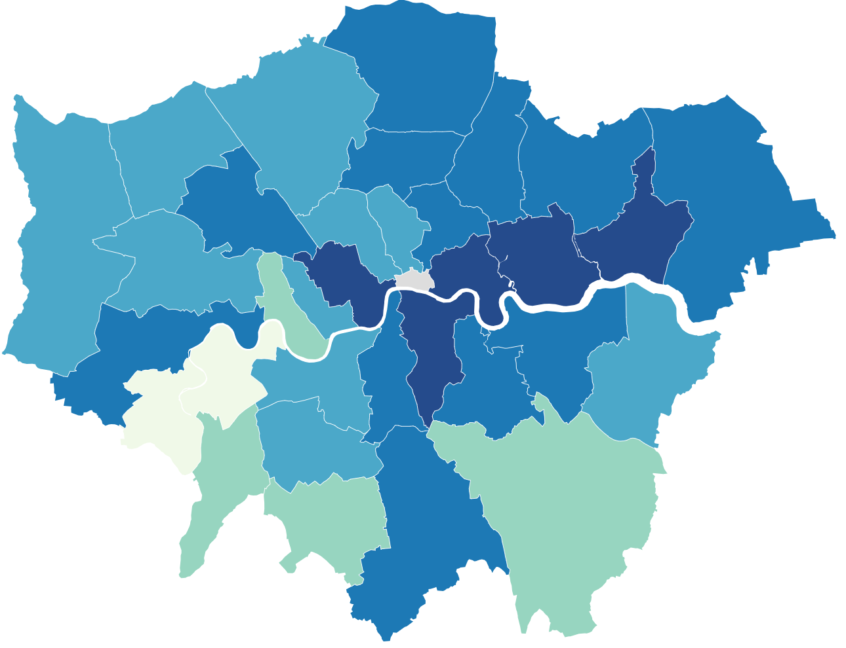
MORE THAN A THIRD OF 10-11 YEAR OLDS IN LONDON ARE OVERWEIGHT OR OBESE
In 2022/23, one in five reception-age children and nearly two in five Year 6 children in London were classified as overweight or obese
Fig 47. Rate of obesity among Year 6 children by borough 2022/23 ³
Excess weight in 4-5 year olds is at a lower prevalence in London (20%) than in England (21.3%) and is lower than it was before the COVID-19 pandemic. However, prevalence varies across boroughs¹.
Excess weight in 10-11 year olds remains at a higher prevalence in London (38.8%) than England (36.6%)². This is a continuation of an increasing trend in London seen before the COVID-19 pandemic.
In London, children in the most deprived areas are more likely to be obese compared to children in the least deprived areas in both Reception (1.5 times more likely) and Year 6 (1.8 times), while the Black African group had the highest prevalence of obesity in both Reception (27.7%) and Year 6 (47.7%).^{1,2}
Across London, excess weight is increasing in 10-11 year olds, and more prevalent compared to reception age.
45.5% of Year 6 children in Newham are overweight or obese, compared to 23.3% in Richmond upon Thames³. Newham has the second highest prevalence of overweight or obesity in England.
Source: (1) OHID Fingertips - Reception: Prevalence of overweight (including obesity, 2022/23)
2) OHID Fingertips– Year 6: Prevalence of overweight (including obesity, 2022/23)

Slide 65
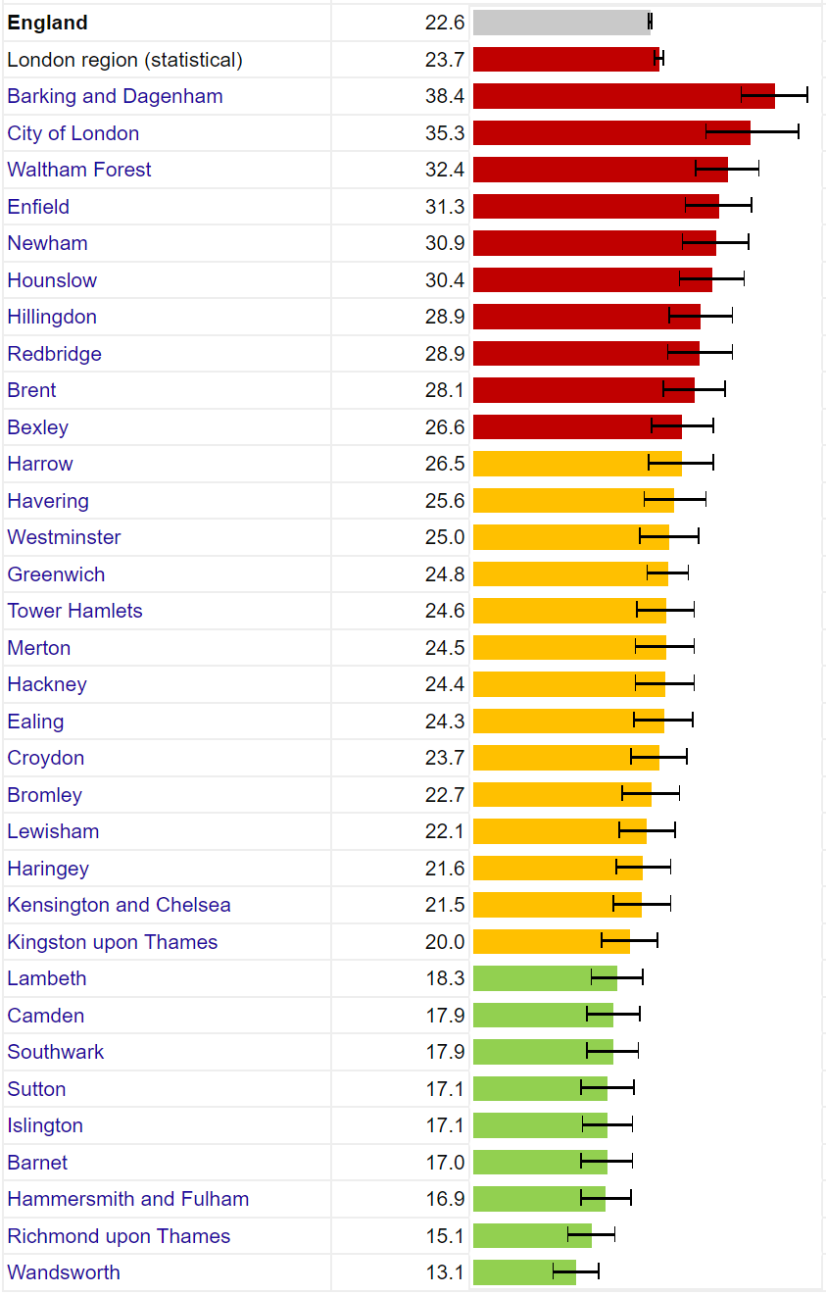
PHYSICAL ACTIVITY IN LONDON
The percentage of physically active adults in London is lower than England with around 1 in 3 adults insufficiently active, but there is significant variation by local authority
In 2022/23, 66.3% of adults (aged 19+) were physically active in London, compared to the England average of 67.1% with significant variation by local authority.¹
  This equates to around 1 in 3 adults being insufficiently physically active in London
Findings from a Sport England report² found wide inequalities in physical activity in adults. The proportion of physically active adults in 2021/22 was lower for: ²
  People in routine/semi-routine jobs and those who are long-term unemployed or have never worked (52.7%)
  Those living with a disability or long-term health condition (47.5%)
  Asian ethnic groups excluding Chinese (55%)
  Black ethnic groups (56%)
Note: The definition of being physically active is taking at least the recommended level of 150 minutes of moderate intensity physical activity or equivalent per week.¹
Fig 48. Percentage of physically inactive adults by local authority, London, ages 19+, 2022/2023
Source: (1) OHID Fingertips -. Percentage of physically active adults (2) Sports England

Slide 66
HEALTH RISKS FROM DRUG AND ALCOHOL MISUSE VARY ACROSS LONDON
Alcohol Misuse The 2021 Health Survey for England showed 25.2% people aged over 16 in London were ‘increasing or higher risk drinkers’ (compared to 21.3% for England). This was an increase from 20.1% in 2019.¹ Around 5.5% of Londoners were ‘higher risk drinkers’ (consuming more than 35 units for women or 50 units for men per week), relative to 3.6% for England. The most recent data at the local authority level is for 2016-2018. This demonstrated significant variability in the prevalence of ‘increasing or higher risk drinkers (from 10.0% in Barnet to 41.3% in Kensington and Chelsea) There were 2,257 alcohol related deaths in London in 2022, representing a rate of 33.4 per 100,000 population. This was significantly lower than the England average 39.7 per 100,000)² Across England, the prevalence of ‘increasing or higher risk’ drinking is highest in the least deprived areas. Meanwhile, the rate of hospital admissions for alcohol-related conditions is highest in the most deprived areas. This mismatch represents a phenomenon known as the 'alcohol harm paradox' and is believed to be due to interactions of alcohol consumption with other health behaviours which are more prevalent in deprived areas such as smoking, poor diet and exercise.¹
Drug Misuse Between 2018-2020, the rate of death due to drug misuse in London was 3.5 per 100,000 people, lower than for England (5.0 per 100,000) and lowest of any region. Within London, rates ranged from 1.9 per 100,000 in Enfield up to 8.0 per 100,000 in Hammersmith and Fulham.³ Data highlights that in England and Wales, the rate of deaths due to drug misuse continue to be highest among those born in the 1970s with the highest rate in those aged 40 to 49.⁴
Source: (1) Health Survey for England Part 1 2021 (2) Public health profiles – alcohol related deaths (3) Public health profiles – deaths due to drug misuse. (4) ONS statistics
Notes:
Updated – blood pressure moved to healthcare inequalities section

Slide 67
PART 5: DEATH AND ILLNESS IN LONDON

Slide 68
PART 5 DEATH AND ILLNESS IN LONDON
This section examines how both the socioenvironmental (Part 3), and behavioural (Part 4) factors lead to health inequalities in London's disease and death rates..
The data presented in this section highlights the diseases and causes of death are driving inequalities in life expectancy, healthy life expectancy and disability-free life expectancy (Part 2) seen in London.
Specifically in this part we will examine below topics and present data cut by dimensions of inequality where available:
  Premature and preventable mortality
  Causes of death
  Causes of illness (morbidity)
  Mental health of adult Londoners
  Infant mortality

Slide 69
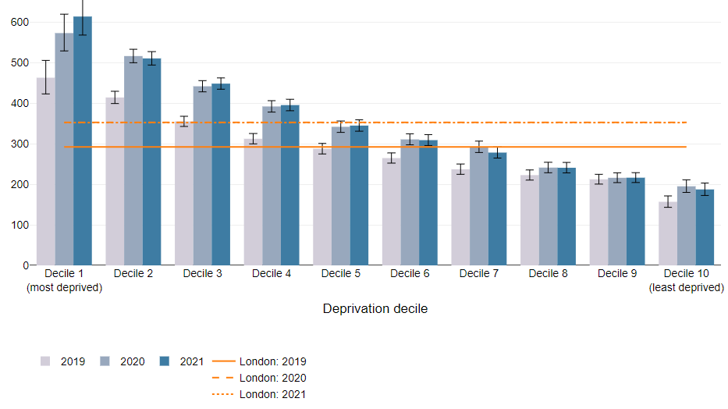
PREMATURE MORTALITY WAS THREE TIMES HIGHER IN THE MOST VS LEAST DEPRIVED DECILE
Premature mortality refers to the age-standardised rate of deaths per 100,000 people aged under 75 years.^{1,2}
All-cause premature mortality in London decreased by 13.8% from 2021 to 2022, representing a return to pre COVID-19 pandemic levels:
  Men have a higher premature mortality rate than women (391.7 per 100,000 vs 234 per 100,000) but also experienced the steepest decline post-pandemic (14.6% for males and 12.7% for females).
The most recent data on inequalities by deprivation are from 2021. In this data, higher rates of premature mortality were seen in the most deprived deciles (as seen in Fig. 49).¹
  The premature mortality rate in the most deprived decile between 2019-21 was consistently nearly three times that of the least deprived decile.
Under 75 mortality rates from all causes considered preventable* were better for London than the England average.²
  This includes for circulatory disease, cancer, liver and respiratory diseases considered preventable*
Fig 49. Premature mortality rates (Age standardised mortality rates for under 75 per 100,000), by deprivation decile for London, 2019-21
*Preventable mortality: Deaths are considered preventable if, in light of the understanding of the determinants of health at the time of death, all or most deaths from the underlying cause could mainly be avoided through public health and primary prevention.
Source: (1) Figure 7b, Health Profile for London, 2021 (2) Fingertips - Mortality profile
Notes:
Partially updated – unable to update further due to no further data on inequalities

Slide 70
HEART DISEASE, DEMENTIA, COVID-19, LUNG CANCER AND RESPIRATORY DISEASES WERE THE COMMON CAUSES OF DEATH IN LONDON IN 2022
Dementia and Alzheimer’s disease (10.7% of all deaths) has replaced COVID-19 as the leading cause of death in London in 2022, with COVID-19 falling to 6th most common cause of death (4.6%). The other leading causes of death include:
  Heart disease (10.6%)
  Stroke (5.1%)
  Chronic respiratory diseases (4.9%)
  Lung cancer (4.7%)
The most common cause of death was heart disease for males (13.8%) and dementia for females (14.1%):
  COVID-19 was still the third leading cause of death for males (5.0%) but only the sixth leading cause for females (4.2%).
  Stroke was the third leading cause of death for women (5.7%) versus the sixth most common for men (4.5%).
Fig 50. Leading causes of death by sex (all ages) in London, 2022
Males
Females
Source: Office for National Statistics, Nomis.

Slide 71
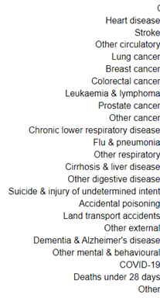
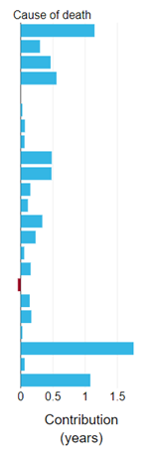
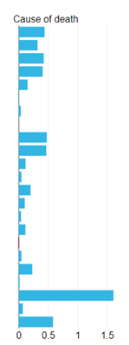
COVID-19, HEART DISEASE, CANCERS AND LUNG DISEASE ADDED TO GAP IN LIFE EXPECTANCY BETWEEN MOST AND LEAST DEPRIVED DECILES
Not updated from 2022
Disparities in death rates across nearly every cause of death contributed to the gap seen in life expectancy between the most and least deprived deciles in 2021.
Higher mortality due to COVID-19 had the biggest impact on the gap in life expectancy between the most and least deprived in 2021. It is possible that this may have changed since this data was last updated.
Deaths due to cardiovascular disease (heart disease, stroke, other circulatory), cancer and respiratory disease also contributed significantly to gaps in life expectancy
Fig 51. Breakdown of the gap in life expectancy in between the most and least deprived deciles by cause of death in London, 2021
Males 2021
Females 2021
Source: OHID CHIME tool

Slide 72

LOW BACK PAIN, DEPRESSION AND HEADACHE CONTRIBUTE MOST TO ILLNESS IN LONDON
Not updated from 2022
Years lived with disability as measured by the Global Burden of Disease tool helps assess the impact across the population of different illnesses and symptoms (morbidity).
Low back pain, depressive symptoms and headache continue to contribute significantly to years lived with disability in London.
There has been an increasing trend in the years lived with disability caused by a range of common health conditions since the 1990s, but the only significant increase has been in diabetes.
For males in 2019, the top three causes were low back pain, diabetes, and depressive disorders. For females, these were low back pain, headache disorders, and depressive disorders.
Figure 52. Age-standardised morbidity rate (years lived with disability) in London for all persons, per 100,000 population, 1990 vs 2019
Note: Change between years should be interpreted with caution as it may reflect changes in methodology and categorisation, and uncertainty limits are wide for most causes.)
Source: Figure 16, Health Profile for London, 2021

Slide 73



PREVALENCE OF SEVERAL COMMONLY DIAGNOSED DISEASES WAS HIGHER IN DEPRIVED GROUPS
The ‘Segmentation Model’ uses nationally available datasets to predict the health conditions of the entire GP registered population based on their historic health service usage (Fig. 53).
Looking at people aged 65-84 years allows us to see inequalities in the pattern of disease at a time of life where prevalence and incidence is particularly high:
Patients aged 65-84 in the most deprived quintile in London, have higher morbidity and much higher (estimated) prevalence of hypertension (46.3% vs 34.8%) and diabetes (32.0% vs 16.0%) compared to the least deprived quintile.
Higher prevalence in more deprived groups of other major diseases was also observed including osteoarthritis, coronary heart disease, cerebrovascular disease, asthma, and depression.
Fig 53. Comparison of prevalence of several common diseases, people aged 65-84, most and least deprived groups, London, September 2022
Most deprived quintile
Key
London
England
Least deprived quintile
Note
Patients with conditions managed entirely within primary care without presenting to secondary/community care will not be 'detected' by the Segmentation Model.
65-84 category is a large age bracket, which could be skewed differently between populations.
Data only captures people who are registered at a GP practice which may underestimate prevalence.
Source: Segmentation Model developed by Data, Analysis and Intelligence Service (DAIS) in NHSEI, Public Health England (PHE), Outcomes Based Healthcare (OBH) and Arden & GEM CSU. https://apps.model.nhs.uk/report/PaPi

Slide 74



THE PREVALENCE OF COMMONLY DIAGNOSED DISEASES IN LONDON VARIES BY ETHNICITY
The Segmentation Model highlights several examples of ethnic inequality in the prevalence of common diseases in London (Fig. 54):
Hypertension: A much higher prevalence is seen in Asian (56.6%) and Black (56.4%) ethnic groups compared to White (42.3%).
Diabetes: A much higher prevalence is seen in Asian (49.5%) and Black (40.2%) ethnic groups than White (18.7%).
Other: Higher coronary heart disease (CHD) and asthma prevalence in Asian ethnic groups; while a lower cancer prevalence is observed.
Note
Ethnicity coding has improved but remains incomplete with concerns remaining especially around secondary care coding quality.
Missing records likely to be skewed towards patients not routinely accessing healthcare services/younger people.
Fig 54. Comparison of prevalence of several common diseases in people aged 65-84, by ethnic group, London, September 2022
White
Key
Asian/British Asian
London
England
Black/British Black
Source: Segmentation Model developed by Data, Analysis and Intelligence Service (DAIS) in NHSEI, Public Health England (PHE), Outcomes Based Healthcare (OBH) and Arden & GEM CSU. https://apps.model.nhs.uk/report/PaPi

Slide 75

NEARLY ONE IN FOUR LONDONERS AGED 16+ REPORT SIGNS OF POOR MENTAL HEALTH
The General Health Questionnaire (GHQ-12) helps to identify minor psychiatric disorders in the general population. Higher scores are indicative of poorer mental health.
  In 2009-10 around one in five (20%) of Londoners aged 16+ reported characteristics of poor mental health. It remained quite stable over the last 10 years, though during the height of the pandemic in 2020-21, the proportion increased to 26%. It has since fallen to 23% in 2021-22.
  Londoners aged 50+ (21%) were less likely to display features of poorer mental health than Londoners aged 16-29 (26%).
Across the UK, people from ethnic minority groups are more likely to have an undiagnosed or untreated mental health condition than White people, to be diagnosed with a severe mental illness, and at higher risk of emergency hospitalisation or detention under the Mental Health Act.
Fig 55. Percentage of Londoners aged 16+ with a high GHQ-12 score (4 or more), 2009-22
Note: The General Health Questionnaire focuses on two major areas: the inability to carry out normal functions; and the appearance of new and distressing phenomena, with each of the 12 items rated on a four-point response scale. A coding method was used whereby the maximum score for any respondent is 12, with higher values indicating poorer mental health. A threshold of 4 or more was set as the difference between 'no or few mental health problems' and 'poorer mental health’.
Source: (1) University of Essex, Institute for Social and Economic Research. (2023). Understanding Society: Waves 1-13, 2009-2022 and Harmonised BHPS: Waves 1-18, 1991-2009. [data collection]. 18th Edition. UK Data Service. SN: 6614 (2) Bansal et al (2022): Understanding ethnic inequalities in mental healthcare in the UK: A meta-ethnography

Slide 76

THE MENTAL HEALTH OF CHILDREN AGED 10-15 YEARS HAS DECLINED IN THE LAST DECADE
In 2009-10, 8% of Londoners aged 10-15 had a probable mental disorder, lower than across the UK (13%). The London proportion has remained below the UK proportion over the last 10 years, and in the most recent wave of the survey covering 2021-22 (partially covering the pandemic period), the proportions were 19% and 23% respectively.
Rates of probable mental disorder in this age group have increased in the last 10 years both in London and the UK.
Fig 56. Proportion of children aged 10-15 in the UK and London with a high or very high total difficulties score (18 or more) (%), 2009-22
Note: This data is from the strengths and difficulties questionnaire (SDQ) which is an emotional and behavioural screening questionnaire for children and young people.
The total difficulties score is the sum of the emotional symptoms, conduct problems, hyperactivity/inattention and peer relationships problems subscales, and ranges from 0-40
The total difficulties score results from the Understanding Society survey for 10-15-year-olds, categorised as: normal (0 to 14); slightly raised (15 to 17); high (18 to 19); and very high (20 to 40).
In 2015, ONS used the proportion of children reporting a high or very high total difficulties score (18+) as the headline measure for the prevalence of mental ill health.
Source: (1) University of Essex, Institute for Social and Economic Research. (2023). Understanding Society: Waves 1-13, 2009-2022 and Harmonised BHPS: Waves 1-18, 1991-2009. [data collection]. 18th Edition. UK Data Service. SN: 6614, DOI: http://doi.org/10.5255/UKDA-SN-6614-19.

Slide 77

LONDON HAD THE HIGHEST RATE OF SEXUALLY TRANSMITTED INFECTIONS IN ENGLAND IN 2022
There were 122,912 new diagnoses of sexually transmitted infections in London in 2022, representing an increase of 21% from 2021.
  The increase has mostly been led by an increase in incidence of gonorrhoea (+36%) and chlamydia (+19%).
  The highest rates and the biggest increases were seen for young adults aged 20-24 (957.3 new STI diagnoses per 100,000) and 25-34 (967.3 per 100,000).
  The rates of new diagnoses in London are still 18% lower than the 2019 level, but rates for gonorrhoea and syphilis are higher than the numbers seen pre-pandemic.
London’s cases represented nearly one third of all new diagnoses in England in 2022 (31%) but rates by local authority ranged significantly (Figure 57):
  The lowest rates were seen in Bexley (91 new STI diagnoses per 100,000 population) and highest in the City of London (3,655 per 100,000 population).
Fig 57. Proportion of children aged 10-15 in the UK and London with a high or very high total difficulties score (18 or more) (%), 2009-22
Source: Spotlight on sexually transmitted infections in London: 2022 data

Slide 78


LARGE INEQUALITIES IN STI DIAGNOSIS OCCUR ACROSS SEXUALITY, DEPRIVATION AND ETHNICITY
People who are gay, bisexual or men who have sex with men (GBMSM) have been estimated to have a rate of new STI diagnoses 15 times higher than the average Londoner:¹
  21,133.3 per 100,000 people who are GBMSM are estimated to have had an STI diagnosed in 2022.
  This rate is likely to be an overestimate, however, due to under-reporting of gay and bisexual orientations in the census
The rate of new STIs among people in the most deprived areas of London is more than 3 times than the rate for people who live in the least deprived areas (1,934 per 100,000 versus 497 per 100,000).¹
Ethnic inequalities occur for Black people in terms of STI diagnosis:
  Black Caribbean Londoners experience the highest rate of new STI diagnoses of all ethnicities (2,857 per 100,000), twice the rate seen for White people (1,294 per 100,000). The Black Caribbean ethnic group, however, also saw the largest fall in its diagnosis rate from 2019 to 2022 (-29%).¹
  Black African people in London are significantly more likely to be diagnosed late with HIV (60%), relative to people of White (30%) and Black Caribbean ethnicity (37%).²
Fig 58. Rate of STI diagnoses per 100,000 population in London in 2022, for deprivation decile (A) and ethnicity (B)¹
(A)
(B)
Source: (1) Spotlight on sexually transmitted infections in London: 2022 data (2) UKHSA HIV Spotlight

Slide 79
INFANT MORTALITY CORRELATES WITH AREA DEPRIVATION AT LONDON AND NATIONAL LEVELS
In 2020-22, infant mortality was 3.6 per 1,000 live births and lower than the England average (4.0 per 1000) with a gradual increase being seen since 2014-16.
Fig 59. Infant mortality rate per 1,000 live births by deprivation score by local authority in London, 2020-22
The infant mortality rate (IMR) is the number of deaths under the age of one year per 1,000 live births. Most infant deaths occur during the first month, most commonly due to immaturity related conditions in babies born preterm (< 37 weeks gestation) and congenital anomalies¹.
Around 7 babies died per week in London in 2020-22, many from preventable causes. There is significant variation across boroughs:
  Greenwich is the only London borough with a significantly higher infant mortality rate than London (4.8 per 1,000).
  Wandsworth is the only borough where it is significantly lower than average (1.9 per 1,000).
The rate has increased in London from 3.2 per 1,000 in 2014-16
Nationally data shows the rate of infant mortality increases as deprivation increases, from 6.2 per 1,000 in the most deprived decile, to 2.9 per 1,000 in the least deprived. This trend is apparent at the London borough level (Fig 59).
Between 2017-19, the rate of stillbirths and infant deaths in England and Wales was highest for Black children, and higher for Asian children, relative to children of White ethnicity². This may be partially explained by children from minority ethnic groups disproportionately being born in more deprived areas.
Greenwich
London avg.
Wandsworth
Note: Infant mortality rates are presented as a three-year rolling average to smooth out variation.
Source: (1) OHID Public health profiles – infant mortality rate (2) ONS

Slide 80
PART 6: HEALTHCARE INEQUALITIES

Slide 81
PART 6 HEALTHCARE INEQUALITIES
The purpose of this section is to demonstrate through selected examples (acknowledging the limitations in available data) how inequalities in access to, quality and experience of health and care provision, can further compound and worsen existing health inequalities.
We will review the topics listed below broken down by inequality dimensions where available:
  Spend on unplanned care by deprivation
  Covid-19 vaccination uptake by deprivation and ethnicity
  Influenza vaccination uptake by deprivation and ethnicity
  MMR vaccination by deprivation and ethnicity
  Breast and Bowel cancer screening uptake by deprivation
  NHS Health Check uptake by deprivation and ethnic group
  Inequality in diabetes care by deprivation
  Inequality in hypertension management
  Inequality in cardiovascular disease incidence and management

Slide 82

THERE IS HIGHER SPEND ON UNPLANNED CARE AND LOWER ON PLANNED IN DEPRIVED AREAS
The Segmentation Model uses nationally available datasets to assign conditions and costs to the entire GP registered population based on their historic health service usage.
Emergency department (ED) and non-elective (NEL) per capita spend in London, for people aged 65-84, is higher in the most deprived quintile than in the least deprived (£114 vs £67; £1,115 vs £665).
Elective (EL) per capita spend is slightly higher in the least deprived quintile than in the most deprived (£528 vs £507).
Outpatient first appointment (OP1) spend is slightly higher in the least deprived quintile than in the most deprived (£232 vs £215). The difference in outpatient follow up appointment (OPFU) spend is negligible.
This collectively highlights how deprived areas tend to receive more reactive than proactive healthcare.
Note:(1) Financial values are based on national tariffs, supplemented with reference cost information where no tariff exists for an indicative price value.
(2) ED=Emergency Department; NEL=Non-elective care; EL=elective care; OP1=outpatient first appointment; OPFU=outpatient follow up appointment.
Fig 60. Cost per capita by point of delivery for care in most deprived compared to least deprived quintiles (ages 65-84)
Source: Segmentation Model developed by Data, Analysis and Intelligence Service (DAIS) in NHSEI, Public Health England (PHE), Outcomes Based Healthcare (OBH) and Arden & GEM CSU. https://apps.model.nhs.uk/report/PaPi

Slide 83
INEQUALITIES IN COVID-19 VACCINATION UPTAKE IN LONDON
Fig 61. Autumn/Winter 2023 COVID-19 vaccination uptake for JCVI eligible cohorts 1 to 11, February 2024
Deprivation decile
Note: Colour-coding is according to a gradient from the highest (dark green) to lowest (dark red) vaccine uptake, with white corresponding to the 50th percentile.
In the 2023 Autumn/Winter, uptake of the COVID-19 vaccine booster varied significantly by level of deprivation and ethnic group (Fig. 61):
  The highest booster uptake in the White British group, with high uptake also seen in White Irish and Chinese groups. Uptake is lower across all black/mixed black ethnic groups as well as in Bangladeshi and Pakistani groups.
  Across ethnicity groups in London, we see a clear gradient of lower uptake in more deprived Indices of Multiple Deprivation (IMD) deciles to higher uptake in less deprived deciles.
  Within ethnicity groups we also tend to see lower uptake in patients with no IMD decile (i.e. no patient address information) recorded.
Source: NHS Foundry

Slide 84
INEQUALITIES EVIDENT IN INFLUENZA VACCINATION UPTAKE IN LONDON
Fig 62. Autumn/Winter 2023 Influenza vaccination uptake for eligible cohorts, February 2024
Deprivation decile
Note: Colour-coding is according to a gradient from the highest (dark green) to lowest (dark red) vaccine uptake, with white corresponding to the 50th percentile.
In the 2023 Autumn/Winter, uptake of the influenza booster varied significantly by level of deprivation and ethnic group (Fig. 62):
  We see the highest flu vaccination uptake in the White British and White Irish groups, with high uptake also seen in Indian and Chinese groups, and other Asian backgrounds. Uptake is particularly low in groups with Unknown ethnicity and across all black/mixed black ethnic groups.
  Across ethnicity groups in London, we see a clear gradient of lower uptake in more deprived IMD deciles to higher uptake in less deprived deciles.
  Within ethnicity groups we also see low uptake in patients with no IMD decile (i.e. no patient address information) recorded.
Source: NHS Foundry

Slide 85
MMR VACCINATION COVERAGE IN LONDON
London’s MMR vaccine uptake is significantly lower than for England and has been on a downward trend since 2015/16
Two doses of the Measles, Mumps and Rubella (MMR) vaccine prevents 99% of measles and rubella, and 88% of mumps infections.
The coverage of full vaccination with MMR (2 doses) in London was 74.0% in 2022/23, lower than for England (84.5%) and well below the WHO target of 95% required for herd immunity¹.
Coverage varies markedly across London boroughs from the lowest coverage in Hackney (56.3%) to the highest in Bromley (87%)
With the exception of the most deprived decile, there was no clear pattern in proportion of children aged 5 registered at GP practices receiving two doses of MMR in 2022/23 by deprivation level² (Fig. 63)
Research looking at vaccine coverage between 2006 and 2021 found that Black African and Caribbean children were less likely to be vaccinated with MMR, and that this disparity increased over time³.
COVID-19 led to a significant decrease in the uptake of MMR in England, occurring to a lesser extent in White children relative to other ethnic groups.⁴
Note:(1) The graph provides data comparing the average proportion of children at each GP practice in London receiving two doses of MMR in 2022/23 by IMD rank.
(2) The higher uptake of MMR observed in GP practices in the most deprived areas may be affected by a relatively much smaller number of patients within these practices compared to the other deciles.
Fig 63. Proportion of children aged 5, who received a reinforcing dose of DTaP/IPV and 2 doses of an MMR vaccine between the ages of 1 and 5 years in 2022/23 at London GP practices, by deprivation decile
Source: (1) OHID (2) QOF 2022/23 (3) Ethnic inequities in routine childhood vaccinations in England 2006–2021 (4) National rates and disparities in childhood vaccination during the COVID-19 pandemic

Slide 86


INEQUALITY IN SCREENING UPTAKE IN LONDON
Uptake of bowel cancer screening in London has been increasing since 2015 with 63.5% of eligible people taking up screening in 2023, but is still below the uptake rate for England as a whole (72%).
Meanwhile, uptake of breast cancer screening has declined significantly following the COVID-19 pandemic from 67.3% in 2019 to 55.8% in 2023. A similar pattern has been seen in England as a whole, but uptake is higher in England (66.2%)
In June 2023, breast and bowel cancer screening uptake was lower in deprived areas (Fig. 64)
Uptake of bowel cancer screening has been found to be lower in most minority ethnic groups (except Chinese) relative to White people in West London¹. There are also differences in uptake by ethnicity for breast cancer screening, with South Asian women being particularly less likely to take up screening².
Fig 64. Percentage uptake of breast cancer screening (persons aged 50-70) and bowel cancer screening (persons aged 60-74) within 6 months of invitations, rolling 12-month uptake to June 2023.
Breast Cancer
Bowel Cancer
Note: IMD metrics are calculated from GP level aggregate data (not patient-level data). Composite GP IMD scores have been calculated based on the proportion of registered population in each LSOA (1=most deprived vs 10=least deprived).
Source: (1) Extracted via the Open Exeter system. (Data was collected by NHS England Public Health London Regional Team), (2) Singh et al: Ethnic disparities in the uptake of colorectal cancer screening, (3) GOV.UK: Breast screening: identifying inequalities
Notes:
Updated slide

Slide 87
NHS HEALTH CHECK UPTAKE IS HIGHER IN DEPRIVED AREAS AND FOR MINORITY ETHNIC GROUPS
NHS Health Checks are offered every 5 years to people aged 40-74 years who do not already have a long-term condition. They aim to provide an opportunity for targeted prevention.
In 2022/23, 45.6% of the 524,168 people invited for an NHS Health Check in London took up the offer, better than the 38.9% uptake of invites for England as a whole.
The most recent data on inequalities come from an analysis of NHS Health Checks in 2017-2018. This data showed:
  People in the most deprived deciles of London were more likely to attend an NHS Health Check when invited than those in less deprived areas (range from 52% in the most deprived decile to 36% in the 3rd least deprived).
  People from Asian, Black and Other ethnicities were the ethnic groups most likely to take up the offer of an NHS Health Check (56.2%, 52.1% and 48.9%, respectively). A large number of patients (10%) had no ethnicity recorded and these were the least likely to attend a Health Check (13.7%).
Fig 65. Proportion of GP registered adults aged 40-74 who took up the invite to an NHS Health Check in 2017-18, by deprivation (top) and ethnicity (bottom)
Source: Quality and Outcomes Framework (QOF) 2020/21, NHS Digital. https://fingertips.phe.org.uk/profile/general-practice/data#page/1/
Notes:
New slide

Slide 88
THERE ARE INEQUALITIES IN THE QUALITY OF DIABETES CARE BY DEPRIVATION IN LONON
An illustration of inequalities in quality of care across long-term illnesses can be seen in patients registered with a GP in London that have well-controlled diabetes.
Maintaining glycated haemoglobin (HbA1c) within recommended levels (target ≤ 58 mmol/mol) is crucial for preventing serious and potentially life-threatening complications associated with poor glucose control in diabetes.
There is significant variation in the achievement of well-controlled HbA1c by deprivation decile (Fig. 64).
  51.6% of patients in the most deprived decile had well controlled HbA1c in 2022/23, compared to 59.1% for the least deprived.
Note:(1) The utility of these measures depends on clinical case finding by GPs (i.e. people with diabetes being detected and properly recorded in GP records). (2) Denominators include Personalised Care Adjustments (PCAs); patients who are deemed unable to receive a particular treatment. PCAs are usually the result of a decision by a patient or GP at a personal level; e.g. patient/carer refusing a treatment, interactions between different medications etc.
Fig 66. Percentage of people with diabetes without moderate/severe frailty, registered at a GP, where HbA1c≤ 58 mmol/mol, by deprivation decile in 2022/23
Source: Quality and Outcomes Framework (QOF) 2020/21, NHS Digital. https://fingertips.phe.org.uk/profile/general-practice/data#page/1/
Notes:
Updated

Slide 89
THE MOST DEPRIVED LONDONERS ARE LEAST LIKELY TO HAVE CONTROLLED HYPERTENSION
The diagnosed prevalence of hypertension (blood pressure consistently >140/90mmHg) in London changed little between 2015/16 (11.0%) and 2022/23 (10.9%)¹
  Bexley (14.7%) had the highest prevalence, while Tower Hamlets (7.2%) had the lowest. Differences in age structure between boroughs may contribute to this variation.
  This data relies on GPs diagnosing all hypertension cases. This is unlikely and may be inconsistent across practices.
Patients aged over 45 in the 2nd-4th most deprived areas are more likely to have had their blood pressure checked in the last 5 years than patients in any other deprivation decile (Fig. 65).²
Hypertension patients in the most deprived areas were less likely to have their blood pressure well controlled in 2022/23 (Fig. 66).²
  61.2% under 80 years in the most deprived decile had blood pressure ≤140/90mmHg, compared to an average of 67.8%
National research between 2006 and 2019 found that Black African and Caribbean patients with hypertension were less likely to have well controlled blood pressure, potentially because of differences in consistently taking medication.³
Fig 67. Proportion of GP registered patients aged over 45 with a blood pressure check in last 5 years, by deprivation, 2022/23
Fig 68. Proportion of hypertension patients aged <80 years with blood pressure reading ≤140/90mmHg in last 12 months.
Source: (1) Public health profiles – hypertension (2) QOF 2022/23 (3) Ethnic differences in hypertension management, medication use and blood pressure
Notes:
New slide

Slide 90
PART 7: CONCLUSION

Slide 91
CONCLUDING COMMENTS
London, as with the rest of the UK, has made progress in recovering from the impact of the COVID-19 pandemic. This is reflected in broad indicators of health in the region, including life expectancy measures that have shown signs of returning to pre-pandemic highs.
Clear inequalities are seen in health status by deprivation and ethnic group. Life expectancy, low birthweight and infant mortality in London correlate with levels of deprivation in the borough. Black African people had a higher life expectancy than most other ethnic groups in 2011-14, but this may not be reflective of the post-pandemic period. Minority ethnic groups experience a wide range of health inequalities.
Inequalities in the wider determinants of health, including education, income, poverty, and living environment, are likely to explain a large degree of the variation in broad health outcomes for people from different deprivation deciles and ethnic backgrounds. The cost of living crisis has led to increasing levels of poverty in London with adverse health outcomes. Meanwhile, people living in the most deprived areas and from minority ethnic groups are most at risk of health effects from changes in the climate.
Health behaviours including smoking, diet and physical activity are among the top contributors to disease and death in London. While smoking rates continue to show a long-term decreasing trend in London, child overweight and obesity is increasing. Obesity and physical activity in adulthood have shown no recent change. People from more deprived areas are less likely to adopt health-promoting behaviours, while Black children are the most likely to be overweight or obese.
A disproportionate amount of spending is allocated to unplanned care in more deprived areas of London, indicating a reactive model of care. Engagement in vaccination and screening programmes generally declines with level of deprivation, as does effective management of diabetes and hypertension. Prevalence of hypertension, diabetes and coronary heart disease is higher in minority ethnic groups. Interestingly, Asian and Black people and people from more deprived areas are more likely to take up the offer of an NHS Health Check, indicating an opportunity to reverse health inequalities affecting these groups.
More systematic and consistent collection, recording and coding of data relating to geography, across all protected characteristics, and of key inclusion health groups should remain a priority to provide more effective intelligence of health inequalities in London, informing strategic action. Partnership working could further unlock more timely, integrated and linked data across health and wider determinants.
Health inequalities persist, and in some cases have worsened across London, from upstream in the wider determinants of health through to ultimate outcomes such as mortality rates. A joined-up approach with partners within and adjacent to health will be needed to address many of the systemic drivers of inequality, possibly through a ‘Health in All Policies’ approach.

Slide 92
GAPS IN EVIDENCE AND GAPS IN THIS DECK
The purpose of this slide deck is to provide a snapshot of health inequalities pertaining to some key issues in London, however it has identified recurrent gaps in our intelligence in particular the need for:
More granular data for topic areas available at a local level and cut by dimensions of inequality, in particular
  Ethnicity, disability and other protected characteristics
  Inclusion health groups
More integrated health and social care data and better linked datasets to allow more effective longitudinal and cross-sectional analysis of inequalities
There is also a clear need for further work on identifying useful and timely intelligence to expand on the impact on health and health inequalities of topic areas, already identified as important for London and aligned to the Building the Evidence (BTE) intervention reviews such as:
Cost of Living
Structural Racism
Housing
Liveable cities
Skills for Work
Climate change

Slide 93
ACKNOWLEDGEMENTS
The initial Snapshot of Heath Inequalities in London was produced by the Building the Evidence (BTE) data working group, comprised of the organisations listed below, as well as the advisory group overseeing the direction of the work.
  GREATER LONDON AUTHORITY (GLA) HEALTH
  GREATER LONDON AUTHORITY (GLA) CITY INTELLIGENCE UNIT
  INSTITUTE OF HEALTH EQUITY
  OFFICE FOR HEALTH IMPROVEMENT AND DISPARITIES LONDON
  ASSOCIATION OF DIRECTORS OF PUBLIC HEALTH LONDON
  NHS ENGLAND
This 2024 refresh is based on the work of previous contributors as well as new analysis, interpretation and revisions provided by a joint effort between the Greater London Authority (GLA) Health, GLA City Intelligence Unit, the Office for Health Improvement and Disparities London (OHIDL) and NHS England (NHSE).

Slide 94
END

