Slide 1
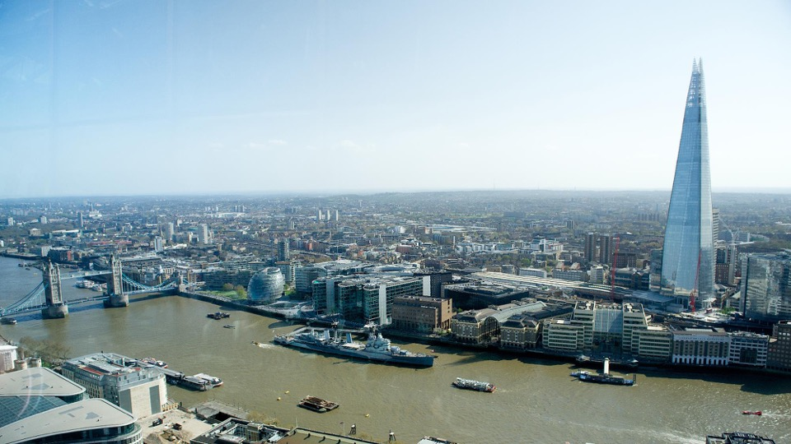



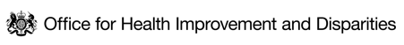


HEALTH INEQUALITIES IN LONDON
Poverty & Cost of Living Pack
BUILDING THE EVIDENCE DATA COLLABORATIVE
August 2024

Slide 2
CONTENTS
CONTEXT
Population of London at the 2021 Census
Population growth in London
BROAD INDICATORS OF HEALTH STATUS
Life expectancy at birth
Healthy life expectancy
Inequalities in premature mortality
POVERTY
Health effects of poverty
Relative poverty in London
Relative poverty by London borough
Persistent poverty and destitution
Longitudinal analysis of relative poverty
Drivers of poverty
Inequalities in relative poverty
Child poverty
COST OF LIVING
A picture of rising cost-of-living in London
Employment and income
Inflation and real-terms wage growth
Housing

Slide 3
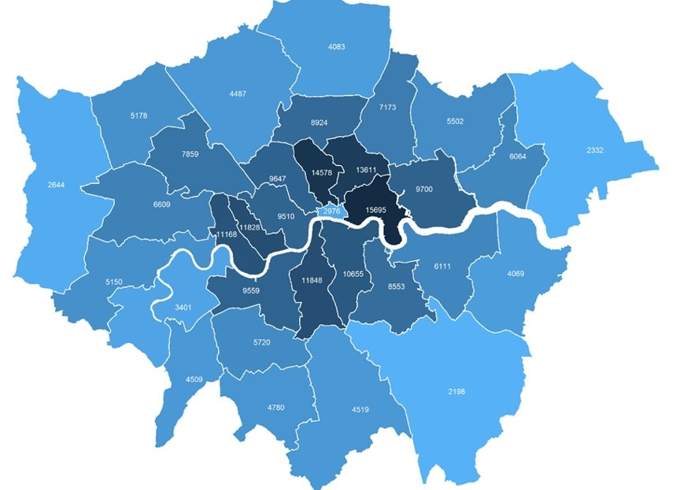

LONDON’S 2021 CENSUS DAY POPULATION WAS 8.8 MILLION, LOWER THAN 2020 OR 2022
The census population estimate of 8.8 million was likely to be close to a low point in London’s population, brought about by a temporary dip during the COVID-19 pandemic.
We know the pandemic caused some outflow of families and young adults from London and a virtual halt in international movements. We don’t know how far COVID affected the census responses that were recorded.
Key Census statistics
41% of Londoners were born outside UK (Rest of England 13%), and 46% were of Asian, Black, Mixed or Other ethnicities
50% of Londoners were aged 35 or under (Rest of England 43%) and 12% were aged 65 or over (Rest of England 20%)
4.2% of Londoners aged 16 or over identified as LGB+ and 0.9% said their gender identity differed from their sex at birth
12% of London’s working-age (aged 18-66) population reported they were disabled (Rest of England 17%) and 3.9% reported bad or very bad health (Rest of England 4.8%)
Fig 1. Population Density (persons per km²) by London Borough, 2021 Census
Source: England and Wales Census 2021

Slide 4
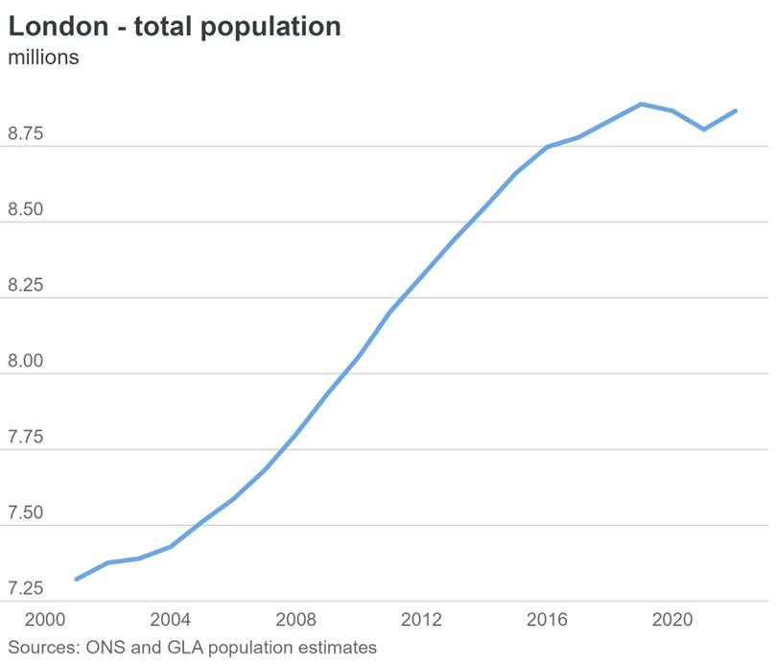
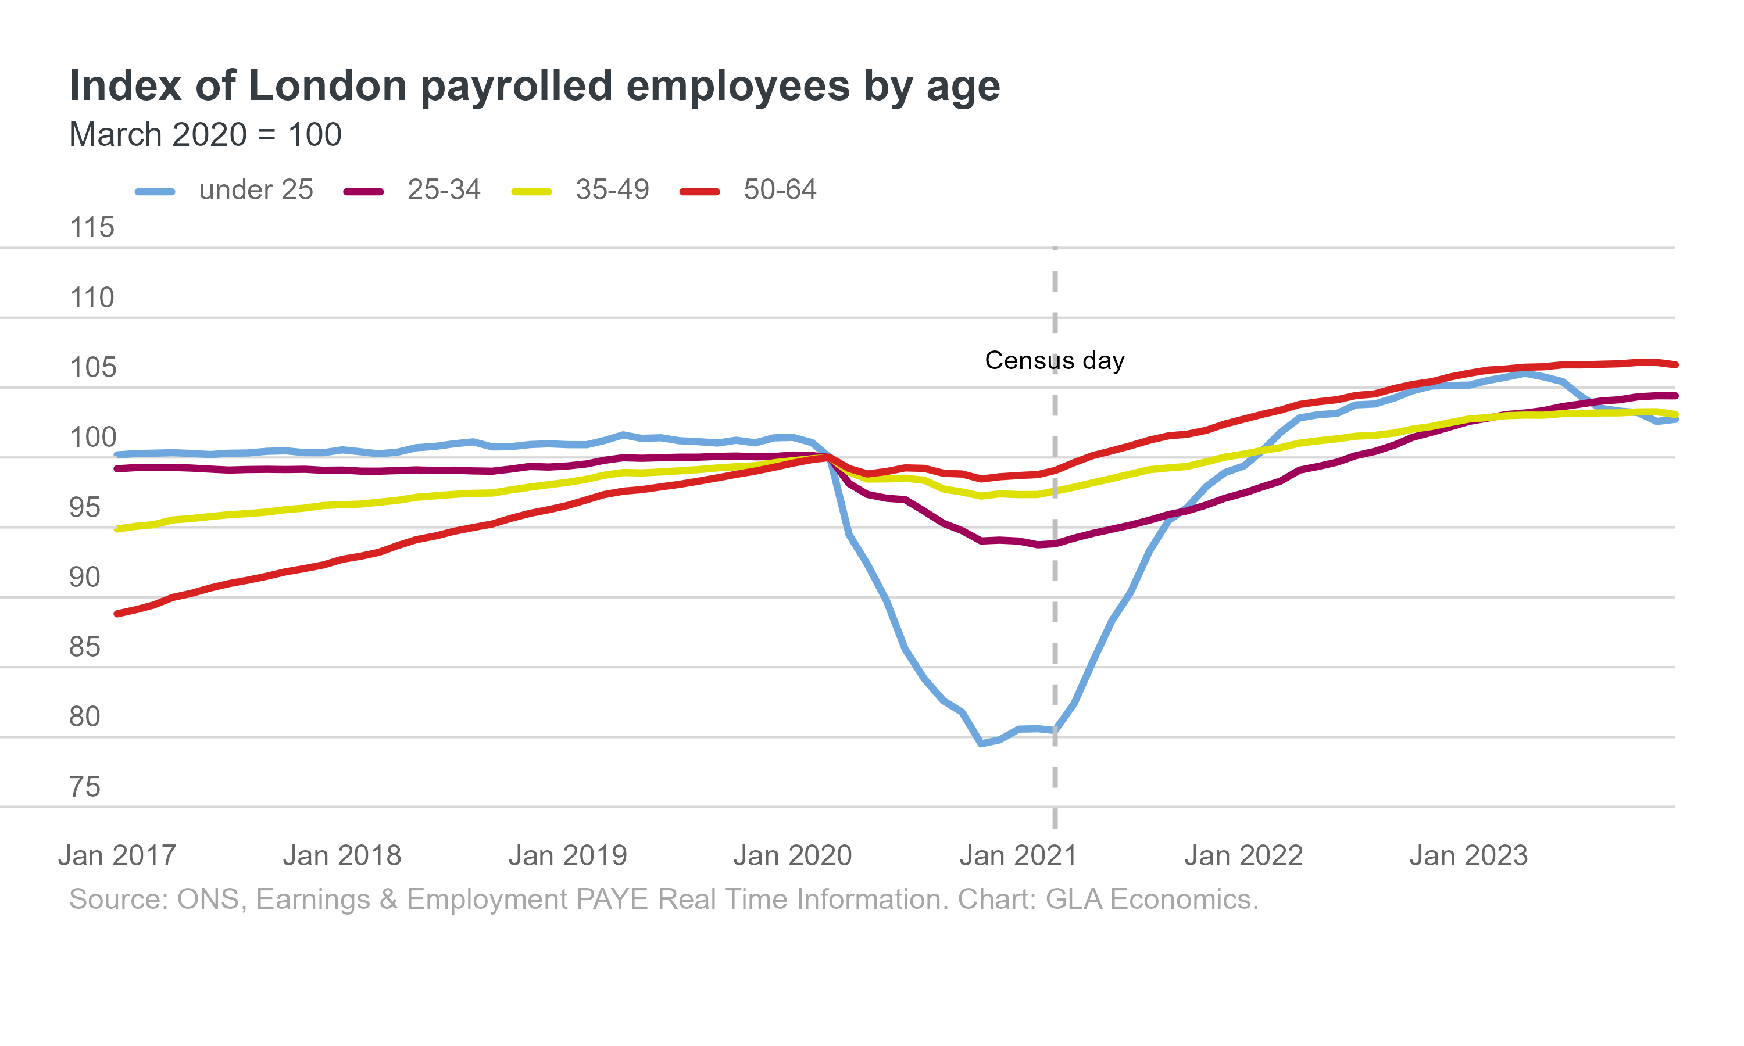
LONDON’S POULATION GROWTH HAS SLOWED SINCE 2015, WITH A TEMPORARY FALL IN POPULATION DURING THE COVID-19 PANDEMIC
London’s population growth has slowed since 2015 as a result of:¹
  Declining birth rates
  Rising domestic outflows
  A fall in international migration following the Brexit referendum.
The COVID-19 pandemic led to a temporary fall in London’s population due to relocation of families and young adults, and international movement restrictions.
Population growth resumed in the year to mid-2022, driven by a significant increase in international migration to the UK.
Fig 2. London’s population, 2000 to 2022
Fig 3. Change in number of London employees over time
Source: (1) ONS and GLA population estimates

Slide 5
LIFE EXPECTANCY AT BIRTH HAS RECOVERED FROM ITS COVID-19 DIP
Fig 4. Trend in life expectancy at birth for females and males in London, three year rolling (dotted line) and single year (solid line), 2010-2022
In 2022, the life expectancy at birth for males and females increased and returned to pre-pandemic peaks following a COVID-19 dip, at 80.3 and 84.4 years respectively.
The three-year rolling average for life expectancy at birth shows a longer trend, but is sensitive to the unique impact of the COVID-19 pandemic on mortality, resulting in the appearance that life expectancy at birth has not yet recovered to previous highs following the pandemic.
Life expectancy at birth in London on both a three-year and single-year basis was consistently higher than the England average before the pandemic. In 2020, life expectancy at birth for males in London fell below the England average, though the gap now shows signs of reversing and widening back out to pre-pandemic levels.
Some boroughs in London did not experience significant declines in life expectancy during COVID-19 and have had a relatively stable life expectancy for both males and females in recent years.
COVID pandemic years 2020 & 2021
Females
Males
Source: OHID PHOF Indicators

Slide 6
HEALTHY LIFE EXPECTANCY IN LONDON
Healthy life expectancy (HLE) provides an estimate of lifetime spent in 'very good' or 'good' health, based on how individuals perceive their general health
HLE has not changed significantly in London since 2011-13, while it has decreased in London overall.
Between 2020-22, HLE at birth for both males and females in London was higher than for England at 63.9 years and 63.7 years respectively. This represents the first time that males had a higher HLE than females since 2011-13.
Males on average spent 80.8% of their life in ‘good’ health versus 76.2% for women.
Fig 5. Trend in healthy life expectancy at birth, by sex, London compared to England, 2011-13 to 2020-22
Male
Female
London
London
England
England
Source: PHE Public Health Outcomes Framework - Healthy life expectancy at birth

Slide 7
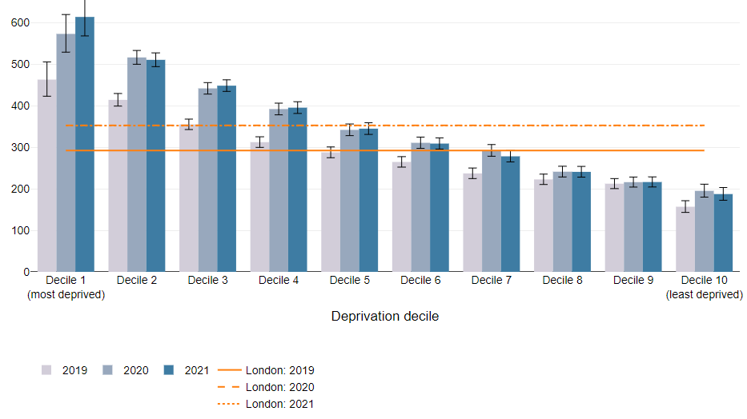
PREMATURE MORTALITY WAS THREE TIMES HIGHER IN THE MOST VS LEAST DEPRIVED DECILE
Premature mortality refers to the age-standardised rate of deaths per 100,000 people aged under 75 years.^{1,2}
All-cause premature mortality in London decreased by 13.8% from 2021 to 2022, representing a return to pre COVID-19 pandemic levels:
  Men have a higher premature mortality rate than women (391.7 per 100,000 vs 234 per 100,000) but also experienced the steepest decline post-pandemic (14.6% for males and 12.7% for females).
The most recent data on inequalities by deprivation are from 2021. In this data, higher rates of premature mortality were seen in the most deprived deciles (as seen in Fig. 6).¹
  The premature mortality rate in the most deprived decile between 2019-21 was consistently nearly three times that of the least deprived decile.
Under 75 mortality rates from all causes considered preventable* were better for London than the England average.²
  This includes for circulatory disease, cancer, liver and respiratory diseases considered preventable*
Fig 6. Premature mortality rates (Age standardised mortality rates for under 75 per 100,000), by deprivation decile for London, 2019-21
*Preventable mortality: Deaths are considered preventable if, in light of the understanding of the determinants of health at the time of death, all or most deaths from the underlying cause could mainly be avoided through public health and primary prevention.
Source: (1) Figure 7b, Health Profile for London, 2021 (2) Fingertips - Mortality profile
Notes:
Partially updated – unable to update further due to no further data on inequalities

Slide 8




POVERTY IMPACTS ON HEALTH AND WIDER LIFE CHANCES. TO UNDERSTAND THE LONDON PICTURE MULTIPLE POVERTY MEASURES MUST BE CONSIDERED
Poverty damages physical and mental health, and poor health increases the risk of poverty.¹
There are different ways to measure poverty. Two commonly used measures of poverty are:
  Relative poverty: where household income is a certain percentage below median incomes
  Absolute poverty: where household income is below a necessary level to maintain basic living standards
To enable comparisons, this section will mainly use relative poverty measures, however key findings from other poverty measures will also be outlined to build a picture of who is most affected and the trends.
Whilst the latest available data and analysis on poverty are presented here at the time of writing, due to data publication timings it will not fully reflect the most recent impact of the cost of living crisis.
Fig 7. Health effects of poverty, adapted from The Health Foundation¹
An inadequate income can cause poor health
because it is more difficult to:
Avoid stress and feel
in control
Access experiences and material resources
Adopt and maintain healthy behaviours
Feel supported by a financial safety net
Living with the day-to-day stresses of poverty in early childhood can have damaging consequences for long-term health.
Money allows people to access better quality living conditions, including housing, and to fully participate in society.
Healthy behaviours can feel unattainable. It can be more expensive to get the energy we need from healthy foods than from unhealthy foods.
A safety net enables people to invest in their future, including studying and retraining.
Source: (1) The Health Foundation - Poverty and health

Slide 9
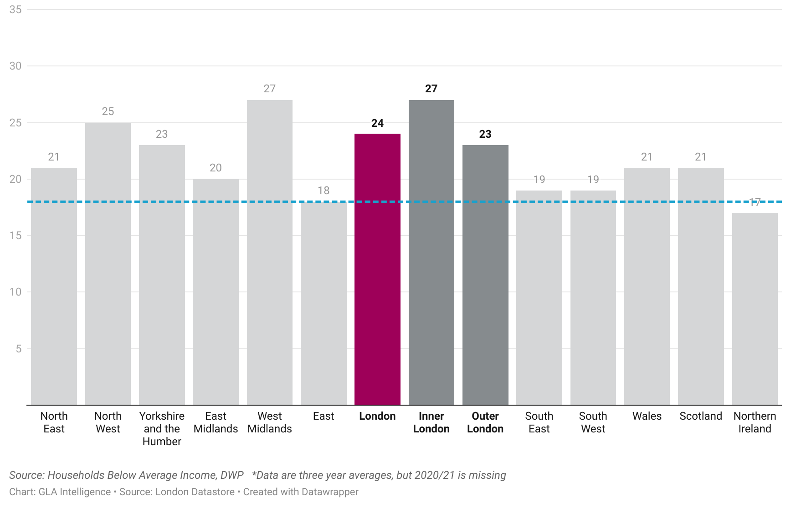
ALMOST A QUARTER OF LONDONERS ARE LIVING IN RELATIVE POVERTY, HIGHER THAN THE UK RATE
Concentrating on the measure of relative poverty after housing costs (AHC), latest data indicate:¹
  The estimated number of Londoners living in poverty for 2020/21–2022/23 was 24% of the population, compared to a UK-wide rate of 22%.
  In recent years London is no longer the region with the highest proportion of residents in poverty. In the latest estimates, 27 per cent of West Midlands residents were estimated to be in poverty while 25 per cent of North West residents were.*
We also know that in 2019/20 – 2021/22 more people living in Outer London were in poverty than in Inner London (see Fig 8).
In 2020/21 to 2022/23, the rate of absolute poverty AHC in London was 20%, compared to A UK-wide rate of 18%.²
*Note: The data collection used to create these poverty statistics was heavily affected by the COVID-19 pandemic. The Department for Work and Pensions (DWP), who publishes these statistics, advises caution when making comparisons with previous years and when interpreting larger changes
Fig 8. Proportion of households in relative poverty after housing costs, 2019/20 – 2021/22
UK rate
Source: (1) Economic Fairness – Population in Poverty – London Datastore, (2) Economic Fairness – Absolute Poverty – London Datastore

Slide 10
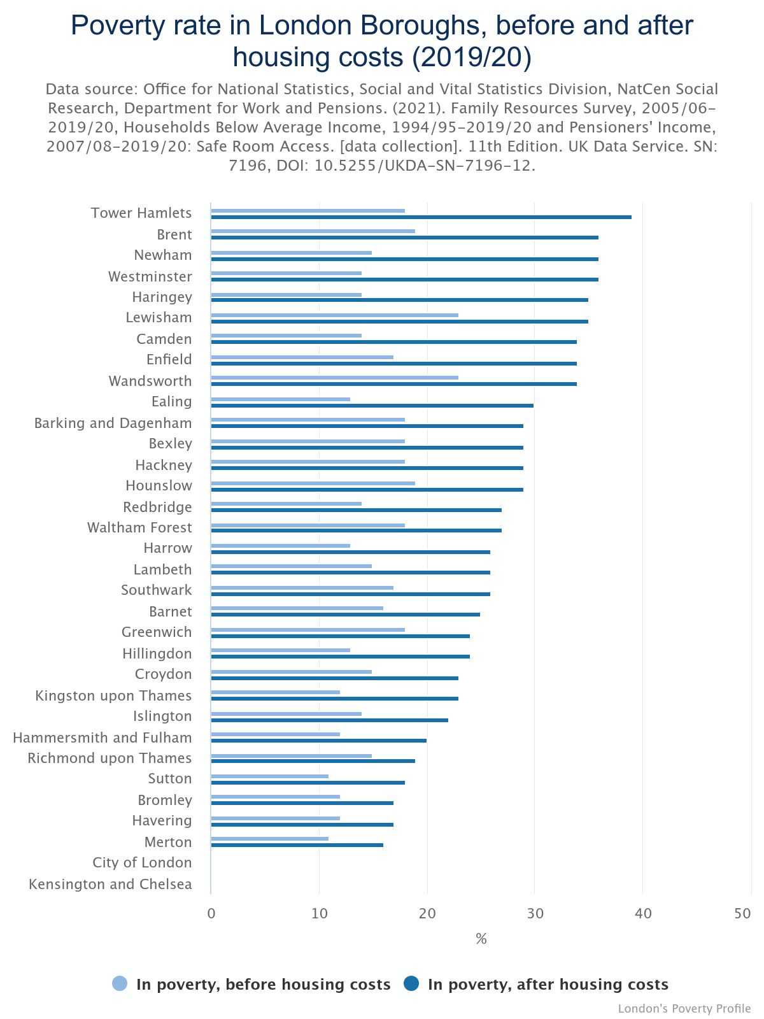
POVERTY RATES VARY ACROSS LONDON BOROUGHS, AND ARE SIGNIFICANTLY IMPACTED BY HOUSING COSTS
Concentrating on the measure of relative poverty and comparing rates before and after housing costs are taken into consideration, the most recent pooled poverty rates for London Boroughs indicate:¹
  Westminster has the most dramatic impact of housing costs on its poverty rate, with a 22 percentage point increase after housing costs (AHC) are factored in, while Richmond-upon-Thames sees the smallest change in poverty rate at 4 percentage points.
  Haringey, Newham, Tower Hamlets, and Camden also see a change in the BHC/AHC poverty rate of greater than 20 percentage points.
*No data for Kensington and Chelsea, and City of London in Figure 9 due to small sample sizes
Fig 9. Poverty rate in London Boroughs, before and after housing costs, 2019/20²
*
Source: (1) London's Poverty Profile: borough-level poverty 2022 | Trust for London (2) ONS

Slide 11
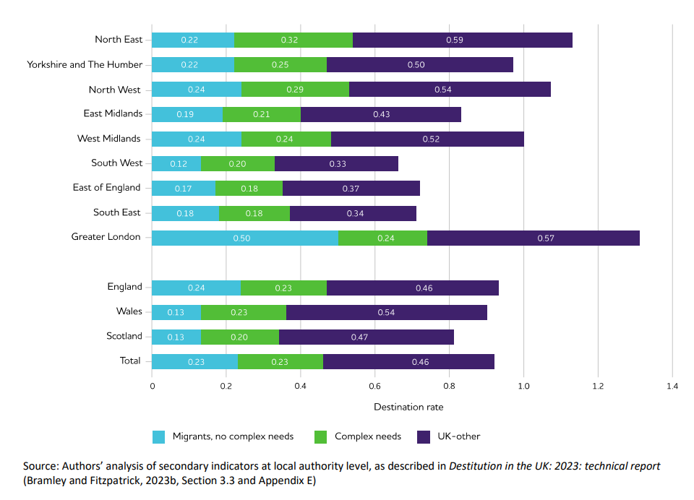
LONDONERS EXPERIENCE HIGHER RATES OF PERSISTENT POVERTY AND DESTITUTION COMPARED TO THE UK
Persistent poverty refers to being in poverty in the current year and at least two of the three preceding years. It is a particularly important issue for health, because prolonged periods of poverty have cumulative effects.¹
  Around one in seven (14%) of all Londoners live in households in persistent poverty (after housing costs), which is higher than the UK at 12%.²
The Joseph Rowntree Foundation (JRF) has investigated the scale of destitution, which is where people cannot afford to meet their most basic physical needs to stay warm, dry, clean and fed. This most extreme form of material hardship impacts on heath, mental health and people’s prospects.³
  London had the highest overall destitution score in 2022, replacing the North East as the region with the highest destitution rates since 2019.
  JRF found that migrants are disproportionately affected by destitution and given the higher levels of migrant population in London compared to the UK as a whole, this has contributed to the higher levels of destitution seen in London, along with high levels of UK-other categories in the capital’s diverse population.
Figure 10: Destitution rates estimated from secondary indicators, by region or country and by analytical subgroup % of households, weekly basis, 2022
Destitution rate
Source: (1) Inequalities in persistent poverty - The Health Foundation, (2) Economic Fairness – Persistent Poverty – London Datastore, (3) Destitution in the UK 2023 | Joseph Rowntree Foundation (jrf.org.uk)

Slide 12
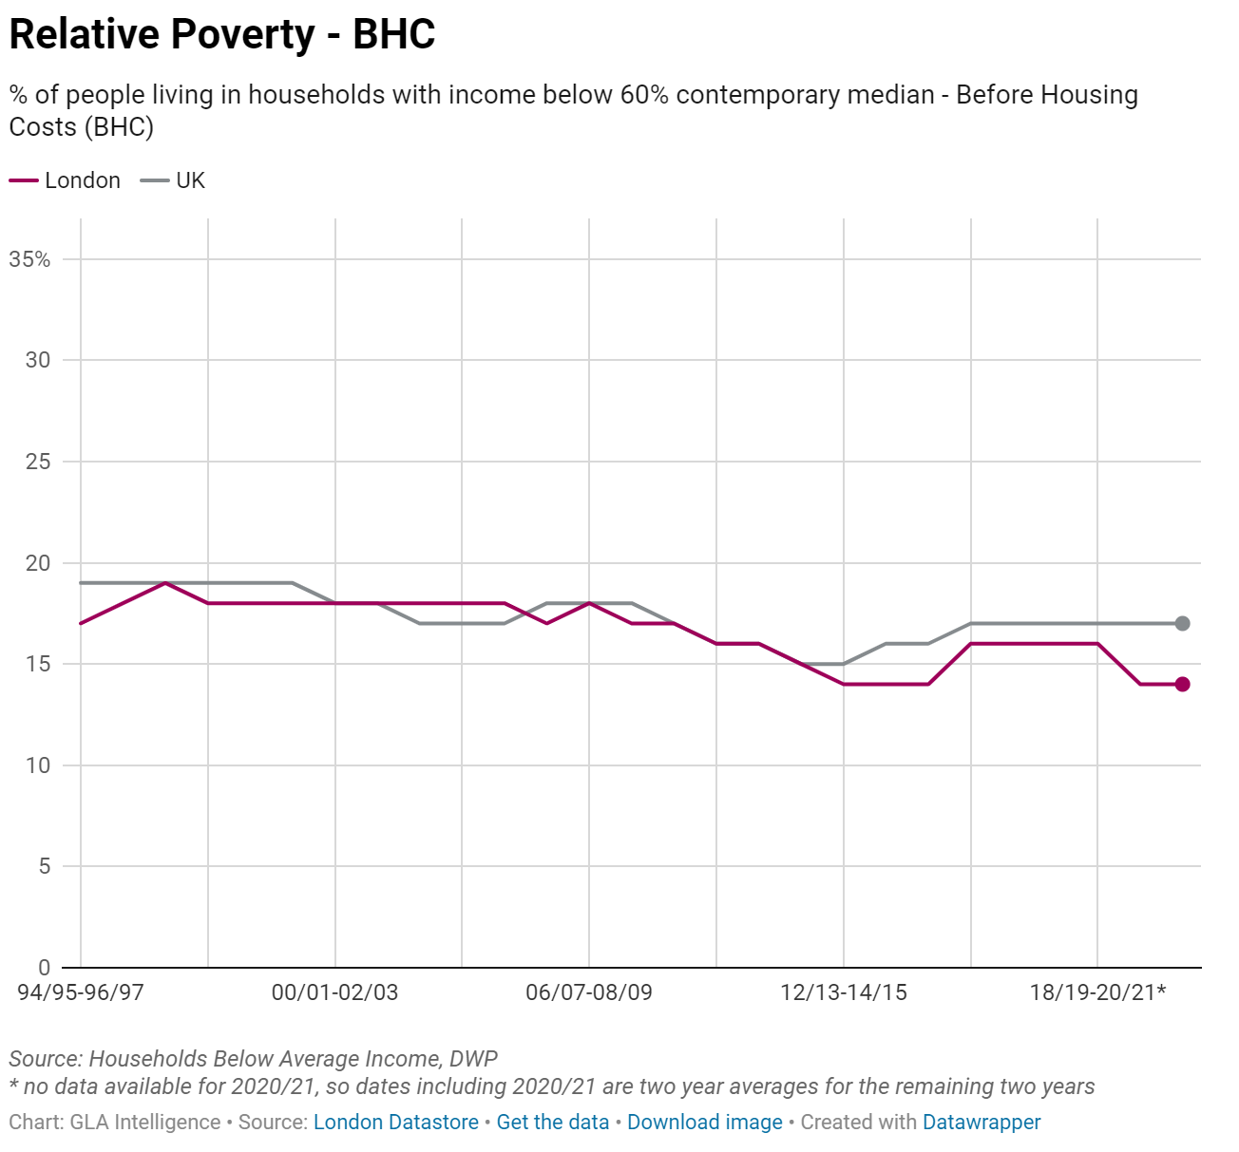
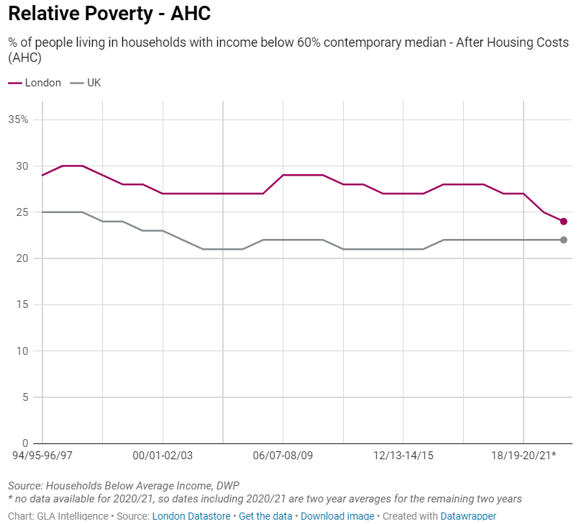
RELATIVE POVERTY RATES AFTER HOUSING COSTS IN LONDON HAVE BEEN CONSISTENTLY HIGHER THAN THE UK RATE IN RECENT YEARS
Latest figures, which goes up to 2020/21-2022/23, show that overall, relative poverty rates (AHC) in London have been fairly stable and consistently higher than in the national average for at least the last two decades.¹
Relative poverty rates before housing costs (BHC) over the last 20 years have been more similar between London and the national average - this shows that housing costs are a significant driver of poverty in London.¹
Relative poverty rates (AHC) in London have technically fallen in recent years, however there are uncertainties associated with recent data due to reduced response rates following the pandemic and this data will not fully reflect the most recent impact of the cost of living crisis.¹
Fig 11: Percentage of households with income below 60% median in London and the UK, 1994-2023, before (left) and after (right) housing costs (%)
Source: (1) Economic Fairness – Population in Poverty – London Datastore

Slide 13
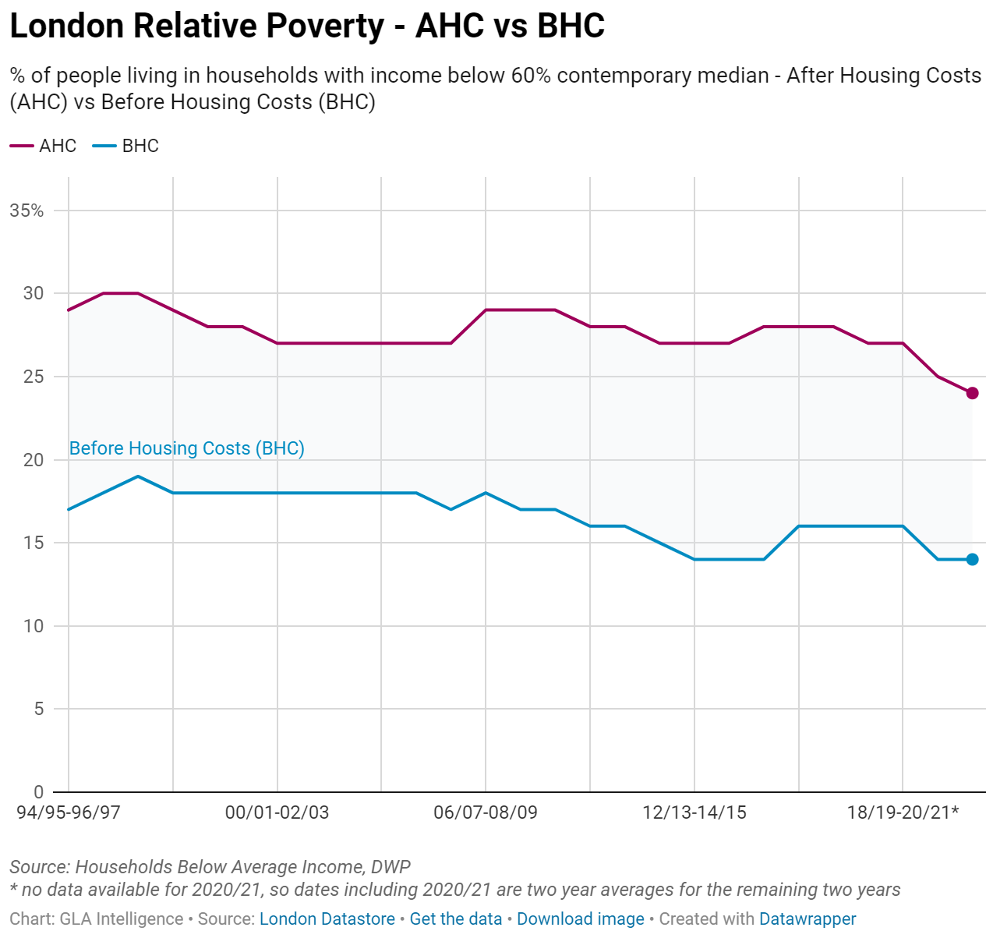
DRIVERS OF POVERTY IN LONDON ARE COMPLEX BUT THERE ARE WIDELY ACCEPTED CONTRIBUTING FACTORS
Housing costs: In London, poverty rates almost double when housing costs are accounted for showing that housing costs are a significant driver of poverty.¹
In work poverty: The proportion of people (aged 16 and over) in poverty who are working appears to be higher in London than it is in the rest of England². This may be being driven by reductions in benefits available to low-income families, increasing housing costs, and being unable to work the number of hours desired³.
Provision of childcare: Costs of childcare are between 25 and 33 per cent higher in London than for Great Britain as a whole, which can lead to a barrier to work.⁴
Cost of Living: Analysis shows Londoners are experiencing higher inflation for local goods and services than the average across the UK.⁵
Figure 12: Percentage of households with income below 60% median in London, 1994-2022, before and after housing costs
Source: (1) Economic Fairness – Population in Poverty – London Datastore, (2) Work & Worklessness, London Unemployment - Trust For London | Trust for London, (3) Economic Fairness – Childcare Costs – London Datastore, (4) Impacts of rising cost of living on London - London Datastore

Slide 14
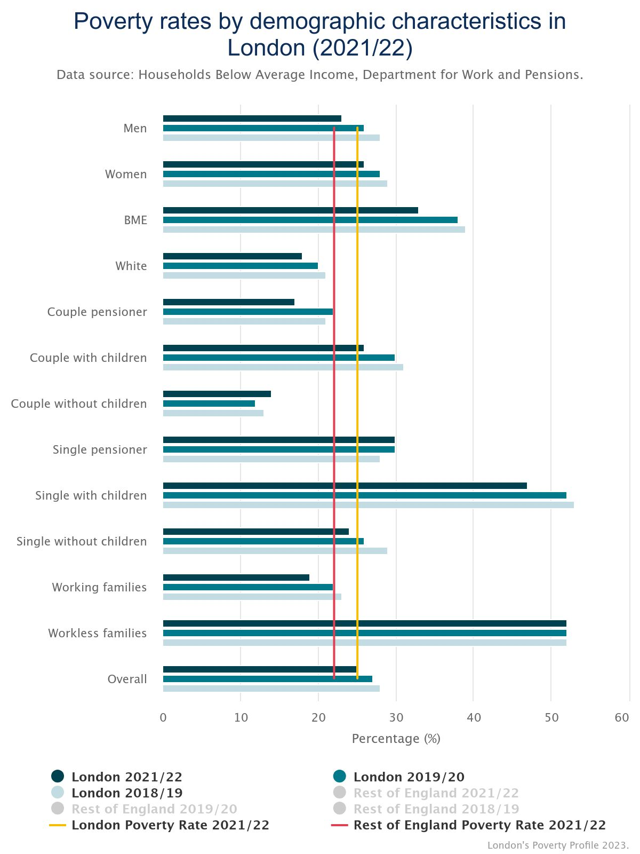
POVERTY RATES VARY SIGNIFICANTLY ACROSS DIFFERENT DEMOGRAPHIC GROUPS IN LONDON
The highest poverty rates are experienced by workless families (52%) and households comprised of single people with children (47%)¹.
Black and minority ethnic groups are far more likely to be in poverty (33%) than White people (18%), and single pensioners also have a higher than average poverty rate at 30%.¹
All groups in London have higher poverty rates than the national average except working families, couples without children, couple pensioner and White individuals.¹
In the three years to 2021/22* Londoners who live in families that include a disabled person are more likely to be in poverty (33%) than those living in families that do not include a disabled person (22%).²
Intersectionality must also be considered because different identities are not separate, but overlapping, and these different elements of identity interact and create distinct experiences of poverty.³
*Note: Data for 2020/21 was not included in this average due to the significant impact of the COVID-19 pandemic in that year
Figure 13: Poverty rates by demographic characteristics in London (2021/22)
Source: (1) Health Inequalities In London - Trust For London | Trust for London; (2) Health Inequalities In London - Trust For London | Trust for London, (3) Intersectionality Revealing the Reality of Poverty and Inequality in Scotland

Slide 15
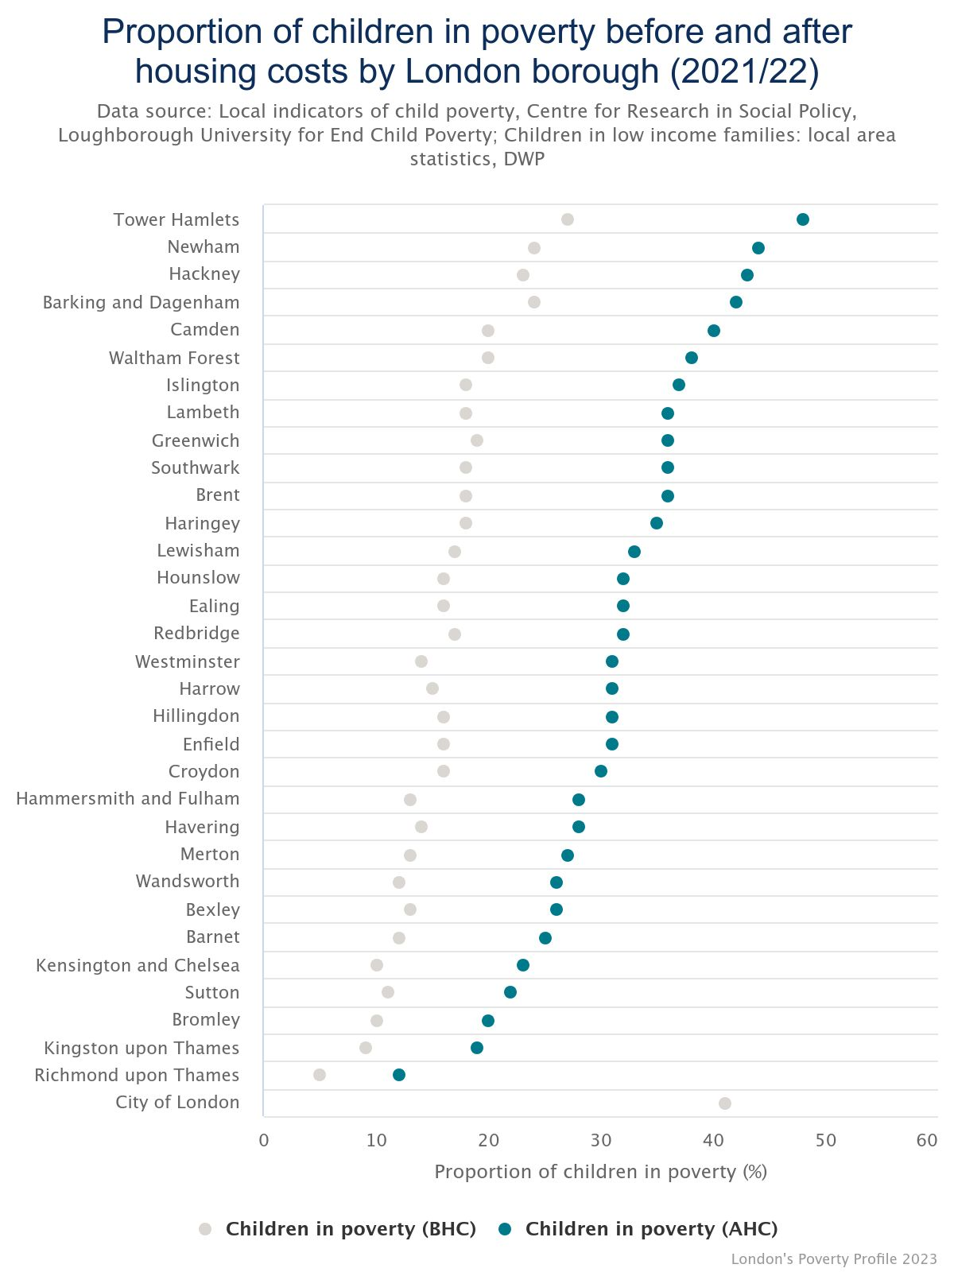
CHILDREN ARE MORE LIKELY TO BE LIVING IN POVERTY IN LONDON AND RATES ARE HIGHER THAN FOR ENGLAND
Children are more likely to be living in poverty than adults overall, with the latest estimate of 32% of London’s children in poverty for 2020/21-2022/23 using the relative poverty after housing costs measure.¹
Whilst this is a substantial decrease on the previous year (38%* of London’s children) and below the rates given for several other regions, it is still well above national levels (30% of children and 25% for the population as a whole).¹
Substantial variation in child poverty rates exist within London, with Tower Hamlets having the highest rate of child poverty (after housing costs). In Tower Hamlets almost half (48%) of children are growing up in poverty.²
The child poverty rate at least doubles when housing costs are accounted for in 20 of the 33 boroughs.²
*Note: The data collection used to create these poverty statistics was heavily affected by the COVID-19 pandemic. The Department for Work and Pensions (DWP), who publishes these statistics, advises caution when making comparisons with previous years and when interpreting larger changes
Figure 14: Percentage of children in poverty before and after housing costs by London borough (2020/21)
This chart was adjusted from Trust for London to add national averages
National child poverty rate
(AHC)
National poverty rate for the whole population (AHC)
Source: (1) Economic Fairness – Population in Poverty – London Datastore, (2) Children in poverty by London borough, before and after housing costs | Trust for London

Slide 16
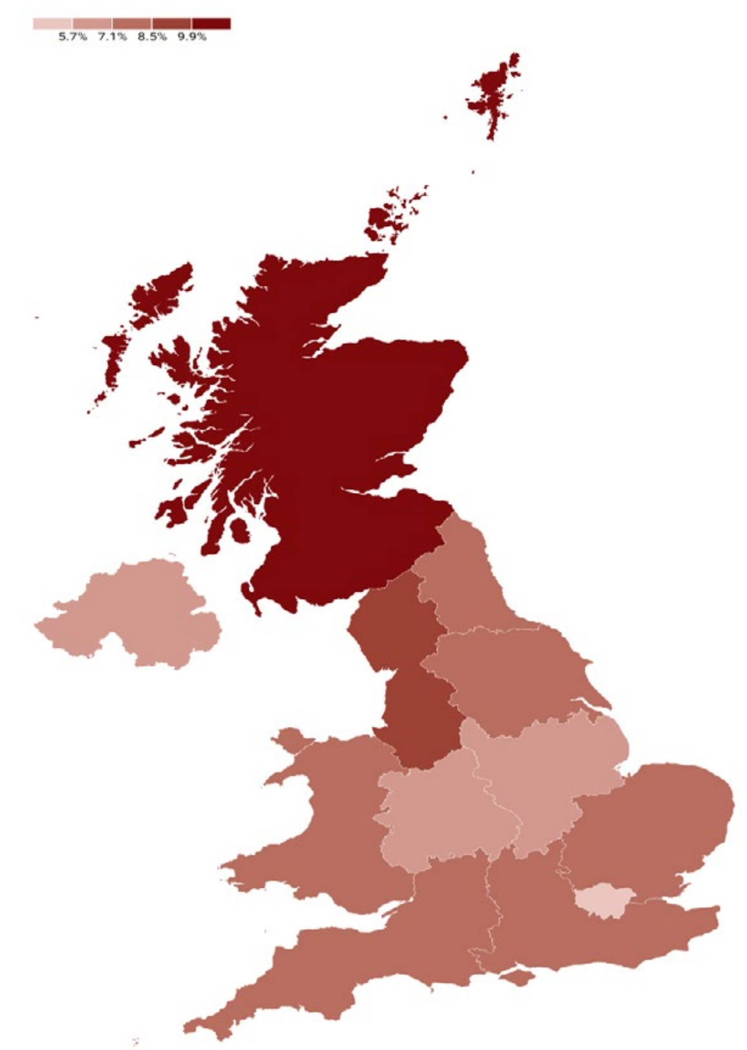

COST OF LIVING CHALLENGES PERSIST AND A SIGNIFICANT PROPORTION OF LONDONERS ARE STILL STRUGGLING
  Core measures of inflation remain stubbornly high.
    Energy costs, despite a significant drop, are still considerably above their levels at the start of 2022.
    Even with the recent decrease, food prices remain elevated relative to the figures recorded in prior years.
  Although the real wage growth has turned positive, wage growth in London is still low. ¹
    The median wage growth in London is 4.2%.
    London’s wage growth rate is the lowest in the UK, with the highest regional rate being 11.3%.
  A majority of Londoners feel that the cost of living is still increasing.²
    A total of 87% of Londoners feel that the cost of living has increased.
    Among them, 48% feel the cost of living has increased a lot, and 38% feel it has increased a little.
  A significant proportion of Londoners have fallen behind or struggled to meet their regular needs in the last six months.
    48% falling behind or struggling to meet credit commitments, 46% their household bills, 43% their housing payments and 51% their food and essential shopping needs (either struggling or going without).
    These figures are similar to those from one year ago.
Fig 15. Weekly Gross Pay Year on Year Growth for the Median Percentile (2022-23)¹
NIESR National Institute UK Economic Outlook Winter 2024;
Source: (1) NIESR National Institute UK Economic Outlook Winter 2024; (2) GLA Cost of Living Polling (Jan 2024).

Slide 17
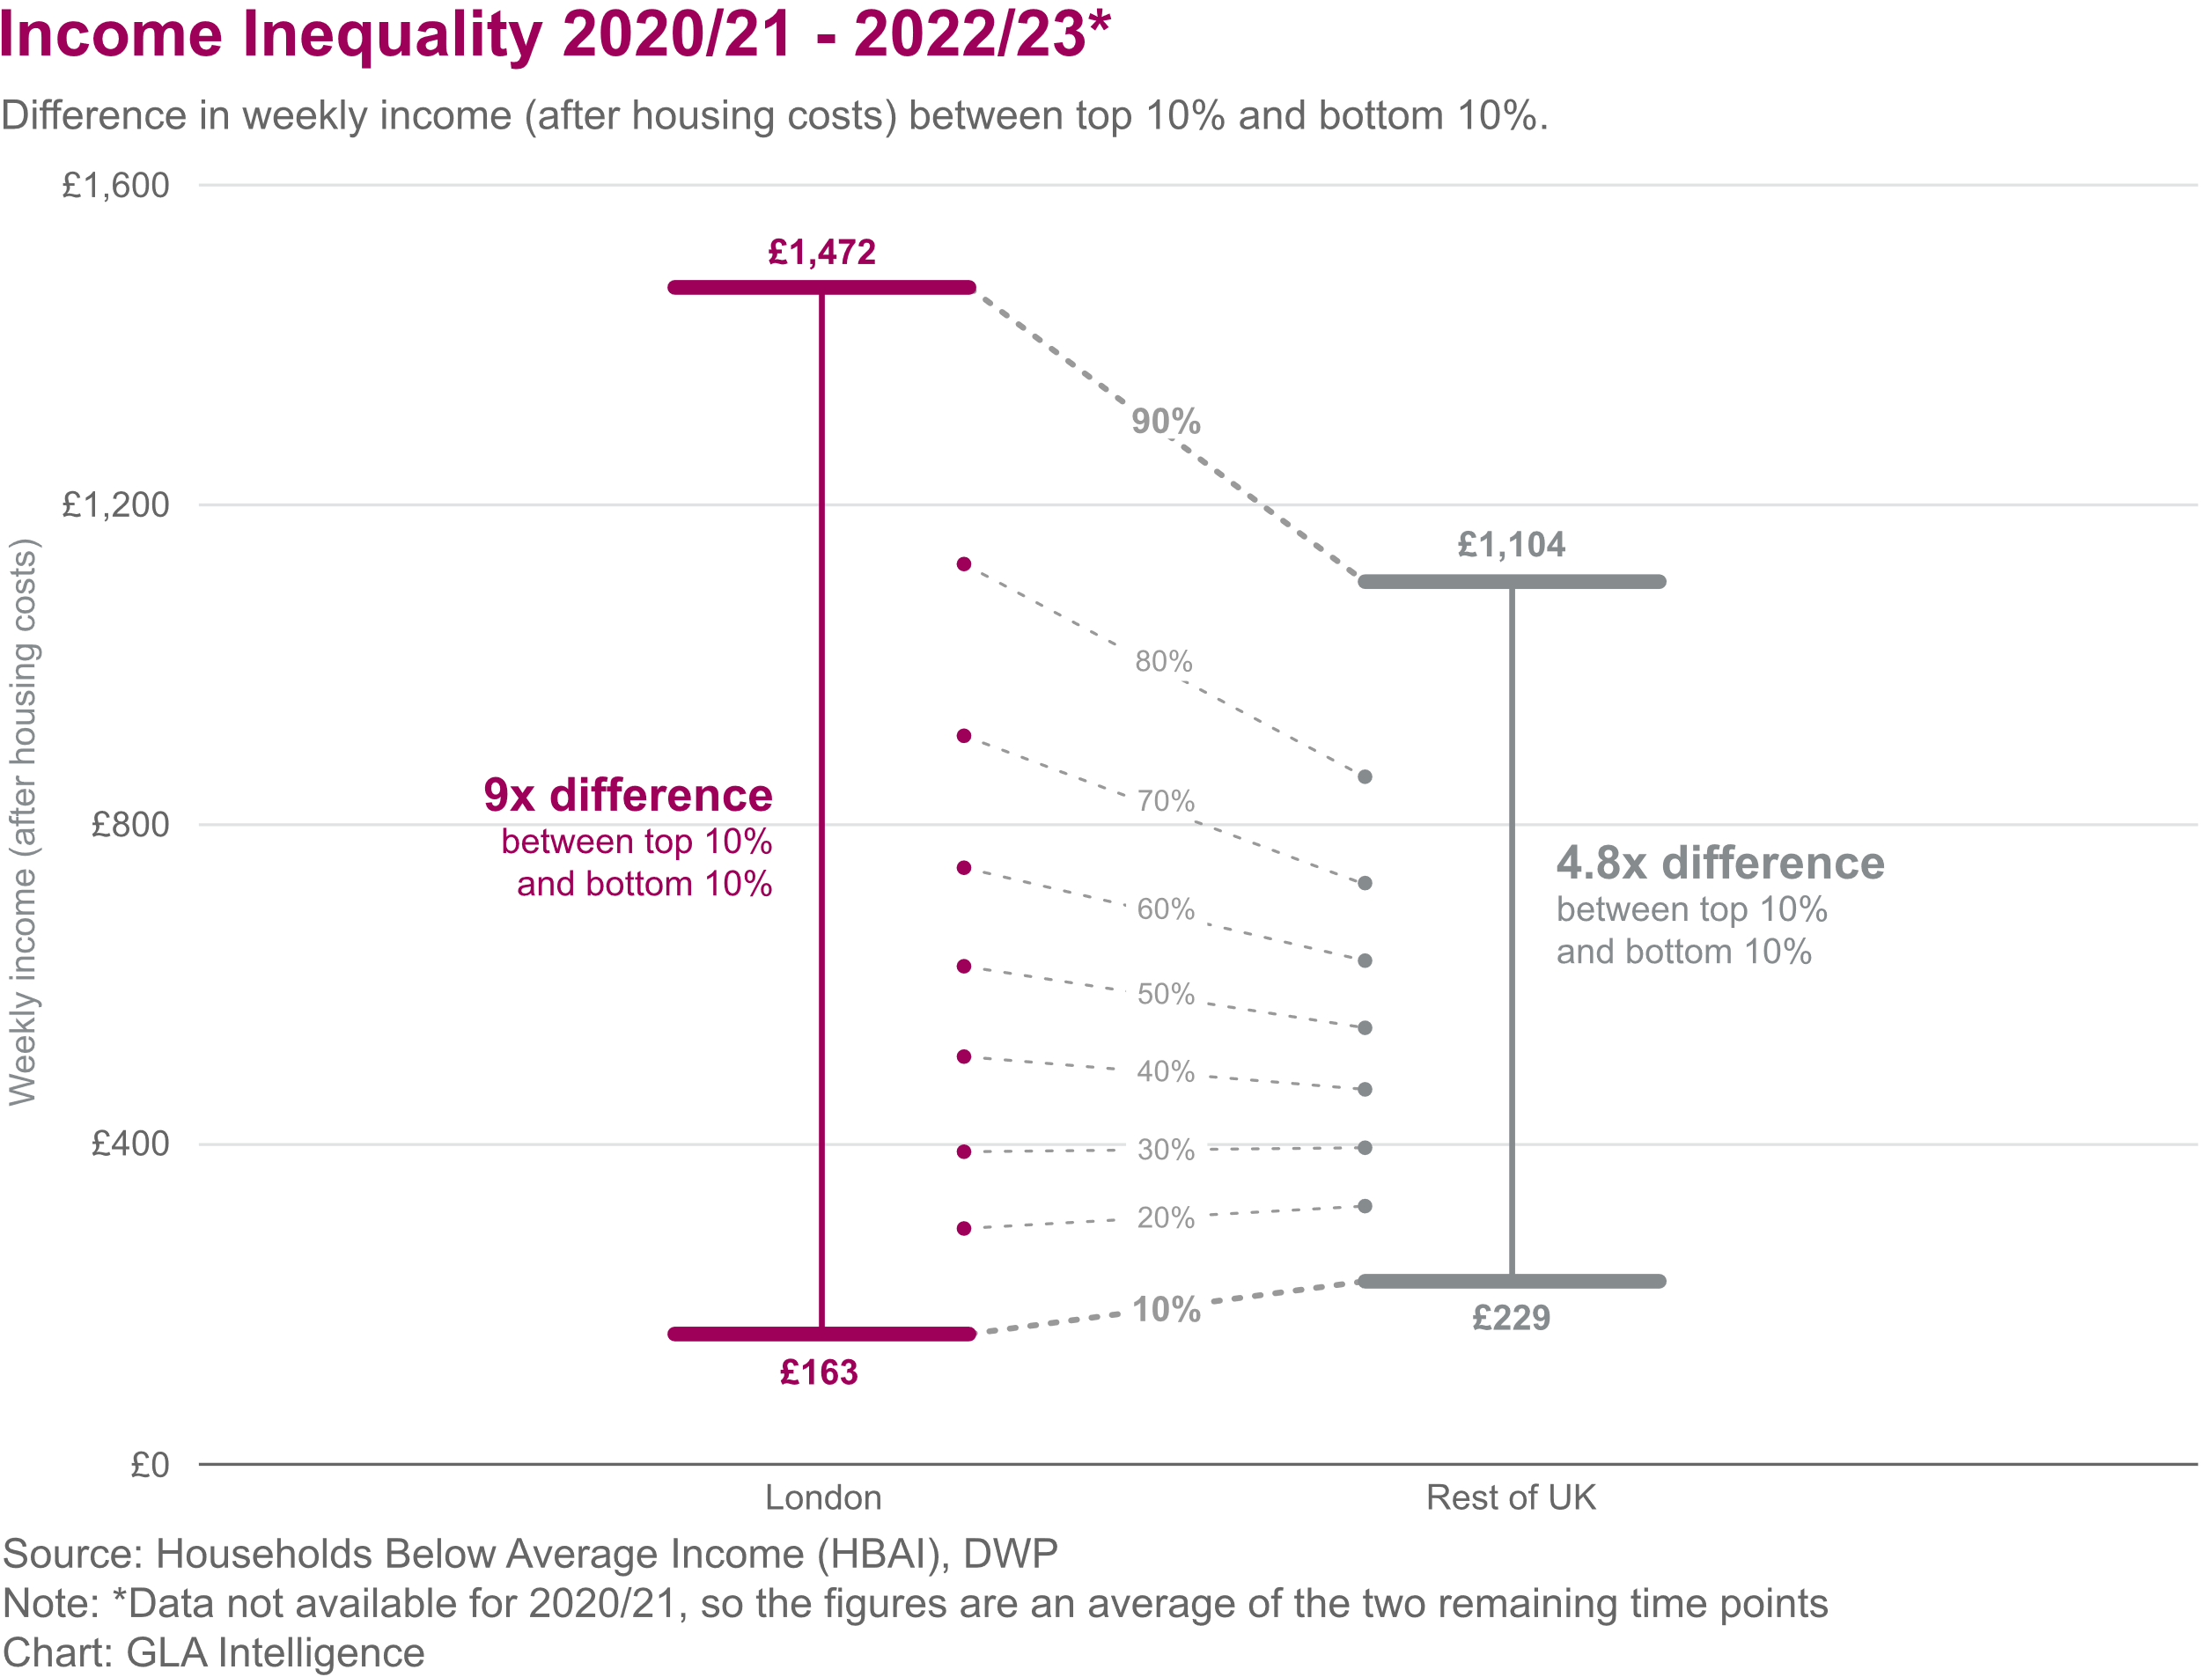
LEAST DEPRIVED LONDONERS RECEIVE 9 TIMES MORE INCOME THAN THE POOREST DECILE
The richest tenth of Londoners have around 9 times the income of the lowest income households in London.¹
  The differences in income are much greater in London than in the rest of the UK, particularly after the high costs of housing in the capital accounted for.
  London has one of the highest rates of poverty of any region in the UK in 2020/21-2022/23*, with around a quarter (24%) of London residents in poverty after housing costs. ²
The unemployment rate in London is above the UK average but varies widely within the capital and despite improvements persistent inequalities in labour market outcomes remain: ³
  The employment gap between disabled and non-disabled Londoners has continued to decrease. In 2023 this was 21 percentage points (pp), with a larger gap between disabled and non-disabled men (28pp) than for women (14pp). ⁴
  The employment gaps between White and all other ethnic minority groups combined has risen slightly between 2022 and 2023 both in London and nationally. Significant gaps still remain, most notably in London, between White and Mixed ethnicity men and White and Black men (both 19pp) and between White and Bangladeshi/Pakistani women (28pp).
Fig 16. Difference in weekly income (after housing costs) between top and bottom deciles in London and UK (2020/21-2022/23*)
*Issues with carrying out surveys during the pandemic and reduced response rates since March 2020 mean there is increased uncertainty in the figures.
Source: (1) London Datastore - Income Inequality (2) London Datastore – Population in Poverty (3) London Datastore – Unemployment Rate (4) London Datastore - Employment Gaps

Slide 18
INFLATION EASED AND EMPLOYEE REAL PAY TURNED POSITIVE IN 2024
Consumer Price Index (CPI) inflation dropped to 4% in January 2024 from the recent peak of 11.1% in October 2022.¹
  Gas price inflation fell by 26.5% in the year to January 2024, and motor fuel prices also decreased by 9.2% during the same period.²
  London's shelf-front food inflation decreased to 7.0% in January 2024, down from a peak of 10.8% in June 2023.³
In real terms, the annual growth of employee real pay turned positive in the last quarter of 2023.⁴
Fig 17. Real pay in London and food inflation in London and UK
a. Decomposition of real median pay in London
b. ‘Shelf-front’ food inflation, London and UK
Note: Inflation measure does not account for region-specific price changes. Sign of inflation rates has been reversed (higher inflation rates are associated with lower real pay growth).
Source: 1) ONS CPI 2) ONS Energy prices; 3) GLA Economics, ONS price quotes in the Long-Run Price Database by Prof. Richard Davies; 4) GLA Calculations based on ONS Pay As You Earn Real Time Information and CPI data.

Slide 19
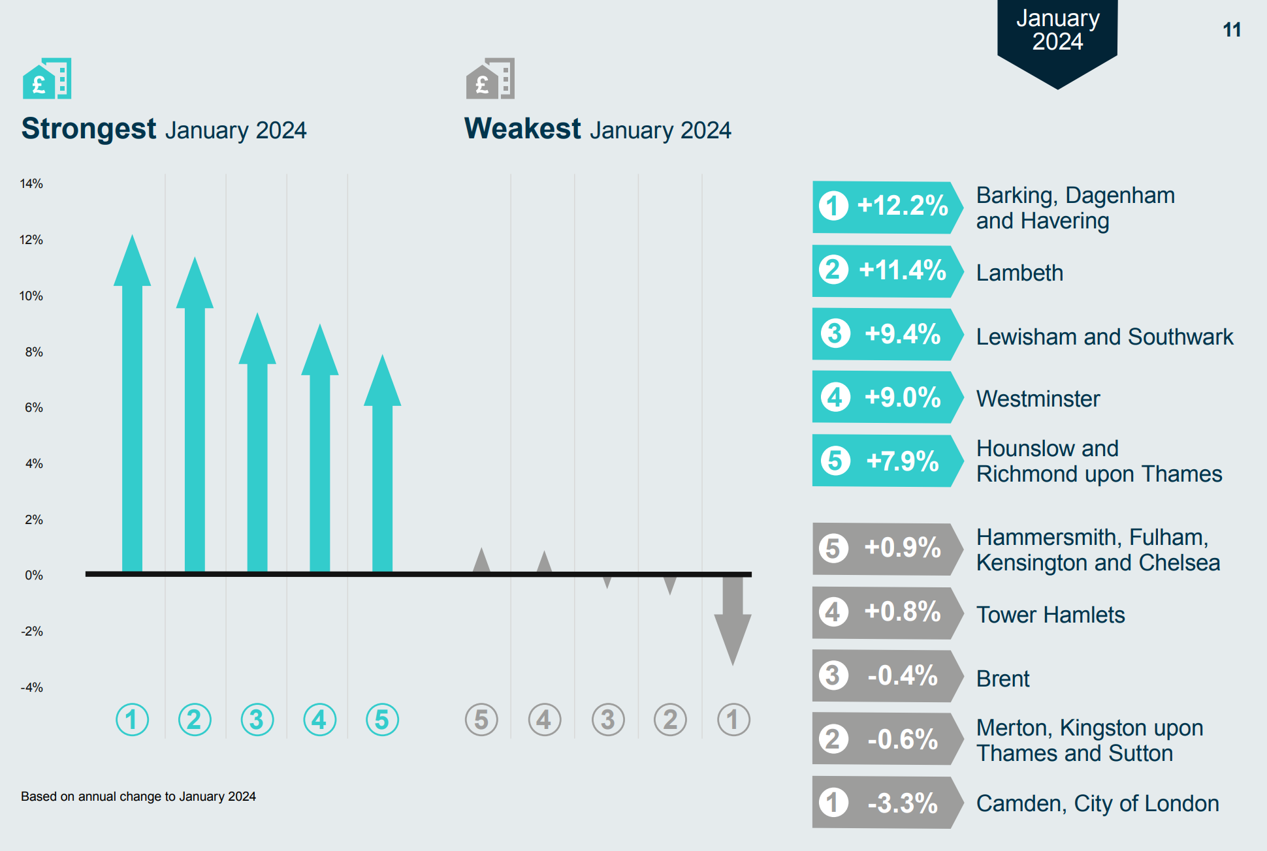
OVERCROWDING, QUALITY AND AFFORDABILITY OF HOUSING AFFECTS LONDONERS UNEQUALLY
Around 9% of households in London are overcrowded (defined as lacking one or more bedrooms compared to estimated need). ¹
  Londoners from Black, Asian and other minority groups are around twice as likely to live in overcrowded conditions as White.
1.6% of all households (57,150) were assessed as owed a homelessness duty in London in 2022-23.¹
  This varies enormously by ethnicity, with the highest rates of homelessness experienced by Black and Mixed Londoners.
  Around 40% (22,740) of households owed a homelessness duty in 2022-23 had dependent children.²
An estimated 9% of homes in London fell below the official Decent Homes Standard in 2021, ranging from 6% of owner-occupied homes to 14% of private rented homes. ¹
  Londoners of Asian ethnicity are more likely to live in homes that fail to meet the Decent Homes Standard, while Black Londoners are more likely to have damp problems.
Average rents for new private tenancies have risen sharply over the past two years, and the affordability burden in London reached a record high in January 2024, according to data from the Homelet Rental Index.
  Black and ethnic minority households in privately rented homes in London spend a significantly higher average proportion of their household incomes on rent, than their White counterparts
Fig 18. Change in average rents for new tenancies in inner London, year to January 2024
Source: (1) London Datastore - Housing in London (2) GOV.UK: Tables on homelessness

Slide 20
END

