Slide 1
MASTERCARD SPEND DATA
HIGH STREETS DATA SERVICE
SEPTEMBER 2022 UPDATE

Slide 2
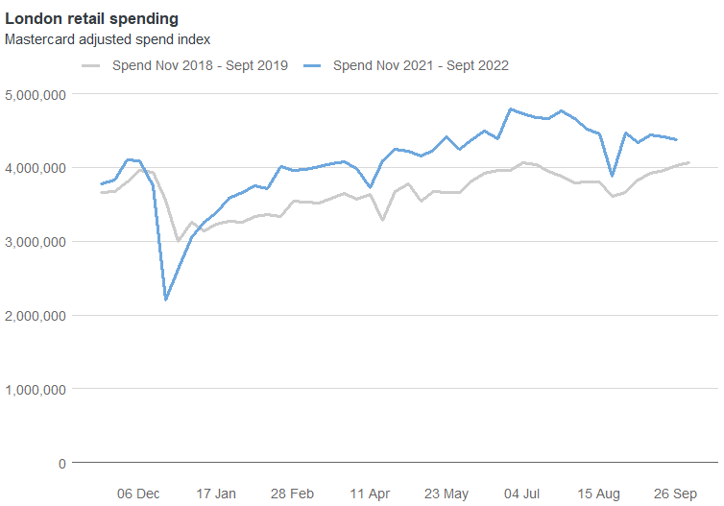
JULY 2019
SEPTEMBER RETAIL SPEND
LONDON-WIDE SPEND
The Mastercard Retail Location Index is used as an indicator of spend across London. The spend index has been adjusted to take into account inflation and the shift of cash to card usage at the beginning of the pandemic.
There has been a slowdown in both weekday and weekend retail spending in August continuing into September, in contrast to preceding years.
Across London, retail spending for weekday and weekend spending has decreased by 7% from its peak in July to September.
Looking at the most recently available data for the week of 20 June 2022,
Anonymised & Aggregated by Mastercard

Slide 3
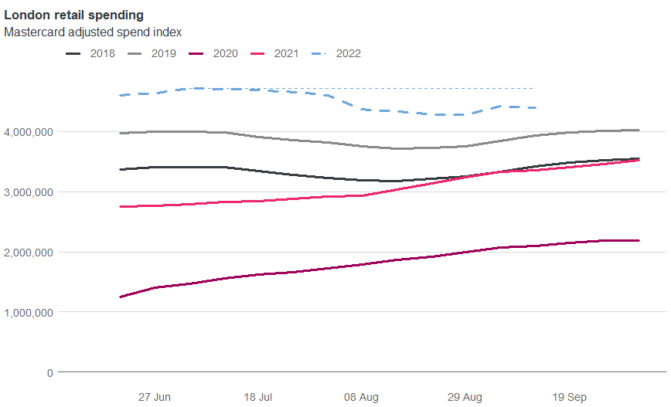
JULY 2019
RETAIL SPEND COMPARISON
LONDON-WIDE SPEND
In comparison to the preceding four years, 2022 is the only year for which adjusted retail spend decreased from July to September.
Before the pandemic, retail spending typically decreased over the summer months, returning to normal by September.
During the pandemic, spending rose consistently in summer months (from a low post-restrictions level). In 2020 and 2021, September spend was around 20-30% above July spend.
In September 2022, however, there was a decrease in retail spend of 7% since July.
-7%
Anonymised & Aggregated by Mastercard

Slide 4
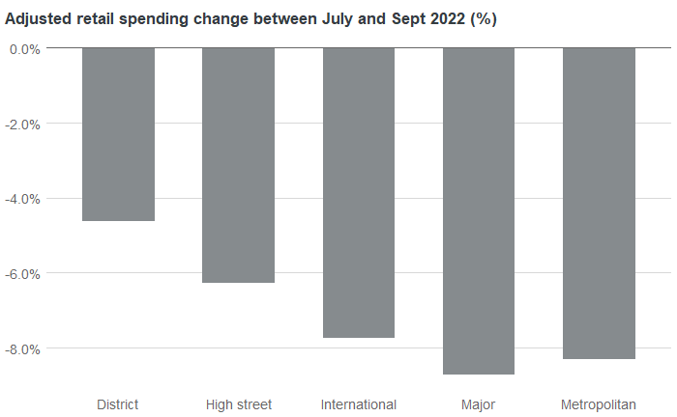
JULY 2019
SPEND BY TOWN CENTRE TYPE
TOWN CENTRE LEVEL SPEND
Town centres in London can be classified into categories: International, Metropolitan, Major and District centres, recognising their differences in size and function. High streets here are defined as those outside larger town centres, servicing more local communities.
The decrease in spend for major town centres is almost double that for smaller district centres.
Splitting the change in retail spend from July to September 2022 by town centre type, larger centres with significant service and leisure functions have a greater decrease in spend of around 8%.
District and smaller high streets which typically serve a more localised catchment experience a smaller decrease in retail spend, on average 5.5%.
Anonymised & Aggregated by Mastercard

