Slide 1

The Employability Performance Rating
Robert Dominic
Sejal Patel
Notes:
The London Employability Rating (EPR) is a comprehensive system which awards ratings based on the quality of contract employability service provision across London.
The Employability Performance Rating: Benchmarks achievements of employability services, Intelligently uses management and performance information collected by delivery partners, and Provides an evidence based track record of delivery against grant.
If you have used it in the past when it was created in 2008, you will find that it looks slightly different and the funder/lead delivery has to input some information at the start, it was updated in 2015 to make it more user friendly but essentially it is the same.
The Greater London Authority requires all Co-Financing Organisations to adopt the EPR for all London ESF contracts for the 2014-2020 ESF Programme. In addition, the European Programme Management Unit (EPMU) requires all directly funded ESF projects in London to use the rating, as well as each of the providers lead organisations sub-contractors.

Slide 2
The Performance Rating
Used with a wide range of skills & employment grant/contracts
Used by Funders, Primes & subcontractors
Annual Performance Rating
Ratings are made public on the datastore
Making best use of existing data
Notes:
Supports the GLA’s objective to benchmark the achievements of providers and our commitment to transparency and openness.
Ratings are made public annually on the Datastore website managed by the GLA between July and August
Widening its use will mean that there is an increasing amount of data available on the delivery of employment and skills services in London.
Prime contractors/Lead Providers could use the EPR to see how well other delivery organisations have performed in the past.
Bid evaluators could use the EPR to assess track record or when seeking references.

Slide 3




History of the EPR
The rating was developed by the West London Working city strategy pathfinder in 2008 to help overcome the following challenges:
No central quality and performance management system
Lack of coordination in the provision and planning of skills and employment services
Multiple and confused points of contact for residents and employers
Framework Development
Overseen by a project board with LDA, local authority, DWP and SFA membership universally welcomed by members of the Development Group, who fed back that there had been a genuine partnership approach to developing the rating.

Slide 4
Employability Performance Rating Timeline
Used by all London NOMS & London Councils ESF Grants
Used by 30 London Councils ESF Grants
Rolled out to all projects on the ESF 2014-20 Programme
Developed and trialled with 13 LDA grant holders
Used by 13 LDA grants with 32 subs
Used by all LDA/GLA Learning and Skills grants
APRIL 08
APRIL 10
APRIL 11
APRIL 16
Notes:
All funders and Direct-Bids within the ESF 2014-20 programme are required to complete the Employability Performance Rating. This includes both Prime and Sub-contractors.

Slide 5
Employability Performance Rating Journey
Training delivered to Funders on how to complete the backsheet and what needs to be completed in the other tabs
Funder will complete templates for all their providers making it bespoke and easy to complete.
Providers will then be able to complete calculators for their subs once they received their calculator from their funder. They will copy the information from the calculator sent by their funder to populate main bulks of the calculator to allow easy uploading.
Providers and subs will complete the sections relevant to them and return them to the sender.
The Funder will send the extraction tool and sub contractor workbooks to the GLA. From here the GLA will deal with the data.
The funder will have all their providers saved in the same folder as the data extraction tool. The providers should have separate grant names and descriptions to make all calculators upload.
Providers will complete grant compliance and load the sub-contractor workbooks into their workbook. The provider will send all workbooks including the subs to the funder.
Providers will send their workbook to their funder to complete the grant compliance for the calculator. This should have all subs’s workbooks loaded into them.
The GLA will then publish on the datastore website during the period July and August.
Notes:
The Employability Performance Rating journey.
This is done on a yearly basis during the financial year from April to March.
We ask for submissions around May/June time.
We then Publish between July and August time.

Slide 6
Performance Rating structure
Key Performance Area (KPA) | Weighting | Indicators | Weighting of indicator within KPA
Grant Performance | 60% | Delivery against grant targets | 48%
 |  | Delivery against grant diversity targets | 12%
Quality | 30% | Conversion Factor | 12%
 |  | Self-Assessment of quality | 9%
 |  | Client satisfaction | 9%
Grant Compliance | 10% | Grant compliance and contractor pro-activity in delivery | 10%
Notes:
The Star Rating is calculated from the assessment of performance in three Key Performance Areas. Grant Performance, Quality and Grant Compliance.
When creating the Calculator it was agreed the Performance Rating should have a high emphasis on performance (i.e. Outputs and Outcomes). This is why the Grant Performance and Quality KPA together contribute 90% of the rating.
Finance related indicators are excluded from the framework as they are already assessed through the Due Diligence checks in the tendering process.
The weightings are also the amount of points received to receive a star rating.
As you can see the highest amount you can receive is from the delivery against grant targets.

Slide 7





Calculating the Star Rating
Stars | Points
 | 87.5 – 100
 | 75 – 87.4
 | 62.5 – 74.9
 | 40 – 62.5
 | 0 – 39.9
Each grant is awarded a Star Rating each year
Calculated using a points based system
Assessment of performance against each indicator results in a fixed number of “Star rating points”
Notes:
The Assessment of performance against each indicator results in Star Rating Points.
The totals of all the Areas are combined to generate a total of Star Rating Points.
100 is the highest. The total Star Rating points will determine which star you will receive.
Typically, projects will have low Star Ratings as they are just starting up and haven’t been in delivery for too long. The usual trend is we see these kind of projects achieve higher star ratings each time they submit new calculators.
All projects will need to submit a calculator and we’ll decide whether we will publish the data.

Slide 8
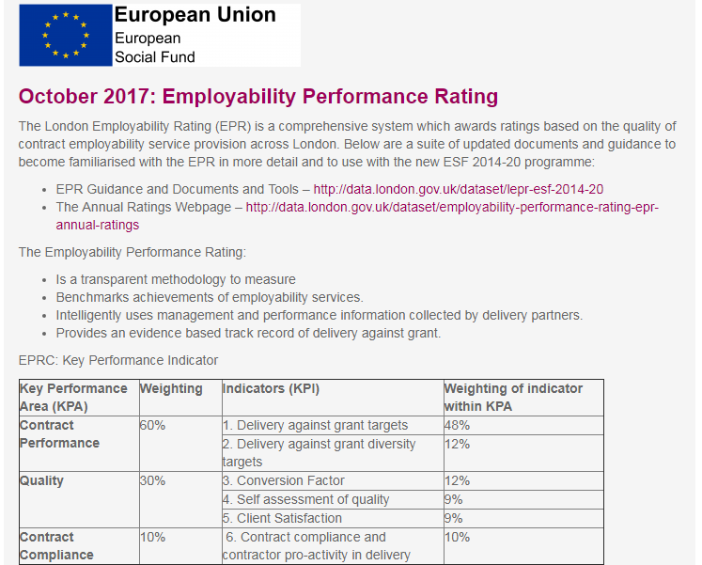
Accessing the calculator
The top link is for access the documents and tools for the calculator
The link below is for charts and the data of previous annual ratings
http://data.london.gov.uk/dataset/lepr-esf-2014-20
Notes:
On the website there are guidance documents for Funders and Providers if they ever get stuck when completing the calculator.
An updated version of the calculator will be available every year. Make sure to only complete the calculator if it has the correct date headings.
The satisfaction survey questions are available online. This is 6 basic questions that need to be asked.

Slide 9
The Backsheet

Slide 10
Indicator | Description
Provider | Name of the organisation providing a service on the contract.
Year | The current rating year. Please enter dates as 2017/18 and not as 2017/2018 – the extraction tool will not pick this up otherwise.
Funder | Name of the funding organisation.
Prime or sub | Whether the provider is a prime or sub contractor.
Number of sub-contractors | If the template is for a prime please enter how many sub-contractors they have if they have any.
Target Group | A small description (maximum of 10 words) of the target group of the contract. For primes, the same target will need to be entered for the sub’s calculators in the exact same wording.
Grant start date | Start date of the grant – not when the provider entered onto the project. Enter as 2017/18 format again.
Year of Grant | Current year of the grant
Grant Value | How much the contract is worth
Grant Description | General description of the aim of the grant an the provider’s role. Should not be longer than a paragraph. The same description should be copied from the provider’s calculator and into all their subcontractor workbooks.
Areas of operation | Entering where the project operates across London. If the project is Pan London please enter a ‘1’ into all boxes. If not, then please enter which boroughs the project is working in individually.
Funding round | Details of the funding stream under which the grant was funded.
Number of Targets | Number of contract performance targets the provider is going to be assessed by within the calculator. this will be a maximum of 6.
Diversity Targets | What are the provider’s diversity targets that they are being assessed on. Most projects say yes. Please be sure to enter them as percentages.

Slide 11
Indicator | Description
Target Type – Specific targets | The type of target to be achieved. Starts is a target type that should always be entered, whether it’s the primary, second or third target. When entering targets in the calculator make sure they are as simple as possible. The ideal targets to be entered are ‘Starts, Entry into Employment and then Sustained Employment’. This perfectly depicts the participants Employability Journey and is easy to find a conversion rating for it. When providers are completing the calculators for their subs, they need to make sure they have the same target names as their provider in the same place. This way when it comes to the prime calculator uploading the data from their subs – they will easily be able to pick up which belongs in that grant.
Outcome Target | The target set in the grant agreement. This needs to be the total of the figures entered in the months from April to March
BAME, Disability and Women Target | This target is set out in the grant agreement and needs to be the same targets for all calculators within the same Grant.
Outcome Target for April to March | The outcome targets set out in the grant agreement. This should be the figures at the start of the financial year. The project might have been reprofiled however we only want to have a snapshot of the year as a whole. The reprofile will then be taken into account the following year. The outcome target in all months needs to add up to the Outcome target. If it doesn’t, it will flag up.
Lifetime target type | The type of target to be achieved. These should be the same as the targets entered in the monthly targets and in the same order.
Lifetime Outcome target | The outcome target should be the amount they expect to achieve across the lifetime of the project.
Lifetime BAME, Disability and Women target | The lifetime BAME, Disability and Women target that has been set out in the Grant Agreement. This should be the same figure entered in the monthly targets.

Slide 12
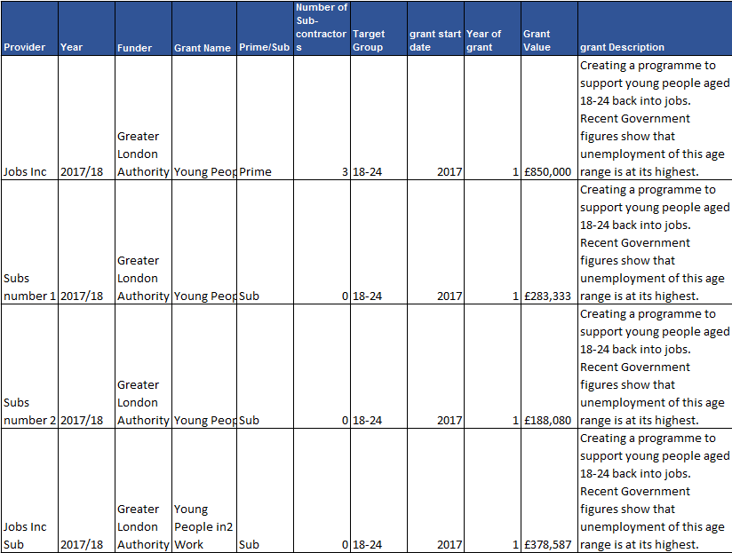
A Prime and their Subs
An example of how they should be set up. In this picture, each row would be an individual calculator. As you can see all the information entered in the subs is the same as the prime meaning the prime will be able to load the subs data into its own calculator.

Slide 13
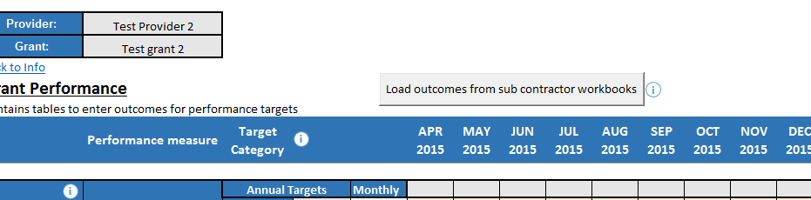
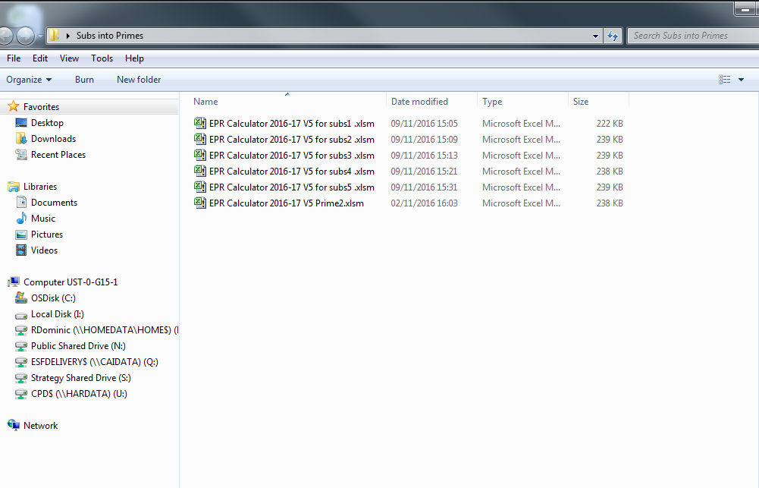
A Prime and their Subs
Notes:
Parts of the calculator have included macros to make it easier for you to upload information from other calculators. For example on the grant performance tab, providers can upload the data from their subcontractors calculators onto the main provider calculator. This means the provider doesn’t manually have to transfer over all the data from the subs onto the main one.
Make sure all the calculators are saved within the same folder.
Make sure the information replicates that of the prime calculator and the prime calculator has entered the number of calculators that is in the folder.

Slide 14
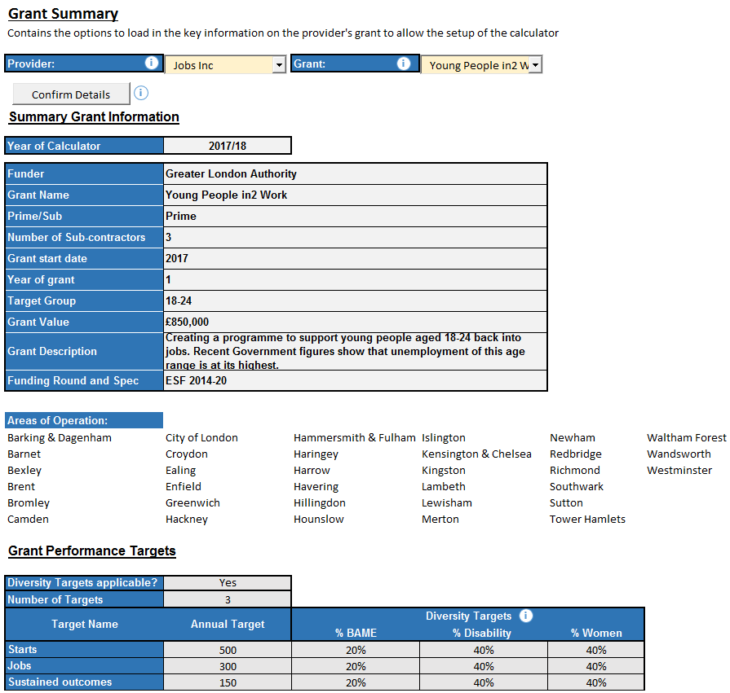
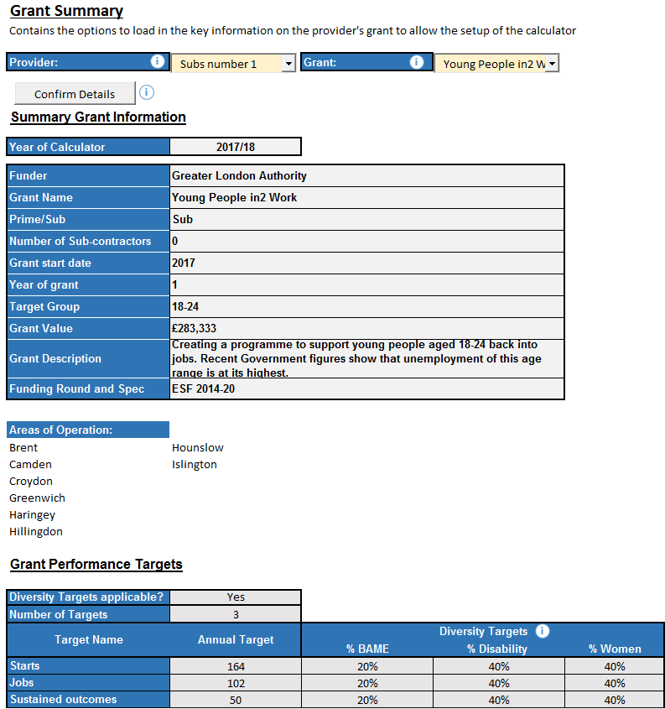
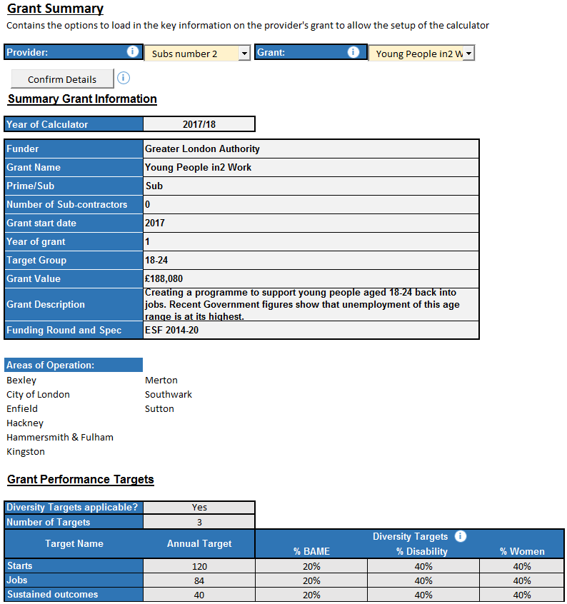
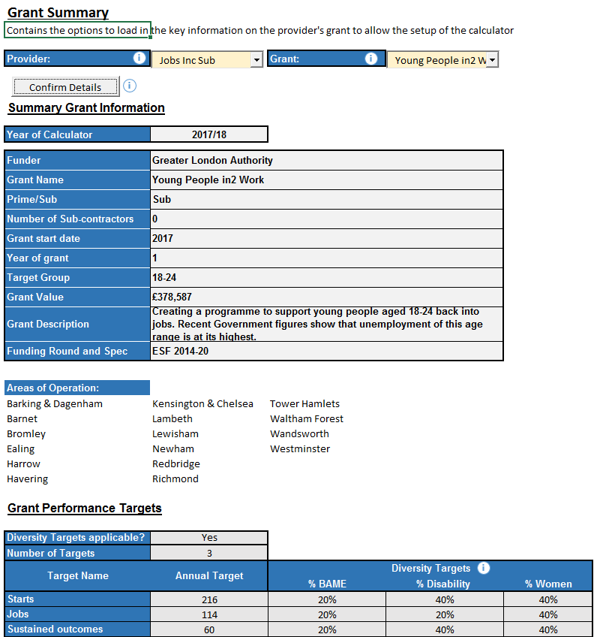
A Prime and their Subs
What the grant summary pages will look like for the previous example. All targets remain the same as well as the diversity targets that are set. This means the Prime calculator will be able to pick up these are all apart of the same grant.

Slide 15
A Prime and their Subs
Items to make sure all subs load into the prime calculator. If the subs are not loading its best to double check these below actions to see if this is why it isn’t working, from the developer himself…
In “Grant Summary”, the subcontractor workbooks have the same Grant Name as the prime workbook
In “Grant Summary”, the subcontractor workbook field “Prime/Sub” is set to Sub
The workbooks must all be .xlsm file
The names of targets of the subcontractor must correspond to the targets of the prime workbook.

Slide 16
Things to remember…
Dates should be entered as 2017/18. 2018/19 etc.
If the project is Pan London, enter ‘1’ in the Pan London cell as well as all the other Boroughs
Lifetime targets must be entered for both Prime and Subs
The ‘Confirm Backsheet Button’ acts as a refresher. Once actual information is entered into the calculator, you shouldn’t press the ‘Confirm Backsheet button’ again as it will delete the information in the calculator and start afresh.
This is also the same for ‘Confirming Details’ on the grant summary tab. Pressing this button again will remove all the information that you have entered in the other tabs.

Slide 17
Completing the Calculator

Slide 18
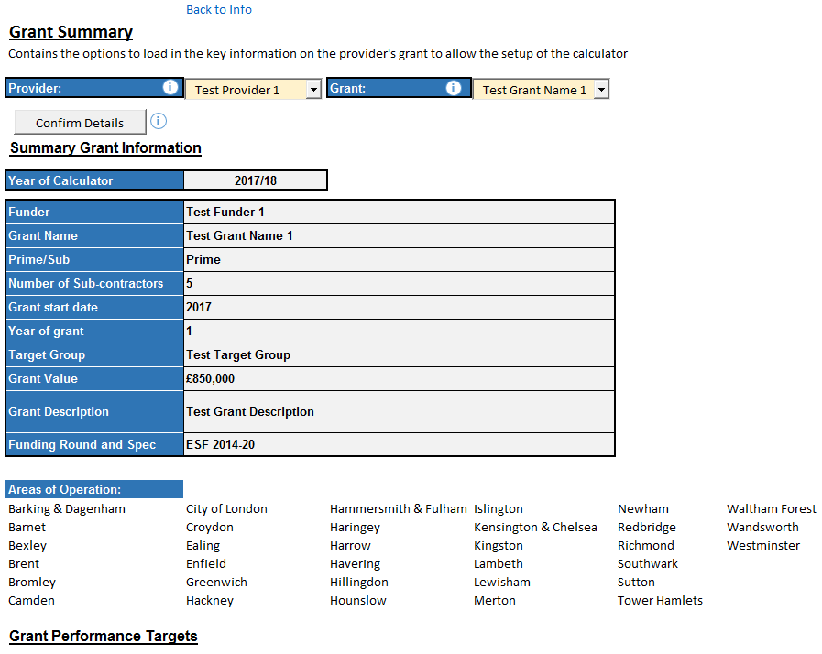
The Grant Summary Tab
Notes:
The Grant summary tab is completed from the information coming from the backsheet.
If you are completing your calculators by having different grants within the backsheet of the calculator – be sure to select the right Provider with the correct Grant before sending it out.
Double check through the information to make sure its complete and then ‘Confirm Details’. This will make the information flow through the calculator. It is really important to make sure to confirm the details otherwise they will be completing the calculator using the test information that is in the spreadsheet.
If there are any issues with the information in the backsheet – it will flag it up here.

Slide 19
Grant Performance
Key Performance Area (KPA) | Weighting | Indicators | Weighting of indicator within KPA
Grant Performance | 60% | Delivery against grant targets | 48%
 |  | Delivery against grant diversity targets | 12%
Grant Targets
Targets in scope confirmed at the beginning of the grant
One target will be identified as the primary outcome
Primary outcome target is 50% point weighting(i.e. 24/48 points available)
All other targets will be weighted equally
Diversity Targets
Against BAME, disabled and women
Notes:
The grant performance tab will contains data entry for Grant Performance outcomes including diversity.
The Grant Performance sheet contains a number of tables, each of which corresponds to one of the targets set (as defined in the Grant Summary Sheet). The Annual targets will have already been put into the backsheet and as well as the Monthly targets.

Slide 20
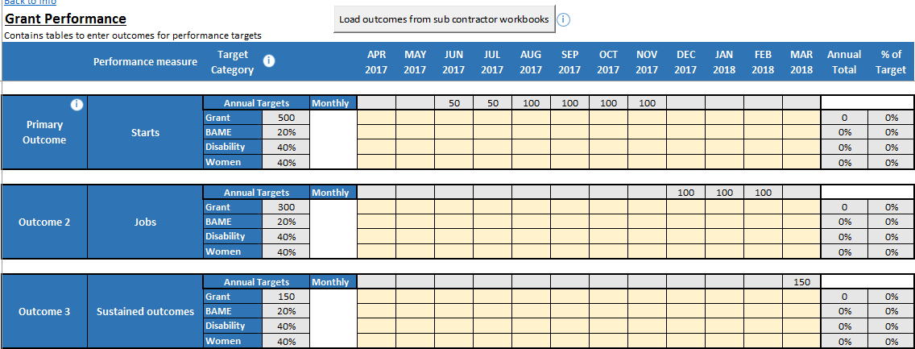
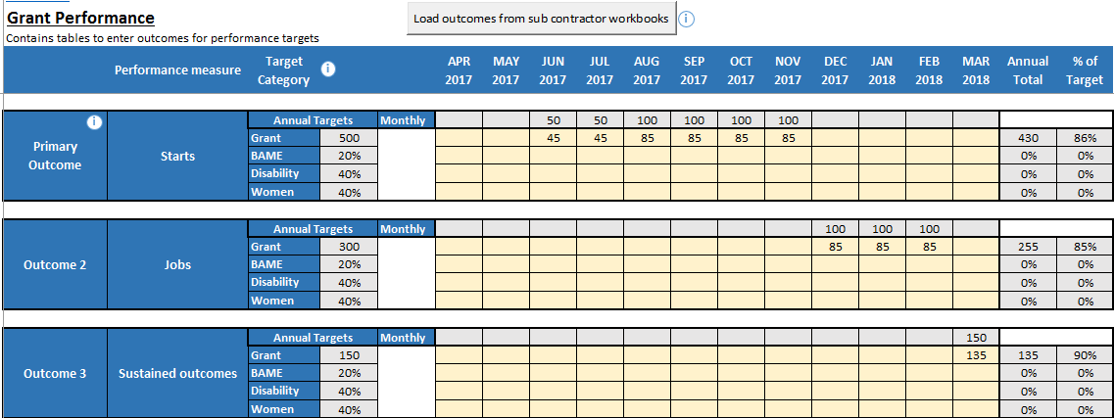
Grant Performance
Notes:
Everything that has been highlighted in yellow will be completed by the providers – this includes the Monthly outcomes achieved for each target and if applicable, the number of people from each diversity group (BAME, Disability and Women) who have achieved the outcome.
Primes/Lead providers will be able to load the subcontractor’s performance from their individual calculators into the prime calculator. As shown previously, they would have to save the prime and sub contractor’s calculators in the same folder so they the prime can pick up there are other calculators to extract information from.

Slide 21
Quality: Participant Satisfaction
Key Performance Area (KPA) | Weighting | Indicators | Weighting of indicator within KPA
Quality | 30% | Conversion Factor | 12%
 |  | Self-Assessment of quality | 9%
 |  | Participation satisfaction | 9%
What do you think of your advisor/trainer’s? Knowledge of the subject Understanding of your needs Support in setting targets to help you achieve your goals Help with finding other support for you Support with helping you to plan your next steps
How has this activity made a difference to you? Improved Improved Not Got Worse Got much a lot a little Changed worse My confidence has My skills have My prospects of getting a job have My knowledge of the options open to me has My motivation to make the next steps has My ability to manage my time and responsibility has
Overall, how satisfied or dissatisfied were you with the activity
Notes:
Prep work required, the questions should be embedded to the exit strategy.
Each table should be completed with the number of participant responses received in the appropriate quarter to each of the required survey questions which are available to download from our webpage.
Some of you will have your own questions but these basic questions need to be asked. The questions can be altered as long as they are similar to the original question.
Before you can receive the 9% / 9 points – you must have had 60% of participants ,over the year, complete the questionnaire. We recommend to complete this on a quarterly basis to make it easier so they don’t lose information and are not rushing around for the information at the end of the year.
The Funder will be made aware of the questions you will need to ask your projects. You will need this to be integrated into the review process and should be used from day one. The questions should be asked when the participants enter into employment or training.

Slide 22
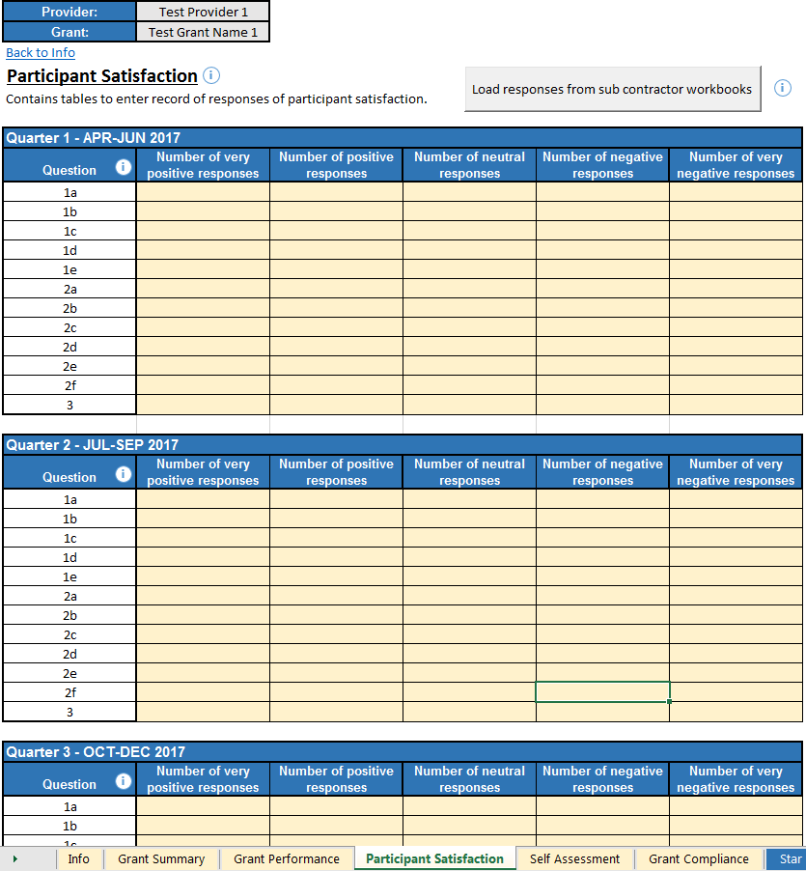
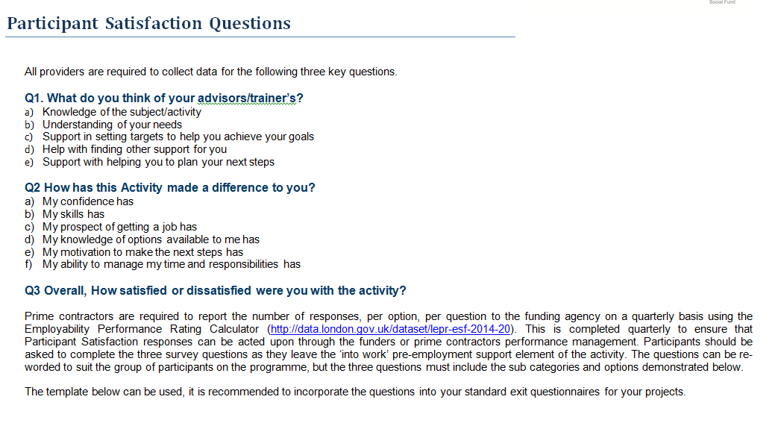
Quality: Participant Satisfaction
Notes:
Similar to the Grant Performance – everything highlighted in yellow is to be completed by the provider.
Responses can be loaded from Sub Contractor workbooks into the Prime contractors by having the workbooks into their designated folders and pressing the button located at the top of the screen.

Slide 23
Quality: Self-Assessment
Key Performance Area (KPA) | Weighting | Indicators | Weighting of indicator within KPA
Quality | 30% | Conversion Factor | 12%
 |  | Self-Assessment of quality | 9%
 |  | Participation satisfaction | 9%
Quality of Provision/Meeting clients needs | Continuous improvement | Leadership, MGT & Infrastructure | Safety and Safe Practice
1. There is a comprehensive induction for all clients 2. Clients receive appropriate advice and guidance on starting and completion 3. Progress reviews are used effectively | 4. Effectiveness is regularly monitored and evaluation 5. An effective QA process is embedded | 6. Organisation has a clear vision 7. Regularly reviewed engagement and outreach strategy 8. Sub-Delivery partners are effectively managed 9. Networks with key stakeholders are effectively used, managed and maintain 10. Commitment to continuous staff professional development 11. Equality & Diversity are effectively promoted and discrimination tackled | 12. To ensure compliance with relevant legislation and good practice to protect participants
Notes:
This a self assessment framework which comprises of twelve questions covering the key quality criteria for providing the contracted services.
For each question – they should be providing an objective rating of how well they believe they have performed on each of the questions. This contributes to 9% of your total score.

Slide 24
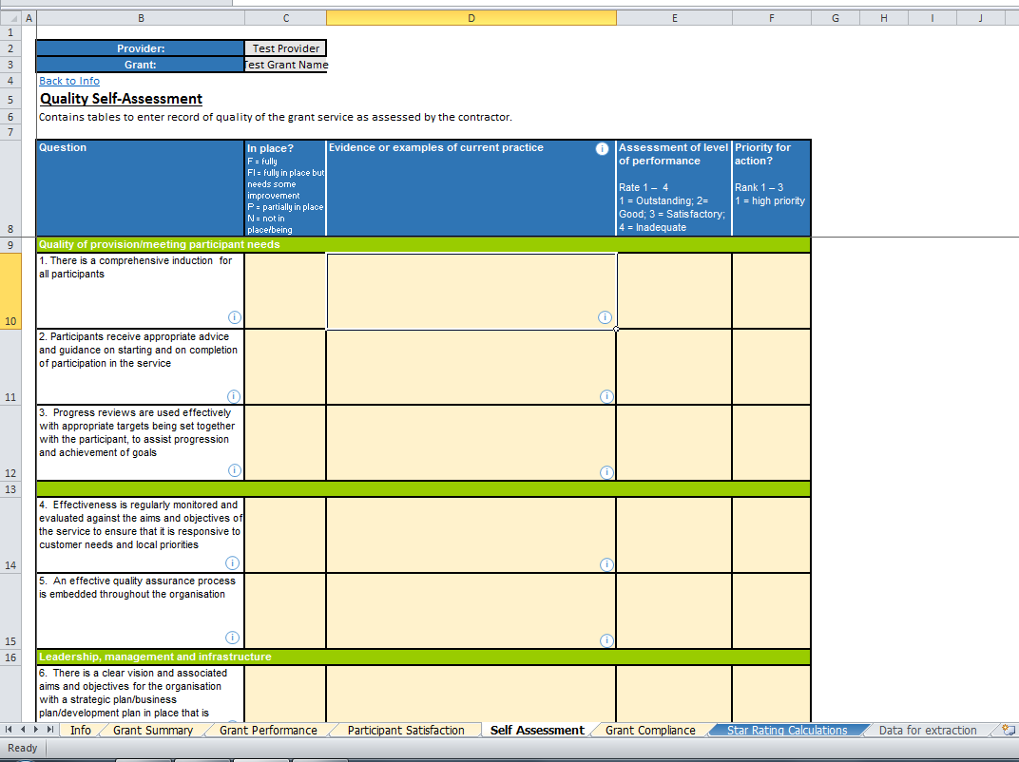
Quality: Self-Assessment
Notes:
For each question – the provider must provider example of evidence to support the rating they have given themselves.
To assist the provider completing the calculator, the information icon buttons give you suggestions about what kinds of examples you can include. Again the Providers will be asked to complete the yellow sections.
The rating of assessment is from 1-4, 1 being outstanding and 4 being inadequate.

Slide 25
Quality: Conversion Rating
Key Performance Area (KPA) | Weighting | Indicators | Weighting of indicator within KPA
Quality | 30% | Delivery against grant diversity targets | 12%
 |  | Self-Assessment of quality | 9%
 |  | Client Satisfaction | 9%
Measures the proportion of starts that achieve the primary outcome
A value added indicator
No points awarded to Providers that underachieve or meet the conversion rate specified in their grant
Notes:
This contributes to 12% of the overall score. This measures the proportion of participant starts that will progress to achieve the Primary Outcome of the provider’s contract.
As an example, this could be from Starts to Jobs.
The idea of the Conversion Rating is to reward providers achieving a higher than contracted conversion rate of starts into the primary contract outcome. No points will be awarded to providers who underachieve or simple meet the conversion rate specified in their contract.
When providers are completing a calculator in the first year of the contract. It won’t be expected they have anything to convert it to, the calculator will take this into account and the 12% will be taken away from the final Star Rating and will give you a score based on the other KPAs.

Slide 26
Grant Compliance
Key Performance Area (KPA) | Weighting | Indicators | Weighting of indicator within KPA
Grant Compliance | 10% | Grant compliance and contractor pro-activity in delivery | 10%
Indicator | Guidance | Rating | Comments
Variance of forecasts from claim | Green = 8 – 10 Amber = 4 – 7 Red = 0 - 3 | 3 | Consistently accurately forecasts the amount claimed
Timeliness of claim | Green = 8 – 10 Amber = 4 – 7 Red = 0 – 3 | 10 | Consistently submits claims to deadlines if not before
Accuracy of claim and associated returns | Green = 8 – 10 Amber = 4 – 7 Red = 0 – 3 | 5 | Submits accurate claims and PPR but occasionally some of the information provided needs to be queried
Responsiveness | Green = 8 – 10 Amber = 4 – 7 Red = 0 – 3 | 10 | Excellent – always respond within a timely timescale
Proactive management of Risk | Green = 8 – 10 Amber = 4 – 7 Red = 0 – 3 | 10 | Always updates risks.
Total Score |  | 45
Notes:
This measures the compliance and the proactivity towards managing the contract. The indicator is based on the Funders (for Lead Providers) or Lead Providers (for Subs) assessment of performance.
The assessment will be based against five statements. The Funder/Lead Provider will rate the provider’s performance against each statement on a scale of one to ten, ten being the highest. The Compliance questions are listed within the calculator.
8-10 being good
4-7 being okay
0-3 being poor

Slide 27
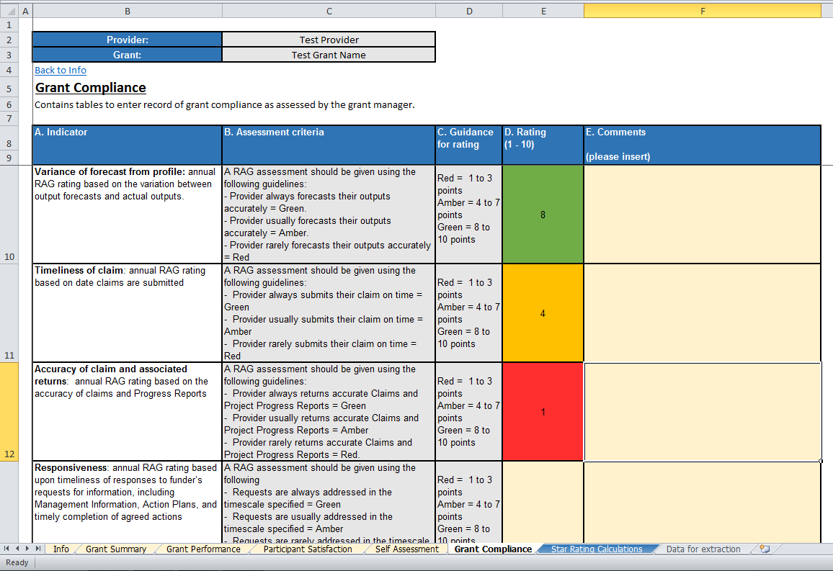
Grant Compliance
Notes:
The comments box is there for the Funder or Prime to justify why they gave the rating they did for their Lead provider or Sub contractor.
Funders or Providers can complete this section before or after they send it to the provider or sub-contractor respectively.

Slide 28
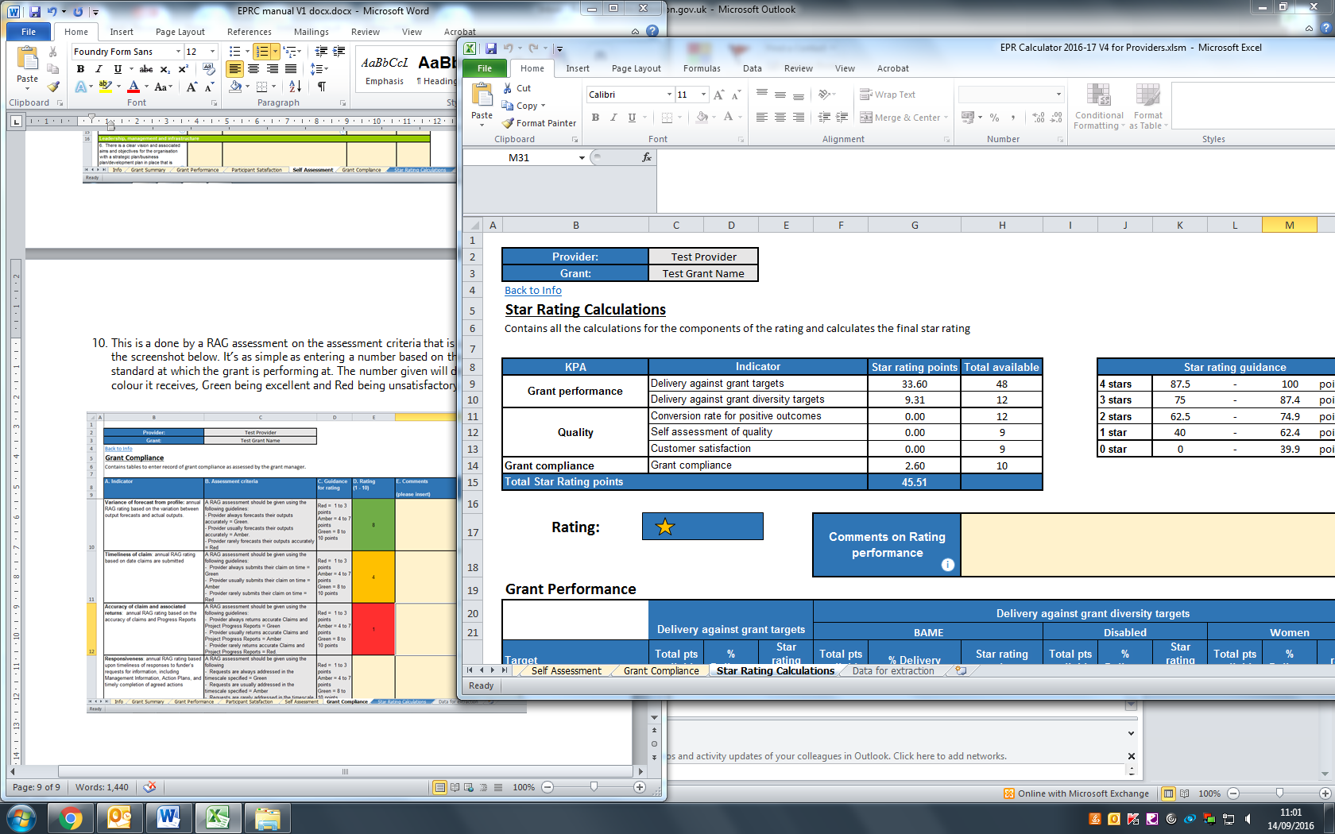
Star Rating
Notes:
Once everything has been entered - a star rating will be given to the overall contract.
The Prime or Sub can then enter how they feel about the Star Rating and whether it is justified.
They can discuss whether they think its deserved.

Slide 29
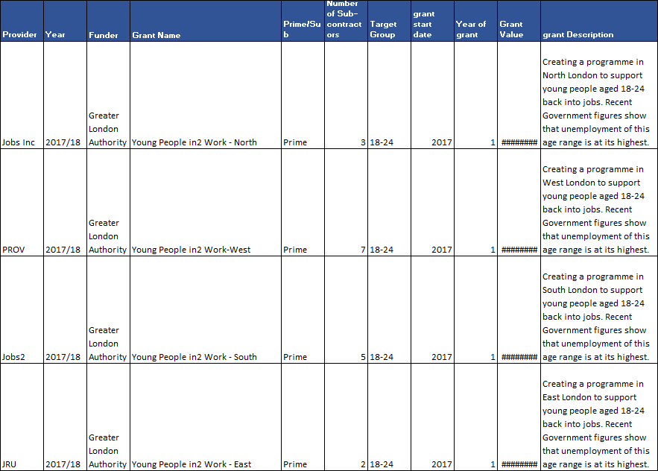
Extraction tool
To make sure all providers are extracted, Funders need to make sure all the calculators they are creating are bespoke. This is the complete opposite to how primes will be setting up their sub’s calculators.
Each of these rows will be its own calculator.
Notes:
The extraction tool won’t be able to tell the difference if they have the same Grant name and description but when a prime is loading the subs into its workbook it needs to realise they are the same so it uploads.

Slide 30
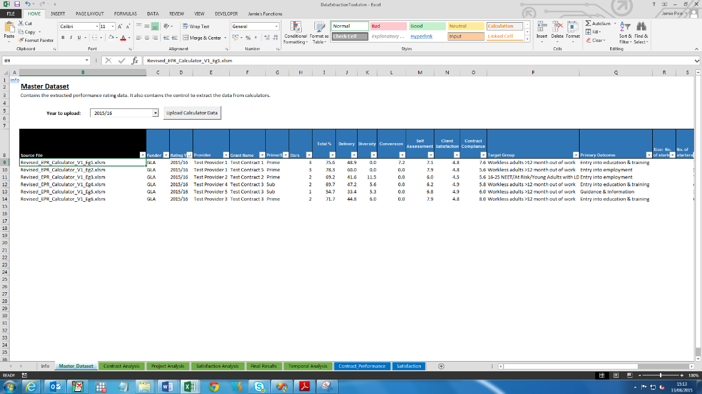
Extraction tool
Notes:
Go to the “Master_Dataset” Sheet.
Ensure the current rating year has been selected in the dropdown menu labelled “Year to upload:”
Click the “Upload calculator data”. The tool will look for EPR Calculator files in the same folder as the extraction tool, and extract the necessary records. Once this has been completed, a full table of records will appear on the sheet. Equivalent tables in the ‘Grant performance’ sheet and ‘Satisfaction’ sheet will also be populated.
We still ask that Funders send over the calculators as well as the data extraction tool.

Slide 31
Preparing for Implementation
Training will offered to all Funders and the Funders are expected to support the delivery partners in completing the calculator. All calculators are submitted to the GLA for quality checks, analysing and publishing of the data.
Providers who want to be trained should put in a request to the GLA and something could be arranged.
Those who submit a calculator which lacks quality or those who do not submit at all will be given a zero rating. This will be raised with the European Programme Management Unit within the GLA and they will deal with the issue from there.
Lead Delivery Partner
Identify who will be responsible for coordinating the Performance Rating. This will involve providing a list of projects to the GLA EPRC coordinator, organising training for employees who require it and liaising with the coordinator to organise when submissions will be made.

Slide 32
Tools & Support
Published ratings and briefings can be found on the London Datastore.
http://data.london.gov.uk/london-employability-performance-rating
Templates and guidance can also be found on the London Datastore.
http://data.london.gov.uk/dataset/lepr-esf-2014-20
For support you can email the Employability Performance Team: eprc@London.gov.uk

