Slide 1




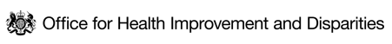

HOUSING AND HEALTH INEQUALITIES
Data Companion Pack
BUILDING THE EVIDENCE DATA WORKING GROUP
May 2023

Slide 2
EXECUTIVE SUMMARY (1 of 2)
The pandemic highlighted the myriad ways in which housing intersects with health outcomes; our ability to enact public health isolation guidance, to work and study, and our mental and physical health, was shaped in large part by our homes. Access to adequate accommodation plays a pivotal role in determining health across the life-course. A good quality, secure and affordable home is the foundation that everybody needs to lead a healthy life.
Despite this, housing is a major driver of poor health outcomes in London, and the effects of this are not felt equally across population groups. Minority ethnic groups, people experiencing deprivation, groups facing social exclusion, and Inclusion Health groups are at greater risk of the poor health outcomes associated with inadequate accommodation. This includes significant impacts on child health, with housing cost in London driving child poverty, and London home to almost 60% of households in temporary accommodation in England, two out of three of which are households with children. Figures released by London Councils show one in 23 children in the capital are homeless, and estimate 166,000 homeless Londoners – including 81,000 children – living in temporary accommodation arranged by their local borough
This report provides a snapshot of housing in London based on data available in the public domain, to accompany the IHE Evidence Review ‘Housing and Health Inequalities in London’. The report offers a narrative overview of existing housing data across the three key strands of housing quality, security, and affordability.
This data companion is part of a series of Evidence Reviews and accompanying data pieces. The second review in this series, on The Rising Cost of Living, is available here.
Part 1 – The Context in London
Between the 2011 and 2021 Censuses, London’s population increased by 7.7%, and the number of households by 4.8%, which suggests a substantial increase in average household sizes. London also has a distinct tenure profile, with a high prevalence of renting. Unaffordable housing is driving inequalities with 38% of children in London living in poverty in 2019/20, compared with 29% in the rest of the UK.
Notes:
TEMPLATE SUMMARY SLIDE

Slide 3
EXECUTIVE SUMMARY (2 of 2)
Part 2 – Housing Quality
More than 1 in 10 homes in London fall below the Decent Homes Standard, with 12% of Londoners rating their homes as poor quality, rising to 19% for council tenants, and with minority ethnic communities at greater risk of housing issues such as overcrowding.
Part 3 – Housing Security
More than one third of renters in London reported in January 2023 that they will struggle to pay their rent payments in the next 6 months, with implications for housing security. There are 56,640 homeless households living in temporary accommodation arranged by London boroughs, including 75,850 children, and there have been recent increases in the number of people rough sleeping.
Part 4 – Affordable Homes
London's rents are so much higher than those of other regions that the median monthly rent for a one-bedroom home in the capital (£1,225) is higher than the median rent for a home with four or more bedrooms across all of the North and Midlands.
When housing costs are included, 2 in 5 children in low-income families live in poverty
Part 5 –Gaps and limitations in available data
The report highlights that data on housing in London is plentiful and can offer valuable context to understand the impact of housing on health and health inequalities across the city. It notes specific gaps in the evidence base, including those relating to key housing quality issues such as overheating, the provision and needs of Specialist and Supported Housing, and pertaining to level of granularity of data in relation to geographical areas and on specific characteristics, for example belonging to Inclusion Health groups.
The report notes that partnership action could be used to identify means of accessing more novel and timely data, and to establish more integrated and linked datasets between heath and care and housing as a key determinant of health. This could incorporate collaborative consideration of how existing housing datasets correlate to the newly-formed ICS geographies in London, and what action could be taken at a system-level to tackle housing-related health inequalities.
Notes:
TEMPLATE SUMMARY SLIDE

Slide 4
APPROACH, PURPOSE AND LIMITATIONS
APPROACH
PURPOSE AND LIMITATIONS
The Greater London Authority (GLA) Public Health, GLA City Intelligence Unit, Office for Health Improvement and Disparities (OHID), NHSE and the Institute of Health Equity (IHE), collaboratively produced this report on housing in London.
Whilst this report draws together datasets from various sources, our thanks go to the GLA Housing and Land team who undertook the vast majority of the data analysis included for the 2022 report ‘Housing in London’, which summarises key patterns and trends across a range of topics relevant to housing in the capital and is updated annually.
The structure of the deck mirrors the accompanying IHE Evidence Review on Housing and Health Inequalities; overviewing current context, housing quality, security, and affordability.
The sources of data included have been identified from existing data in public domain and cover a range of key housing issues, with potential to provide a platform for more in-depth work.
We aim to use this work to
  Provide an accompanying overview of the best available data on housing in London, for the IHE Evidence Review: Housing and Health Inequalities in London.
  Provide a platform for partnership work on housing-related health inequalities across London, including providing an overview of key issues, and identifying key gaps in intelligence that would help improve understanding of housing-related inequalities across the capital.
Specific limitations in terms of how data has been developed, cut and presented are highlighted throughout where possible.
From the outset we want to acknowledge the following limitations -
This is a snapshot of housing in London and is not intended to comprehensively cover all housing issues affecting London, or every inequality dimension.
We are currently in a cost of living crisis which is likely to have a significant impact on the picture of housing in London. See the IHE Evidence Review on the Rising Cost of Living.
Notes:
TEMPLATE METHODS AND LIMITATIOSN SLIDE

Slide 5
CONTENT NAVIGATOR
PART 1: The Context in London: The impact of housing on health inequalities, and the tenure and population profile of London
PART 2: Housing Quality: Inequalities in housing quality including overcrowding, fuel poverty and overheating risk
PART 3: Housing Security: Rates of homelessness and housing insecurity
PART 4: Affordable homes: Increased costs, inequalities in affordability, and increased welfare benefits
PART 5: Gaps and limitations in available data: gaps in the data that would support improved monitoring of impacts of housing on health in London
Notes:
TEMPLATE SUMMARY SLIDE

Slide 6
PART 1: THE CONTEXT IN LONDON
IMPACTS ON HEALTH AND DEMOGRAPHIC OVERVIEW
Notes:
TEMPLATE SECTION SLIDE IF NEEDED

Slide 7
HOUSING QUALITY, SECURITY AND AFFORDABILITY IMPACTS HEALTH THROUGHOUT THE LIFECOURSE
Housing plays a pivotal role in health throughout the life course in a myriad of ways. Housing quality, security and affordability are significant drivers of health inequalities, with minority ethnic groups, people experiencing deprivation, people with disabilities and long-term health conditions, groups facing social exclusion, and Inclusion Health* groups, at greater risk of the poor health outcomes associated with inadequate accommodation. As well as direct health impacts, housing also influences population health outcomes due to pressures on health services and systems. The health impacts of homelessness and poor housing are felt in A&E departments across London, and a recent Building Research Establishment analysis found that the per annum cost to the NHS of poor housing in the capital is £114m.¹
Impacts of housing quality on health:
Overcrowding is linked to poor physical and mental health outcomes, including higher rates of infectious disease transmission, and higher levels of depression and stress. Living in an overcrowded home is associated with lower educational attainment for children.
Cold homes adversely affect child development, can cause and worsen respiratory conditions, cardiovascular diseases, poor mental health, dementia and hypothermia, and it is estimated that 1 in 5 excess winter deaths is due to cold homes.
Overheating increases strain on the cardiovascular and respiratory systems - which are the main causes of illness and death during a heatwave - and hyperthermia, heat exhaustion and heat stroke. Young children and the elderly are among the groups most vulnerable.
Impacts of housing security on health: ​
Insecure housing - the threat of being evicted - contributes to poor mental and physical health. The majority of children who are homeless and living in temporary accommodation in England are located in London, with significant implications for health.​
Impacts of housing affordability on health:​
Unaffordable housing - unaffordable housing puts pressure on people's income and drives poverty with significant implications for child health; when housing costs are taken into account, 38% of children in London were living in poverty in 2019/20, compared with 29% in the rest of the UK.²
Source: (1) BRE The Cost of Poor Housing in London, 2021 2) IHE Evidence Review: Housing and Health Inequalities, 2022
*Note: Inclusion health includes any population group that is socially excluded. This can include people who experience homelessness, drug and alcohol dependence, vulnerable migrants, Gypsy, Roma and Traveller communities, sex workers, people in contact with the justice system and victims of modern slavery but can also include other socially excluded groups.

Slide 8
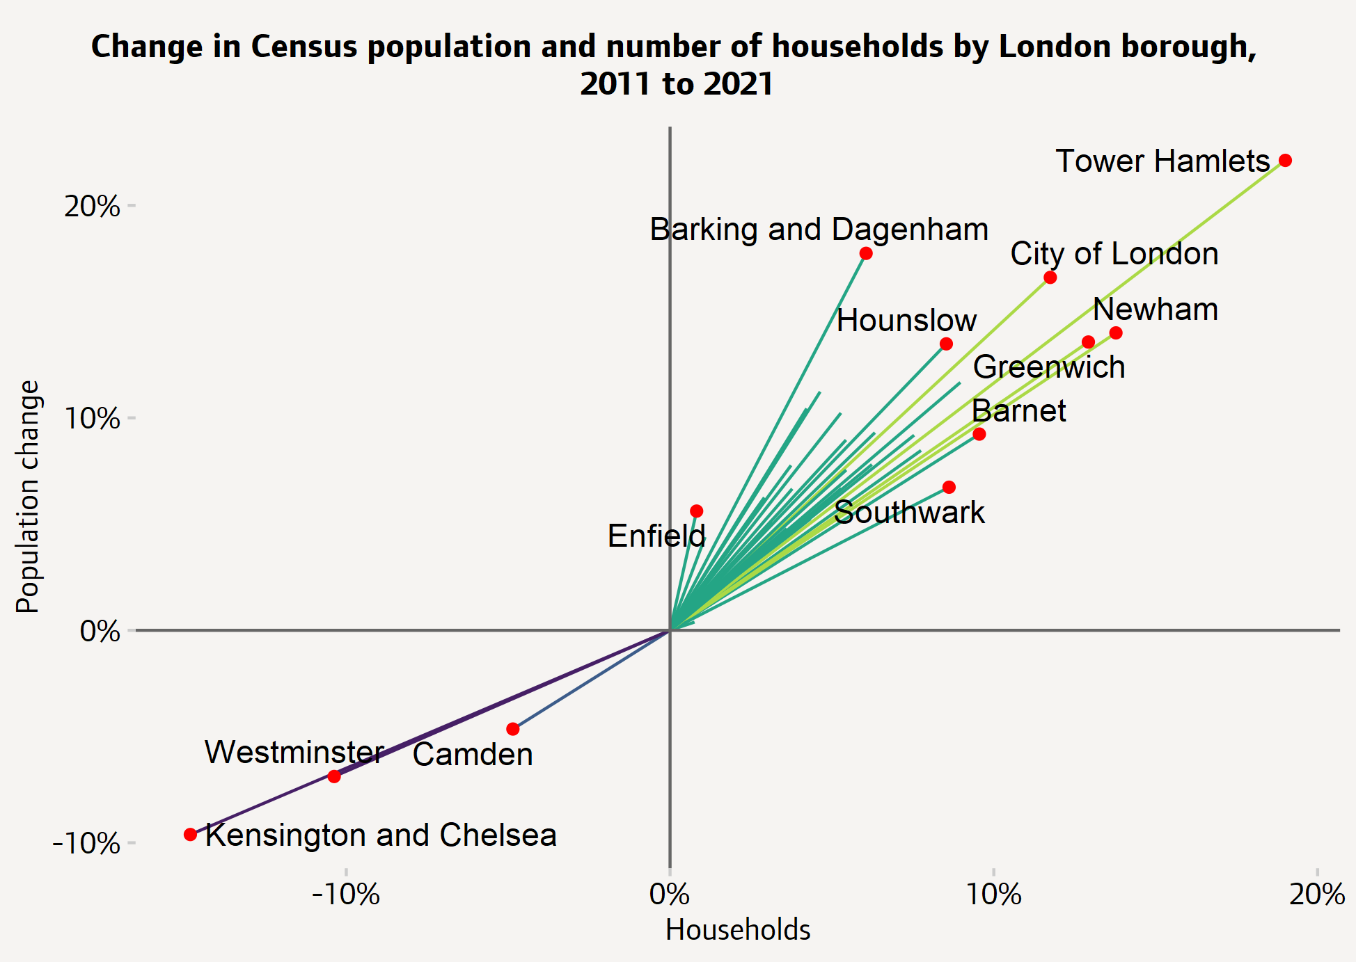
THE LONDON POPULATION IN 2021 IS THE HIGHEST ON RECORD, WITH INCREASED AVERAGE HOUSEHOLD SIZE
Fig 1. Change in Census population and number of households by London Borough, 2011-221
The 2021 Census estimated that London’s population was 8.8 million in March 2021, the highest Census population on record.
Between the 2011 and 2021 Censuses, London's population was estimated to have grown by 7.7%, although there were sharp falls in a handful of central boroughs.
Whilst the population has grown by 7.7%, the number of households has increased by 4.8%, which suggests a substantial increase in the sizes of average households.¹
The Census was carried out when London was still experiencing the effects of the Coronavirus pandemic, and there is reason to think that London, particularly Inner London, has seen significant population changes since then.²
Source: (1) ONS, Census, 2021 (2) GLA Housing in London, 2022

Slide 9
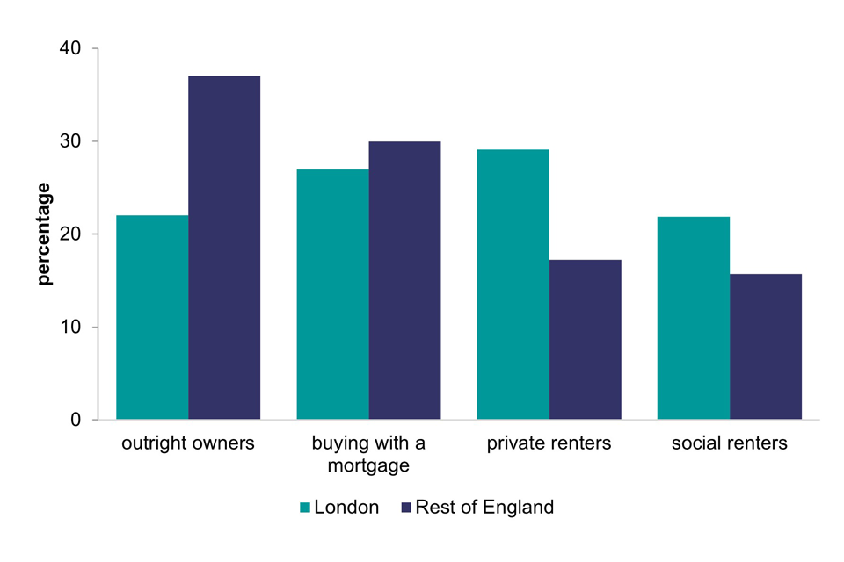
THERE IS A HIGHER PREVALENCE OF RENTERS IN LONDON THAN ELSEWHERE IN ENGLAND
When compared with other English regions, London has a very different tenure profile. Renting is more prevalent and outright ownership is less prevalent in London than in the rest of England.¹
In 2021-22, 29% of households in London were private renters, compared to 17% in the rest of England. A similar pattern is seen in the social rented sector, with 22% of London households being social renters, compared to 16% in the rest of England. The proportion of people living in private rental accommodation in London has implications for unequal vulnerability to the cost of living crisis, and subsequent tenure insecurity, as rents rise faster than inflation.²
There are similar proportions of households renting from housing association in London (11%) compared to the rest of England (10%). However, the proportion of households in London (11%) renting from a local authority was much higher than the proportion in the rest of England (6%).
In 2021-22, owner occupation rates were lower in London (49%) than in the rest of England (67%). This disparity appears to be driven by a difference between the proportion of outright owners in London compared to the rest of England. In London, 22% of households are outright owners, compared to 37% in the rest of England.
Fig 2. Tenure in London and the rest of England 2021-22
Note: Whilst the English Housing Survey is a rich data source, it comes with a substantial time lag​
Source: (1) DLUHC, English Housing Survey 21-22, (2) IHE Evidence Review: Housing and Health Inequalities, 2022

Slide 10
PART 2: HOUSING QUALITY
DEMOGRAPHIC OVERVIEW OF LONDON AND COVID RECOVERY
Notes:
TEMPLATE SECTION SLIDE IF NEEDED

Slide 11
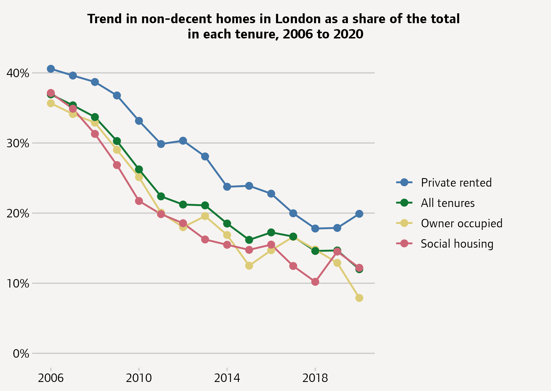
MORE THAN 1 IN 10 HOMES IN LONDON STILL FALL BELOW THE DECENT HOMES STANDARD
Adequate housing quality can be measured by the four components of the Decent Homes Standard; be free of hazards, in good repair, with modern facilities and energy-efficient. Increasing the number of homes that achieve the Decent Homes Standard, particularly in the private rented sector, is vital to improving health and reducing health inequalities.¹
Fig 3. Trend in non-decent homes in London
Between 2006 and 2020, the proportion of homes in London below the official Decent Homes Standard fell from 37% to 12%.
The proportion of homes below the standard fell from 36% to 8% for owner occupied homes 37% to 12% for social rented homes and from 41% to 20% for privately rented homes.²
The higher proportion of homes below the standard in the private rented sector is likely to reflect in part the fact that there is a higher share of older homes in the sector.
The sharp changes seen between 2019 and 2020 may also reflect the disruptive effects of the pandemic, which meant that English Housing Survey data for 2020 was based on modelled estimates rather than internal surveys of each property.³
Source: (1) IHE Evidence Review: Housing and Health Inequalities, 2022 (2) GLA, Housing in London 2022 (3) DLUHC, English Housing Survey

Slide 12
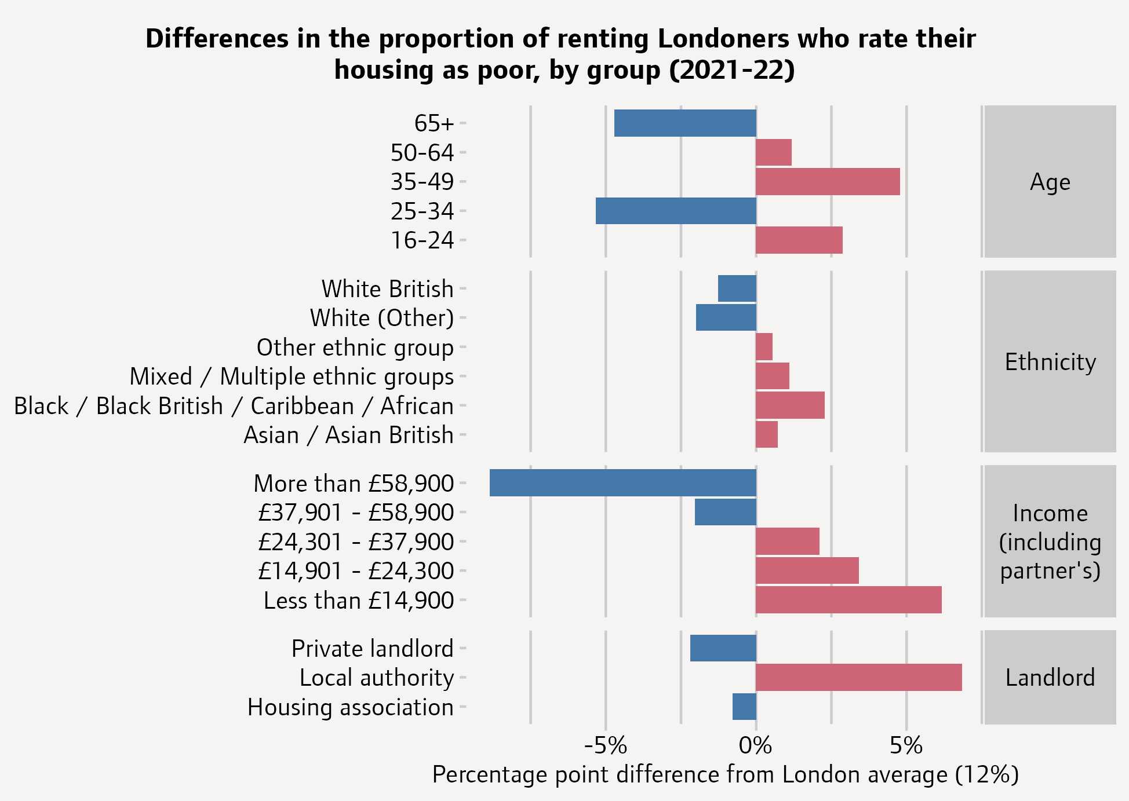
12% OF LONDONERS RATED HOMES AS POOR QUALITY, RISING TO 19% FOR COUNCIL TENANTS
Fig 4. Differences in proportion of renting Londoners who rate their housing as poor, compared to London average, by group (2021-22)
The 2021-22 Survey of Londoners was an online and paper self-completed survey of 8,630 adults in London. The survey asked private and social tenants to rate the quality of their housing and, across both groups, 12% rated their homes as 'poor’.¹
There were significant variations across demographic groups. 19% of council tenants rated their homes as poor, 7% above the London average. Young adults and those in middle age were also more likely to say they were living in poor housing, as were those on lower incomes.
Among the broad ethnicity categories shown here, Asian and Black renters were most likely to say their housing was poor. But there are significant differences within some of these categories too: most notably, 26% of Bangladeshi and 19% of Pakistani renters said their housing was poor, compared to only 6% of Indian renters.²
Source: (1) GLA Housing in London, 2022 (2) GLA, Survey of Londoners 2021-22
Note: the colour legend relates to the percentage point difference from the London average, with blue below the average and red above. Fieldwork took place in Nov 21 with a pre-selected reference group, and some COVID restrictions were introduced after fieldwork began, potentially impacting results.
Notes:
It is important to understand the context in which the Survey of Londoners 2021-22 took place. Survey fieldwork began in November 2021; so, up to that point, it had been four months since most legal limits on social contact had been removed. However, after fieldwork had started, some restrictions due to the emergence of the Omicron variant were introduced. This may or may not have had some effect on the data. Given these changing circumstances, caution should be applied when interpreting the results.

Slide 13
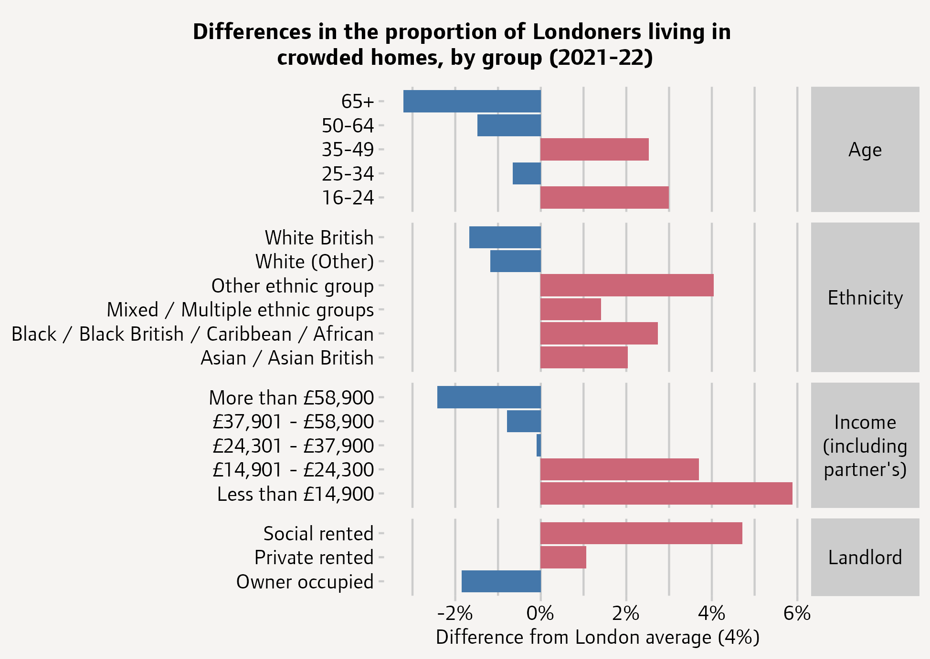
LONDONERS IN SOCIAL HOUSING AND ON LOW INCOME MORE LIKELY TO LIVE IN OVERCROWDED HOMES
Fig 5. Proportion of adults living in crowded homes compared to the London average, by group (2021-22)
London has the highest rates of household overcrowding in England.
The 2021-22 Survey of Londoners asked whether in their household two or more people aged 10 or over and of different sexes have to sleep in the same room (discounting couples sharing a room). This question was intended to identify homes with some level of overcrowding, although it is not the same measure as the 'bedroom standard' used in the English Housing Survey.¹
Across all Londoners, 4% of adults said their home was crowded by this measure. Adults living in social housing were twice as likely as the London average to say their homes were crowded, and those on lower incomes were also significantly more likely to be living in crowded conditions.²
Comparatively, the rate of overcrowding in London based on the ‘bedroom standard’ was estimated to be 8.3% in 2018/19.³
Key inequalities
Among the broad ethnicity categories shown here, the highest rates of crowding were reported by Bangladeshi (18%), Black African (9%) and other (non-Caribbean) Black Londoners (10%).
Source: (1) GLA Housing in London 2022, (2) GLA, Survey of Londoners 21-22, (3) DLUHC English Housing Survey
Note: the colour legend relates to the percentage point difference from the London average, with blue below the average and red above. Fieldwork took place in Nov 21 with a pre-selected reference group, and some COVID restrictions were introduced after fieldwork began..

Slide 14
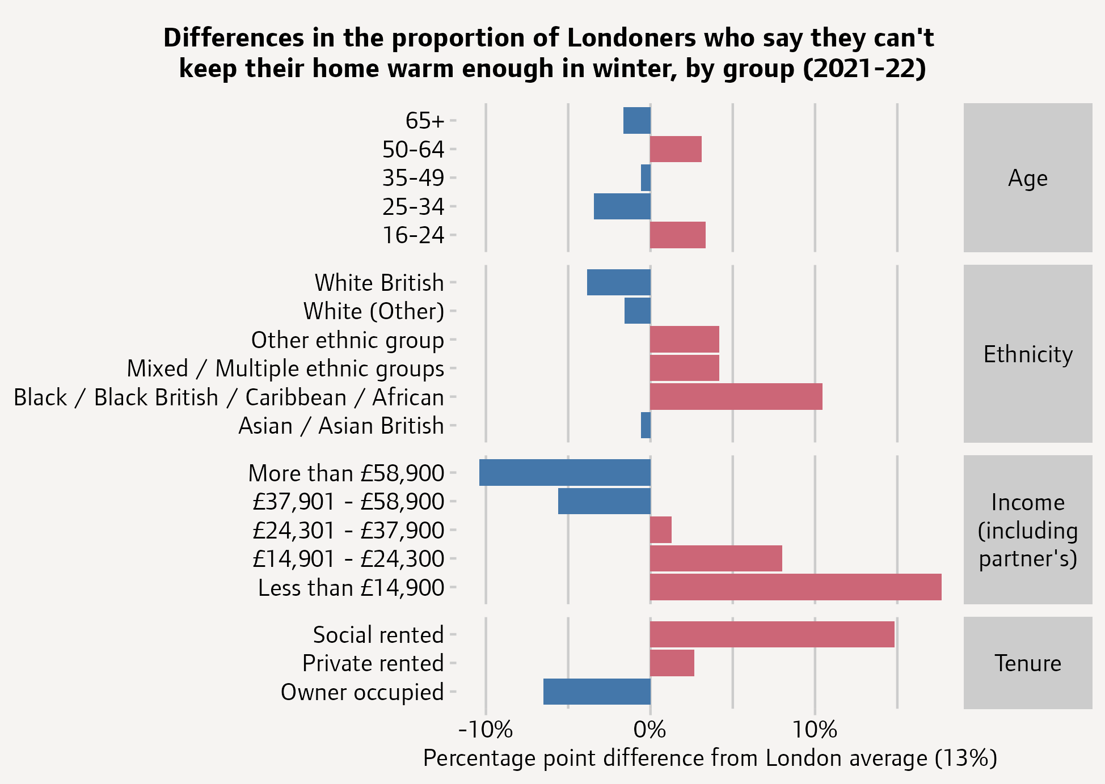
OVER 1 IN 4 LONDONERS IN SOCIAL HOUSING STRUGGLING TO KEEP THEIR HOMES WARM
In late 2021 and early 2022, 13% of adults in London said they couldn’t afford to keep their home warm enough in winter.
Difficulties staying warm were much more common among those living in social housing, 28% of whom said they couldn't afford to keep their home warm.
Within the broad ethnicity categories shown here, particularly high proportions of Bangladeshi (24%), Pakistani (21%) and Black African (25%) and other (non-Caribbean) Black Londoners (31%) said they couldn’t afford to keep their homes warm enough.
The fieldwork for this survey largely took place in November and December 2021, before the onset of the energy costs crisis. Many more households are likely to be living in cold homes, with increased damp and mould, as household energy bills continue to rise into 2023.
Groups experiencing particularly high levels of exclusion and inequalities, or inclusion health groups, may experience greater challenges keeping warm, but there remains a lack of evidence on this.
Fig 6. Differences in the proportion of Londoners who say they can't keep their home warm compared to London average, by group (2021-22)
Source: GLA, Survey of Londoners 2021-22.
Note: the colour legend relates to the percentage point difference from the London average, with blue below the average and red above. Fieldwork took place in Nov 21 with a pre-selected reference group, and some COVID restrictions were introduced after fieldwork began, potentially impacting results.

Slide 15
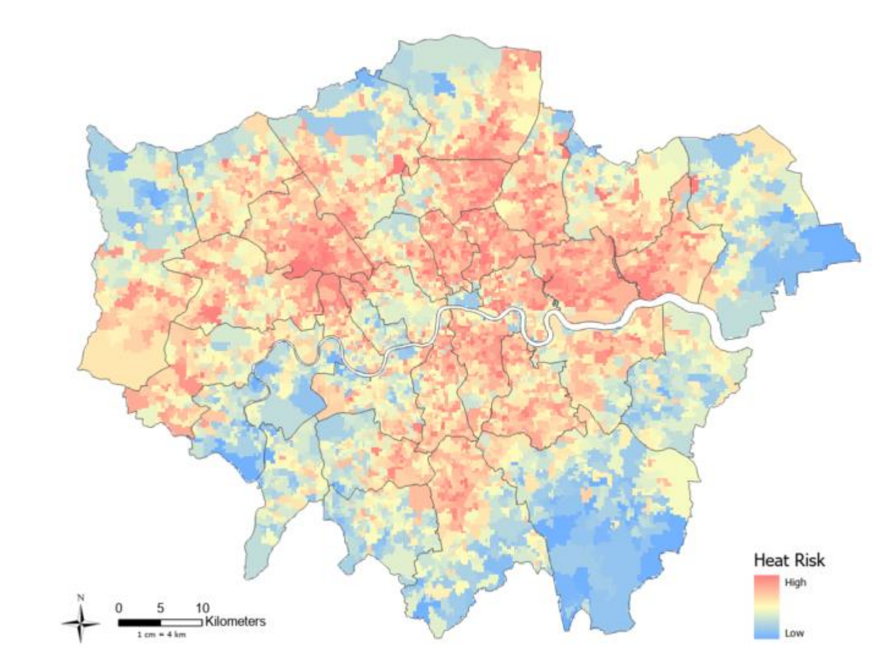
LONDONERS ALMOST TWICE AS LIKELY TO DIE FROM HEAT-RELATED CAUSES THAN ENGLAND AVERAGE
Fig 7. Bloomberg London Heat Risk map, 2022
Climate change is widely accepted to be one of the greatest threats to human health, with London facing increasing risks associated with rising temperatures.
Between 2000 and 2019, Londoners were almost twice as likely to die from heat-related causes than average for England.¹
Vulnerability to heat is not felt equally across populations, and exposure can depend on factors such geographical location, housing stock, socioeconomic factors and individual vulnerabilities.
There is a lack of granular data available in the public domain on overheating risk in London. Existing data includes -
  2006 GLA mapping of Mortality Risk from High Temperatures in London, demonstrating vulnerability to heat across the "Triple Jeopardy" metrics of the Urban Heat Island – the phenomenon where temperatures are relatively higher in cities compared to surrounding rural areas; housing stock; and Population age.²
  2022 Bloomberg Spatial Analysis of Climate Risk Across Greater London. The Bloomberg Heat Risk map can be used as a guide for heat risk in the city, alongside local data and intelligence on the quality of housing and vulnerability of the population.³
Source: (1) IHE Evidence Review, 2022 (2) GLA Mortality Risk from High Temperatures in London, 2006 (3) Bloomberg, London Climate Risk, 2022

Slide 16
PART 3: HOUSING SECURITY
SECURITY OF TENURE AND HOMELESSNESS IN LONDON
Notes:
TEMPLATE SECTION SLIDE IF NEEDED

Slide 17
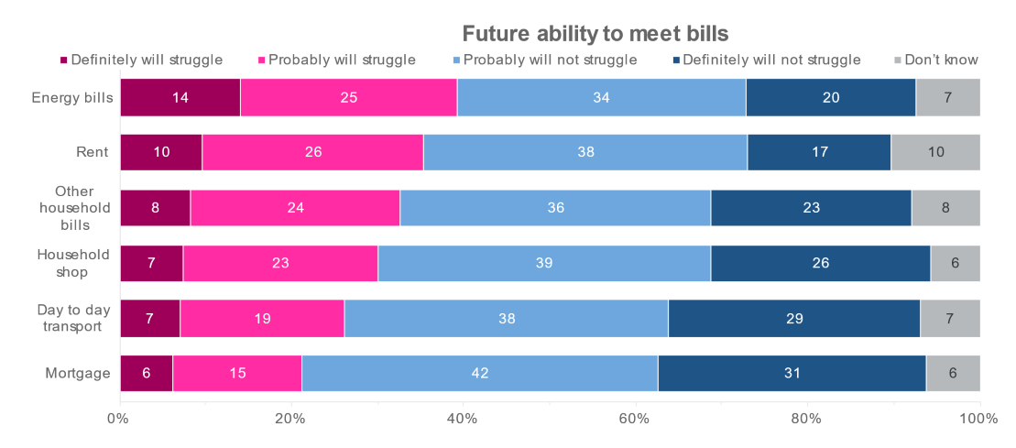
MORE THAN A THIRD OF RENTERS STRUGGLING TO MEET RENT PAYMENTS IN NEXT 6 MONTHS
As London enters a period of the highest inflation seen in a generation there is a real risk of greater insecurity of tenure, leading to increasing homelessness.
When surveyed, over a third of renters (39%) think they will definitely or probably struggle to pay their energy bills (39%) and rent (36%) in the next six months.
There is a gap in available data on the number of households at threat of, or facing, a section 21 eviction, but rising rent costs and increased difficulty paying rents, will lead to an increased threat of eviction and homelessness across London.
See the IHE Evidence Review on the Rising Cost of Living for further information.
Fig. 8 Ability to meet costs over the next 6 months, January 2023
Source: YouGov Plc polling data completed on behalf of the GLA, January 2023

Slide 18
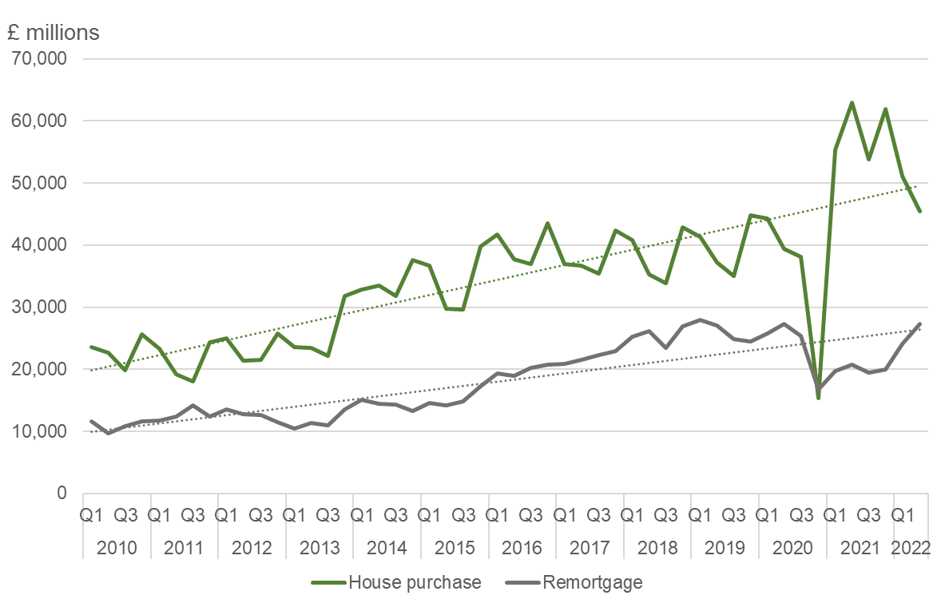
HOUSING SECURITY OF OWNER OCCUPIERS WILL ALSO BE IMPACTED BY RISING INTEREST RATES
The average amount loaned each month against house purchases and re-mortgages in London increased by more than 150% between 2010 and 2022.
This has implications for exposure to higher interest rates when remortgaging.
Fig. 9 Residential loans to individuals for house purchase or remortgage, £ millions, London, 2010 Q1 – 2022 Q2
Source: Bank of England

Slide 19
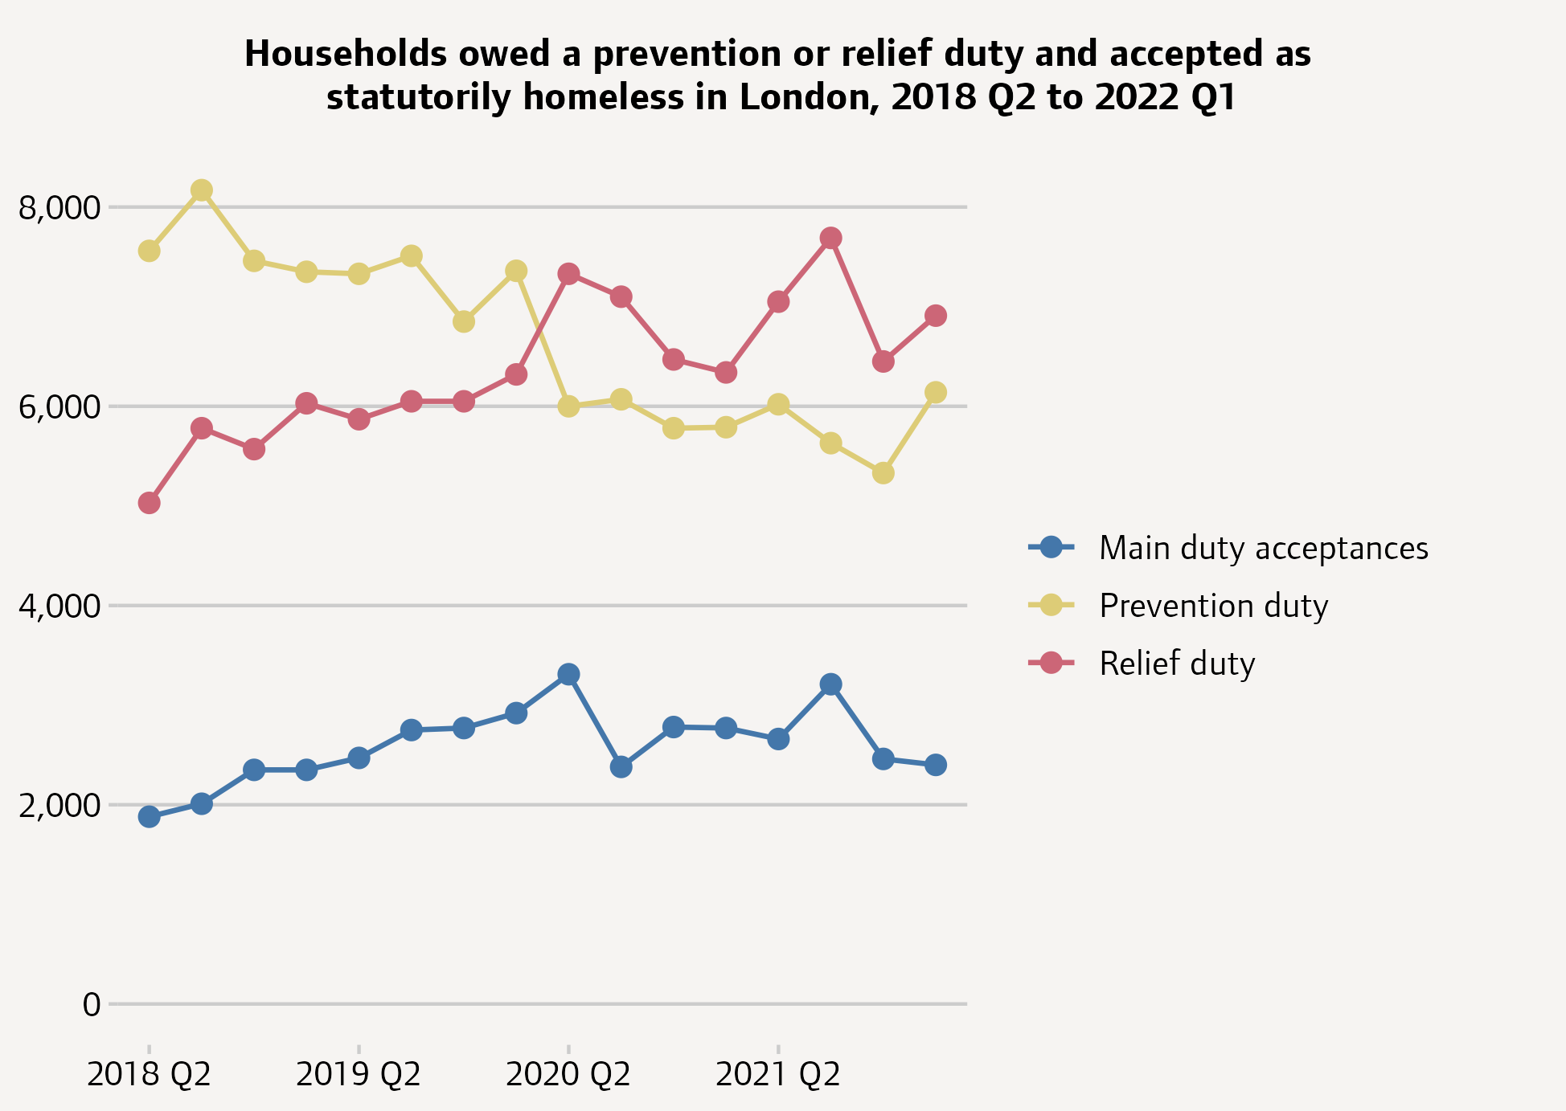
MORE HOUSEHOLDS ALREADY HOMELESS WHEN ACCESSING LOCAL AUTHORITY SUPPORT
The pandemic led to a shift in the patterns of homelessness assessments by local authorities, with fewer households requiring support to prevent them becoming homeless and more who had already become homeless needing help to secure accommodation
The Homelessness Reduction Act came into force in 2018. Under the Act, a prevention duty is owed to households threatened with homelessness within 56 days and a relief duty is owed to households that are already homeless and require help to secure accommodation. The relief duty lasts 56 days, after which a household can be accepted as statutorily homeless and owed a main homelessness duty.
There were 13,050 households assessed as owed a new prevention or relief duty in London in 2022 Q1, including 6,140 prevention and 6,930 relief duties. The number of households owed a prevention duty has fallen since the onset of the pandemic while the number already homeless and owed a relief duty has risen.
There were 2,400 households accepted as statutorily homeless by London boroughs in 2022 Q1. This figure increased during the early part of the pandemic but has trended downwards since then.
Fig. 10 Households owed a prevention or relief duty, 2018-22
Source: GLA, Housing in London, 2022

Slide 20
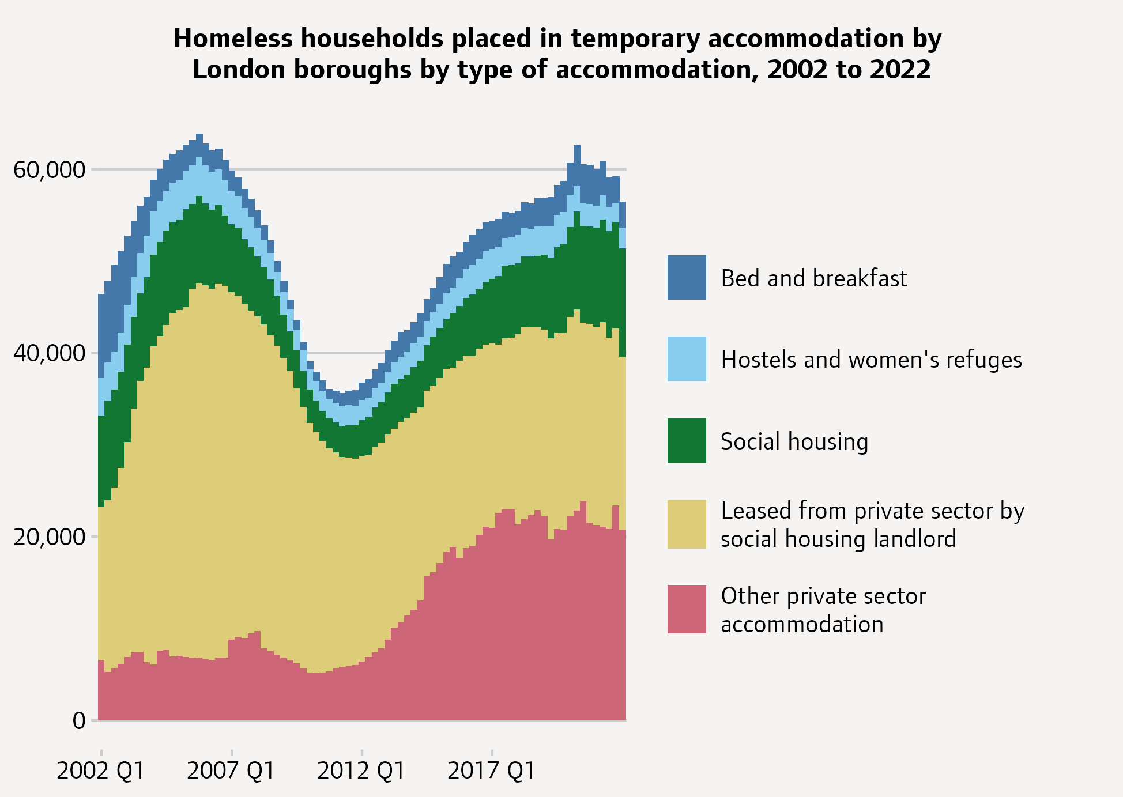
81,000 CHILDREN LIVING IN TEMPORARY ACCOMMODATON ARRANGED BY THEIR BOROUGH
London is home to almost 60% of households in temporary accommodation in England, two out of three of which are households with children.¹
In March 2022 there were 56,640 homeless households living in temporary accommodation arranged by London boroughs, including 75,850 children.²
21,620 of the households in temporary accommodation arranged by London boroughs, or 38% of the total, were placed outside their home borough.
The number of households in bed and breakfast accommodation (2,890) was down 30% from March 2021.
18,890 homeless households were living in accommodation leased from the private sector by a social housing landlord, and a further 20,670 were in some other form of private sector accommodation. 11,770 were being temporarily accommodated in social housing, the highest figure on record.
By March 2023, London councils now estimate that this has risen to 81,000 children living in temporary accommodation arranged by their local borough*.³
Fig. 11 Homeless households placed in Temporary Accommodation 2002-22
Source: (1) Dept for Levelling Up, Housing and Communities, Homelessness Statistics (2) GLA, Housing in London, 2022 (3) London Councils, Boroughs estimate one child in every London classroom is homeless *Data from London Councils is not currently in the public domain, and therefore differs from public data

Slide 21
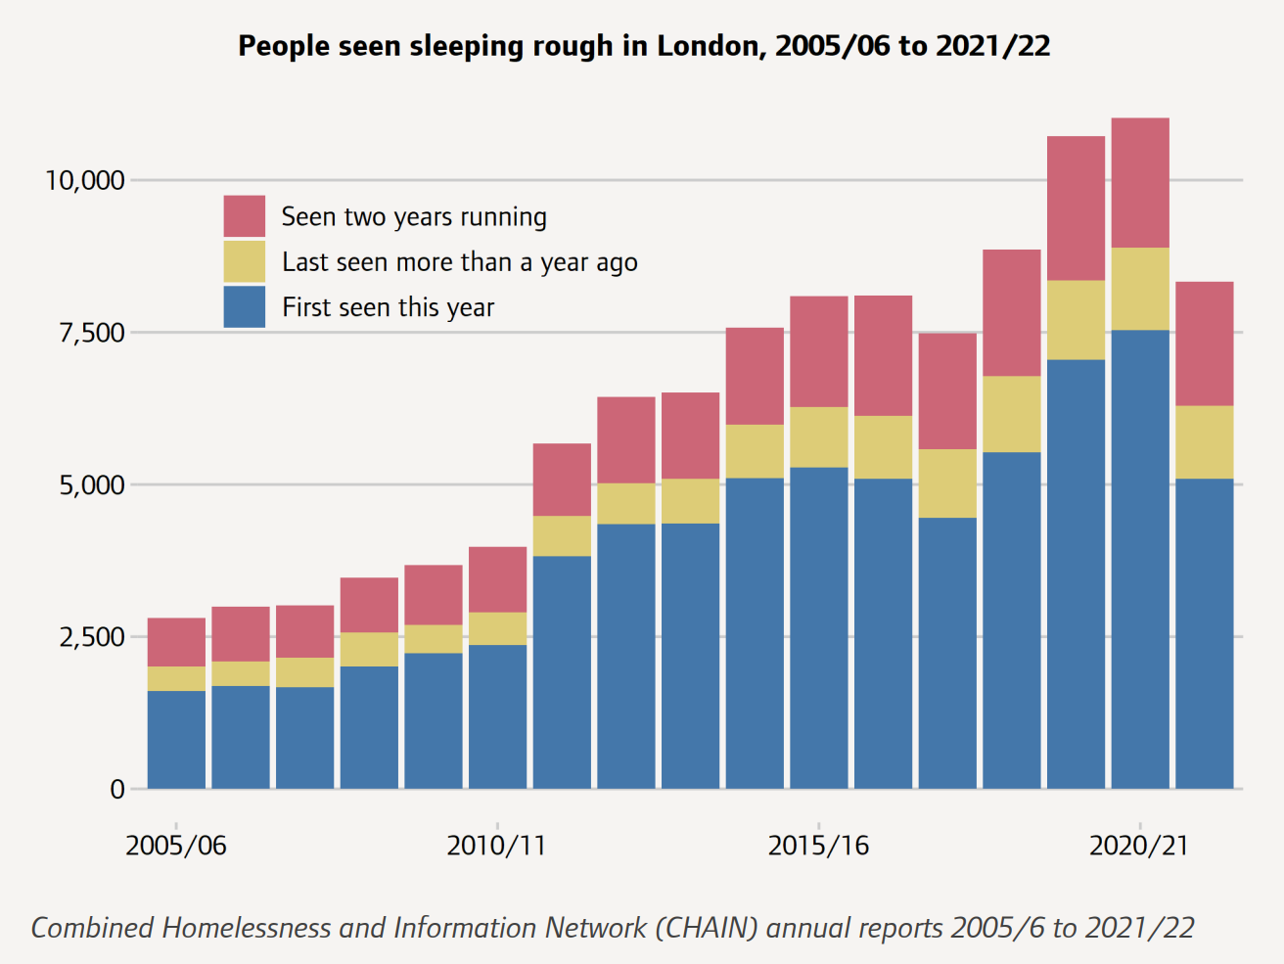
ROUGH SLEEPING HAS INCREASED OVER TIME, WITH THOUSANDS SLEEPING ROUGH IN LONDON EACH YEAR
Fig. 12 Trends in people seen sleeping rough in London
In the CHAIN annual report 2021/22, 8,329 people were seen sleeping rough in London, which, whilst a considerable fall from 11,018 in 2020/21 and the lowest number since 2017/18, masks significant increases since 2005/6, with numbers more than doubling in this time period.¹
The largest group of rough sleepers in 2021/22 were the 5,091 people seen sleeping rough for the first time.²
The latest Q3 CHAIN data reports on rough sleeping record a total of 7272 people rough sleeping during the quarter, with 13 of 14 reporting areas noting an increase in the number of people rough sleeping from the same period the previous year.³ Intermittent rough sleeping was 23% higher than the same period last year.
It is likely that the impact of the cost of living crisis will drive increases in people experiencing homelessness in London.
Key Demographics and Support Needs:
50% of rough sleepers had a mental health support need, compared to 44% in 2020/21.
31% had an alcohol support need, compared to 29% in 2020/21, and 34% had a drug support need, compared to 31% in 2020/21.
83% of people seen rough sleeping in 2021/22 were men.
8% of people seen rough sleeping in 2021/22 were aged 25 or under.
32% of people seen rough sleeping during the period had experience of spending time in prison.³
Source: (1) CHAIN annual reports 2005/6 to 2021/22 (2) GLA Housing in London 2022,
(3) CHAIN Q3 report 2022/23

Slide 22
PART 4: AFFORDABLE HOMES
AFFORDABILITY OF HOUSING IN LONDON
Notes:
TEMPLATE SECTION SLIDE IF NEEDED

Slide 23
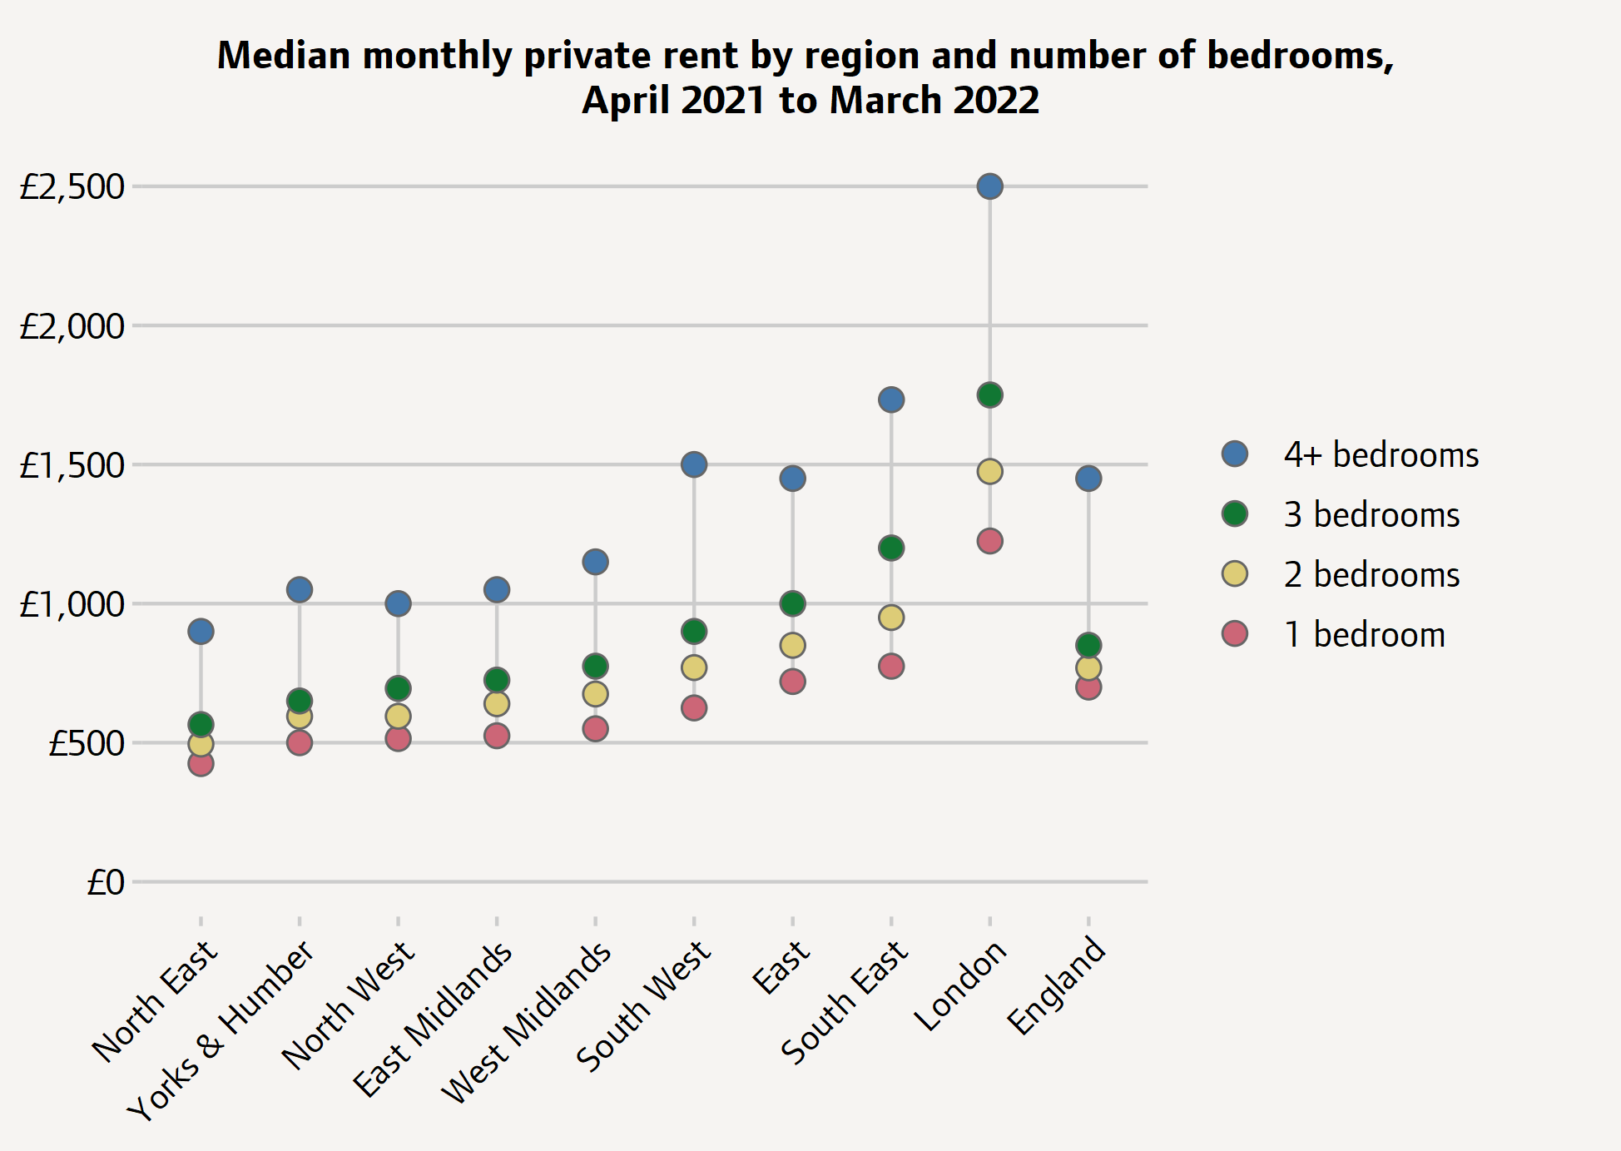
MEDIAN MONTHLY RENT IN LONDON ALMOST DOUBLE OF THOSE ELSEWHERE IN ENGLAND
Fig. 13 Median monthly private rent by region and number of bedrooms 2021-22
Median monthly private rents in London are almost double those elsewhere in England, with a one-bedroom home in London on average costing 44% more than a three-bed home in other regions
In the year to March 2022, the median rent for a privately rented home in London was £1,450 per calendar month, almost twice as high as the median in England as a whole (£795).
London's rents are so much higher than those of other regions that the median monthly rent for a one-bedroom home in the capital (£1,225) is higher than the median rent for a home with four or more bedrooms across all of the North and Midlands.
Rent is the single biggest outgoing for many people in London and one on which they devote a higher share of their spending than the UK average.
New rental prices are soaring in the capital, with the HomeLet Rental Index showing London asking rents rising nearly 14% year on year. As existing contracts roll over to line up with new prices, overall housing costs for Londoners will rise sharply.
Source: 1) GLA Housing in London 2022, based on ONS private rental market summary statistics

Slide 24
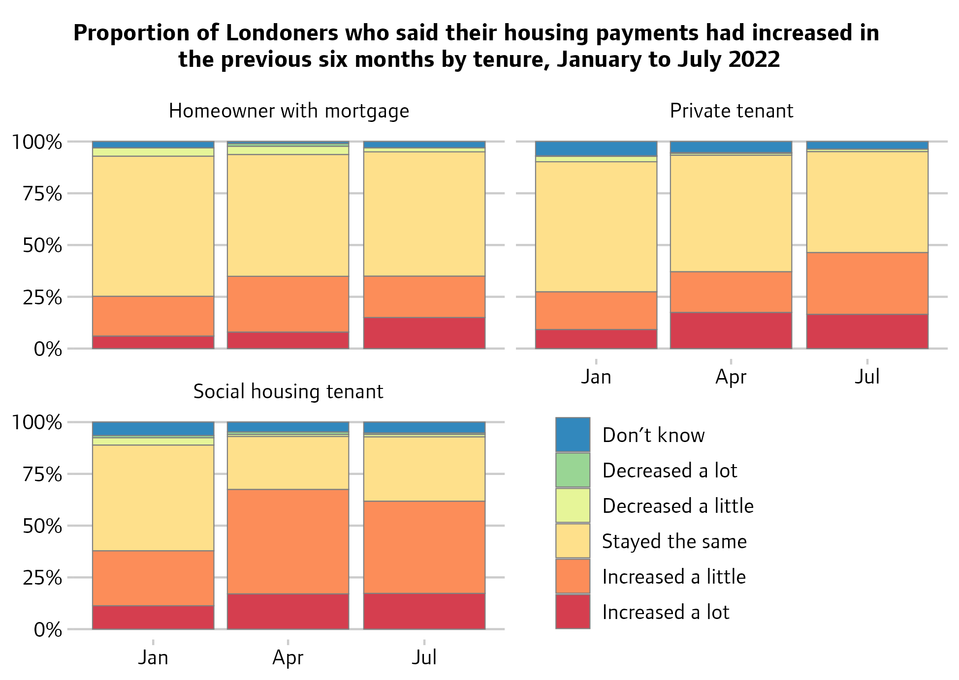
HOUSING COSTS IN LONDON INCREASE, PARTICULARLY FOR RENTERS
More than half of social housing tenants and nearly half of private tenants in London said in July 2022 that their rent had recently increased.^{1,2}
At the start of the year, most people in all three tenures were reporting no change in their costs, but as the year progressed a growing proportion of Londoners, particularly renters, started to report that their housing costs had recently increased.
In July 2022, 17% of social housing tenants in London said their rent had increased a lot in the last six months, and 45% said it had increased a little.
Among private renters, 17% said their rent had increased a lot and 30% a little.
Fewer homeowners reported increases in their mortgage costs, with 15% reporting their costs had increased a lot and 20% a little.
Fig. 14. Reported housing payment increases, 2022
Source: (1) GLA Housing in London, 2022, (2) YouGov cost of living polling for GLA.

Slide 25
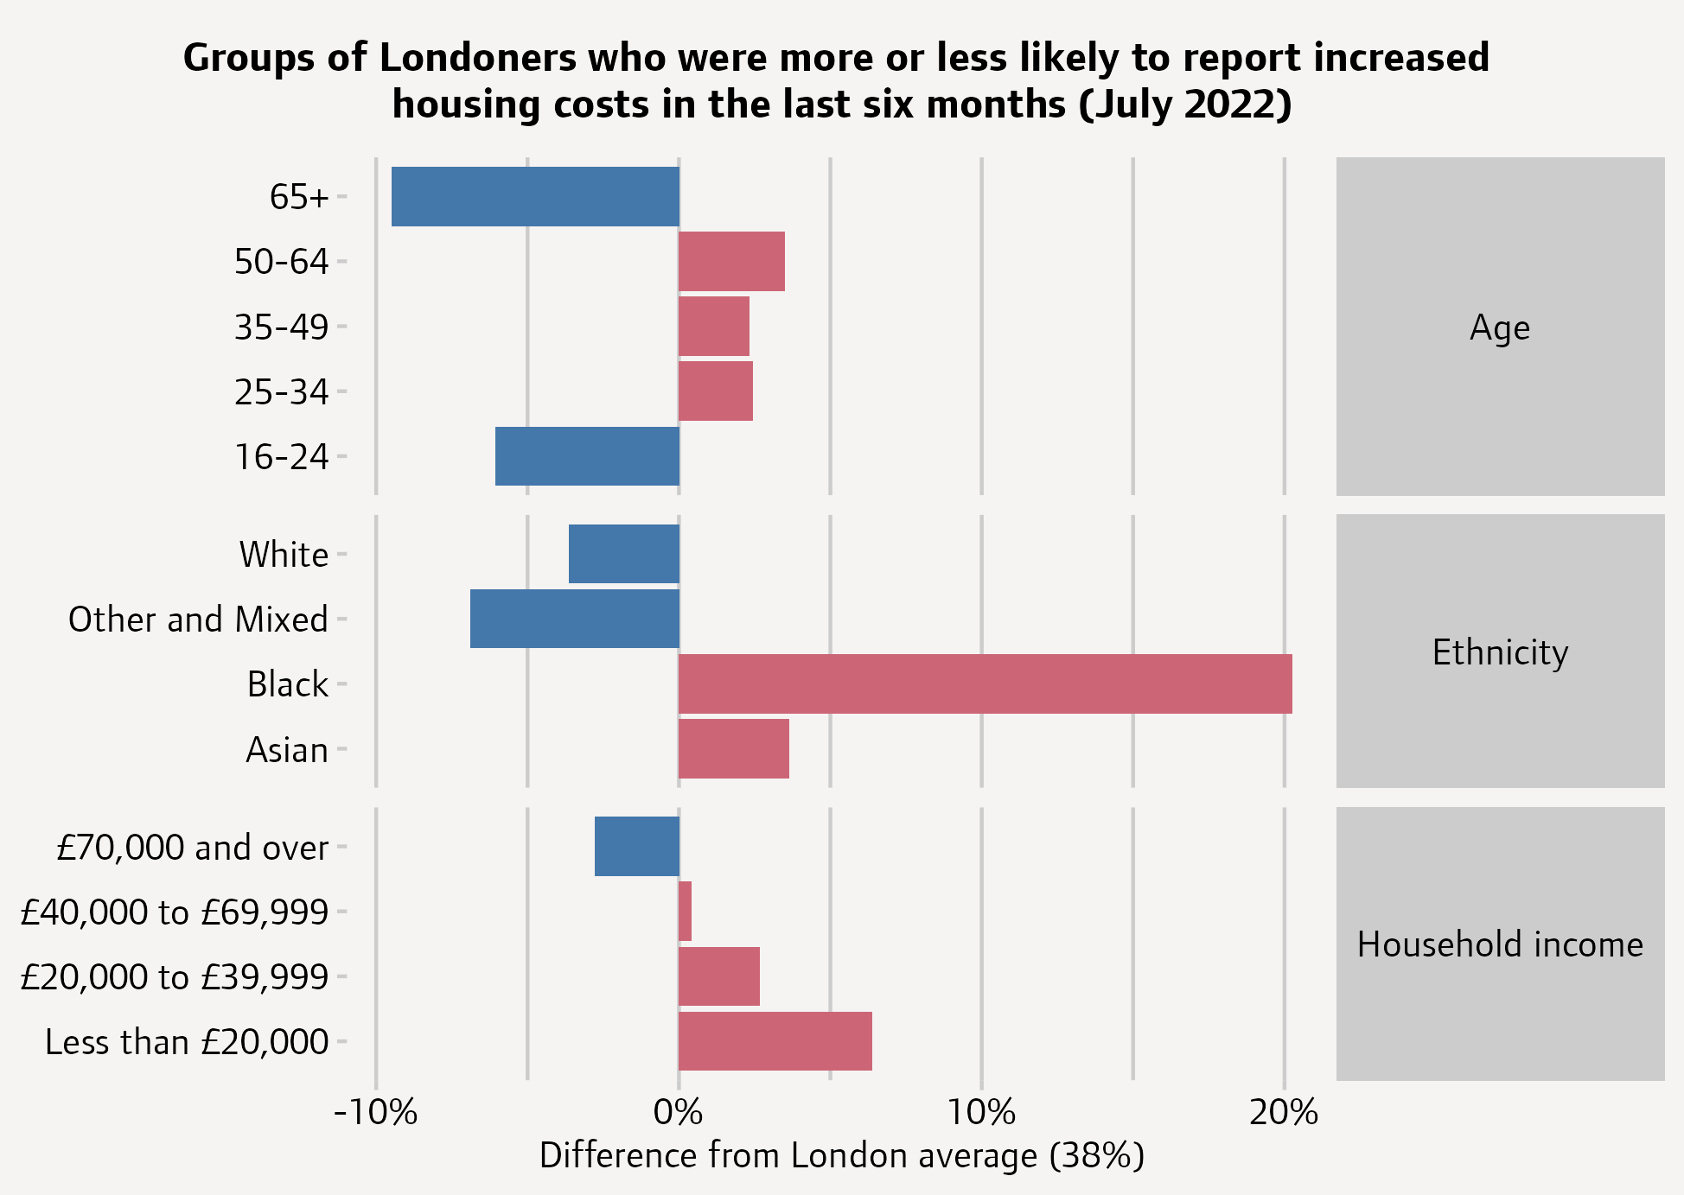
STARK INEQUALITIES EVIDENT IN HOUSING COSTS RELATING TO ETHNICITY AND INCOME
Fig. 15. Inequalities in increased housing costs, 2022
In July 2022, 38% of the Londoners surveyed by YouGov on behalf of the GLA said that their housing payments had increased a little or a lot in the last six months.
There are stark inequalities between different groups of Londoners; 58% of Black Londoners said in July that their housing costs had increased in the previous six months. This is probably due, in part, to a lower home ownership rate, as homeowners were less likely to report cost increases (27%) than renters (53%). Asian Londoners were also more likely to report increased housing costs, with 42% giving this response.
There was a clear difference by income, with 44% of those on the lowest incomes reporting that their housing costs had increased recently.
Source: GLA Housing in London, 2022. All figures, unless otherwise stated, are from YouGov Plc. Total sample size was 1245 adults. Fieldwork was undertaken between 15th - 20th July 2022. The survey was carried out online. The figures have been weighted and are representative of all London adults (aged 18+).

Slide 26
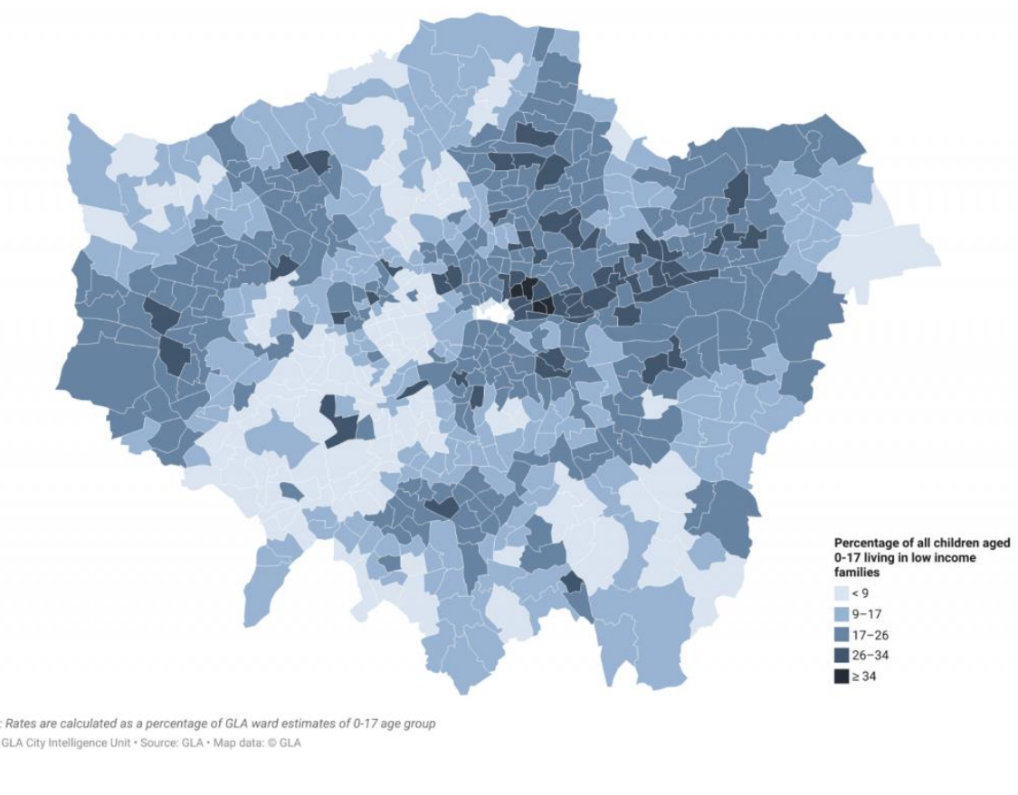
2 IN 5 CHILDREN IN LOW INCOME FAMILIES LIVE IN POVERTY WHEN HOUSING COSTS ARE INCLUDED
Data from previous years, informs us that nearly 40% of London’s children in low-income households are likely to be living below the poverty line (using the relative poverty after housing costs measure).^{1,2}
Modelled estimates of children living in low-income families indicate that 17% of London’s children overall were living in poverty before taking housing costs into account in 2020/21.^{1,2}
  Estimates for small areas highlight some of the areas in London where the issue of child poverty is most acute, most notably some of the wards in Tower Hamlets and Camden.
The Survey of Londoners 2021-22 found that 14% of parents had children who had experienced food insecurity in the past 12 months (around 300,000 children).³
Groups of parents more likely to have children in food insecurity included; Black parents, disabled parents, nondegree educated parents and single parents.
Due to methodological difficulties in data collection in the pandemic, there is increased data uncertainty and more detailed characteristics of the data have not been published. There are no published poverty estimates for London for 2020/21
Fig. 16. Percentage of children under 18 living in low-income families, London wards, 2020/21
Source: : (1) London Datastore – Poverty in London 2020/21 (2) London Datastore – Economic Fairness (3) GLA, Survey of Londoners 2021-22

Slide 27
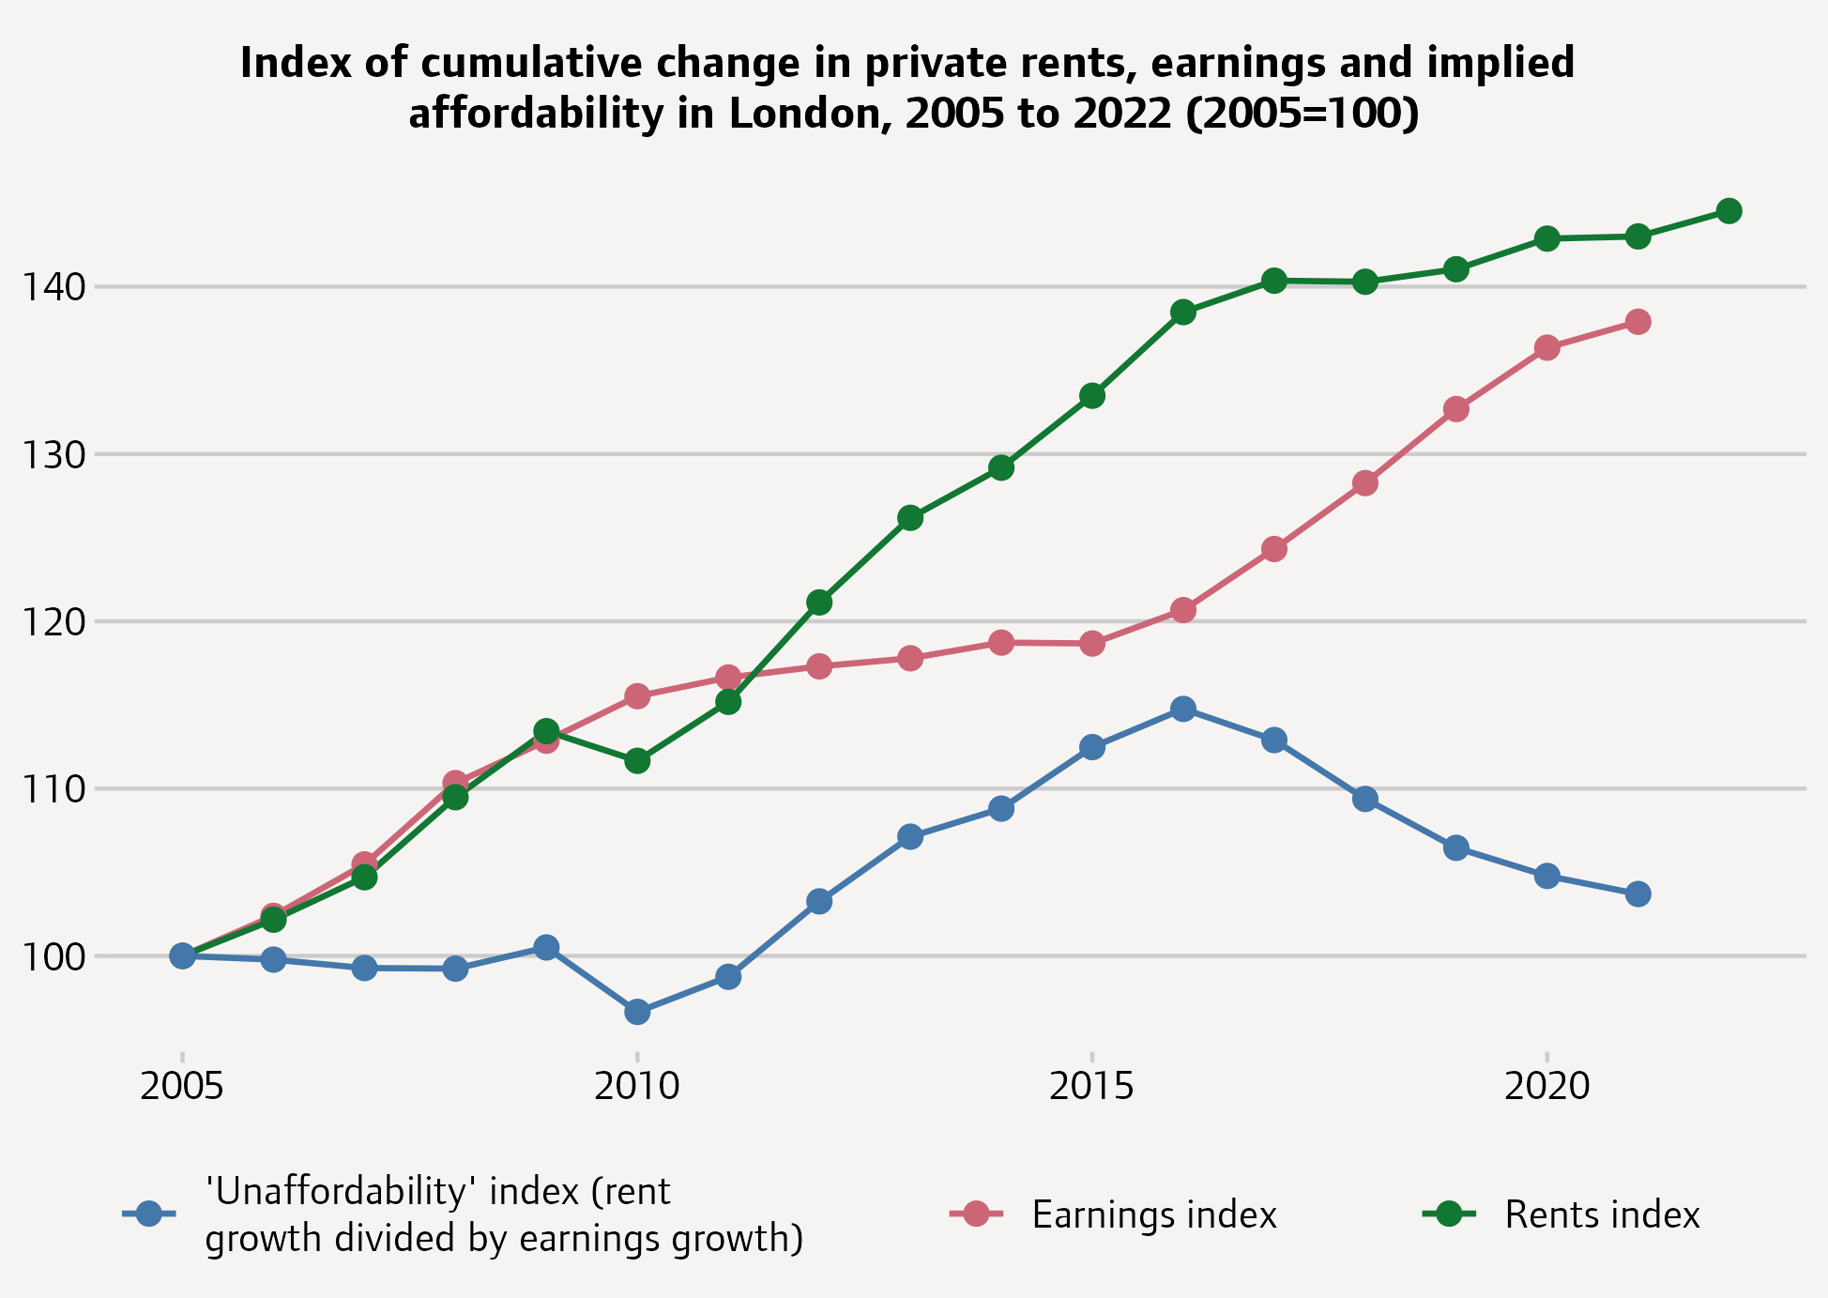
AVERAGE PRIVATE RENTS RISING MORE THAN EARNINGS MAKING HOUSING LESS AFFORDABLE
The ‘unaffordability’ index shown here is cumulative change in rents divided by cumulative change in earnings.
Between 2005 and 2016 average private rents in London rose by more than earnings, leading to worse affordability.
Following this, rents have been relatively stable in nominal terms, while earnings have increased, bringing affordability back towards where it was at the start of the 2010s.
However, it is important to note that the data displayed here does not yet reflect the rapid increases in advertised rents in 2021 and 2022.
Fig. 17. Implied affordability in London, 2005-22
Source: GLA Housing in London, 2022

Slide 28
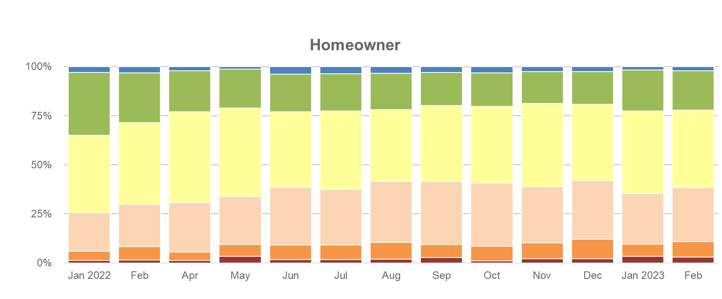

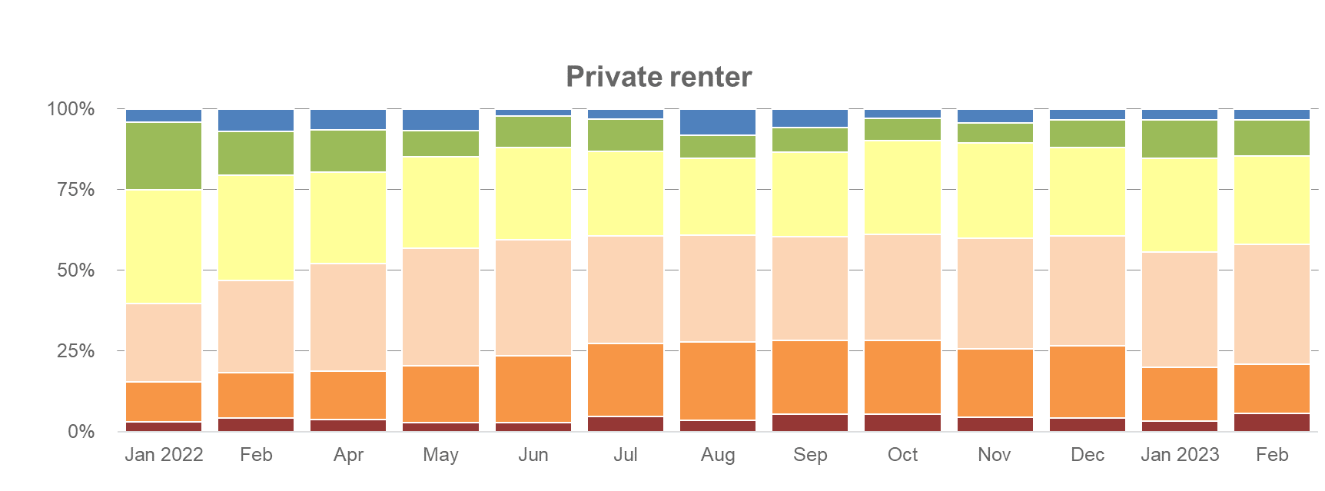
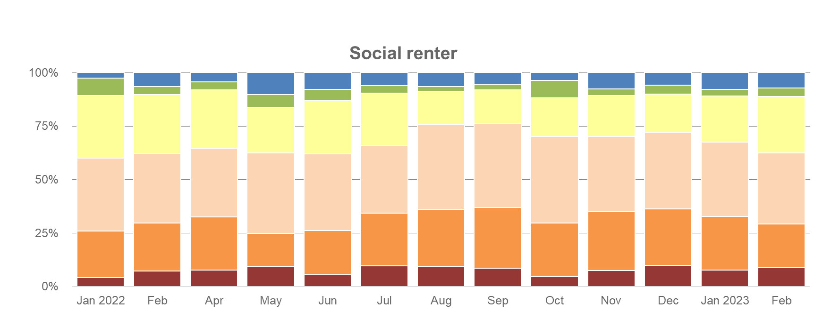
PRIVATE AND SOCIAL HOUSING TENANTS FACING GREATEST DIFFICULTY AFFORDING BASIC NEEDS
Fig. 18. Self-reported financial situation of Londoners by housing tenure, Jan 2022- Feb 23
London has the highest rates of poverty after housing costs in England.¹
Over the course of 2022-23 more and more Londoners, particularly private and social tenants, reported that they are struggling to make ends meet or to afford basic needs.²
In January 2022, 6% of homeowners, 16% of private renters and 26% of social housing tenants said they were struggling to make ends meet or pay for basic needs. The financial situation of Londoners deteriorated over the following year, and, by February 2023, this had risen to 11%, 21%, and 29% respectively.
In February 2023, 62% of social renters and 58% of private renters said that they were just about managing, struggling or unable to meet their basic needs, whereas most homeowners said they were coping or comfortable financially, at 62%.³
Don't know/prefer not to say
I am comfortable financially
I am coping okay financially
I am just about managing
I'm struggling to make ends meet
I am having to go without my basic/needs and/or rely on debt to pay for my basic needs
Source: (1) IHE Evidence Review: Housing and Health Inequalities, (2), GLA Housing in London, 2022, (3) GLA/YouGov cost of living polling. The homeowner category includes mortgaged owners, outright owners and shared owners.

Slide 29
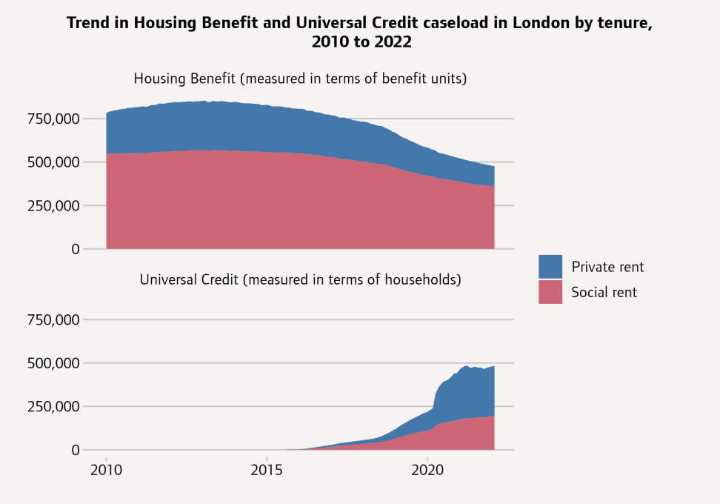
STEEP INCREASE IN WELFARE BENEFITS, PARTICULARLY AMONG PRIVATE RENTERS
Fig. 19. Trend in Housing Benefit and Universal Credit caseload by tenure
The number of Housing Benefit and Universal Credit (with a housing costs component) recipients in London was broadly consistent in the years preceding 2020 with a steep increase due to the economic impacts of the pandemic. This increase was predominantly among private tenants.
In January 2020 there were 808,000 recipients in London, but by January 2021 this figure had risen to 995,000. A year later the total was only slightly smaller at 968,000, and whilst claims had reduced, they have more recently (since Autumn 2022) been showing signs of increase again.
In January 2020 there were 271,000 private renting recipients, but this figure increased to 423,000 in January 2021 then fell back only slightly to 405,000 in January 2022. Over the same period the number of social renting recipients rose from 531,000 to 554,000.
Universal Credit has accounted for the vast majority of new cases since its full-service roll-out in 2016, and it now makes up nearly half of all housing cases in London.
Source: GLA Housing in London, 2022 - Compiled by GLA from: 1998 to 2001: UK Housing Review and 2002 to 2022 DWP, Housing Benefit caseload statistics and Stat Xplore. Housing Benefit recipients are measured in terms of benefit units and Universal Credit recipients in terms of households. Chart excludes a small number of cases where the tenure is unknown.

Slide 30
PART 5: GAPS AND LIMITATIONS IN AVAILABLE DATA
HOUSING AND HEALTH INEQUALITIES IN LONDON

Slide 31
GAPS AND LIMITATIONS IN AVAILABLE DATA
Whilst there is significant data available in the public domain on housing in London, there are some noteworthy gaps and limitations.
Supported and Specialist Housing: There is a notable absence of data available on housing for people with complex needs, disabilities, and other forms of supported and specialist housing. This has been identified as a priority future area of focus within the Housing Evidence Review.
Overheating: In addition, there is a lack of granular data available in the public domain on overheating in London, particularly relating to affected areas or populations due to housing stock, and associated risks.
Housing Benefits: There are notable gaps in local data on recipients of Housing Benefits, which would require accurate population denominators – a recognised challenge in London.
Inclusion Health Groups: There are gaps in available data on the specific accommodation and health inequalities issues experienced by particularly socially excluded population groups, such as migrants in vulnerable circumstances, sex workers, and Gypsy, Roma and Traveller communities. This would require more systematic and consistent data collection, recording, and coding of data of key inclusion health groups across systems.
Damp and mould: The Research Briefing Health Inequalities: Cold or Damp Homes provides an overview of existing data inequalities in risk of damp and mould exposure in the home. Our estimate from the English Housing Survey data is that there are just under 20,000 homes in London with HRSS Category 1 hazard damp and mould.¹ More granular and up to date data on this issue would be beneficial.
Age: Whilst the Survey of Londoners provides some breakdown of self-reported housing quality by age, and the DWP have previously demonstrated that younger people may be more impacted by inequalities in housing affordability, further data on housing and health inequalities in relation to age would be beneficial.
ICS Geographies and whole-system data sharing: Partnership action could be used to identify means of accessing more novel and timely data, and to establish more integrated and linked datasets between heath and care, and housing, as a key determinant of health. This could incorporate collaborative consideration of how existing housing datasets correlate to the newly-formed ICS geographies in London.
Limitations in relevancy: Some rich housing data sources have a substantial lag, which impacts their relevancy. For example, the English Housing Survey comes with a notable time lag, and the pandemic has impacted the accuracy of this as a data source.
Source: (1) DLUHC English Housing Survey

