Slide 1
Housing and Health – ICS Profile
January 2025

Slide 2
Contents
Introduction
ICS Snapshots
Housing Quality
Housing Security
Housing Affordability
Annex (Data summary and list of figures)

Slide 3
Introduction

Slide 4



Context
Access to adequate accommodation plays a pivotal role in determining health across the life-course. A good quality, secure and affordable home is the foundation that everybody needs to lead a healthy life.¹
Despite this, housing is a major driver of poor health outcomes in London, and recent research estimates that the per annum cost to the NHS of poor housing in London is £100.1m. ²
The effects of poor housing are not felt equally across society; minority ethnic groups,³ people experiencing deprivation, and groups facing social exclusion, such as Inclusion Health groups, are all at greater risk of poor health outcomes associated with inadequate accommodation.⁴
Sources: (1) IHE, Evidence Review: Housing and Health Inequalities in London, 2022 (2) The Cost of Poor Housing in London, GLA. November 2023 (3) GLA Housing and Land, Housing and race equality in London: An analysis of secondary data, March 2022.
(4) IHE, Evidence Review: Housing and Health Inequalities in London, 2022 and GLA Housing and Land, Housing and race equality in London: An analysis of secondary data, March 2022

Slide 5
Who is this for?
Whilst people working in Integrated Care Systems (ICSs) and Integrated Care Boards (ICBs) will be aware of the broad impacts housing has on health, this resource provides more information around the specific housing issues that are driving health inequalities, and healthcare usage, within their area.
This resource presents key housing data for London at sub-regional ICS geography and borough level. The data is presented across the three narrative themes of housing quality, security, and affordability.
We hope this will support your work to understand, mitigate and tackle the key housing-related issues that drive poor health in London.
We have made suggestions at the end of each section for how this resource can be used both in practice and as a starting point for further action.
For more information, please contact SocialEvidence@london.gov.uk (Data Analysis) and/or GLAPublicHealthInbox@london.gov.uk (Public Health).

Slide 6

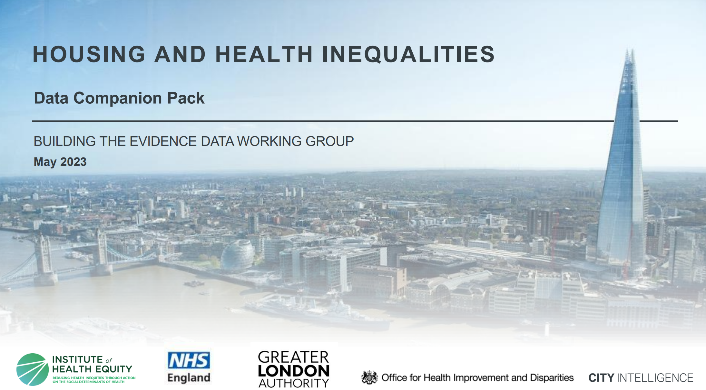
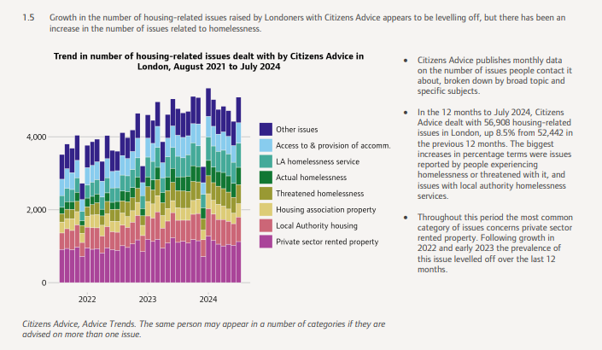
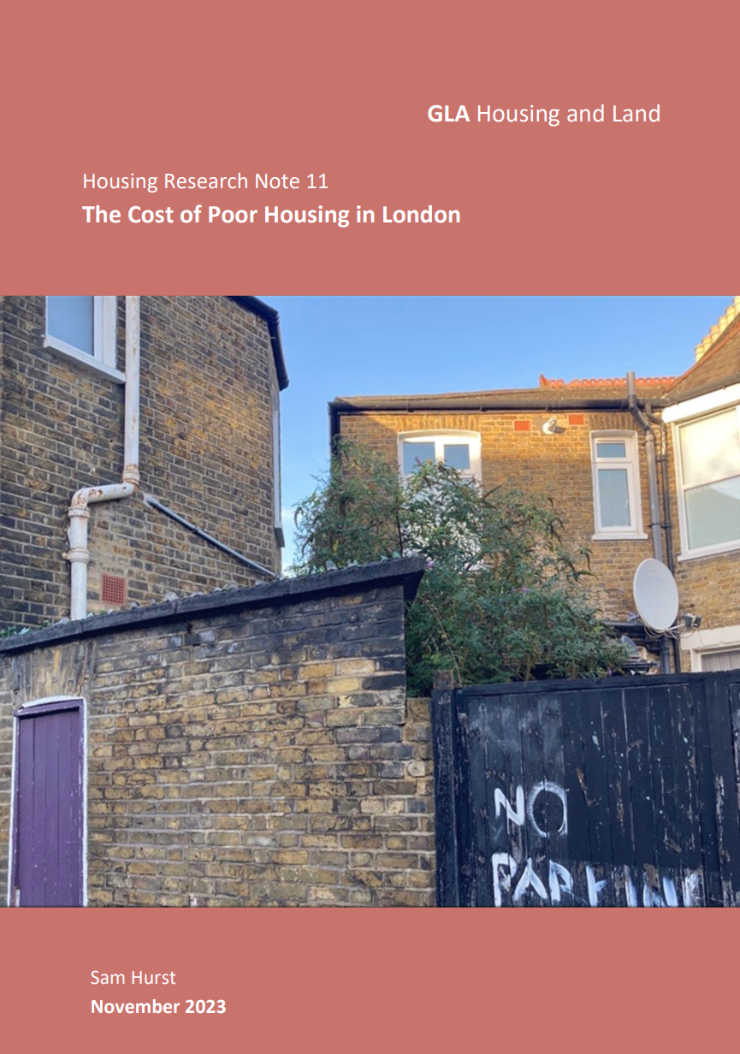
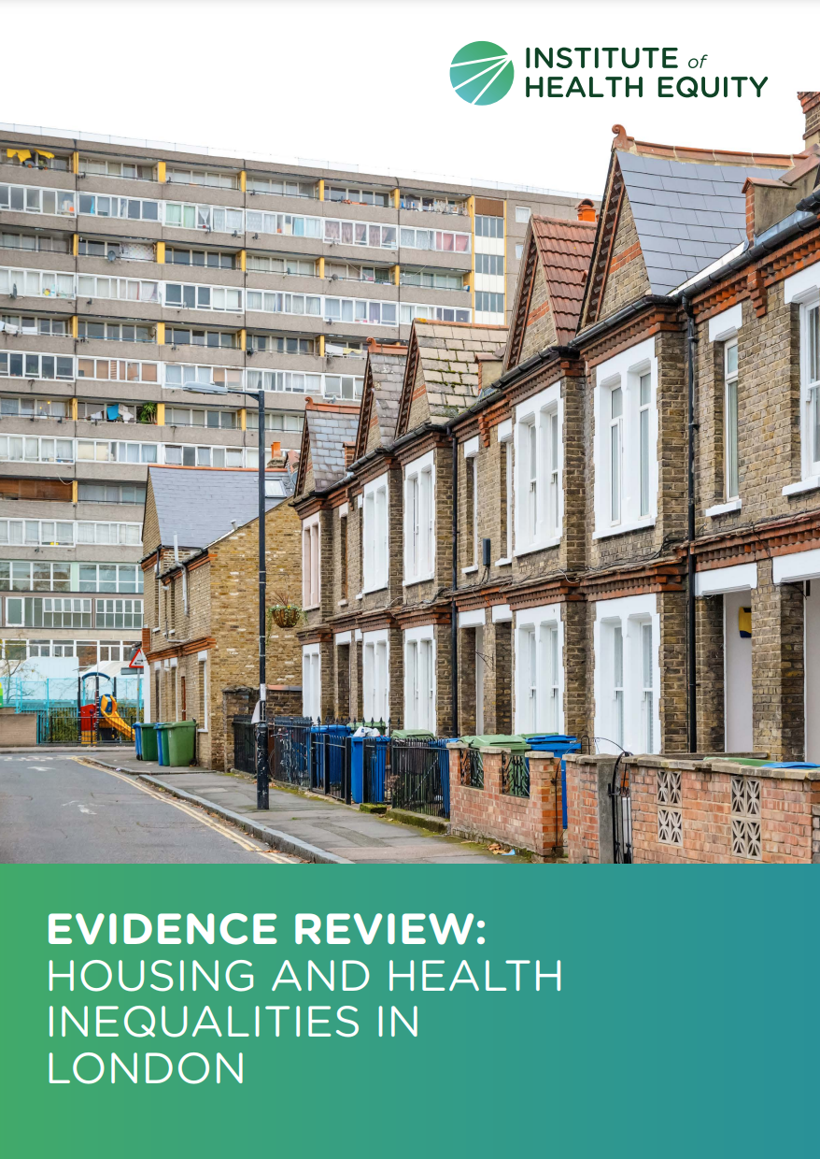
This data companion pack is a resource intended to frame and be read alongside the IHE Evidence Review. The resource provides intelligence and context on the housing and health inequalities in London only.
Useful complementary resources
The resource is intended to be complementary to other reports, including those outlined below:
Housing in London annual report (GLA)
Evidence Review: Housing and Health Inequalities in London (IHE)
Data Companion Pack: Housing and health Inequalities in London (GLA, OHIS, NHSE, IHE)
Cost of poor housing in London (GLA)
The annual ‘Housing in London’ report is the evidence base for the Mayor’s housing policies, summarising key patterns and trends across a wide range of topics relevant to housing in the capital.
This research note estimates the annual cost to the NHS of homes in poor condition in London. It also estimates the cost of repairing all the homes in London that are in poor condition, calculating how long it would take the savings to pay off the repair costs.
This rapid evidence review considers the evidence for housing interventions that support health and that can contribute to reducing health inequalities

Slide 7
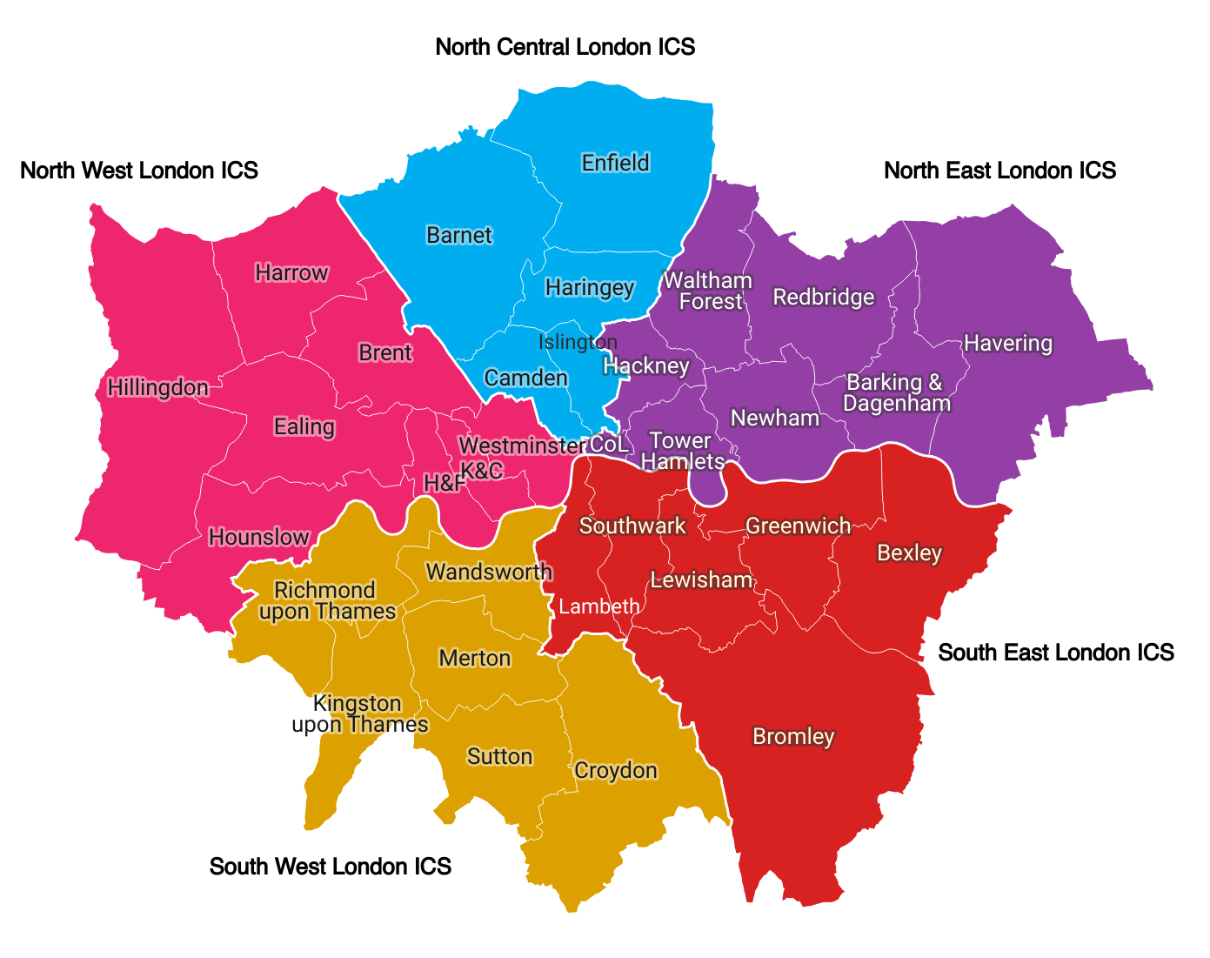
Sub-regional data breakdowns
The data included in this report is the most recent available at the time the report was written (December 2024).
This report aims to provide a sub-regional profile of housing and health in London.
Where available, data is broken down by ICS and local authority (LA). In some cases, LSOA-level data is presented.
In some cases, data is available by local authority but cannot be aggregated to ICS level. This is typically due to double-counting between authorities, meaning that they cannot be added together.
The following acronyms have been used throughout this report:
  ICS – Integrated Care System
  NCL – North Central London
  NEL – North East London
  NWL – North West London
  SEL – South East London
  SWL – South West London
  H&F – Hammersmith and Fulham
  K&C – Kensington and Chelsea
  CoL – City of London
  TA – Temporary Accommodation

Slide 8

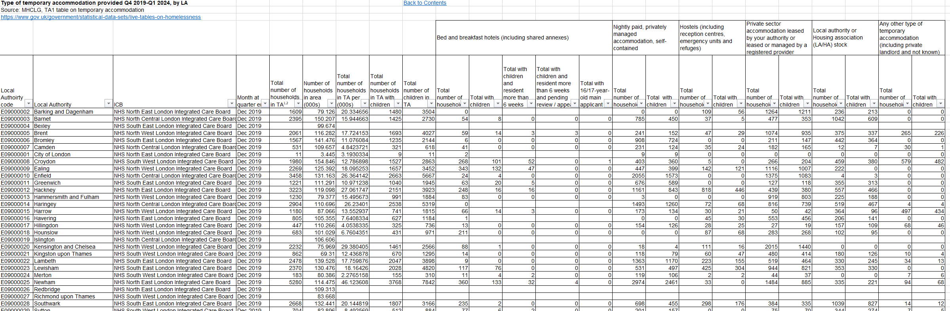
Housing profile data summary (workbook 1)
Want to explore the data in more detail?
Why should I use the data summary?
By using the data summary, you can find further information on the key themes of housing quality, housing security and housing affordability such as:
  Trends over time
  Different geographical breakdowns
  Alternative metrics
  See the Annex for full detail of the data summary and figures.
How do I use the data summary (workbook 1)?
For example, if you are looking for further information on temporary accommodation provided by local authorities in London ICSs, you can find the data in the data summary. This will enable you to answer further questions such as:
  How has the number of households placed in temporary accommodation changed over time?
  How do the local authorities differ in my ICS?
  How many households with children are placed in hostels in local authorities within my ICS?
Lookout for this popout box on the slides which outlines where further data can be found in the data summary.

Slide 9
ICS Snapshots
The following slides contain one-page visual summaries for each ICS

Slide 10
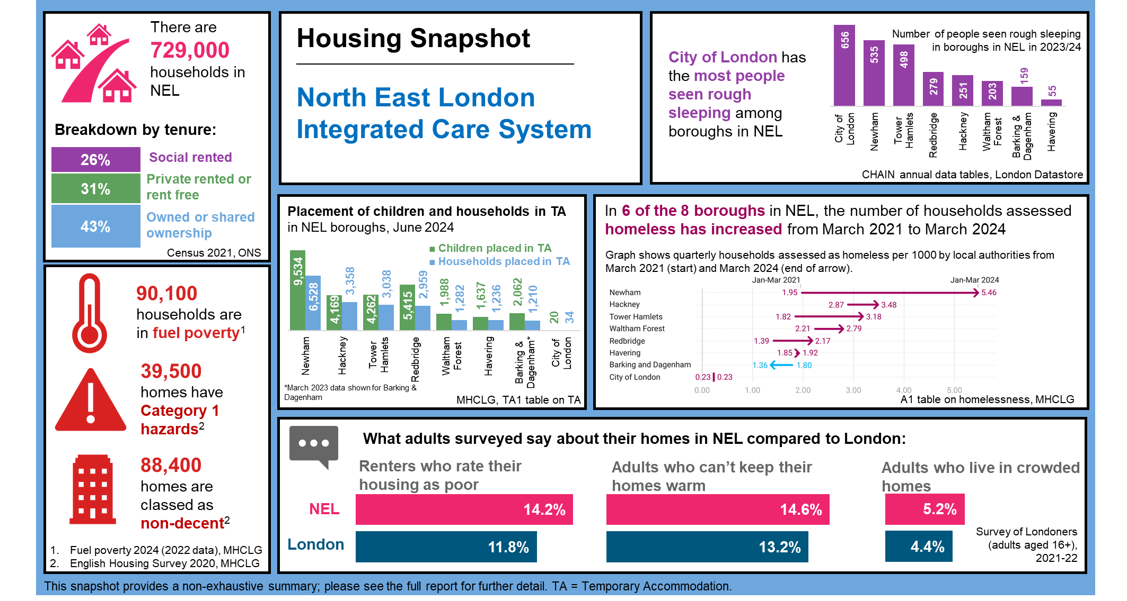

Slide 11
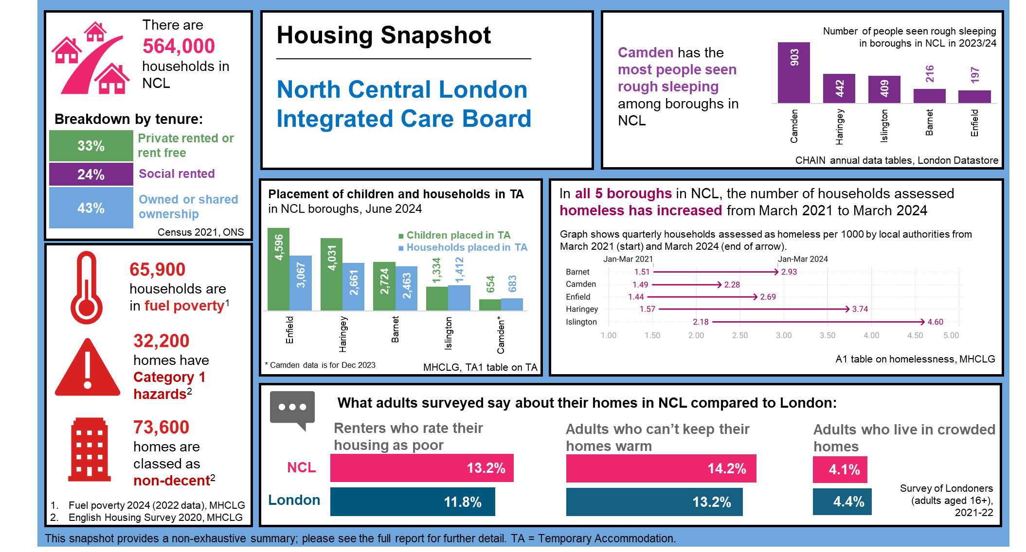

Slide 12
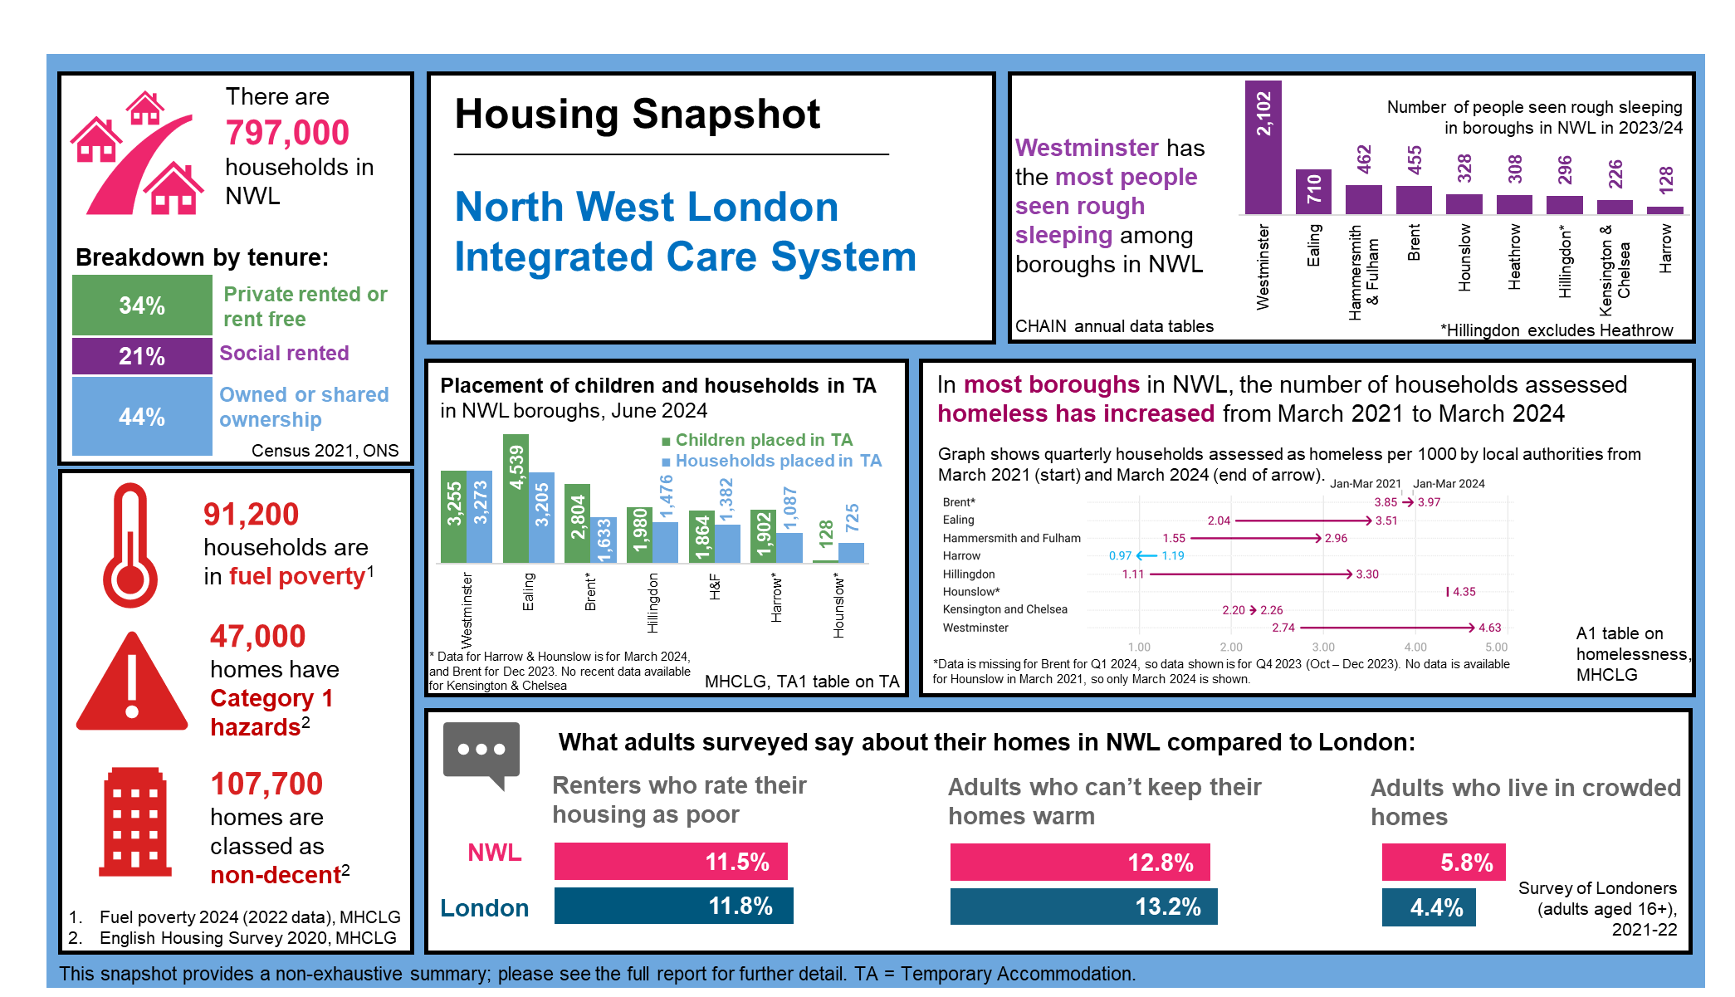

Slide 13
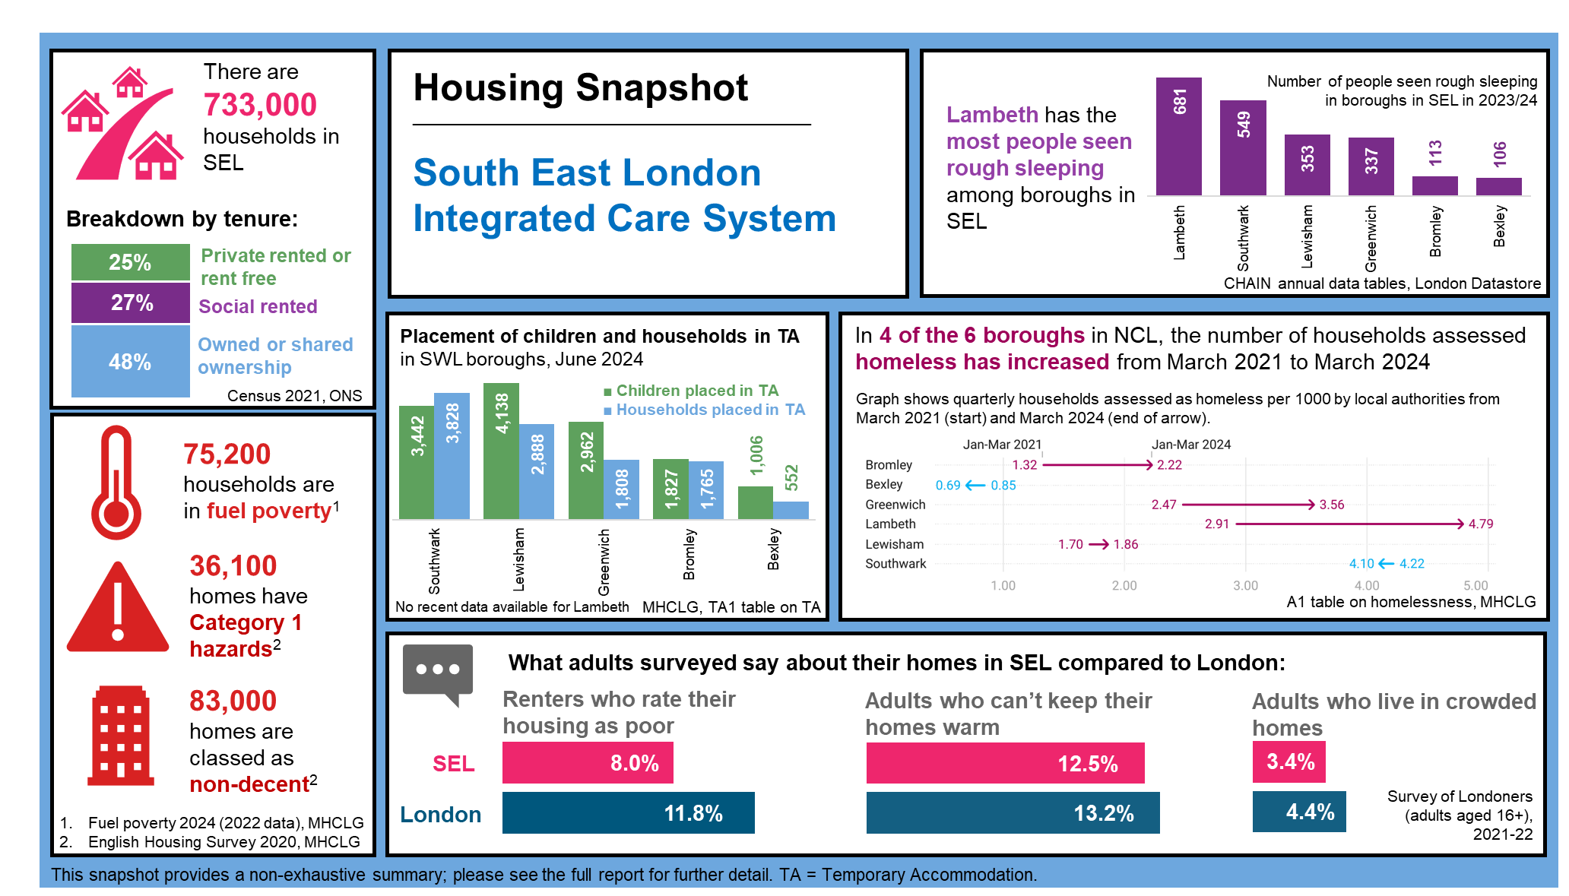

Slide 14
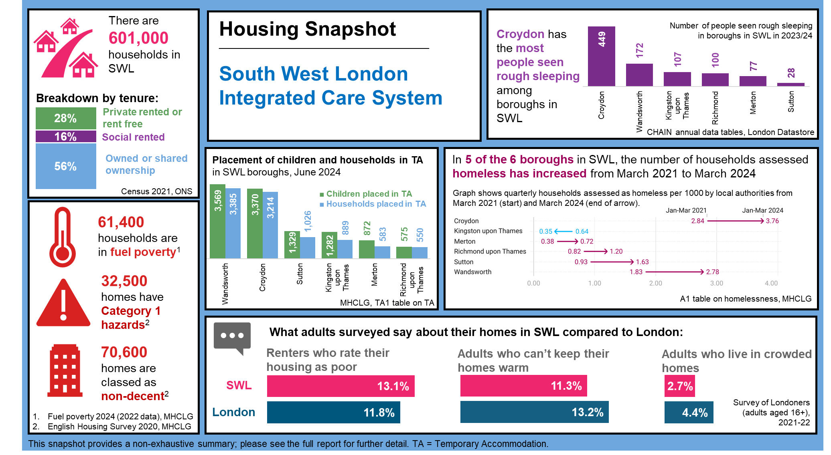

Slide 15
Housing quality

Slide 16



The health impacts of housing quality in London (1/2)
The quality of housing in London impacts health in a myriad of ways, both in terms of direct impacts, such as increased prevalence of respiratory conditions related to damp & mould, and by placing pressures on health services and systems from related falls, accidents, respiratory, cardiovascular, and mental health causes.¹
Housing quality also drives health inequalities. Poor housing conditions are not felt equally across ethnic groups; Londoners of Asian ethnicity are more likely to live in non-decent homes, and Black Londoners are more likely than people of other ethnicities to have damp problems in their homes.​²
Six groups of people have been identified as typically at greater risk of harm from their housing conditions: those with dependent children; those registered disabled; those in receipt of means-tested benefits; those aged over 65; recent migrants; and those on a low income and not receiving benefits.³​
Sources: (1) IHE, Evidence Review: Housing and Health Inequalities in London, 2022 (2) GLA Housing and Land, Housing and race equality in London: An analysis of secondary data, March 2022. (3) Rhodes and Rugg (2018). Vulnerability amongst Low-Income Households in the Private Rented Sector in England. Centre for Housing Studies, University of York, UK: York

Slide 17






The health impacts of housing quality in London (2/2)
Please see summaries below of the housing quality issues covered in the following slides, and their impacts on health. ​
Tenure profile: There is a higher proportion of private renters in London than the rest of the UK. Private rented homes are evidenced to impact both physical and mental health, both in terms of the stress caused by insecure tenure, and because privately rented homes are more likely to fail to meet the decent homes standard.¹
Overcrowding: Overcrowding is linked to poor physical and mental health outcomes, including higher rates of infectious disease transmission, and higher levels of depression and stress. Living in an overcrowded home is associated with lower educational attainment for children.^{1​}
Homes that fail to meet the Decent Homes Standard (DHS): Homes that fail to meet the DHS have evidenced negative impacts on health, whether these are cold homes impacting cardiovascular health, trip and fall hazards, or other poor conditions.¹
Cold homes: Cold homes adversely affect child development, can cause and worsen respiratory conditions, cardiovascular diseases, poor mental health, dementia and hypothermia, and it is estimated that 1 in 5 excess winter deaths is due to cold homes.¹
Damp and mould: inhaling mould spores can cause allergic type reactions, the development or worsening of asthma, respiratory infections, coughs, wheezing and shortness of breath. Some groups are at greater risk than others, including infants and older adults, or those with underlying conditions.²
Overheating: Overheating increases strain on the cardiovascular and respiratory systems - which are the main causes of illness and death during a heatwave - and hyperthermia, heat exhaustion and heat stroke. Young children and the elderly are among the most vulnerable.¹
Sources: (1) IHE, Evidence Review: Housing and Health Inequalities in London, 2022 (2) House of Commons, Health Inequalities: Cold or Damp Homes, 2023

Slide 18
There is a higher prevalence of renters in London compared to England
Data summary: see sheet tenure_ics and tenure_la for full data on tenure in London.
Fig 1. Proportion of households by grouped tenure, 2021
When compared to England, London has a very different tenure profile. Renting is more prevalent, and outright ownership is less prevalent in London compared to England.
Within London, SWL had the greatest proportion of property ownership with 56% owning or having shared ownership of a property. This compared to 43% in NEL and NCL.
NWL has the greatest proportion of households renting privately or living rent free at 34%, compared to 25% in SEL.
Table 1. Number of households by detailed tenure, 2021
ICS | Owned or shared ownership |  |  | Social rented |  | Private rented or lives rent free |  |  | Total
ICB | Owns outright | Owns with a mortgage or loan | Shared ownership | Rents from council or local authority | Other social rented | Private landlord or letting agency | Other private rented | Lives rent free | Total
NCL | 114,895 | 119,222 | 6,979 | 83,322 | 53,796 | 171,471 | 13,089 | 1,411 | 564,185
NEL | 130,317 | 172,280 | 13,491 | 101,919 | 88,269 | 204,859 | 16,218 | 1,485 | 728,838
NWL | 172,907 | 169,308 | 12,088 | 81,589 | 87,669 | 249,093 | 22,765 | 1,625 | 797,044
SEL | 143,389 | 195,431 | 12,467 | 101,442 | 98,775 | 165,877 | 14,574 | 1,125 | 733,080
SWL | 148,551 | 182,254 | 7,470 | 45,639 | 48,538 | 155,077 | 12,506 | 707 | 600,742
Source: Tenure, ONS Census 2021.
Note: Categories in Fig 1 are combined as follows: Owned or shared ownership (Owns outright, Owns with a mortgage or loan, Shared ownership), Social rented (Rents from council or local authority, Other social rented) and Private rented or lives rent free (Private landlord or letting agency, Other private rented, Lives rent free).

Slide 19
Housing quality can be measured by the Decent Homes Standard and Health and safety rating system
Data summary: see sheets decent_homes_ics and hhsrs_cat1_ics for the full data.
Non-decent homes
Adequate housing quality can be measured by the four components of the Decent Homes Standard; be free of hazards, in good repair, with modern facilities and energy-efficient. Increasing the number of homes that achieve the Decent Homes Standard, particularly in the private rented sector, is vital to improving health and reducing health inequalities. In London, 12.0% of dwellings are classed as non-decent compared to 15.6% in England.
Category 1 hazards
Housing health and safety rating system (HHSRS) Category 1 hazards pose the most severe risk and are characterised by their immediate and severe threat to life and wellbeing. Where these exist in a home, it fails to meet the statutory minimum standard for housing in England. In London, 5.3% of dwellings have Category 1 hazards, compared to 9.2% in England.
Fig 2. Number of non-decent dwellings, 2020
Percentage of total dwellings in ICS shown in brackets
Fig 3. Number of dwellings with Cat 1 hazards, 2020
Percentage of total dwellings in ICS shown in brackets
Sources: (1) MHCLG, English Housing Survey
Note: Data has been aggregated from local authority level, so where there was suppression or missing data at local authority level this will have impacted the ICS totals. Figures are rounded to nearest 100 and percentages to the nearest percent..

Slide 20
The private rented sector has the highest proportion of non-decent homes in all London ICSs
Data summary: see decent_homes_tenure_la sheet for further breakdowns by local authority.
Fig 4. Proportion of non-decent dwellings by tenure, 2020
The private rented sector has the greatest proportion of non-decent dwelling across all ICSs in London, followed by social rented and with owner occupied at the lowest.¹
The proportion of dwellings which are non-decent is greater in England compared to London for owner-occupied (England: 13.8%, London: 7.9%) and private rented dwellings (England: 22.9%, London: 20.0%). For the social sector, the proportion is similar (England: 11.2% , London: 11.8%).¹
It's important to note that the impacts of poor housing standards are not felt equally between different ethnic groups: Londoners of Asian ethnicity are more likely to live in homes that fail to meet the Standard, and Black Londoners are more likely than people of other ethnicities to have damp problems in their homes.²
The Institute for Health Equity (IHE) have identified six groups of people typically at greater risk of harm from their housing conditions: those with dependent children; those registered disabled; those in receipt of means-tested benefits; those aged over 65; recent migrants; and those on a low income and not receiving benefits.²
Table 2. Number of non-decent dwellings by tenure, 2020
ICS | Owner occupied | Private rented | Social
NCL | 22,400 | 34,600 | 16,600
NEL | 28,200 | 39,700 | 20,600
NWL | 34,300 | 53,000 | 20,400
SEL | 27,100 | 32,500 | 23,400
SWL | 28,800 | 30,900 | 10,900
Source: MHCLG, English Housing Survey
Note: Data has been aggregated from local authority level, so where there was suppression or missing data at local authority level this will have impacted the ICS totals. Figures are rounded to nearest 100 and percentages to the nearest percent..
Sources: (1) MHCLG, English Housing Survey (2) IHE, Evidence Review: Housing and Health Inequalities in London, 2022

Slide 21
Bungalows followed by flats are the most likely type of dwelling to be non-decent
Data summary: see sheet decent_homes_type_la for further breakdowns by local authority.
Fig 5. Proportion of dwelling that are non-decent by type, 2020
Among different types of homes across all ICSs in London, bungalows and flats are most likely to be non-decent, and houses (detached, semi-detached and terraced) least likely to be non-decent.
Table 3. Number of non-decent dwellings by type, 2020
ICS | Detached | Semi-detached | Bungalow | Terraced | Flats
NCL | 1,700 | 5,400 | 1,200 | 15,300 | 50,000
NEL | 1,200 | 5,300 | 1,900 | 26,400 | 53,600
NWL | 2,600 | 10,300 | 1,600 | 20,900 | 72,300
SEL | 2,500 | 7,000 | 2,300 | 17,000 | 54,300
SWL | 3,700 | 8,400 | 1,800 | 16,800 | 40,000
Source: MHCLG, English Housing Survey
Note: Data has been aggregated from local authority level, so where there was suppression or missing data at local authority level this will have impacted the ICS totals. Figures are rounded to nearest 100 and percentages to the nearest percent..

Slide 22
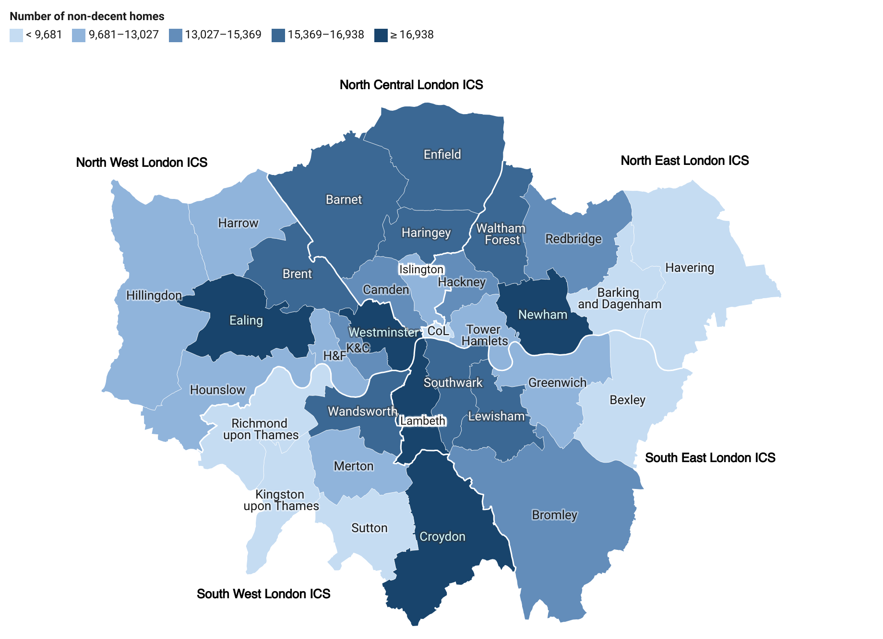
The proportion of dwellings that are non-decent varies by local authority, ranging from 8% to 19%
Data summary: see sheet decent_homes_tenure_la for full data.
Fig 6. Number of non-decent dwellings by local authority, grouped by ICS, 2020
The number of dwelling that are non-decent is greatest in Croydon (20,352), followed by Lambeth (17,444) and Westminster (17,408). The lowest number is in City of London (635), followed by Kingston upon Thames (7,395) and Barking and Dagenham (8,304).
The proportion of dwellings that are non-decent is greatest in Kensington and Chelsea (19%) and Westminster (18%), and lowest in Havering (8%) and Bexley (9%).
The quality of homes across all tenures places demands on healthcare from falls, accidents, respiratory, cardiovascular and mental health causes.²
H&F = Hammersmith and Fulham
K&C = Kensington and Chelsea
CoL = City of London
Source: MHCLG, English Housing Survey
Sources: (1) MHCLG, English Housing Survey (2) IHE, Evidence Review: Housing and Health Inequalities in London, 2022

Slide 23
The private rented sector has the greatest proportion of homes with Category 1 hazards, the most severe hazard category
Data summary: see sheet hhsrs_cat1_tenure_la for further breakdowns by local authority.
Fig 7. Proportion of dwellings with Category 1 Hazards by tenure, 2020
Across all ICSs, the private rented sector has the greatest proportion of Category 1 Hazards, at between 9% and 10%. This compares to Owner Occupied dwelling which are around 3%.
The proportion of dwellings which have Category 1 Hazards is greater in England compared to London for owner-occupied (England: 9.2%, London: 3.3%), private rented dwellings (England: 13.2%, London: 9.7%) and is similar in the social sector, the proportion is similar (England: 5.0% , London: 4.6%).¹
Table 4. Number dwellings with Category 1 Hazards by type, 2020
ICS | Owner occupied | Private rented | Social
NCL | 9,200 | 16,600 | 6,400
NEL | 11,900 | 19,500 | 8,100
NWL | 13,800 | 25,200 | 8,000
SEL | 11,300 | 15,700 | 9,100
SWL | 12,300 | 15,600 | 4,600
Source (all text and figures): MHCLG, English Housing Survey
Note: Data has been aggregated from local authority level, so where there was suppression or missing data at local authority level this will have impacted the ICS totals. Figures are rounded to nearest 100 and percentages to the nearest percent..

Slide 24
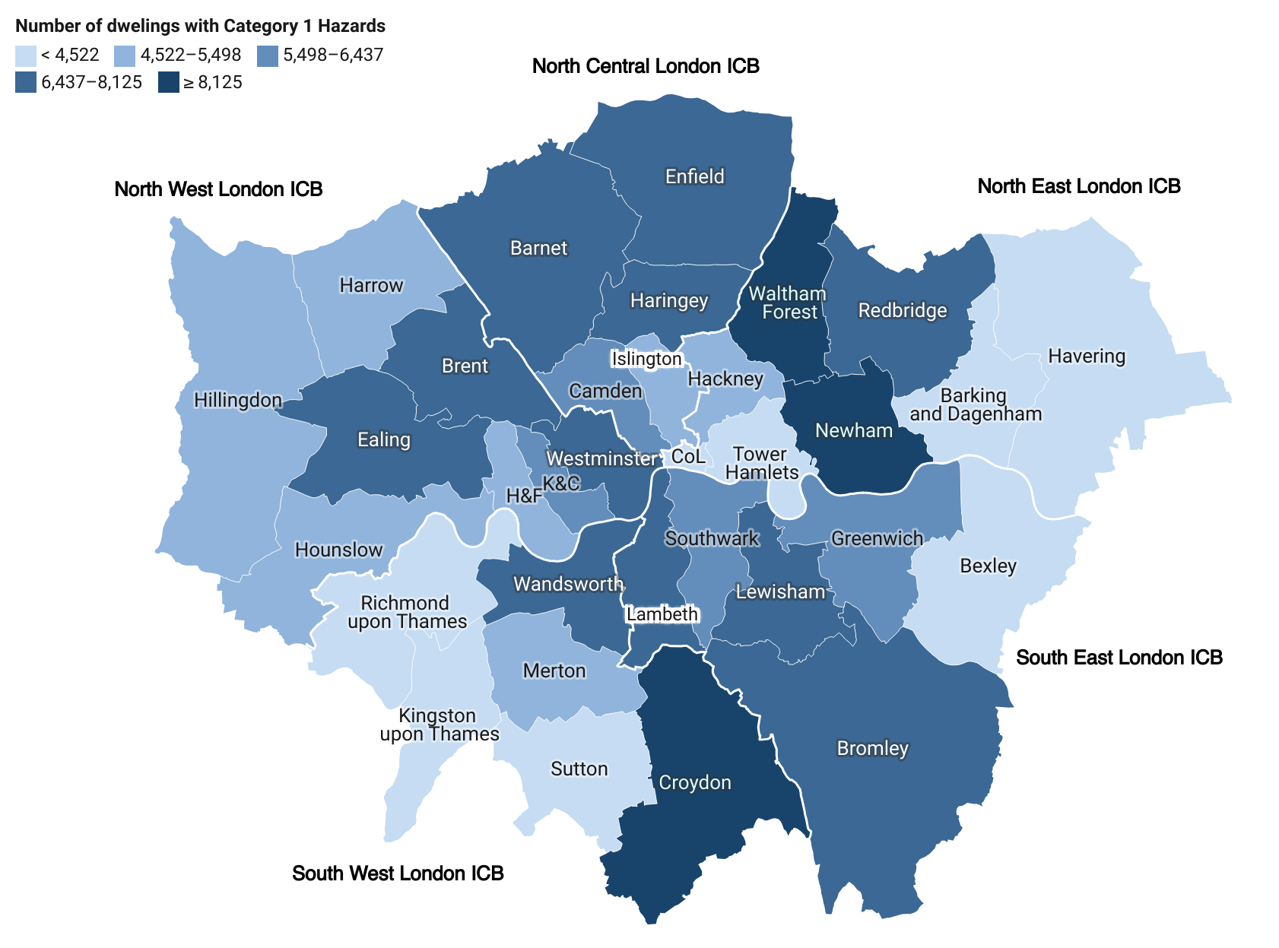
The proportion of dwellings that with Category 1 Hazards varies by local authority, ranging from 2.8% to 8.1%
Data summary: see sheet hhsrs_cat1_tenure_la for further breakdowns by local authority.
Fig 8. Number of dwellings with Category 1 Hazards by local authority, grouped by ICS, 2020
The number of dwellings with Category 1 Hazards is greatest in Croydon (9,822), Newham (8,266) and Waltham Forest (8,125). The number is lowest in City of London (152), followed by Kingston upon Thames (3,347) and Tower Hamlets (3,437).
The proportion dwellings with Category 1 Hazards is greatest in Kensington & Chelsea (8.1%) & Waltham Forest (7.7%), and lowest in Tower Hamlets (2.8%) and City of London (3.0%).
H&F = Hammersmith and Fulham
K&C = Kensington and Chelsea
CoL = City of London
Source: MHCLG, English Housing Survey

Slide 25
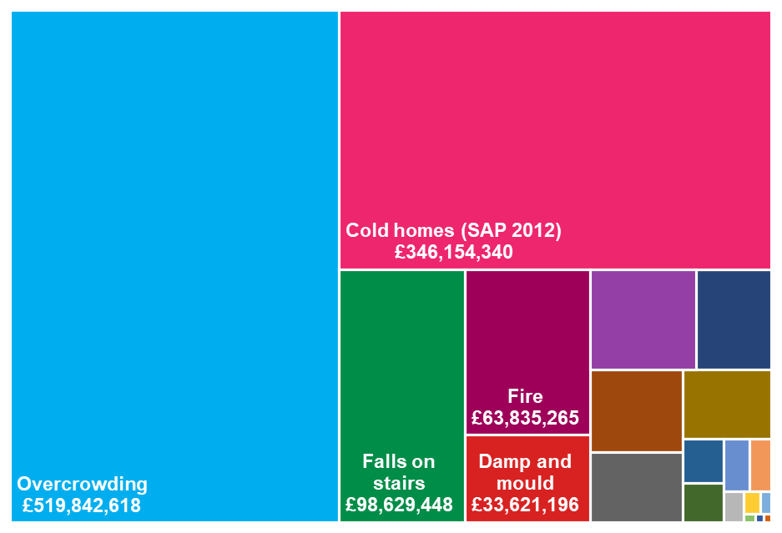
Removing all Category 1 Hazards in homes in London would save the NHS over £100 million in first-year treatment costs alone every year
Category 1 Hazards are costly to the NHS and wider society. In London:
Repairing all HHSRS Category 1 Hazards present in London’s housing would cost £1,203.8m (see Fig 9 for breakdown).
Removing these hazards would save the NHS £100.1m in first-year treatment costs every year.
That means that the cost of the repairs would be repaid in NHS savings in 12 years.
Falls are the most common hazard, and three of the four most common hazards relate to falls. Falls on stairs, between levels, on the level, and associated with baths, comprise 44 per cent of all hazards present in London housing (Fig 10*).
The second most common hazard is cold homes. Fixing London’s cold homes would save the NHS £40.6m per year.
Fig 9. Total cost to repair all hazards in London homes
English Housing Survey 2017 and 2019 data combined
Fig 10. Count of dwellings with HHSRS hazards in London (top 10)
English Housing Survey 2017 and 2019 data combined
* ‘Falls associated with baths’: 1,214 – not in top 10 hazards
Sources: (1) The Cost of Poor Housing in London, GLA (Tables 4 & 6) . November 2023. Uses English Housing Survey Data for 2017 and 2019 pooled and blended to increase the sample size. Research does not account for all risks and costs (e.g. cladding) and does not include societal costs. Equivalent analysis is not currently available at ICS level.

Slide 26
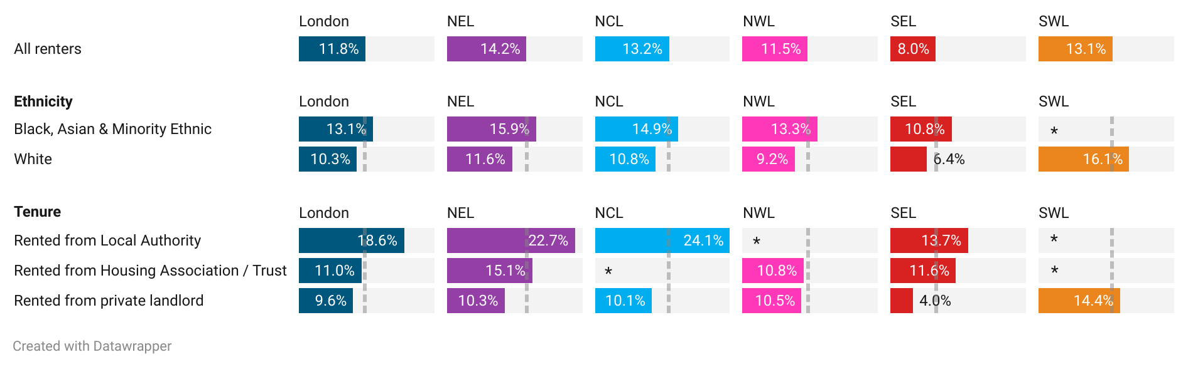
12% of renters in Londoners rated homes as poor quality, rising to 19% for council tenants
Data summary: see sheet poor_housing_ics for full data and sample size of the survey.
Fig 11. Proportion of renters who rate their housing as poor by group for each ICS overall, by ethnicity and landlord type, 2021-22
Dotted lines show average for all renters in area
The 2021-22 Survey of Londoners was an online and paper self-completed survey of 8,630 adults in London. The survey asked private and social tenants to rate the quality of their housing and across both groups in London 12% rated their homes as ‘poor’.
Among the London ICSs, NEL has the greatest proportion of renters who rated their housing as poor in 2020-21 at 14.2%. This compares to SEL where 8.0% rated their housing as poor.
* = sample size too small to display figure (n<100).
The proportion of renters who rate their accommodation as poor varies ICS, by ethnicity and landlord status:
The proportion is highest in NEL (14.2%) and lowest in SEL (8.0%).
A greater proportion of renters with BAME ethnicity rate their housing as poor compared to the ICS average across all ICSs except for SWL where the sample is too in NEL (+2pp), NCL (+2pp), NWL (+2pp) and SEL (+3pp).
A greater proportion of renters in local authority housing rate their housing as poor compared to ICS averages in NEL (+9pp), NCL (+11pp) and SEL (+6pp). The sample size is too small to determine this in NWL and SWL.
Source (all text and figures): Survey of Londoners, GLA.
Note: Internal analysis by ICS and demographics. Base: Renters aged 16 and over (NEL: 1,746, NCL: 582, NWL: 793, SEL: 713, SWL: 493, London: 3,439). Fieldwork took place in Nov 21 with a pre-selected reference group, and some COVID restrictions were introduced after field work began, potentially impacting results. It also took place just before the full effects of the cost-of-living crisis began to set in. It is highly likely that the situations of Londoners have changed while analysis was taking place.

Slide 27
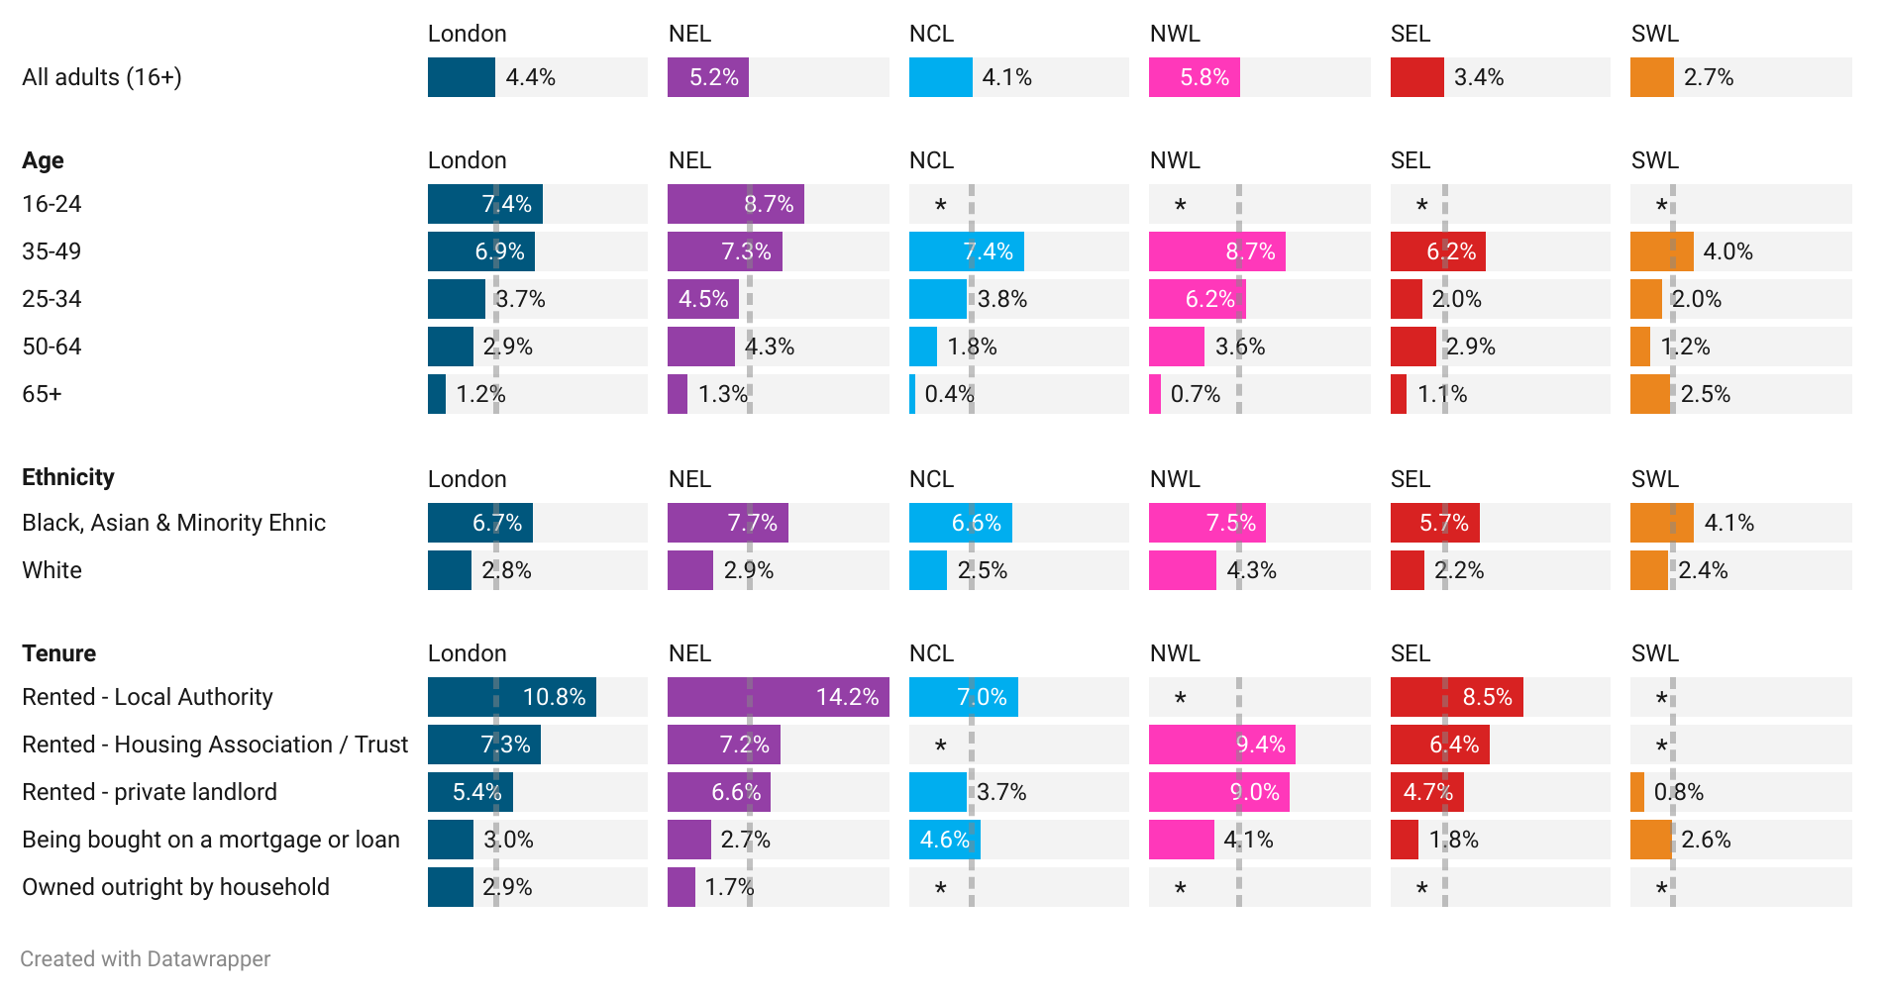
Londoners in social housing and on low income more likely to live in crowded homes
Data summary: see sheet crowded_housing_ics for full data and sample size of the survey.
London has the highest rates of household overcrowding in England. Overcrowding is linked to serious physical and mental health outcomes including infectious disease transmission, stress and depression. Overcrowded homes are also associated with lower educational attainment in children.¹
The proportion who live in crowded homes varies by ICS, age, ethnicity and housing tenure:²
The proportion is highest in NWL (5.8%) and lowest in SWL (2.7%).
A greater proportion of Black, Asian & Minority Ethnic people live in crowded homes compared to the ICS averages (NEL: +2pp; NCL +3pp; NWL: +2pp; SEL +2pp; SW: +1pp).
A greater proportion of people renting from their local authority live in crowded conditions compared to the ICS average for NEL (+9pp), NCL (+3pp) and SEL (+5pp).
A lower proportion of people aged 50-64, and 65+, rate as crowded compared to the ICS average.
Fig 12. Proportion of adults living in crowded homes by group for London and each ICS, 2021-22
Dotted lines show average for all adults in each area
* = sample size too small to display figure (n<100).
Source (1) IHE, Evidence Review: Housing and Health Inequalities in London, 2022 (2) (remaining text and figures): Survey of Londoners, GLA. Note: Internal analysis by ICS and demographics. Base: Aged 16 and over (NEL: 4,265, NCL: 1,330, NWL: 1,949, SEL: 1,915, SWL: 1,512, London: 8,630. Fieldwork took place in Nov 21 with a pre-selected reference group, and some COVID restrictions were introduced after field work began, potentially impacting results. It also took place just before the full effects of the cost-of-living crisis began to set in. It is highly likely that the situations of Londoners have changed while analysis was taking place.

Slide 28
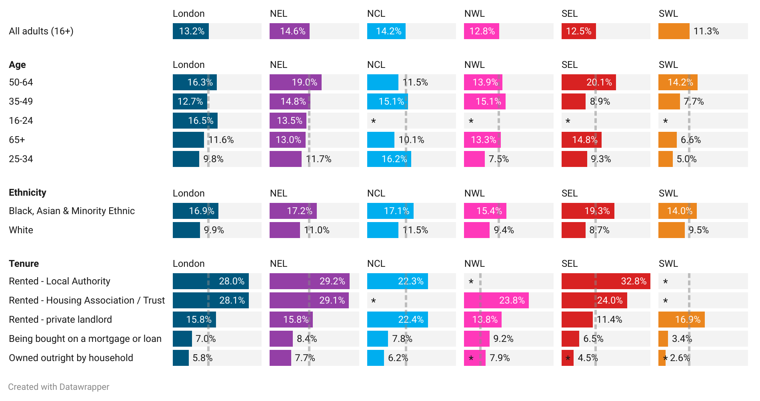
Over 1 in 4 Londoners in social housing struggling to keep their homes warm
Data summary: see sheet warm_housing_ics for full data and sample size of the survey.
Fig 13. Proportion of those who say they can’t keep their home warm enough in winter by group for London and each ICS, 2021-22
Dotted lines show average for all adults in each area
Cold homes have direct and indirect health impacts and are associated with respiratory and cardiovascular conditions, such as heart attack and hypertension, asthma and wheeze in children, avoidable hospital admissions, and depression and poor mental health in adults. It is estimated that about one in five excess winter deaths occurs due to living in a cold home.¹
The proportion who can’t keep their home warm in winter varies by ICS, age, ethnicity and housing tenure:²
The proportion is highest in NEL (14.6%) and lowest in SEL (12.5%).
A greater proportion of people who are Black, Asian & Minority Ethnic said that they can’t keep their home warm in winter compared to the ICS average in NEL (+3pp), NCL (+3pp), NWL (+3pp), SEL (+7pp) and (+3pp).
A lower proportion of people who own outright or have bought a home on mortgage or loan say that they can’t keep their homes warm across all ICSs compared to ICS averages.
* = sample size too small to display figure (n<100).
Source (1) IHE, Evidence Review: Housing and Health Inequalities in London, 2022 (2) (emaining text and figures): Survey of Londoners, GLA. Note: Internal analysis by ICS and demographics. Base: Aged 16 and over (NEL: 4,625Base: aged 16 and over renting their home (NEL: 4,265, NCL: 1,330, NWL: 1,949, SEL: 1,915, SWL: 1,512, London: 8,630). Fieldwork took place in Nov 21 with a pre-selected reference group, and some COVID restrictions were introduced after field work began, potentially impacting results. It also took place just before the full effects of the cost-of-living crisis began to set in. It is highly likely that the situations of Londoners have changed while analysis was taking place.

Slide 29
Based on limited data it is estimated that around 5,000 social homes have damp and mould in London, but this is likely to be an underestimate
There is limited data on damp and mould in homes in London.
Using pooled data from the English Housing Survey (EHS) in 2017 and 2019, it is estimated that there are just under 20,000 homes in London with damp and mould. Around 5,000 of these are homes are social housing.¹
  Note this data is the most recent available, but more granular and up to date data on this issue would be beneficial.
However, these figures are likely an underestimate as:
The damp and mould cases shown are only those that are captured as Category 1 hazards in the EHS. It is possible that there are further cases of damp and mould that are not included within the EHS as they are not classified as Category 1 hazards.
Additionally, other cases of damp and mould may not be recorded in the EHS as they are recorded under another hazard. For example, it may be recorded as excess cold if this is the cause.
Other evidence suggests there that there are far more than 5,000 households in the social housing with damp and mould.
  For example, a recent Regulatory Judgement (August 2024) in Hackney included that that Hackney had “more than 1,400 open damp and mould cases [in social housing], including more than 500 cases that are overdue, and over 600 cases identified as severe”.² Considering that Hackney is one of 33 London boroughs, this would suggest that there are far more than the estimated 5,000 social homes in London with damp and mould.
Source: (1) GLA Analysis of EHS, 2017 and 2019, MHCLG. Uses English Housing Survey Data for 2017 and 2019 pooled and blended to increase the sample size.
(2) London Borough of Hackney (00AM) Regulatory Judgement: 09 August 2024.

Slide 30
Among London ICSs, NEL has the highest proportion of households in fuel poverty at 11.5% in 2022
Data summary: see sheets fuelpv_ics and fuelpv_la for full data on ICSs and local authorities.
Fig 14. Number and proportion of households in fuel poverty by ICS in London, 2022
Proportion of households in ICS shown in brackets
Using MHCLG’s definition, fuel poverty in England is measured using the Low Income Low Energy Efficiency (LILEE) indicator. Under this indicator, a household is fuel poor it meets two criteria:
  they are living in a property with a fuel poverty energy efficiency rating of band D or below
  when they spend the required amount to heat their home, they are left with a residual income below the official poverty line
As shown in Figure 14, NEL has the greatest proportion of households in fuel poverty (11.5%), however all ICSs are in close the range of 9.5-11.5%.
This compares to an overall rate of fuel poverty of 10.4% in London and 13.1% in England.
Source: Sub-regional fuel poverty data (local authority), MHCLG.
Note: Data has been aggregated from local authority level, so where there was suppression or missing data at local authority level this will have impacted the ICS totals. Number of households have been rounded to the nearest 100.

Slide 31
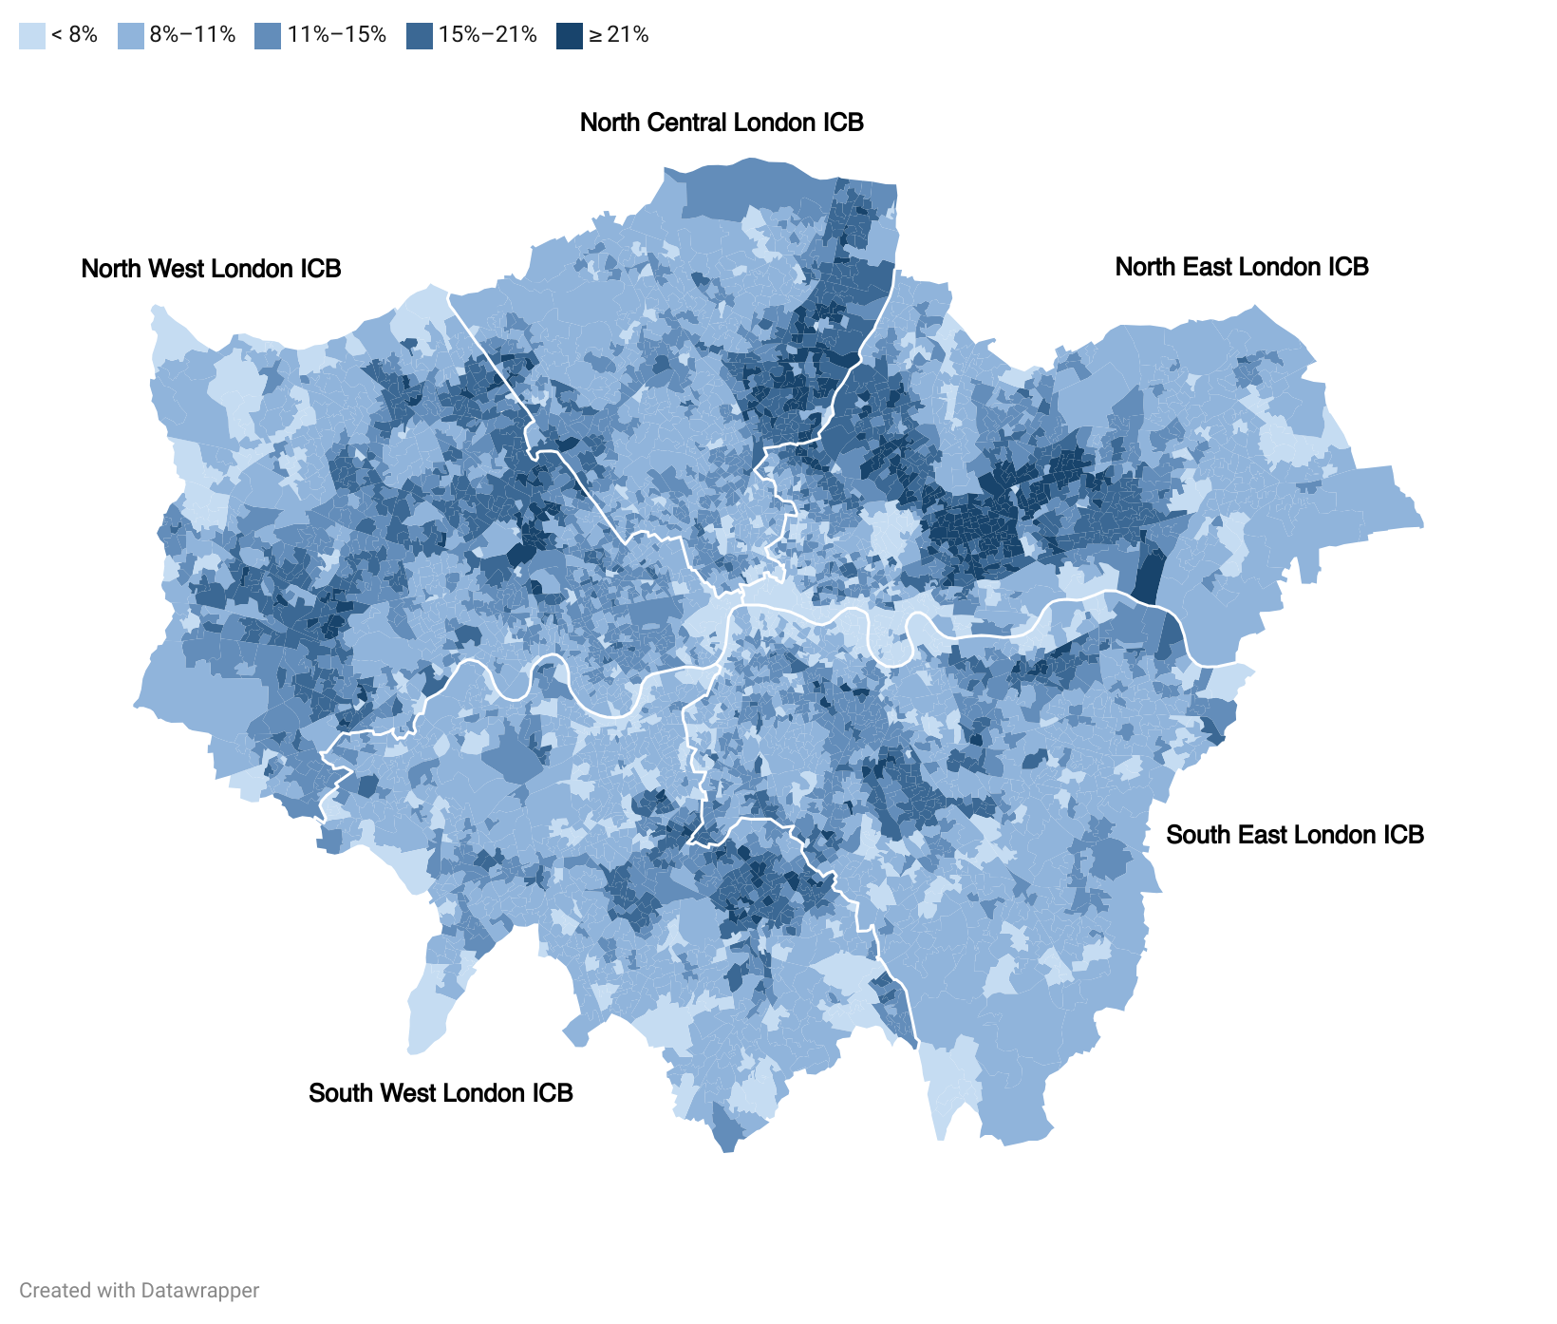
Fuel poverty also varies considerably at LSOA level
Fig 15. Proportion of households in fuel poverty by LSOAs in London, 2022
Data summary: see sheets fuelpv_lsoa for full data behind this map.
Source: Sub-regional fuel poverty data 2024 (2022 data), MHCLG.
Note: Estimates of fuel poverty at Lower Super Output Area (LSOA) should be treated with caution. The estimates should only be used to look at general trends and identify areas of particularly high or low fuel poverty. They should not be used to identify trends over time within an LSOA, or to compare LSOAs with similar fuel poverty levels due to very small sample sizes and consequent instability in estimates at this level. See Sub-regional fuel poverty report, 2024.

Slide 32
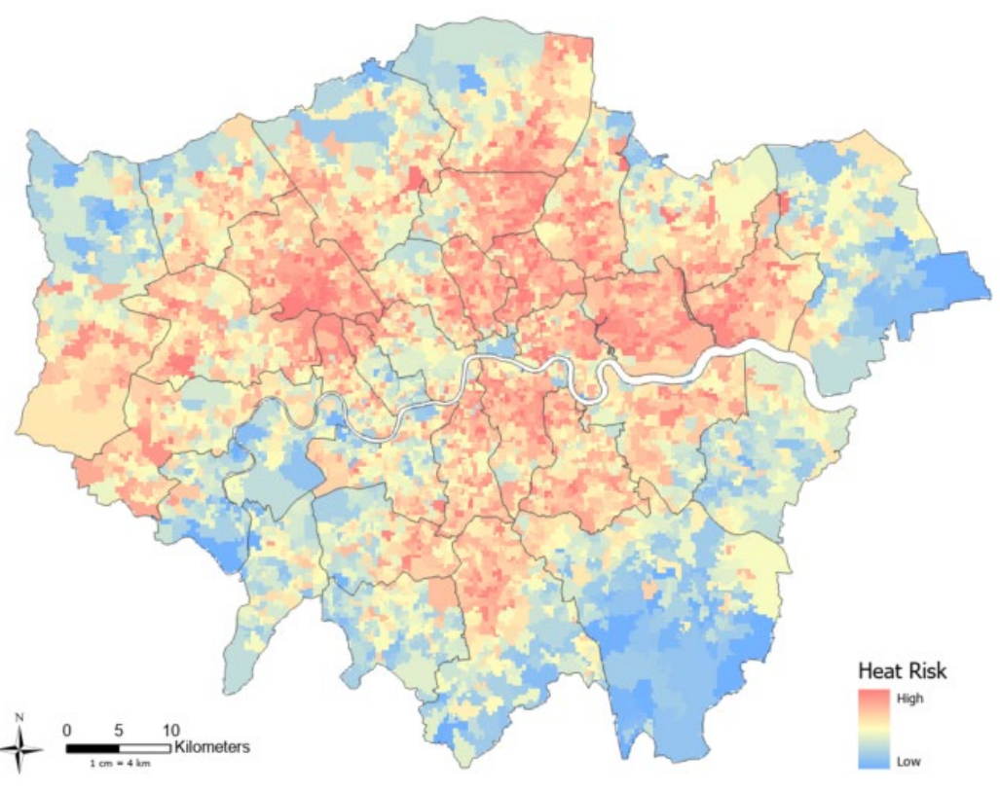
Londoners are almost twice as likely to die from heat related causes than the England average
Climate change is widely accepted to be one of the greatest threats to human health, with London facing increasing risks associated with rising temperatures.
Between 2000 and 2019, Londoners were almost twice as likely to die from heat-related causes than average for England.¹
Vulnerability to heat is not felt equally across populations, and exposure can depend on factors such geographical location, housing stock, socioeconomic factors and individual vulnerabilities.
There is a lack of granular data available in the public domain on overheating risk in London. Existing data includes -
  2006 GLA mapping of Mortality Risk from High Temperatures in London, demonstrating vulnerability to heat across the "Triple Jeopardy" metrics of the Urban Heat Island – the phenomenon where temperatures are relatively higher in cities compared to surrounding rural areas; housing stock; and Population age.²
  2022 Bloomberg Spatial Analysis of Climate Risk Across Greater London. The Bloomberg Heat Risk map can be used as a guide for heat risk in the city, alongside local data and intelligence on the quality of housing and vulnerability of the population.³
Fig 16. Bloomberg London Heat Risk map, 2022
Source: Map taken directly from: Bloomberg, London Climate Risk, 2022
Note: The Heat Risk map was published in 2022 and uses 11 metrics: Ages Under 5 (ONS, 2019), Ages Over 75 (ONS, 2019), English Proficiency (ONS, 2011), Income Deprivation (MHCLG, 2015), Social Renters (ONS, 2019), BAME (ONS, 2011), Average Land Surface Temperature (ARTi Analytics BV, 2016-2020), PM2.5 (GLA/TFL, 2016), NO2 (GLA/TFL, 2016), Tree Canopy Cover (GLA, 2016), Areas of Deficiency in Access to Public Open Space (GiGL, 2016)
Source: (1) IHE, Evidence Review: Housing and Health Inequalities in London, 2022 (2) GLA Mortality Risk from High Temperatures in London, 2006 (3) Bloomberg, London Climate Risk, 2022

Slide 33




For front-line professionals:
How can we tackle the impacts of housing quality on health?
Here are some examples that could apply to your work:
The London Damp and Mould Checklist
The Report a Rogue Landlord Tool
This Checklist is designed by London’s public health system partners to support health and social care professionals who visit patients at home to identify, assess vulnerability, and take action on damp and mould in homes.
If you are visiting a private tenant with unaddressed concerns about housing conditions, consider signposting to the GLA Report a Rogue Landlord Tool.
The Seasonal Health Intervention Network (SHINE)
Consider a referral to SHINE, which offers a dedicated helpline and affordable warmth interventions to ensure households get the help they need to reduce utility bills, tackle energy debt and ultimately stay well and warm.
ECO4 FLEX Scheme
Are you visiting a household in private tenure living either in fuel poverty or living on a low income and who are particularly vulnerable to the effects of living in the cold? Consider if they may be eligible for ECO4 Flex.

Slide 34






For those in strategy roles:
How can we tackle the impacts of housing security on health?
Local Authorities: ​
The IHE Evidence Review on Housing and Health Inequalities includes a number of recommendations for local authorities on Housing quality, including (among others):
Spotlight on:
Norfolk and Waveney ICS: Integrated anticipatory care team
Support people who require home adaptations for mobility needs to access available grants.
Deliver a range of interventions to address fuel poverty, including financial, advisory and practical – to support households facing difficulties with energy and repair bills.
In March 2022, partners from the ICS, NHS, county and district councils and VCSE set up an integrated anticipatory care team.
The team provides home adaptations, support with moving house, benefits advice and help managing properties, such as decluttering.
The team is based in City Hall and includes an NHS care coordinator, council caseworkers, and VCSE social prescribers.
It was initially funded by the Community Transformation Fund after a joint bid by partners. When this ended, Norwich City Council funded a two-year extension to 2026.
In its first 20 months, 587 people were referred to the service. 40 homes were adapted, 24 people were supported to move home and 12 people were given mobility aids.
Health and Care:​​
Based on examples of best practice working in this space, health and care strategic professionals could consider the following:
Explore opportunities to develop a housing and health strategy for each ICS.
Establish Anticipatory care teams that can support with home adaptations, moving house, benefits advice and help managing properties, such as decluttering. ​
Explore opportunities to embed specialist housing advice in health settings.

Slide 35
Housing security

Slide 36



The health impacts of housing security in London
Insecure housing and the threat of eviction have significant negative mental health effects, including heightened anxiety and depression and recurrence of underlying mental health conditions.
Housing insecurity impacts the health of families and children due to loss of routine, negative impacts on people’s sense of home and community, social isolation, and educational attainment for children. The majority of children who are homeless and living in temporary accommodation in England are located in London.
Housing insecurity or instability impacts peoples' access to key social infrastructure, and causes disruptions in access to health and care services
Source: IHE, Evidence Review: Housing and Health Inequalities in London, 2022

Slide 37
Homeless when accessing local authority support
Data summary: see sheet homesless_circ_la for quarterly data on homelessness since Dec 2019.
Table 5. Total households owed prevention or relief duty, threatened with homelessness and assessed as homeless, quarterly data, April-June 2024*
 | Households owed prevention or relief duty | Households assessed as threatened with homelessness per 1,000 | Households assessed as homeless per 1,000
North Central London Integrated Care Board
Barnet | 874 | 2.25 | 3.30
Camden* | 351 | 0.66 | 2.28
Enfield | 505 | 1.46 | 2.36
Haringey | 724 | 1.77 | 4.75
Islington | 893 | 1.98 | 6.18
North East London Integrated Care Board
Barking & Dagenham | 337 | 2.90 | 1.30
City of London | 8 | 0.23 | 1.61
Hackney | 730 | 2.08 | 3.77
Havering | 458 | 2.59 | 1.64
Newham | 892 | 2.35 | 5.11
Redbridge | 453 | 1.86 | 2.20
Tower Hamlets | 706 | 1.79 | 3.08
Waltham Forest | 398 | 1.15 | 2.62
NHS North West London Integrated Care Board
Brent* | 703 | 1.93 | 3.97
Ealing | 822 | 3.36 | 3.27
Hammersmith & Fulham | 275 | 1.02 | 2.27
Harrow | 291 | 1.68 | 1.63
Hillingdon | 372 | 1.36 | 1.93
Hounslow | 520 | 1.88 | 3.18
Kensington & Chelsea | 271 | 0.96 | 2.60
Westminster | 759 | 1.22 | 4.71
South East London Integrated Care Board
Bexley | 254 | 1.86 | 0.63
Bromley | 464 | 1.15 | 2.07
Greenwich | 651 | 2.19 | 3.36
Lambeth | 934 | 2.39 | 4.22
Lewisham | 606 | 2.84 | 1.64
Southwark | 920 | 1.96 | 4.71
NHS South West London Integrated Care Board
Croydon* | 1,419 | 5.26 | 3.76
Kingston upon Thames | 76 | 0.23 | 0.85
Merton | 171 | 1.60 | 0.54
Richmond upon Thames | 202 | 1.20 | 1.15
Sutton | 231 | 1.12 | 1.60
Wandsworth | 547 | 1.51 | 2.44
The Homelessness Reduction Act came into force in 2018. Under the Act:
  a prevention duty is owed to households threatened with homelessness within 56 days and;
  a relief duty is owed to households that are already homeless and require help to secure accommodation. The relief duty lasts 56 days, after which a household can be accepted as statutorily homeless and owed a main homelessness duty.
A breakdown of households assessed as owed prevention or relief duty by borough is shown in Table 5.
In London overall in April-June 2024, the overall rate of households assessed as threatened with homelessness was 1.93 per 1,000, greater than for England at 1.54 per 1,000. Similarly the number of households assessed as homeless was greater in London (1.93 per 1,000) compared to England as a whole (1.90 per 1,000).
Source: A1 table on homelessness, MHCLG.
*Data is missing for three local authorities for Q2 2024. The table shows data for Q1 2024 (Jan-March 2024) for Camden and Croydon, and Brent for Q4 2023 (Oct-Dec 2024) for Brent.
Note: Only includes households assessed as homeless on initial assessment.

Slide 38
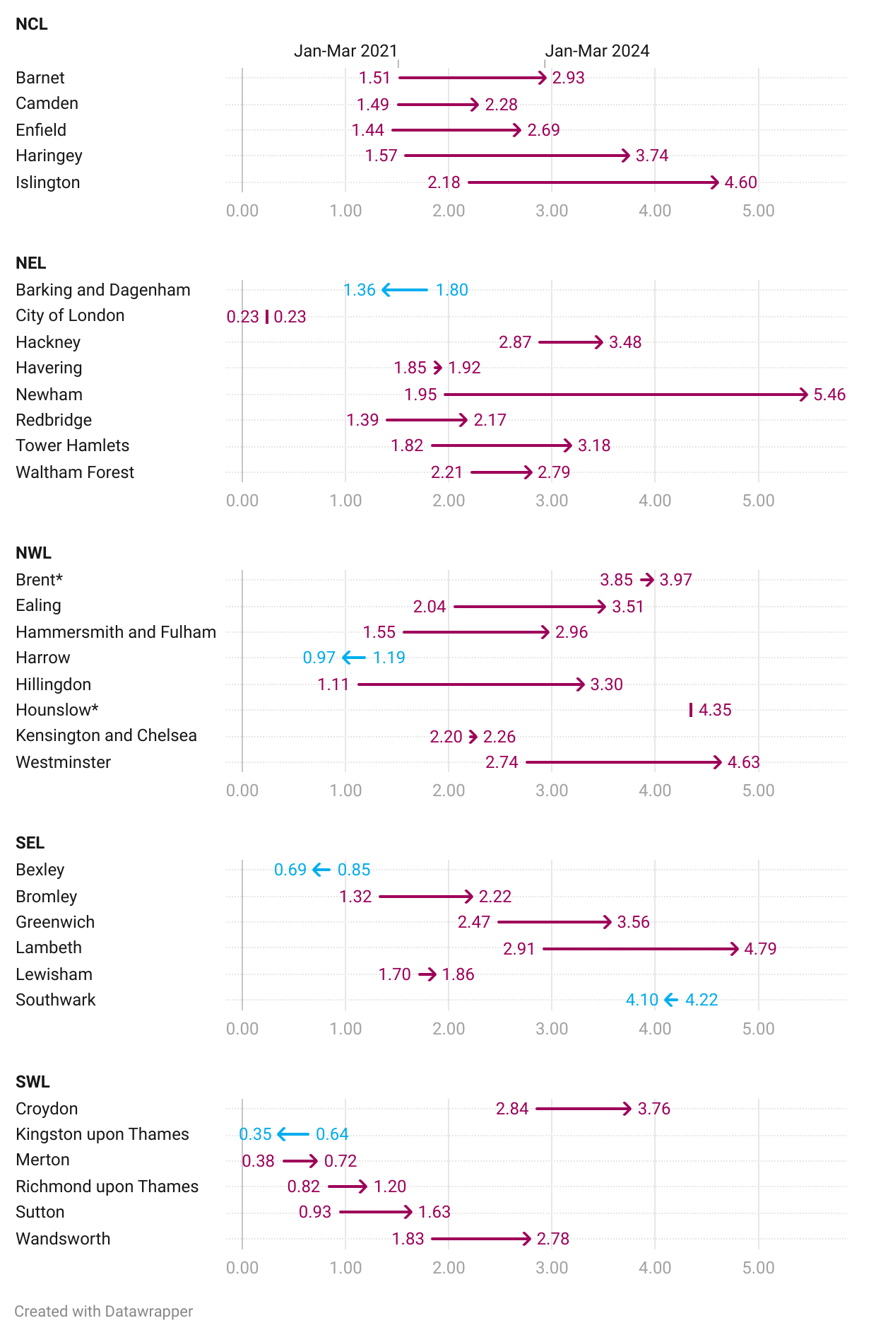
The number of households assessed as homeless by local authorities has increased in 4 in 5 local authorities in London over the last three years
Data summary: see sheet homesless_circ_la for quarterly data on homelessness since Dec 2019.
Fig 17. Change in households assessed as homeless by local authorities per 1000, March 2021 to March 2024
Arrow shows the households assessed as homeless per 1000 in March 2021 (start of arrow) to March 2024 (end of arrow)
Sources: A1 table on homelessness, MHCLG.
*Data is missing for Brent for Q1 2024, so data shown is for Q4 2023 (Dec 2023). No data is available for Hounslow in March 2021, so only March 2024 is shown.
Note: Only includes households assessed as homeless on initial assessment. Local authorities with a decrease in households assessed as homeless are shown in blue. Data downloaded 10/12/24.

Slide 39
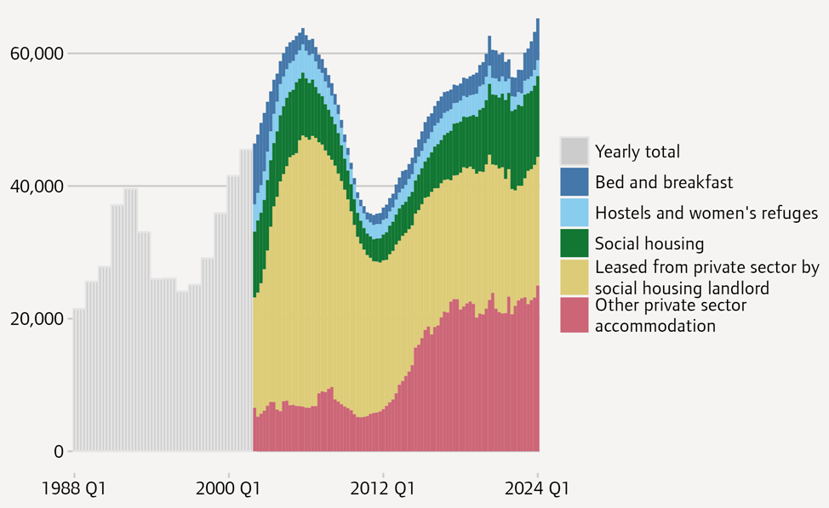
There has been a 9% increase in homeless households placed in temporary accommodation (TA) in London over the last year to Q1 2024
Data summary: see sheet temp_acc_la for further breakdowns by local authorities over time
At the end of March 2024 there were 65,280 homeless households in TA arranged by London boroughs. This is a 9% increase compared to one year earlier (when it was 60,100) and the highest value since the data series began in 1988.
28,680 of the households in TA arranged by London boroughs were placed outside their home borough, an increase of 23% compared to one year earlier, and the highest figure yet recorded.
6,330 households lived in bed and breakfast accommodation at the end of March 2023, a 49% increase compared to one year earlier. 68% of households in TA (44,370) were in some form of private sector accommodation, an increase of 8% compared to a year earlier.
There were 86,810 children living in temporary accommodation in March 2024, an increase of 13% in the last year.
Fig 18. Households placed in temporary accommodation by London local authorities by type of accommodation, 1988 to Q1 2024
Source: Chart and text directly from: Housing in London Annual Report, 2024 (4.7). Compiled by GLA from: Housing Finance Review 1995/96; UK Housing Review 2004/05; MHCLG live tables 775 and TA1. The resolution is yearly between 1988 and 2001 inclusive and quarterly 2002 Q1 onwards.

Slide 40
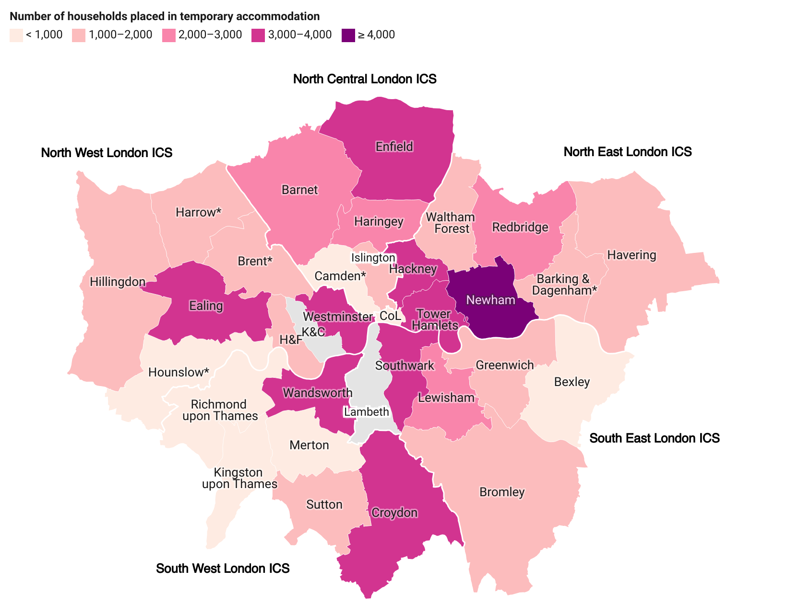
Among those reporting, 13 boroughs have over 2,000 homeless households placed in temporary accommodation
Data summary: see sheet temp_acc_la for further breakdowns by local authorities over time
Fig 19. Total number of homeless households placed in temporary accommodation by local authority, June 2024*
Among local authorities that reported, Newham had the greatest number of households placed in temporary accommodation (TA) by the local authority at 6,528.
The housing charity Shelter surveyed 1,112 people living in TA and found 66% of mothers reported it had a negative impact on their physical and mental health, 57% felt it was adversely affecting their children’s physical and mental health, 47% of children had to move school and 39% stated that living in TA made it harder for them to access healthcare appointments for them and their children.²
Aside from the disruption living in TA may cause, the quality of the housing provided can be poor. The Public Accounts Committee found that TA is “often of a poor standard and does not offer value for money".³
Sources: (1) MHCLG, TA1 table on temporary accommodation (2) Shelter, Still Living in Limbo, 2023 (3) House of Commons Committee of Public Accounts, Homeless households (parliament.uk), 2017
H&F = Hammersmith and Fulham, K&C = Kensington and Chelsea, CoL = City of London
Source: MHCLG, TA1 table on temporary accommodation Note: * For five local authorities data for previous quarters is shown in the figure as data is not available for the current quarter. For Barking and Dagenham, Harrow, Hounslow, data from the previous quarter is shown (March 2024). For Camden and Brent data for Dec 2023 is shown. Recent data is not available for Lambeth and Kensington & Chelsea, so it is not shown in this figure.

Slide 41
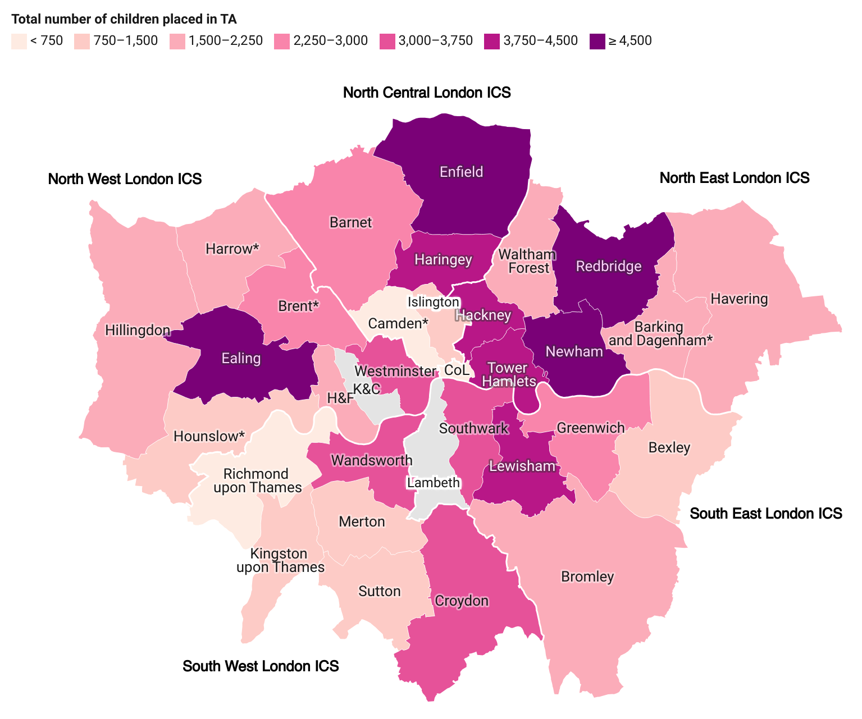
Among those reporting, 12 boroughs have over 3,000 children placed in temporary accommodation
Data summary: see sheet temp_acc_la for further breakdowns by local authorities over time
Fig 20. Total number of children placed in temporary accommodation by local authority, June 2024*
Newham had placed the greatest number of children in homeless households placed in temporary accommodation at 9,534 (children) in Q2 2024. This is followed by Redbridge (5,415) and Enfield (4,596).
Note this is among the boroughs that have reported on this. There is no recent data (last year) data available for Kensington & Chelsea or Lambeth.
Source: MHCLG, TA1 table on temporary accommodation Note: * For five local authorities data for previous quarters is shown in the figure as data is not available for the current quarter. For Barking and Dagenham, Harrow, Hounslow, data from the previous quarter is shown (March 2024). For Camden and Brent data for Dec 2023 is shown. Recent data is not available for Lambeth and Kensington & Chelsea, so it is not shown in this figure.
H&F = Hammersmith and Fulham
K&C = Kensington and Chelsea
CoL = City of London

Slide 42
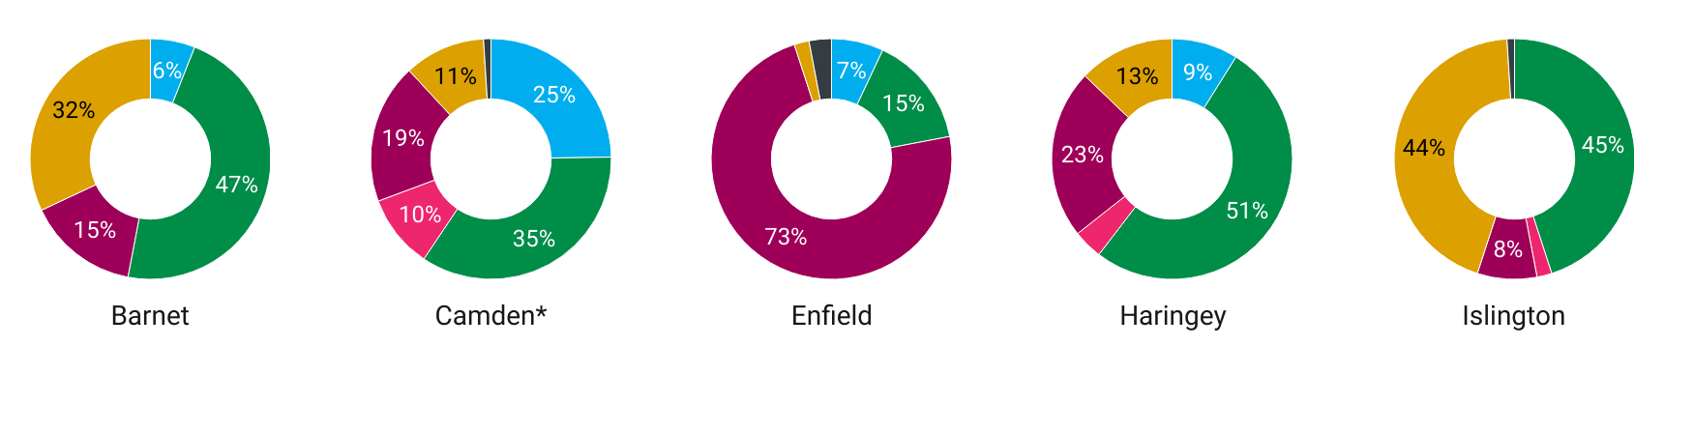
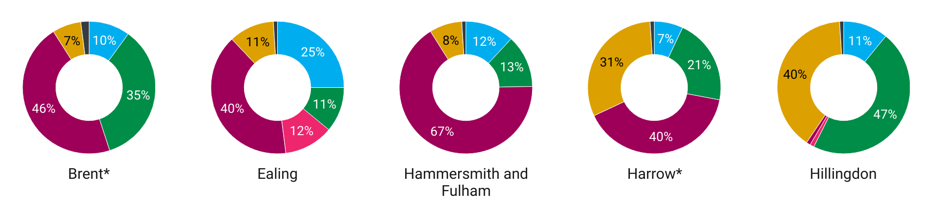
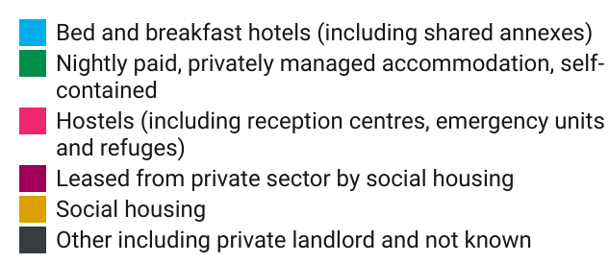
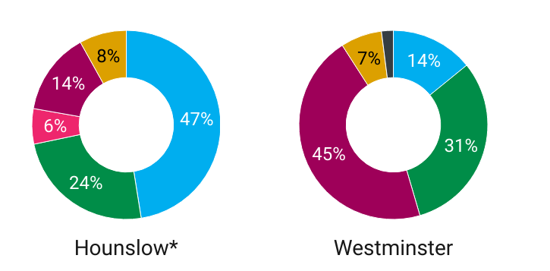
The type of temporary accommodation used varies across London local authorities considerably (1/3)
Data summary: see sheet temp_acc_la for further breakdowns by local authorities over time
Fig 21A. Proportion of homeless households placed in temporary accommodation by local authority by type of accommodation, June 2024*
NCL
NWL
Source: MHCLG, TA1 table on temporary accommodation
Note: * For five local authorities data for previous quarters is shown in the figure as data is not available for the current quarter. For Barking and Dagenham, Harrow, Hounslow, data from the previous quarter is shown (March 2024). For Camden and Brent data for Dec 2023 is shown. Recent data is not available for Lambeth and Kensington & Chelsea, so it is not shown in this figure. Percentages may add to over 100% due to rounding.

Slide 43
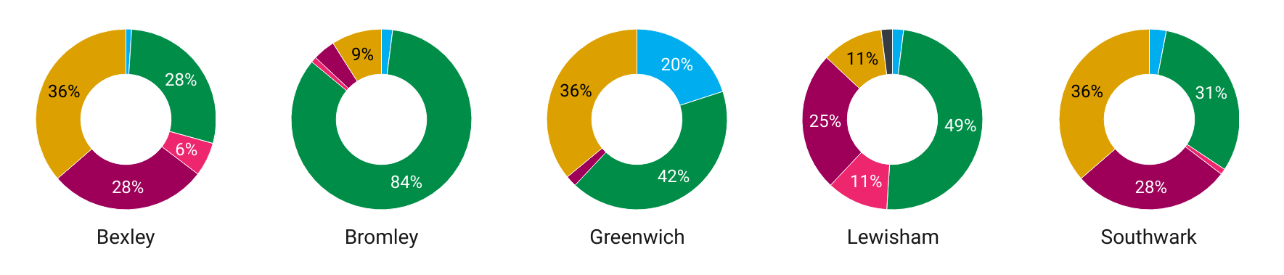
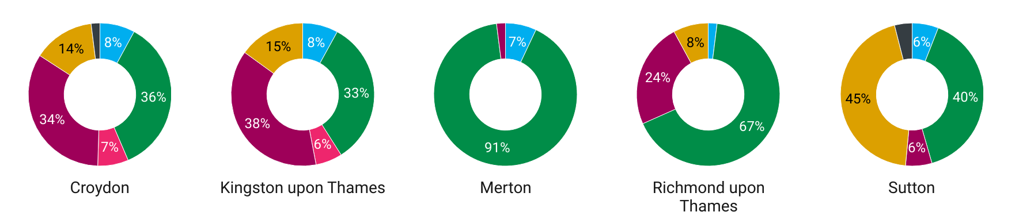
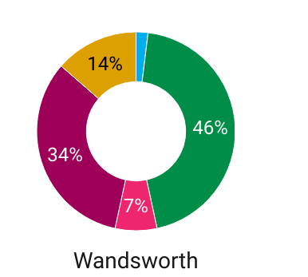
The type of temporary accommodation used varies across London local authorities considerably (2/3)
Data summary: see sheet temp_acc_la for further breakdowns by local authorities over time
Fig 21B. Proportion of homeless households placed in temporary accommodation by local authority by type of accommodation, June 2024*
SEL
SWL
Source: MHCLG, TA1 table on temporary accommodation
Note: * For five local authorities data for previous quarters is shown in the figure as data is not available for the current quarter. For Barking and Dagenham, Harrow, Hounslow, data from the previous quarter is shown (March 2024). For Camden and Brent data for Dec 2023 is shown. Recent data is not available for Lambeth and Kensington & Chelsea, so it is not shown in this figure. Percentages may add to over 100% due to rounding.

Slide 44
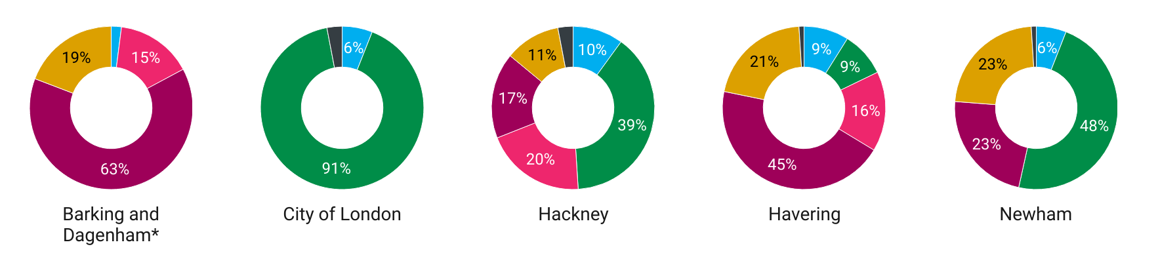
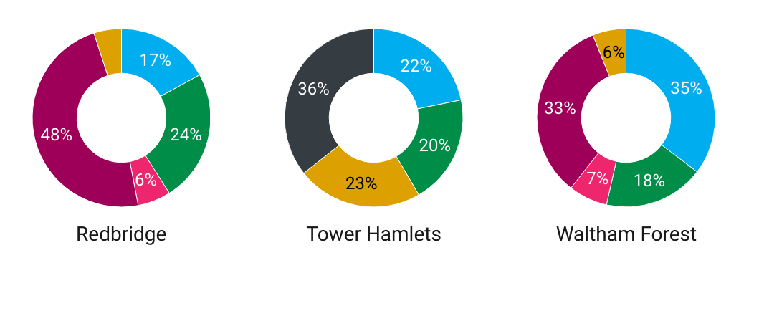
The type of temporary accommodation used varies across London local authorities considerably (3/3)
Data summary: see sheet temp_acc_la for further breakdowns by local authorities over time
Fig 21C. Proportion of homeless households placed in temporary accommodation by local authority by type of accommodation, June 2024*
NEL
Source: MHCLG, TA1 table on temporary accommodation
Note: * For five local authorities data for previous quarters is shown in the figure as data is not available for the current quarter. For Barking and Dagenham, Harrow, Hounslow, data from the previous quarter is shown (March 2024). For Camden and Brent data for Dec 2023 is shown. Recent data is not available for Lambeth and Kensington & Chelsea, so it is not shown in this figure. Percentages may add to over 100% due to rounding.

Slide 45
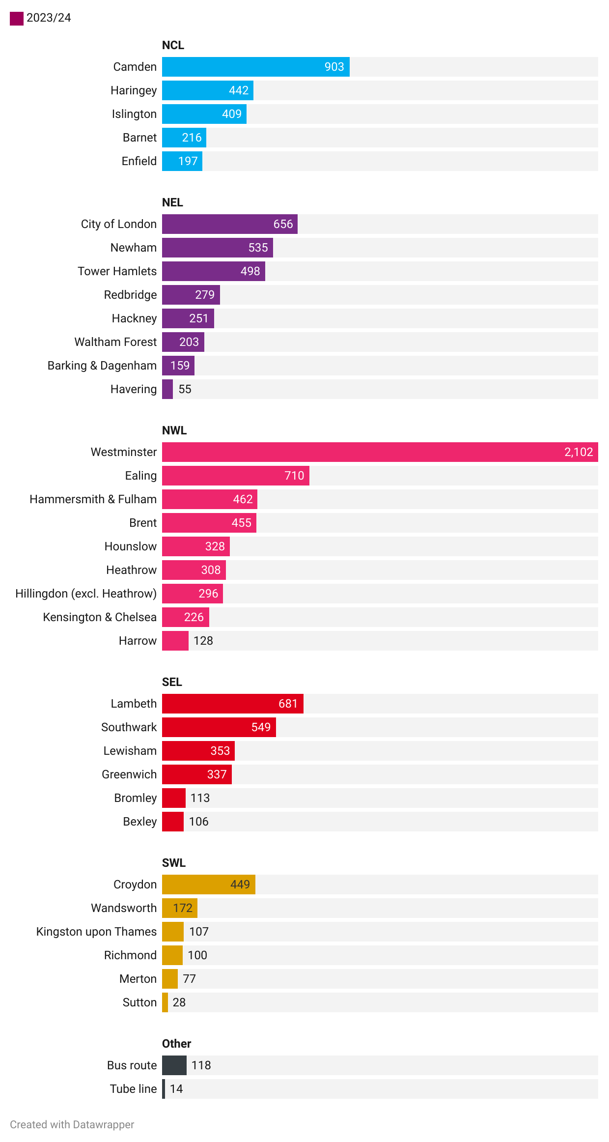
Almost 12,000 people were seen rough sleeping in London in 2023/24, with the most seen in Westminster
For breakdowns over time, by category, nationality, gender, age, ethnicity and support needs see the full CHAIN publications
Fig 22. Number of people seen rough sleeping in London local authorities and areas by ICS, 2023/24
Combined Homelessness and Information Network (CHAIN) data found that there were 11,993 people seen rough sleeping in London in 2023/24, an increase from 10,726 in 2019/20.
  Of these, 16% were female and 82% male (2% unknown, 0.1% non-binary).
Among the Local Authorities in London in 2023/24:
  Westminster had the greatest number of people seen rough sleeping at 2,102.
  Sutton has the fewest number of people seen rough sleeping at 28.
The number of people seen sleeping rough has increased from 2019/20 to 2023/24 for 21 of the 33 of Local Authorities in London.
Source: CHAIN annual data tables, London Datastore.
Note: People are counted as having been seen rough sleeping if they have been encountered by a commissioned outreach worker bedded down on the street, or in other open spaces or locations not designed for habitation, such as doorways, stairwells, parks or derelict buildings. The report does not include people from “hidden homeless” groups such as those “sofa surfing” or living in squats, unless they have also been seen bedded down in one of the settings outlined above.

Slide 46




For front-line professionals:
How can we tackle the impacts of housing security on health?
Here are some examples that could apply to your work:
Refer to Resources on Homelessness from Transformation Partners for Health and Care
Refer to the All Our Health guide on Homelessness
Health and care professionals play an important role to identify risk of homelessness and prevent this; minimise the impact on health of homelessness among people who are already experiencing it; and enable improved health outcomes for people experiencing homelessness.
Whether you’re a healthcare professional, advocate, or simply seeking knowledge, explore a wealth of information from THPC aimed at fostering compassionate care and driving good practice.
Understand and adopt the Principles of Housing First
Signpost so tenants understand their rights
Housing First is an approach to ending long-term and recurrent homelessness that has been extensively trialled in the UK. Consider how to apply the core principles of Housing First while offering person-centred, flexible and holistic support to individuals with complex needs who are, or are threatened with being made, homeless.
You can signpost to organisations with specific housing expertise where appropriate. It's important to recognise the bi-directional relationship of mental health and housing insecurity. As well as referring those facing housing insecurity for relevant mental health support where needed, consider signposting to key information, such as Breathing Space for tenants.

Slide 47





For those in strategy roles:
How can we tackle the impacts of housing security on health?
Local Authorities: ​
The IHE Evidence Review on Housing and Health Inequalities includes recommendations for local authorities on security, including (among others) :
Spotlight on:
Sussex: Housing Team Embedded in MH services
SPFT has a Housing Team that provides advice and advocacy casework for people using inpatient and community mental health services. The aim is to support the identification and resolution of housing needs as early as possible. Team members are housing specialists co-located with a local authority.
A housing needs triage process is used to enable frontline staff to identify housing needs and connect them with housing specialists.
The model was co-produced with people using services and local authorities. It is funded by a mix of repurposed vacant posts and non-recurrent pots, from both SPFT and SHC.
Outcomes after first year:
  528 people supported, with 93% of people’s housing situations improved, 214 people secured new housing and 138 people supported to stay in their own homes.
  70% decrease in bed delay days due to housing, which reduced the inpatient beds contracted from the independent sector by 60 beds.
  £2.9m savings from the reduction in contracted inpatient beds, representing a 1:5 return on investment from costs of £550,000.
Seek to raise standards of temporary accommodation to ensure that no child is raised in single-room or bed and breakfast accommodation​.
Apply the core principles of Housing First while offering person-centred, flexible and holistic support to individuals with complex needs who are, or are threatened with being made, homeless. ​
​Maintain and increase provision of services to prevent evictions, and offer debt and financial advice to tenants, taking into account cultural and language barriers to access.
Health and Care:​​
Based on examples of best practice working in this space, health and care strategic professionals could consider the following:
Consider provision of specialist housing advice in hospital settings and suitable step down provision to ensure no one is discharged from hospital to the street.

Slide 48
Housing affordability

Slide 49



The health impacts of housing affordability in London
Unaffordable housing drives poverty with significant implications for child health. London has the highest rates of poverty, after housing costs are taken into account, in England, and children in the capital are significantly more likely to grow up in after-housing cost poverty than the average for England.¹
Children born to parents living in poverty are more likely to be low birthweight and less likely to survive the first year of life. They are also more likely to suffer from asthma and other childhood diseases. Children who grow up in poverty may also experience poor health throughout the life course as a result.²
Unaffordable housing impacts the capacity of healthcare services to meet need; London has the greatest shortage of health and social care workers in England, and this is in part driven by the shortage of affordable housing for key workers.¹
Sources: (1) IHE, Evidence Review: Housing and Health Inequalities in London, 2022 (2) CPAG, The Effects of Child Poverty

Slide 50
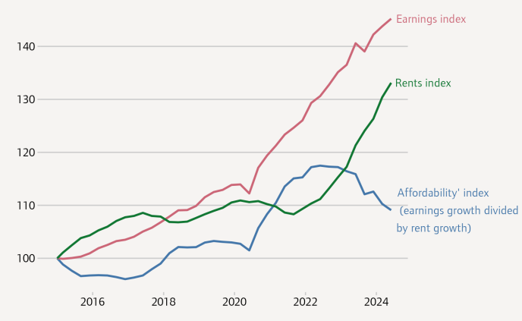
The affordability of average private rents (including ongoing and new tenancies) in London compared to average earnings improved between 2020 and 2022 but has since worsened
This chart shows an ‘affordability’ index, calculated as the cumulative change in earnings divided by the cumulative change in private rents (on all tenancies).
Between 2015 and 2020, rents were relatively stable in nominal terms while earnings increased at a marginally higher rate, maintaining affordability on this measure close to where it was at the start of 2015. Rents then dipped in 2020 and 2021 while earnings rose strongly.
Rents increased sharply from 2022 onwards and are currently outpacing earnings growth, leading to a deterioration in affordability.
The ONS rental data shown here reflects rents paid on all tenancies, and therefore reacts more slowly to changes in the market for new tenancies. Another caveat to note is that earnings data only reflects payrolled employees and does not reflect changes in benefits.
Fig 23. Index of cumulative change in private rents (on all tenancies), earnings and implied affordability in London, 2015 to 2024
Index January 2015 = 100
Source: Chart and text directly from: Housing in London Annual Report, 2024 (3.11). Compiled by GLA from: Housing Finance Review 1995/96; UK Housing Review 2004/05; MHCLG live tables 775 and TA1. The resolution is yearly between 1988 and 2001 inclusive and quarterly 2002 Q1 onwards. Median full-time weekly earnings by place of work, London. From ONS Pay As You Earn Real Time Information, UK. Rents: ONS Price Index of Private Rents, monthly statistics, UK. Affordability index: Rent index divided by median weekly earnings.
Note: The earnings index here is based on place of work rather than residence.

Slide 51
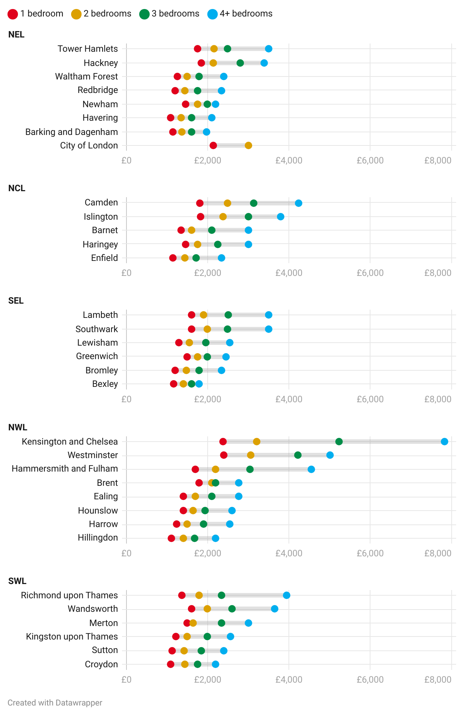
Median monthly private rent for a two-bedroom property is over £2,000 in 9 of the 33 London boroughs
Data summary: see sheet rent_type_la full data including mean rent and quartiles.
Fig 24. Median monthly private rent by number of bedrooms, FY 2023/24
Source: Private rental market summary statistics in London: April 2023 to March 2024, ONS.
Note: Housing Benefit claimants are not included in the sample.
These statistics are not comparable with the Office for National Statistics' Official Statistics releases on the private rental market (discontinued). Both use the Valuation Office Agency's data collected by Rent Officers from landlords and letting agents, however, the sample and methodology used to produce the figures is not the same.

Slide 52
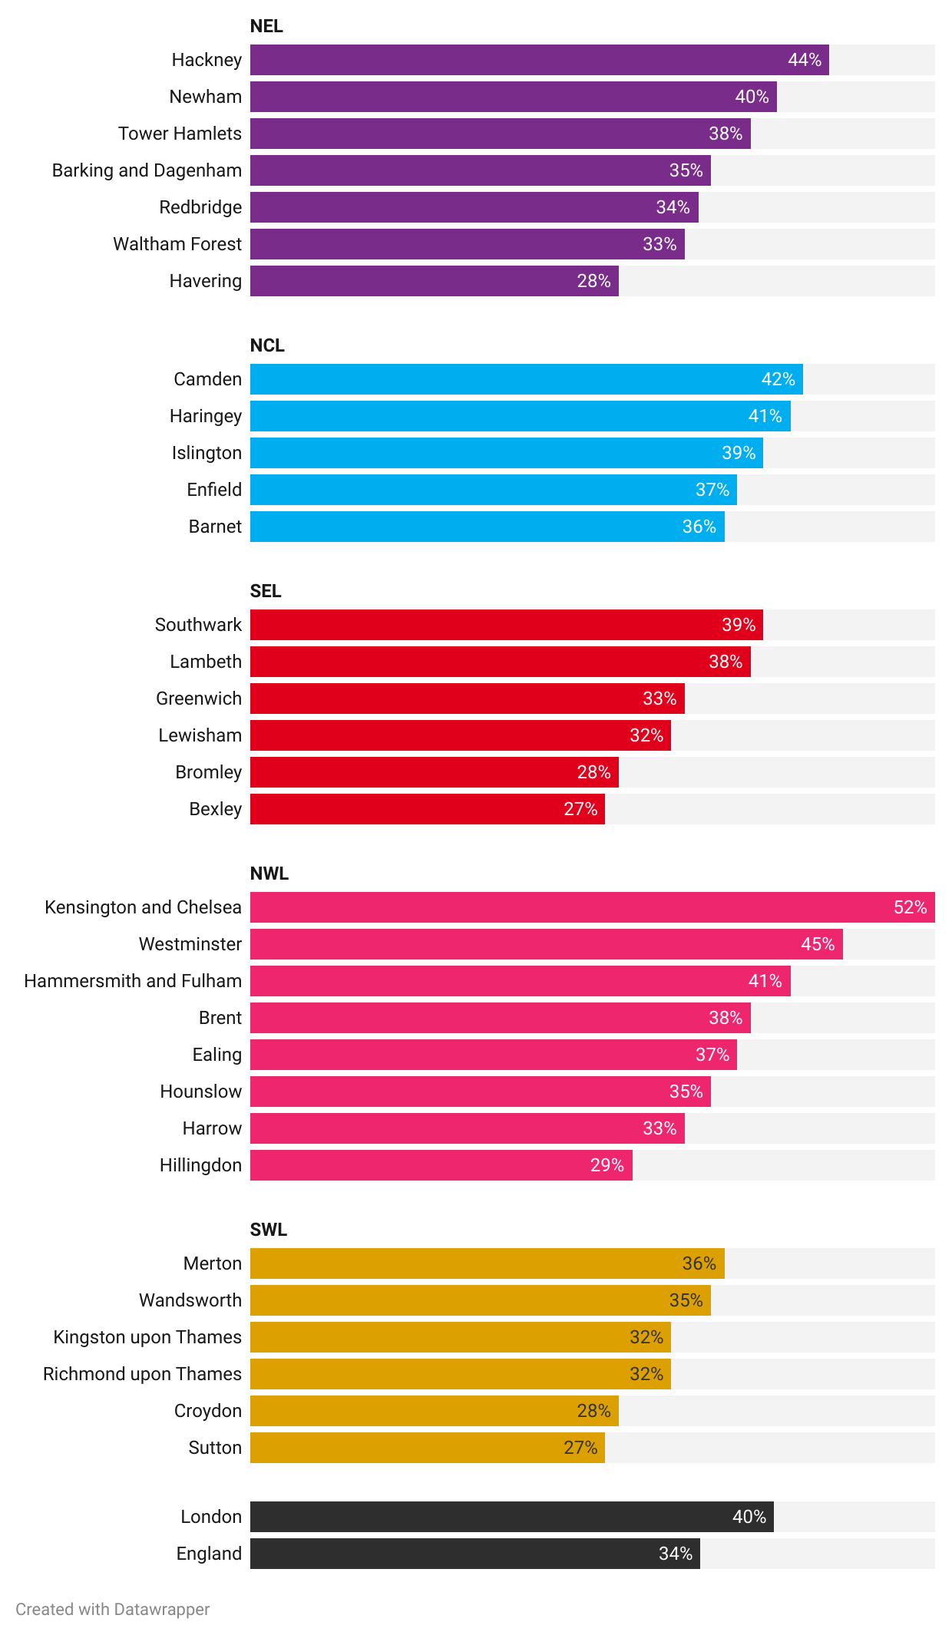
Private renting households spend two fifths of their income on rent in London
Data summary: see private_rent_la for data on private rent affordability over time from 2014/15.
Fig 25. Proportion of income of private renting households that is equivalent to rent for London local authorities, FY 2022/23
Source: Private rental affordability, England and Wales, ONS (Table 4).
Note: To create the local authority level versions of these rents the ONS have used an additional administrative data source: the Earnings and employment from Pay As You Earn Real Time Information, UK series, to scale the FRS incomes. These are official statistics under development involving additional uncertainty over and above the use of the FRS incomes, and so caution should be used, especially when looking at year-on-year changes.

Slide 53
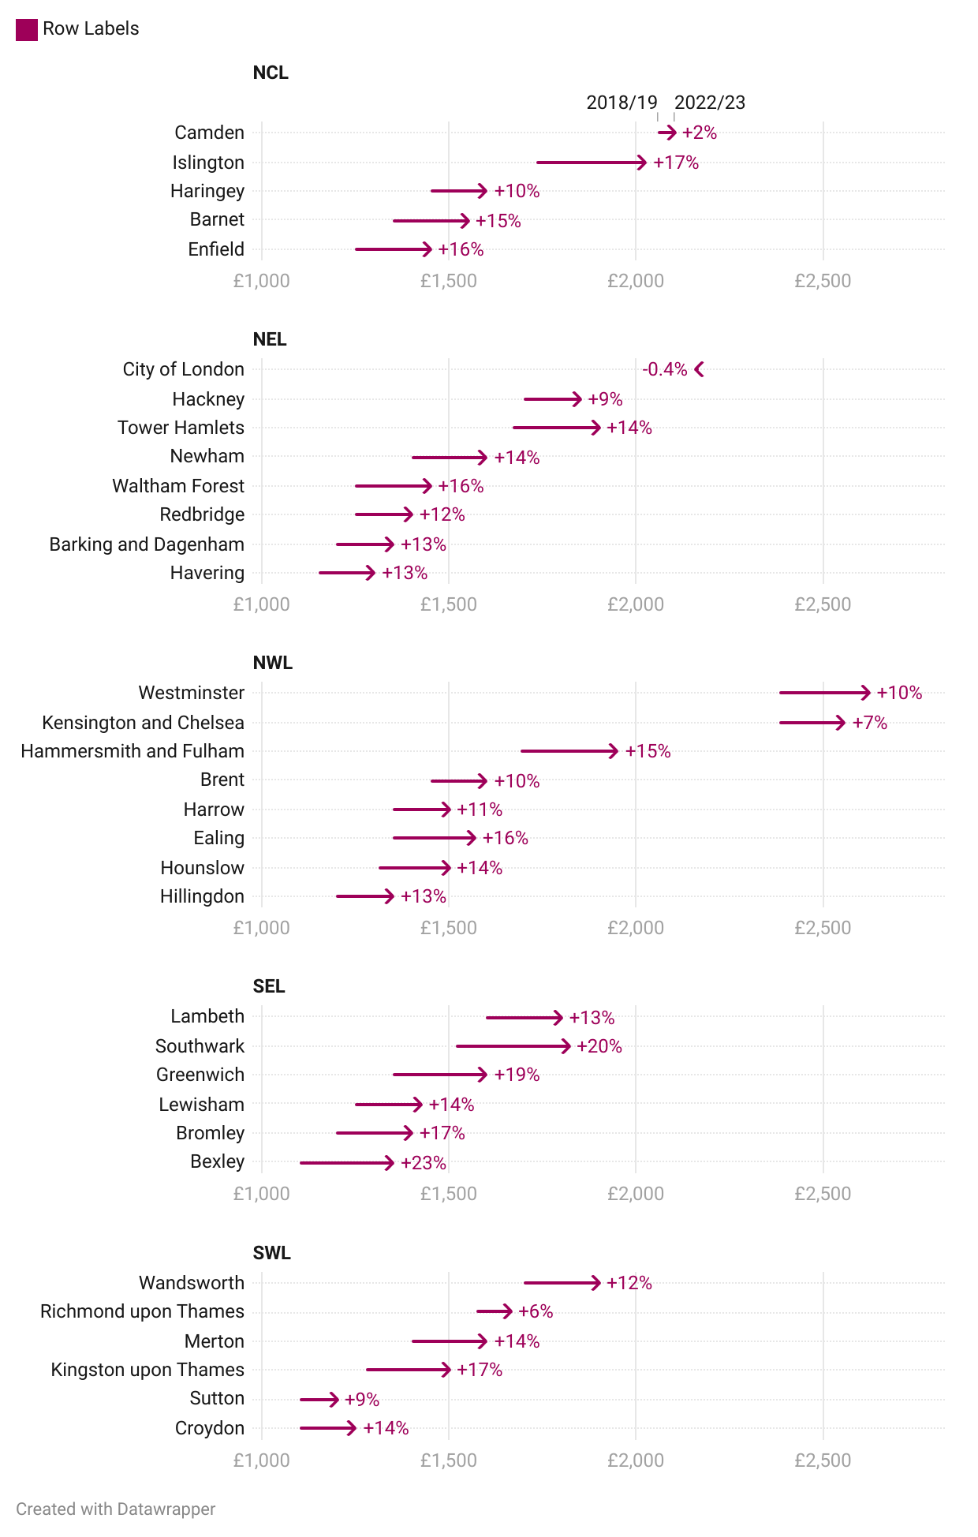
Monthly rent has increased over five years for all local authorities (except City of London), with Bexley showing the greatest percentage increase of 23%
Data summary: see sheet rent_type_la for further breakdowns by local authorities over time
Fig 26. Change in monthly rent (all property types) 2018/19 to 2022/23
Arrow shows rent from 2018/19 (Oct 2018 – Sept 2019) to 2022/23 (Oct 2022 – Sept 2023) and the with percentage change over this period
Source: Private rental market summary statistics in England, ONS.
Note: Housing benefit claimants are not included in this sample. Figures may not be consistent over time, so caution should be taken when comparing over time or between areas. 2018/19 refers to October 2018 – September 2019, and 2022/23 to October 2022 – September 2023.

Slide 54
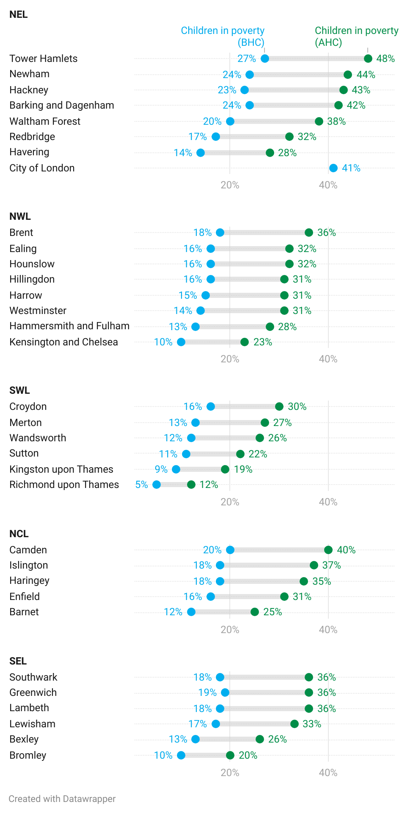
The child poverty rate at least doubles when housing costs are accounted for in 20 of the 33 boroughs
Data summary: see sheets childpov_la and povahc_la for further breakdowns on poverty
The relationship between poverty and ill health and lower life expectancy in London is well established. Children are more likely to be living in poverty than adults overall, with the latest estimate of 32% of London’s children in poverty for 2020/21-2022/23* using the relative poverty after housing costs measure.¹
Whilst there appears to be a substantial decrease since pre-pandemic (38% of London’s children in 2017/18-2019/20) and below the rates given for two other regions, it is still well above national levels (30% of children and 24% for the population as a whole).¹
As shown in Fig 29, the cost of housing has a large impact on poverty; the child poverty rate at least doubles when housing costs are accounted for in 20 of the 33 boroughs.
  Tower Hamlets has the greatest different before and after housing costs at an increase of 21pp.
  This compares to an increase of 7pp for Richmond Upon Thames which has the lowest poverty rate BHC and AHC.
Fig 27. Proportion of children in poverty before and after housing costs by local authority, 2021/22
Source: Local indicators of child poverty, Centre for Research in Social Policy, Loughborough University for End Child Poverty; Children in low-income families: local area statistics, DWP via Trust for London
Note: Figure adapted directly from Trust for London.
Sources: (1) London Datastore – Poverty
* No data available for 2020/21, so dates including 2020/21 are two-year averages for the remaining two years (see London Datastore).

Slide 55

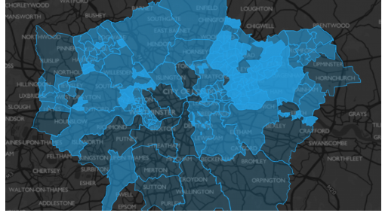
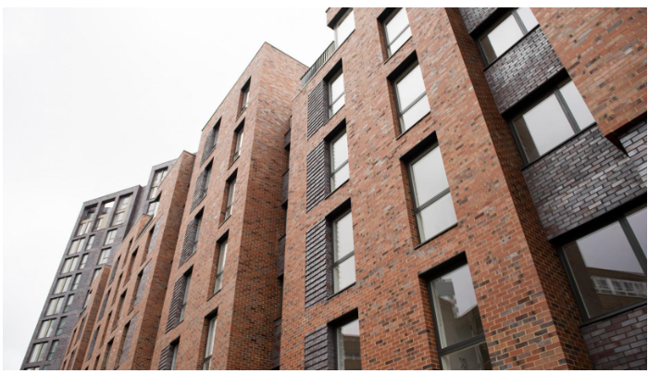
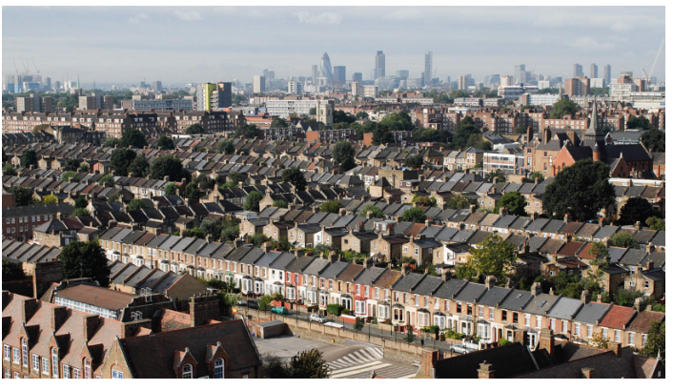
For front-line professionals:
How can we tackle the impacts of housing affordability on health?
Here are some examples that could apply to your work:
Help with the cost of living
Help for Renters
Find information about benefits, grants and discounts you can get if you’re in financial difficulty, from Greater London Authority, the government, your local council, charities and advice centres.
Renters deserve protection from rogue landlords and agents, as well as a more secure and affordable private rented sector. See available guidance, resources, and support.
Help for Homeowners
Help for Buyers
Explore available help and support for managing mortgages.
Explore tips and resources to help people onto the property ladder.

Slide 56



For those in strategy roles:
How can we tackle the impacts of housing affordability on health?
Here are some examples that could apply to your work:
Consider opportunities for co-location and integration of advice and welfare services into health care services, pathways and settings to improve access and take up of housing-related benefits, support and energy measures.
Consider how best to ensure patient and client facing staff are aware of local and regional sources of information, advice and support and know how to signpost and refer, for example through staff training or local MECC programmes.
Spotlight on:
Hampshire and Isle of Wight Keep Well Collaborative
The Hampshire and Isle of Wight ICS commissioned the Keep Well Collaborative to support integration on homes and health, with a focus on enabling cross-sector risk-sharing, sustaining vulnerable tenancies and maximising collective resource use.
Keep Well help to identify opportunities, build relationships, and develop infrastructure for joint programmes and collective use of workforce and property.
Keep Well supported the mental health trust Southern Health NHS FT and Abri, a housing association, to develop a step-out pathway with 15 homes that have mental health support and long-term leases.

Slide 57
Annex

Slide 58
Data summary (1/2)
The table below outlines all of the data that can be explored in the housing profile data summary (workbook 1) (continues on the next page).
Sheet name | Dataset
tenure_ics | Tenure by London ICS, London and England, 2021
tenure_la | Tenure by London Local Authority, 2021
decent_homes_ics | Non-decent dwellings by London ICS, 2020
decent_homes_tenure_ics | Non-decent dwellings by London ICS and tenure, 2020
decent_homes_type_ics | Non-decent dwellings by London ICS and dwelling type, 2020
decent_homes_la | Non-decent dwellings by London Local Authority, 2020
decent_homes_tenure_la | Non-decent dwellings by London Local Authority and tenure, 2020
decent_homes_type_la | Non-decent dwellings by London Local Authority and dwelling type, 2020
hhsrs_cat1_ics | Dwelling with Category 1 hazards by London ICS, 2020
hhsrs_cat1_tenure_ics | Dwelling with Category 1 hazards by London ICS and tenure, 2020
hhsrs_cat1_type_ics | Dwelling with Category 1 hazards by London ICS and dwelling type, 2020
hhsrs_cat1_la | Dwelling with Category 1 hazards by London Local Authority, 2020
hhsrs_cat1_tenure_la | Dwelling with Category 1 hazards by London Local Authority and tenure, 2020
hhsrs_cat1_type_la | Dwelling with Category 1 hazards by London Local Authority and dwelling type, 2020
household_depr_ics | Household deprivation by dimensions by London ICS, 2021
household_depr_la | Household deprivation by dimensions by London Local Authority, 2021

Slide 59
Data summary (2/2)
Sheet name | Dataset
poor_housing_ics | Proportion of renters who rate their housing as poor by ICS and group 2021-22
crowded_housing_ics | Proportion of adults living in crowded homes by ICS and group 2021-22
warm_housing_ics | Proportion of adults who say they can't keep their home warm enough in winter by ICS and group 2021-22
homeless_circ_la | Initial assessment of homelessness circumstances and needs by Local Authority, Q4 2019-Q2 2024
temp_acc_la | Type of temporary accommodation provided Q4 2019-Q2 2024, by LA
roughsleeping_la | Number of people seen rough sleeping in London, by area, 2019/20 to 2023/24
rent_type_la | Monthly rents by London borough and bedroom category, April 2023 to March 2024
private_rent_la | Proportion of income of private renting households that is equivalent to rent for London local authorities, financial year ending 2015 to 2023
hb_tenure_ics | Housing Benefit (measured in terms of benefit units) by ICS, 2018-2024
hb_tenure_la | Housing Benefit claimants by LA and detailed housing type, 2018-2024
fuelpv_ics | Fuel poverty by London ICS, 2022
fuelpv_la | Fuel poverty by London LA, 2022
fuelpv_lsoa | Fuel poverty by London LSOA, 2022
povahc_la | Poverty rates (after housing costs) by London borough, 2021/2022
childpov_la | Proportion of children in poverty before housing costs (BHC) and after housing costs (AHC) by London borough (2021/22)

Slide 60
Figures
A full list of the figures in this report is shown below and can also be found in the Housing Profile figures (workbook 2) accompanying this publication. All tables included in this report can be found in the Housing Profile data summary (workbook 1).
Title
Fig 1. Proportion of households by grouped tenure, 2021
Fig 2. Number of non-decent dwellings, 2020
Fig 3. Number of dwellings with Cat 1 hazards, 2020
Fig 4. Proportion of non-decent dwellings by tenure, 2020
Fig 5. Proportion of dwelling that are non-decent by type, 2020
Fig 6. Number of non-decent dwellings by local authority, grouped by ICS, 2020
Fig 7. Proportion of dwellings with Category 1 Hazards by tenure, 2020
Fig 8. Number of dwellings with Category 1 Hazards by local authority, grouped by ICS, 2020
Fig 9. Total cost to repair all hazards in London homes
Fig 10. Count of dwellings with HHSRS hazards in London (top 10)
Fig 11. Proportion of renters who rate their housing as poor by group for each ICS overall, by ethnicity and landlord type, 2021-22
Fig 12. Proportion of adults living in crowded homes by group for London and each ICS, 2021-22
Fig 13. Proportion of who say they can’t keep their home warm enough in winter by group for London and each ICS, 2021-22
Fig 14. Number and proportion of households in fuel poverty by ICS in London, 2022
Fig 15. Proportion of households in fuel poverty by LSOAs in London, 2022
Fig 16. Bloomberg London Heat Risk map, 2022
Fig 17. Change in households assessed as homeless by local authorities per 1000, March 2021 to March 2024
Title
Fig 18. Households placed in temporary accommodation by London local authorities by type of accommodation, 1988 to Q1 2024
Fig 19. Total number of homeless households placed in temporary accommodation by local authority, June 2024
Fig 20. Total number of children placed in temporary accommodation by local authority, June 2024
Fig 21. Proportion of homeless households placed in temporary accommodation by local authority by type of accommodation, March 2024*
Fig 22. Number of people seen rough sleeping in London local authorities and areas by ICS, 2023/24
Fig 23. Index of cumulative change in private rents (on all tenancies), earnings and implied affordability in London, 2015 to 2024
Fig 23. Median monthly private rent by number of bedrooms, April 2023 to March 2024
Fig 24. Proportion of income of private renting households that is equivalent to rent for London local authorities, FY 2022/23
Fig 25. Proportion of income of private renting households that is equivalent to rent for London local authorities, FY 2022/23
Fig 26. Change in monthly rent (all property types) 2018/19 to 2022/23
Fig 27. Proportion of children in poverty before and after housing costs by local authority, 2021/22

Slide 61
Date: January 2025
For more information, please contact SocialEvidence@london.gov.uk (Data Analysis) and/or GLAPublicHealthInbox@london.gov.uk (Public Health)
City Intelligence
Greater London Authority
City Hall
Kamal Chunchie Way
London E16 1ZE
www.london.gov.uk
Copyright © Greater London Authority, 2024

